Slide 1
Annual Facility Representative Conference
FR Lessons Learned “Wild Land Fires”
Presented By
Michael J. Childers
Nevada Site Office
May 16, 2007

Slide 2
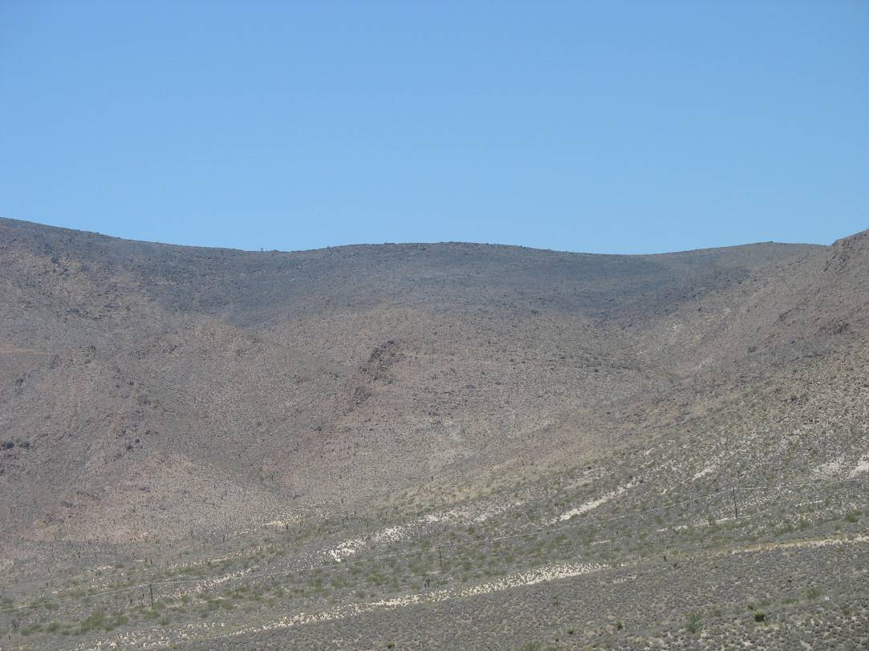
FR Lessons Learned Wild Land Fires
The Department of Energy complex includes thousands of acres of what is commonly referred to as wild lands.

Slide 3
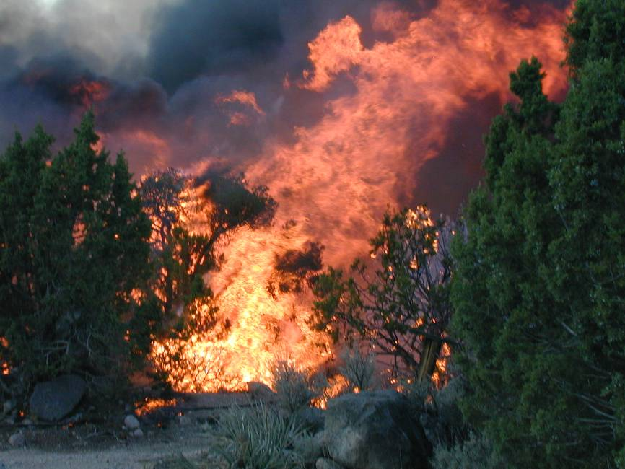
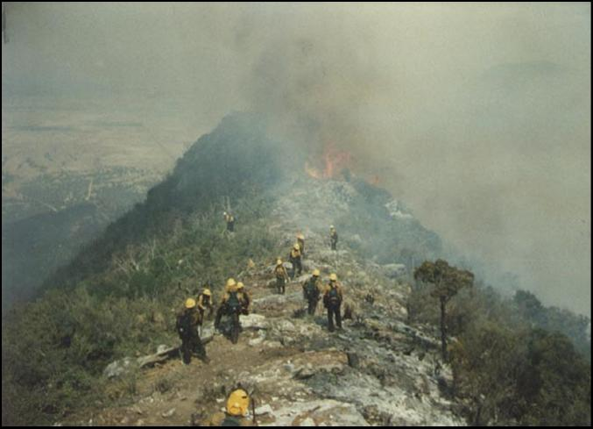
FR Lessons Learned Wild Land Fires
In these areas, due to the often dry weather conditions, wild land fires are a natural process that play an important role in the health of arid ecosystems.

Slide 4
FR Lessons Learned Wild Land Fires
While they may be a natural phenomenon, such fires can cause catastrophic damage to Federal facilities and surrounding communities.
The Department has experienced several large wild land fires over the last several years which have threatened the safety and viability of Department personnel, facilities, and equipment.
These fires occurred at the Nevada Test Site, Los Alamos National Laboratory, Hanford Site, and Idaho National Laboratory and burned well over 200,000 acres (312 sq. mi.) of Department land, resulting in fire-related costs totaling almost $130 million at Los Alamos alone.

Slide 5
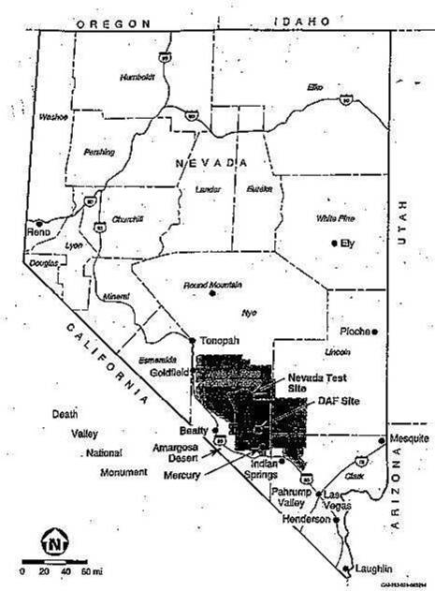
FR Lessons Learned Wild Land Fires

Slide 6
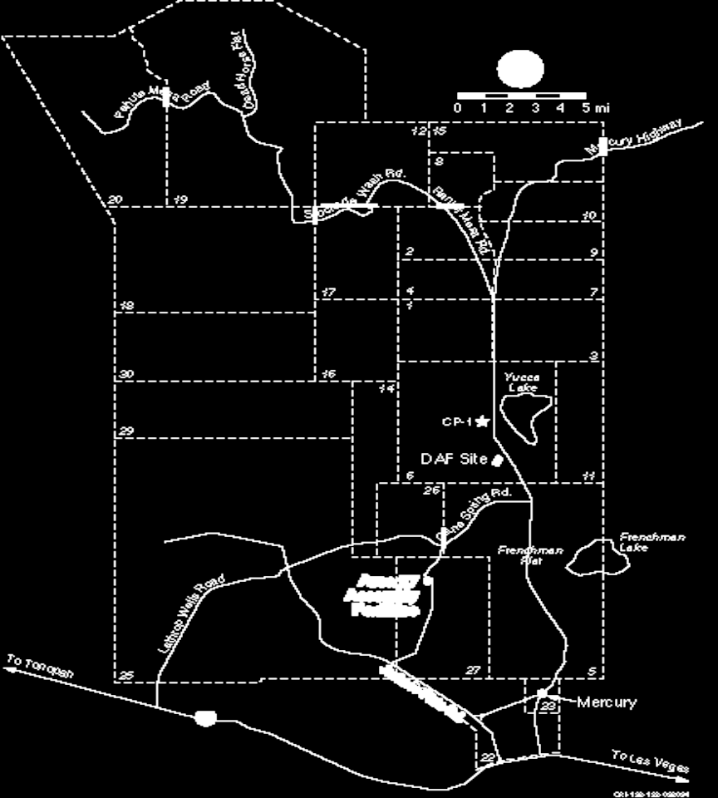
FR Lessons Learned Wild Land Fires
X
X
X
X

Slide 7
FR Lessons Learned Wild Land Fires
Lessons Learned at the NTS
Early Detection, Suppression and Asset Protection
Wild land fires often occur in rugged terrain only accessible by All Terrain Vehicles (ATV’s)
Prior to 2005, only two (2) were available and were primarily used for scouting and extraction of injured firefighters
After 2005 the number of ATVs was increased to six (6) and were equipped with “homemade” fire suppression systems.
NTS Craft personnel were trained on Incident Command and Wild Land fire Safety in order to support fire fighting activities.
A vegetation abatement program was initiated in order to reduce the potential fire hazard near facilities on the NTS.

Slide 8
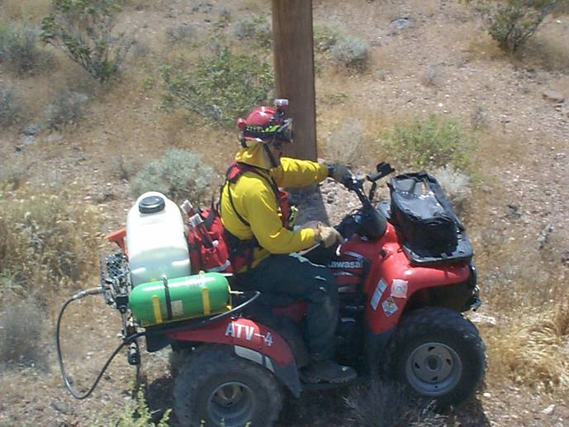
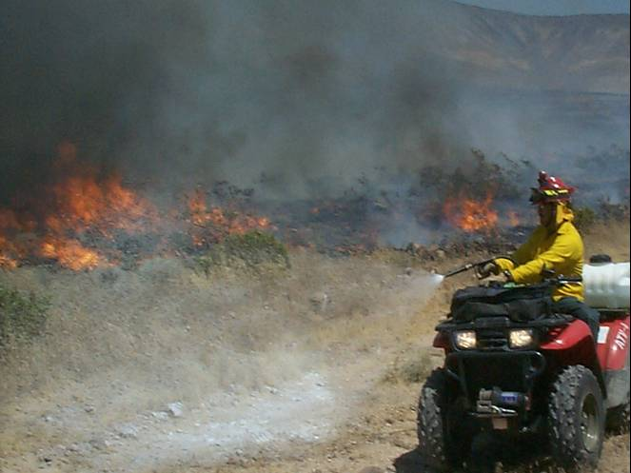
FR Lessons Learned Wild Land Fires

Slide 9
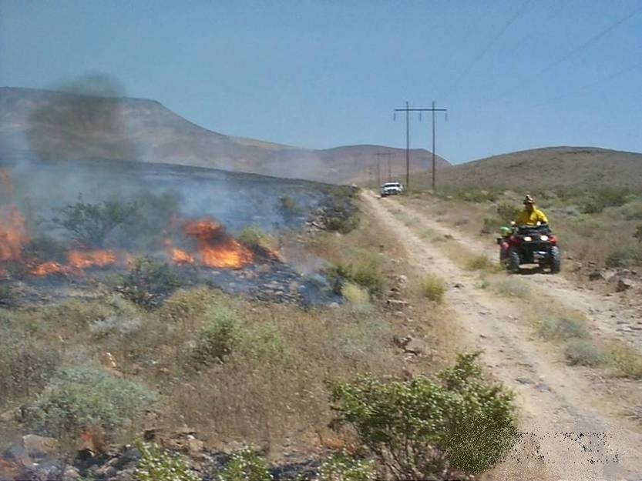
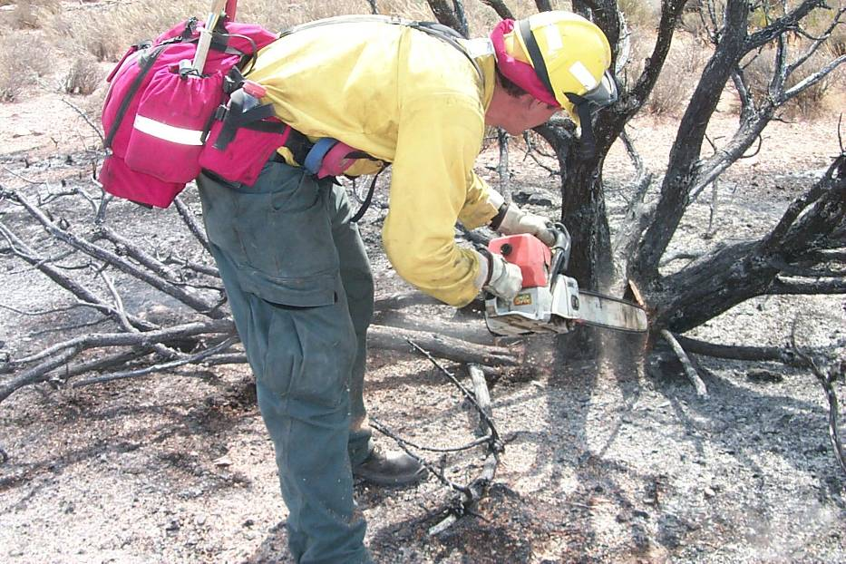
FR Lessons Learned Wild Land Fires

Slide 10
FR Lessons Learned Wild Land Fires
Lessons Learned at the NTS
Research Local Sources and Identify Available Technologies
  USAF assets had cameras with zoom capabilities
  Helicopter support near the NTS had water hauling/dumping capabilities
  The Site contractor initiated a program to install additional cameras throughout the NTS
  The Site contactor also installed a Command, Control, Coordination, and Communication Visualization and Analysis System (C4VAS) to provide a more effective picture of activities occurring on the NTS

Slide 11
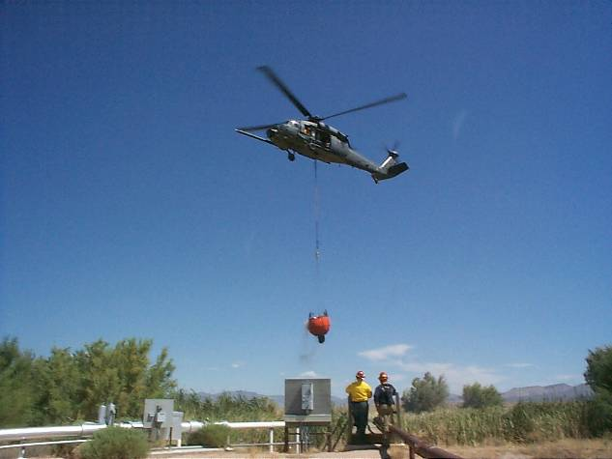
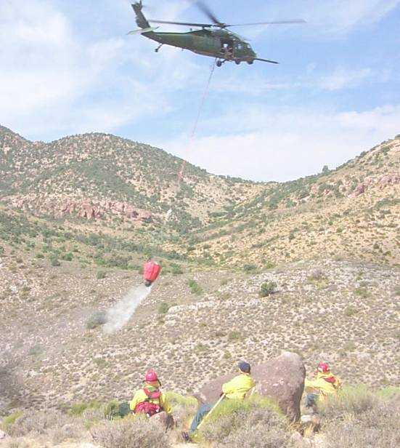
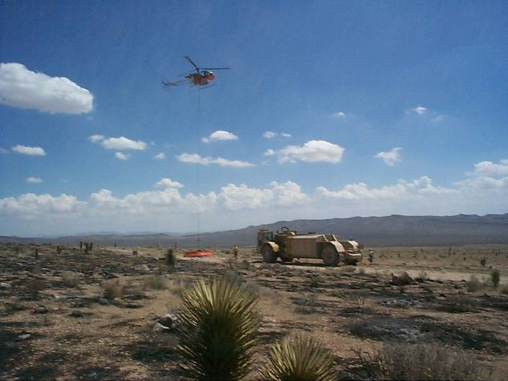
FR Lessons Learned Wild Land Fires

Slide 12
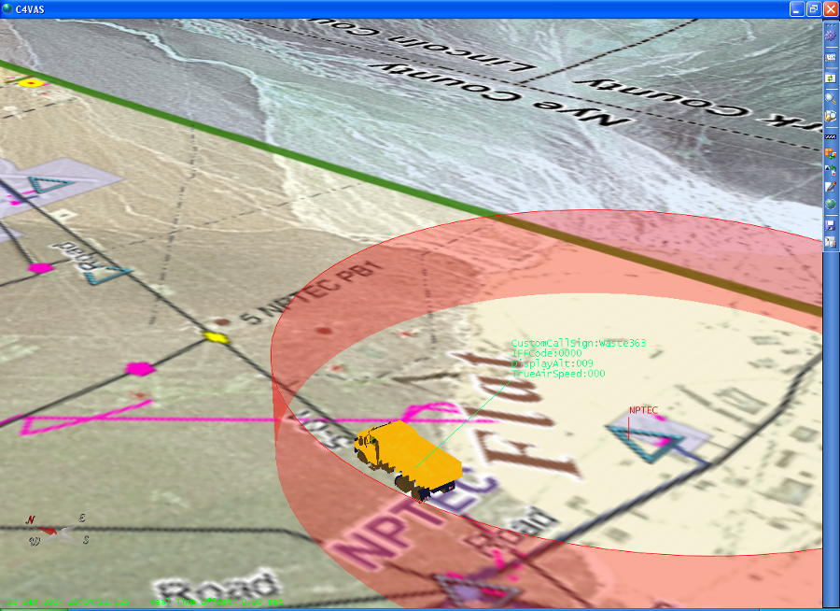
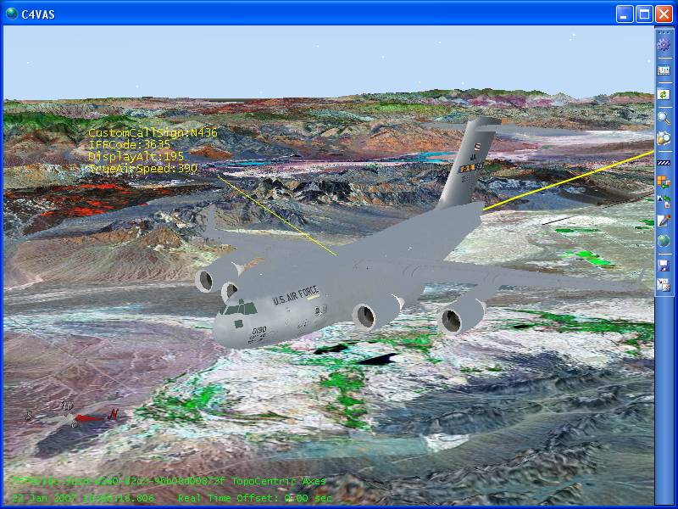
FR Lessons Learned Wild Land Fires

Slide 13
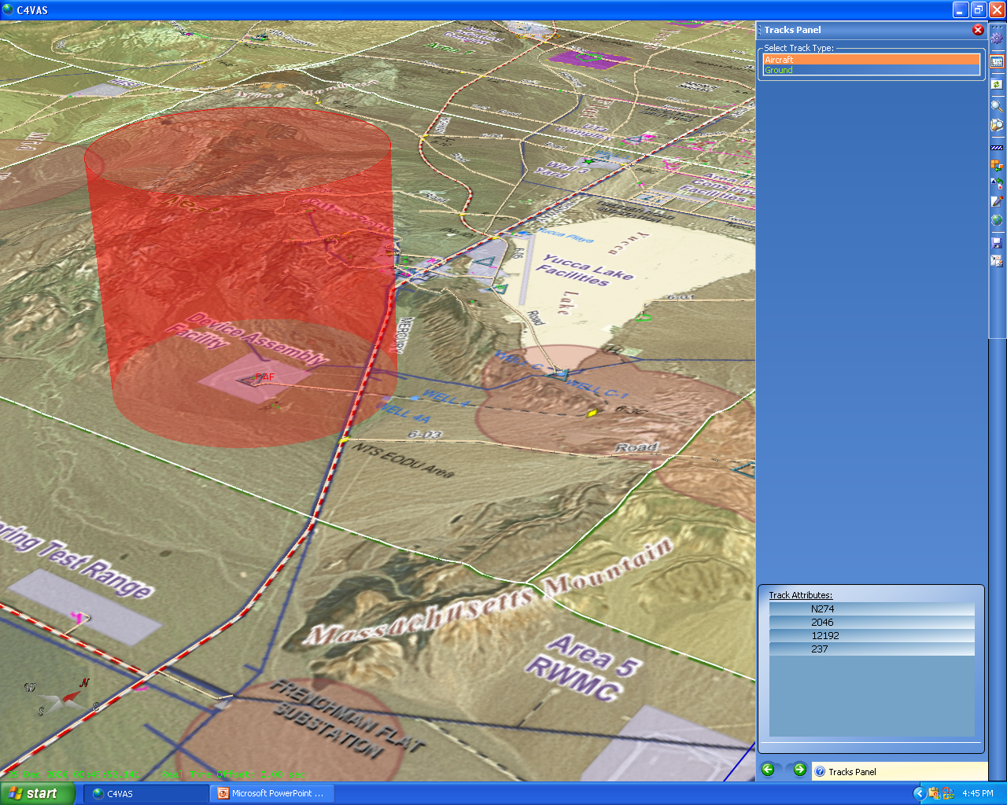
FR Lessons Learned Wild Land Fires

Slide 14
FR Lessons Learned Wild Land Fires
Lessons Learned at the NTS
The following camera locations were selected for location and access to current infrastructure to allow video control to the OCC:
Doe Point
Echo Point
Mobile Camera System
  Spotted Range
  Desert Rock Air Field
  Skull Mountain
  Monastery Peak
  Motorola Peak

Slide 15
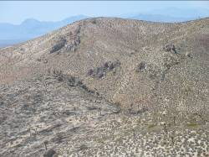
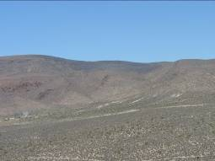
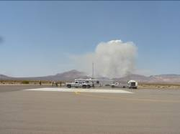
FR Lessons Learned Wild Land Fires
Camera Locations on the NTS

Slide 16
FR Lessons Learned Wild Land Fires
Lessons Learned at the NTS
Understand Communication Limitations and Develop Contingencies
Remote areas have limited radio/cell coverage
Additional communication equipment was acquired to resolve this problem

Slide 17
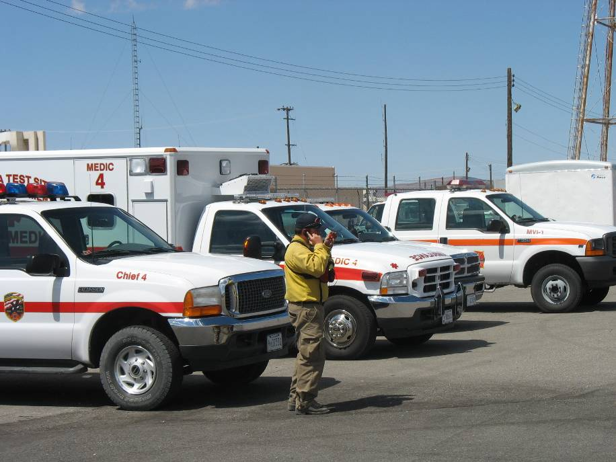
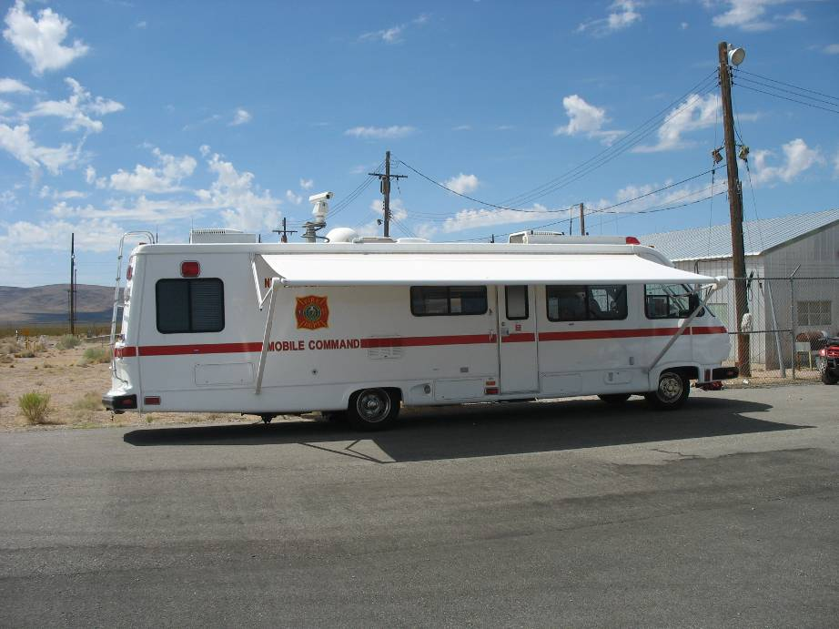
FR Lessons Learned Wild Land Fires

Slide 18
FR Lessons Learned Wild Land Fires
Lessons Learned at the NTS
Address External Responder Issues
Security Issues
Specificity within existing MOU’s
  MOU’s were revised between the NSO and BLM to include a well defined cost sharing agreement
  MOU’s were revised between the NSO and USAF to develop an optimized to manage fires that occur on the NTS and NTTR

Slide 19
FR Lessons Learned Wild Land Fires
Lessons Learned at the NTS
Identify Weather Forecasting Assets
Partnership between NTS Fire & Rescue assets and Air Research Laboratory/Special Operations and Research Division (ARL/SORD) was strengthened.
ARL/SORD meteorologists provide alerts on weather conditions
ARL/SORD staff members have been trained on wild land fire safety and incident command principles

Slide 20
FR Lessons Learned Wild Land Fires
FR Should Be Knowledgeable of Their Facilities experience or potential for wild land fires, and
Know when weather condition lend themselves to wild land fires
Know the availability of resources to manage/fight wild land fires
Recognize that resources other than firefighting may be needed on the fire line
  Bulldozers
  Backhoes
  Water masters
    (water masters with side spray nozzles provide additional capabilities to wet down an area at risk such as around facilities, roads and power lines)

Slide 21
FR Lessons Learned Wild Land Fires
FR’s are the eyes and ears within the facility for Site Office Manager,
During wild land fire seasons understanding the environmental conditions for your facility will enhance the site office’s oversight effectiveness.

