Slide 1

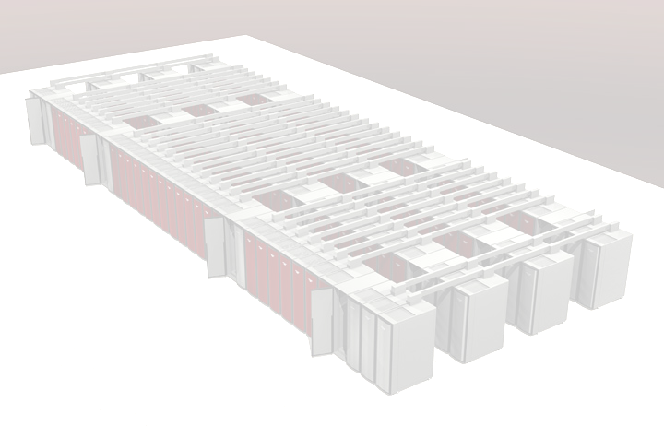


Limited Availability Red Storm User Environment Milestone
Jim Handrock, Karen Jefferson, Judy Sturtevant

Slide 2
Limited Availability Red Storm User Environment Milestone
Demonstrate a user environment that provides application development and execution, data analysis and visualization, and distance computing in accordance with ASC Red Storm and application requirements as defined in the Red Storm Usage Model. PSE, together with VIEWS and DisCom, will build on the limited environment delivered in FY04 to deliver both a local and distance-computing environment for a limited user base.

Slide 3
The project plan for the Limited Availability Red Storm User Environment Milestone is well underway.
Call for RSUM capabilities, risks, metrics, and dependencies
Coordination established with LA Milestone and RSUM
Tri-lab review completed of RSUM
Establish Tri-lab testing scenarios.
Complete testing and review
Nov
Jan
March
May
July
Sept.
Establish capability providers for RSUM
Complete integration of Tri-lab comments into RSUM.
Establish testing team. Begin communication with team.
Review Capabilities and begin testing.
Complete documentation
Create version 1.0 RSUM
Monitor risks and communicate issues facing capability providers.
Bi-monthly Tri-lab coordination meetings.

Slide 4
A new version of the ASC Computing Environment (ACE) requirements now exists
Each laboratory surveyed ASC platform users for requirements. Nov 20 – Jan 21
PSE execs developed consensus on ACE requirements – ACE version 8.0. Jan 27
For every ACE requirement, each laboratory is generating the appropriate level of need. Ongoing

Slide 5
Completion of the SNL ACE Survey leveraged the requirements gathering processes of the SEPR Systems Engineering Group
Platforms
  Q, White, Red
Who
  2 analysts (NM: Greg Tipton, CA: Jay Dike)
    Heavy Q and White users
    Had Red experience
  2 code developers (NM: Judy Sturtevant, Arne Gullerud)
    Had experience on platforms of interest
Leveraged the SEPR SEG’s previously gathered requirements and their related attributes where possible
  Mapped FY04 analyst requirements and FY05 software developer requirements to ACE requirements categories
Survey completed in 12/04
  Requested time spent (per category), functionality satisfaction (per requirement), level of need (per requirement), and comments (where applicable)
  Additional requirements themes by category obtained from previously gathered requirements

Slide 6




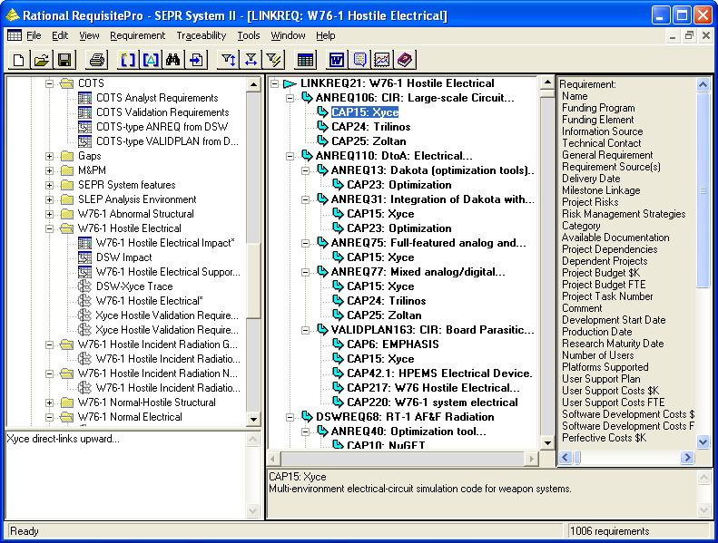
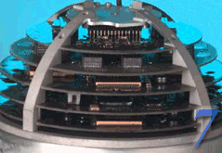
The SEPR SEG collects and organizes requirements and capabilities from many sources in the SEPR Requirements Management System
Validation Plans
Software Developer Requirements
FY05: 50 developers
SEPR Project Descriptions, Deliverables, and Status
FY04
QASPR Requirements
FY05
ReqPro
Analyst Requirements
FY04: 30 analysts
FY05: 116 analysts
SEPR Requirements Management System
DSW Requirements
FY04

Slide 7
RSUM version 1.0 is a vehicle to capture the capabilities provided in the Limited Availability Red Storm User Environment Milestone
RSUM Version 1. 0 includes
Capabilities provided for the LA Milestone
Future capabilities beyond the LA Milestone
Appendices
  Risks and risk mitigation strategies (Rough draft)
  Project dependencies, metrics and testing procedures (Rough draft)
  Mapping of the Usage Model to the ACE requirements

Slide 8
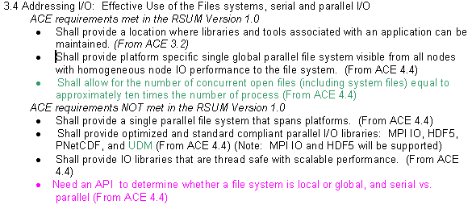
An Example of an ACE Mapping to RSUM Version 1.0
Version 8 was used for the mapping.
Every RSUM section contains the following format
Notes:
Pink = new ACE requirement in version 8. Green denotes the requirement has been modified from version 7s to version 8. Black indicates the requirement did not change.

Slide 9
Anticipated Capabilities provided in the Red Storm Limited Availability Milestone Environment
Documentation including static and dynamic system and resource information; printable web documentation
User support from 7AM to 6 PM MST
File transfer through pftp and archival storage (HPSS) access through pftp and dsacp
An interactive partition of 100-200 nodes
PGI compilers for C, C++, F77, and F90; Gnu compilers for C, C++, F77, and F90
MPI; Parallel HDF5 and MPI-I/O (MPI-1)
Parallel debugger TotalVIEW
PBS for job submittal
Visualization through Red Storm service nodes or RoSE/Feynman clusters
Notes:
Dsabrowse utility on Red Storm and RoSE systems provides ftp-based browsing and management of data on the SNL HPSS.

Slide 10
Capabilities Not Found in the Red Storm Limited Availability Milestone Environment
On-line Training (except for the Driver’s License Training)
Red Storm visualization nodes
Sharing of Red Storm file systems
User level ability to change default shell and user group
MPI-2
Virtual Memory

Slide 11
Red Storm System Attributes
Compute and Service nodes access physical memory only.
Service nodes run diskless variant of SuSE Enterprise Server 9.0.
Compute nodes run lightweight kernel ‘Catamount’ and do not support:
  fork(), exec(), system(), or dynamic process management
  TCP/IP protocol stacks (MPI is used instead)
  UNIX-style interprocess communication (pipes, fifos, etc.)
  daemon-based programming models (programs that wait for system events, especially I/O or network events other than MPI)
  Dynamic linking (job startup will not scale)
  User logins to compute nodes
  Threads

Slide 12
Near-term Milestone Activities
Definition of the Limited Availability Milestone Certification Process
Definition of the objective success criteria
Creation of testing scenarios to assess the accomplishment of the objective criteria
Initiation of bi-monthly Tri-lab coordination meetings

