Slide 1
Earned Value Management Tutorial Module 5: EVMS Concepts and Methods
Prepared by:

Slide 2
Module 5: EVMS Concepts and Methods
Welcome to Module 5. The objective of this module is to introduce you to Basic Earned Value concepts and methods.
The Topics that will be addressed in this Module include:
Earned Valve Management System (EVMS) Criteria
The definitions and illustrations of the basic EVMS terminology
The definition and illustrations of the EV methods

Slide 3
Review of Previous Modules
In the previous four modules, we discussed the framework needed to perform Earned Value and develop an Earned Value Management System (EVMS).
In Module 1 we introduced you to earned value and the requirements for properly implementing an earned value management system (EVMS)
In Module 2 we discussed the development of the work breakdown structure (WBS), organizational breakdown structure (OBS) and the integration of WBS and OBS in creating the responsibility assignment matrix (RAM)
In Module 3 we discussed the development of the project schedule and the schedule baseline
In Module 4 we discussed the development of the project budget and the cost baseline
Now lets discuss the basic Earned Value concepts and methods.

Slide 4
EVMS Criteria
Before we start discussing the Earned Value concepts and methods, let’s look at an overview of the criteria needed for EVMS. There are numerous EVMS guidelines that have been developed in both the government and commercial industry.
On the next page, we will look at the
Industry Standard Earned Value Management
System guideline published in DoD 5000.2-R.
These guideline comes from the ANSI/EIA
standard 748-98.
Department of Defense
5000.2-R
Department of Defense
5000.2-R
Department of Defense
5000.2-R
Notes:
The graphic show a piece of paper with the text, Department of Defense 5000.2-R

Slide 5
EVMS Criteria
The Industry Standard Earned Value Management System guide provides a uniform set of 32 criteria for developing an EVMS. It is compliant with the ANSI/EIA Standard 748-98 discussed in Module 1.
The criteria represents the requirements against which the validity of a contractor’s Earned Value Management System will be judged. The criteria provides contractors the flexibility to develop and implement effective management systems tailored to meet their respective needs, while still ensuring that fundamental Earned Value Management concepts are provided for.
Let’s review these criteria on the next page.
Department of Defense
5000.2-R
Department of Defense
5000.2-R
Department of Defense
5000.2-R
Notes:
The graphic show a piece of paper with the text, Department of Defense 5000.2-R

Slide 6
EVMS Criteria
The criteria are divided into five categories:
Organization
Planning and Budgeting
Accounting
Analysis and Management Reporting
Revisions and Data Maintenance
On the followings pages we provide a summary level review of the criteria. As mentioned earlier there are 32 criteria but for the purpose of a summary review, the criteria were combined. For a complete list of the criteria and the guideline go to the frequently asked questions (FAQ) section or reference section of this web site.
Industry Standard Earned Value Management System
Department of Defense
5000.2-R
Department of Defense
5000.2-R
Industry Standard Earned Value Management System
Department of Defense
5000.2-R
Department of Defense
5000.2-R
Notes:
The graphic show a piece of paper with the text, Industry Standard Earned Value Management System

Slide 7
EVMS Criteria - Organization
Industry Standard Earned Value Management System
  Organization
  Planning & Budgeting
  Accounting
  Analysis & Management Reporting
  Revisions & Data Maintenance
The first category is Organization. Within
Organization the criteria require the following:
Define the Work Breakdown Structure (WBS)
Define the Organizational Breakdown Structure (OBS)
Establish the work authorization and cost accumulation processes
Establish Cost and Schedule Integration Process
Identify Indirect/Overhead Cost Structure
Create the Responsibility Assignment Matrix (RAM)
Notes:
The graph shows a box with the title, Industry Standard Earned Value Management System. There are 5 bulleted text with he titles of Organization, Planning and Budgeting, Accounting, Analysis and Management Reporting, and Revisions and Data Maintenance.

Slide 8
EVMS Criteria – Planning and Budgeting
Industry Standard Earned Value Management System
  Organization
  Planning & Budgeting
  Accounting
  Analysis & Management Reporting
  Revisions & Data Maintenance
The second category is Planning and Budgeting.
Within Planning and Budgeting the criteria require
the following:
Create the Integrated Master Schedule
Identify Milestones, Key Events, Technical Performance Measures
Establish and Maintain a Time-Phased Budget Baseline
Identify Management Reserves and Undistributed Budget
Ensure that the Contract Budget Base (CBB) is reconciled with the Total Allocated Budget (TAB)
Notes:
The graph shows a box with the title, Industry Standard Earned Value Management System. There are 5 bulleted text with he titles of Organization, Planning and Budgeting, Accounting, Analysis and Management Reporting, and Revisions and Data Maintenance.

Slide 9
EVMS Criteria - Accounting
Industry Standard Earned Value Management System
  Organization
  Planning & Budgeting
  Accounting
  Analysis & Management Reporting
  Revisions & Data Maintenance
The third category is Accounting. Within Accounting
the criteria require the following:
Provide summary and detail visibility of costs
Establish process for reporting Material, Other Direct Costs, and Subcontractor Costs
Provide full accounting of all material purchased for the project
Record direct and indirect costs in accordance with company disclosure statement
Notes:
The graph shows a box with the title, Industry Standard Earned Value Management System. There are 5 bulleted text with he titles of Organization, Planning and Budgeting, Accounting, Analysis and Management Reporting, and Revisions and Data Maintenance.

Slide 10
EVMS Criteria – Analysis and Management Reports
Industry Standard Earned Value Management System
  Organization
  Planning & Budgeting
  Accounting
  Analysis & Management Reporting
  Revisions & Data Maintenance
The fourth category is Analysis and Management
Reports. Within Analysis and Management
Reports the criteria require the following:
Provide variance reporting of Budget (BCWS), Earned Value (BCWP), and Actual (ACWP)
Provide explanation of indirect costs
Implement recovery plans, management actions, recommendations
Develop revised estimates (EACs, LREs) based on performance to date and estimates of future performance
At least monthly, provide information at the Control Account Level necessary for analysis and reporting using actual cost data that is reconcilable with the approved accounting system
Notes:
The graph shows a box with the title, Industry Standard Earned Value Management System. There are 5 bulleted text with he titles of Organization, Planning and Budgeting, Accounting, Analysis and Management Reporting, and Revisions and Data Maintenance.

Slide 11
EVMS Criteria – Revisions and Data Maintenance
Industry Standard Earned Value Management System
  Organization
  Planning & Budgeting
  Accounting
  Analysis & Management Reporting
  Revisions & Data Maintenance
The final category is Revisions and Data
Maintenance. Within Revisions and Data
Maintenance the criteria require the following:
Establish Change Management System
Provide Reconciliation and Revision Reports
Control and Document changes
Notes:
The graph shows a box with the title, Industry Standard Earned Value Management System. There are 5 bulleted text with he titles of Organization, Planning and Budgeting, Accounting, Analysis and Management Reporting, and Revisions and Data Maintenance.

Slide 12
EVMS Criteria – Revisions and Data Maintenance
In modules 1 through 4, we discussed the criteria in the first 3 categories: Organization, Planning and Budgeting, and Accounting.
In this and succeeding modules we will cover the criteria in the final two categories: Analysis and Management Reporting, and Revisions and Data Maintenance.
Let’s get started!
Industry Standard Earned Value Management System
  Organization
  Planning & Budgeting
  Accounting
  Analysis & Management Reporting
  Revisions & Data Maintenance
Notes:
The graph shows a box with the title, Industry Standard Earned Value Management System. There are 5 bulleted text with he titles of Organization, Planning and Budgeting, Accounting, Analysis and Management Reporting, and Revisions and Data Maintenance.

Slide 13
EVMS Basic Concepts
At this point, you should understand that Earned Value helps determine if your project is on schedule and within budget. It does this by assessing the project on the basis of cost and schedule as compared to what has been accomplished.
In determining the status of projects, three key components are examined
Cost and Schedule baseline
Actual Charges (expenditures)
Reported accomplishments or “Earned Value”
Understanding how the three components work in earned value is explained on the following pages.

Slide 14
Planned Value (PV)
Cost and Schedule baseline refers to the physical work scheduled and the approved budget to accomplish the scheduled work. Together, they result in an important value: Planned Value (PV). PV tells you what you plan to do. Simply stated,
Planned Value = Physical Work + Approved Budget
PV can be looked at in two ways: cumulative and current.
Cumulative PV is the sum of the approved budget for activities scheduled to be performed to date.
Current PV is the approved budget for activities scheduled to be performed during a given period. This period could represent days, weeks, months,etc.

Slide 15
Planned Value (PV) consists of a 5 step process…
PV, also known as Budget Cost of Work Scheduled (BCWS), can be defined as:
Define Scope: What you are tasked to do (Scope Statement)
Assign Scope: Breakdown scope into manageable parts (WBS)
Schedule Scope: Time-phased, logic driven with critical path (Project Schedule)
Budget Scope: develop cost (budget) for all approved scope (Performance Measurement Baseline)
Baseline: Snap-shot in time, frozen. What performance measurement will be based on.
Now let’s look at an example of Planned Value on the next page.

Slide 16
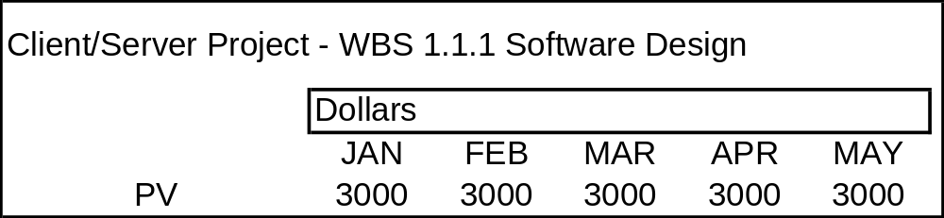
Planned Value (PV) example
We are working on a Client/Server project, and part of the scope is for Software Design. The time frame is 5 months and the budget for this scope is $15,000, resulting in a budget of $3,000 per month.
Time Now
Notes:
The graph shows a table with the months of January, February, March, April, and May across the top and Planned Value as the topic with the value 3000 in each month.

Slide 17
Planned Value (PV) example
Based on these figures, we can calculate the cumulative PV and the current PV.
The Cumulative PV is the total for the elapsed months: January – March. The cumulative PV is $9,000.
The Current PV is the budget for the current month, March, and equals $3,000.
This example uses dollars as units of measure, but note that you can use any unit of measurement: hours, days, dollars, etc.
Time Now
Notes:
The graph shows a table with the months of January, February, March, April, and May across the top and Planned Value as the topic with the value 3000 in each month.

Slide 18
Budget at Completion (BAC)
So far we have discussed the cumulative budget and current budget, but what about the budget at the end of the project? Earned Value also uses this figure, termed Budget at Completion (BAC).
BAC is the sum of all budgets allocated to a project scope.
Keep some important points in mind regarding BAC:
  BAC = PMB
  BAC can be examined by work packages and control accounts
  The Project BAC must always equal the Project Total PV. If they are not equal, your earned value calculations and analysis will be inaccurate.
Let’s examine BAC using our previous example. Take a look on the next page.

Slide 19
Budget at Completion (BAC)
Take a moment to review the Software Design project. Knowing that BAC is the sum of all budgets allocated to a project, what is the BAC for this project if Software Design is the complete scope of the project?
Yes, BAC = $15,000. And, in keeping with the previous points about BAC, the project BAC equals the Project Total PV. The Earned Value calculations are correct.
Notes:
The graph shows a table with the months of January, February, March, April, and May across the top and Planned Value as the topic with the value 3000 in each month.

Slide 20
EVMS Basic Concepts
As you recall from earlier in the module, three key components are required to determine the status of projects. So far, we have examined the first: Cost and Schedule Baseline.
Now let’s turn our attention on the following pages to the second, Actual Charges.
Cost and Schedule baseline
Actual Charges (expenditures)
Reported accomplishments or “Earned Value”

Slide 21
Actual Cost (AC)
Actual Cost (AC), also called actual expenditures, is the cost incurred for executing work on a project. This figure tells you what you have spent and, as with Planned Value, can be looked at in terms of cumulative and current.
Cumulative AC is the sum of the actual cost for activities performed to date.
Current AC is the actual costs of activities performed during a given period. This period could represent days, weeks, months,etc.
AC is also called Actual Cost of Work Performed (ACWP).

Slide 22
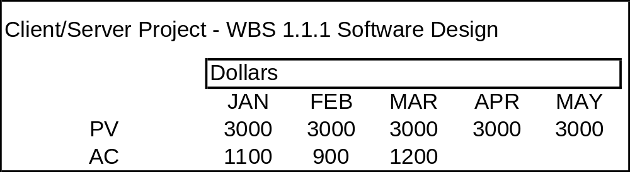
Actual Cost (AC) example
Illustrating again from the Client/Server project example, can you determine the cumulative AC and current AC? Remember, Cumulative AC is the sum of the actual cost for activities performed to date, and Current AC is the actual costs of activities performed during a given period.
Time Now
The Cumulative AC is the total for the elapsed months: January – March. The cumulative AC is $3,200.
The Current AC is the actual cost for the current month, March, and equals $1,200.
Notes:
The graph shows a table with the months of January, February, March, April, and May across the top and Planned Value as one topic with the value 3000 in each month and Actual Cost as the other topic with the value of 1100 in January, 900 in February, and 1200 in March.

Slide 23
EVMS Basic Concepts
So far, we have examined Cost and Schedule Baseline and Actual Changes.
Now let’s turn our attention on the following pages to the last of the three components, Actual Charges.
Cost and Schedule baseline
Actual Charges (expenditures)
Reported accomplishments or “Earned Value”

Slide 24
Earned Value (EV)
To report the accomplishments of the project, you must apply Earned Value (EV) to the figures and calculations in the project.
EV is the quantification of the “worth” of the work done to date.
In other words, EV tells you, in physical terms, what the project has accomplished. As with PV and AC, EV can be presented in a Cumulative and Current fashion.
Cumulative EV is the sum of the budget for the activities accomplished to date.
Current EV is the sum of the budget for the activities accomplished in a given period.
Earned Value is also called Budgeted Cost of Work Performed (BCWP).

Slide 25
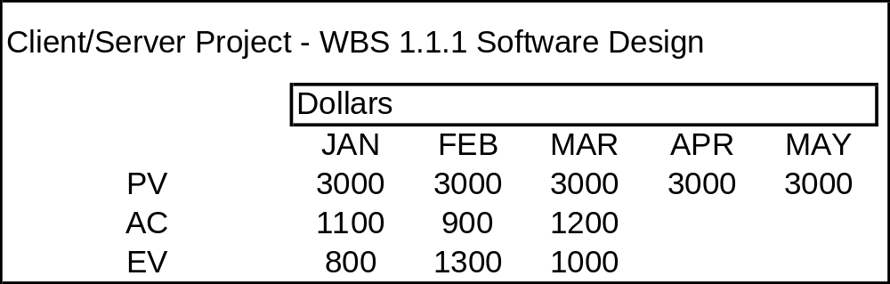
Earned Value (EV) example
Through the Software Design example we have answered several questions, namely, the cumulative PV and AC, the current PV and AC, and the BAC. Let’s now determine the cumulative and current EV.
Time Now
The Cumulative EV is the sum of the budget for the activities accomplished to date: January – March. The cumulative EV is therefore $3,100.
The Current EV is the sum of the budget for the activities accomplished in the current month, March, and equals $1,000.
Notes:
The graph shows a table with the months of January, February, March, April, and May across the top and Planned Value as one topic with the value 3000 in each month and Actual Cost as the other topic with the value of 1100 in January, 900 in February, and 1200 in March and Earned Value as a topic with the value of 800 in January, 1300 in February, and 1000 in March.

Slide 26
Earned Value (EV) example
Armed with a thorough picture of this project’s progress, let’s summarize the findings we have.
Cum PV = $9,000 Current PV = $3,000 BAC = $15,000
Cum AC = $3,200 Current AC = $1,200
Cum EV = $3,100 Current EV = $1,000
Time Now
Notes:
The graph shows a table with the months of January, February, March, April, and May across the top and Planned Value as one topic with the value 3000 in each month and Actual Cost as the other topic with the value of 1100 in January, 900 in February, and 1200 in March and Earned Value as a topic with the value of 800 in January, 1300 in February, and 1000 in March.

Slide 27
Review
At this point, you should have a solid understanding of the three key earned value components. Let’s review them now.
Planned Value (PV) is determined by the cost and schedule baseline (discussed in Module 2 through 4)
Actual Cost (AC) is determined by the actual cost incurred on the project
Earned Value (EV) tells you, in physical terms, what the project accomplished.
Cost and Schedule baseline
Actual Charges (expenditures)
Reported accomplishments or “Earned Value”

Slide 28
Earned Value (EV) Methods
As you know, EV is determined by what has been physically accomplished. But how do you determine the “physical” accomplishment? Physical accomplishment is determined by measuring the progress of a given activity.
There are numerous EV methods to measure progress. On the following pages, we will focus on the following techniques:
Earned Value Methods
Fixed Formula
Milestone Weights
Milestone Weights with % Complete
Units Complete
Percent Complete
Level of Effort

Slide 29
Earned Value (EV) Methods - Fixed Formula
Earned Value Methods
Fixed Formula
Milestone Weights
Milestone Weights with % Complete
Units Complete
Percent Complete
Level of Effort
The Fixed Formula method for determining
progress applies to work packages and control
accounts that span a short period of time (within
an accounting period, < 3 months). This method
applies a percent complete to the start and finish
of an activity. Generally, the percentages used
in the formula are 0/100, 50/50, or 25/75.
  0/100 - Nothing is earned when activity starts but 100% of budget is earned when completed
  50/50 - 50% is earned when activity starts and the balance is earned on completion
  25/75 - 25% is earned when activity starts and the balance is earned on completion

Slide 30
Earned Value (EV) Methods – Fixed Formula
The Fixed Formula method has several advantages and disadvantages:
Advantages: Works well for short term work packages, and requires minimal effort to status.
Disadvantages: No significant disadvantages for short term, low value work packages. Not very effective for longer term work packages.

Slide 31
Earned Value (EV) Methods – Milestone Weighting
The next method of calculating EV that
we will discuss is Milestone Weights.
The Milestone Weighting method assigns
budget value to each milestone. Not until
full completion of each milestone is the
budget earned. Milestone Weighting is
used as a method for work packages with
long term durations and ideally should have
milestones each month or accounting period.
Let’s take a look at an example on the next page.
Earned Value Methods
Fixed Formula
Milestone Weights
Milestone Weights with % Complete
Units Complete
Percent Complete
Level of Effort

Slide 32
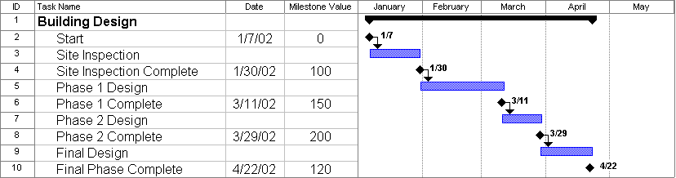
Earned Value (EV) Methods – Milestone Weighting
Below is an example of the Milestone Weighting method. For the purposes of this and future examples, we will assume that the Building Design is the Control Account Level and the activities are at the Work Package level. Below are the activities and milestones in the Control Account for completing a building design. The dates for each milestone are given, along with the value for each milestone upon completion.
Let’s use this example and see how Milestone Weighting is applied.
Notes:
The graphic shows a schedule for design a building. The activities are Start, Site Inspection, Site inspection complete, Phase 1 Design, Phase 1 Complete, Phase 2 Design, Phase 2 Complete, Final Design, and Final Phase Complete.

Slide 33
Earned Value (EV) Methods – Milestone Weighting
For this example, assume that all activities begin and complete as scheduled. With this in mind, can you determined the earned value as of January 31th?
As you can see by the schedule the project has started (1/7). The “Start Inspection milestone” has been completed, but no value appears for that milestone. The “Site Inspection Complete” milestone has also been completed, and its value is 100. There are no more milestones completed through January, so our Current EV is 100. Because it is the first month for the control account, the Cumulative EV is also 100. Now lets look at what has been earned through February.
Time Now
Notes:
The graphic shows a schedule for design a building. The activities are Start, Site Inspection, Site inspection complete, Phase 1 Design, Phase 1 Complete, Phase 2 Design, Phase 2 Complete, Final Design, and Final Phase Complete.

Slide 34
Earned Value (EV) Methods – Milestone Weighting
As you can see by looking at the schedule below, there are no milestones scheduled for February (remember we assumed all activities will start and complete as scheduled), but we have started the Phase 1 Design. What are the Current EV and Cumulative EV as of February 28th?
The Current EV is 0. Remember we can only take “earned” if milestone is complete. Since there were no milestones scheduled for or accomplished in February, we have earned no value under the milestone weighting approach. The Cumulative EV is 100, which includes the 100 from January and the 0 from February.
Lets take a look at one more month.
Time Now
Notes:
The graphic shows a schedule for design a building. The activities are Start, Site Inspection, Site inspection complete, Phase 1 Design, Phase 1 Complete, Phase 2 Design, Phase 2 Complete, Final Design, and Final Phase Complete.

Slide 35
Earned Value (EV) Methods – Milestone Weighting
Two milestones are scheduled for March. What is are Current EV and Cumulative EV as of March 31th?
The Current EV is 350. Completion of Phase 1 Design (150) and Phase 2 Design (200).
The Cumulative EV is 450, which includes the Site Inspection Complete from January (100), February (0), plus the current March EV (350).
Time Now
Notes:
The graphic shows a schedule for design a building. The activities are Start, Site Inspection, Site inspection complete, Phase 1 Design, Phase 1 Complete, Phase 2 Design, Phase 2 Complete, Final Design, and Final Phase Complete.

Slide 36
Earned Value (EV) Methods – Milestone Weighting
The advantages and disadvantages of Milestone Weighting are:
Advantages: Requires objective measurable milestones, which most customers or Project Managers prefer.
Disadvantages: Does not allow partial credit for in-process work, and requires detailed milestone planning.

Slide 37
Earned Value (EV) Methods – Milestone Weighting with Percent Complete
Earned Value Methods
Fixed Formula
Milestone Weights
Milestone Weights with % Complete
Units Complete
Percent Complete
Level of Effort
We will now look at the third method for
determing EV: Milestone Weights with
Percent Complete.The Milestone
Weighting with Percent Complete method
assigns budget value to each milestone,
and it is earned based on the percent of work
Completed against each individual milestone.
Like Milestone Weighting, Milestone Weighting
with Percent Complete is used as a method for
work packages with long term durations and ideally
should have milestones each month or
accounting period.
Take a look on the following pages at how using Milestone Weighting with Percent Complete affects the Building Design example demonstrated previously using simple Milestone Weighting.

Slide 38
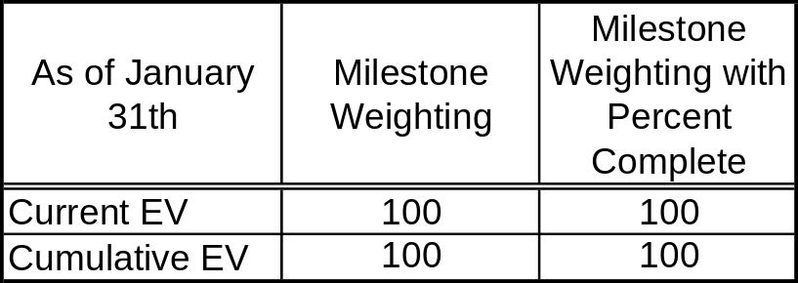
Earned Value (EV) Methods – Milestone Weighting with Percent Complete
There is no difference using either Milestone Weighting method for determining the “earned” value for January because the milestone was 100% completed during the month.
Time Now
Notes:
The graphic shows two items, First,a schedule for design a building. The activities are Start, Site Inspection, Site inspection complete, Phase 1 Design, Phase 1 Complete, Phase 2 Design, Phase 2 Complete, Final Design, and Final Phase Complete. Second is a chart with the a current and cumulative comparison of the two methods. The totals for each method are 100 for both cumulative and current.

Slide 39
Earned Value (EV) Methods – Milestone Weighting with Percent Complete
Through February the Milestone Weighting method had a current EV of 0 and a cumulative of 100. Remember, because there are no milestones completed in February, the project cannot earn anything. Using the Milestone Weighting with Percent Complete method, however, you are able to “earn” a portion of the value of the milestone equal to the amount of the work completed for the activity(s) that make up the milestone.
Time Now
Notes:
The graphic shows a schedule for design a building. The activities are Start, Site Inspection, Site inspection complete, Phase 1 Design, Phase 1 Complete, Phase 2 Design, Phase 2 Complete, Final Design, and Final Phase Complete.

Slide 40
Earned Value (EV) Methods – Milestone Weighting with Percent Complete
Using the Building Design schedule, you can see that the Phase 1 Design is nearly complete by the end of February. For example, lets say that at the end of February the Phase 1 Design was determined to be 70% complete. Now let’s take this information and determine the EV for February using the Milestone Weighting with Percent Complete method and compare.
Time Now
Notes:
The graphic shows a schedule for design a building. The activities are Start, Site Inspection, Site inspection complete, Phase 1 Design, Phase 1 Complete, Phase 2 Design, Phase 2 Complete, Final Design, and Final Phase Complete.

Slide 41
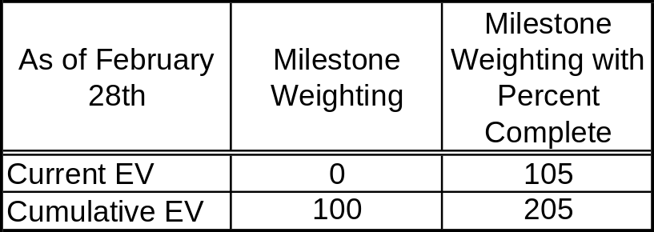
Earned Value (EV) Methods – Milestone Weighting with Percent Complete
Because it has been determined that you are 70% complete with Phase 1 Design, you can take credit for earning 105 of the 150 for completing Phase 1 Design in February. See the chart below to compare the two methods as of February 28th.
Time Now
Notes:
The graphic shows two items, First,a schedule for design a building. The activities are Start, Site Inspection, Site inspection complete, Phase 1 Design, Phase 1 Complete, Phase 2 Design, Phase 2 Complete, Final Design, and Final Phase Complete. Second is a chart with the a current and cumulative comparison of the two methods. The totals for each method are as follows: Current EV is 0 for Milestones Weighting, 105 for Milestone Weighting with Percent complete, 100 for cumulative Milestone Weighting, and 205 for Milestone Weighting with Percent complete.

Slide 42
Earned Value (EV) Methods – Milestone Weighting with Percent Complete
The advantages and disadvantages of Milestone Weighting with Percent Complete are:
Advantages: Requires objective measurable milestones, which most customers prefer, and allows for partial credit against milestones.
Disadvantages: Requires a Control Account Manager (CAM) assessment of the % complete for each milestone and requires documentation of assessment methodology.

Slide 43
Earned Value (EV) Methods – Unit Complete
Earned Value Methods
Fixed Formula
Milestone Weights
Milestone Weights with % Complete
Units Complete
Percent Complete
Level of Effort
Now let’s look at the Unit Complete method
of computing EV.The Unit Complete method
uses a physical count to determine what is
earned. To use Unit Complete you must have
units that are identical or similar and they must
have the same budget value.
To examine the Unit Complete method, let’s
take a look at a different example on the next
page.

Slide 44
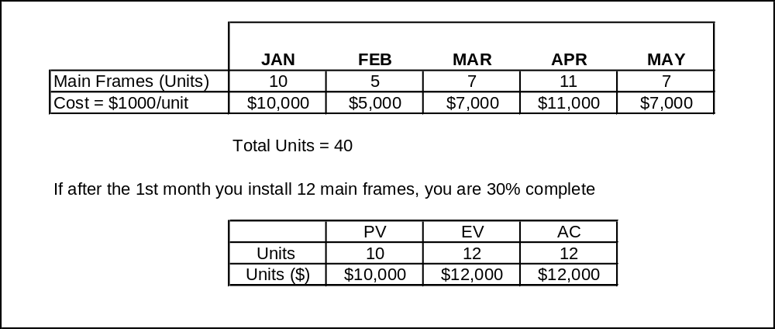
Earned Value (EV) Methods – Unit Complete
For this example, you must install a total of 40 mainframe computers over five months. The number of units and the schedule to install them is listed below. After the 1st month, you have installed 12 mainframes, which means you are 30% complete with the total job. The earned value analysis shows that the PV is 10 units($10,000), EV is 12 units($12,000) and the AC is 12 units ($12,000).

Slide 45
Earned Value (EV) Methods – Unit Complete
The advantages and disadvantages of Unit Complete are:
Advantages: An objective and easy way of determining the earned value for an activity.
Disadvantages: Limited to production type atmosphere of similar items that are fixed unit prices. Does not take into consideration labor fluctuations so may misrepresent actual EV.

Slide 46
Earned Value (EV) Methods – Subjective Percent Complete
Earned Value Methods
Fixed Formula
Milestone Weights
Milestone Weights with % Complete
Units Complete
Percent Complete
Level of Effort
The fifth method of EV calculation that we will
review is Subjective Percent Complete. The
Subjective Percent Complete method applies
a percent complete to a budget value to
determine what is earned. The percent
complete value is determined by the Control
Account Manager or other designated
individuals. The percent complete is applied
to the Budget at Completion (BAC) for a
given activity to determine the current and
cumulative EV.
Take a look on the next page at how Subjective Percent Complete is used.

Slide 47
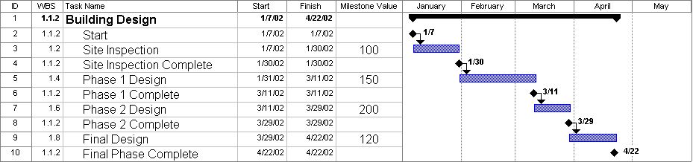
Earned Value (EV) Methods – Subjective Percent Complete
To use the Subjective Percent Complete method, the value is placed on the work activity, not the milestone (as in the Milestone Weighting method). Using the Building Design Project from earlier, this becomes more clear.
Notes:
The graphic shows a schedule for design a building. The activities are Start, Site Inspection, Site inspection complete, Phase 1 Design, Phase 1 Complete, Phase 2 Design, Phase 2 Complete, Final Design, and Final Phase Complete.

Slide 48
Earned Value (EV) Methods – Subjective Percent Complete
Looking at the Site Inspection activity in the schedule below, the start date is January 7th with a scheduled completion date of January 30th. Let’s status the activity as of January 15th.
To determine the percent complete for January 15th, the control account manager (CAM) must use an educated guess to determine the percent complete of the activity. The CAM must maintain the logic for assessing each activity’s percent complete.
In this example, the CAM decides that the activity is 45% complete as of January 15th. Given this, the EV for Site Inspection as of January 15th is 45.
Notes:
The graphic shows a schedule for design a building. The activities are Start, Site Inspection, Site inspection complete, Phase 1 Design, Phase 1 Complete, Phase 2 Design, Phase 2 Complete, Final Design, and Final Phase Complete.

Slide 49
Earned Value (EV) Methods – Subjective Percent Complete
The advantages and disadvantages of Subjective Percent Complete are:
Advantages: This is one of the more subjective methods. Earned Value is based on the CAM’s assessment of the work package progress. Detailed planning at the milestone level is not required.
Disadvantages: Customer Satisfaction maybe low due to the subjectiveness involved and the lack of detailed planning, however, CAMs are required to provide the customer with their assessment methodology.
Note: Milestones do not apply to this method. Labor and non-labor must be identified in separate work packages if this method is applied. This method is highly subjective, and documentation in support of percent complete derivations is required.

Slide 50
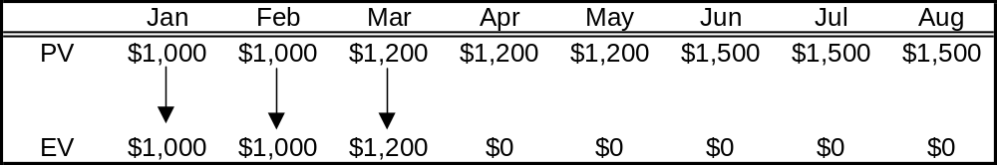
Earned Value (EV) Methods – Level of Effort
Earned Value Methods
Fixed Formula
Milestone Weights
Milestone Weights with % Complete
Units Complete
Percent Complete
Level of Effort
The last EV method to define is Level of
Effort. The Level of Effort (LOE) method
is based on the passage of time. A monthly
budget value is earned with the passage of
time and is always equal to the monthly
planned amount. When using LOE, the PV
is always equal to the EV (see chart below).
This method is usually used for accounts that
are more time related than task oriented.
Example of an LOE account is Program and
Project Management support.
Time Now
Notes:
The graphic shows 1000 in each month for both Planned Value and Earned Value.

Slide 51
Earned Value (EV) Methods – Level of Effort
The advantages and disadvantages of Level of Effort are:
Advantages: This EVM does not require statusing, and is appropriate for sustaining tasks like Program Management.
Disadvantages: Level of Effort work packages are often challenged by the customer. This EV method should be kept to a minimal number of work packages. LOE work packages require accurate assessment (planning) of monthly performance.

Slide 52
Review
At this point, you should have a firm grasp of the EV methods of calculation.
Now that we are finished reviewing the EV methods, let’s take a look at our ACME House Building project using the concepts discussed in this module.
Earned Value Methods
Fixed Formula
Milestone Weights
Milestone Weights with % Complete
Units Complete
Percent Complete
Level of Effort

Slide 53
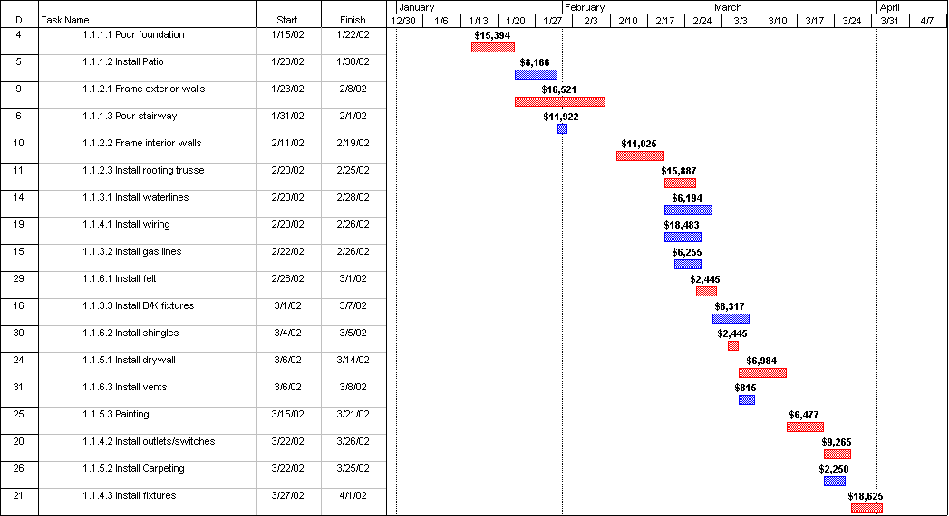
Project Status: Example
Let’s recall, from previous modules, the project baseline (schedule and cost) for the House Building project. The project start date is 1/15, with an expected completion date of 4/1. It is now 1/31. The project started on schedule and needs to be statused as of 1/31. Look at the schedule and identify the activities that need to be reviewed for status.
Status as of 1/31
Notes:
The graphic shows the schedule for the ACME House Building project with status line at 1/14. There are four activities affected by the status date, Pour Foundation, Frame Exterior Walls,,Pour Stairway and Install Patio

Slide 54
Project Status: Example
According to the baseline, the following activities need to be reviewed for status as of 1/31:
Pour Foundation
Install Patio
Frame Exterior Walls
Pour Stairway
Status as of 1/31
Notes:
The graphic shows the schedule for the ACME House Building project with status line at 1/14. There are four activities affected by the status date, Pour Foundation, Frame Exterior Walls,,Pour Stairway and Install Patio

Slide 55
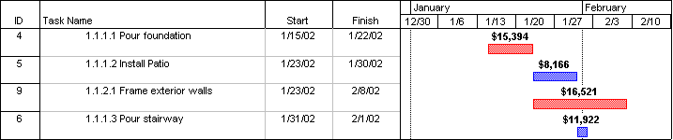
Project Status: Example
Before we go any further a few assumptions need to explained.
The activities will be done as sequenced, thus no other activities, besides the four mentioned, will be affected by the 1/31 statusing effort.
Activity cost is spent uniformly across each activity
With these assumptions at hand, let’s focus on statusing the project.
Status as of 1/31
Notes:
The graphic shows the schedule for the ACME House Building project with status line at 1/14. There are four activities affected by the status date, Pour Foundation, Frame Exterior Walls,,Pour Stairway and Install Patio

Slide 56
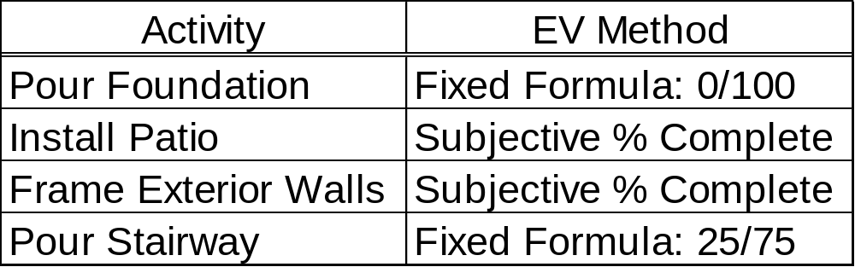
Project Status: Example
Now we need to determine our Earned Value (EV) for each activity. As we discussed on the previous pages, there are numerous EV methods used for measuring progress each method more applicable to certain types of activities than other methods. For example we will use the following EV methods for, the four activities we are statusing.
Now that we understand what activities need statusing and what method of EV will be used for each activity, it is time to status the project activities.
Notes:
Chart showing the four activities affected by the 1/14 statusing and the Earned Value method for each.

Slide 57
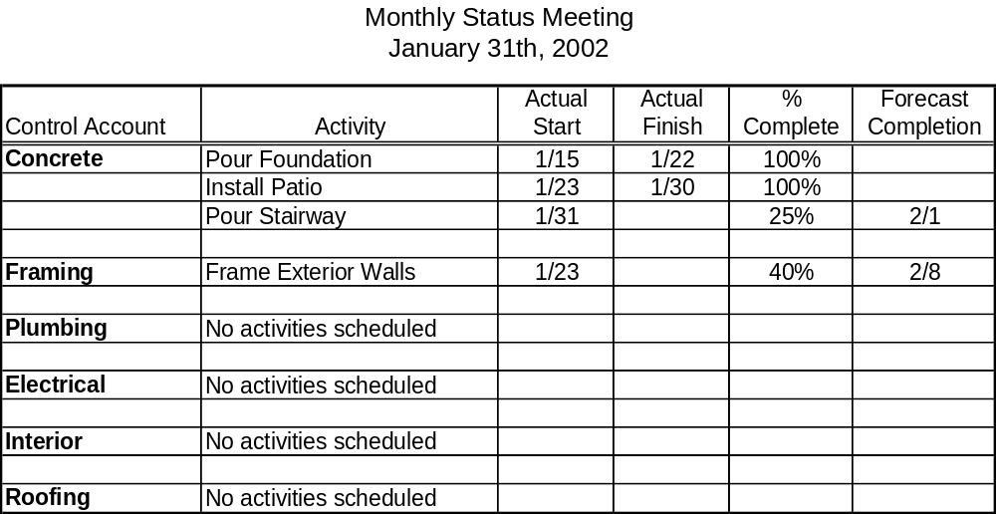
Project Status: Example
To obtain our project activity status, we will need to meet with the Project Manager or those responsible for the work. In our case, we will need to meet with the different CAMs or Project Superintendents responsible for each Control Account. Below are the results of that meeting.
Notes:
The graphic shows the activities as there status information. Pour Foundation was started on 1/1 and finished on 1/8, Install Patio was started on 1/9 and finished on 1/11, Pour Stairway was started on 1/12 and is scheduled to complete on 1/15; It is 25% complete, and Frame Exterior Walls was started on 1/9 and is scheduled to complete 1/25; it is 40% complete.

Slide 58
Project Status: Example
Now let’s review the status of each activity.
The first activity is Pour Foundation. This activity was scheduled to start on 1/15 and finish on 1/22 (see schedule below). It’s actually started on 1/15 and finished on 1/22 (see status report below). Thus this activity was on schedule and is 100% complete. What is its Planned Value (PV), Earned Value (EV), and Actual Cost (AC)?
Notes:
The graphic shows the schedule and chart previously explained.

Slide 59
Project Status: Example
The Planned Value is determine by what was “planned” or scheduled to be complete. Using the schedule below, the activity was planned to start on 1/15 and finish on 1/22 thus as of 1/31 the PV for Pour Foundation is $15,394, the entire value of the activity.
The Earned Value (EV) is what was actually done as of 1/31. The activity is 100% complete and its EV is $15,394 (100% of PV). Remember you cannot earn more then was planned.
The Actual Cost (AC) is what was actually spent and can be obtained from the accounting system. The AC is $15,850.
Notes:
The graphic shows the schedule and chart previously explained.

Slide 60
Project Status: Example
The next activity, Install Patio, is handled the same way as the previous activity. It was completed on schedule and is 100% complete as of 1/31. Its PV, EV and AC are as follows:
    Planned Value (PV) = $8,166
    Earned Value (EV) = $8,166
    Actual Cost (AC) = $7,200
Notes:
The graphic shows the schedule and chart previously explained.

Slide 61
Project Status: Example
The next two activities are a little different because they are not 100% complete, and they use two different methods of determining EV.
Let’s take a look at the activity, Frame Exterior Walls first. Check out this activity on the next page.
Notes:
The graphic shows the schedule and chart previously explained.

Slide 62
Project Status: Example
The activity, Frame Exterior Walls, was schedule to start on 1/23 and finish on 2/8. It started on 1/23 and is forecasted to complete on 2/8 (see status report), thus the activity is on schedule. As of 1/31 the Project Superintendent said the activity was 40% complete. Remember the EV method used for this activity is Subjective % Complete. What is our PV, EV and AC?
Notes:
The graphic shows the schedule and chart previously explained.

Slide 63
Project Status: Example
The Planned Value is $8,748. Let’s review how the planned value was determined.
The activity is schedule from 1/23 to 2/8, which is 17 calendar days or 13 working days. We will use calendar days in our example calculation. Remembering the assumption that all costs are spent uniformly across each activity, we need to determine what the PV is as of 1/31. Let’s take a look at the calculations on the next page.
Notes:
The graphic shows the schedule and chart previously explained.

Slide 64
Project Status: Example
The cost of the activity, $16,521, will be divided by the total duration of the activity, 17 days, to give us a value of $972 per day. Next we take the planned start date (1/23) and the status date (1/31) to determine the amount of days planned (9). Now let’s determine the Planned Value (PV).
The PV is determined by taking the amount of days (9) times the value per day ($972). Our PV is $8,748. Remember that there is a difference between cumulative and current. For this example they are the same.
Now let’s take a look on the next
page at determining EV.
Notes:
The graphic shows the schedule and chart previously explained.

Slide 65
Project Status: Example
The Earned Value for this activity is determined by taking the activity's total value, $16,521, and multiplying it by the % complete. In this case, the % complete is 40%. The EV for this activity, as of 1/31, is $6,608.
The Actual Cost (AC) as derived from the accounting system is $6,250.
In summary:
PV = $8,748
EV = $6,608
AC = $6,250
Now let’s take a look at our last activity.
Notes:
The graphic shows the schedule and chart previously explained.

Slide 66
Project Status: Example
The last activity is Pour Stairway. This activity was scheduled to start on 1/31 and finish on 2/1. It started on schedule on 1/31 and is forecasted to complete on 2/1 (see status report), thus the activity is on schedule. Its EV method is Fixed Formula 25/75, so its % complete is 25%. Using the same processes discussed on the previous pages, what is the PV, EV and AC for this activity?
PV = $5,961 ($11,922/2 calendar days)
EV = $2,981 ($11,922 x .25)
AC = $3,100 (from accounting system)
Now let’s review our project status.
Notes:
The graphic shows the schedule and chart previously explained.

Slide 67
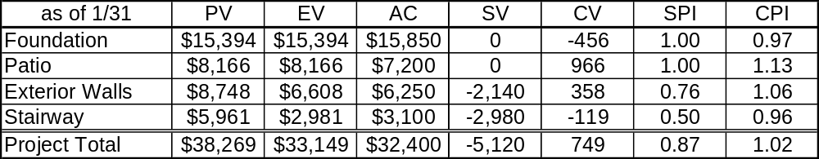
Project Status: Example
The chart below lists the project status results as of 1/31. But what does this information tell us?
Note: SV = Schedule Variance, CV = Cost Variance, SPI = Schedule Performance Index, CPI = Cost Performance Index
Can you answer these questions?
Is the Project on Schedule?, If not, what activity(s) is behind?
Is the project overrunning? If so, what activity(s) is overrunning?
Is the project going to miss the project completion milestone?
Is the project going to need more budget?
These questions and others will be answered in the next module, Module 6 – Metrics, Performance Measures and Forecasting where the value of EVM will become apparent.
Notes:
The graphic shows a chart with the status information as follows: For Installing Foundation PV $15,394, EV $15,394, AC $15,850, SV 0, CV –456, SPI 1.00, and CPI 0.97. For Installing Patio PV $8,166, EV $8,166, AC $7,200, SV 0, CV 966, SPI 1.00, and CPI 1.13. For Framing Exterior Walls PV $5,832, EV $6,608, AC $6,250, SV 776, CV 358, SPI 1.13, and CPI 1.06. For Installing Stairway PV $8,941, EV $2,980, AC $3,100, SV –5961, CV –120, SPI 0.33, and CPI 0.96. For Project Total PV $38,333, EV $33,148, AC $32,400, SV –5185, CV 748, SPI 0.86, and CPI 1.02

Slide 68
Estimate at Completion (EAC)
One final item that needs to be covered briefly is Estimate at Completion (EAC).
The Estimate at Completion (EAC) is the actual cost to date plus an objective estimate of costs for remaining authorized work. The objective in preparing an EAC is to provide an accurate projection of cost at the completion of the project. There are multiple ways and varying degrees of detail to calculate EAC, and they will be covered in a future module. The most common is:
EAC = Actual Cost (AC) + Estimate to Complete (ETC)
The Estimate to Complete (ETC) is the cost of completing the authorized remaining work.

Slide 69
Review of Module 5
Take some time to review the major items of this module
There is an Industry Standard Earned Value Management System guideline published in DoD 5000.2-R. It contains 332 criteria in 5 categories.
There are three key components to earned value: Planned Value, Earned Value and Actual Cost.
  PV (BCWS) is the physical work scheduled or “what you plan to do”.
  EV (BCWP) is the quantification of the “worth” of the work done to date or “what you physically accomplished”.
  AC (ACWP) is the cost incurred for executing work on a project or “what you have spent”.
There are numerous EV methods used for measuring progress.
  Fixed Formula
  Milestone Weights
  Milestone Weights with % Complete
  Units Complete
  Percent Complete
  Level of Effort

Slide 70
Summary of Module 5
In previous modules, we examined the basics of planning, scheduling, budgeting, and establishing a baseline. In this module we examined the basic EVMS concepts and methods. The next module takes us into analyzing the Metrics of Earned Value, along with addressing Performance Measures and Forecasting.
If you have a firm grasp of the concepts covered in these first five modules, feel free to progress to the next module. Otherwise, review the modules to ensure you have a solid understanding of the basics.
This concludes Module 5.

