Slide 1

From Flowchart to WBS
2005 Census Software Engineering
Process Group Conference
November 8, 2005
Nancy Noell, PMP

Slide 2
Theme
“Software Process Improvement at Census”
Purpose
How to take a traditional Software Development tool, a flowchart, and leverage it for Software Project Management tool, the WBS.

Slide 3
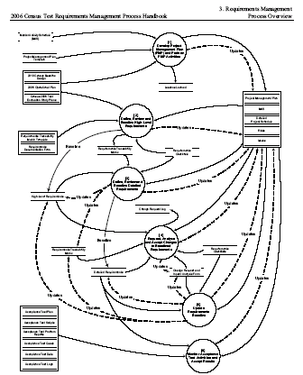
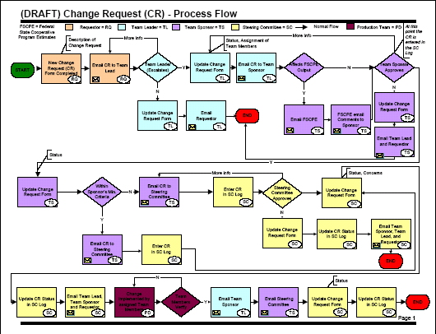
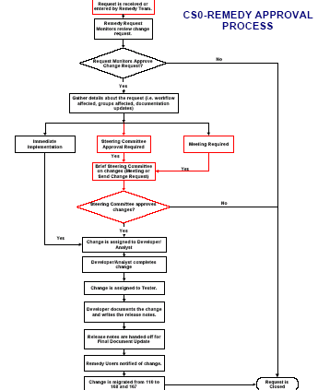
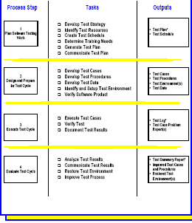
The Challenge: How can we use a flowchart to help us define the WBS for a project?

Slide 4
WHAT’S THE DIFFERENCE TO BEGIN WITH?
Flowchart: A schematic representation of a sequence of operations. (American Heritage Dictionary)
WBS: A deliverable-oriented grouping of project elements which organizes and defines the total scope of the project. (Guide to the PMBOK)

Slide 5
WHY IS THIS A BIG DEAL?
Project managers use schedules NOT ONLY TO TRACK, but also to FORECAST.
Using a flowchart-like WBS to track and forecast dates in a schedule is like trying to open your front door with a hammer, when what you want is a key.

Slide 6
HUH?
A flowchart helps us understand how
  a case,
  a dataset
  a trouble ticket,
  a questionnaire,
  a change request
  or some other unit of work
flows through a business process.
Or how parts of different processes relate to each other.
A WBS helps us understand what the deliverables of a project are.

Slide 7
        SO
How can we use a flowchart to help us define the WBS for a project?

Slide 8
First let’s look at what makes a good WBS

Slide 9
CRITERIA FOR A GOOD WBS
“Dynamic Scheduling”, E. Uyttewaal, 2005
PMI Practice Standard for Work Breakdown Structures, 2001
DELIVERABLE-ORIENTED
NOUN – VERB / NOUN STRUCTURE
REAL TASKS WITH SIGNIFICANT EFFORT
FORWARD PROGRESSION
LET’S LOOK AT EACH OF THESE in TURN….

Slide 10
CRITERIA FOR A GOOD WBS
“Dynamic Scheduling”, E. Uyttewaal, 2005
PMI Practice Standard for Work Breakdown Structures, 2001
DELIVERABLE-ORIENTED
Deliverable Item (i.e. HANDOFF—not “PHASE”)
Verifiable Acceptance Criteria for the Item
Milestone Definition
PMI: All single, tangible deliverables in WBS!

Slide 11
CRITERIA FOR A GOOD WBS
“Dynamic Scheduling”, E. Uyttewaal, 2005
PMI Practice Standard for Work Breakdown Structures, 2001
B. NOUN – VERB/NOUN STRUCTURE
    NOUN (HANDOFF)
    Verb/Noun
    Verb/Noun
    …
    M: Noun is ready for Handoff
PMI: Asymmetrical leveling ok in WBS!
PMI: Leveling should represent work!

Slide 12
CRITERIA FOR A GOOD WBS
“Dynamic Scheduling”, E. Uyttewaal, 2005
PMI Practice Standard for Work Breakdown Structures, 2001
C. REAL TASKS WITH SIGNIFICANT EFFORT
    Avoid “Nano” activities!
    Avoid “To Do” lists!
    ….explicitly in the WBS….
PMI: Limit definition for effective control!

Slide 13
CRITERIA FOR A GOOD WBS
“Dynamic Scheduling”, E. Uyttewaal, 2005
PMI Practice Standard for Work Breakdown Structures, 2001
D. FORWARD PROGRESSION
    Logical Dependencies
    Rather than
    Looping
    Chronological Dependencies
PMI: Define logical relationships!

Slide 14
        SO
How can we use a flowchart to help us define the WBS for a project?

Slide 15
GATE 1
Is the flowchart even a candidate to help with the WBS?

Slide 16
GATE 1
Good candidates are flowcharts that depict
Overall flow of data collection
Overall flow of data processing
Overall flow of data dissemination
Overall flow of your project!
Poor candidates are flowcharts that depict
Flow of a “unit of work”
    Trouble ticket
    Interview
    Failed edit case
    Etc….

Slide 17
GATE 2
Follow the steps on the next slide………

Slide 18
STEPS– WHOA! One Step at a Time!
Identify key milestones.
Articulate milestone deliverable as a NOUN .
Craft the milestone statement.
Create the work package task which is just the noun.
Detail work steps for creating deliverable.
Ask yourself: For each step, are these of significant effort to warrant remaining in the WBS?
Repeat Steps 1-6 to build out WBS.
Final check: Does WBS allow you to monitor the forward progression of deliverables in your project?
Notes:
Study the flowchart for key milestones you need to track.
Articulate as a NOUN what deliverable is available when the milestone is reached.
Craft the milestone statement.
Create the work package task which is just the noun.
Articulate the steps necessary to get from the start of work on the deliverable to the milestone.
Ask yourself: For each “Verb/Noun” in step 5, are these of significant effort to warrant remaining in the WBS?
Repeat Steps 1-6 to build out WBS
Final check: Does WBS allow you to monitor the forward progression of deliverables in your project?

Slide 19
STEPS
Identify key milestones.
    CLUES:
        Diamond-decision points
        End-of-flow points
        Artifacts
        Overall flowchart product
Notes:
Study the flowchart for key milestones you need to track.
Articulate as a NOUN what deliverable is available when the milestone is reached.
Craft the milestone statement.
Create the work package task which is just the noun.
Articulate the steps necessary to get from the start of work on the deliverable to the milestone.
Ask yourself: For each “Verb/Noun” in step 5, are these of significant effort to warrant remaining in the WBS?
Repeat Steps 1-6 to build out WBS
Final check: Does WBS allow you to monitor the forward progression of deliverables in your project?

Slide 20
STEPS
Study the flowchart for key milestones you need to track.
Articulate milestone deliverable as a NOUN.
    That’s pretty easy…or should be.
    Is this really the deliverable to track?
Notes:
Study the flowchart for key milestones you need to track.
Articulate as a NOUN what deliverable is available when the milestone is reached.
Craft the milestone statement.
Create the work package task which is just the noun.
Articulate the steps necessary to get from the start of work on the deliverable to the milestone.
Ask yourself: For each “Verb/Noun” in step 5, are these of significant effort to warrant remaining in the WBS?
Repeat Steps 1-6 to build out WBS
Final check: Does WBS allow you to monitor the forward progression of deliverables in your project?

Slide 21
STEPS
Study the flowchart for key milestones you need to track.
Articulate milestone deliverable as a NOUN.
Craft the milestone statement.
      M: <deliverable> is ready
Notes:
Study the flowchart for key milestones you need to track.
Articulate as a NOUN what deliverable is available when the milestone is reached.
Craft the milestone statement.
Create the work package task which is just the noun.
Articulate the steps necessary to get from the start of work on the deliverable to the milestone.
Ask yourself: For each “Verb/Noun” in step 5, are these of significant effort to warrant remaining in the WBS?
Repeat Steps 1-6 to build out WBS
Final check: Does WBS allow you to monitor the forward progression of deliverables in your project?

Slide 22
STEPS
Study the flowchart for key milestones you need to track.
Articulate milestone deliverable as a NOUN.
Craft the milestone statement.
Create the work package task which is just the noun.
Notes:
Study the flowchart for key milestones you need to track.
Articulate as a NOUN what deliverable is available when the milestone is reached.
Craft the milestone statement.
Create the work package task which is just the noun.
Articulate the steps necessary to get from the start of work on the deliverable to the milestone.
Ask yourself: For each “Verb/Noun” in step 5, are these of significant effort to warrant remaining in the WBS?
Repeat Steps 1-6 to build out WBS
Final check: Does WBS allow you to monitor the forward progression of deliverables in your project?

Slide 23
STEPS
Study the flowchart for key milestones you need to track.
Articulate milestone deliverable as a NOUN.
Craft the milestone statement.
Create the work package task which is just the noun.
Detail work steps for creating deliverable.
      Verb / Noun
      Verb / Noun
      Verb / Noun
Notes:
Study the flowchart for key milestones you need to track.
Articulate as a NOUN what deliverable is available when the milestone is reached.
Craft the milestone statement.
Create the work package task which is just the noun.
Articulate the steps necessary to get from the start of work on the deliverable to the milestone.
Ask yourself: For each “Verb/Noun” in step 5, are these of significant effort to warrant remaining in the WBS?
Repeat Steps 1-6 to build out WBS
Final check: Does WBS allow you to monitor the forward progression of deliverables in your project?

Slide 24
STEPS
Study the flowchart for key milestones you need to track.
Articulate milestone deliverable as a NOUN.
Craft the milestone statement.
Create the work package task which is just the noun.
Detail work steps for creating deliverable.
Ask yourself: For each step, are these of significant effort to warrant remaining in the WBS?
      D. Frame “100 hour” criterion
      E. Uyttewaal “1% - 10%” criterion
      PMI GOVSIG “5%” criterion
Notes:
Study the flowchart for key milestones you need to track.
Articulate as a NOUN what deliverable is available when the milestone is reached.
Craft the milestone statement.
Create the work package task which is just the noun.
Articulate the steps necessary to get from the start of work on the deliverable to the milestone.
Ask yourself: For each “Verb/Noun” in step 5, are these of significant effort to warrant remaining in the WBS?
Repeat Steps 1-6 to build out WBS
Final check: Does WBS allow you to monitor the forward progression of deliverables in your project?

Slide 25
STEPS
Study the flowchart for key milestones you need to track.
Articulate milestone deliverable as a NOUN.
Craft the milestone statement.
Create the work package task which is just the noun.
Detail work steps for creating deliverable.
Ask yourself: For each step , are these of significant effort to warrant remaining in the WBS?
Repeat Steps 1-6 to build out WBS
Notes:
Study the flowchart for key milestones you need to track.
Articulate as a NOUN what deliverable is available when the milestone is reached.
Craft the milestone statement.
Create the work package task which is just the noun.
Articulate the steps necessary to get from the start of work on the deliverable to the milestone.
Ask yourself: For each “Verb/Noun” in step 5, are these of significant effort to warrant remaining in the WBS?
Repeat Steps 1-6 to build out WBS
Final check: Does WBS allow you to monitor the forward progression of deliverables in your project?

Slide 26
STEPS
Study the flowchart for key milestones you need to track.
Articulate milestone deliverable as a NOUN.
Craft the milestone statement.
Create the work package task which is just the noun.
Detail work steps for creating deliverable.
Ask yourself: For each step, are these of significant effort to warrant remaining in the WBS?
Repeat Steps 1-6 to build out WBS
Final check: Does WBS allow you to monitor the forward progression of deliverables in your project?
Notes:
Study the flowchart for key milestones you need to track.
Articulate as a NOUN what deliverable is available when the milestone is reached.
Craft the milestone statement.
Create the work package task which is just the noun.
Articulate the steps necessary to get from the start of work on the deliverable to the milestone.
Ask yourself: For each “Verb/Noun” in step 5, are these of significant effort to warrant remaining in the WBS?
Repeat Steps 1-6 to build out WBS
Final check: Does WBS allow you to monitor the forward progression of deliverables in your project?

Slide 27
So Let’s Try one now…

Slide 28
Handout: SPI Process Flow

Slide 29
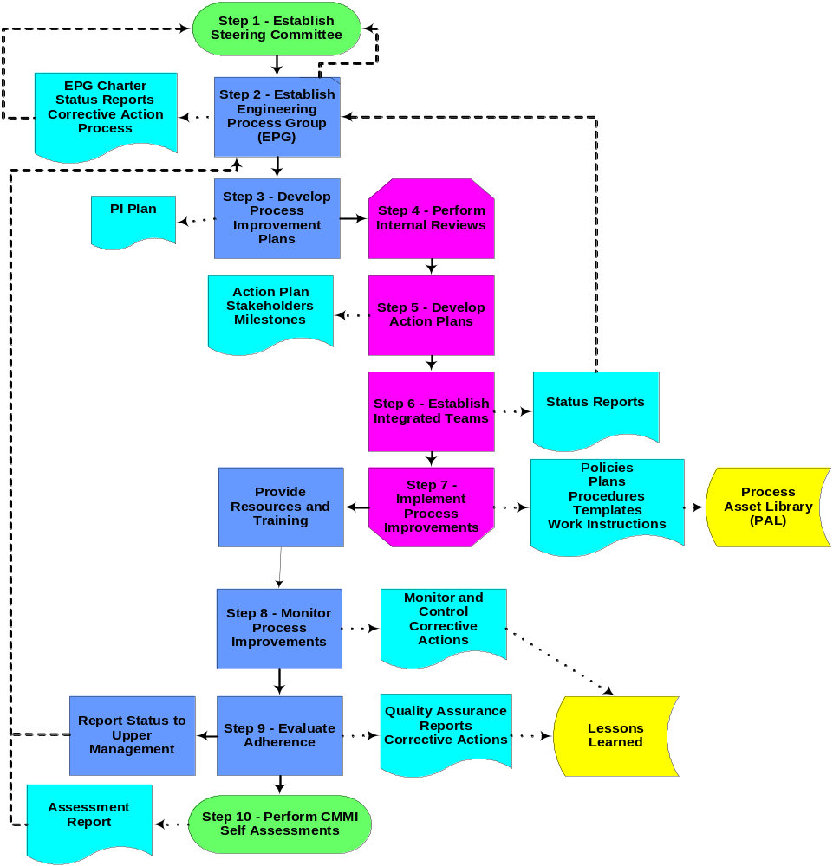

Slide 30
Step 1: Find the milestones
Let’s hear from you!

Slide 31
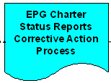
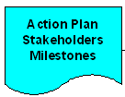
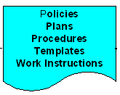

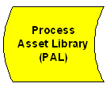
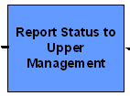

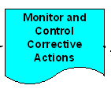
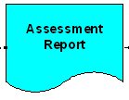
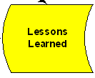
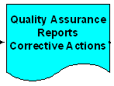
Step 1: Here’s what I see

Slide 32
Step 2: Name the milestones
Process Improvement (PI) Plan
Policies
Plans
Procedures
Templates
Work Instructions
Process Asset Library (PAL)
Lessons Learned (LL)
Status Reports
Assessment Report
Upper Management Report

Slide 33
Step 2: Are ALL of these tracked separately?
For Instance:
    Process Assets
      Policy
      Plans
      Procedures
      Templates
      Work Instructions

Slide 34
Step 3: Craft milestone statement
M: PI Plan is Baselined
M: PAL is accessible to staff
M: Process Assets are on PAL
M: Lessons Learned Distributed
M: Assessment Report Complete
M: Upper Mgt Report Delivered
….etc….

Slide 35
Step 3: Craft milestone statement
This raises an interesting question:
Is there just ONE of each
or
Perhaps several???

Slide 36
Step 4: Craft Workpackage Task
Process Improvement Plan
PAL Repository
Process Assets (PA) for <Topic>
Lessons Learned for <Topic>
Assessment Report
Upper Mgt Report
….etc…..

Slide 37
Step 5: Craft Steps
PA for Requirements Mgt
  Develop draft and route
  Comment and walkthrough
  Update draft and finalize
  M: PA for Req Mgt are on PAL

Slide 38
Step 6: Are steps significant?
Well, what’s the real work involved in each?

Slide 39
Develop PA Req Mgt draft and route for comment
  Research different Req Mgt techniques
  Present Req Mgt techniques @ SPI meeting
  Consult with other SPI groups
  Type up, post to repository and email link to our SPI group
    Policy for Req Mgt
    Plans for Req Mgt
    Procedures for Req Mgt
    Templates for Req Mgt
    Work Instructions for for Req Mgt

Slide 40
Step 6: Are steps significant?
D. Frame “100 hour” criterion
E. Uyttewaal “1% - 10%” criterion
  Min Duration = 1% Project duration (rounded)
  Max Duration = 10% Project duration (rounded)
PMI GOVSIG “5%” criterion
  Task duration is about 5% of project duration (rounded)

Slide 41
Step 7: Repeat!
PI Plan
  Develop draft and route
  Comment and walkthrough
  Update draft and finalize
  M: PI Plan is Baselined
PAL Repository
  Requirements
  Design
  Construction and Release
  M: PAL is accessible to staff

Slide 42
Step 7: H-m-m-m
Does this need further decomposition?
PAL Repository
  Requirements
  Design
  Construction and Release
  M: PAL is accessible to staff

Slide 43
Step 7: It’s your decision
Consider Size advice
Consider asymmetry advice
PAL Repository
  Requirements
    Develop draft and route
    Comment and walkthrough
    Update draft and finalize
    M: PAL Repository Req are Baselined
  Design
    Develop draft and route
    Comment and walkthrough
    Update draft and finalize
    M: PAL Repository Design is Baselined
  ….etc….

Slide 44
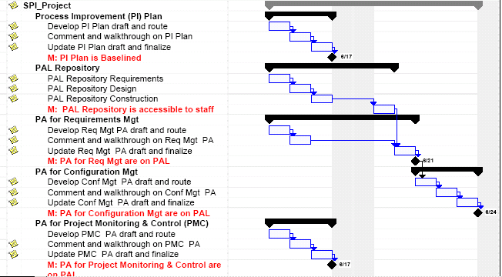
Step 8: Forward progression?

Slide 45
So what about those “nano” activities?
WBS Dictionary !

Slide 46
WBS Dictionary:
  when can you say you are done?
    Definition of the work
    Exit or Acceptance Criteria
    Checklist

Slide 47
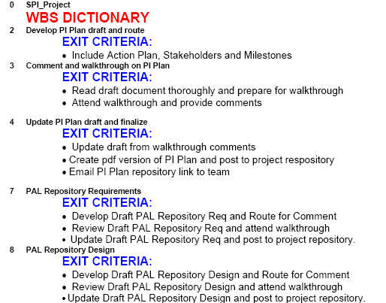
WBS Dictionary

Slide 48
Now it’s YOUR turn…..

Slide 49
At your table you will find:
A set of flowcharts
A set of post-its
A marker or two
A flipchart

Slide 50
Your assignment:
Pick a presenter
Pick ONE flowchart
Craft a WBS from the flowchart
Put your WBS on the flipchart

Slide 51
Questions
?

Slide 52
Contact Information
Name: Nancy Noell
Division: HRD
Phone Number: 301-763-3269

