Slide 1

Overview of Ecotoxicological Assays
NACEPT
Endocrine Disruptor Methods Validation Subcommittee
March 2002
Les Touart

Slide 2

Wildlife – Human Connection

Slide 3
EDSTAC Recommended Ecotoxicological Assays
Tier 1
Fish Gonadal Recrudescence Assay
Frog Metamorphosis Assay
Tier 2
Fish Life Cycle
Avian Reproduction
Amphibian Development and Reproduction
Mysid Life Cycle

Slide 4
Purpose of Diverse Taxa
in Screening Battery
To reduce the likelihood that important pathways for metabolic activation or detoxification of the test substances are overlooked

Slide 5

Fish Short-term Reproduction Assay
(Tier 1)
[a.k.a. Fish Gonadal Recrudescence Assay]
Unique to Screening Battery
Adult life stage
Oviparity
Gametogenesis
Spawning

Slide 6
Fish Reproduction Assay
(Tier 1)
Milestone Meeting Date
DRP Mar 2002
  FHM comparative study Mar 2003
  Vitellogenin methods Mar 2003
Prevalidation Report July 2003
Validation Report 2004
Integrated Summary 2004

Slide 7
Amphibian Metamorphosis Assay
(Tier 1)
Milestone Meeting Date
DRP June 2002
evaluate utility & future of assay before setting milestone dates

Slide 8
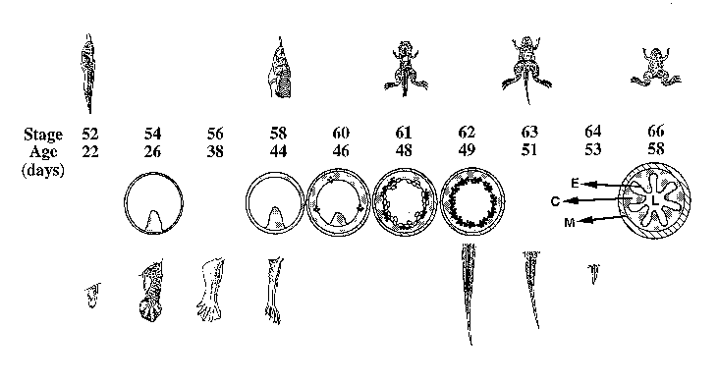
Why Use an Amphibian Metamorphosis Model for Thyroid Disruption?
Amphibian metamorphosis is TH dependent event
Transforms aquatic larval lifestage to adult tetrapod
Characterized by:
Remodeling of
tissues
Development of
new tissues
Resorption of tissues
(adapted from Shi, et.al., 1996)

Slide 9
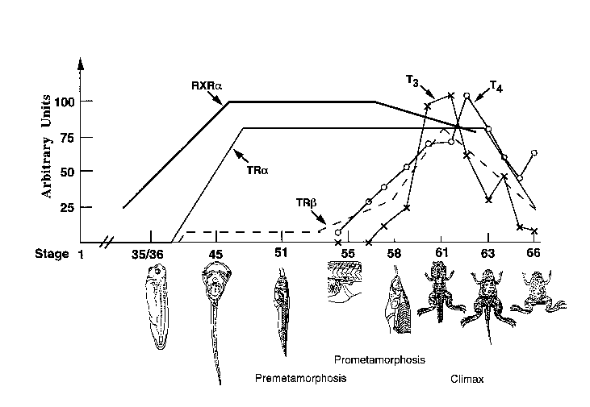
Metamorphosis in X. laevis
Alternative
Protocol
EDSTAC
Protocol
Thyroid
functional
(adapted from Shi, et.al., 1996)

Slide 10
Conclusions From MED Analysis of EDSTAC- Proposed Amphibian Metamorphosis Assay
EDSTAC-Proposed Frog Tail Resorption Assay is Not Ready for Use as a Screening Tool
  1) Developmental stage 60 is relatively insensitive
  2) Tail tissue is relatively insensitive
  3) Changes in tail resorption rates not diagnostic
  4) Insufficient data on known agonists/antagonists
  5) Interaction with other endocrine systems is source of uncertainty

Slide 11
German Proposal for an Amphibian Metamorphosis Assay
(XEMA)
Uses Xenopus laevis at developmental stage 48
Exposed to test substance for 28 days
Endpoints measured
  Whole body length
  Tail length
  Staging
Ring test underway

Slide 12
Purpose of Tier 2
Determine if endocrine-active substance causes adverse effects in animals
Identify the adverse effects
Establish a quantitative relationship between the dose and the adverse effects

Slide 13
Fish Life Cycle
(Tier 2)
Milestone Meeting Date
DRP June 2002
Prevalidation May 2003
Validation 2004
Integrated Summary 2004

Slide 14
Avian 2-Generation
(Tier 2)
Milestone Meeting Date
DRP Dec 2002
Dosing study Dec 2002
Prevalidation Report 2004
Validation Report 2004
Integrated Summary 2004

Slide 15
Amphibian Development and Reproduction
(Tier 2)
Milestone Meeting Date
DRP Sept 2002
Prevalidation Report 2004
Validation Report 2005
Integrated Summary 2005

Slide 16
Mysid Life Cycle
(Tier 2)
Milestone Meeting Date
DRP June 2002
Prevalidation Report May 2003
Validation Report 2004
Integrated Summary 2004

Slide 17
OECD Activity
Test Guidelines Program
EDTA
(VMGin vitro)
VMGmammal
VMGeco
fish
birds
amphibians

