Slide 1
Instructions for Building an Entry Quad Chart:
General:
Simply copy the format/fonts, etc. for each type of quad in the illustrations provided.
Some brief comments on each of the four quads are also provided below. All Quads should have the Title of the task, in the first line, and the PI Name: Institution in thesecond line. Both of these are above the red and blue lines, in the area where the NASA “meatball” is. The font is “Comic Sans”.
Entry Quad:
- Top Left Quadrant: The Objective (“what” the task will do) in bullet format.
- Top Right quadrant: A representative illustration of the technology, at the initial
stage of the task.
- Bottom Right Quadrant: Key Milestones (“when”) for accomplishment of the
task in the format of “Month/Yr”. (E.g.: 03/06 for the second milestone.)
o At the bottom, center of this quadrant, the entry TRL for the technology in
the format TRLin = m
- Bottom Left Quadrant: Approach (“how”); in bullet form the task will be
accomplished. This quadrant also lists any Co-Is/Partners.
- Provide the date (month/yr; e.g.: 10/05) the chart was created, in a small font, on the
lower left of the slide, below the double blue lines. Place the date (month/year) for the
quad in the lower left in a small font below the blue lines.
Page 2 of this presentation contains an example slide and page 3 contains a blank template.

Slide 2

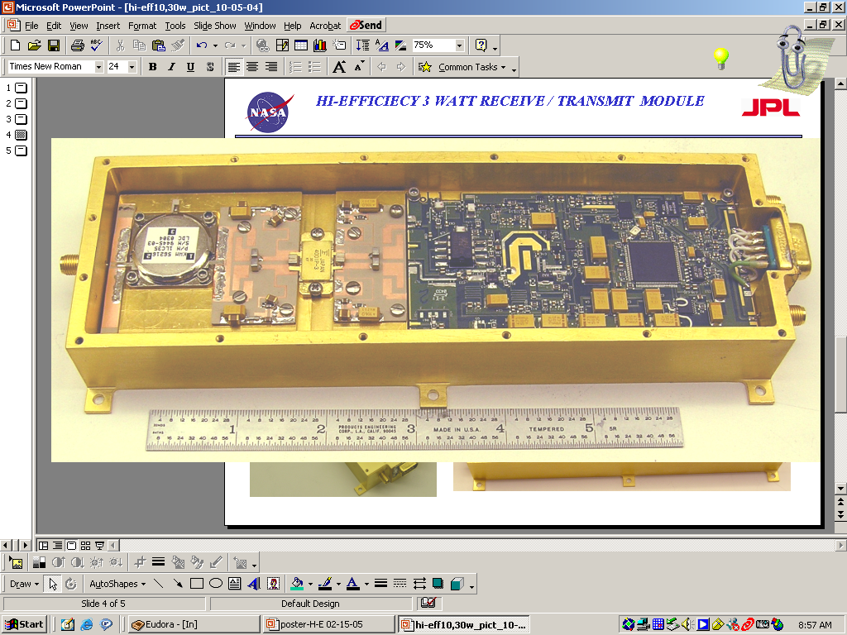

Adaptive Self-Correcting T/R Module
PI: Wendy Edelstein / JPL
Objective
Develop a practical and low cost adaptive L-band T/R module with integrated calibrator for use in phase-stable array antennas for interferometric synthetic aperture radar (InSAR) applications.
Performance goals are <1 deg absolute phase stability and <0.1 dB absolute amplitude stability over temperature.
Technologies include high efficiency L-band T/R module; integrated phase/amplitude detector; closed-loop detection and correction circuitry.
Closed-Loop Calibration Scheme
High-Efficiency L-band T/R module to be modified with integrated calibrator
EXAMPLE SLIDE
Approach:
Key Milestones
Modify an existing high-efficiency L-band T/R module with built-in calibrator by:
  Developing a stable closed-loop amplitude and phase detector circuit.
  Integrating the calibrator circuit into the L-band T/R module.
  Characterizing performance over temperature to demonstrate ability to self-correct for variations in insertion phase or amplitude.
Requirements, architecture, design 7/06
Breadboard demo (TRL 5) 1/07
Build T/R with integrated calibrator 7/07
Prototype validation (TRL 6) 1/08
CoIs: Constantine Andricos, Gregory Sadowy, JPL
TRL_{in} = 4
04/07

Slide 3
TITLE HERE
PI: Name Here
Objective
Objective Here
Image / Picture Here with Caption
Approach:
Key Milestones
Approach Here
Milestone Here Mo/Yr
Milestone Here Mo/Yr
Milestone Here Mo/Yr
Milestone Here Mo/Yr
Milestone Here Mo/Yr
CoIs: CO-Is / Partners Here
TRL_{in} = ?
Mo/Yr

