Slide 1
Aerospace Operations Systems
Technical Accomplishment
Experiments for Color Image Visibility Model Development
POC: Al Ahumada, ARC
May 2000
Relevant Milestone: Color extension of the contrast-gain control visibility model. (Visibility Models and Metrics Program Milestone, due 4Q, FY00)
Shown: Targets, masks, and masking results of experiment to help develop and calibrate models.
Accomplishment / Relation to Milestone and ETG: Completed a preliminary experiment in color target detection on color noise backgrounds and used the results of the experiment to develop and calibrate a preliminary extension to color of the contrast-gain control visibility model. The results were presented at the Annual Meeting of the Association for Research in Vision and Ophthalmology which provided very useful feedback.
  Two targets were used. They were red/green uniform squares. The luminance target was the background yellow. For the red/green target, the green gun level decreased as the red increased, keeping the luminance constant. The color of the red/green target varied from red to the background yellow as the target contrast was lowered. The luminance masks were the background yellow. The red/green masks were isoluminant. The sum mask was the sum of those two images. A similar low contrast set of three masks was formed at half the contrast.
  Luminance noise did not mask the red/green target. Red/green noise masking of the luminance target was small, but significant. The sum results show this latter effect could only be seen with masking imagery of very low luminance contrast. Masking was fairly well predicted by a model with contrast masking within channels only.
These models will allow display designers to ensure the visibility of critical information.
Future Plans: Include more target shapes and more color masks to make model complete. Test model on multi-band IR images combined into color images with various sensor fusion algorithms.
ETG: Reduce the aircraft accident rate by a factor of five within 10 years, and by a factor of 10 within 25 years

Slide 2
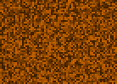

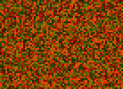




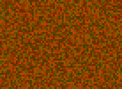
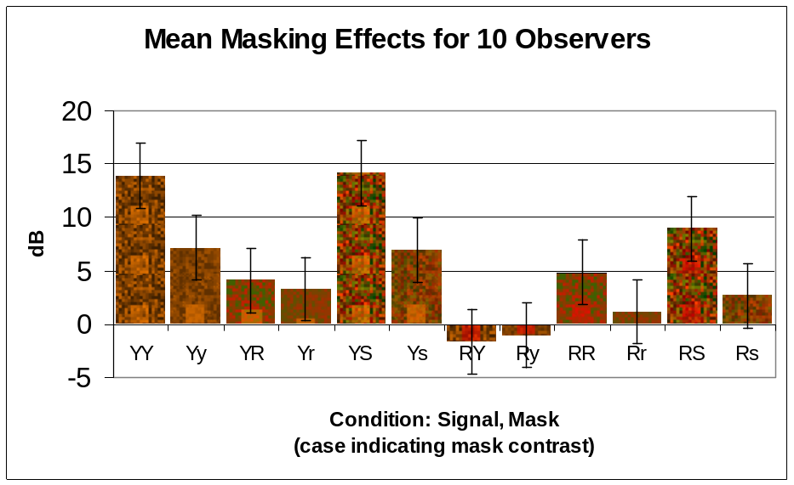
Aerospace Operations Systems
Experiments for Color Image Visibility Model Development
MASKS
TARGETS on the UNIFORM BACKGROUND
High Contrast
Luminance Noise
(Y)
High Contrast
Red/Green Noise
(R)
Summed
High Contrast Noises
(S)
Luminance (Y)
Red/Green (R)
Low Contrast
Luminance Noise
(y)
Low Contrast
Red/Green Noise
(r)
Summed
Low Contrast Noises
(s)
BEHAVIORAL RESULTS

