Slide 1
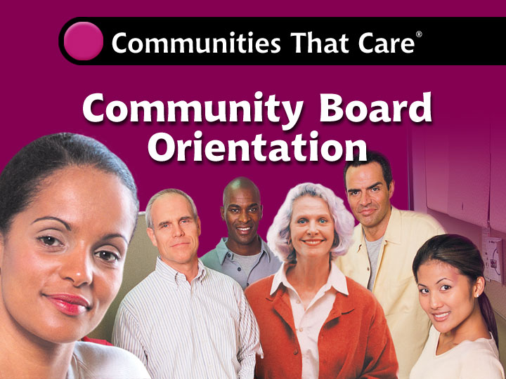

Community Board Orientation
1-1
Notes:
12.15.00KLO 1-<number>

Slide 2
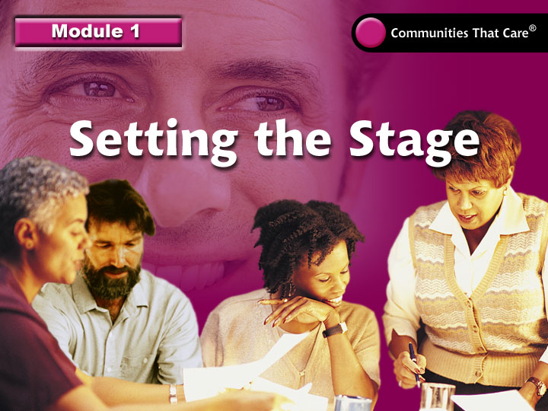
Community Board Orientation
1-2
Notes:
12.15.00KLO 1-<number>

Slide 3
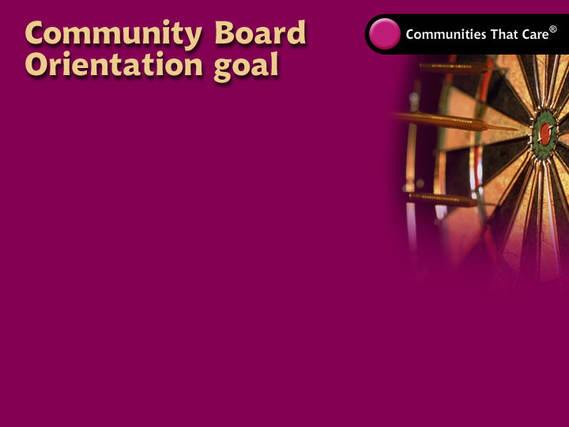
Build the Community
Board’s capacity to implement
the Communities That Care
prevention-planning system.
Community Board Orientation
1-3

Slide 4
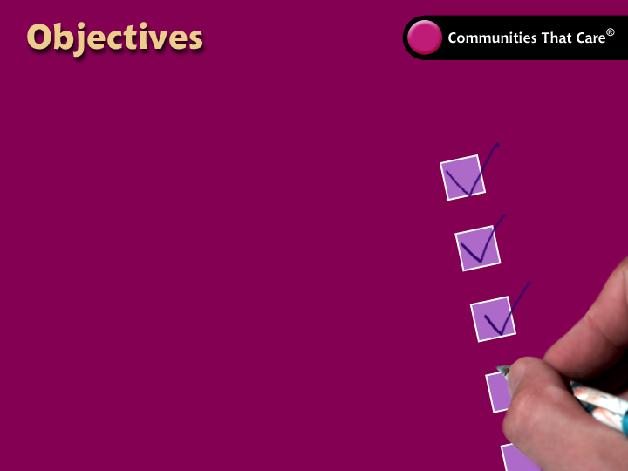
  On completing this orientation, you will be able to:
  explain how the prevention-science research base
  helps build positive futures for youth
  and prevent problem behaviors
  describe the Communities
  That Care system
  address outstanding community
  readiness issues
  involve Key Leaders,
  community members and youth
  develop a Community Board
  organizational structure
  plan for the next steps.
Community Board Orientation
1-4

Slide 5
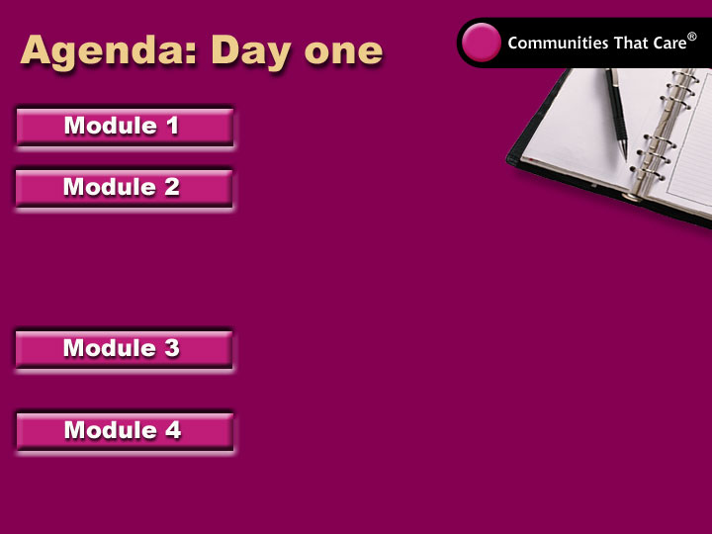
Setting the Stage
Overview: The
Research Foundation
and Process
LUNCH
Milestone: Address
Readiness Issues
Milestone: Engage Key Leaders
Wrap-up and evaluations
Community Board Orientation
1-5

Slide 6
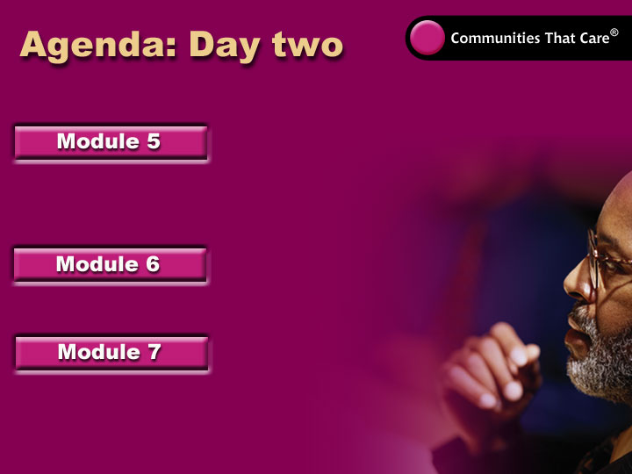
Community Meeting
Milestone: Educate and
Involve the Community
LUNCH
Milestone: Create an
Effective Community Board
Next Steps
Wrap-up and evaluations
Community Board Orientation
1-6

Slide 7
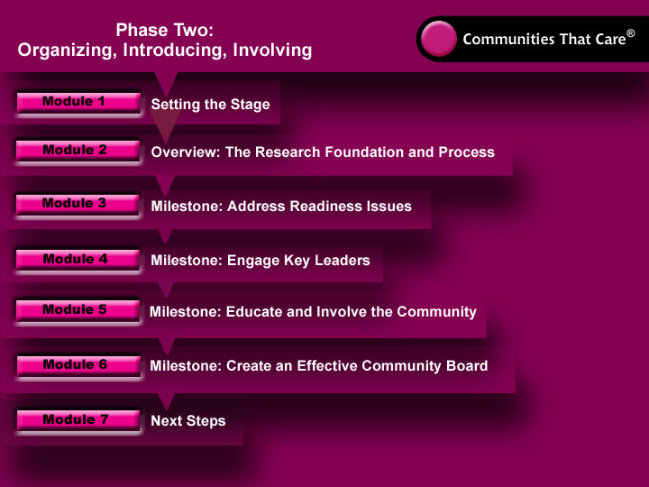
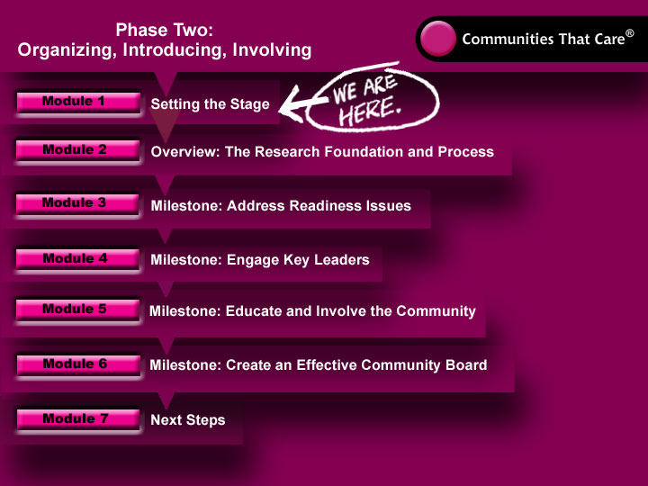
Community Board Orientation
1-7
Notes:
Review flow chart.

Slide 8
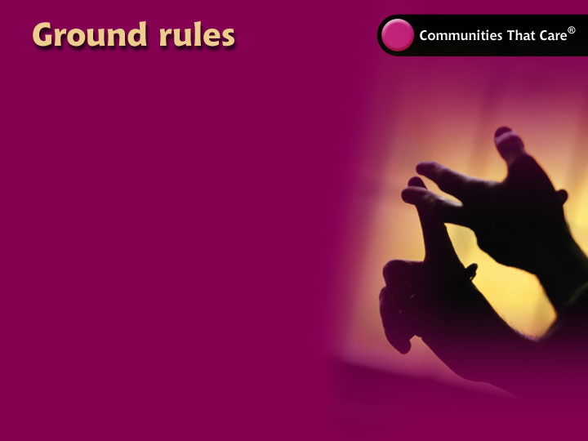
Everyone gets a
chance to speak.
Everyone listens when
someone has the floor.
(No side conversations.)
One person talks at a time
and doesn’t get interrupted.
Respect others’ perspectives
and ideas. (No put-downs.)
Start and end on time.
Community Board Orientation
1-8

