Slide 1

e-Payroll Status
May 27, 2004

Slide 2
Overview
Meeting Purpose
Milestone Checkpoints
Project Schedule
Project Status
Test Readiness Review
Criteria for Proceeding
Issues Summary
Options for Proceeding
Project Recommendation
Risk Summary
Back-up

Slide 3
Meeting Purpose
The purpose of this meeting is to
Provide the status of the e-Payroll migration; and
obtain the e-Payroll Steering Committee’s authorization to proceed with NASA’s first Formal Parallel test of the Department of Interior’s (DOI) Federal Personnel and Payroll System (FPPS).

Slide 4
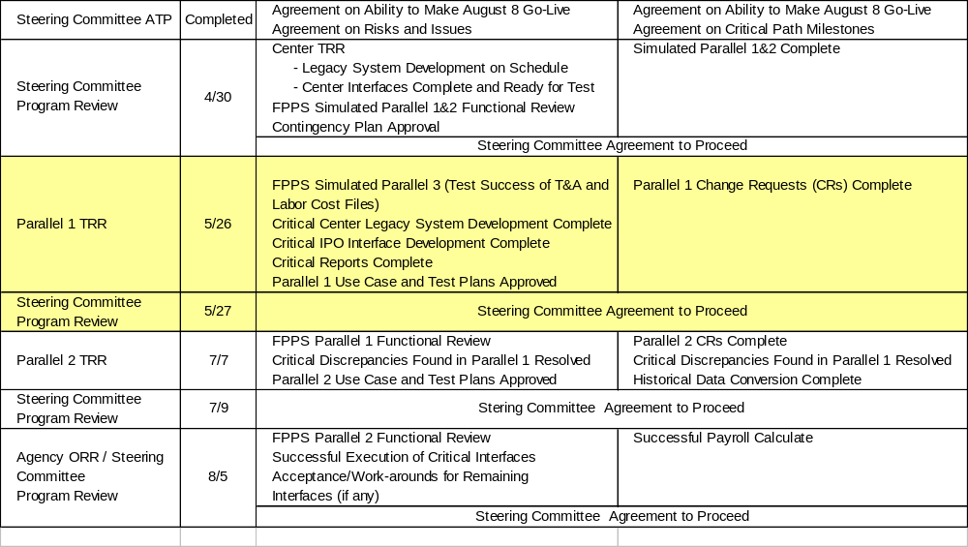
Milestone Check Points

Slide 5
Project Schedule
FY2004
February
March
April
May
June
July
August
Interface Design
Report Design
Interface Development / Unit Test
Parallel 1 TRR
5/26
Center TRRs
4/26 – 4/29
Report Development
Test Scripts
3/30
FPPS Online Testing
System Connectivity and Acceptance Testing
Parallel 1
Parallel 2
Sim. Parallel (SP) 1
3/22
SP 2
4/19
SP 3
5/17
CRs Available
5/30
CRs Available
7/11
Training
Historical Data Conversion
Deployment
Go-Live
8/8
Notes:
The Summary Status shall be reported for the month. For purposes of this chart, the “month”, or “M”, is the period between the last MSR and the current MSR. Please utilize the criteria on this page for reporting summary status.
The intent of this chart is to provide an overall status of the project.
NOTE: Any red or yellow assessment requires an explanation.
The Integration Project Office (IPO) summary status shall reflect cost/schedule/technical status for each active project.

Slide 6
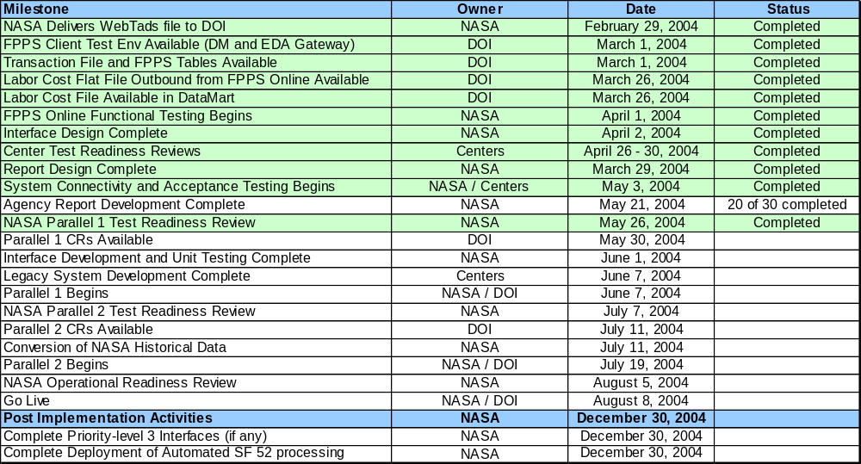
Project Status

Slide 7
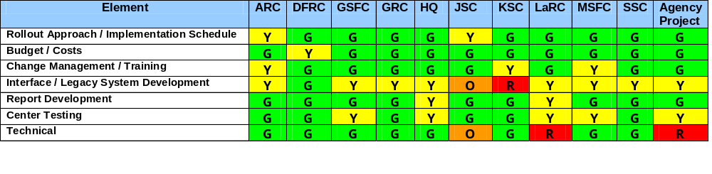
Center Test Readiness Review (TRR)
Purpose: To validate Center readiness to proceed with testing for Parallel 1
Major Issues
  FPPS System Performance (Server Disconnects)
  Labor file processing and validation
  Legacy system modifications
    NEBS (JSC)
    MSFC Oracle
  Highly compacted testing schedule
KSC has noted their Labor interface will complete end-to-end integration testing by June 25, 2004
Awaiting final development of WebTADS interface file for delivery of cost structures to FPPS

Slide 8
Agency Test Readiness Review (TRR)
Purpose: To validate Agency readiness to proceed from Interface Development and End-to-End/Acceptance Testing to Parallel 1 Testing
  FPPS Simulated Parallel 3 (Test Success of T&A and Labor Cost Files)
  Critical Center Legacy System Development Complete
  Critical IPO Interface Development Complete
  Critical Reports Complete
  Parallel 1 Use Case and Test Plans Approved
  Parallel 1 CRs Complete

Slide 9
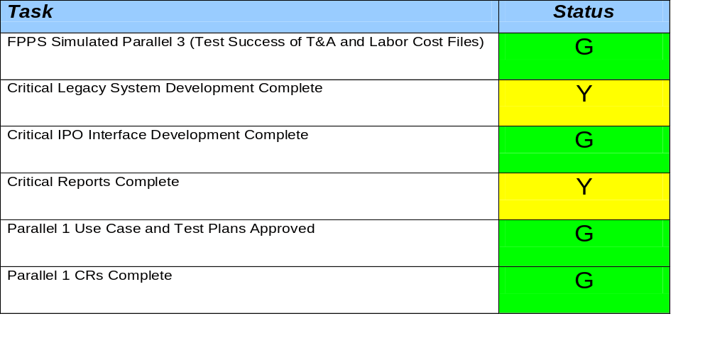
Criteria for Proceeding
Incomplete legacy interfaces and critical reports are not required to be completed until after the pay calculate process occurring on June 16, 2004
Centers have indicated that required development will be completed prior to the June 16, 2004 pay calculate date

Slide 10
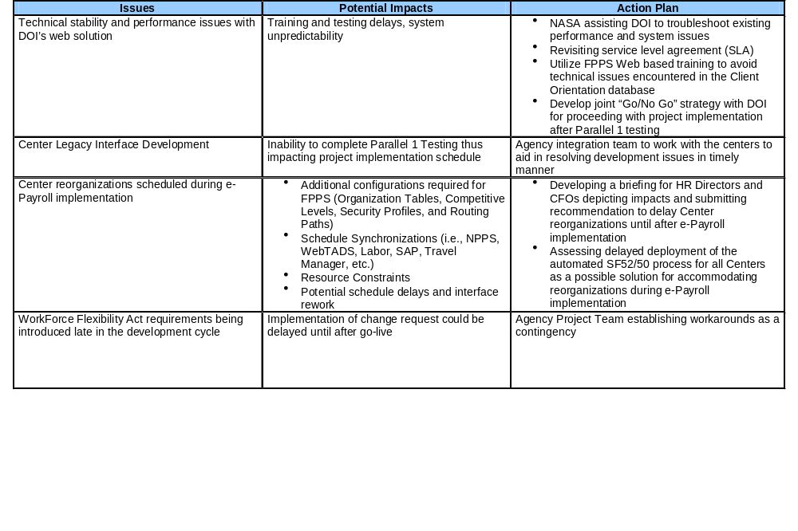
Issues Summary

Slide 11
Options for Proceeding
Option 1: Go forward with Parallel 1 testing at DOI utilizing the FPPS web based Client Orientation Database (uncertain of DOI support – PC’s, testing room, printers, fax, etc.)
  Establish milestone for SSL stability of June 18, 2004
  Emergency Steering Committee meeting for Go/No-Go decision
Option 2: Delay e-Payroll deployment to next available window (Calendar Year End 2004)
  Re-plan for future deployment
  Reassess center and agency cost of delaying implementation

Slide 12

Project Recommendation for Authorization to Proceed
Recommendation: Go forward with Parallel 1 testing at DOI and establish joint milestone review to assess technical issues for June 18, 2004
Steering Committee Decision? Steering Committee agreed on recommendation to proceed

Slide 13
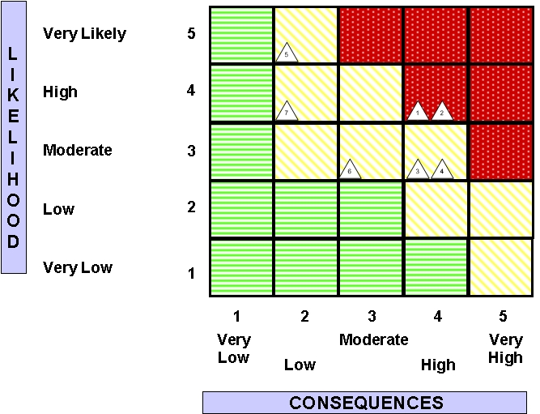
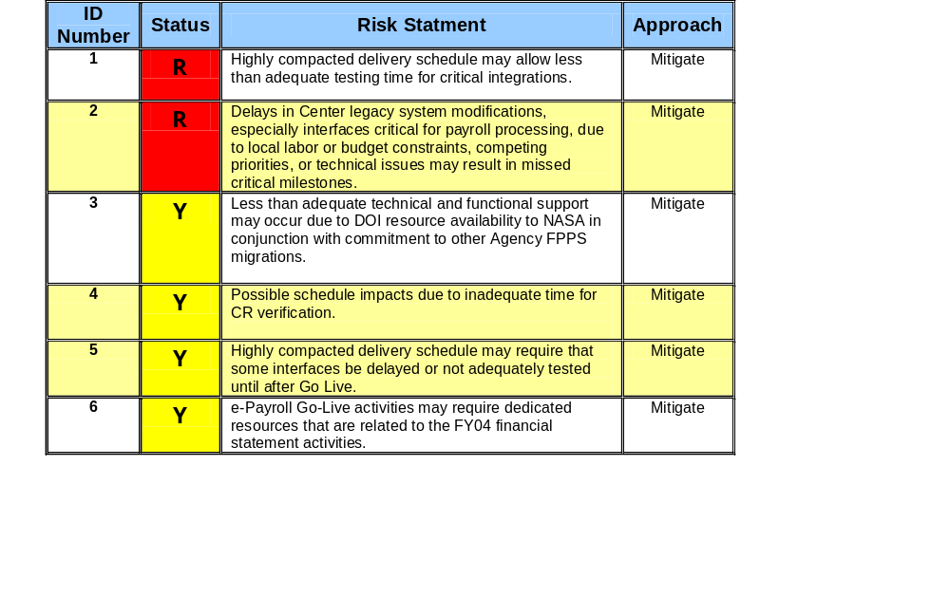
Risk Summary

Slide 14
Backup
BACKUP

Slide 15
Interface Prioritization
Priority 1
Awards Inbound
CFC Inbound & Outbound
Employee Information Update
Labor
SAP Vendor Master
Travel Manager
WebTads T&A Adjustments
WebTads Employee Number
WebTads Inbound & Outbound
WebTads Labor
X500 Inbound & Outbound
Agency Master Delta
Priority 2
Awards Outbound
IDMS Outbound
IRIS
WIMS (HQ)
ARC ISIS
ARC Sybase
GRC SIMS
GSFC LISTS
GSFC WIT
PCS
JSC NEBS
KSC EDW
LaRC DataMart
MSFC MEDIS
MSFC Oracle
Priority 3
AdminStar
Center-to-Center Transfer
CMS
Go Learn
HEIDI
Perf. Rating Updates
GRC HRIS
GRC Master Data
GSFC Profiles
GSFC WISP

Slide 16
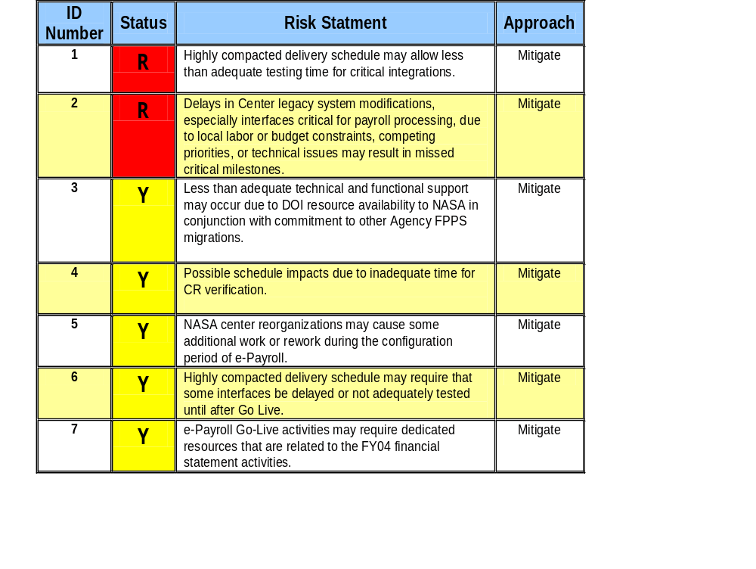
Risk Matrix

Slide 17
Parallel 1 Authority to Proceed Options
Option | Benefits
Go forward with Parallel 1 testing at DOI (uncertain of DOI support – PC’s, testing room, printers, fax, etc.) | Continues current deployment timeline (cost effective) Non-SSL Web-FPPS can be used in exactly same manner as SSL version currently used at Centers without security concerns Allows NASA to continue interface testing and development with incorporated CRs Eliminates the need for re-training testers for alternative solutions (i.e., Blue Zone 3270, TN3270)
Delay e-Payroll deployment to next available window (Calendar Year End 2004) | Provides DOI time to identify and correct server disconnects and performance issues Eliminates potential fiscal year end impacts Provides Centers/IPO time to complete development and perform proper testing

Slide 18
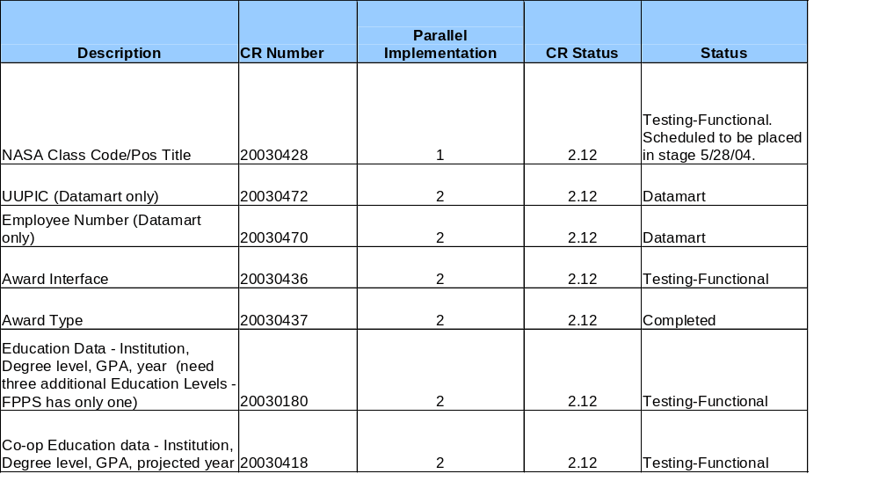
CR Status

Slide 19
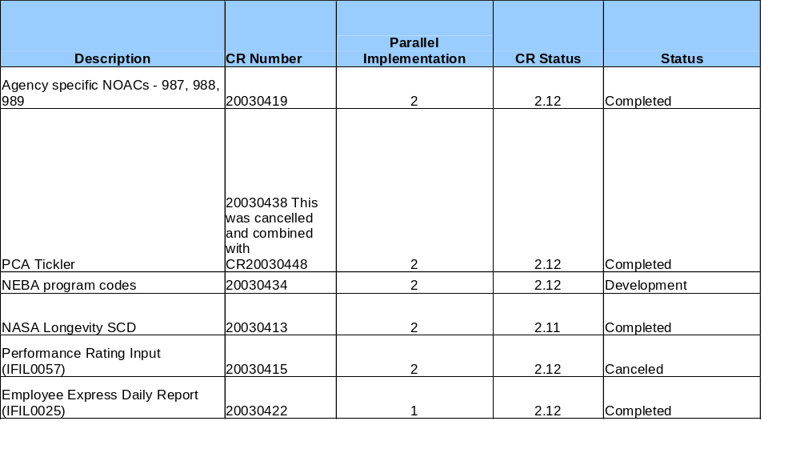
CR Status

Slide 20
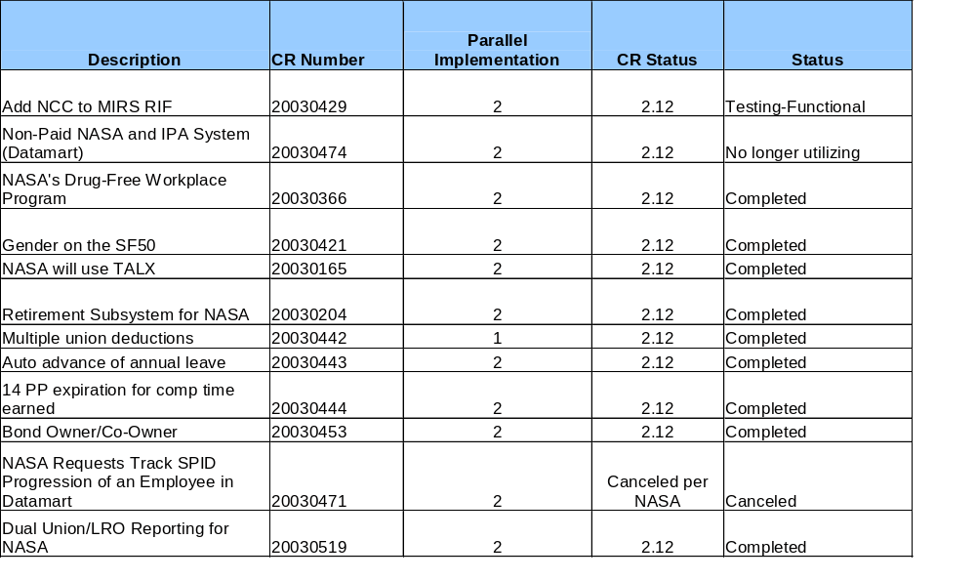
CR Status

Slide 21
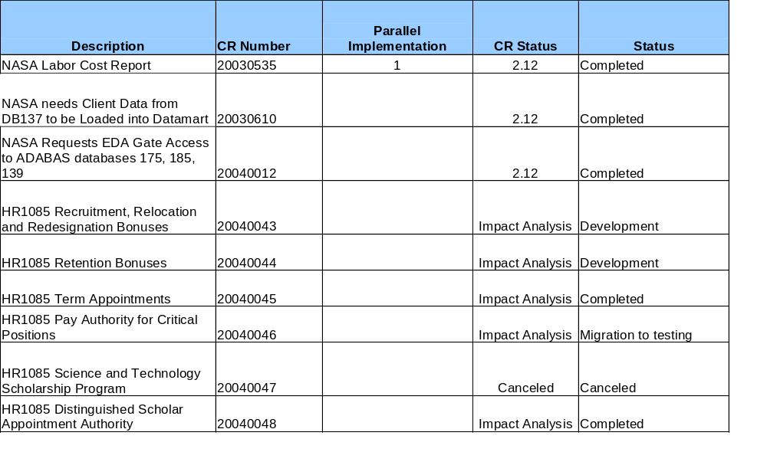
CR Status

Slide 22
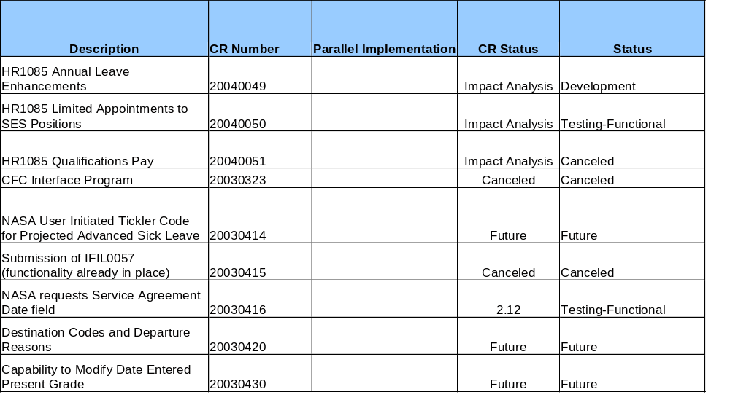
CR Status

Slide 23
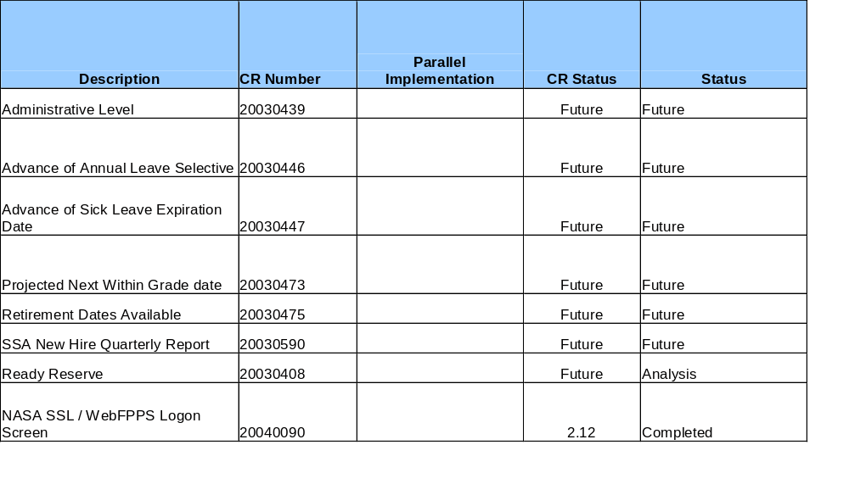
CR Status

