Slide 1
PHOBOS
Silicon Sensors Production
TAC Review @ BNL
Nov. 6 1998
W.T. Lin
Dept. of Physics, National Central University
Chung-Li, Taiwan
Introduction
Design and Production of Si-Sensors
Milestone and Status of Si-Sensors
Conclusions

Slide 2
Unique feature of PHOBOS
A single detector technology
for almost the whole experiment
Silicon detectors (pad and strip):
small pad for high density detection
truly two dimensional readout
well developed technology
438 Silicon sensors with 134,832 channels

Slide 3
Sensors for PHOBOS expt.
Type Assembly Spare Total
1-arm Spectrometer
1 8 4 12
2 14 14 28
3 28 14 42
4 21 14 35
5 66 20 86
Multiplicity counter
Oct 92 18 110
Ivtx 8 2 10
Ovtx 16 4 20
Ring 48 12 60

Slide 4
Phobos Silicon Sensors
The electric characteristic of each component
can be measured from test keys
Bulk 320+/- 30 μm
1st metal 5000 A
2nd metal 20000 A
SOG 12000 A
ONO 3200 A
VF.D. < 70 V
Ileak = 1 - 5 μA
Rpoly > 1 MΩ
CSOG = 40 +/- 2 pF/mm²
CONO = 170 +/- 5 pF/mm²

Slide 5

Design of PHOBOS Silicon Sensors
AC-coupled
Direct bias
Double metalization
signal lines
bias bus
-V
ONO thin oxide
vias
metal 2
SOG thick oxide
metal 1
320μm
5KΩ-cm
Signal
p+ Implant
Polysilicon
Drain Resistor
n+ Implant
+V

Slide 6
Dimensions of Sensors
Type Dimen. Of Sensor Dimen. Of Pad channels
1 7.16x3.78(cm) 940x940(μm) 1536
2 8.04x4.485 5940x367 500
3 8.04x4.4838 7440x607 512
4 8.04x4.4838 14940x607 256
5 7.98x4.43 18940x607 256
Oct 8.41x3.63 8650x2648 120
Ivtx 6.2104x5.04 11975x413 512
Ovtx 6.2104x5.04 24010x413 256
Ring 11>R>5 45deg varies 64
Pad size from 1 mm² to 23 mm²
Gap btw pads 60 μm
Width of signal traces 15 μm
Gap btw traces >35 μm

Slide 7
Mask Design
6 masks to define
1st : P+(Implant 0.8μm)
2nd: Polysilicon (L:250μm, W:15μm)
3rd: Contact window (L:10μm, W:10μm)
4th: Metal 1(T:0.5μm)
5th: Via (L:15μm, W:15μm)
6th: Metal 2 (T:1.2μm, W:15μm)
34 Stages to process
Normal run : 0.8 - 1 stage/day
Hot run : 1.5 - 2 stage/day

Slide 8
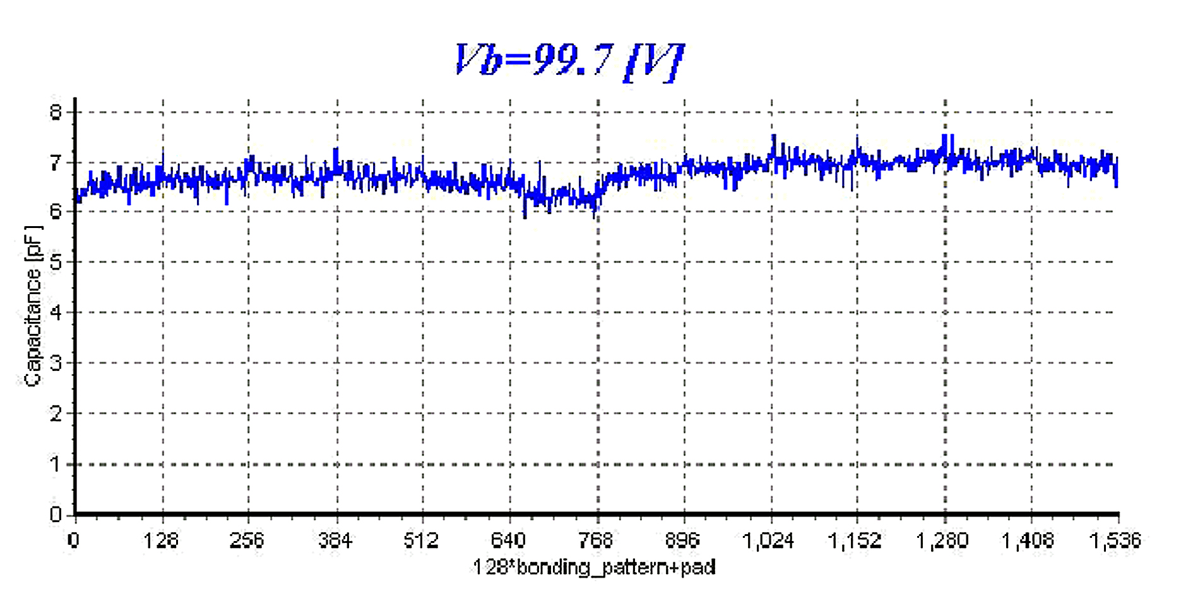
CV Scan
Type-1 : 1536 channels
Time consume: 128-180 min/wafer

Slide 9
Criteria of Accepted Sensor
Rpoly > 1 MΩ
Ileak < 5 μA @ (1.1)*VFD or
Ileak < 10 μA with a flat IV line shape
Yield of pinhole < 3%
VFD < 70V

Slide 10
Status of Spectrometer
1-arm spectrometer
Need NCU MIT Tested Accepted Rejected
Type-1 12 66 27 17 10
Type-2 28 89 10 7 3
Type-3 42 23 64 23 18 5
Type-4 35 39 50 48 45 3
Type-5 86 100 114 105 67 38

Slide 11
Milestone of Spectrometer
WBS milestone Sensor delivered
Jan Feb Mar Apr May Jun Jul Aug Sep Oct Nov Dec
Type-1
7 12 24 31
Type-2
7 9 28 63
Type-3
7 5 9 7 41 2337
Type-4
7 43 25 39 20
Type-5
4616 50 35 40 25 100

Slide 12
Status of Multiplicity Counter
Need NCU UIC Tested Accepted Rejected
Octagon 110 82 58 53 23 30
Inner 10 13 13 8 5
Outer 20 39 7 7 3 4
Ring 60 60 70 58 41 17
Need 1 batch of inner vtx and 4 batches of octagon
to fulfill multiplicity detector.

Slide 13
Milestone of Multiplicity Counter
WBS milestone Sensor delivered
‘98
Jan Feb Mar Apr May Jun Jul Aug Sep Oct Nov Dec
Octagon
12 10 1102 34 82
Inner Vtx
7 10 1 5
Outer Vtx
3 4 20 39
Ring
6070 60
Annual shut down for maintenance is during Chinese New Year.
ERSO changed a brand new implanter.

Slide 14
Conclusions
Most silicon wafer production has been
completed and sensors now being tested.
Most of production was on time except
for type-5 and octagon.

