Slide 1





AWC 2008 Review
Steverino Silberberg
Bruce Entwistle
NOAA/NWS/NCEP/Aviation Weather Center
Kansas City, MO
December 9, 2007

Slide 2
AWC Products
Serve the Nation and the World
Monthly number of forecaster issued products by NCEP Service Centers
MONTHLY Total = 25,380
TPC, 3360, 13%
SWPC, 400, 2%
SPC, 1380, 5%
AWC
CPC
AWC, 9900, 39%
HPC
OPC
OPC, 4590, 18%
SPC
SWPC
TPC
CPC, 650, 3%
HPC, 5100, 20%

Slide 3
AWC Guidance from EMC/NCO/GSD
GFS
NAM-NMM-WRF, NAM-HiRes, NAM-KF, & NAM-WRF 4 km
NGM
RUC
RUC-ConvProb (test from GSD)
SREF (Aviation-Jun Du; SPC-David Bright)
Importance of observations, data assimilation, spin-up, dynamics, microphysics, and physics

Slide 4
AWC Appreciation for EMC/GSD Progress in 2008
GFS
  WAFS icing, turbulence, and cb grids
  post-processing of lowest freezing level height to use 2 m temp instead of sfc temp
NAM
  extended NAM domain
  post-processing of lowest freezing level height to use 2 m temp instead of sfc temp
  addition of new observations (e.g. TAMDAR), improvements in data assimilation, and model improvements e.g. land surface
RUC
  addition of microphysics & radar reflectivity to RUC output
  improvements to RUC observation ingest, data assimilation, model improvements e.g. Grell-Devenyi, land surface, convection
SREF Aviation Diagnostics
  icing, turb, LIFR, IFR, MVFR, VFR

Slide 5
AWC Wish List: 2009 p. 1
Post additions
  Add microphysics, radar reflectivity, cloud coverage and height to GFS
  Add simulated echo tops (18.3 dBz) to GFS, NAM, & RUC output
  Add OPC visibility to main GFS output grids
  Add mountain wave diagnostic/gravity waves to GFS, NAM, and RUC
  Add Turbulence Diagnostics to GFS, NAM, and RUC: every 25 hPa in isobaric output for grids sent to AWC (Ellrod, Ri, TKE is in NAM)

Slide 6
AWC Wish List: 2009 p. 2
Model Changes:
  RUC: Extend on-time RUC to F24: add F15, F18, F21, F24
  RUC: Extended RUC/RR domain (in progress)
  Make RUC-Convective Probability Operational
    SPC’s David Bright is calibrating RUC-CP in this effort to assist AWC in forecasts of Cbs during peak air traffic hours → AWC milestone “n+1”
  NAM: Make 4 km Hi-Res NAM Operational
Data assimilation: Add ascent/descent soundings from ACARS/TAMDAR into RUC (hopefully very soon) & GFS
Increase convective diversity in SREF
  Include RUC, RUC-CP, and NGM (Kuo scheme) for convection
Dataflow:
  Need to continue receiving the WAFS global grids of cb-ice-turb used to create "high glance" displays → AWC milestone “n+2”
  Delete hourly NAM output on grid 104 → AWC milestone “n+3”
  Add hourly NAM64 grids to F36 → AWC milestone “n+3”
  Add GFS Lamp T-storm grib2; convert to GEMPAK

Slide 7
AWC Wish List: 2009 p. 3
Concerns about current Model Evaluation Process:
  Need to establish plans for bringing parallel and experimental data into NAWIPS/AWIPS with sufficient lead time to perform evaluations → AWC milestone “n+4”
  Not possible to perform more than one model evaluation at a time given personnel and computing constraints
  Suggestion: Please notify AWC 3 weeks before parallel dataflow begins because AWC requires:
    AWC Configuration Control Board Approval for DBNet and NAWIPS configuration changes to acquire, configure, compute, and render AWC-specific diagnostics
    Implementation of AWC model evaluation procedure

Slide 8
Example 1
Lowest freezing level height improvement in NAM and GFS
  Discovered by Andy Fischer of AWC
  Thanks to Hui-ya Chuang for investigating and changing the post
  Thanks to Eric Rogers for re-runing a key case
  New post uses 2 m T instead of sfc T

Slide 9
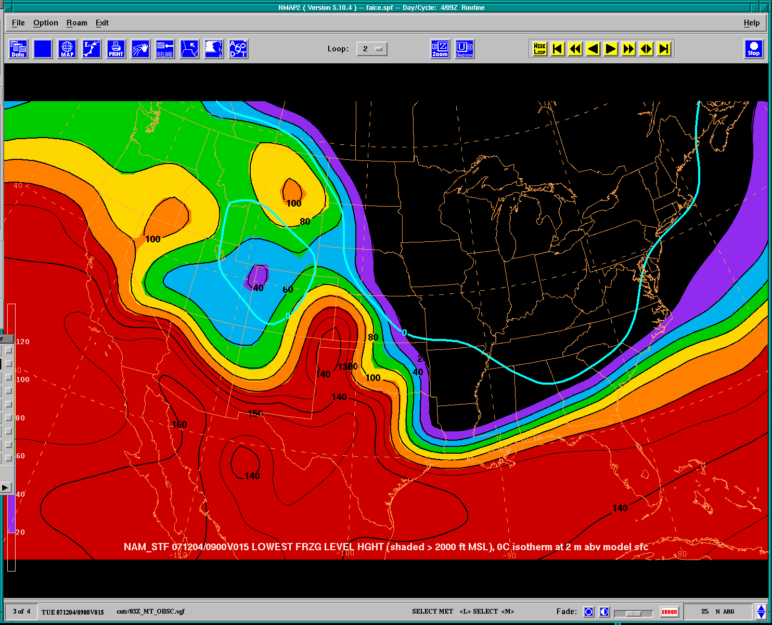
Operational NAM Lowest Freezing Level Height in hundreds of feet (eg 100 = 10,000’)
KTXK

Slide 10
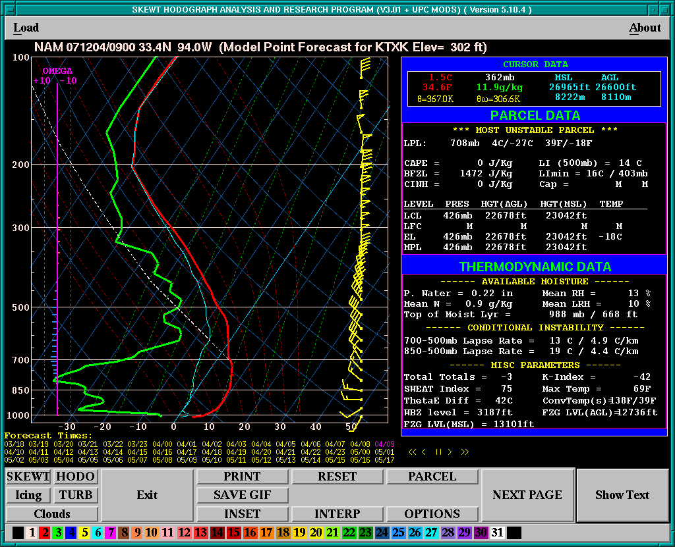
Point fcst sndg Frzl @ Texarkana is >13,101’
Freezing level height low is <2,000’
Forecast error ~ 11,000’

Slide 11

Operational NAM Lowest Freezing Level Height in hundreds of feet (eg 100 = 10,000’)
KTXK
Error of 8,000 to 11,000 feet in area

Slide 12
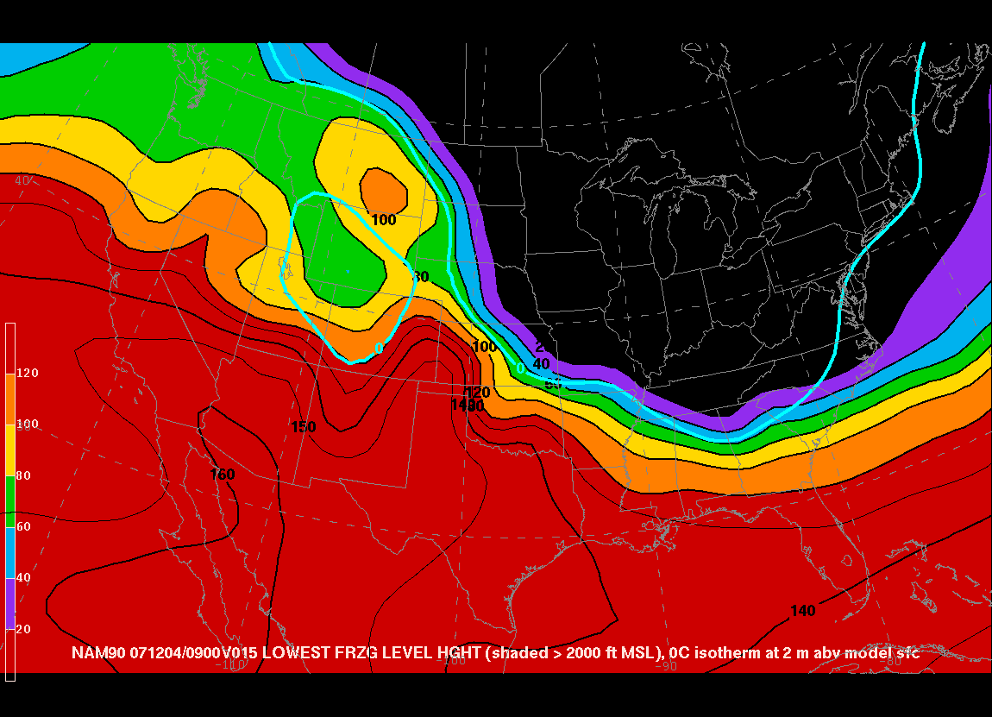
NAM-PARA Lowest Freezing Level Height in hundreds of feet (eg 100 = 10,000’)
KTXK
No error in area. KTXK freezing level height agrees with point Fcst sounding

Slide 13
Example 2
UKMET vs. GFS WAFS Global grids for Cb’s

Slide 14
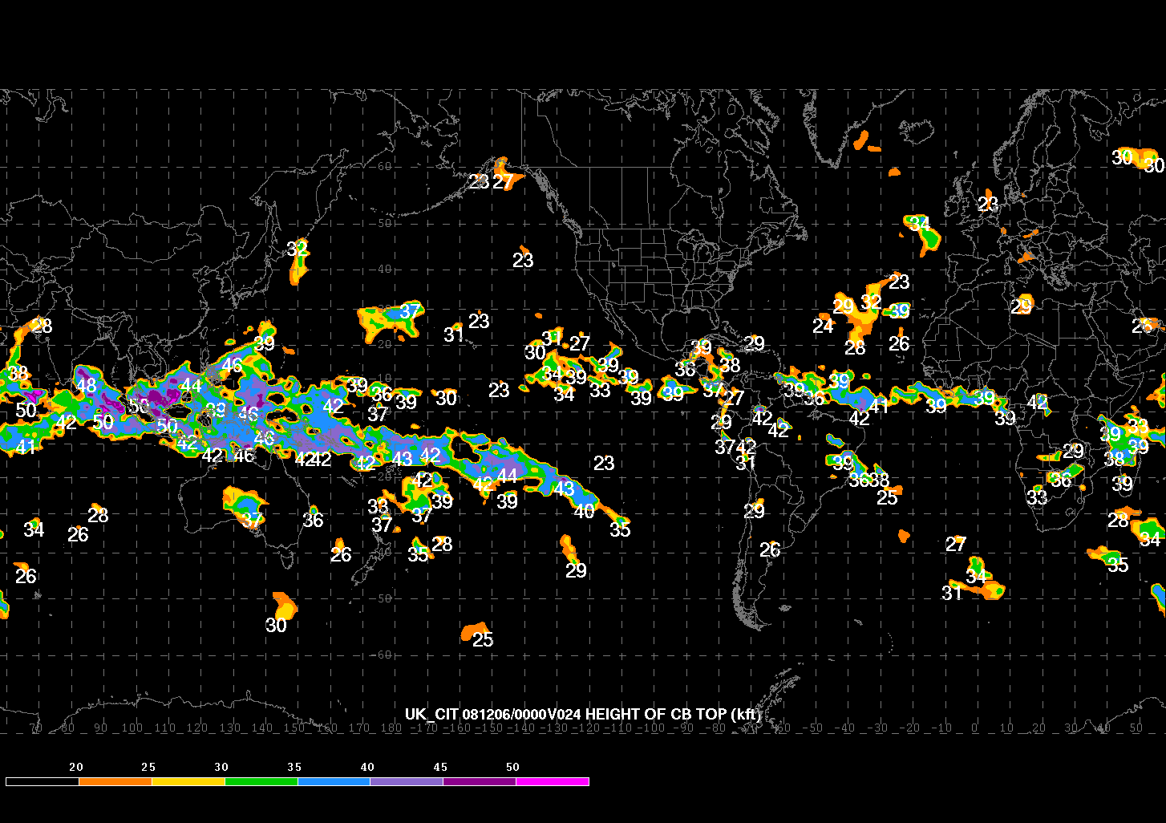
UKMET Cb Top Height in thousands of feet (e.g. 23 = 23,000’)
NAM-PARA Lowest Freezing Level Height in hundreds of feet (eg 100 = 10,000’)
No error in area. KTXK freezing level height agrees with point Fcst sounding

Slide 15
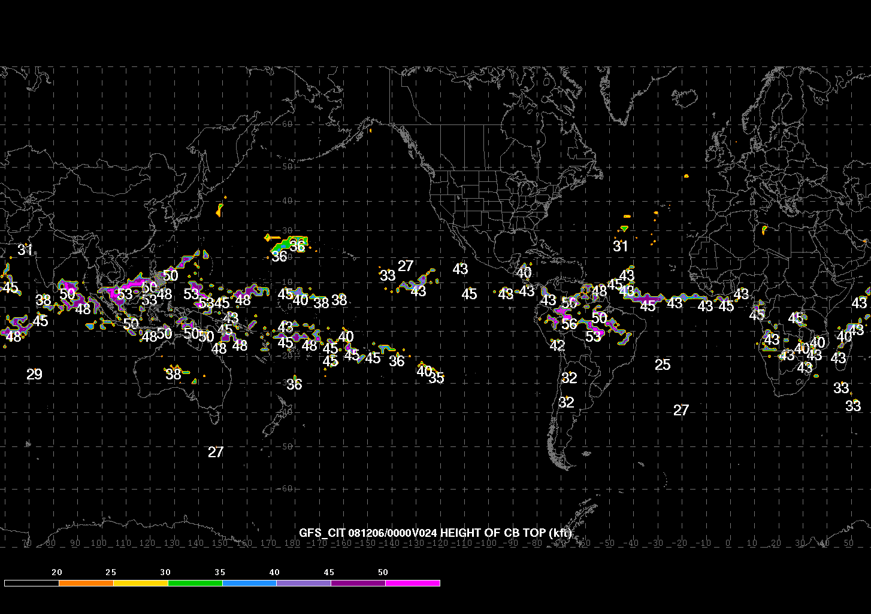
GFS Cb Top Height in thousands of feet (e.g. 45 = 45,000’)
NAM-PARA Lowest Freezing Level Height in hundreds of feet (eg 100 = 10,000’)
No error in area. KTXK freezing level height agrees with point Fcst sounding

Slide 16
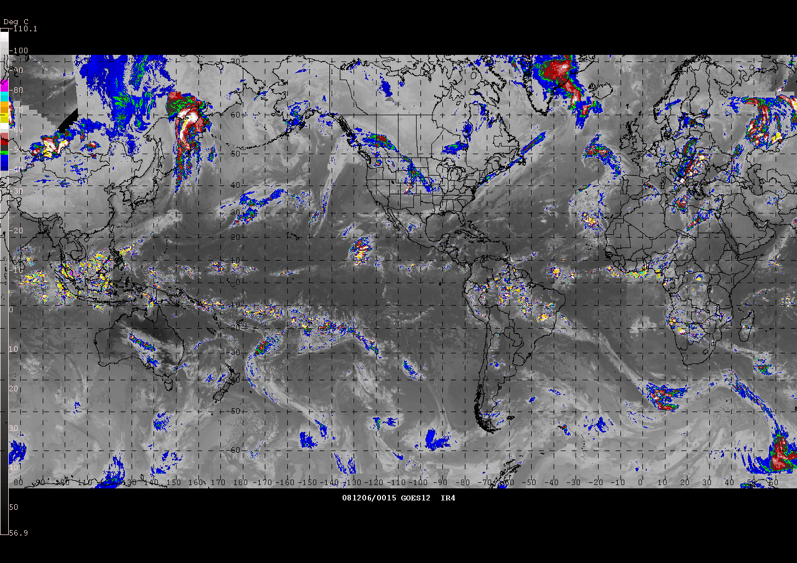
“The Inconvenient Truth”
NAM-PARA Lowest Freezing Level Height in hundreds of feet (eg 100 = 10,000’)
No error in area. KTXK freezing level height agrees with point Fcst sounding
AWC created World IR Mosaic with m58 Enhancement in NAWIPS

Slide 17
UKMET vs. GFS WAFS
Global Grids for Cb’s
UKMET greatly overforecasts areal extent of tropical convection
UKMET Cb tops are too low
GFS does a much better job of forecasting areal extent of tropical convection
GFS Cb tops more accurate based on IR retrievals of height using Std Atmosphere
Thanks to George Trojan for GFS WAFS grids

Slide 18
Summary
Thank you EMC, NCO, GSD, & NCEP Centers for:
  2008 Improvements and Collaboration
  Responsiveness to AWC needs
Best Wishes for a successful and productive 2009

