Slide 1
Run-8 in February and beyond*
* we hope!
Barbara Jacak
for the PHENIX Collaboration

Slide 2
It is absolutely crucial to run p+p!
RHIC/Collaboration Issue
  2 years in a row without p+p running will send the spin community looking elsewhere
RIKEN
  New MOU with BNL started in 2007
  2nd year without spin run poses a significant difficulty
  likely to damage credibility with RIKEN, MEXT
  Milestone: First W measurement by March 2011
  requires production running in Run-9 or 10

Slide 3
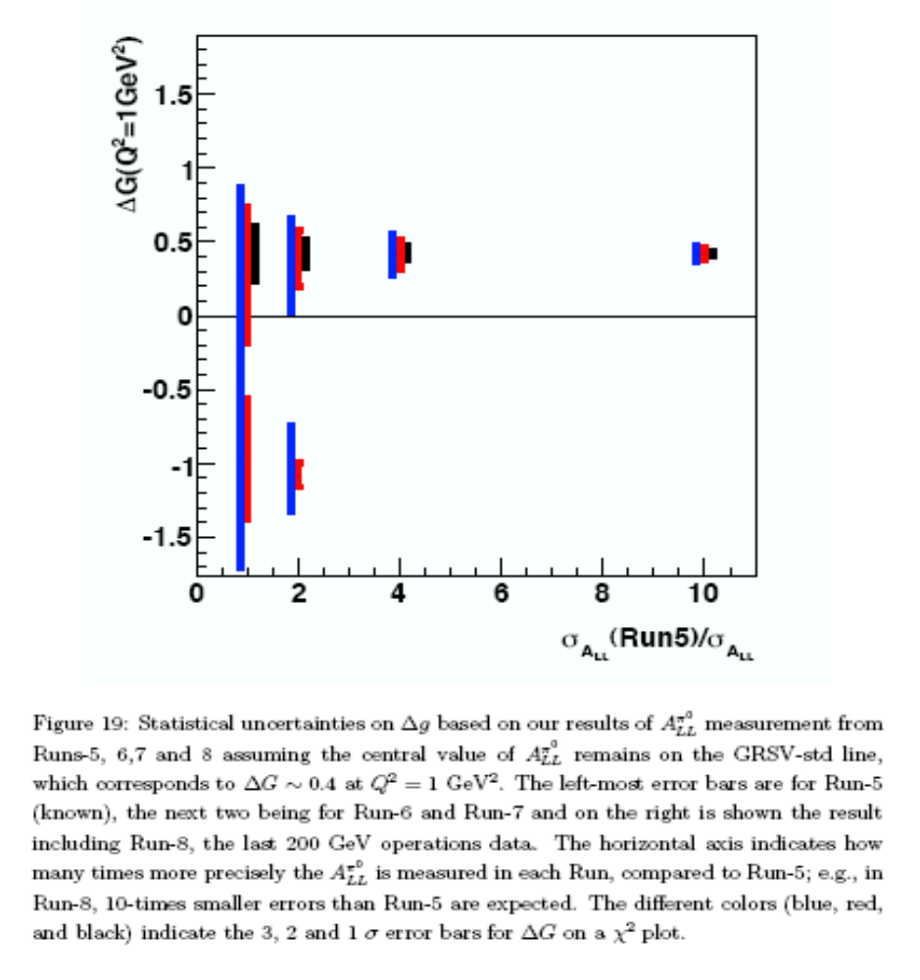
200 GeV p+p goal:
3, 2, 1 σ errors
Run-5
Run-8
to achieve this, need
≥ 71 pb⁻¹ recorded
DOE milestone for ΔG
measurement: 2008
PHENIX remains committed to yearly p+p running,
to develop required luminosity & polarization.
Next goal is 500 GeV p+p for W production

Slide 4
minimum 200 GeV p+p run for new physics
5 pb⁻¹ of transverse p+p recorded
-> 5 weeks of p+p, transversely polarized, physics running.
is 7 cryo weeks enough??
goal: forward physics with MPC
  π⁰ in MPC + charged pion single spin asymmetry
need a lot more p+p for the Spin Plan milestone.
  This is a minimum data set for some new physics

Slide 5
if 4-5 cryo weeks: 500 GeV p+p
Goals
  - demonstrate 500 GeV collisions
  - establish 250 GeV polarimetry in both p-C and H-Jet polarimeters
  - measure cross section for neutral pions & photons
  compare to pQCD, publish!
  - W → e±
  rate: 68 e (single sign) per week for 3.6 pb⁻¹/week
  assume Run-6 L x 2.5 for emittance shrinkage
  - measure J/ψ and Y: 1500/40 J/ψ/Y μμ per week
  - study muon backgrounds for W measurement
Important step toward RIKEN RHIC deliverables!

Slide 6
backup slides

Slide 7
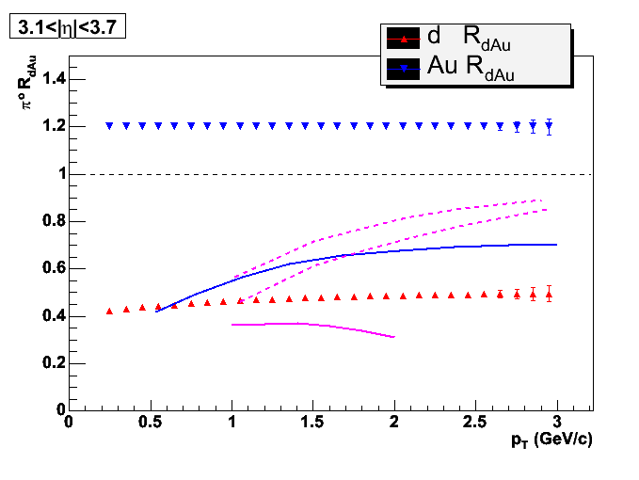
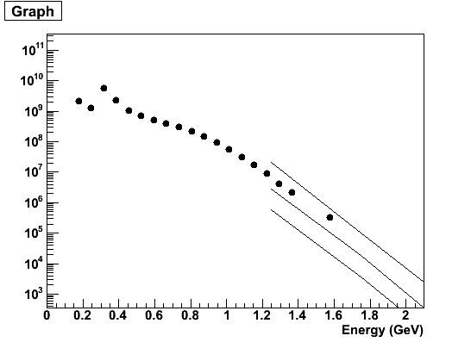
forward π⁰ R_{dA} with the MPC
Qiu/Vitev, PLB 632, 507 (2006)
coherent multiple scattering
Kharzeev, et al, PLB599
CGC
y=3
y=4
Vitev, hep-ph/0609156
+ initial state energy loss
π⁰ spectrum
in MPC south

Slide 8
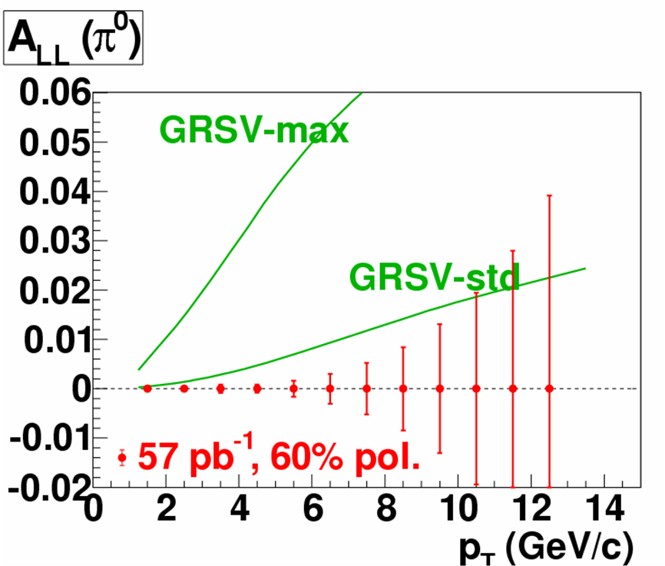
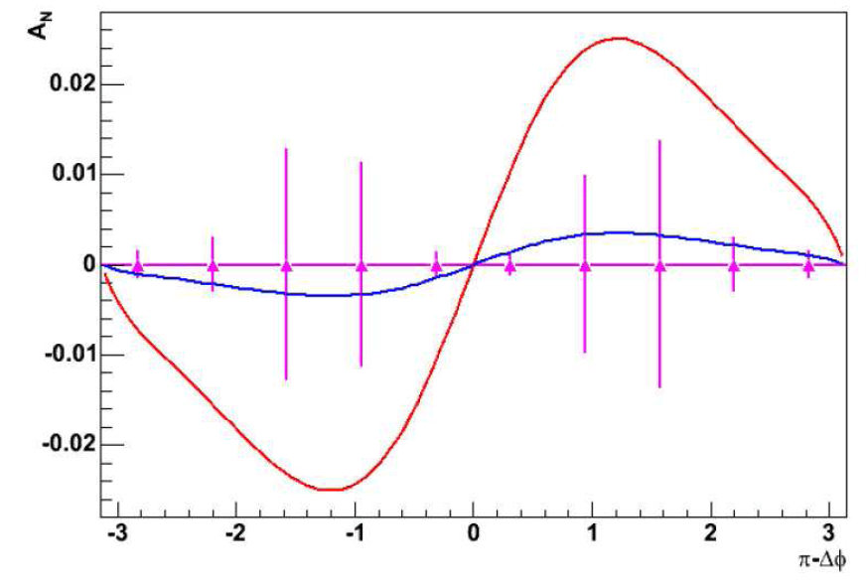
From our previous Run-7 request
for 2.7 + 6.0 pb⁻¹ transverse
pol. recorded (<Run-8)
di-hadron (+ singles) measurement
Boer and Vogelsang, hep-ph/0312320
Gluon Sivers = N_{d}(x)
Gluon Sivers = 0
approximately
what’s expected
for Run-8
π−Δφ

Slide 9
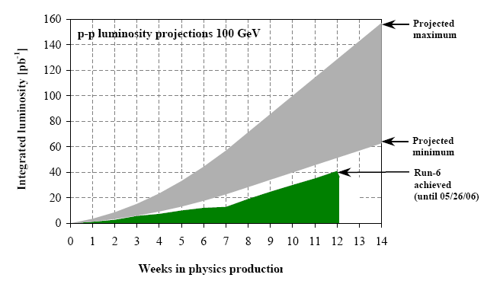
Run-8 polarized p+p
71 pb⁻¹ recorded (167 delivered)
  to measure ΔG (aim to follow RHIC Spin Plan)
goal
optimal
conservative
15

Slide 10
Run 9 & 10 plan
Run-9
complete large 200 GeV/A Au+Au data set
  → definitive measurements with rarest probes
if needed, complete 200 GeV polarized p+p
begin 500 GeV polarized p+p for W production
aim to begin low energy scan & utilize HBD
Run-10
begin commissioning VTX detector (HBD removed)
  → both p+p and heavy ion running
  ion species/energy depend on Runs-7,9 and EBIS
significant 500 GeV polarized p+p for W production
  utilizing muon trigger

Slide 11
