Slide 1
Electronic Freight Manifest Initiative
ITS JPO Lead: Kate Hartman
Technical Lead: Mike Onder, Office of Freight Management and Operations

Slide 2
Challenge
Current economic forecast indicate that freight volumes will double by 2020.
Existing and planned physical capacity to move this amount of freight will be severely challenged.
Freight movement is multi-modal, among partners with different with needs for information.

Slide 3
Opportunity
The activities under this initiative will:
  Assist supply chain partners by using ITS to:
    Exchange information electronically in a standardized format;
    Provide an open architecture in which all shippers, across all modes can access needed information;
    Allow information concerning freight to be made available for security screening.

Slide 4
Goal
Improved operational efficiency, productivity and security of the transportation system through the use of a common electronic freight manifest (EFM) and message portal that enables access to shipment information to all supply chain partners in real time.

Slide 5
Milestone/End Product
Initial Milestone: Can all supply chain partners integrate the EFM into their business processes? Do we go forward with the deployment test?
Initiative Milestone: Do we expand to other modes?

Slide 6
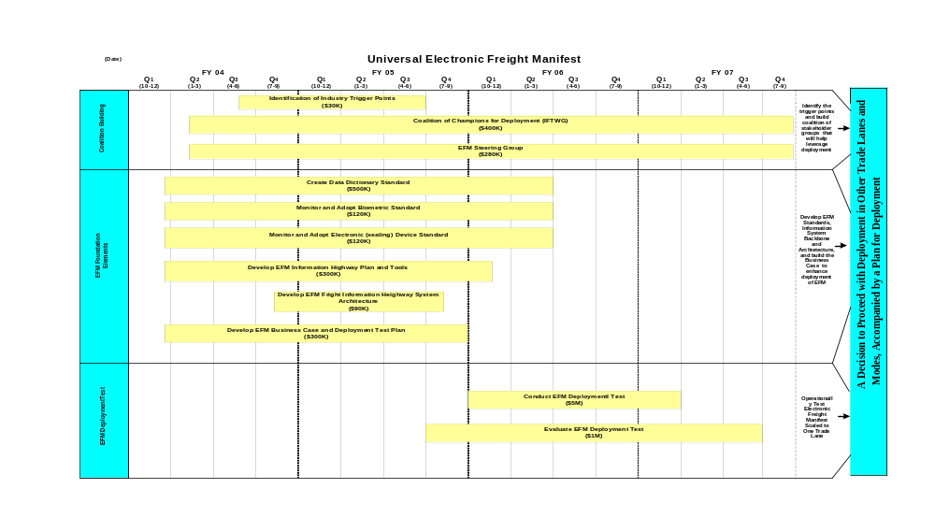
Roadmap

Slide 7
Program Plan/Approach
1. Coalition Building
  Intermodal Freight Technology Working Group
    A neutral organization for industry and government to work together on applying technology to freight issues of mutual concern.
  EFM Steering Group
    Project leaders from industry and government to help shape / direct this effort

Slide 8
Program Plan/Approach
2. Foundation Elements
  EFM Standards
  Create Data Dictionary Standard
    Electronic freight manifest
  Monitor Biometric Standards
    Biometric identifier to positively ID the possessor
  Monitor Electronic Tracking & Tracing Device Standards
    Tracking and tracing devices on cargo or conveyances
  Working through International Standards Organization (ISO) on all three.

Slide 9
Program Plan/Approach
2. Foundation Elements (cont.)
  EFM Freight Information Highway (FIH)
  Operation Plan and Tools
    Develop a concept for allowing an electronic message to move through a virtual portal for all supply chain partners to have equal access.
  System Architecture
    Develop an architecture approach for information flows between the virtual portal and the traffic management centers and traveler information systems.

Slide 10
Program Plan/Approach
2. Foundation Elements (cont.)
  EFM Business Case
  Develop Deployment Test Plan
    Map the supply chain and model the changes that an EFM would require.
    Determine the rules of engagement for partners.
  System Level Design Document
    Determine the operating procedures for adopting EFM, FIH and biometrics.
  Initial Decision Point

Slide 11
Program Plan/Approach
3. EFM Deployment Test and Evaluation
  Conduct Deployment Test
    All procedures in place and adopted.
    Operate over 6-8 month period of time with new procedures.
  Evaluate Deployment Test
    Gather baseline data before test and operating data during test.
  Initiative Decision Point

Slide 12
Summary
Improve supply chain efficiency
Technology
  Data Standards
  Freight Information Highway
Improved methods of information sharing
Deployable across modes when successful
Broad benefits to industry

