Slide 1
Peer Review Process
Changes in the Process

Slide 2
Changes in OSQR
Manual
Project Plan Elements
  Project Management and Evaluation
  Prior Accomplishments
Milestone Table
Panel Briefings
Re-Reviews
Ad Hoc Reviews

Slide 3
Components
Process
  What are we learning from reviews about the process and ARS Science?
Procedures
  What have we changed to improve the process?

Slide 4
What are we learning?
Scores in the second round haven’t significantly changed from the first round.
Need to place an emphasis on quality of the project plan
Quality begins with and rests with the project team
Signature page should carry a reflection of review

Slide 5
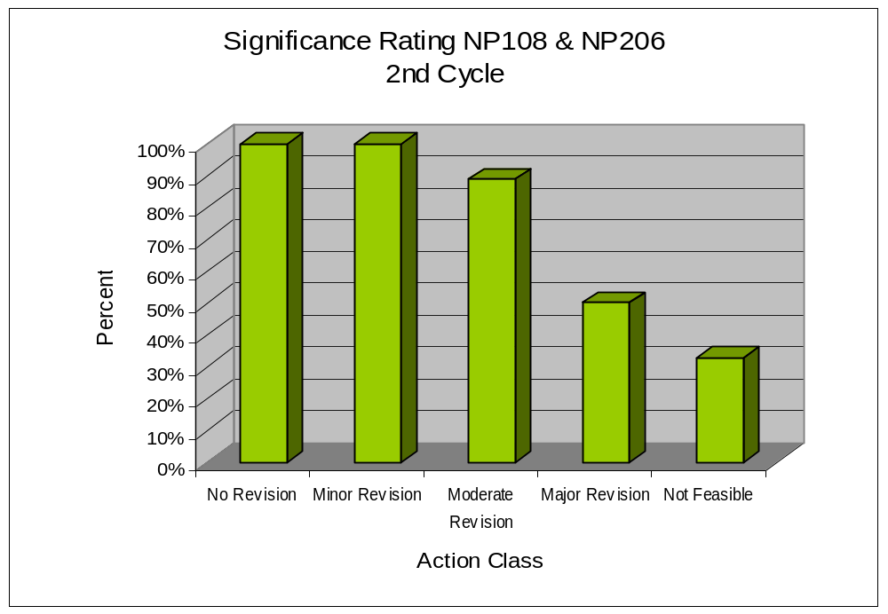
Where are the problems?

Slide 6
Comment Sampling “No Revision”
…studies will fill rather substantial knowledge gaps.
…well written and comprehensive
…well written project plan
…well organized, cogently prioritized and comprehensive research plan…

Slide 7
Comment Sampling “Minor Revision”
…studies will fill rather substantial knowledge gaps.
…well written and comprehensive
…well written project plan
…well organized, cogently prioritized and comprehensive research plan…
…well written, well organized, and easy to follow.

Slide 8
Comment Sampling “Moderate Revision”
one of the better written
excellent discussion of technology
large research project plan but poorly organized.
concerns that some of the objectives can be completed by this team.
work and ability described as "adequate"
missing current information
hypotheses and plan well conceived, approaches appropriate

Slide 9
Comment Sampling “Major Revision”
…a heroic course that…will not achieve the stated objectives
serious flaws in experimental designs…
General Lack of focus. Plan is so broad that it leaves out important details…not clear data will be relevant or interpretable.
lacks cohesion and clear direction
writing style, quality, and organization significantly detract…
Short on details. Not well planned. Need to take process seriously.

Slide 10
Comment Sampling “Not Feasible”
approaches highly flawed, lack detail, many experiments duplicative
poorly written…difficult to discern what the authors want to do.
proposed research contradicts intention of the proposal.
exaggerations, incomplete reviews…, and misleading comments, as well as poor grammar and organization.
lack of knowledge…incomplete understanding …fundamental misunderstanding…
Work does not address stated objectives.

Slide 11
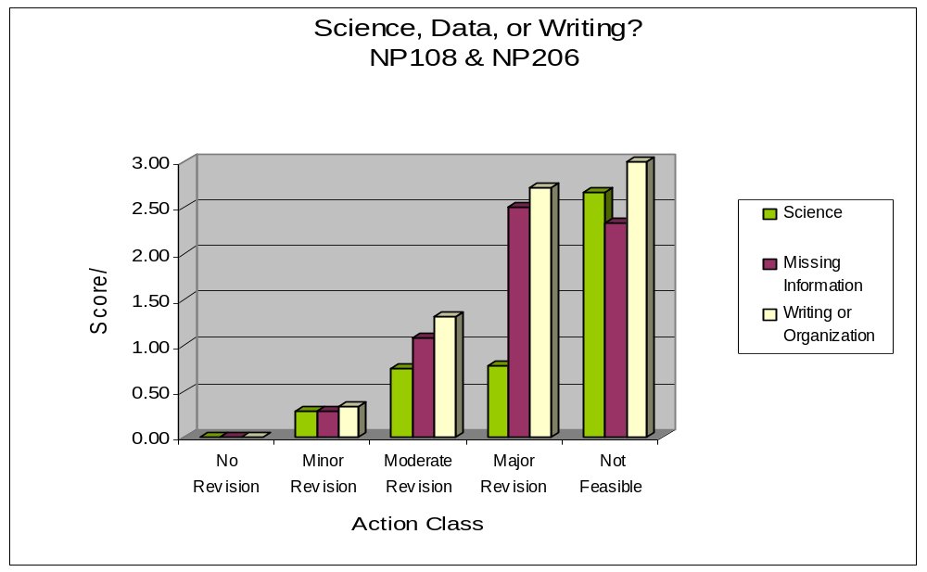
Where are the problems?
(Content)

Slide 12
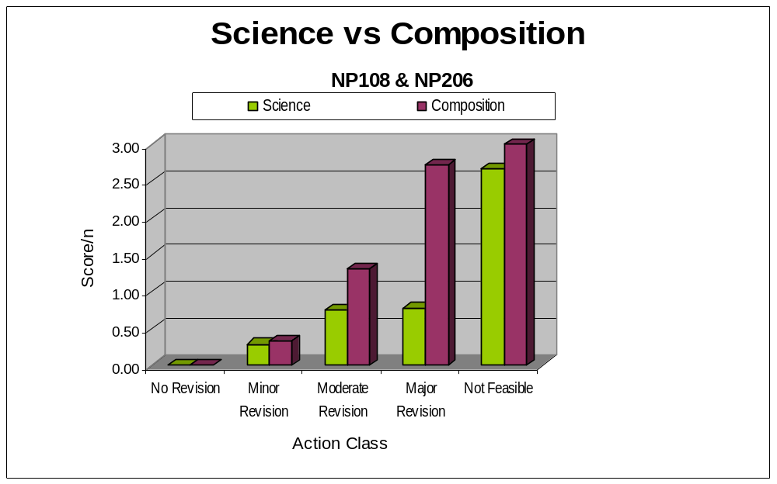
Where are the problems?
(Content)

Slide 13
Processes
What are we learning that can help us do a better job in research planning?
What can we do in the process to develop better plans?

Slide 14
Panel Training
Web-based panel training to introduce chairs and panelists to OSQR process
Review of project objective development
Updated National Program Action Plan
Introduction to the National Program components

Slide 15
1. Stakeholder Workshop (customers, scientists, National Program Staff, Center Directors, Area Directors).
Congressional Mandate
2. National Program developed.
Input
Input
8. Retrospective evaluation.
3. Program Priorities set (PDRAM).
Assessment
Planning
4. Research Project Plan describing research prepared.
7. Annual progress reviews
Implementation
5. OSQR Review and Certification.
6. Research initiated

Slide 16
Procedures
Manual
Project Plan
Milestone Table
Project Evaluation and Management
Prior Accomplishments
Web-based briefings and introduction to OSQR and National Programs
Re-Reviews
Ad Hoc Reviews

Slide 17
The Goal of Peer Review
Enhance research through independent, expert examination of PROSPECTIVE plans for scientific and technical merit.

Slide 18
Importance to ARS
Congressional intent was to enhance research.
OMB Analyses. President’s initiative places high emphasis on peer review.
Provides for Agency Accountability
Enhances ARS Image
A strong image for ARS can translate
into enhanced funding for research

Slide 19
What is a Research Plan?
The “story” of your research
An integrated and logical presentation
A clearly presented argument
A “Marketing” brochure (and more!)
A
Your plan should present your work in a clear, logical fashion that will transmit enthusiasm for the work and convince the reader that your team is best suited to perform it.

Slide 20
Project Review Criteria
Adequacy of Approach and Procedures
Probability of Successfully Accomplishing the Project’s Objectives
Merit and Significance

Slide 21
Reviewers want to know…
What is the problem?
Why is it important?
Where are you going with it?
How are you going to get there?
And how will you know you have arrived?

Slide 22
Document Outline
Title and Investigator(s)………….page 1
Signature Page……………...........page 2
Table of Contents……….………….page 3
Project summary (250 words)...page 4
Objectives...…………..................page 5
Need for research (1-2 p)
Scientific Background (5-7 p)
Prior Accomplishments (2 p)
Approach & Procedures (6-15 p)
Milestone Table (1-3 p)
Literature Cited
Past Accomplishments of Project Team Members
Issues of Concern statements
Appendices (letters plus other material)
15 - 30 pages

Slide 23
Project Plan Components
NEED FOR RESEARCH: 1-2 pages
Where are you going?
Express need scientifically AND in the context of NP Action Plan
Be concise in statement of research purpose
Discuss potential benefits and anticipated products
Identify relevant customers and stakeholders
Briefly note the principle methods you will utilize (e.g., …using microarray technologies we will elucidate…”

Slide 24
Project Plan Components
Scientific Background: 5-7 pages
Why are you going there?
Highlight what is known and not known
Show how this creates a Rationale for the proposed objectives
Show how project will fill identified knowledge gaps
Not more than 1/3 of project plan length
Include mention of other, similar projects within and outside CRIS
Cite preliminary data, if available

Slide 25
Project Plan Components
Prior Accomplishments: 1-2 pages
What have you done before?
Name prior project terminated within two years
Major objectives and accomplishments
Prior project investigators
Impact of prior work (science, technology, users)
Pertinent publications
Mark all publications from this research on the investigator
publication list

Slide 26
Project Plan Components
Approaches & Procedures: 6-12 pages
How are you going to get there?
Set out your Experimental design
Describe approaches and methods that are
appropriate, modern, and sound
Discuss advantages and limitations (especially
important if methods are “risky”)
Illustrate how objectives can be achieved
Who will do what, how, and when
Include management, evaluation and contingencies
Describe nature and extent of collaborations
Letters in Appendix need to confirm what you say!

Slide 27
Milestone Table
Link to the NP Action Plan
Significant Components
  SY’s involved in each subobjective/hypothesis
  Critical milestones
  Progress/changes (link to 421)
  Products

Slide 28
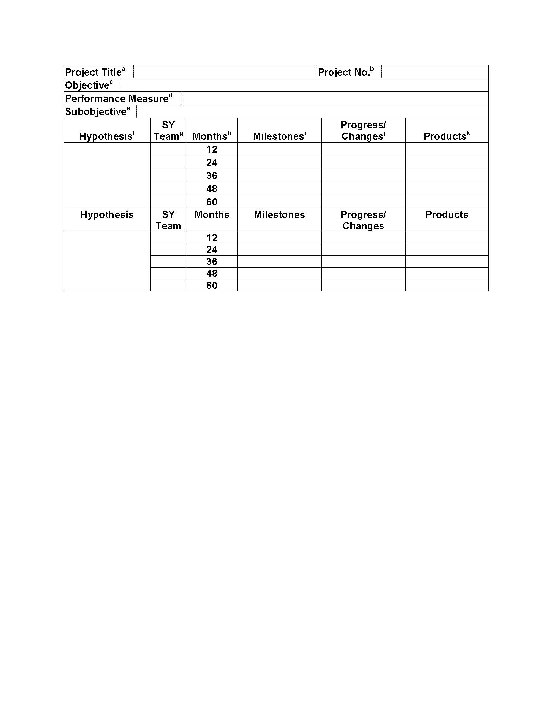
Project Plan Components
MILESTONES AND OUTCOMES
MILESTONES TABLE
Summarizes the project
Dynamic over project lifecycle

Slide 29
Good vs Excellent Project Plans
Good Plans
  Description of the research problem
  Defined objectives
  Concise hypotheses
  Adequate research procedures
  Solvable problems with potential impact
  Clear milestones
Excellent Plans
  Show the gap in the current knowledge and the project role in filling the gap
  Clear, linked objectives
  Well defined research procedures
  Clear, compelling, description of project plan and path to success

Slide 30
Action Class Ratings
No Revision
Excellent project. No changes or additions are required.
Minor Revision
Approach sound. Some minor changes required
Moderate Revision
Some change to an approach required but project is generally feasible.
Major revision
Requires significant revision. Major gaps in plan or information.
Not feasible
Major flaws, omissions. Unfeasible or not possible to assess.

Slide 31
Project Plans in ARS

Slide 32

Program Structure
Project Plan
Accountability
Stewardship
Leadership
Oversight
ARMPS
SCA’s
Grants
Annual
Reviews,
RPES
Planning
Performance
Progress
AD421’s, Publications, Tech Transfer

Slide 33
Summary
Improved training process for panelists and the products they produce
Improved manual to help ARS project teams understand the scope of the project plan

