Slide 1
FTA Research
Program Requirements
Bruce Robinson
Office of Research, Demonstration and Innovation
April 17, 2007

Slide 2
FTA Research Circular
FTA C 6100.1C Transit Research and Technology Programs: Application Instructions and Program Management Guidelines

Slide 3
Authorization Legislation
SAFETEA-LU -- Safe, Accountable, Flexible, Efficient Transportation Equity Act: A Legacy for Users (2005-2009)

Slide 4
United States Code
49 USC 5314 National Research Programs
  49 USC 5312 (a) Research, Development, Demonstration, and Deployment Projects for:
    Research
    Development
    Demonstration
    Deployment projects, and
    Evaluation of technology of national significance to public transportation
    That will “improve public transportation service”

Slide 5
Project Budgets
TEAM uses scope code and account line item (ALI) system
  Scope classifies type of project. Normally 55 Research or 70 University Research
    May have scopes for each task
  ALI’s define type of expenditures
    Personnel, Fringe Benefits, Faculty salaries, Equipment, Supplies, etc…

Slide 6
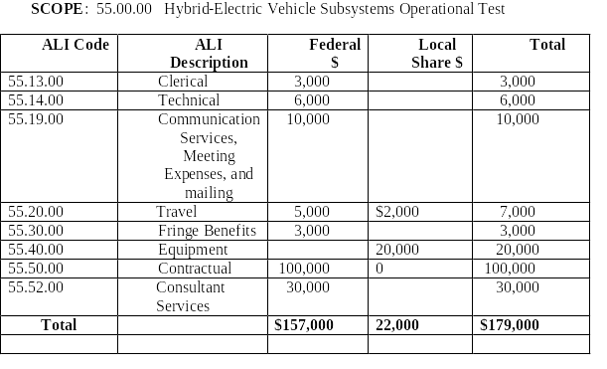
Project Budgets

Slide 7
Project Reporting
Milestone Reporting
  Information about completing milestones should be input into remarks/comments section of TEAM

Slide 8
Project Reporting
Quarterly Reports
  Due 1/31; 4/30; 7/31; 10/31
  At a minimum should include:
    Summary narrative of accomplishments by task/milestone during the period
      Include % of budget expended by task
      Indicate expenditures by ALI to match FSR
    Reason why any objectives not being met
    Significant events affecting progress
    Whether project is within approve budget
    Whether project is on schedule
    Projected activities for the next quarter
    Estimated completion dates, % completed, and funds required to complete
  See template

Slide 9
Project Reporting
Reports of Significant Events
  Unforeseen events that impact the schedule, cost, capacity, usefulness or purpose of the project should be reported to FTA immediately after detection

Slide 10
Financial Reporting
Financial Status Reports
  SF269A – accompanying the Quarterly Report
  SF270 Request for Reimbursement may be substituted
  Echo no longer permitted for National Research projects

Slide 11
Financial Reporting
Additional Information
  FTA project manager may request
    Breakout of cost by ALI
    Breakout of cost by task/milestone
    Copies of receipts to support costs

Slide 12
Payments
Echo no longer permitted for National Research projects
Must submit Request for Advance or Reimbursement (SF270) to FTA project manager
FTA will approve payment by Automated Clearing House if:
  Recipient is complying with its obligations
  Has satisfied FTA that it needs the requested funds during the period, and
  Is making adequate progress towards timely completion of the project
  FTA may only reimburse apparent allowable costs incurred

Slide 13
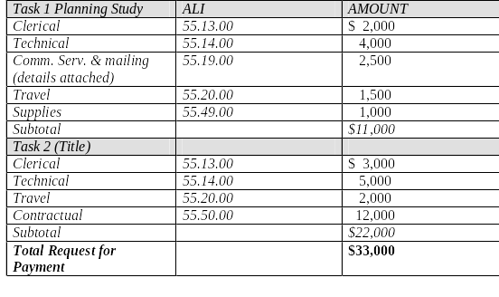
Payments

Slide 14
Project Budget Revisions
Cannot be used to materially change the purpose or intent (i.e. scope) of the grant
May be revised, depending on whether funds are expended on a particular ALI as anticipated
  If expenses on an ALI increase beyond the approved amount – recipients must request prior approval from FTA project manager in TEAM
  Recipients may change dollar amount of particular items under an ALI
  Total costs approved cannot be exceeded without an amendment to the agreement
  At the conclusion of the project, recipient must submit in TEAM a final project budget revisions if ALIs need adjustment because of overspending on an item

Slide 15
Extensions
Extensions of the project completion date will be accomplished by a letter from FTA to the recipient in response to a written request by the recipient

Slide 16
Amendments
To change the scope of the project or to add FTA funding to the project
Recipient follows same application procedures as for the original application

