Slide 1
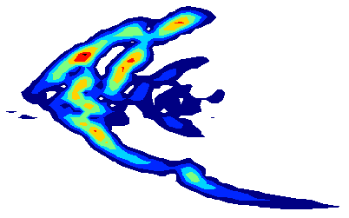
Research directions for wave-particle interactions in 2007
E D Fredrickson
PPPL
WP SFG, Nov. 15, 2006

Slide 2
Waves&particles has a Joule-level milestone in FY07
Effort will be to extend previous work to non-linear regime.
Emphasis on complete diagnostic sets to allow full benchmarking of simulations

Slide 3
Five generic fast-ion physics areas
Joule-milestone requires plan in December
  Need to develop plan, present at forum.
  Target is to acquire necessary data for M3D, Nova, Orbit, etc.
  Physics of possibly new or unique fast-ion instabilities
  Energetic Ion Phase-space structures
  Fast ion transport by “other” MHD
  Develop *AE quiescent NB-heated regime (ISD)
  RF stochastic thermal ion heating

Slide 5
Physics of possibly new or unique fast-ion instabilities
Finish study of Alfv_x0005_én Cascades
  Show conversion to TAE?
  More extensive critical beta scaling study
Documentation of Alfvén-acoustic mode
Bounce-resonance fishbones
  No MSE data as yet
  Better documentation of eigenfunction, NPA/FLIP
  Candidate for Orbit calculations
Non-linear wave coupling (f.b.-TAE-GAE-CAE)
  Better experimental data to guide theoretical progress?

Slide 6
Low β_{e} Alfvén Cascades
Present only in low β/q² plasmas.
  Explore beta scaling at different toroidal fields
GAM/BAE convert to TAE at saturation - should be able to see this.

Slide 7
Energetic Ion Phase-space structures:
Non-linear saturation, interaction and evolution of *AEs
Angelfish (GAE or CAE hole-clumps)
  RF power scan with β_{fast} scan
“TAE” hole-clumps
  Understand threshold for generation
Alfvén Avalanches
  Careful documentation of amplitude
  Model phase-space-island overlap condition
Classic fishbones (perhaps finished)
  Candidate for NPA hole-clump measurements?

Slide 8
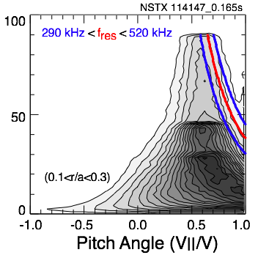
Frequency sweeping implies coherent structures: particle trapping in phase space
  GAE/CAE fits frequency and resonance conditions at r/a=0.2/0.5, = - |k||v_{A}| + _{ci}
Mirnov signal at the edge
TRANSP distribution function and
beam ion resonances
From Mirnov signal observations we can potentially infer (Berk, iaea'06)
- mode growth rate
- physics of wave-particle interaction
- fast-ion phase space diffusivity
- effects of additional scattering from HHFW on wave particle structures

Slide 9
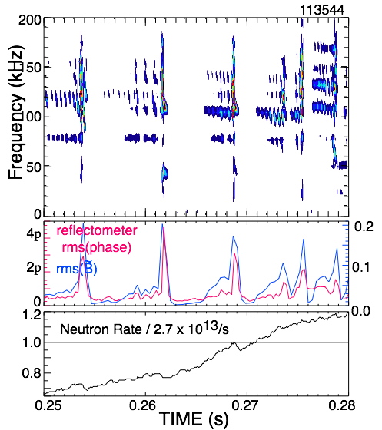
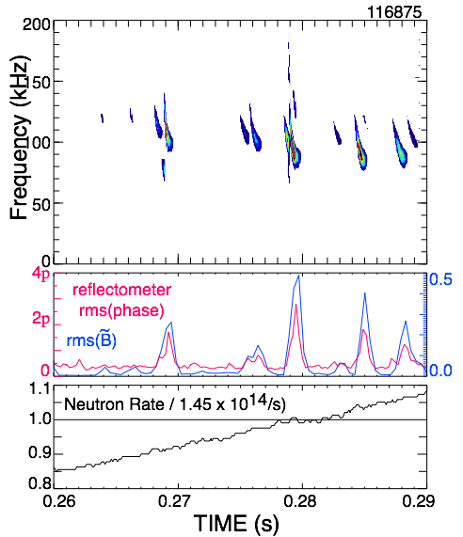
Explore fast-ion phase-space island overlap regime with full diagnostic coverage – including MSE
NSTX observes that multi-mode TAE bursts induce larger fast-ion losses than single-mode bursts:
TAE avalanches cause enhanced fast-ion losses.
Potential to model island overlap condition with full diagnostic set.
5% neutron rate decrease:
1% neutron rate decrease:
E. Fredrickson, Phys. Plasmas 13, 056109 (2006)

Slide 10
Develop *AE quiescent regime (ISD)
  Validate bootstrap and beam-driven current models
Fast ion transport by “other” MHD
  Sawteeth
  Internal kink modes
  NTMs
RF stochastic thermal ion heating
  Measure antenna coupling to CAE/GAE
  Initial experiments to launch waves.

Slide 11
"Strawman" list of XP's
Alfvén Cascades/TAE hole-clumps
  (800kA with He puffing)
  HHFW to suppress TAE hole-clumps
  TF scans to explore effect of beta on Cascades
  Measure conversion to TAE with reflectometer
Bounce-resonance fishbones and Alfvén Acoustic modes
  (1 MA with He puffing)
  Document q-profile during mode activity.
  Measure eigenfunctions with sxi/reflectometer

Slide 12
"Strawman" list, continued
CAE/GAE Hole-clumps/stochastic heating study
  Explore CAE/GAE growth rate in various regimes
  Estimate maximum heating power from CAE
  Use HHFW to control frequency chirping
Develop *AE quiescent regime
  Validation of TRANSP bootstrap and beam driven current models.

