Slide 1
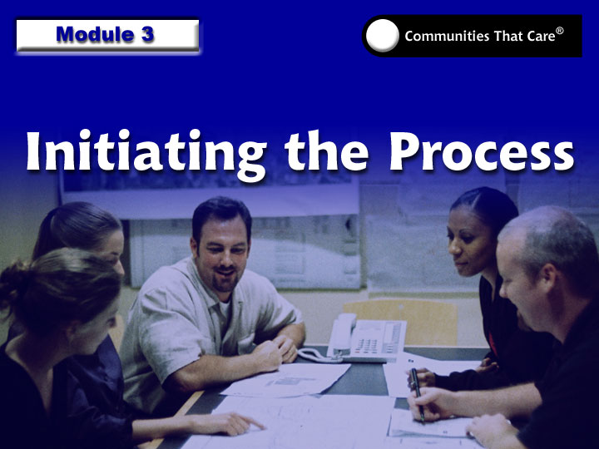
Training of Coordinators
3-1

Slide 2
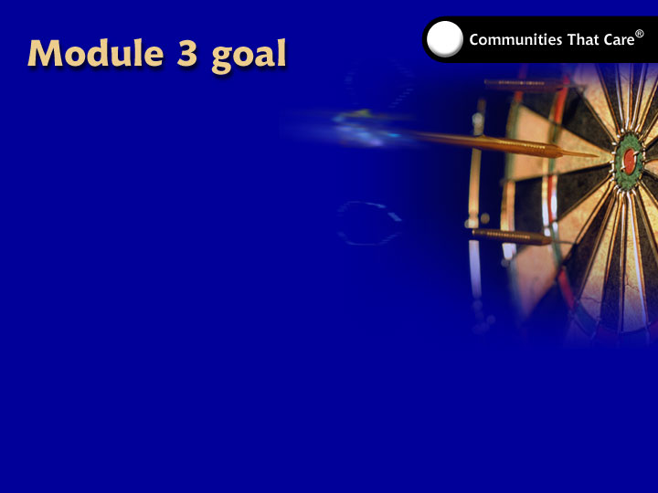
To provide the knowledge
and skills necessary for
supporting the Communities
That Care effort through
Phase One.
Training of Coordinators
3-2

Slide 3
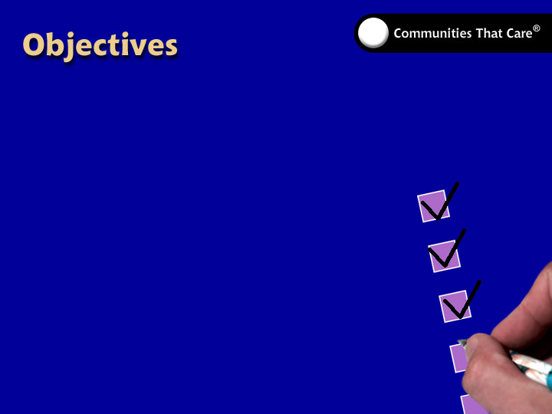
Participants will be able to:
  Describe the role of the Coordinator.
  Explain the function of milestones and benchmarks.
  Carry out the responsibilities of the Coordinator during Phase One.
  Help the community move to Phase Two.
Training of Coordinators
3-3

Slide 4

  Qualities:
    openness
    commitment
  Skills:
    organization
    communication
    facilitation
  Expertise:
    familiarity
Training of Coordinators
3-4

Slide 5
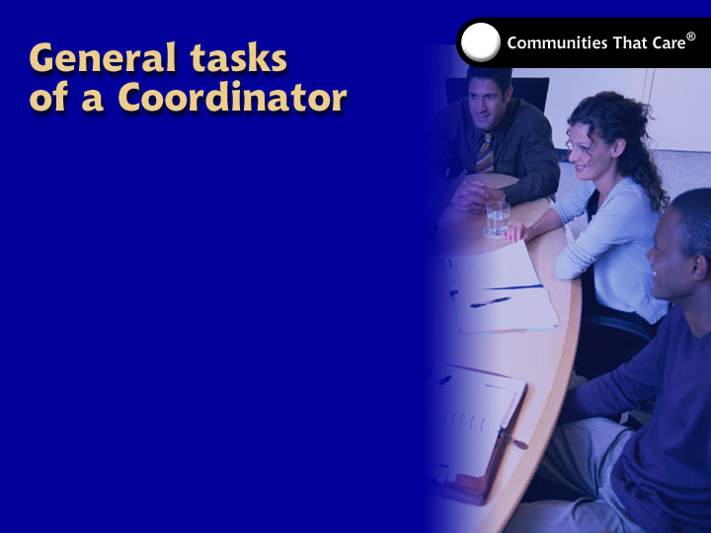
  provide staff support
  coordinate training and
  technical assistance
  prepare for and follow up on
  Community Board meetings
  document the
  Communities That Care effort
  prepare reports
Training of Coordinators
3-5

Slide 6
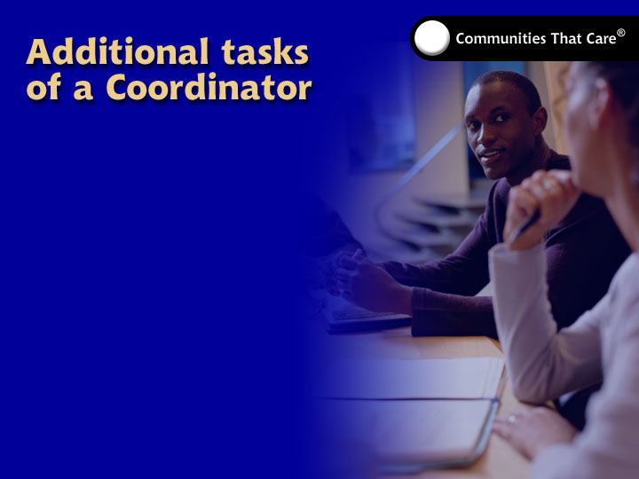
Coordinators may need to:
  rally support for the
  Communities That Care effort
  set up and/or arrange for Community Board or work group meetings, beyond normal preparation
  take care of minor difficulties, such as scheduling board meetings.
Training of Coordinators
3-6

Slide 7
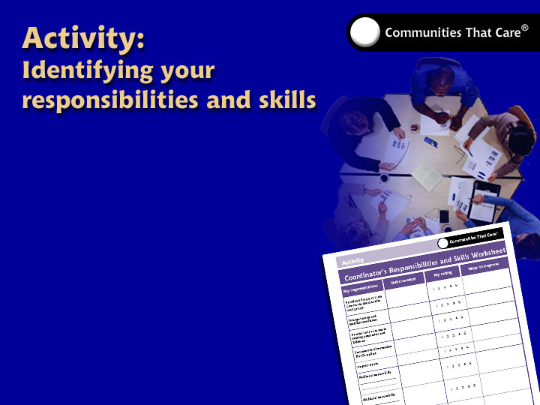
  Turn to the Coordinator’s Responsibilities and Skills Worksheet in your
  Participant’s Guide and
  fill in the spaces provided.
  Share some of
  your responses.
Training of Coordinators
3-7

Slide 8
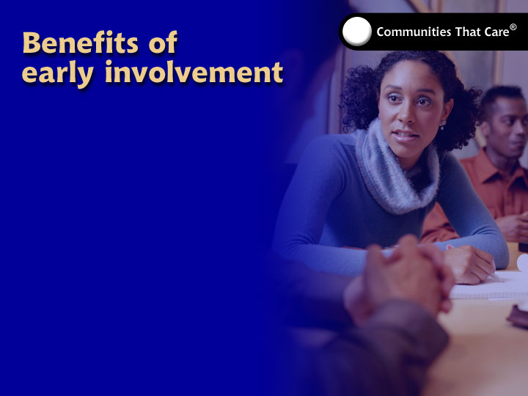
The Coordinator can:
  support the effort as soon
  as possible
  understand the community’s
  readiness issues
  help organize the work that needs
  to be done from one phase to the next
  support the work of several people and groups.
Training of Coordinators
3-8

Slide 9
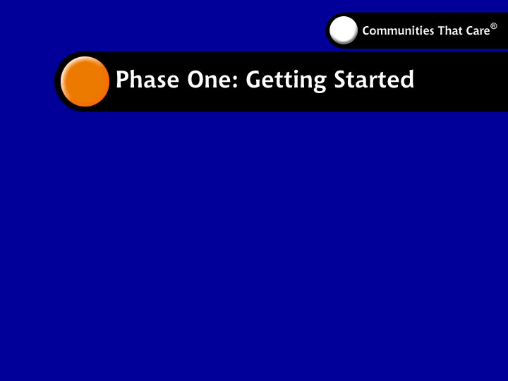
Purpose: Begin the Communities
That Care process. Identify:
  people
  scope
  readiness
  resources.
Support: Strategic Consultation; Tools for Community Leaders: A Guidebook for Getting Started
Training of Coordinators
3-9

Slide 10
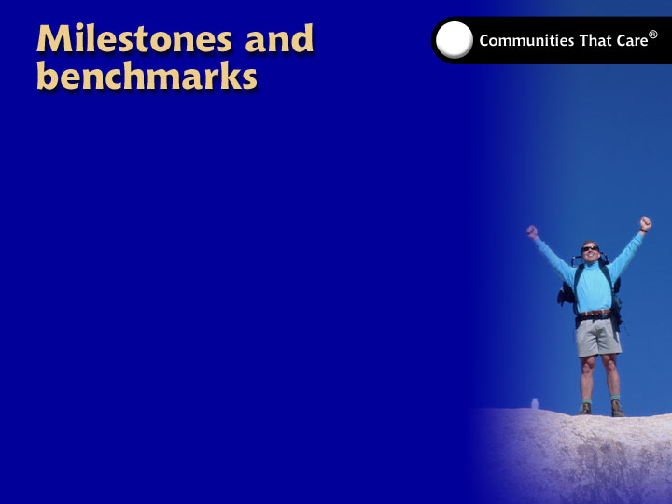
  Established for each phase
  Indicate critical steps
  and procedures
  Document and celebrate accomplishments
  Supported by training modules
Training of Coordinators
3-10

Slide 11
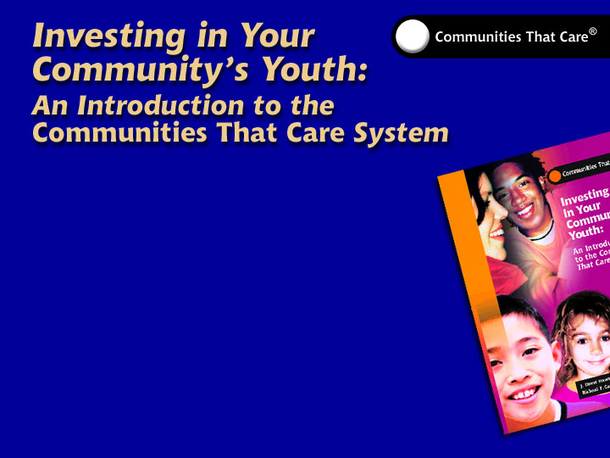
  introduction
  a description of the
  Communities That Care system
  a description of the research foundation
  the process of implementation
  the Communities That Care system at work
  sources
Training of Coordinators
3-11

Slide 12
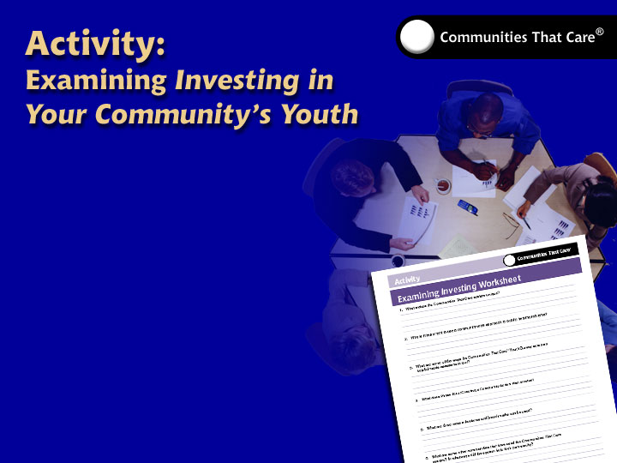
  • Turn to the Table
  of Contents.
  • Answer questions
  on the Examining
  Investing Worksheet.
  • Share your responses
  with the group.
Training of Coordinators
3-12

Slide 13
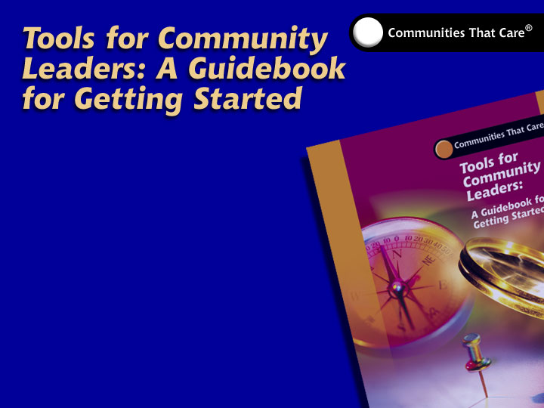
  Step 1—Complete Preliminary
  Organization Tasks
  Step 2—Define the Scope
  of the Prevention Effort
  Step 3—Address Community
  Readiness Issues
  Step 4—Plan for Phase Two:
  Organizing, Introducing, Involving
Training of Coordinators
3-13

Slide 14
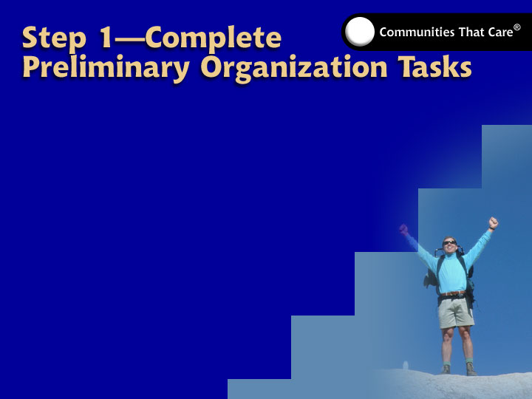
  Milestone 1-1: Organize the community to begin the Communities That Care process.
Training of Coordinators
3-14

Slide 15

  Milestone 1-2: Define the scope of the prevention effort.
Training of Coordinators
3-15

Slide 16
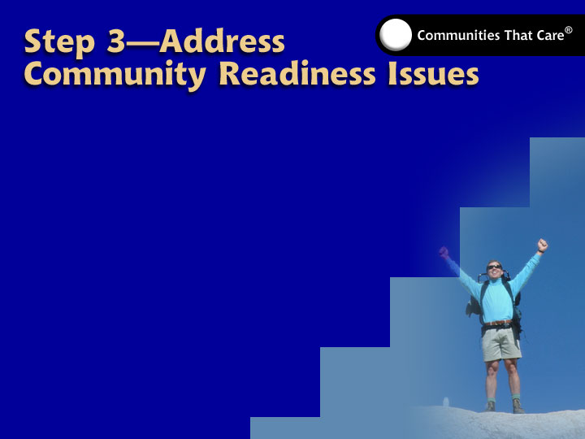
  Milestone 1-3: Identify community readiness issues.
  Milestone 1-4: Analyze and address community readiness issues,
  or develop a plan for
  addressing them.
Training of Coordinators
3-16

Slide 17
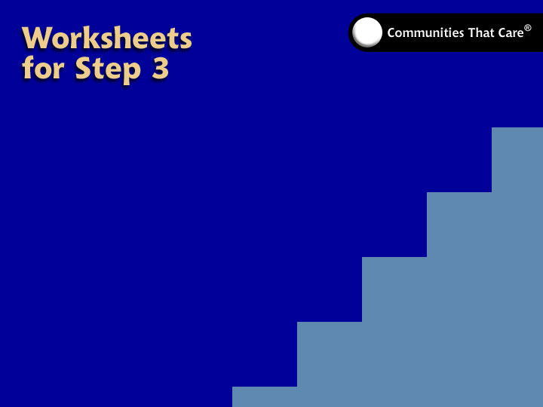
The following worksheets help address readiness issues in the first benchmark of Step 3:
  The Obtaining School District Support
  for the Communities That Care
  Youth Survey worksheet
  The Community Initiatives
  worksheet
  The Stakeholder
  Identification and
  Analysis worksheet.
Training of Coordinators
3-17

Slide 18
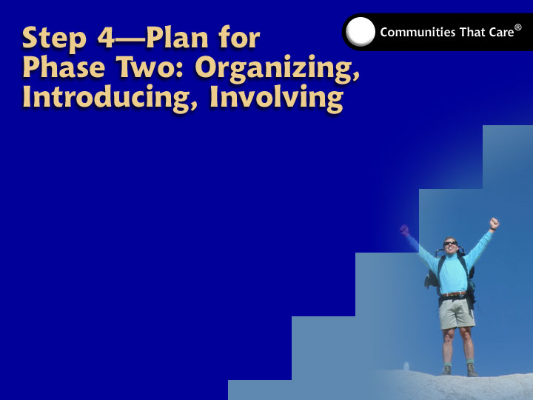
  Milestone 1-5: The community is ready to move to Phase Two: Organizing, Introducing, Involving.
Training of Coordinators
3-18

Slide 19
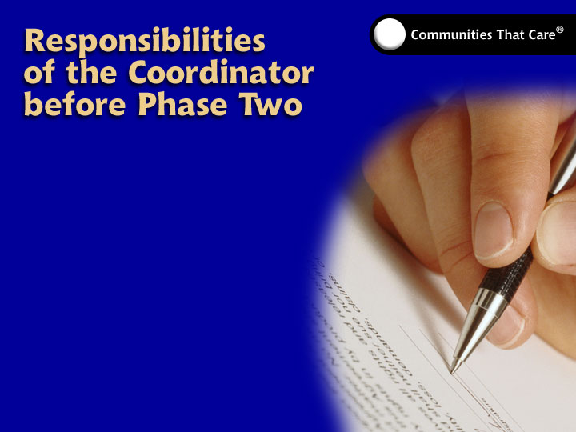
  Clerical tasks
  Meeting logistics
Training of Coordinators
3-19

Slide 20
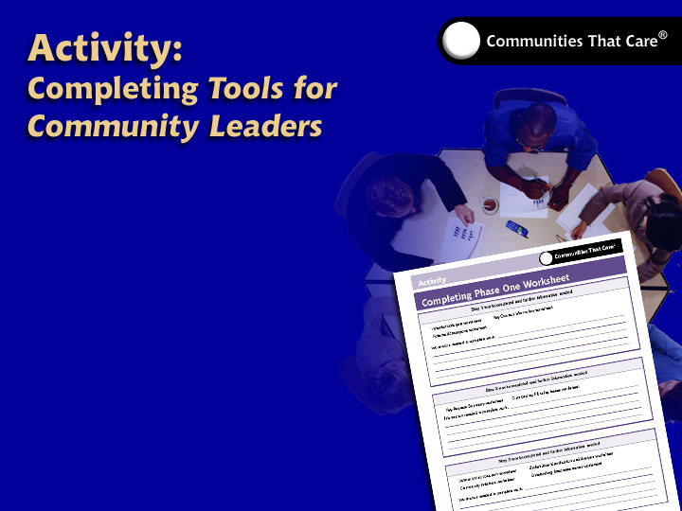
  Turn to the
  Completing Phase One
  Worksheet in your
  Participant’s Guide
  and answer the
  questions listed.
  Share your responses
  when you finish.
Training of Coordinators
3-20

Slide 21
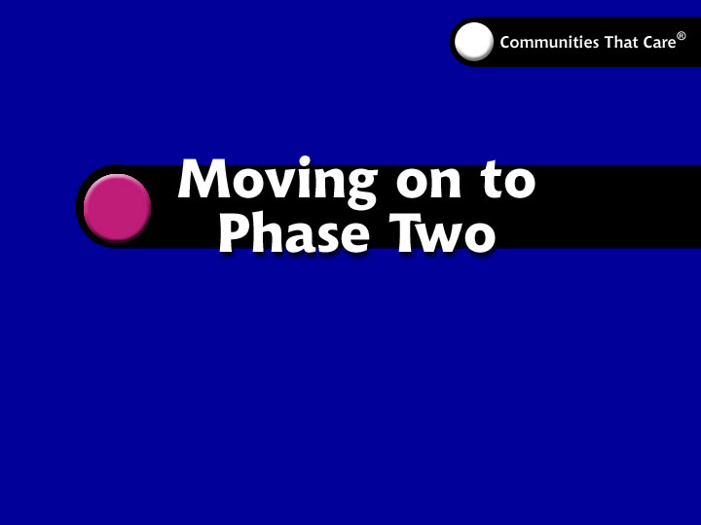
Training of Coordinators
3-21

