Slide 1

e-Payroll Status
April 30, 2004

Slide 2
Overview
Meeting Purpose
Milestone Checkpoints
Project Schedule
  Outstanding Interface Control Documents
Project Status
e-Payroll Testing
Center Test Readiness Review
Issues Summary
Implementation Assessment Summary
Contingency Plan
Risk Summary
Next Steering Committee Meeting
Back-up

Slide 3
Meeting Purpose
The purpose of this meeting is to
Provide the status of the e-Payroll migration; and
obtain the e-Payroll Steering Committee’s authorization to proceed with the implementation of Department of Interior’s (DOI) Federal Personnel and Payroll System (FPPS).

Slide 4
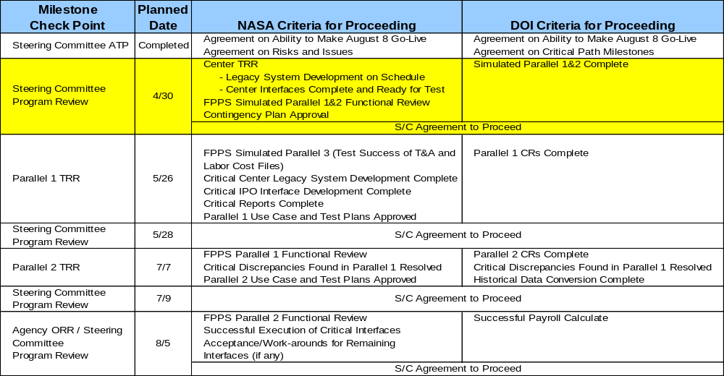
Milestone Check Points

Slide 5
Project Schedule
FY2004
February
March
April
May
June
July
August
Interface Design
45 of 50 signed
Report Design
Interface Development / Unit Test
Parallel 1 TRR
5/26
Center TRRs
4/26 – 4/29
Report Development
Test Scripts
3/30
FPPS Online Testing
System Connectivity and Acceptance Testing
Parallel 1
Parallel 2
Sim. Parallel (SP) 1
3/22
SP 2
4/19
SP 3
5/17
CRs Available
5/30
CRs Available
7/11
Training
Historical Data Conversion
Deployment
Go-Live
8/8
Notes:
The Summary Status shall be reported for the month. For purposes of this chart, the “month”, or “M”, is the period between the last MSR and the current MSR. Please utilize the criteria on this page for reporting summary status.
The intent of this chart is to provide an overall status of the project.
NOTE: Any red or yellow assessment requires an explanation.
The Integration Project Office (IPO) summary status shall reflect cost/schedule/technical status for each active project.

Slide 6
Outstanding Interface Control Documents (ICDs)
Interface | Priority | Estimated Completion Date | Status
JSC Labor | 1 | 5/7/2004 | Rework
JSC NASA Employee Benefits System (NEBS Database) | 2 | 5/7/2004 | Not Complete
MSFC Oracle Database | 2 | 5/14/2004 | Not Complete
Incident Reporting Information System | 2 | 5/7/2004 | Not Complete
WIMS (HQ) | 2 | 5/14/2004 | Not Complete
Prioritization:
Critical for payroll processing
Critical for business operations
Necessary but not critical for business continuity

Slide 7
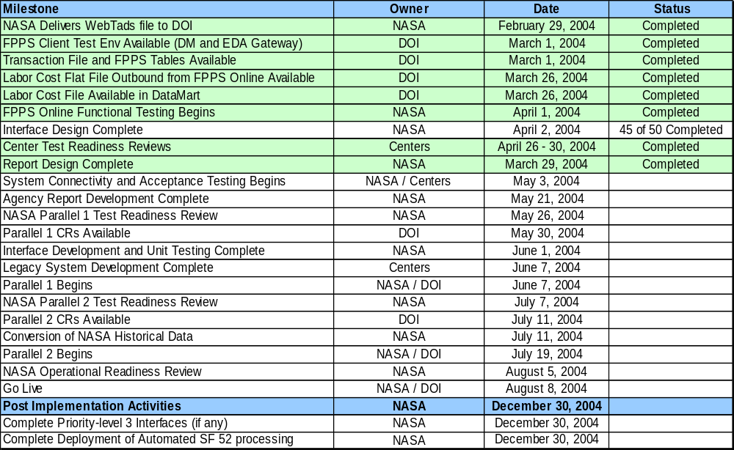
Project Status

Slide 8
Project Status
Communications
  DOI has committed to providing all of the CRs in time for NASA to adequately test before go-live
    Awards Interface CR originally slated for parallel 1 will not be available until parallel 2
    NEBA and Workforce Flexibility CRs assigned to parallel 2
  Submitted budgetary guidance to centers concerning e-Payroll cost estimates and funding responsibilities
Historical Data Conversion
  Completed all software development for conversion of historical data
  Test files have been sent to the DOI datamart team and 4 of the main files have been loaded successfully with the remaining scheduled for completion mid June 2004
Change Management
  Developed draft procedures for help desk process
  Completed 100% of e-Payroll Agency sponsored training
  Developing a process for monthly updates to HR Directors and CFOs

Slide 9
e-Payroll Testing
Simulated Testing
  Completed Simulation Parallel Test 1 (March 22 – 31)
    Successfully loaded and validated the Time and Attendance data from WebTADs
    Validated approximately 70% of the bi-weekly pay processing functions with the remaining 30% scheduled for simulations 2 and 3
    Accomplished objective of balancing one center’s payroll cost
  Completed Simulation Parallel Test 2 (April 19 – 24)
    Unable to accomplish objective for balancing 5 Centers due to HR data quality, system performance, and server disconnect issues
    Successfully performed spot testing for various employee records
    Successfully tested changes to Time and Attendance file from simulation 1
  Simulation Parallel Test 3 (May 17 – 22)
    Objective: Enter HR and Payroll transactions for all Centers and balance Payroll Cost
NASA Internal Testing
  Completed Center Connectivity/Configuration and Transaction Testing
    User access
    Printing
    Security
    Transaction test scenarios

Slide 10
Center Test Readiness Review (TRR)
Purpose: To ensure center readiness to proceed from Interface Design, Application Development, and Unit Test Phase to End-to-End/Acceptance Testing Phase
  Legacy System Interface Development
  Application (EAI) Connectivity
  IT Readiness
  User Accounts/FPPS Security
  Test Team Identification
  Test Strategy Development

Slide 11
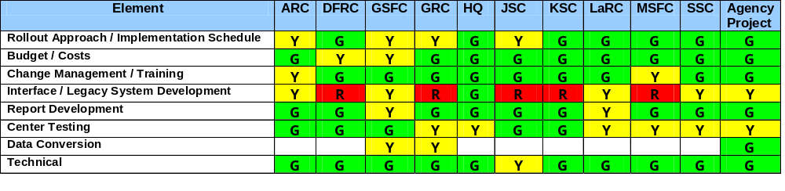
Center Test Readiness Review (TRR)
Major Issues
  Availability of labor file from IPO
  Legacy system modifications
  Highly compacted testing schedule
  Center ability to validate converted data
All center project managers, with exception of GSFC, presented recommendation to proceed to testing phase
  GSFC “No-Go” recommendation based on excessive schedule risk

Slide 12
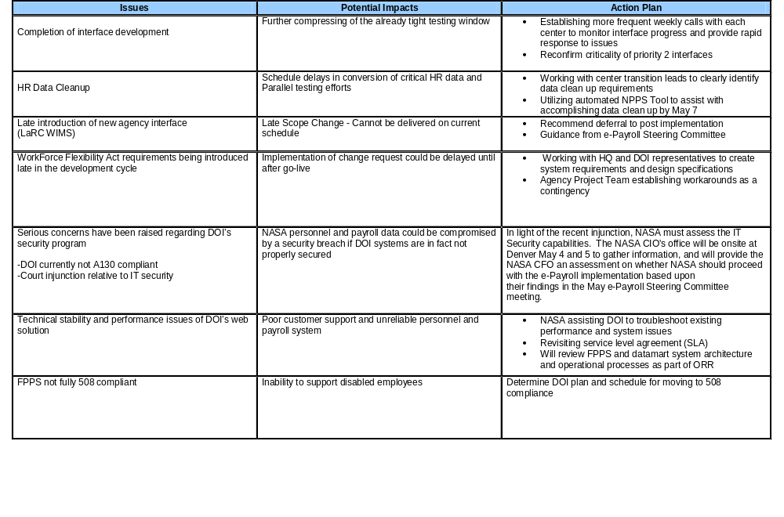
Issues Summary

Slide 13

Project Recommendation for Authorization to Proceed
Recommendation: Continue to Proceed with End-to-End Testing of Interfaces
Project Major Concerns
  Interface Design, Development, and Testing
  Data Cleanup
  Legacy system modifications
    Labor
    NEBS (JSC)
    MSFC Oracle
Steering Committee Decision? Answer: Steering Committee Recommends Proceed

Slide 14
Contingency Plan
Perform “Operational Parallel” at Cut-over to Department of Interior’s (DOI) Federal Personnel and Payroll System (FPPS)
  Maintain NASA Personnel and Payroll System (NPPS) in a production state throughout the first official FPPS pay cycle (August 8 – 25), for use in operational parallel processing
  Ensure centers retain pre-FPPS software for processing payroll data in critical systems (i.e., Labor)
  Continue parallel processing through August 24, 2004 (FPPS pay calculation date)
  Load production time and attendance data in NPPS, perform pay calculation, and compare to FPPS pay calculate
  Validate FPPS production readiness for payments to the Treasury
If FPPS is not successful in producing final pay products for transmission to the treasury, produce final pay products from NPPS
  Generate payroll vouchers
  Extract labor cost data for transmission to centers
  Transmit payment data to treasury
  Continue to use NPPS for payroll processing until recovery plan is implemented
Recovery in FPPS will not be feasible prior to pay period beginning November 14, 2004, due to fiscal year-end processing impacts
Steering Committee Approval? Answer: Steering Committee Approves Contingency Plan

Slide 15
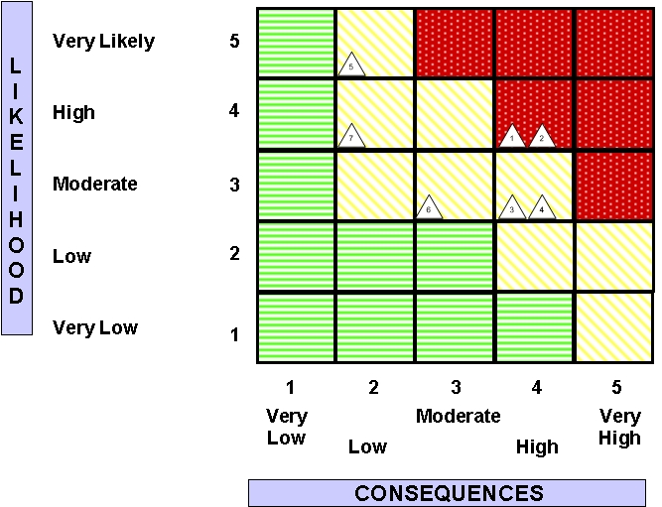
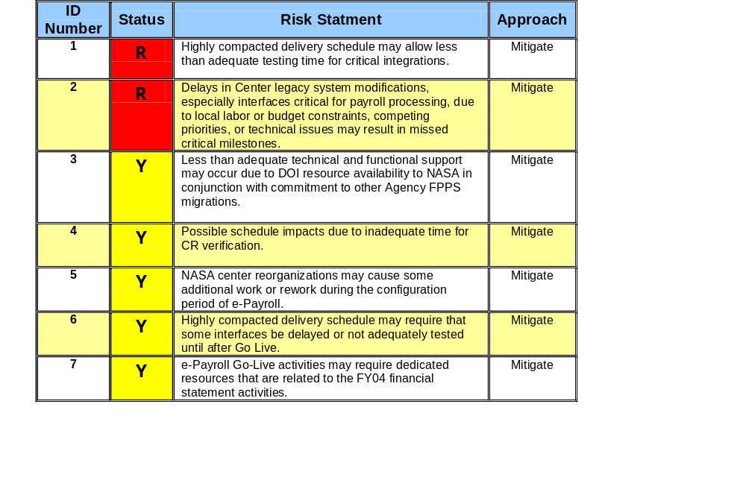
Risk Summary

Slide 16
Next Steering Committee Meeting
Authority to Proceed with Formal Parallel 1 Testing
  NASA Criteria for Proceeding
    FPPS Simulated Parallel 3 (Test Success of T&A and Labor Cost Files)
    Critical Center Legacy System Development Complete
    Critical IPO Interface Development Complete
    Critical Reports Complete
    Parallel 1 Use Case and Test Plans Approved
  DOI Criteria for Proceeding
    All Parallel 1 CRs complete

Slide 17
Backup
BACKUP

Slide 18
Interface Prioritization
Priority 1
Awards Inbound
CFC Inbound & Outbound
Employee Information Update
Labor
SAP Vendor Master
Travel Manager
WebTads T&A Adjustments
WebTads Employee Number
WebTads Inbound & Outbound
WebTads Labor
X500 Inbound & Outbound
Agency Master Delta
Priority 2
Awards Outbound
IDMS Outbound
IRIS
WIMS (HQ)
ARC ISIS
ARC Sybase
GRC SIMS
GSFC LISTS
PCS
JSC NEBS
KSC EDW
LaRC DataMart
MSFC MEDIS
MSFC Oracle
Priority 3
AdminStar
Center-to-Center Transfer
CMS
Go Learn
HEIDI
Perf. Rating Updates
GRC HRIS
GRC Master Data
GSFC Profiles
GSFC WISP
GSFC WIT

Slide 19
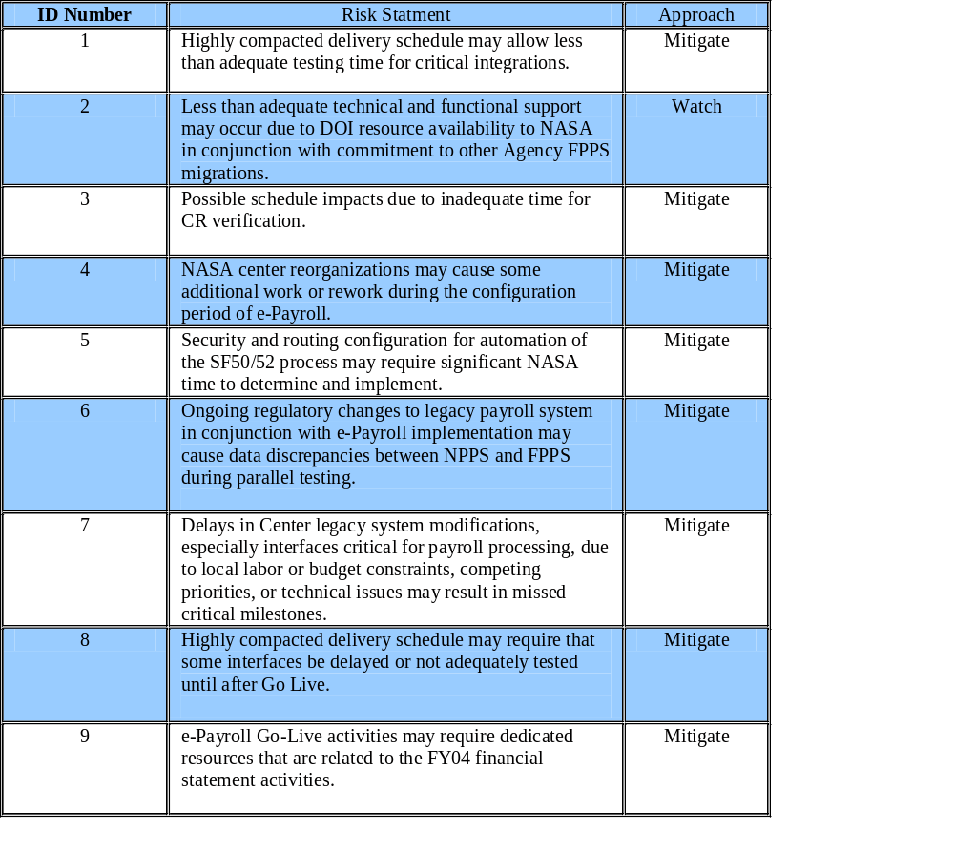
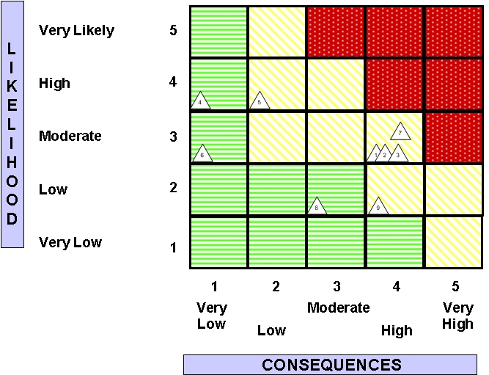
Previous Risk Matrix

Slide 20
Priority 1 ICD Status
Priority 1 Interfaces | Scheduled Completion Date | Signed | ICD Status
Agency Master Delta | 03/05/04 | 03/05/04 | Complete
Awards Inbound | 04/06/04 | 04/26/04 | Complete
CFC Inbound | 03/05/04 | 03/05/04 | Complete
CFC Outbound | 03/15/04 | 03/15/04 | Complete
Employee Information Update | 03/26/04 | 03/12/04 | Complete
Labor
ARC | 03/12/04 | 03/12/04 | Complete
DFRC | 03/12/04 | 03/12/04 | Complete
GRC | 03/12/04 | 04/16/04 | Complete
GSFC | 03/12/04 | 04/16/04 | Complete
HQ | 03/12/04 | 03/12/04 | Complete
JSC | 03/12/04 | Not Signed | In Process
KSC | 03/12/04 | 04/09/04 | Complete
LaRC | 03/12/04 | 03/12/04 | Complete
SSC | 03/12/04 | 03/12/04 | Complete
MSFC | 03/12/04 | 04/22/04 | Complete

Slide 21
Priority 1 ICD Status
Priority 1 Interfaces | Scheduled Completion Date | Signed | ICD Status
SAP (Vendor Master) | 03/12/04 | 03/12/04 | Complete
Travel Manager | 03/12/04 | 04/09/04 | Complete
WebTads Employee Number | 03/26/04 | 04/09/04 | Complete
WebTads Inbound | 03/12/04 | 04/16/04 | Complete
WebTads Outbound | 03/19/04 | 04/16/04 | Complete
WebTads Labor | 03/19/04 | 04/16/04 | Complete
WebTads T&A Adjustments | 03/12/04 | 04/09/04 | Complete
X500 Inbound | 03/26/04 | 03/26/04 | Complete
X500 Outbound | 03/26/04 | 03/26/04 | Complete

Slide 22
Priority 2 ICD Status
Priority 2 Interfaces | Scheduled Completion Date | Signed | ICD Status
Awards Outbound | 03/05/04 | 04/26/04 | Complete
IDMS (Outbound) | 03/05/04 | 03/05/04 | Complete
Incident Reporting Information System | 03/05/04 | Not Signed | In Process
PCS | 03/12/04 | 04/09/04 | Complete
WIMS | 03/22/04 | Not Signed | In Process
ARC Physical Security Data (ISIS) | 01/09/04 | 01/09/04 | Complete
ARC Sybase Database | 03/19/04 | 03/19/04 | Complete
GRC Security Information Management System (SIMS) | 01/09/04 | 01/09/04 | Complete
GSFC Locator System (LISTS) | 01/23/04 | 01/23/04 | Complete
JSC NASA Employee Benefits System (NEBS Database) | 03/12/04 | Not Signed | In Process
KSC Employee Data Warehouse (EDW) | 04/02/04 | 04/02/04 | Complete
LaRC Data Mart | 03/05/04 | 03/05/04 | Complete
MSFC Employee Data Information System (MEDIS) | 03/05/04 | 03/05/04 | Complete
MSFC Oracle Database | 03/12/04 | Not Signed | In Process

Slide 23
Priority 3 ICD Status
Priority 3 Interfaces | Scheduled Completion Date | Signed | ICD Status
AdminStar | 01/09/04 | 01/09/04 | Complete
Agency Center to Center Transfer | 03/05/04 | 03/05/04 | Complete
Competency Management System | 03/05/04 | 04/29/04 | Complete
Go Learn | 03/05/04 | 03/05/04 | Complete
HEIDI | 03/26/04 | 04/16/04 | Complete
Performance Rating Updates | 03/12/04 | 04/09/04 | Complete
GRC Human Resources Information System (HRIS) | 03/19/04 | 03/19/04 | Complete
GRC Master Data Locator System | 01/09/04 | 01/09/04 | Complete
GSFC HR Info (Profiles) | 03/19/04 | 03/19/04 | Complete
GSFC Workforce Information Tool (WIT) | 04/02/04 | 04/02/04 | Complete
GSFC Workforce Tool (WISP) | 04/02/04 | 04/02/04 | Complete

