Slide 1

Department of Defense
Building a Better Financial Management Foundation with Standardization
James E. Short
Deputy Chief Financial Officer
March 11, 2008

Slide 2
Agenda
DoD Financial Management Standardization:
  Financial Improvement and Audit Readiness Plan (FIAR)
  Enterprise Transition Plan (ETP)
  Standard Financial Information Structure
  Priorities
  Emerging Issues
  Accomplishments
  Summary

Slide 3
Financial Improvement and Audit Readiness
  DoD Financial Improvement and Audit Readiness Plan (FIAR)
  Built on a foundation of Army, Navy, Air Force, and Defense Logistics Agency Financial Improvement Plans (FIPs)
  Incremental, prioritized improvement work based on segments
  of the DoD business and financial environment
  Improvements address Policies, Processes, Controls
  (OMB Cir. A-123), Systems, and Human Capital
  Integrated with Enterprise and Component Transformation Plans
  Over 2,000 milestones maintained and managed in a web-based project repository with FIPs and Enterprise Transition Plan
  Components report progress and status in achieving FIAR Plan milestones monthly
  Progress and status are reviewed quarterly by the DCFO, USD(C), Deputy Secretary of Defense, and OMB

Slide 4
FIAR E2E Business Process Segments
Provides a systematic, structured approach to improvement activities
Ensures all essential business and financial processes are addressed during Discovery and Correction
Provides a means to utilize BEA products and to integrate Business Transformation initiatives
Identifies functional communities that perform each process step
Is consistent with the auditor’s approach to financial statement audits
Provides a method for monitoring and measuring progress and status that also provides visibility of completed improvement activities

Slide 5
What Is a FIAR Segment?
Segments are either:
  Balance Sheet line items
  (e.g., Environmental Liabilities)
  End-to-end business processes
  (e.g., Acquire to Retire for Real Property)
  Organizations/Commands in a Component
  (e.g., Naval Supply Command)
Segments are used for:
  Planning and executing improvements to: Policies, Processes,
  Controls, Systems, and Human Capital
  Planning for Management Assertions
  Performing Validations by IG or an IPA
  Managing sustainment until completely audit ready
The FIAR Plan contains individual Key Milestone (KM) Plans for each SEGMENT with tasks
in Component FIPs
for each FIAR KM.
Notes:
Business processes that can be addressed end-to-end, such as Civilian Pay.
· Groups of financial statement lines that are closely related and may be addressed by making similar improvements, such as Fund Balance with Treasury, Accounts Payable, and Accounts Receivable.
· Individual financial statement lines in which improvements can be easily segregated, such as Cash and Other Monetary Assets.
· Material sub-lines, such as Military Equipment.
________________________________
Segments can be formed by either bringing together closely related areas of financial management or further breaking apart areas into more manageable portions. This allows the Department greater flexibility in how it organizes and prioritizes financial management improvement efforts. Segments may be business processes, groups of related financial statement lines, sub-lines, or a single line.

Slide 6
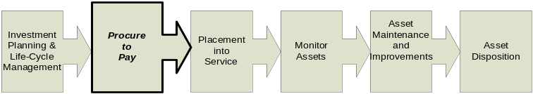
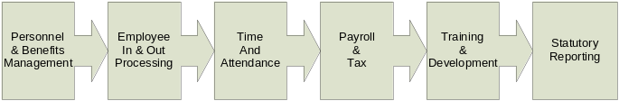
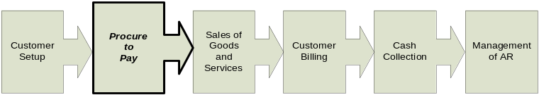
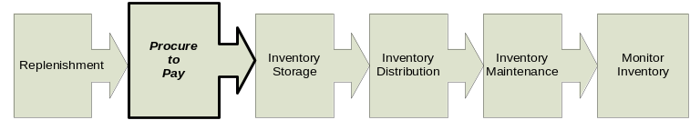
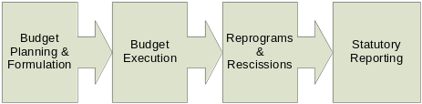
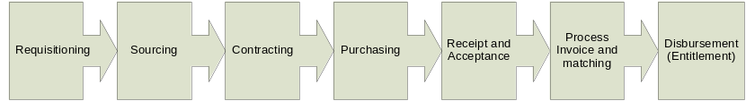
FIAR End-to-End (E2) Business Processes
Acquire to Retire
Hire to Retire
E2E Business
Processes provide
a link to Process
Steps; Data Objects;
and Laws, Regs,
and Policies in the
BEA
Order to Cash
Plan to Fulfill
Budget to Report
Procure to Pay
E2E Business Processes provide a means for engaging the functional
communities who perform the activities within the process steps.

Slide 7
How Functional Communities Are in the FIAR Plan
Example: Acquire to Retire and Procure to Pay for Military Equipment
Logistics
Process Step
Acquisition Process Steps
Investment
Planning
&
Requisitioning
Sourcing
Contracting
Purchasing
Receipt and
Life
-
Cycle
Acceptance
Management
Asset
Process
Placement
Maintenance
Invoice and
Disbursement
into
Monitor
and
Asset
matching
(
Entitlement
)
Service
Assets
Improvements
Disposition
Financial Process Steps
Logistics Process Steps

Slide 8
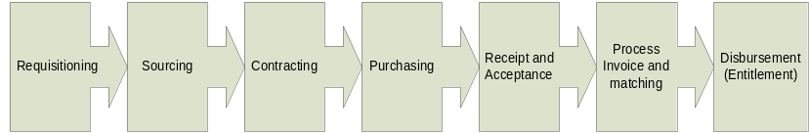
How E2E Processes Are in the FIAR Plan
FIAR Key Milestone
Project Plans Maintained
Web-Based in FIAR Tool
Procure to Pay
 | 2008 | 2009 | 2010 | 2011
Requisition Process Step
Policies
Processes
Controls
Systems
Human Capital
Sourcing Process Step
Policies
Processes
Controls
Systems
Human Capital
1 Key Milestone
for each Process Step
Policies
Processes
Controls
Systems
Human Capital
5 Milestones / one for each
type of improvement activity
Note: Each milestone is supported by tasks
in Component Financial Improvement Plans
maintained in the Web-based FIAR Tool.

Slide 9
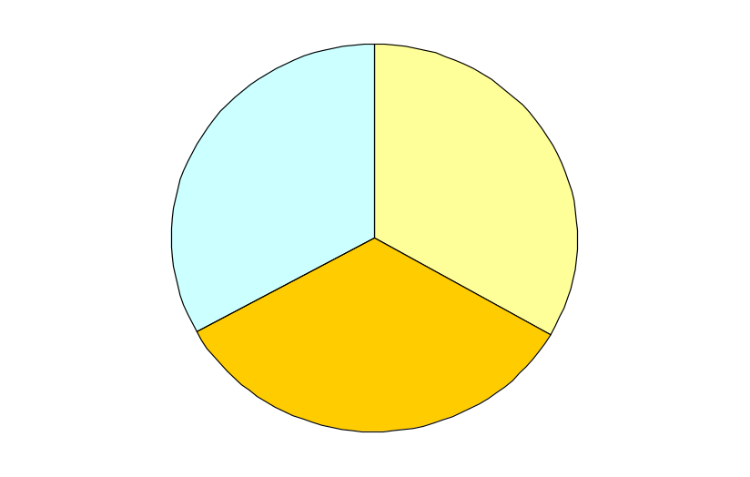
How FIAR Segments Lead to Financial Audits
Segments matrix together to equal each Component’s:
  Mission, business, and financial operations, and
  The business and financial data reported in Financial Statements
E2E
Business
Process
Segments
Balance
Sheet
Line
Segments
Financial
Statement
Management
Assertion
Financial
Statement
Audit
Clean
Audit
Opinion
Balance
Sheet
Command
Segments
Component Mission, Business
and Financial Operations
Financial Statements
Notes:
Business processes that can be addressed end-to-end, such as Civilian Pay.
· Groups of financial statement lines that are closely related and may be addressed by making similar improvements, such as Fund Balance with Treasury, Accounts Payable, and Accounts Receivable.
· Individual financial statement lines in which improvements can be easily segregated, such as Cash and Other Monetary Assets.
· Material sub-lines, such as Military Equipment.
________________________________
Segments can be formed by either bringing together closely related areas of financial management or further breaking apart areas into more manageable portions. This allows the Department greater flexibility in how it organizes and prioritizes financial management improvement efforts. Segments may be business processes, groups of related financial statement lines, sub-lines, or a single line.

Slide 10
Financial Improvement and Audit Readiness
Discovery
&
Correction
Segment
Assertion
Audit
Readiness
Validation
Audit
Readiness
Sustainment
Financial
Statement
Assertion
Financial
Statement
Audit
Discovery & Correction:
  Processes, systems and controls documented, evaluated and tested
  Weaknesses identified
  Corrective actions, including system modernization or deployment, completed
Segment Assertion: Management asserts audit readiness to OIG and OUSD(C) for concurrence
Audit Readiness Validation: OIG or IPA validates management’s segment assertion
Audit Readiness Sustainment: Annual verification by segment using OMB A-123, Appendix A, as guidance
Financial Statement Assertion: Management asserts audit readiness to OIG and OUSD(C) for concurrence
Financial Statement Audit: OIG or IPA performs an audit

Slide 11
This Is How We Measure Progress
Policy
Process
Int. Control
System
People
Military Equipment Segment (23% of DoD Assets)
Audit
Readiness
Army 4%
Current Opinion
Navy 11%
Assertion
Air Force
7%
End-to-End Segment Improvements
DoD’s Total Assets and Liabilities
USACE Audit
DISA Audit
USMC Audit
MERHCF Audit
TRICARE Audit
Component
Audits
Clean opinions on a portion of DoD’s assets and liabilities

Slide 12
This Is How We Oversee Progress
Deputy Secretary of Defense
(Chief Management Officer)
USD(C)/CFO
Secretaries of Army, Navy,
and Air Force meet quarterly
with Deputy Secretary
to review financial statements
and FIAR progress
FIAR
Committee
(Chaired by
DCFO)
FIAR
Subcommittee
FIAR
Plan
Army
Plan
Navy
Plan
Air Force
Plan
Defense
Agency
Plans
Components report monthly progress on Financial Improvement
and Audit Readiness milestones

Slide 13
DoD Enterprise Transition Plan
Enterprise Transition Plan (ETP) is the roadmap.
The ETP articulates a systematic process for delivering improved capabilities that will have a major impact on the performance of DoD's business mission.
The ETP gives DoD - particularly the Defense Business Systems Management Committee (DBSMC) and Investment Review Boards - a comprehensive management tool for business modernization, with measurable plans, schedules, and budgets.
Major milestones for the systems and initiatives that are critical to achieving transformation priorities are outlined in the ETP.

Slide 14
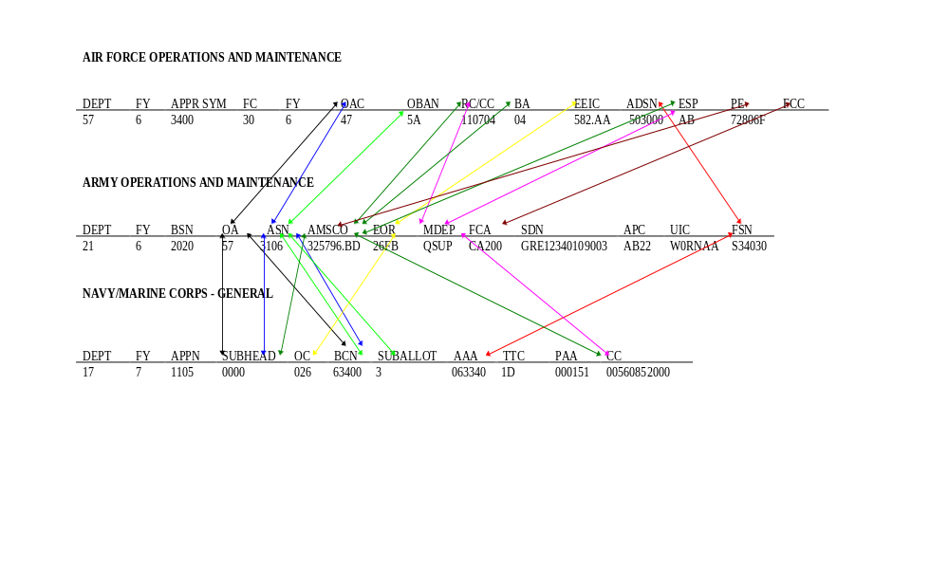
Integrated Information Is Impossible Without Data Standards
An Example of Pre-SFIS Data Mappings
Lack of financial data standards across the Services impedes the ability to analyze performance on an enterprise-wide basis

Slide 15
Standard Financial Information Structure
System
Accomplishment
Why Important
Completed SFIS plan that tracks when each DoD business feeder and accounting system will be SFIS compliant
SFIS Phase III: Cost accumulation structure released in BEA 4.1 Q2 FY07
Developed DoD-wide SFIS on-line training and ERP configuration guides in Q1 FY08
Standard Financial Information Structure (SFIS)
SFIS is DoD’s common business language that facilitates the consistent collection and reporting of financial information
SFIS provides standard definitions, lengths, values, and business rules that enable transparency and interoperability across the DoD enterprise
Strategic priorities focus on continuous improvement in fulfilling
critical responsibilities

Slide 16
DoD FM Priorities
Transform Financial Operations
Improve Stewardship
Recruit and Retain a World-class Workforce
Providing better support to the warfighter
Delivering timely, accurate, reliable information to decision makers
Standardizing business data and rules
Integrating enterprise-wide processes and systems
Deploying state-of-the-art technology
Building and executing robust metric programs
Strengthening internal controls
Eliminating material weaknesses, and safeguarding taxpayer’s dollars
Delivering transparency
Achieving clean audit opinions
Using innovative strategies to recruit talent
Investing in a world-class financial workforce
Achieving outcomes by aligning National Security Personnel System Individual Development Plans to strategies
Initiating the CFO Academy at the National Defense University
Strategic priorities focus on continuous improvement in fulfilling
critical responsibilities

Slide 17
DoD FM Emerging Issues
Transform Financial Operations
Improve Stewardship
Recruit and Retain a World-class Workforce
Driving financial reform in a warfighting culture
Balancing the global scale of operations and diverse missions
Managing external and oversight stakeholder expectations
Building and executing a totally integrated financial improvement and audit readiness plan
Changing operational perceptions about the value of internal controls
Building relationships with stakeholders that lead to successful outcomes
Finding the optimal balance between risk and cost
Achieving clean audit opinions
Paying competitive rates for financial talent
Retaining institutional knowledge in light of retirement bow wave
Using innovative strategies to recruit talent
Achieving outcomes by aligning National Security Personnel System Individual Development Plans to strategies
Financial Transformation is delivering results and the Department
is committed to meeting the challenges ahead

Slide 18
DoD FM Accomplishments
Transform Financial Operations
Improve Stewardship
Recruit and Retain a World-class Workforce
Clean audit opinions on $1.3T or 36 percent of all assets and liabilities
Five unqualified and two qualified audit opinions for FY2007
Standard Financial Information Structure across the Department
Enterprise-wide Integrated Financial Improvement and Audit Readiness Plan (FIAR)
Reduced self-identified internal control weaknesses from 116 to 19
Zero weakness in the civilian pay system internal control design
Prevented over $452m in duplicate payments
DCAA audited $358B of contracts; saved the Department $2.4 B
Provided financial assistance to employees seeking advanced degrees and professional certification
DFAS Leaders-in-Motion Program recruits and trains an average 225 financial employees each year
The Department is investing in the CFO Academy at NDU
The Department has a responsibility to be good stewards over the resources we manage. We take this responsibility seriously!

Slide 19
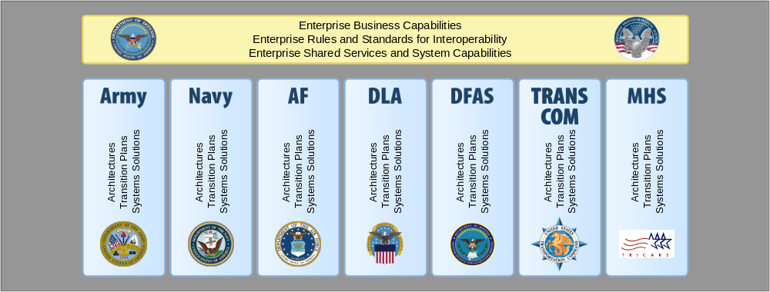
This Is How We Will Succeed
Tiered Accountability
OSD and DoD Components share the requirement to produce an integrated improvement plan, based on:
DoD Enterprise Priorities
Focus on systems and initiatives critical to the Business Enterprise Priorities
Component Priorities
Each Component has the responsibility to represent its own transformation story in the context of its Business Mission
Focuses on systems and initiatives critical to each Component’s transformational efforts
Components are responsible for developing and maintaining architectures and transition plans that detail each Component’s Priorities.

Slide 20
Summary
The Department’s mission and the changing nature of the threats to which it must respond, require it to be nimble, adaptive, flexible, and accountable.
The Department’s business model must allow it to adapt and flex as decision makers deal with growing competitive pressures, changing regulations, and strategic and tactical course shifts.
In this model, transformation is about reacting instantly and effectively to what today’s modular, agile, technologically-advanced joint force demands. This new reality has given increased urgency to transforming the Department’s business operations.
Transforming those operations is no longer just a matter of achieving cost, schedule, and performance requirements. It’s about business agility.
Notes:
For the past several decades, the Defense Department’s business model has been configured to support a military dependent on large-scale weapons systems and prepared for sustained, predictable battlefield engagements in specific parts of the world. The contemporary defense business model must be different, to keep pace with the changing nature of the DoD’s warfighting challenges.

