Slide 1
LBNL Project Management Overview
LBNL
Project Management:
Project Realities
February 2003

Slide 2
Objectives
This module will:
Reinforce the use of project management terms consistent with their approved definitions
Provide guidance for project conduct and participation
Enable participants to contribute to project success
Provide additional references about project management

Slide 3
Agenda
Project Team Formation
Project Planning
Change Management
Progress Reporting
Reviews – Product and Project
Risk Assessment and Management
Communication
Problem Management
Recommended Reading

Slide 4
A. Introduction to Project Management
A. Project Team Formation

Slide 5
Project Team Formation
Attributes of an effective project team:
Clear goals and objectives
  Overall understanding of team’s role in project, its responsibilities and what it needs to accomplish
  Involve all team members in defining the goals
  Clarify roles, decisions and responsibilities
Understanding of interdependence
  If everyone does their “own thing,” no real team exists
  Most deliverables influence other people’s deliverables

Slide 6
Project Team Formation
Attributes of an effective project team:
Cohesiveness
  Depends on number of personal needs each member can satisfy by belonging to the team
  Increases as team’s ability to meet individual needs increases
Level of trust
  Build working relationships that are characterized by openness and trust
  Openly recognize conflict and resolve it through discussion
Potency
  Belief that team can achieve goal of the project
  Reward early successes of project team

Slide 7
Project Team Formation
Leadership Styles:
Directing
  Organize and direct work of others
  Make each person accountable for specific deliverables
  Motivate by demonstrating what needs to be done
Supporting
  Set high but realistic standards of performance
  Explain what needs to be done
  Motivate by giving feedback
  Be personally involved

Slide 8
Project Team Formation
Leadership Styles:
Coaching
  Recognize and praise good work
  Be open and supportive
  Motivate by letting others structure their own work
Delegating
  Assign task responsibilities and let others carry them out
  Motivate by giving control and showing respect
  Limit personal involvement in deliverables

Slide 9
Project Team Formation
Five Stages of Team Development:
Forming
Storming
Norming
Performing
Mourning

Slide 10
Project Team Formation
Forming
Members come together as set of individuals, not yet a group
Members try to make sense out what they are supposed to do
Members learn acceptable interpersonal behaviors
Members look for directing leadership

Slide 11
Project Team Formation
Storming
Members are more comfortable with each other and begin to understand the project goal
  Members decide whether they like project and how committed they will be to do it
Original agreements are challenged as group struggles to agree on objectives and strategy
  Personal agendas may be revealed, generating certain amount of interpersonal hostility
Members look for supporting leadership

Slide 12
Project Team Formation
Norming
Members settle into project behaviors and are comfortable with the level of commitment
Members come to consensus on norms and practices
Members look for coaching leadership

Slide 13
Project Team Formation
Performing
Final solution or decision emerges; implementation proceeds smoothly
Each member has a role and is comfortable with it
Members look for delegating leadership

Slide 14
Project Team Formation
Mourning
Members complete project and prepare for break up of the team
Members falter as patterns must change to complete final details and finishing touches
Members drift from team roles and sense of cohesion
Members look for supportive leadership

Slide 15
A. Introduction to Project Management
B. Project Planning

Slide 16
Project Planning – Key Steps
Implementing a Project Management System:
Adopt the right organization structure
  With clear accountability and procedures (rules)
Match the right people with the right job
  No system is better than the people who implement it
Allow adequate time and effort for planning
  Use Work Breakdown and Dependency Network Planning that clearly defines who will do what, for how much, and when
Ensure that deliverable packages are properly sized
  Must be manageable, have organizational accountability
  Must be realistic-in terms of effort, time and money

Slide 17
Project Planning – Key Steps
Implementing a Project Management System:
Work at ensuring realistic information flow (communication)
  Accurate information is required for management
  Poor communication causes many project difficulties
Establish and use Integrated Planning and Control Systems as a focal point for implementation of the project
  Know where you are going
  How you are getting there
  When you have arrived

Slide 18
Project Planning – Key Steps
Implementing a Project Management System:
Be willing to re-plan
  The best laid plans go astray; change is inevitable
Long before the end of the project, plan for the end
  Plans must be developed for:
    Personnel
    Other resources
    Transfer of knowledge

Slide 19
Project Planning
Integrated Performance Measurement:
It is a continuing process throughout the life cycle of the project
It should not be an occasional panic exercise triggered by sudden awareness of a crisis
Regular feedback is the only way of keeping the project on track

Slide 20
Project Planning
Integrated Performance Measurement:
Provide visibility for the integrated plan and performance standards
Identify significant problems before they occur, to the extent possible, so they can be avoided or their effects minimized
Identify opportunities for schedule acceleration, cost reduction, or technical improvement, and exploit them before the opportunity is lost

Slide 21
Project Planning
Integrated Performance Measurement:
Facilitate the comparison of actual performance to the predetermined plans and standards, at successively lower levels within the organization
Identify significant deviations from the plan
Assure corrective action when needed by promoting the analysis of significant deviations

Slide 22
Project Planning
Integrated Performance Measurement:
Determine value earned (what are you getting for money and time allocated)
Provide feedback to management and/or the customer and the performers of the work

Slide 23
Project Planning
Purpose of Project Planning:
Clarify project objectives and expectations
Serve as a basis for negotiating commitments
Record commitments for everyone’s information
Help identify the optimal assignment of people and resources

Slide 24
Project Planning
Purpose of Project Planning:
Provide a baseline* against which actual performance can be compared
Facilitate the early identification of potential problems
Make people aware of project deliverables
  * Baseline is the word used in projects to describe the original estimates of cost, schedule and performance

Slide 25
Project Planning
The project planning process includes:
  Setting objectives
  Deciding the overall program or strategy to be followed
  Developing the schedule
  Estimating resource requirements (includes $ and people)
  Forecasting the future project environment
  Developing the project organization
  Preparing required operating policies and procedures
  Developing standards for performance

Slide 26
Project Planning
Why people fail to plan:
  Don’t appreciate what planning will help them accomplish
  Don’t realize the potential consequences of not planning
  Don’t know how
  Don’t have the right people
  Don’t have time
  Don’t equate planning with “real” work
  FEAR

Slide 27
Project Planning
It is not possible to successfully complete a relatively simple project without planning
Project planning uses a set of techniques that every manager should understand and apply
  You want to be the first to know if trouble is on the horizon
  You do not want other stakeholders to find out first

Slide 28
Project Planning
The total Project Plan should contain:
Reference to Project Charter
Acceptance criteria for deliverables
Performance standards
Schedule of deliverables and milestones
Resource requirements for
  People
  Funds
  Equipment
  Facilities
  Information
Project organization
Relevant policies and procedures

Slide 29
Project Planning
Work Breakdown Structure (WBS):
The WBS is a framework for identifying and displaying all deliverables the team must perform in order to complete the project.
It includes the breaking out of project work into increasingly smaller pieces called Work Components which:
  Are more precisely defined
  Require smaller amounts of time and resources to complete
  Usually consist of sets of deliverables

Slide 30
Project Planning
Work Breakdown Structure (WBS):
Estimating resources for a number of small, well-defined deliverables is easier than estimating a complex work component
  Each deliverable estimate is evaluated by someone very knowledgeable in the associated deliverables
  The person responsible for the deliverable “owns” the estimate
  Total estimate based on summary of pieces is more credible

Slide 31
Project Planning
Developing the Dependency Network:
Select the group of deliverables which will be included in the project network diagram
  All, or some sub-section, of the deliverables from the WBS
Assign a number to each deliverable and consider each in turn
  WBS number is easiest, but it can be ordinal numbers
Mark each deliverable on a Post-it® note
  Record ID number / Name
  Time estimate to complete deliverable
  Resources required for deliverable (people, facilities, etc.)

Slide 32
Project Planning
Developing the Dependency Network:
For each deliverable, ask:
  Which deliverable(s) must be completed immediately before this deliverable can be started (this may change)?
Record milestones on Post-it® notes in a fashion that distinguishes them from deliverables
If useful, conduct affinity analysis

Slide 33
Project Planning
Developing the Dependency Network:
Determine the order of precedence among deliverables / milestones as follows:
  Find those that have no immediate predecessors; these will be your starting deliverables
  It is best to make a single milestone the Start – or kickoff
  Next, identify the deliverable(s) which have these initial deliverables as their immediate predecessors; these will be the next deliverables to be scheduled
  Connect deliverable/milestone dependencies
    Finish/Start
    Start/Start (usually with lag)
    Avoid Start/Finish and Finish/Finish (distorted logic)
  Continue until all deliverables have been arranged in the diagram

Slide 34
Project Planning
Example Dependency Network:
Deliverable 1
5 days – Res A
Milestone
Inbetween - J
Deliverable 5
1 day – Res C
Milestone
Start - S
Deliverable 4
3 days – Res A
Deliverable 6
4 days – Res D
Deliverable 7
2 days – Res B
Milestone
End - E
Deliverable 2
2 days – Res B
Deliverable 3
6 days – Res C

Slide 35
Project Planning
Developing the Dependency Network:
Find the critical path – the sequence of operations that determine the shortest time the project can be completed (without regard to resources or availability)
This critical path is the infinite resources critical path.
Record results for further analysis
(resource allocation and schedule management)
If critical path changes, delivery date changes; communicate immediately

Slide 36
Project Planning
Dependency Network Development Worksheet
Deliverable/Milestone | ID | Duration | Resource | Predecessor
Start milestone | S | 0 | - | -
Deliverable 1 | 1 | 5 | A | S
Deliverable 2 | 2 | 2 | B | S
Deliverable 3 | 3 | 6 | C | 2
Deliverable 4 | 4 | 3 | A | S
Deliverable 5 | 5 | 1 | C | J
Deliverable 6 | 6 | 4 | D | 4
Deliverable 7 | 7 | 2 | B | 3,5,6
Inner Milestone | J | 0 | - | 1,4
End milestone | E | 0 | - | 7

Slide 37
Project Planning
Improving the quality of the project schedule:
The overall quality of the final project schedule depends heavily upon the accuracy of the estimates of individual span times developed for each individual deliverable
The accuracy of the these estimates can be improved if:
  The deliverables for which estimates of span time are developed are defined in sufficient detail to minimize complexity and uncertainties
  Span time estimates are developed by, or in consultation with, those people have the most knowledge and/or experience with each deliverable

Slide 38
Project Planning
Improving the quality of the project schedule:
When estimating span times:
  First estimate the actual deliverable time
    The amount of time it would take one person working full time on the deliverable to complete it
  Then extend this estimate by the external constraints affecting the deliverable in order to arrive at an estimate of span time

Slide 39
Project Planning
Displaying the project schedule:
The network diagram is useful to support the analysis of the project.
The final schedule is more commonly displayed in one or more of the following formats:
  Key Events Scheduler – a tabular listing of project milestones
  Deliverables Plan (project “to do”list) – a tabular listing of project deliverables to be completed
  Milestone Chart – a graphical representation of project milestones
  Bar (Gantt) Chart – a graphical representation of project deliverables to be created

Slide 40
Project Planning
Displaying the project schedule:
While each of the formats presents the schedule information in an easy-to-read format, none of them depicts deliverable inter-relationships gracefully.

Slide 41
Project Planning
Bar or Gantt Chart
2003
J
a
n
F
e
b
M
a
r
A
p
r
M
a
y
J
u
n
J
u
l
Deliverable 1
Deliverable 2
Deliverable 3

Slide 42
Project Planning
Uncertainty increases with time
The work done in the initial phases predicts the ultimate schedule
Detailed plans, schedules, estimates, are only of value through the next few phases
Ultimate goal is generally understood, and may be refined as the project progresses
Don’t Drive Beyond the Headlights

Slide 43
Project Planning
Bar or Gantt Chart:
The Bar or Gantt Chart may be modified to represent earliest and latest start times, slack times, and deliverable interdependencies
These charts are useful for displaying the project schedule to other audiences
The dependency network is one of the most useful tools for project planning.

Slide 44
Project Planning
Do you detail plan the whole thing?
NO!

Slide 45
A. Introduction to Project Management
C. Change Management

Slide 46
Change Management
Issues and Change Relationship
Issues Categorization
Issues Log
Issues Severity
Issues Audit Trail
What is Change Management?
Cost of Change
Change Log
Change Management Process
Change Management Plan

Slide 47
Issues and Change Relationship
Change Management
Log Issue
Change Request
Enhancement Request
New Project
Issue
Additional Feature

Slide 48
Change Management
Issues Categorization
Log Issue
Change Request
Enhancement Request
New Project
Issue
Additional Feature
Flaw, Defect,Error
Design Flaw
Training
Understanding
Route to
Someone
Else
Consideration

Slide 49
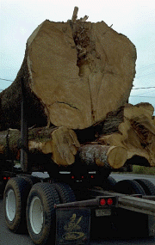
Change Management
Issues log
  Simple rule –>
  When an issue comes up,
  Just Log It
  Single source for the project

Slide 50
Change Management
Structure of an issue:
Issue
  Action Item
  Action Item
  Action Item
Issues can spawn multiple action items to get them resolved
Do you keep a separate log of Action Items?

Slide 51
Change Management
Examples of Log Data:
Issue id
Title
Author
Date discovered
Description
Priority
Severity
Complexity
Type of issue
Person assigned to issue
Date person was assigned
Description of resolution
Person who resolved issue
Date resolved

Slide 52

Change Management
Managing Issues
A database tool would be ideal
Use Excel until it’s implemented

Slide 53
Change Management
Issues Severity:
  Green - annoyance, cosmetic
  Yellow - will become very painful (red) if not attended to eventually
  Red - show-stopper
From perspective of:
  Project Sponsor
  Project Director
  Project Manager
  Other Stakeholders

Slide 54

Change Management
Issues Audit Trail
  Entering the resolution information in the Issues Log provides a valuable audit trail, no matter how winding the path may be

Slide 55
Change Management
What is change management?
  A set of FORMAL procedures that provide for the ORDERLY management of change in a dynamic environment
  It is not a plan to prohibit or inhibit change

Slide 56
Change Management
Examples of Change:
  Added function
  Incorrect assumption
  Imposed delays
  New standards / ways
  Environment alterations
  Extended approval times
  Etc.

Slide 57
Change Management
Issues Log
  Worth doing
  Steering Committee and Project Directors are interested in it
  Not hallway conversation topic

Slide 58
Change Management - Process
Request
Submitted
Estimate
To Assess
Impact
Proposed
To Project
Manager
Approved?
Feedback
To
Requestor
No
Yes
Assess
Impact
Estimate
To
Implement
Proposed
To Project
Manager
Approved?
Feedback
To
Requestor
No
Yes
Large?
Yes
Escalate
to Project
Director
Etc.
Implement
Change
Feedback
To
Requestor
No

Slide 59
Change Management
Change Management Plan
  States who is going to do what, when, where and how
  Provides basis for work that follows product development
    Know what you did
Lays the groundwork for:
Integrity, Repeatability, Traceability

Slide 60
Change Management
Change Management Plan Contents
  Introduction
    Describes the plan’s purpose, scope of application, key terms and references; e.g., it lays the foundation for what’s to come. Sets expectations, etc.
  Organization
    Participants and responsibilities

Slide 61
Change Management
Change Management Plan Contents cont.
  Change Management Process
    Process diagram
    Describe process steps
  Change Management Tool
    Describe software tool(s) to be used, it any
  Checklists and templates as needed
    Change Request Form
    Etc.

Slide 62
A. Introduction to Project Management
D. Progress Reporting

Slide 63
Progress Reporting
Linkage between Tracking and Status Reporting
Collecting Tracking Data
Status Reporting

Slide 64
Progress Reporting
How does a project get to be a year late?
One day at a time.
- Fred Brooks

Slide 65
Progress Reporting
Tracking
  Collecting Data
  State of Deliverables, Time, Cost
  Analyzing Data
Status Reporting
  Telling Stakeholders results of Analysis
  Proposing Options to Improve Project
    (aka Corrective Action)

Slide 66
Collecting Project Status Data
Progress Reporting
What
When
Why
Where and How
Who

Slide 67
Progress Reporting
State of Deliverables
  Progress
  Issues
Time
  Resource Hours Spent
  Estimate to Complete*
Cost
  Spent via Purchase
  Spent via Resource Time
What

Slide 68
Progress Reporting
Weekly
Ever need it more frequently?
  Maybe; near phase-end or near Go Live
When

Slide 69
Progress Reporting
With deliverables < 25 hours
  You know your status every week
Why

Slide 70
Progress Reporting
Where
&
How
Written status report
Weekly status meeting
If needed, daily face time

Slide 71
Progress Reporting
Project Manager
Project Administrator
Who

Slide 72
Progress Reporting
Project Administrator:
Communications focal point for project so specialists can stay tuned in to their work
Provides consistent and efficient administration of the project
    Minute-taking and producing reports
    Updating and displaying project schedules
    Building productive working relationships
    Liaising with clients and Project Manager

Slide 73
Progress Reporting
Data Collection Challenges:
Submitting time data to project management software can be time-consuming
Working on multiple projects
    Clients
    DBA’s, etc.

Slide 74
Collect Black & White Deliverable Status with 3 Factoids:
Progress Reporting
Weekly Status Report
Deliverable Assignment
Sheet
Deliverable Status Done? Y N
Estimate to Complete ____________
Expected Date of Completion _______
Completion Criteria
______________
?? % Complete ??

Slide 75
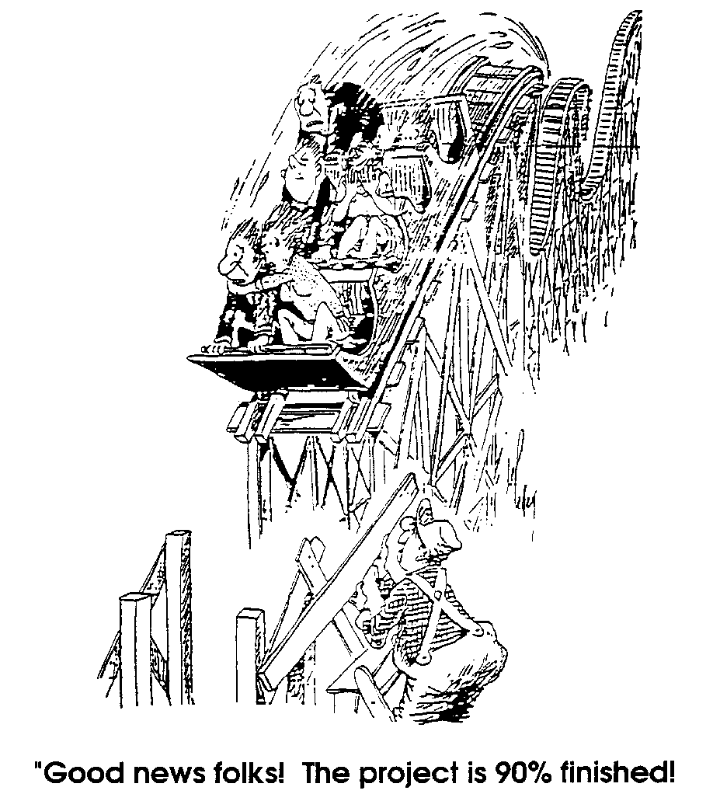
Effective
Progress
Tracking
Progress Reporting
Notes:
Have you ever noticed how quickly a project gets to be 90% complete and how long that final 10% seems to take?? So often, we base project progress on the passage of time rather than the completion of project deliverables.
Progress is based on the completion of project products or deliverables, not by the usage of time spent on the project.
A detailed plan enables us to schedule exactly who will be producing a project deliverable and when.
What is needed is a control which will track progress by completion of deliverable.

Slide 76
Progress Reporting
Everyone Wants Status – Just Different Information
Program Sponsor
Important Stakeholders
Enterprise Computing
Program
CIO
Peripheral Stakeholders
Integrated Project
Management Office
ECSC
Program Coordinator
Project Director
Project Sponsor
Project Steering
Committee
Project Team
Project Manager
Internal Audit
IT Technical
Specialists
End User
Business
Specialists

Slide 77
Progress Reporting
Project Assumptions:
  Everyone wants success
  Everyone wants to know what they can do
  Everyone wants to know quickly
  Executives want to solve problems
    and they will drill down to get details when they need them…

Slide 78
Status Reporting:
Progress Reporting
Many projects throughout LBNL
We all want to know, AT A GLANCE, what the status is
We want MBE (Management By Exception)

Slide 79
Overall Project Status at LBNL
Progress Reporting
Green
Yellow
Red
Three characteristics
  State of Deliverables
  Time
  Cost

Slide 80
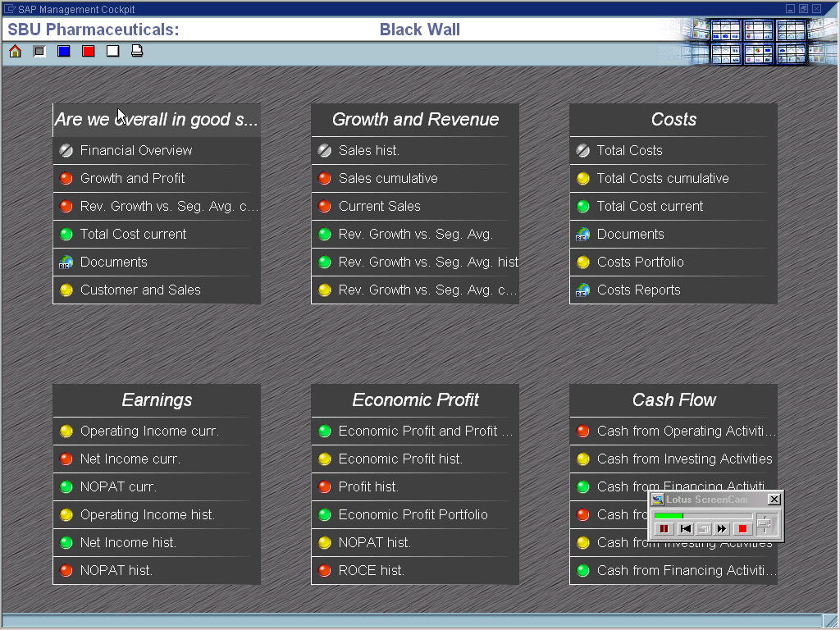
Progress Reporting - Example

Slide 81
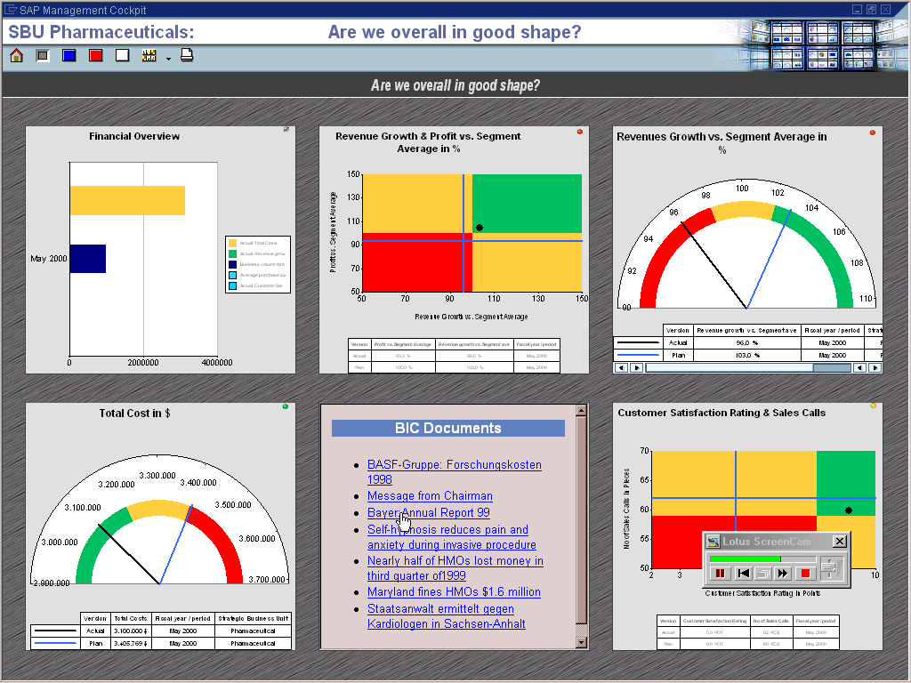
Progress Reporting - Example

Slide 82
Analyzing collected data to report status
Progress Reporting
State of Deliverables
Time
Cost

Slide 83
What does PMI* recommend you track?
Progress Reporting
Quality
Scope
Risks
Schedules
Costs
Procurement
Using
  Variance Analysis
  Trend Analysis
  Earned Value Analysis
* Project Management Institute (PMI)

Slide 84
Analyzing collected data – Map to PMI
Progress Reporting
State of Deliverables
  Progress
  Issues
Time
  Resource Hours Spent
  Estimate to Complete*
Cost
  Spent via Purchase
  Spent via Resource Time
Quality
Scope
Risks
Schedules
Costs
Procurement

Slide 85
Analyzing data for State of Deliverables:
Progress Reporting
Progress
    Green - Done and accepted
    -or-
    Green - On track
    Yellow - Might miss
    Red - Will miss
Drilldowns
    Change controls - Scope
    Issues - State of Deliverables
    Schedule - Time

Slide 86
Analyzing data for State of Deliverables:
Progress Reporting
Issues
    Number of Red
    Number of Yellow
    Number of Green
Drilldowns
  Trend Analysis = Will they be finished on time?

Slide 87
Progress Reporting
Analyzing data for Time:
Resource hours spent
    Green - on target
    Yellow - % high or low
    Red - % high or low
Drilldowns
  Variance Analysis
  Trended Analysis
Beware the simplistic % complete trap from project management software.

Slide 88
Deliverable Starts vs. Completes
Progress Reporting
No. of Deliverables
Start
Today
Planned End
Planned Starts
Example of how trend analysis might look
Actual Starts
Planned Finishes
Actual Finishes

Slide 89
Progress Reporting
Analyzing data for Time:
Estimate to complete
    Green - on target
    Yellow - in trouble
    Red - not a chance
Drilldowns
  Variance Analysis
  Trended Analysis
Not from project management software – from status reports

Slide 90
Progress Reporting
Analyzing data for Cost:
Spent via purchase / resource time
    Green - on budget
    Yellow - % over/under budget
    Red - % over/under budget
Drilldowns
  Variance Analysis
  Trended Analysis

Slide 91
A. Introduction to Project Management
E. Reviews – Product and Project

Slide 92
Reviews – Product and Project
Is the product OK?
Is the project OK?
Quality Assessment
Project Reviews
Project Retrospective
Design Review
Internal Audit
Test Review
ISS Project Review

Slide 93
Reviews – Product
Candidates for Review
Build
Implement
Support &
Maintain
Identify
&
Assess
Plan
Analyze/design
Project Request
Project Charter
Project Plan
Communication Plan
Risk Management Plan
Change Management Plan
Issues Log
Essential Data Model
Essential Process Model
Essential State Change Model
Data Dictionary
Design Specifications
Data Storage Schema
Prototype
Test Plans
Service Level Agreements
Code
All Test Results
Go Live Plan
Go live Client Acceptance Sign-Off
Training Materials
User Procedures
System Document-ation
Support Model
Project Lessons Learned

Slide 94
Quality Assessment:
Reviews – Product
Rigorous Reviews
  Essence models
  Design specs
  Prototype & corresponding documentation
Test Reviews
  Approach
  Completeness
  Issues raised and resolutions

Slide 95
Reviews – Project
Quantitative?
  Usually covered by status reports
Qualitative
  Usually Checklist-based
  Other items to review:
    Perceptions
    Acceptance
    Cooperation
    Choices

Slide 96
Project Retrospectives:
Reviews – Project
After the dust settles:
  Re-create the history of the project
      Use artifacts to reconstruct the experience
      Use stories to reconstruct the feelings
  Acknowledge
      What we did that really worked
      What we might do differently next time
  Learn
      Lessons Learned become part of organization’s revised Best Practices

Slide 97
A. Introduction to Project Management
F. Risk Assessment and Management

Slide 98
Risk Assessment and Management
Risk Factors
Risk Assessment
Risk Management

Slide 99
Risk Assessment and Management
Risk “implies a voluntary taking of doubtful or adverse chances”; “exposure to loss, disadvantage or destruction”
- Webster’s International Dictionary Unabridged
Risk is about the possibility of failure……

Slide 100
Risk Assessment and Management
Risk Factors:
Project size
Number of physical sites
Lack of team dedication
Stringent quality vector
Schedule rigidity
Lack of sponsor commitment/support
System effect on business operations
Size/diversity of user community
Incomplete communication
Expectations are not realistic

Slide 101
Risk Assessment and Management
Risk Factors:
Dependency on other systems
Lack of team’s control of critical elements
Hardware/software complexity, availability, integration
Experience level of all participants
Lack of dedication of funding
Constrained project work locations
Misperceptions/hidden agendas
Lack of availability of decision makers
Duration
Lack of participant commitment

Slide 102
Risk Assessment and Management
Risk assessment is the active investigation of the risk factors to predict:
    Likelihood of causing difficulty
    Severity of that difficulty
If likelihood/severity are high:
    Mitigation Planning offers a reduction of likely failure and/or a way to reduce the detrimental effects

Slide 103
Risk Assessment and Management
Processes required to systematically identify, analyze, and respond to project risks:
      Risk Management Planning
      Risk Identification
      Qualitative Risk Analysis
      Quantitative Risk Analysis
      Risk Response Planning
      Risk Monitoring & Control

Slide 104
Risk Assessment and Management
Risk Management Protocol:
  Reactively – managing surprises, “putting out fires”
  Proactively – risk avoidance, “buy off” risk
Assessing failure factors
Creating mitigation plans
Securing agreement to proceed anyway
– or –
Pulling the plug prudently

Slide 105
A. Introduction to Project Management
G. Communication

Slide 106
Communication
Effective Listening
Congruence
Empathy
Agreements

Slide 107
Communication
Skills for Effective Listening:
Use attentive body language
Use thinking speed constructively
Maintain silence / observe
Avoid prejudice
Avoid jumping to conclusions
Be an active listener
Additional listening skills

Slide 108
Communication
Congruence is an important factor
Two perspectives:
  Internally
    When feelings, thoughts and words are all on the same wavelength
  Externally
    When interacting with others, keeping a balance among these:
SELF
OTHER
CONTEXT
- From Virginia Satir

Slide 109
Communication
At the heart of congruence is self-esteem.
SELF
OTHER
SELF
ESTEEM
CONTEXT

Slide 110
Communication
Types of Incongruence:
XXXXX
BLAMING
“I am everything; you are nothing”.
  Criticize
  Boast
  …. who needs friends anyway…
SELF
OTHER
SELF
ESTEEM
CONTEXT
PLACATING
“You are everything; I am nothing”.
  Apologize
  Grovel
  …. who deserves friends anyway…
SELF
OTHER
XXXX
SELF
ESTEEM
CONTEXT

Slide 111
Communication
Types of Incongruence:
XXXX
XXXXX
SUPER-REASONABLE
“It is everything; you and I are nothing”.
  Explain
  Ignore practicality
  …. friends aren’t important anyway…
SELF
OTHER
SELF
ESTEEM
CONTEXT
IRRELEVANT
“Nothing counts for anything”.
  Chatter; squirm
  Interrupt
  …. huh? …
XXXXX
SELF
OTHER
XXXX
SELF
ESTEEM
CONTEXT
XXXXXXX

Slide 112
Communication
Types of Incongruence:
LOVER-HATER:
“It is nothing; you and I are everything”.
  Match movements
  Speak only to other
  Anticipate the other
  …. who else matters? .…
SELF
OTHER
SELF
ESTEEM
CONTEXT
XXXXXXX

Slide 113
Communication
Congruence:
  Every interchange is a creative effort
  Freedom
  Personal responsibility
  Sharing
  Clarity
  Realism
SELF
OTHER
SELF
ESTEEM
CONTEXT

Slide 114
Communication
Empathy
“A respectful understanding of what others are experiencing.”
- Marshall Rosenberg
Advice and reassurance are different from empathy
First we need empathy for ourselves
Then, we hear the other from their perspective
Perhaps use paraphrasing to clarify what you hear
Intellectual understanding blocks empathy

Slide 115
Communication
Empathy
Messages that intimidate us are from individuals with needs unmet (appealing to us to contribute to their well being)
  empathy allows us to hear those needs
We can then choose whether to respond to requests that stem from those needs
  after we listen fully
Always be willing to ask a third party to help if things get stuck

Slide 116
Communication
Agreements
When agreements occur that affect:
  plans for the project
  models/specifications for the project
  roles/responsibilities
Make sure they are captured in writing, and
Forwarded to appropriate stakeholders

Slide 117
A. Introduction to Project Management
H. Problem Management

Slide 118
Problem Management
Perception
Problem Arenas
Problem Resolution

Slide 119
Problem Management
Our typical response
Try to change the things we perceive
(sometimes we can change the things we desire)

Slide 120
Problem Management
A way to look at problems:
PROBLEM
YOU
Things as Desired
(The Plan)
Things as Perceived
(The Work)

Slide 121
Problem Management
“Management by exception”
is a problem-centric style of communication
Early bad news is far more preferable than delayed bad news
Make exception reports part of ongoing status reporting

Slide 122
Problem Management
In Times of Trouble . . .
Ideally, problems should be discovered by the person responsible for the system or sub-system
Sometimes the person responsible may be scared to bring up the problem and is trying desperately to solve it without involving upper management
    Upper management must ensure that information is passed up the chain of command without fear of reprisals

Slide 123
Problem Management
In Times of Trouble . . .
Sometimes, the person responsible is too close to the day-to-day problems and is unaware of the magnitude of the problem
    Upper level management needs to keep informed of the work proceeding at lower levels in the project organization
    Integrated performance measurements provide a neutral way of evaluating progress
“Trust, but verify”

Slide 124
Problem Management
Problem Categories:
Catastrophic event
    Easy to diagnose and organize a response
    Every manager recognizes the need for resources to be applied to the deliverable which is in trouble
Project Manager warns of problems meeting the cost, schedule or performance goals
    Project Director needs to confirm
      If confirmed, a response is required
      If not confirmed, Project Manager needs reassurances about resources

Slide 125
Problem Management
Problem Categories:
Project Director suspects problems with deliverable in his area or performance metrics indicate that there are problems
    Project Manager needs to confirm
      If confirmed, a response is required
      If not confirmed, Project Director needs reassurances about the deliverable

Slide 126
Problem Management
Corrective Action:
When problems are identified ACTION MUST BE TAKEN
    Delays will only make matters worse
Actions may include
    Revising the schedule
      Accept the delay as inevitable
    Re-allocating resources
      Work smarter toward the same goals
    Revising overall project objectives and/or performance criteria
      Work at same rate towards reduced goals

Slide 127
Problem Management
Corrective Action:
First consideration should be given to corrective actions which:
    Are simple
    Will have the smallest impact on overall project progress
Only if all such actions prove to be inadequate should more serious steps be considered

Slide 128
Problem Management
Corrective Action:
When corrective actions are necessary:
    The impact of such actions on all aspects of the project should be carefully assessed
    Project plans should be revised to reflect the impact of any major changes on overall performance specifications, schedules and resource requirements
    All audiences who will be affected by the changes should receive written copies of the revisions

Slide 129
Problem Management
Corrective Action:
Special attention should be directed towards monitoring the corrective actions taken to ensure that they do, in fact, successfully resolve the problem(s) identified

Slide 130
Problem Management
Making Changes to an Approved Plan:
If changes to the approved plan become necessary during the course of the project, be sure to:
    Thoroughly assess the impact of such changes on all aspects of the project
    Make such changes in writing
    Obtain all necessary sign-offs and approvals of the revised plan
    Share the new plan or plan amendments with all audiences, being sure to emphasize how the changes will affect them

Slide 131
Problem Management
Making Changes to an Approved Plan:
Do not ignore funding agencies, government officials
    They will normally be nervous of changes they do not understand
    External review committees can help make changes more acceptable

Slide 132
Problem Management
Changing the Schedule
Evaluate the deliverable in trouble:
  Is the deliverable on the critical path?
  Can more resources be applied to the deliverable?
    Look at resource loading graphs
  Can the deliverable be delayed?
  If the deliverable is delayed, does this affect resource allocation?
    Look at resource loading graphs

Slide 133
Problem Management
Changing the Schedule
Evaluate each deliverable following the deliverable in trouble:
  Is the deliverable on the critical path?
  Can more resources be applied to the deliverable?
    Look at resource loading graphs
  Can the deliverable be delayed?
  If the deliverable is delayed, does this affect resource allocation?
    Look at resource loading graphs

Slide 134
Problem Management
Changing the Schedule
If resource loading is a problem:
  Can additional people be found?
    Temporary/transfer work
  Can additional equipment, material, facilities be found?

Slide 135
Problem Management
Re-allocating Resources:
In general, changing the schedule changes the resources
  Presumably, the resource loading was already optimized
The general philosophy of most projects is to try and limit the schedule changes to the fewest number of deliverables
  Focus more resources on the deliverable in trouble
  Try and add resources that are not already committed to other deliverables
  If deliverable is being performed in the Lab, assign part of deliverable to a vendor
  If deliverable is being performed by a vendor, assign part of deliverable to the Lab

Slide 136
Problem Management
Re-allocating Resources:
  If deliverable is being performed by a vendor, assign part of the deliverable to another vendor
    This is the reason why deliverables with a high risk factor are often split initially between two vendors to maximize the options later
The original contracts must be carefully written with measurable performance goals and non-performance clauses

Slide 137
Problem Management
Changing the Work Breakdown Structure:
Evaluate the deliverable in trouble and the deliverables following it to modify the way in which the work is broken down
  Use “brainstorming” with a small group of knowledgeable people to come up with as many alternate ideas as possible
    One of them may save you
  Transfer work from oversubscribed resources and assign it to free (or less occupied) resources
  Re-examine political limitations
  Modify strategy to concentrate on less risky approach
If there are already delays in the deliverable, do not add more risk.

Slide 138
Problem Management
Revising Performance Objectives:
Examining Internal Objectives
Evaluate the deliverable in trouble and the deliverables following it to see whether any of the performance objectives can be reduced
First, examine whether the performance goals of the Project Manager are the same as the project performance objectives
  It is natural for Project Managers to want to do the best possible job

Slide 139
Problem Management
Revising Performance Objectives:
Examining Internal Objectives cont.
  No manager wants their deliverable to limit the performance of the project
  Some of the “internal” performance objectives of the deliverable will be tighter than those strictly required for the project as a whole
  Most senior managers know that this is a common practice
    Aiming high is how a good manager guarantees that the required performance is reached
  In times of crisis, this “comfort factor” may be removed in the interest of the project as a whole
  This decision can be made at the level of the Project Manager’s supervisor (next level up)

Slide 140
Problem Management
Revising Performance Objectives:
Revising Project Performance Objectives
Finally, it may be necessary to revise the project performance objectives
  Can only be initiated at the level of the Project Manager
The technical contingency should be addressed first
  Can problems be resolved by removing one or more of the technical contingencies from the project scope?

Slide 141
Problem Management
Revising Performance Objectives:
Revising Project Performance Objectives cont.
  Is this option more acceptable to the funding agency, government officials and future users than other alternatives?
    It is always better to propose options, rather than an all-or-nothing proposal when negotiating
    You can be sure that if you do not provide alternative solutions, someone else will (and you will look bad)
As a last resort, a change of the project cost, schedule and/or performance objectives should be proposed – REBASELINE

Slide 142
Problem Management
Rebaseline:
Occasionally in the project cycle, it will be necessary to re-evaluate the entire state of the project and re-establish:
  Modified project goals and performance criteria
  Total project costs
  Annual project costs
  The top-level project schedule
Every effort should be made to include all known variances in the new plan

Slide 143
Problem Management
Rebaseline:
Issues Log
You will lose the confidence of the funding agency if:
  Rebaselines occur frequently
  Additional changes in the project plan occur soon after the rebaseline
    Why were they not included?
    How can you be sure that there aren’t other changes?

Slide 144
Problem Management
Response to Technical Problems:
All of the previous discussions focused primarily on cost and schedule problems
Some new projects, by their very nature, push the envelope of what is possible
  Technical difficulties are almost guaranteed
  These can only be solved by people with technical expertise
  This is why specialists are taught management, rather than having professional managers run the project

Slide 145
Problem Management
Response to Technical Problems:
There are three categories of technical problems
  Solving many small difficulties takes more time than foreseen
    This has already been discussed
  A major problem comes up
  The person or vendor responsible is unable to meet the performance specifications

Slide 146
Problem Management
Problem Arenas:
Local
  Known to a few
  State of deliverables/cost/schedule
  Local remedies
System wide
  Known to many
  Sometimes blurred by symptoms
  Often involves rework
Cataclysmic
  Everyone knows
  Everyone pitches in
  Might benefit from contingency planning

Slide 147
Problem Management
Three Step Problem Solution Protocol:
Discovery
  Is / is not
  Severity / urgency / generality
Solution Ideas
  Good fit?
  Effectiveness?
Potential problem forecast
  Adherence?
  New problems?

Slide 148
Problem Management
Upper management will continue to be
informed to the same degree they
demonstrate trust.

Slide 149
Problem Management
Problem Resolution:
Better sooner than later
Options
  Revise schedule
  Change resources
  Modify the Charter
  Sacrifice quality
Negotiate choices
  Or escalate…. or impose….

Slide 150
Problem Management
Problem Resolution:
Smallest nearest fix
  Keep risk levels in mind
Let everyone know about the change
  In writing
Monitor resolution for effectiveness
When all else fails, start over

Slide 151
A. Introduction to Project Management
I. Recommended Reading

Slide 152
Recommended Reading
Project Retrospectives: A Handbook for Team Reviews by Norman L. Kerth
Controlling Software Projects: Management, Measurement, and Estimates by Tom Demarco, Barry W. Boehm
Peopleware : Productive Projects and Teams, 2nd Ed. by Tom Demarco, Timothy Lister
The Politics of Projects by Robert Block
The Deadline: A Novel About Project Management by Tom Demarco
People and Project Management by Rob Thomsett
Becoming a Technical Leader: An Organic Problem-Solving Approach by Gerald M. Weinberg
Are Your Lights On?: How to Figure Out What the Problem Really Is by Donald C. Gause, Gerald M. Weinberg
Teaching the Elephant to Dance: The Manager's Guide to Empowering Change by James A. Belasco
A Whack on the Side of the Head: How You Can Be More Creative by Roger Von Oech

Slide 153
Recommended Reading
Quality Software Management, Vol. 1: Systems Thinking by Gerald M. Weinberg
Quality Software Management, Vol. 2: First-Order Measurement by Gerald M. Weinberg
Quality Software Management, Vol. 3: Congruent Action by Gerald M. Weinberg
Quality Software Management, Vol. 4: Anticipating Change by Gerald M. Weinberg
New Peoplemaking by Virginia M. Satir
Nonviolent Communication : A Language of Compassion by Marshall B. Rosenberg
Masterful Coaching by Robert Hargrove
Practical Project Management : Restoring Quality to DP Projects and Systems by Meilir Page-Jones, Rob Thomsett
Handbook of Walkthroughs, Inspections, and Technical Reviews: Evaluating Programs, Projects, and Products by Daniel P. Freedman, Gerald M. Weinberg

