Slide 1


The Explorer AO and
Selection Process
Explorer Workshop
March 12, 2002
Washington, DC
Paul Hertz
Explorer Program Scientist
Office of Space Science

Slide 2
MIDEX 2001 AO Evaluation Flow
AO
Released
Preproposal
Briefing
@ U. Md.
Receipt of
Notices of
Intent
Receipt of
Proposals
Compliance
Check of
Proposals
7/16/01
8/10/01
8/17/01
10/30/01
Nov 2001
TMC
Kickoff
@ LaRC
TMC
Evaluation
TMC Panel
@ LaRC
Nov 2001
Nov 2001 – Jan 2002
Jan 2002
Early Mar 2002
Late Mar 2002
Science Merit
& Feasibility
Evaluation
Science Panel
@ Washington
MIDEX
Categorization
Committee @ HQ
Space Science
Steering Committee
@ HQ
Jan 2002
Feb 2002
Program Requirements
Schedule, Budget &
Cost Considerations
April 2002 (Target)
Selection by Associate
Administrator
Selection
Announcement
and Debriefings
Notify
Administrator
TBD
TBD
11/18/01 Public Version

Slide 3
Creating the AO
Using preliminary MIDEX 2001 schedule as an example
Milestone Date Months
Explorer Team Meeting Discussion 28-Sep-00 -9.25
Initial Draft to HQ 19-Dec-00 -6.50
Release Draft AO for community review 21-Feb-01 -4.25
Release AO 01-Jul-01 0.00
Proposals due 29-Sep-01 3.00
Target Date for Selection for Phase A 19-Jan-02 6.75
Target Date for Selection for Flight 17-Sep-02 14.75
First Launch 16-Sep-06 63.50

Slide 4
Creating the AO
Milestone Date Months
Explorer Team Meeting Discussion 28-Sep-00 -9.25
Resolve Key Issues with OSS Senior Management 01-Nov-00 -8.00
Initial Draft to HQ 19-Dec-00 -6.50
Deadline for HQ comments 09-Jan-01 -5.75
Community Draft version to HQ 30-Jan-01 -5.00
Release Draft AO for community review 21-Feb-01 -4.25
Community comments due 23-Mar-01 -3.25
AO to HQ for Approval 13-Apr-01 -2.75
AO approved by AA/OSS 08-Jun-01 -0.75
Release AO 01-Jul-01 0.00
Preproposal Briefing 15-Jul-01 0.50
Notice of Intent due 31-Jul-01 1.00
Proposals due 29-Sep-01 3.00
Non-U.S. Letters of Endorsement due 29-Oct-01 4.00

Slide 5
Creating the AO
Milestone Date Months
Proposals due 29-Sep-01 3.00
Non-U.S. Letters of Endorsement due 29-Oct-01 4.00
TMCO Review 10-Nov-01 4.50
Science Review 28-Nov-01 5.00
Categorization 19-Dec-01 5.75
Steering 09-Jan-02 6.50
Target Date for Selection for Phase A 19-Jan-02 6.75
Phase A Kickoff 18-Feb-02 7.75
Concept Study Report due 18-Jun-02 11.75
TMCO Review 30-Jul-02 13.25
Site Visits Complete 20-Aug-02 13.75
TMCO Review 03-Sep-02 14.25
Target Date for Selection for Flight 17-Sep-02 14.75
First Launch 16-Sep-06 63.50

Slide 6
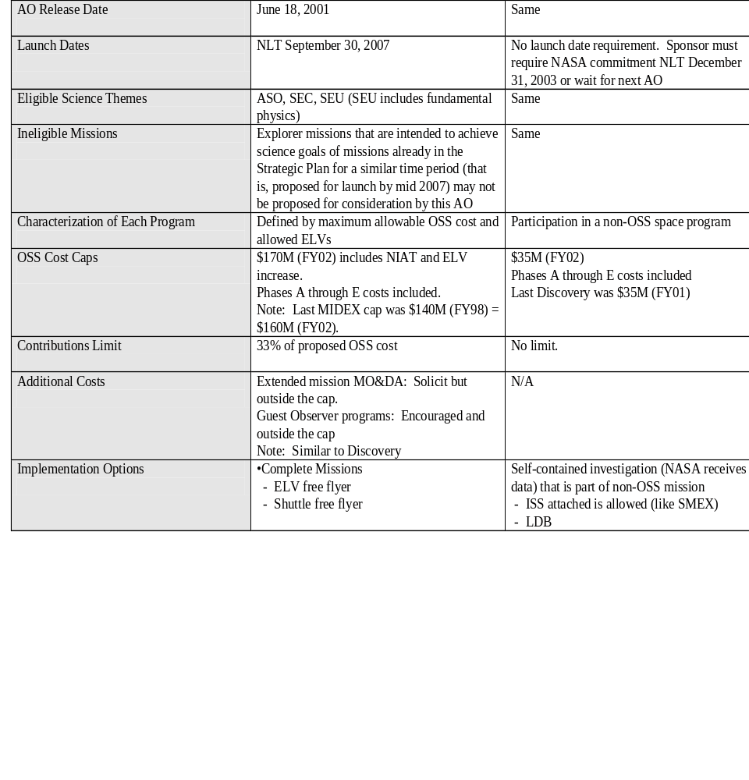
AO Requirements Matrix
Using preliminary MIDEX 2001 matrix as an example

Slide 7
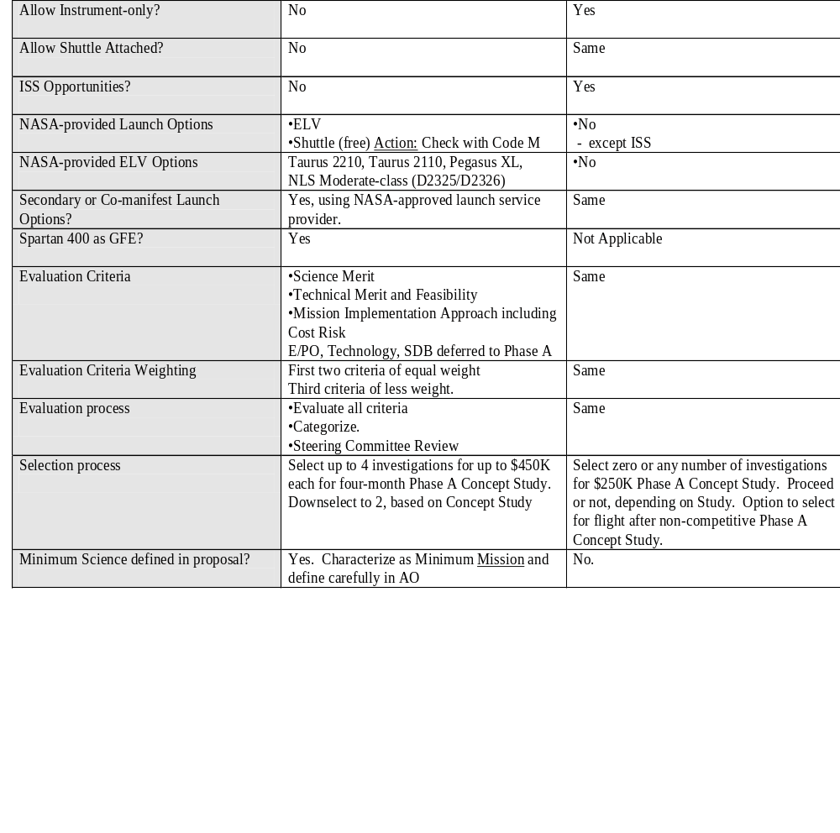
AO Requirements Matrix
Using preliminary MIDEX 2001 schedule as an example

Slide 8
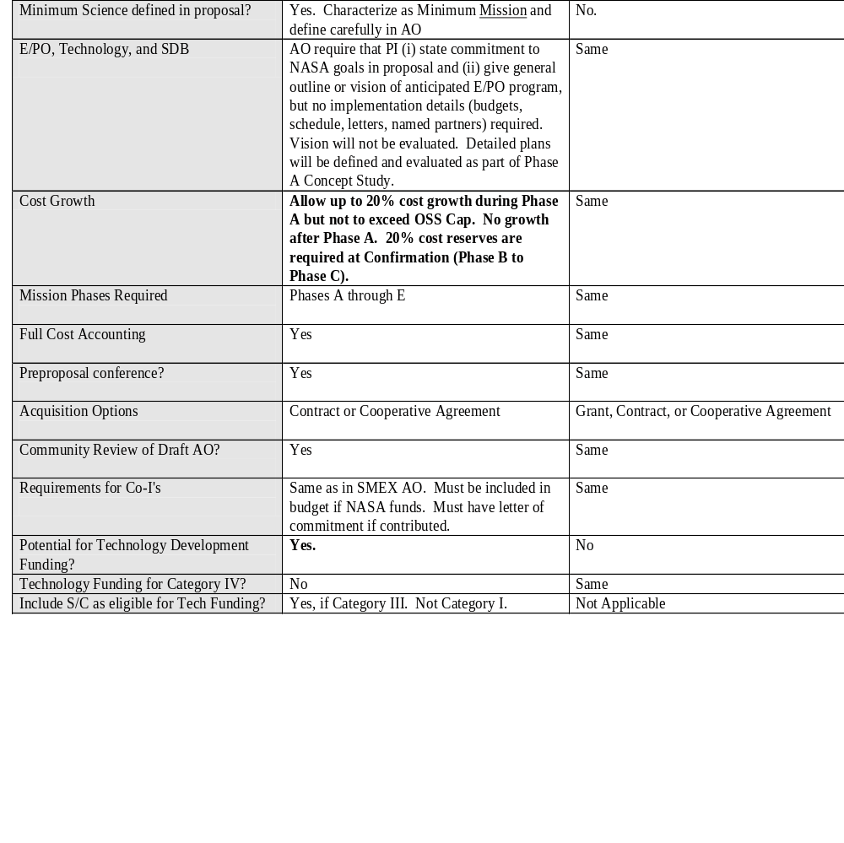
AO Requirements Matrix
Using preliminary MIDEX 2001 schedule as an example

Slide 9
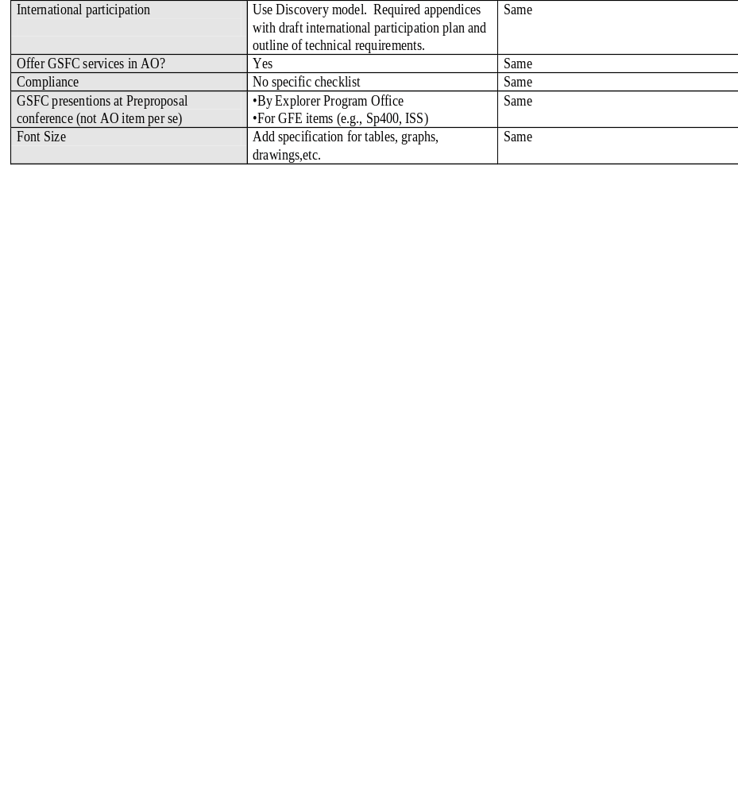
AO Requirements Matrix
Using preliminary MIDEX 2001 schedule as an example

Slide 10
Cost Cap vs. Launch Rate
Explorer development budget is ~$150M/yr
  Does not include MO&DA (~15%)
Budget must support
  MIDEX is ~$160M (excludes MO&DA)
  SMEX is ~$75M (excludes MO&DA)
  Program overhead (AO’s, concept studies, etc.) is ~$10M
So current budget supports 2 MIDEX and 2 SMEX every 3.4 years (an AO every 1.7 years)
  MO’s delay AO’s
Raise cost cap by 20%
  Reduces launch rate to 2 MIDEX and 2 SMEX every 4.0 years (an AO every 2.0 years)

Slide 11
Missions of Opportunity
Traditional
  OSS contribution to international or non-OSS mission
Small ISS Attached
Long Duration Balloons
Astrobiology Flight Experiments
  Indoor science
Data Buys
Other??

Slide 12
Other Constraints
Contributions limit
Science enhancement options
GSFC services
E/PO proposals
Evaluation criteria (deferred discussion)
Mission design requirements (deferred discussion)
Launch options (deferred discussion)
International partnering (deferred discussion)
Other??

Slide 13
MIDEX Downselect Schedule/Evaluation Flow
Selection by Associate Administrator &
Board of Directors @ HQ
Concept Study
Kickoff @ HQ
Receipt of
Concept Studies
6/18/99
Evaluation Kickoff
Meeting @ LaRC
TMCO Check of Concept Studies
6/29/99
Evaluate Science as Required
6/21-29/99
Evaluation Panel Plenary @ LaRC
Science Changed
Science Check of Concept Studies
6/29/99 - 9/2/99
7/19-23/99
Use Form A from Phase-1 Proposal Review
Science Unchanged
6/21-29/99
Final Evaluation Panel Plenary @ LaRC
Prepare HQ Briefing
Site Visits
8/1-20/99
8/30/99 - 9/2/99
9/3-9/99
Debriefings
Downselection(s) Announcement
TBD
TBD
Notify Administrator
PI Presentations to AA & Board @ HQ
Brief AA & Board @ HQ
Contract Options Initiation
TBD
Target: 9/14/99
Target: 9/10/99
TBD

Slide 14
MIDEX Downselect Site Visit Schedule
Evaluation Panel Plenary @ LaRC
Fax NGSS Questions @ 2 pm
FAX FAME
Questions @ 2 pm
Travel to SDL,
N. Logan, UT
NGSS
Site Visit
7/19 - 23/99
7/27/99
7/30/99
8/1/99
8/2/99
FAME Site Visit Evaluation
FAME
Site Visit
Travel to LMATC,
Palo Alto, CA
NGSS Site Visit
Evaluation
Fax Swift Questions @ 2 pm
8/5/99
8/4/99
8/3/99
Travel Home
Swift Site Visit Evaluation
8/6/99
Travel to GSFC,
Greenbelt, MD
Travel Home
Travel to APL,
Laurel, MD
Fax AMM Questions @ 2 pm
Swift
Site Visit
Fax ASCE Questions @ 2 pm
8/16/99
8/11/99
8/12/99
8/13//99
Final Eval Panel Plenary @ LaRC
ASCE Site Visit Evaluation
ASCE Site Visit
AMM Site Visit Evaluation
AMM
Site Visit
8/31/99 - 9/2/99
Travel home
8/19/99
Travel to SAO,
Cambridge, MA
8/17/99
8/20/99
8/18/99
1/13/99

Slide 15
Downselect Options
One Stage vs. Two Stage
  Competitive downselect or not
Format of site visit for downselect
  At team site, at NASA
Science evaluation
  Reevaluate or not
Science briefings to AA & Board
  PI presents to HQ or not

