Slide 1
Status of SUSY searches
Jean-François Grivaz
LAL – Orsay
Physics at LHC – Vienna 2004

Slide 2
What this talk will not be:
an introduction to SUSY (you are all experts)
a discussion of cosmological implications (my own inability)
a comprehensive review (half-an-hour)
What it will address:
the LEP legacy (no experimental details)
recent results from the Tevatron
In which framework ?
mostly “standard” SUSY, i.e.(C)MSSM / mSUGRA
some GMSB (clean and simple)
no RPV (too many equally acceptable scenarios, no DM)
[Apologies to our HERA colleagues]

Slide 3
Standard SUSY:
The MSSM with some unification conditions
R-parity conservation
Neutralino LSP
At LEP:
All sparticles democratically produced (not the gluino…)
Search for the next-to-lightest one(s) and express the results
in a model-independent (or moderately dependent) way
Combine the results within some constrained framework
At the Tevatron:
Colored sparticles (squarks and gluinos) have the largest
production cross sections, but backgrounds are also large
Electroweak gauginos have small cross sections,
but benefit from clean signatures (will win in the end…)
Hard to get away from highly constrained models

Slide 4
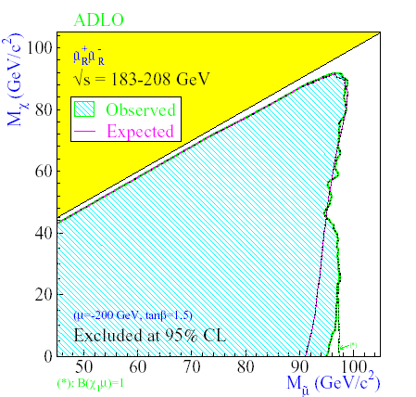
A simple case at LEP: smuons
Pair production only via s-channel γ/Z exchange
⇒ m_{sμ} = 1st parameter
Assume sμ_{R} is NLSP
(sμ_{L} is heavier in typical unified models,
and would have larger cross section)
Only decay mode: sμ_{R} → μχ
⇒ m_{χ} = 2nd parameter
Signature = acoplanar pair of muons
Well controlled background:WW → μνμν
With gaugino mass unification,
cascade decays (sμ_{R} → μχ’ with χ’→χγ) can be taken into account
Other sleptons are more model dependent:
Staus because of L-R mixing (Z-sτ₁-sτ₁ coupling may vanish)
Selectrons because of t-channel neutralino exchange

Slide 5
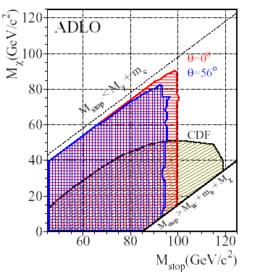
Another simple case at LEP: stops
Squarks are more efficiently searched
at the Tevatron but…
st₁ could be (very) light because of
renormalization and mixing effects
(both due to large topYukawa)
For st₁ NLSP, st₁ → cχ (loop decay)
Window for LEP at small/moderate
st₁ − χ mass difference
Search in acoplanar jet topology
Needed dedicated generator because of
competing decay and hadronization times
For very small mass differences, specific searches have been
performed for stop-hadrons with macroscopic decay lengths,
and for (quasi) stable stops

Slide 6
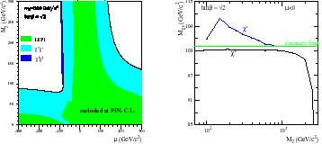
Charginos and neutralinos at LEP (I)
Chargino pair production (neutralino pair or associated production)
involves s-channel γ/Z exchange, which depends on the field content,
as well as t-channel sneutrino (selectron) exchange.
First assume heavy sleptons ⇒ s-channel only + decays to χW* (χ Z*)
Charginos are then fully described in terms of M₂, μ and tanβ
Neutralinos need M₁ in addition:
Assume unification (M₁~M₂/2)
Direct and indirect
mass limits
Search extended to very small χ⁺−χ mass differences
(ISR tagging, stable charged particles)
Applies to the deep higgsino region, or in AMSB models (M1~M2)

Slide 7
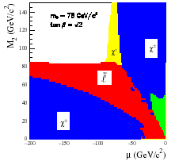
Charginos and neutralinos at LEP (II)
The impact of light sleptons:
Reduced chargino cross section (negative interference)
Enhanced neutralino production (positive interference)
Invisible decay modes: χ’ → ν sν_{L}
or χ⁺→l sν_{L} with small χ⁺− sν_{L}mass difference (the “corridor”)
⇒ Use slepton searches and
assume scalar mass unification
For m₀ and tanβ given, a slepton
mass limit gives a constraint on M₂
⇒ Robust chargino mass limit

Slide 8
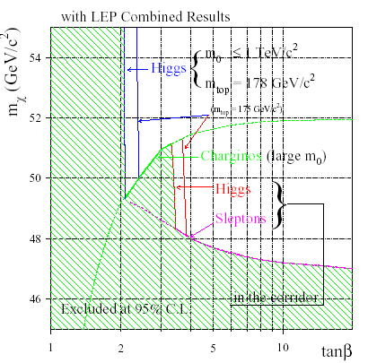
The LSP mass limit at LEP
There is no absolute neutralino-LSP mass limit from LEP
(e⁺e⁻→χχ vanishes for a pure photino and heavy selectrons)
Indirect limits have been
obtained under the assumption
of gaugino mass universality
For large slepton masses:
~ m_{χ+}/2 (52 GeV) at large tanβ,
somewhat lower otherwise
For low slepton masses, scalar
mass universality is also needed
(The limit is set in the “corridor”)
And finally Higgs searches are
used at low tan β…
The impact of stau mixing has recently been investigated: no loophole

Slide 9
On the LEP Higgs constraints
Assume scalar (sfermions only) and gaugino mass unifications
(m_{A} and μ remain free parameters, compared to mSUGRA)
m₀, tanβ and M₂ ⇒ masses of st_{L} and st_{R}
maximal impact of stop mixing + large m_{A} ⇒ m_{h-max}
for large m_{A}, h is SM-like ⇒ compare to SM-Higgs limit
This provides an upper limit on M₂, given m₀ and tanβ,
which is most constraining at low m₀ and low tanβ
However, configurations exist for m_{h} < SM-Higgs limit, which
are not excluded by SM-Higgs searches (e.g. h → bb vanishes)
Need to supplement SM-Higgs searches by other ones:
hA, H⁺H⁻, invisible, flavor independent + SUSY particles
Perform a parameter scan (with dichotomies as appropriate)
Result: the SM-Higgs limit is robust,
and hence was adequately used to set the LSP mass limit

Slide 10
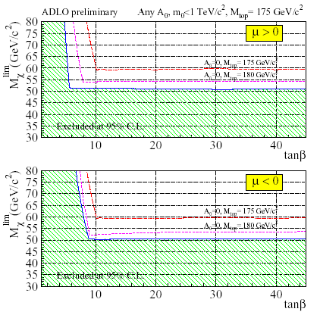
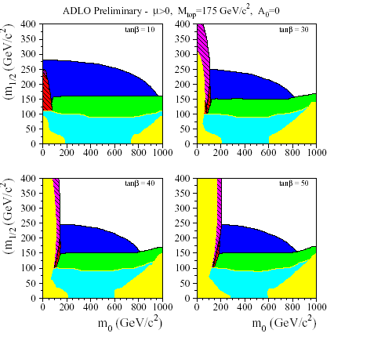
mSUGRA at LEP
Compared to the previous LSP-mass analysis,
m_{A} and μ are no longer free parameters,
A₀ controls all sfermion mixings
Excluded by…
theory
the Z width
chargino
Higgs
slepton
stable particle
… searches

Slide 11
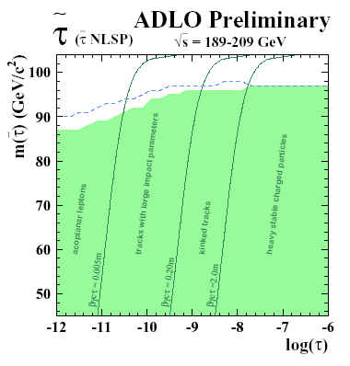
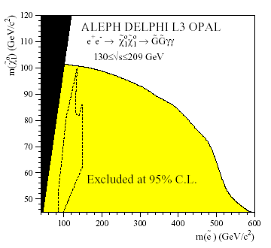
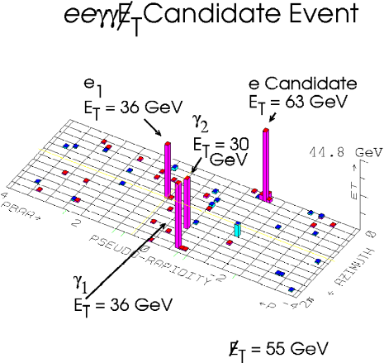
A bit of GMSB at LEP
In GMSB, the LSP is a (very light) gravitino G
The phenomenology depends mostly on the nature
(and lifetime) of the NLSP:
A slepton, preferably
a stau: sτ₁ → τ G
A neutralino: χ → γ G
CDF Run I
Interpretations within mGMSB are available

Slide 12
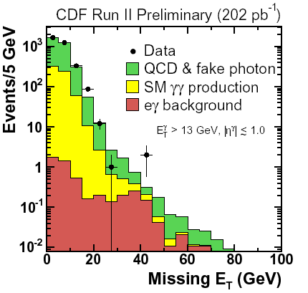
GMSB at the Tevatron (I)
Inclusive searches for γγ + Missing E_{T} by both CDF / DØ
Photon = electron without track
Photon ET > 13 / 20 GeV
Missing ET > 45 / 40 GeV
Mild topological cuts
Main backgrounds:
EM-jets (or real QCD photons)
+ fake Missing ET
electron + photon
+ real Missing ET
All determined from the data
CDF : 0 vs 0.6 expected
DØ : 1 vs 2.5 expected

Slide 13
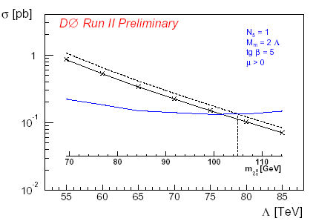
GMSB at the Tevatron (II)
Interpretation within mGMSB
with:
N = 1
M_{messenger} = 2Λ,
μ > 0,
tanβ = 15 (CDF)
or 5 (DØ, aka “Snowmass slope”)
Signal dominated by chargino-
neutralino production
World best limit:
m_{χ} > 105 GeV

Slide 14
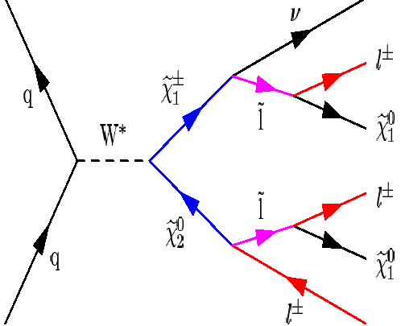
Trileptons at the Tevatron (I)
Arise from chargino-neutralino
associated production
Clean signature but:
- low cross sections (× BR)
- soft leptons
- taus (at large tanβ)
Needs large integrated luminosity
Combine various final states
(Also decays via W/Z exchange)
DØ analysis based on 145 − 175 pb⁻¹
Combines eel, eμl and same sign dimuon final states
Addresses “just beyond LEP” mSUGRA

Slide 15
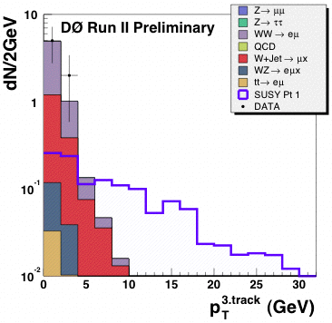
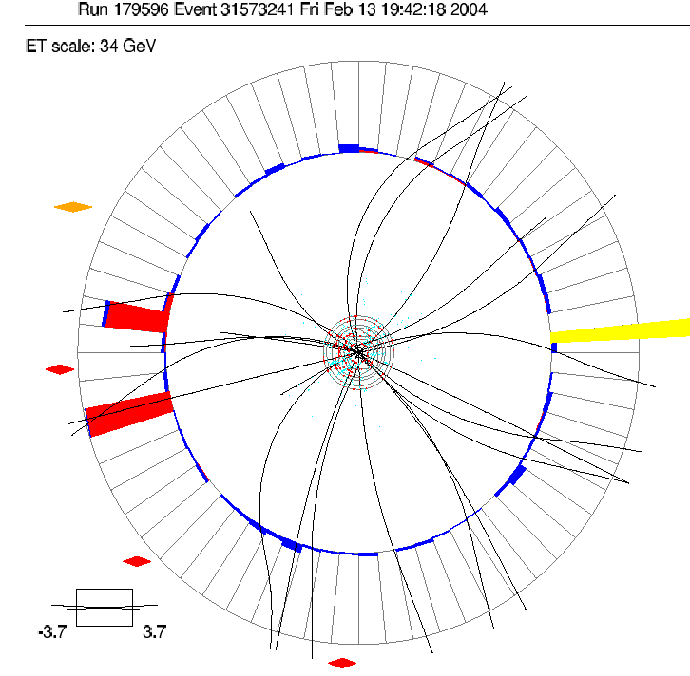
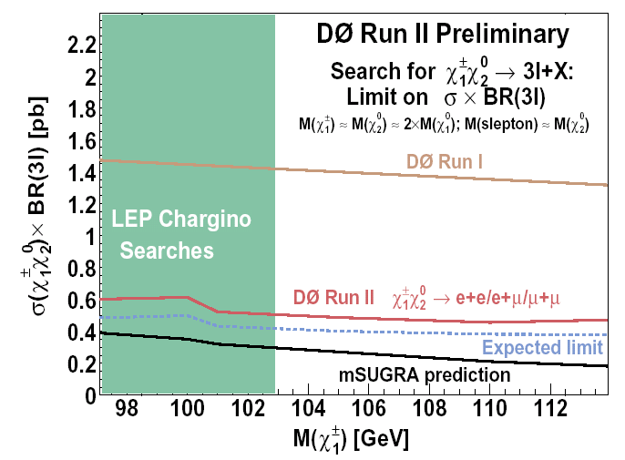
Trileptons at the Tevatron (II)
Two isolated (rather soft) e or μ
Require some Missing E_{T}
+ channel-dependent cuts (e.g. anti Z)
Two same sign muons, or
An isolated third track (no e or μ ID)
Main backgrounds: WW, WZ, Wγ, a bit of bb
Altogether: 2 events observed vs 0.9 ± 0.5 expected
Substantial improvement
wrt Run I
Should soon probe virgin
mSUGRA territory

Slide 16
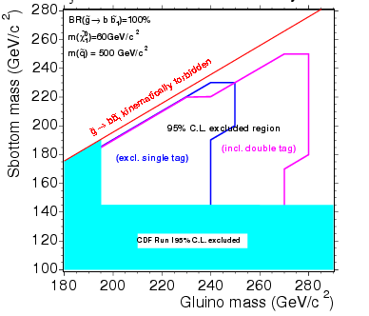
Stop and sbottom at the Tevatron
CDF has searched for charged massive particles in 53 pb⁻¹
appear as slow moving (TOF) high p_{T} muons
result interpreted for (meta)stable stop
⇒ m_{stop}>108 GeV (isolated) or 95 GeV (non-isolated)
CDF has searched for sbottoms
in gluino decays (156 pb⁻¹)
assumes sb₁ much lighter than
all other squarks (large tanβ)
gluino → sb₁ b
⇒ 4 b-jets + Missing E_{T}
for gluino pairs
the selection requires at least
one b-tag, no isolated lepton

Slide 17
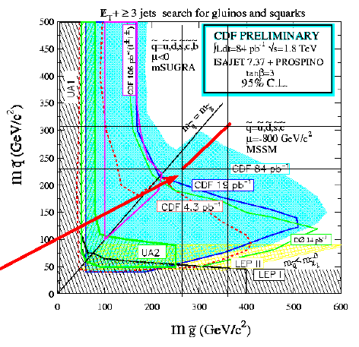
Generic squarks at the Tevatron (I)
Strong production of:
sq-sqbar
sq-sq
sq-gl
gl-gl
In 85pb⁻¹, DØ has searched
along the “minimum sq-mass
line” of mSUGRA:
very low m₀ (25 GeV),
(tanβ = 3, A₀ = 0, μ < 0),
scan over m_{1/2}
⇒ Mostly sq-sqbar with sq → q χ ⇒ Acoplanar jets + Missing E_{T}

Slide 18
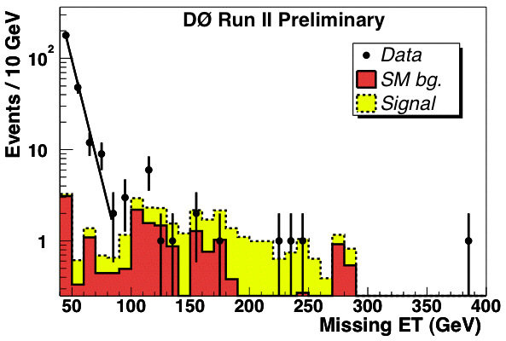
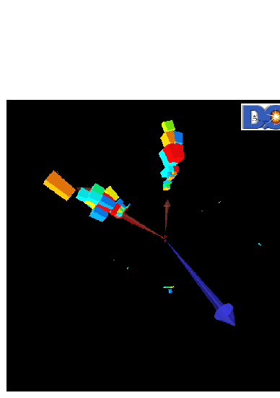
Generic squarks at the Tevatron (II)
Main selection cuts:
at least two high pT jets
isolated lepton veto
Missing ET should not be
along or opposite to a jet
Sum of jet p_{T} > 275 GeV
Missing E_{T} > 175 GeV
Main backgrounds left:
(Z → νν) + jets
(W→ τν) + jets
QCD negligible
4 events selected
vs
2.7 + 2.3 − 1.5
expected

Slide 19
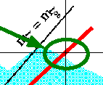
Generic squarks at the Tevatron (III)
Slight improvement over CDF-Run I
along that “minimum sq-mass line”:
(m_{sq} > 292 GeV and m_{gl} > 333 GeV)
How relevant are the Tevatron
results on squarks and gluinos ?
LEP slepton and chargino limits ⇒ much tighter constraints
on m₀ and m_{1/2} within mSUGRA (or even MSSM with unification)
The Tevatron should consider models with smaller M3/M2 ratios:
not unnatural in GUTs (e.g. M3/M2 ~ 1 if SUSY breaking by a 75)
or in string inspired models

Slide 20
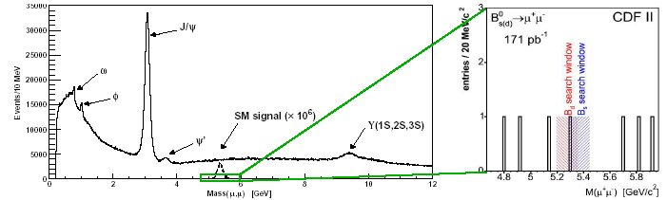
B_{s} → μμ at the Tevatron
In SM, tiny BR ~ 3.5 10⁻⁹ (and 25 times smaller for B_{d})
But in SUSY, a (tanβ)⁶ factor could lead to an enhancement
by as much as three orders of magnitude
Select dimuons originating from displaced vertices, and look inside a mass window:
CDF BR limit (95% CL): 7.5 10⁻⁷ (Previous best: CDF Run I < 2.6 10⁻⁶)
DØ: sensitivity study, but the box hasn’t yet been opened…
Close to getting relevant

Slide 21
Conclusions
As of today, the main constraints on (RPC-) SUSY
from accelerator searches remain those established by LEP:
Slepton and chargino masses > 100 GeV
But…
The Tevatron already entered new GMSB territory:
NLSP neutralino mass > 105 GeV
Trilepton searches should provide relevant results very soon
Squark and gluino searches are well underway
(awaiting adequate interpretation)
B_{s} → μμ is about to probe large tanβ SUSY
…and the Tevatron luminosity is steadily increasing…

