Slide 1


A d+Au data-driven prediction of cold nuclear matter (CNM) effects on J/ψ production in Au+Au collisions at RHIC
Raphaël Granier de Cassagnac
LLR – École polytechnique / IN2P3
(thanks to Jean Gosset
& Klaus Reygers)
Notes:
ABSTRACT
Heavy quarkonia production is expected to be sensitive to the
formation of a quark gluon plasma. It is also sensitive to cold
nuclear matter and subtracting the ``normal'' suppression is a key
point in any interpretation of quarkonia production in heavy ion
collisions. Data from p+A or d+A collisions provide good insights
into the various effects cold nuclear matter has on quarkonia
(shadowing, absorption, etc.) To extrapolate them to A+A collisions,
one always rely on models.
After a quick review of models used so far, I will present a new
Glauber-inspired approach. It uses the first centrality dependent
d+A quarkonia measurement, namely $J/\psi$ in d+Au collisions seen
by the PHENIX experiment to derive the Au+Au nuclear modification
factor in a as much as possible model-independent way.

Slide 2
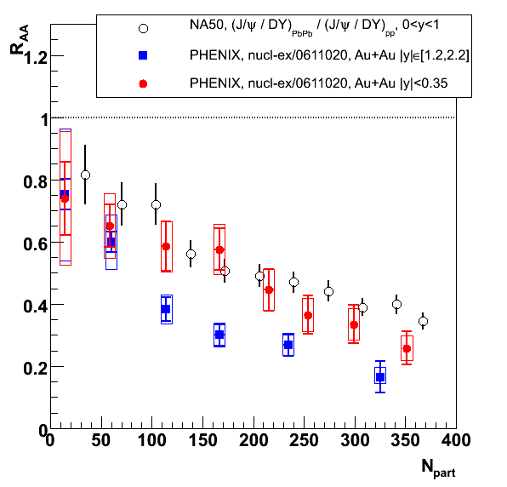
Motivation & outline
Subtracting cold nuclear matter (CNM) effects is crucial to interpret J/ψ suppression
  How is it done @ SPS ?
  How is it done @ RHIC ?
  A new method for RHIC…
J/ψ nuclear modification factor
±11% global systematics
±12% global systematics
± 7% global systematics
Notes:
(or not done in fact) @ RHIC
@SPS, Et analysis.

Slide 3
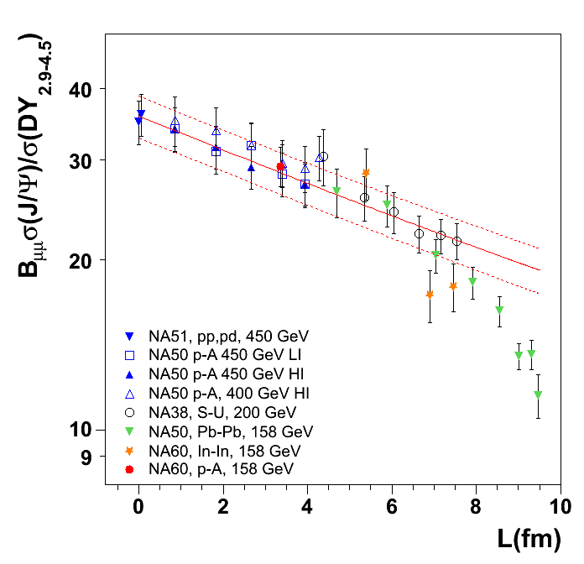
Cold nuclear matter @ SPS
J/ψ / DY rescaled to 158 GeV
Normal nuclear absorption alone does a splendid job in describing pA, SU, and peripheral PbPb & InIn…
  (including preliminary pA @ 158 GeV from NA60)
exp(-σ_{abs} ρ₀ L)
  (or in Glauber model)
  σ_{abs} = 4,18 ± 0,35 mb
  L nuclear thickness:
NA60 preliminary
J/ψ
L
NA50, EPJ C39 (2005) 335
& E. Scomparin’s talk

Slide 4
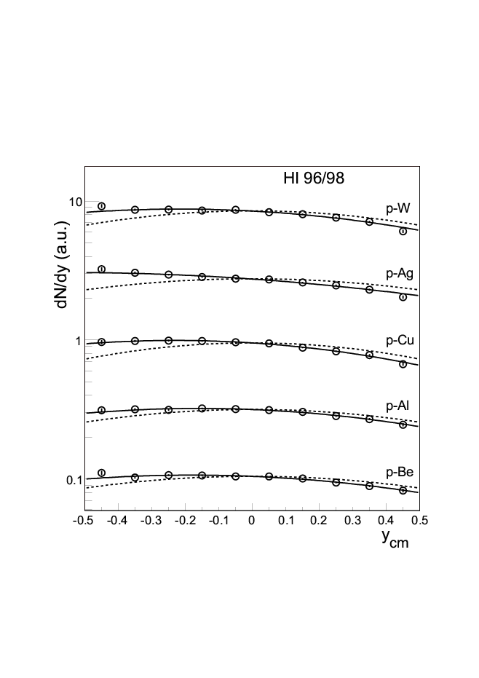
(Anti) shadowing @ SPS ?
Do we fully understand CNM @ SPS ?
Not these surprising rapidity distribution asymmetries →
  Variation of ~30 to ~50% in one unit of rapidity !
  Is it (anti)shadowing ?
  Not taken into account in CNM extrapolation…
J/ψ yield
+50%
+30%
NA50, CERN-PH-EP/2006-018,
to appear in Eur. Phys. J. C.

Slide 5
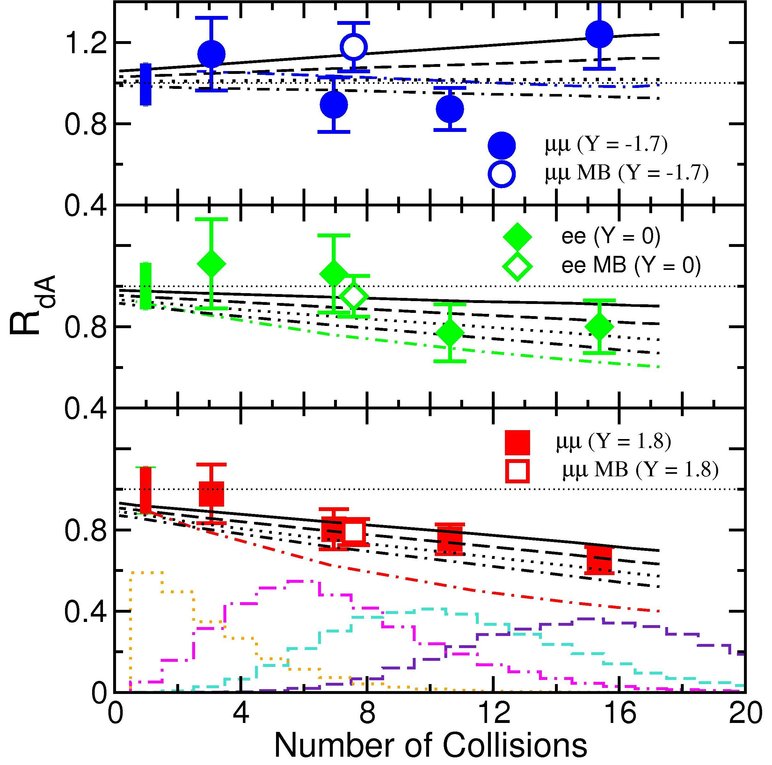
Cold nuclear matter @ RHIC
R_{dAu}
First centrality dependence in dA (or pA) of J/ψ production !
Reproduced by Ramona Vogt
  Black lines: EKS98 shadowing
    + σ_{abs} = 0 to 3 mb
  Colored lines: FGS shadowing + σ_{abs} = 3 mb
Favoring moderate shadowing + moderate absorption…
Y = –1.7
Y = 0
Y = +1.8
PHENIX, PRL96 (2006) 012304
Klein,Vogt, PRL91 (2003) 142301

Slide 6
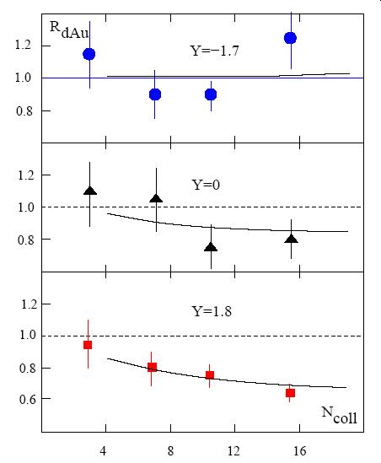
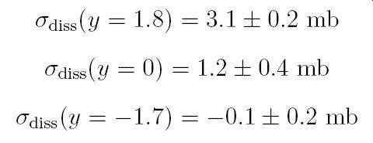
From dA to AA @ RHIC
What is on the market ?
Model of nuclear absorption +
inhomogeneous (anti)shadowing
  (Ramona Vogt, nucl-th/0507027)
exp –[ (σ_{diss}(y)+σ_{diss}(-y)) ρ₀L ]
  (Karsch, Kharzeev & Satz PLB637(2006)75)
  σ_{diss} from fits on dA data →
  (unrealistic error bars)
  But shadowing doesn’t go like L…
KKS, PLB637(2006)75
Notes:
First, the dA data are poor…

Slide 7
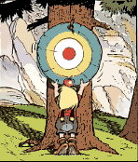
3. Another approach…
Goal
  Predict R_{AA} from R_{dA}
Concerns
  Stay as much as possible data-driven
  Take full advantage of dAu centrality-dependence…
© Uderzo & Goscinny,
Asterix chez les helvètes
Notes:
« We have not sacrificed this poor little child for nothing »

Slide 8
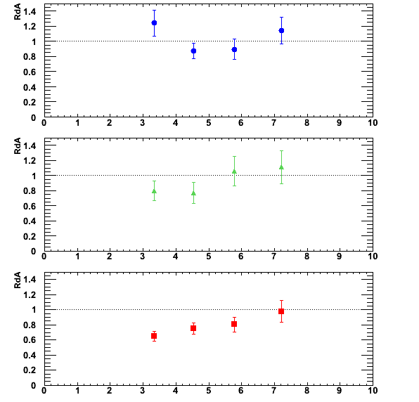
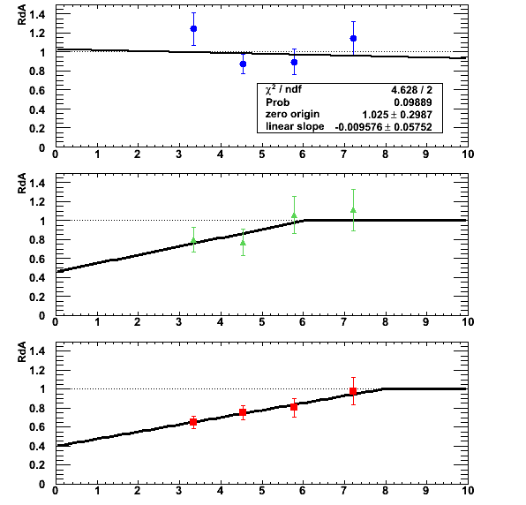
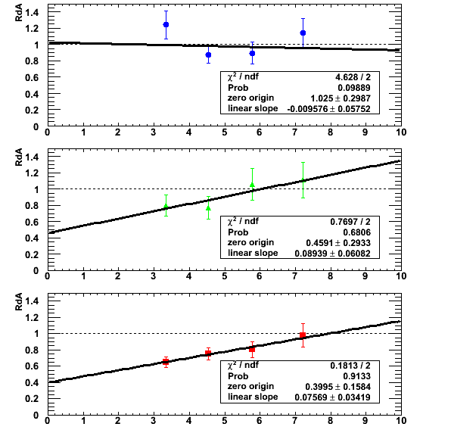
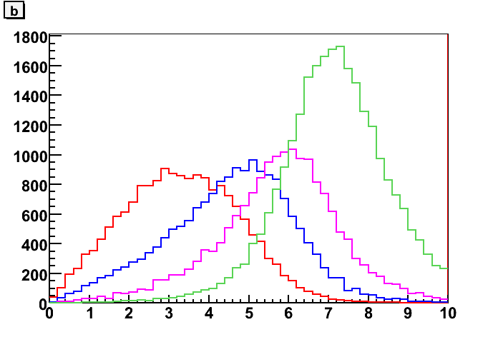
R_{dA} vs impact parameter b
Re-plot PHENIX R_{dA} vs impact parameter b from Glauber model
Phenomenological fit to R_{dA}(b) →
Cut off RdA=1 at high b
  Physically expected
  OK for an upper bound of CNM
R_{dA}
Y = -1.7
Y = 0
0- 20% 20- 40% 40- 60% 60- 88%
Y = +1.8
b(fm)
b(fm)
Notes:
Negative – Nul – Positive

Slide 9
Plugged in Glauber model
Glauber provides, for a given A+A collision at b_{AA}, a set of N+N collisions occurring at b^{i}₁ and b^{i}₂.
One minimal assumption is rapidity factorization: R_{AA}(|y|,b_{AA}) =
  Σ_{collisions} [ R_{dA} (-y,b^{i}₁) x R_{dA} (+y,b^{i}₂) ] / N_{coll}
Works (at least) for absorption & shadowing since production
~ pdf1 x pdf2 x exp –ρσ(L₁+L₂)
b₁
b₂
b_{AA}
J/ψ
= x
J/ψ
J/ψ
= x

Slide 10
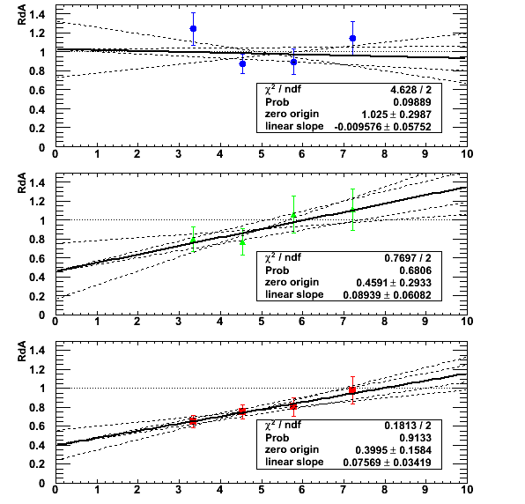
Propagating dA error
Varying the fit parameters
  Uncorrelated
  Within ±1σ
to propagate the statistic + systematic dAu uncertainties throughout the Glauber computation
R_{dA}
Y = -1.7
Y = 0
Y = +1.8
b(fm)

Slide 11
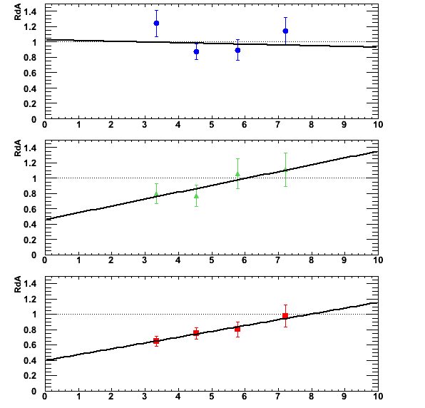
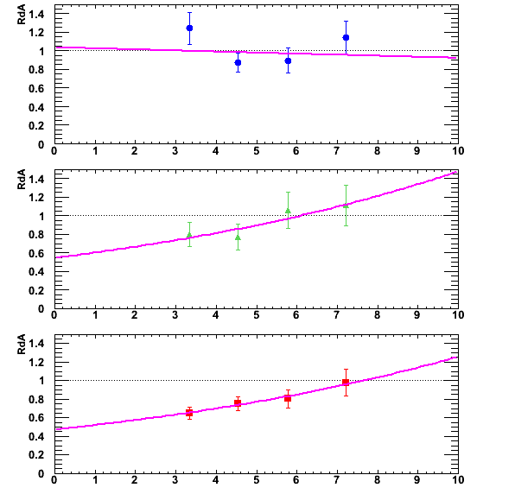
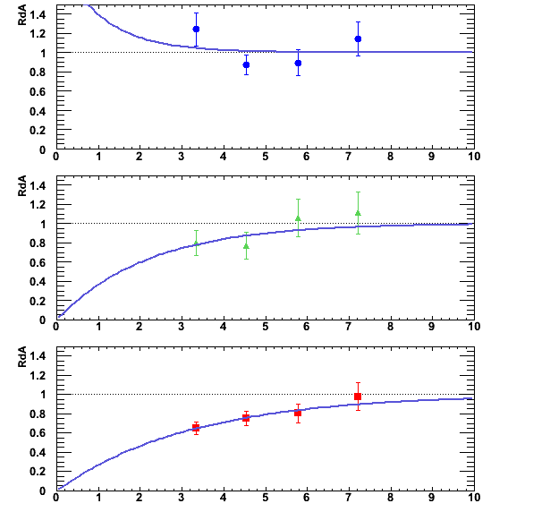
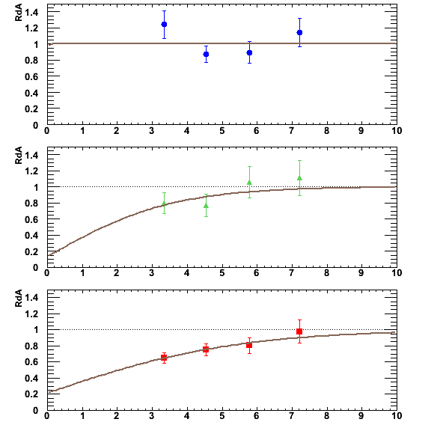
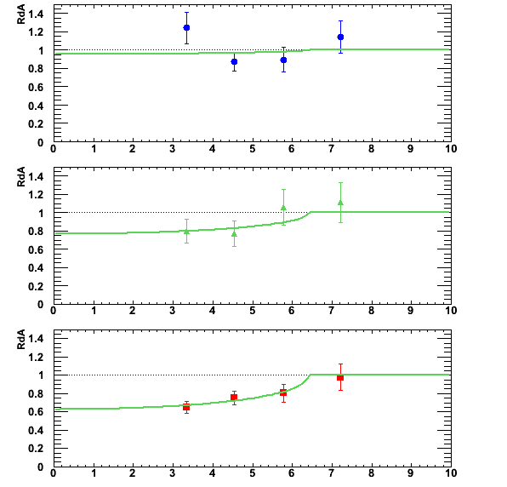
Systematic uncertainties
Varying line shapes →
  3 to 5% @ y ~ 1.7
  3 to 12% @ y ~ 0
  (asymmetric and depending on centrality)
Varying Glauber parameters (pp total cross section, Woods Saxon parameters,…)
  2% @ y ~ 1.7
  4% @ y ~ 0
R_{dA}
Y = -1.7
Y = 0
Y = +1.8
b(fm)

Slide 12
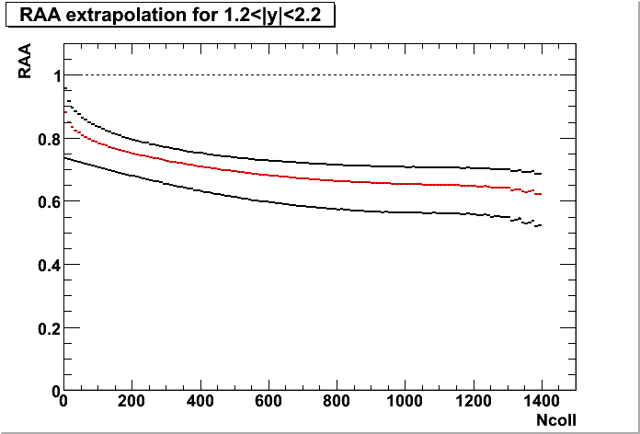
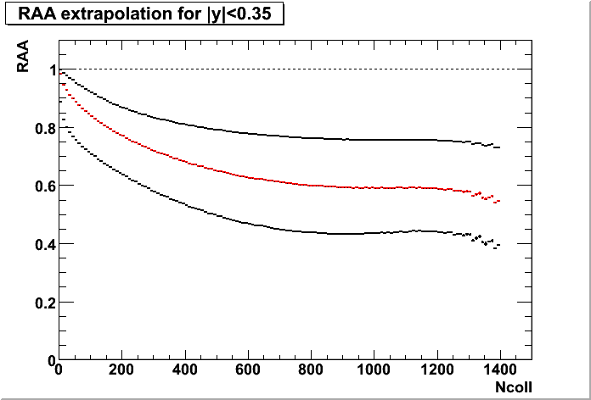
The output: R_{AA} (N_{coll})
R_{AA} extrapolation
1.2 < |y| < 2.2
R_{AA} extrapolation
|y| < 0.35
Black curves reflect stat. and syst. errors from dAu
Much less constrained @ y~0 because:
  R_{dA}(0) measurements are less precise than R_{dA}(-1.7) and R_{dA}(+1.7)
  and squared while computing RdA(-y) x RdA (+y)
Then, take the average in experimental centrality classes

Slide 13
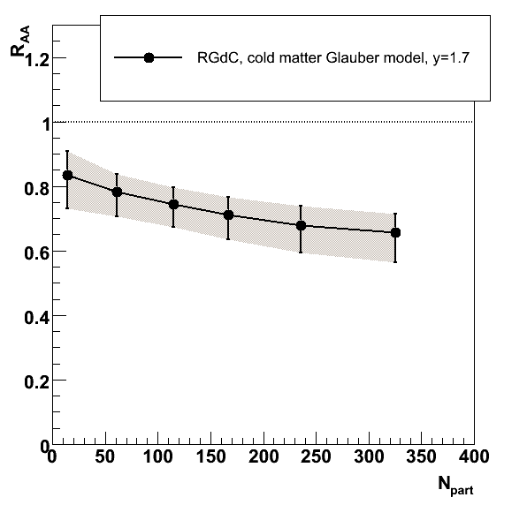
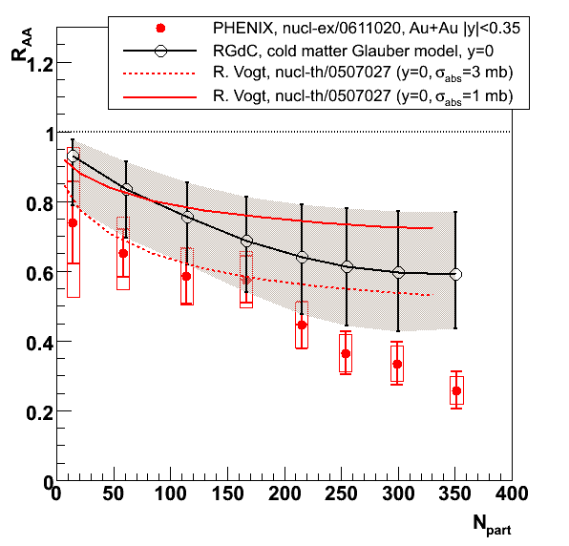
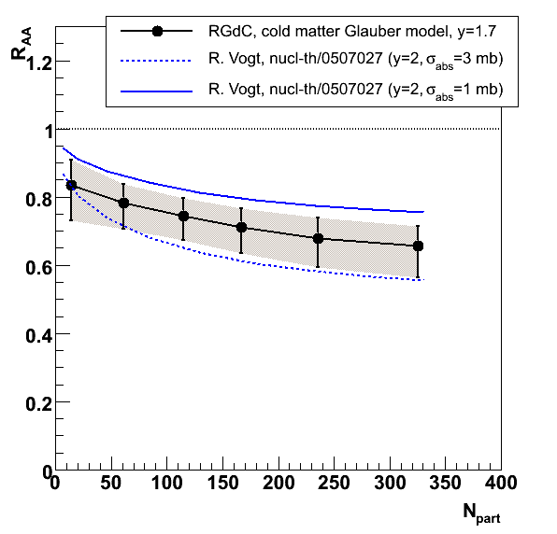
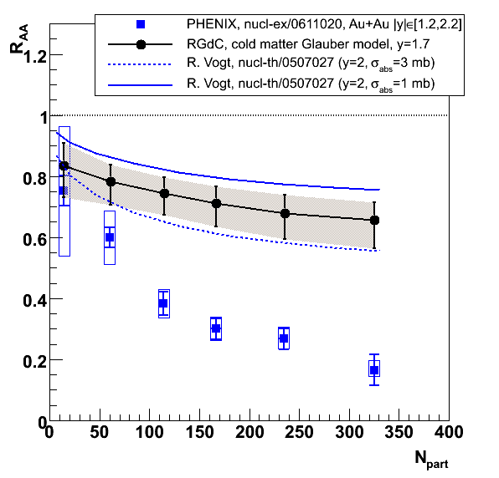
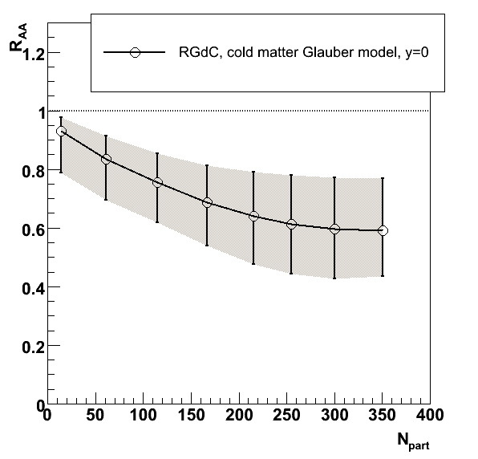
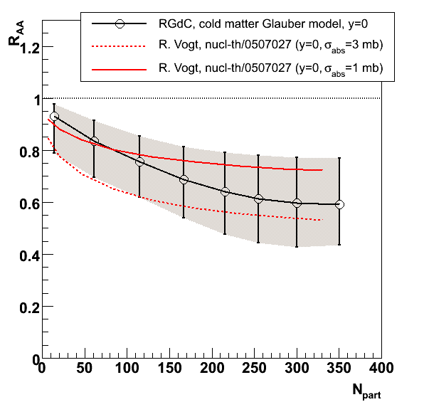
Comparison to models & data
See T. Gunji & A. Glenn talks
Consistent with Vogt’s prediction (EKS shadowing + 1 or 3 mb σ_{abs})
Prediction @ y~1.7 is much more powerful than @ y~0

Slide 14
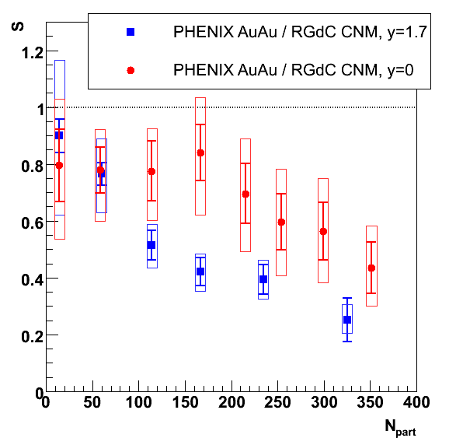
R_{AA} / CNM @ RHIC
J/ψ survival beyond CNM
First RAA/CNM extraction including (proper) error propagation
Boxes are correlated errors from AuAu & dominant CNM
Important: missing overall global relative uncertainty
  30% @ y ~ 1.7 / 35% @ y ~ 0
  Due to different pp references that don’t cancel in R_{dA} and R_{AA}
  R_{AA}(|y|) / R_{dA}(-y) x R_{dA}(+y)
44±
23%
±35% global systematics
±30% global systematics
25±12%
← This will decrease by recomputing
RdA with new pp data (A.Bickley’s talk)

Slide 15
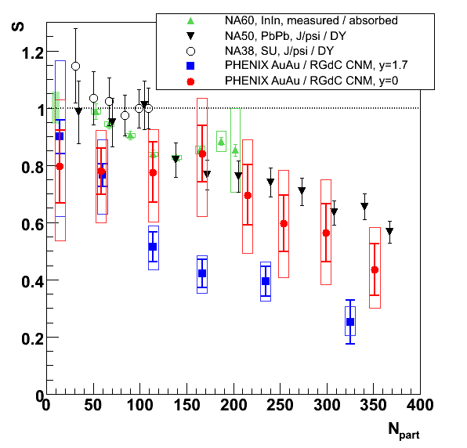
Quick comparison to SPS
J/ψ survival beyond CNM
At mid-rapidity, the amount of surviving J/ψ @ RHIC is compatible with SPS (~60%) but depends a lot on CNM (and pp references)…
At forward rapidity, RHIC anomalous suppression is much stronger !
44±
23%
±11% global systematics
±35% global systematics
±30% global systematics
25±12%

Slide 16
Conclusions
Pro’s
  Very little model dependence (apart from Glauber)
    (no σ_{abs} , no shadowing scheme, y=0 & 1.7 independence,…)
  Proper error propagation from dAu (and pp)
  Proper centrality selection (experimental classes)
  → J/ψ survival of 25±12% @ y=1.7 & 44±23% @ y=0
Con’s
  Not applicable without p+A (or d+A) centrality dependence at same energy and at both +y and –y wrt A+A collisions (thus not at SPS or LHC)
  Limited by dAu statistic ! We need more !
    Especially @ y~0 (and dCu to apply this to CuCu)

Slide 17
Back-up slides

Slide 18
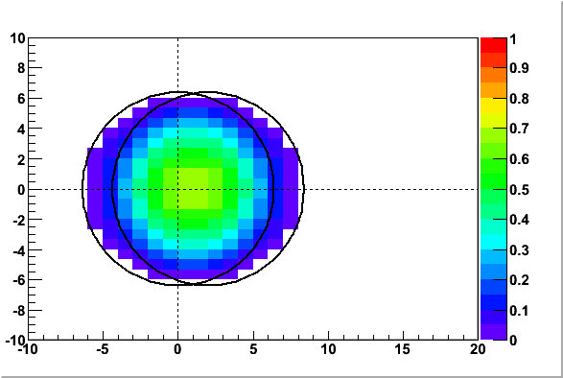
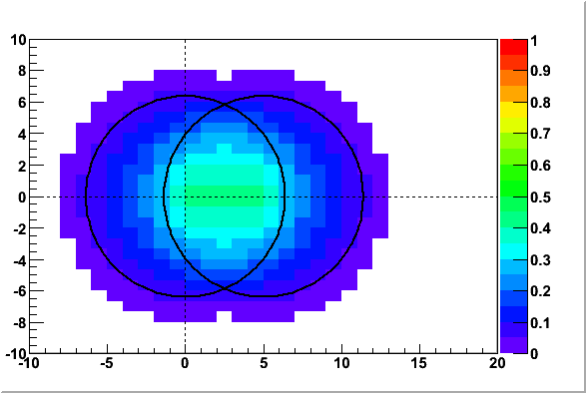
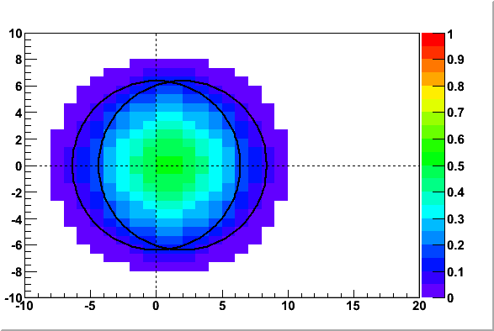
Collision display
Disappearance probability
Disappearance probability
  No assumption on production point
  Weighted by Woods Saxon
y ~ 0
2 fm
y ~ 1.7
5 fm
y ~ 1.7
2 fm

Slide 19
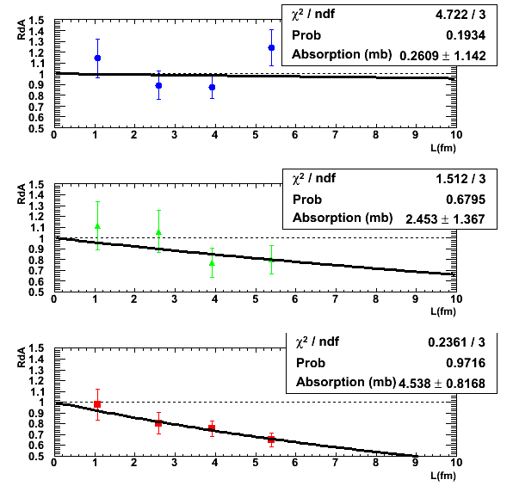
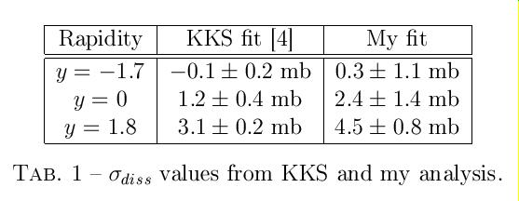
Nuclear absorption only
Compute L with Glauber model
Fit exp(-σ_{abs} ρ₀ L)
Results are different wrt KKS numbers
KKS, PLB637(2006)75

Slide 20
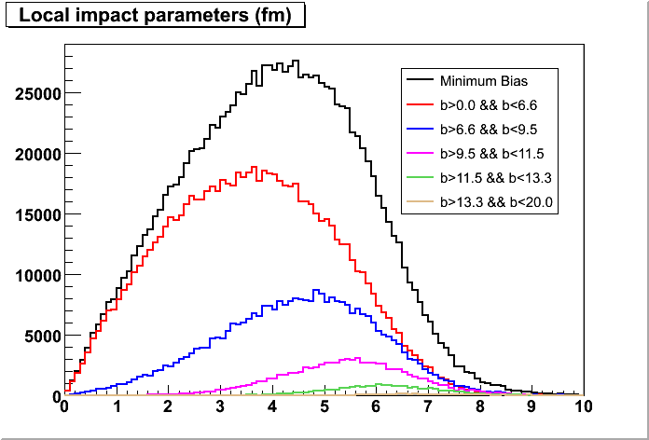
Sampling local impact parameter in AuAu

Slide 21
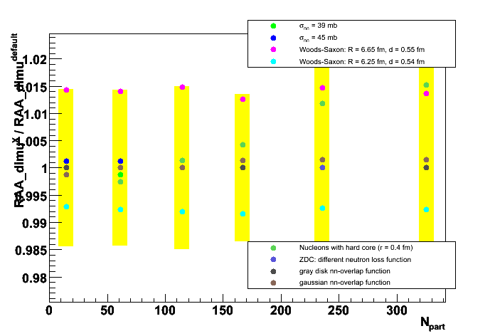
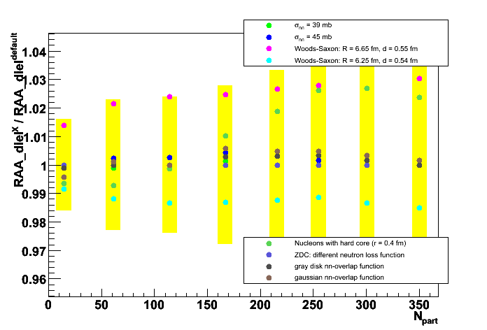
Varying Glauber parameters

Slide 22
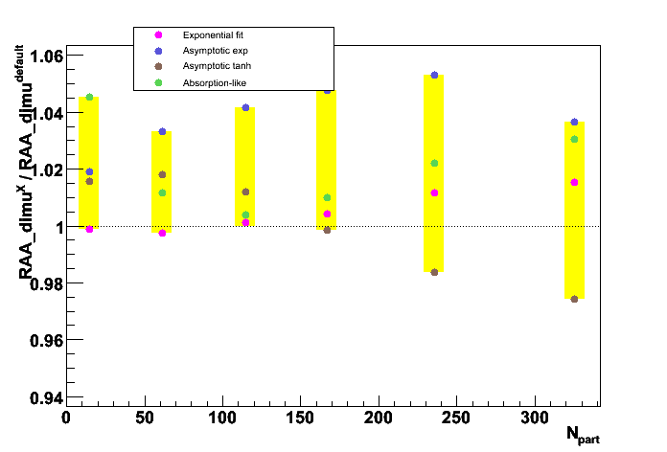
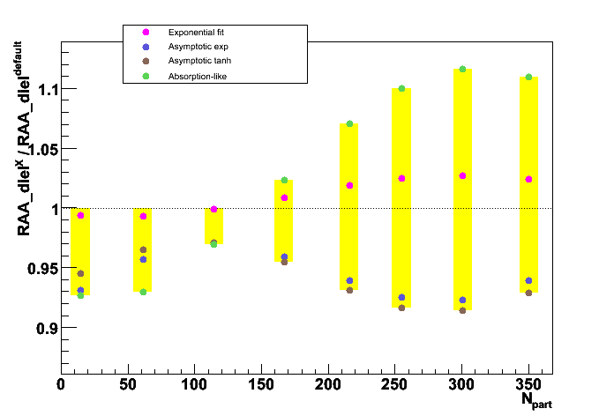
Varying the line shape

Slide 23
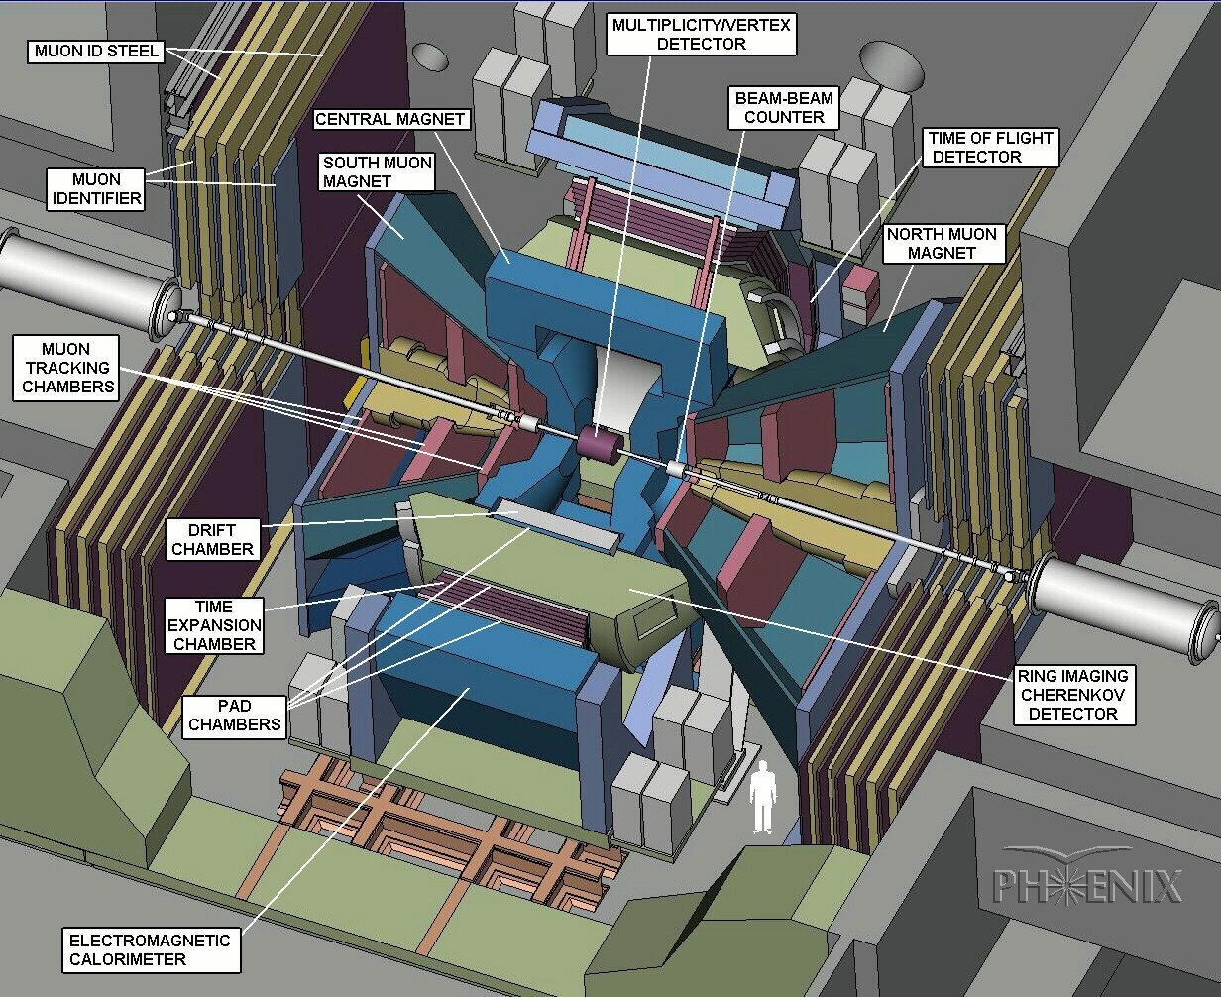
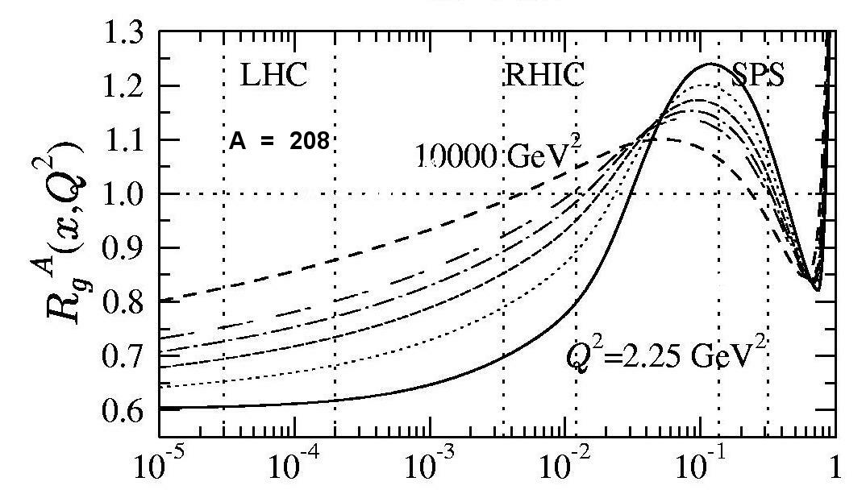
Deuteron → ← Gold
In PHENIX, J/ψ mostly produced by gluon fusion, and thus sensitive to gluon pdf
Three rapidity ranges probe different momentum fraction of Au partons
  South (y < -1.2) : large x₂ (in gold) ~ 0.090
  Central (y ~ 0) : intermediate x₂ ~ 0.020
  North (y > 1.2) : small x₂ (in gold) ~ 0.003
d
Au
An example of gluon shadowing prediction
x₂
rapidity y
gluons in Pb / gluons in p
x₁
J/ψ at
y < 0
Shadowing
Anti
Shadowing
x₁
x₂
J/ψ at
y > 0
x
Eskola, Kolhinen, Vogt
NPA696 (2001) 729
Notes:
…
“ If we see a Jpsi at negative rapidity, it has to come from a high x in the gold. Indeed our average X in the south is 0.09. On the contrary, if we see a northern psi, is has to come from a low X in the gold, and our average is 3.10 ^ -3. The midrapidity measurement is around 0.02. Here is a example of theoretical prediction of shadowing. This is the ratio of the gluon pdf in a lead nucleon to the gluon pdf in a proton versus X. You can see that our forward measurement is sitting in shadowing-land, while the backward should see anti-shadowing. ”
Shadowing diffère d’un facteur trois entre modèles…

Slide 24
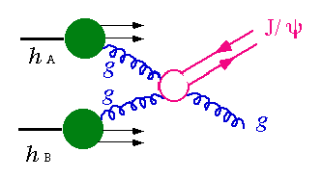
Cold nuclear matter effects ?
J/ψ (or cc) absorption
(Anti) shadowing
  (gluon saturation, CGC…)
Energy loss of initial parton
p_{T} broadening (Cronin effect)
Complications from feeddown ψ’ & χ_{c} ?
Something else ?
An example of gluon shadowing prediction
gluons in Pb / gluons in p
Shadowing
Anti
Shadowing
x
Eskola, Kolhinen, Vogt
NPA696 (2001) 729

Slide 25
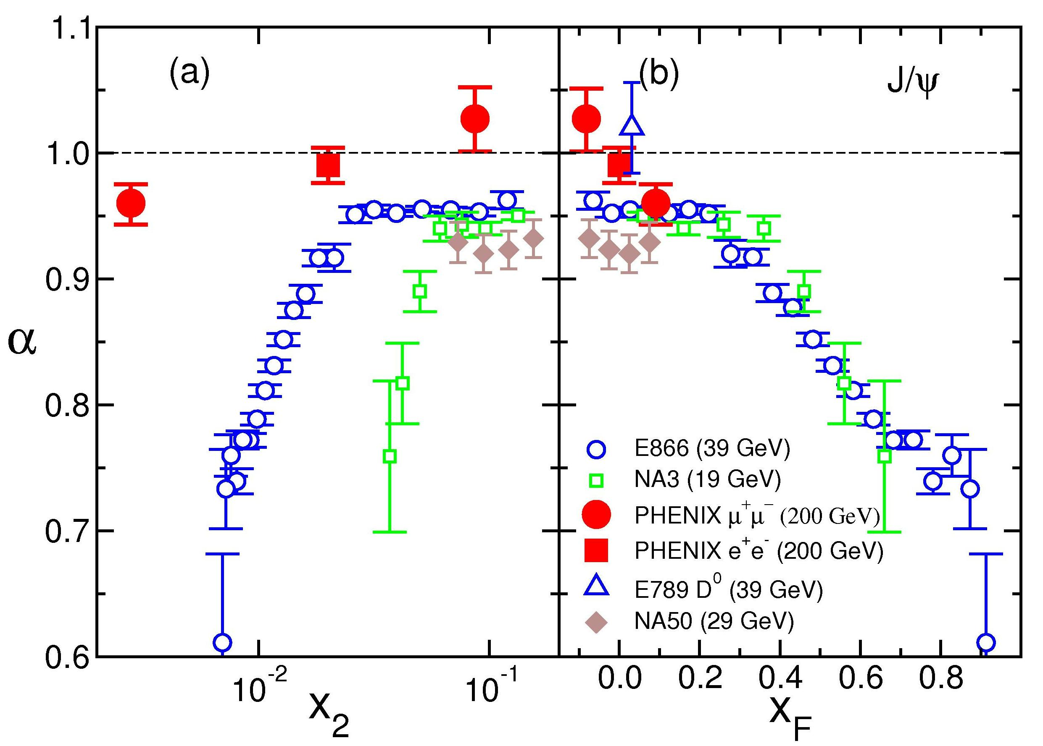
Cold nuclear matter effects ?
A real puzzle ! Especially when one goes to low x₂, high x_{F}…
σ_{ψ}(pA) =
σ_{ψ}(pp) x A^{α}
Shadowing ?
open charm
Absorption ?
dE/dx ?
Intrinsic
Charm ?
= x_{A}
= x_{p}- x_{A}
Notes:
NA50 from pA only…
E866 is Be, Fe, W…

Slide 26


