Slide 1

EIDs across TAXA
Humans
Wildlife
Forests
Coral/Seagrasses
Fish & Marine Mammals
Climate Change & Habitat
Coral Reefs
Forest Fragments & Fires
Coastal Wetlands
Montane Regions
Arctic Ringed Seals & Polar Bears

Slide 2
ECOLOGICAL DYNAMICS
r-strategists
K-strategists
Wastes
Resources

Slide 3
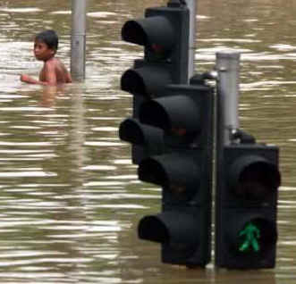
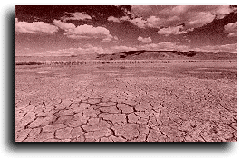
AGRICULTURAL PESTS &
EXTREME WEATHER EVENTS
FLOODS Fungi
DROUGHT
  Aphids
  Whiteflies – Geminiviruses
  Locust

Slide 4
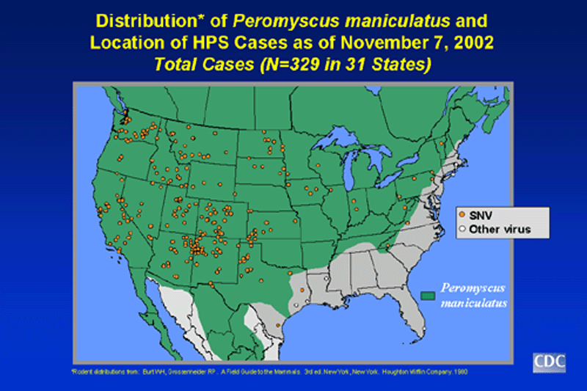
Hantavirus Pulmonary Syndrome
1993 Drought, Then Early Rains
10X Explosion of Mice Populations

Slide 5
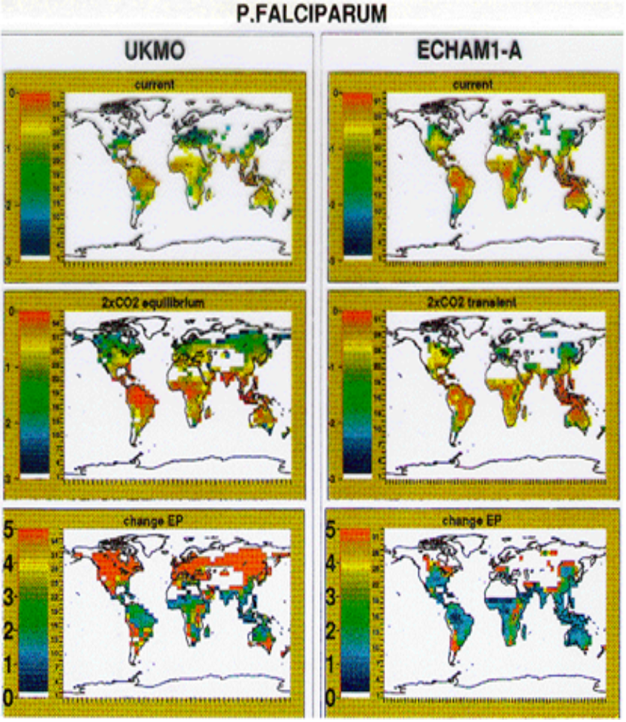
Climate Models and Potential Malaria Distribution
T
~1ºC/C
Average
T MINIMUMS
~2ºC/C
1950 2000

