Slide 1
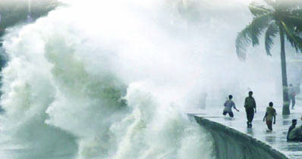

Flash Flood Forecasting as an Element of Multi-Hazard Warning Systems
Wolfgang E. Grabs
Chief, Water Resources Division
WMO

Slide 2
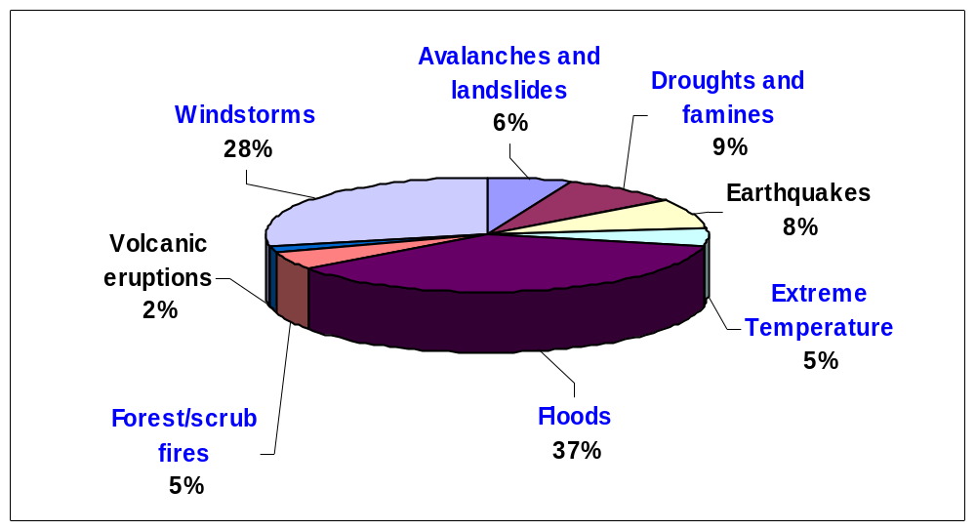
Global Distribution of Natural Hazards (1993-2002)

Slide 3
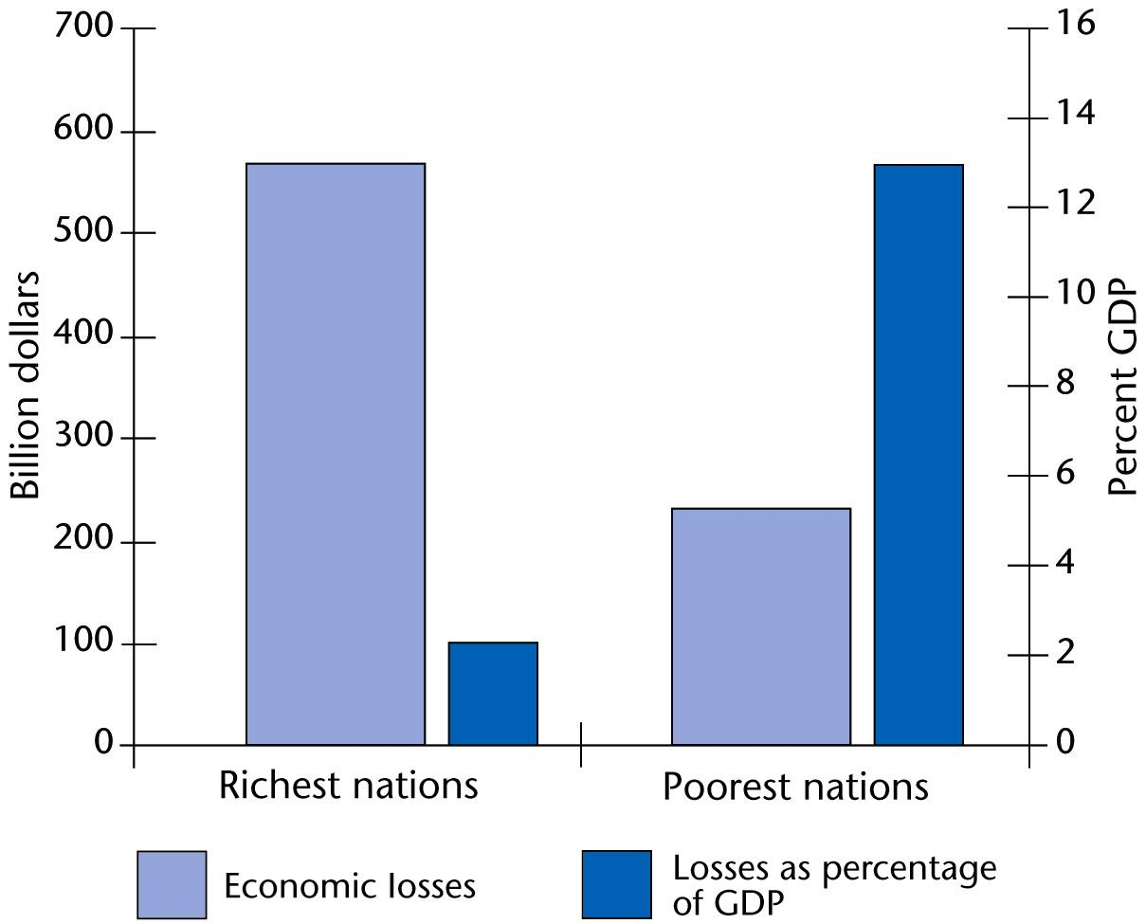
Developing countries are hit the hardest …

Slide 4
WMO Works With NMHSs to …
Increase awareness of hazards
  High impact weather, climate, hydrological events, storm surges, tsunamis, etc.
Provide warnings that are easily accessible and understandable
Better utilize, integrate and extend existing warning services
Enable effective decision-making by individuals and agencies through translating complex technical information into a message that can enable any member of community to take appropriate action.

Slide 5
WMO Global Network Includes …
National Meteorological and Hydrological Services of its 187 Members
10 International Scientific and Technical Programmes (Weather, Climate and Water)
  Basic infrastructure, observing, research, modeling and forecasting, early warnings development and dissemination, Capacity building, technology transfer, education and public outreach)
Three World Meteorological Centres and 40 Regional Specialized Meteorological Centers
  Operated or supported by NMHSs
WMO Secretariat based in Geneva
  Coordination of activities at international and regional levels
  Support NMHSs for enhancement of their services

Slide 6
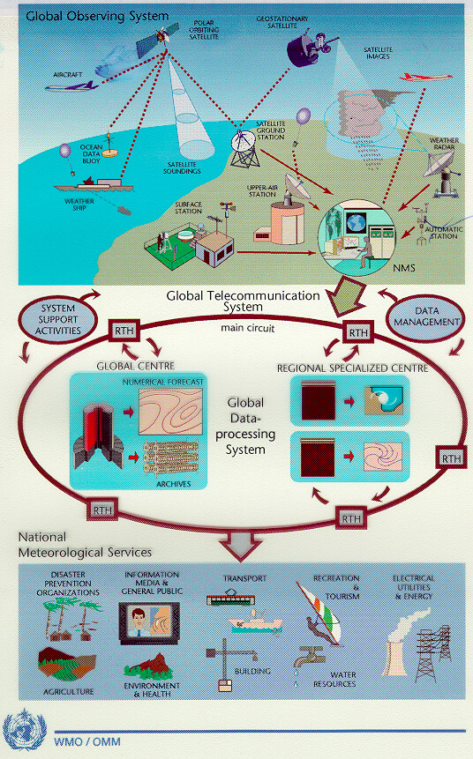
How Does the Global Operational Network of WMO Operate?
NMHSs of 187 countries contribute to Global Observing System every day
Global Telecommunication System- 32 Regional Tele-communication Hubs
3 World Meteorological Centres
40 Regional Specialized Centers
NMHSs deliver data and early warning services

Slide 7
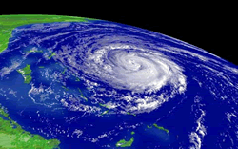
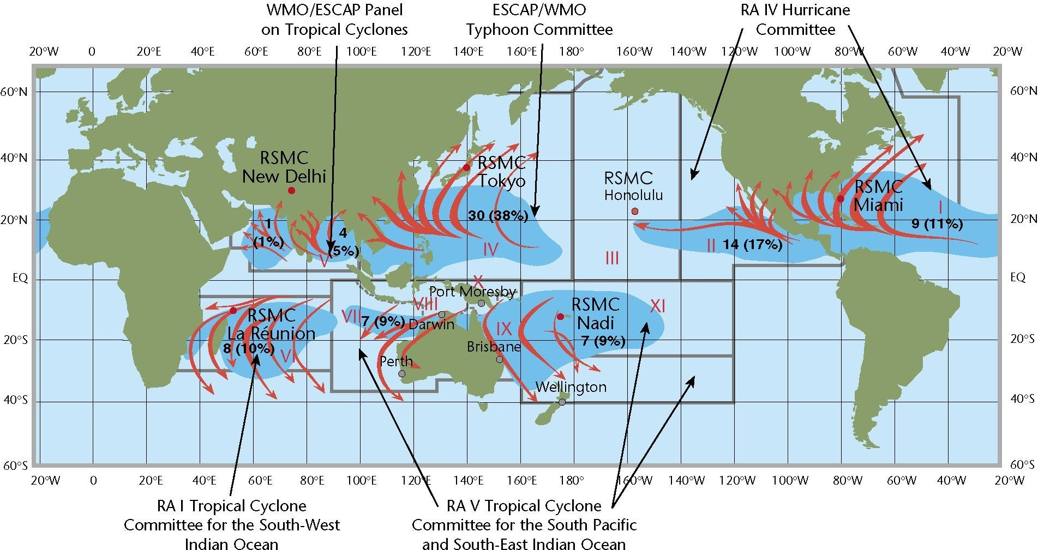
WMO’s Global Tropical Cyclone Early Warning System

Slide 8
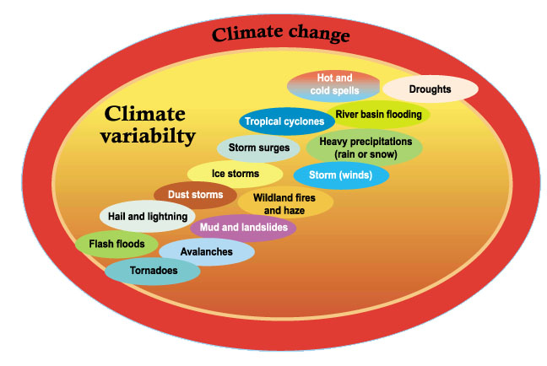
WMO Research Programmes Advance Knowledge of Natural Hazards and Their Changing Patterns
Extending limits and quality of predictions and early warnings of hazards from next hour to longer timescales

Slide 9
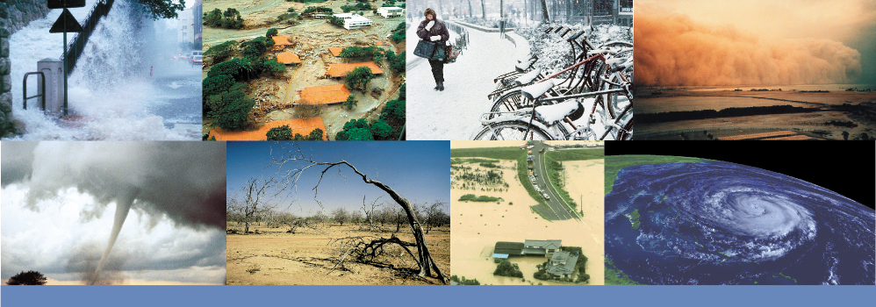
National Meteorological and Hydrological Services are operational 24/7 organizations responsible for Monitoring, Detecting, Developing and Disseminating Early Warnings for Natural Hazards Related to Weather, Climate and Water …
Severe storms, tropical cyclones (hurricanes and typhoons), storm surges, floods, cold spells, heat waves, droughts, forest fires, locust swarms, etc…

Slide 10
COMMUNICATION GAP
Between meteorological and hydrological services
Meteorological information and forecasts are often not provided in a form usable for hydrological forecasting,
Non-standardized data archiving, data formats and transmission protocols severely limit timely access to data and information,
Use of different forecasting concepts, methods and technical language,
PROGRAMME HIGHLIGHTS
Between forecasters and forecast users
Forecasting is often not objective-driven; different users of forecasting information require specific forecasting products,
Use technical vocabulary in forecast and warning dissemination
The Flood Forecasting Initiative
Improve the capacity of meteorological and hydrological services to jointly deliver timely and more accurate products and services required in flood forecasting and warning and in collaborating with disaster managers.
Notes:
WMO Flood Forecasting Initiative Regional Workshops:
DMC, Nairobi, July 2003 for East African Region
Pretoria (October 2003) for Southern Africa
Valencia (March 2004) for Ibero-American countries -120 participants from 20 countries
West Africa – 3rd trimester 2004

Slide 11
Traditional Approach:
Forecasting and warning services provided by government agencies are largely based on single hazard system approaches.
Shortfalls:
Multitude of forecasting and warning systems that often lack interoperability;
Basic infrastructure and reporting systems are duplicated.
Sector-focused early warning and disaster management, lack of systems integration

Slide 12
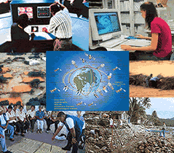
WMO Multi-Hazard Strategy for Natural Disaster Risk Reduction
Coordinated, user-driven approach
Strong partnerships, international, regional and national levels
Advance global capabilities for space- and land-based observations
  WMO’s observation programmes
  GEOSS
Enhanced early warnings
  Global capabilities deliverd at regional & national levels
Enhanced role of National Meteorological and Hydrological Services
National capacity building, training, sharing best practices
Awareness raising and education

Slide 13
Multi-Hazard Systems:
General National Context
Multi-hazard Warning Systems must be developed and implemented within an overall (national) disaster management plan as part of the overall national development plan
Flash Flood Warning Systems need to be part of an Integrated Flood Management Framework

Slide 14
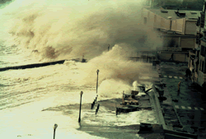
From Storm-Surge Warning to Coastal Flood Management
National Hydrological Services prepare coastal flood warnings based on storm-surge forecasts developed by National Meteorological Services and communicate with relevant authorities to ensure timely and accurate flood warnings.

Slide 17
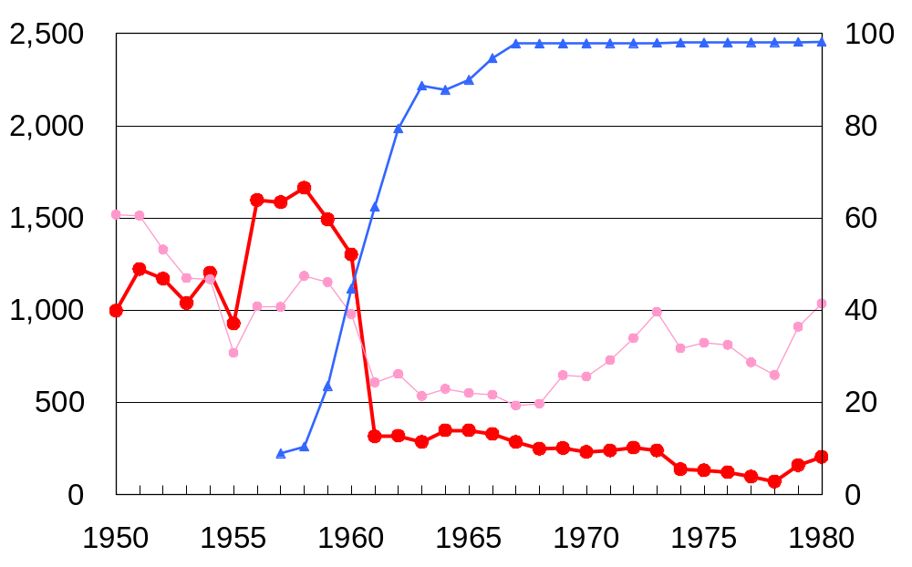
Human loss has been reduced dramatically (Case of Japan)
Typhoon tracking forecast was started in 1953
Computer based forecast was started in 1959
Penetration rate of TV
TV coverage （%）
Death (persons), Damage (billion yen)
Number of death by flood
Year
Source: 水害統計
Notes:
This is a case of Japan. In 1953 … In 1959 … Since around 1960, human loss by flood has been reduced dramatically as you see in a red line.

Slide 18
Human loss has been reduced dramatically (Case of Bangladesh)
1991 Cyclone in Bangladesh
Maximum Wind Speed: 225km/hr
Number of Death: 138,882
Accurate and timely forecasting system
Adequate proper warning
dissemination operation
Social mobilization and awareness raising
Proper coordination among
government agencies
1997 Cyclone in Bangladesh
Maximum Wind Speed: 220km/hr
Number of Death: 134
Source: State of the Environment, Bangladesh 2001, UNEP
Notes:
This is a case of Bangladesh. In 1991 … In 1997 … This can be happened, because Bangladesh has established an effective early warning, through …

Slide 19
Stages of Multi-Hazard End-to-End
Early Warnings
  Commitment, collaboration, coordination, and information sharing
    - at international, regional, national and local levels
  Integrated Observing Systems and hazard forecasting and warnings;
  Integration of risk information in the warning messages;
  Distributing warning messages to all stakeholders
  Preparedness and response activities
  Educating the public and other stakeholders
Communication is the backbone for integration!

Slide 20
End-to-End Early Warning Systems
Need for Multi-hazard Approach
It is essential that EWS are available for all hazards, while ensuring operational effectiveness, cost effectiveness and sustainability of these systems over time.
Development and sustainability of effective end-to-end EWS is costly and resource intensive.

Slide 21
Multi-Hazard approach: best return on investment
Realization of organizational, technical and operational, dissemination synergies
More effective integrated warning information and services ➔Better decisions (e.g., better integrated hydro-meteorological warnings)
Cost effectiveness, sustainability, more effective utilization of resources
On-going improvements due to more frequent use of the system
Notes:
To this end, a multi-hazard approach would enable building on the existing EWS technical and organizational capacities and infrastructures of various partners, while realizing the synergies at different stages of end-to-end EWS process, including,
exploiting the maximum capacity of observational networks to observe multiple hazards when technically appropriate,
utilisation of technical operational regional and national warning centres and their services for multi-disciplinary multi-hazard modelling and forecasting capacities, when technically appropriate,
efficient and effective utilisation of the global telecommunication networks for dissemination of data and information on hazards with large scale impacts
ongoing improvement of national dissemination (alert) and response mechanisms through their frequent use,
cost-effectiveness and efficiency for maintenance of these systems.
[1] The WMO Global Telecommunications System (GTS) is the operational 24/7 global network of telecommunication facilities and centres connecting countries and territories through their National Meteorological and Hydrological Services (NMHSs). WMO GTS is the backbone systems for global exchange of multi-hazard data and information, including all meteorological and related data; weather, water and climate analyses and forecasts; tsunami related information and warnings and seismic parametric data.

Slide 22
Multi-Hazard Warning Systems
Technological requirements
Integrated, multi-platform observations systems require interoperability of system components;
Standardized protocols and formats for the transmission of data and information;
Improved data integration for the generation of multi-purpose, user-specific information and warning products

Slide 23
Many challenges Remain …
…to ensure that EWS are implemented as an integral part of disaster risk reduction strategies within a multi-hazard framework:
Legislative,
Financial,
Organisational,
Technical,
Operational,
Training and capacity building
But……
Notes:
Cultural shift from post-disaster response to preparedness
Legislation –
Recognition of EWS as an integral part of disaster risk reduction (DRR)
Clear structures for DRR
Clarification of the processes, roles of different players/agencies working in a multi-disciplinary decision making process
Organizational – Incentives to overcome turf issues
Development of a practical framework (flexible, adaptable)
Development and maintenance of multi-hazard observing networks
Technical– Improvement of forecasts and development of inter-disciplinary approach to EWS (bridging disciplines)
All hazard alert and dissemination mechanisms
Multi-hazard approach to emergency preparedness and planning

Slide 24
It is unacceptable that lives, infrastructure and property are lost at a time when the relevant technologies, expertise and capacities are largely available to prevent hydrometeorological hazards including riverine floods, flash floods and storm surges from turning into major disasters.

Slide 25
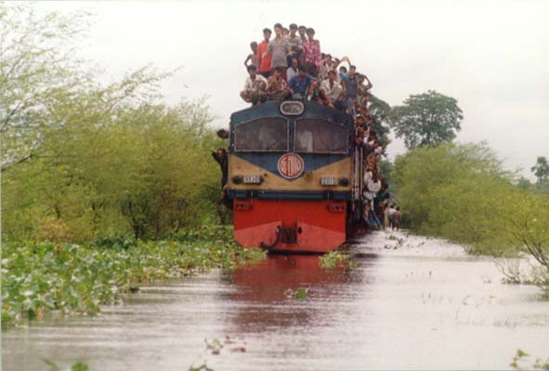
The Train must Move On !

