Slide 1

Safety Update
Maj Larry Mattiello
Assistant National Safety Officer
Southwest Region Safety Officer
lmattiello@airsure.com
917-969-1812

Slide 2
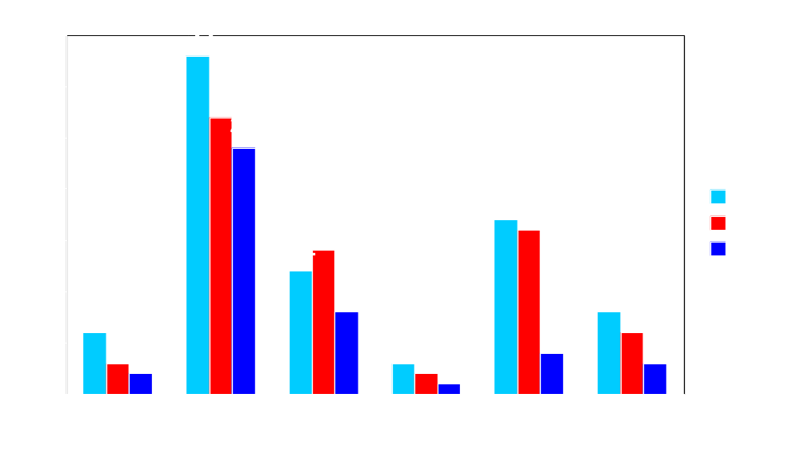
Yearly Mishap Comparison
Current as of: 10 August 06

Slide 3

FY 2006 Hours vs. Mishaps

Slide 4
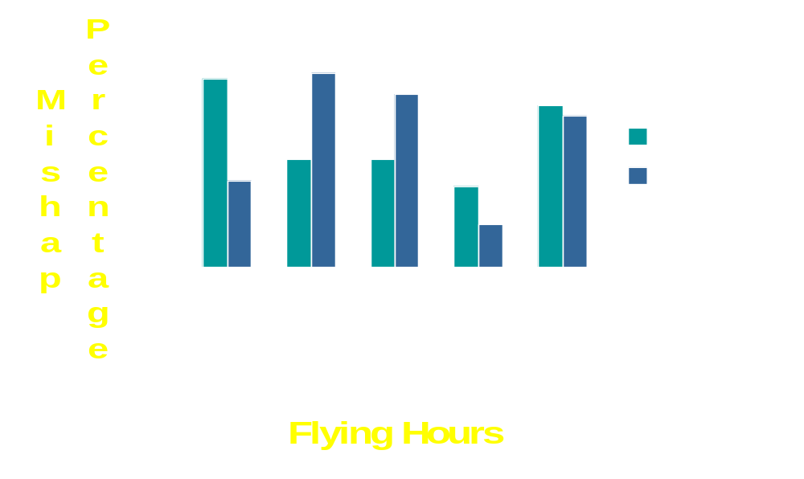
FY 98 – 06 Hrs vs. Mishaps

Slide 5
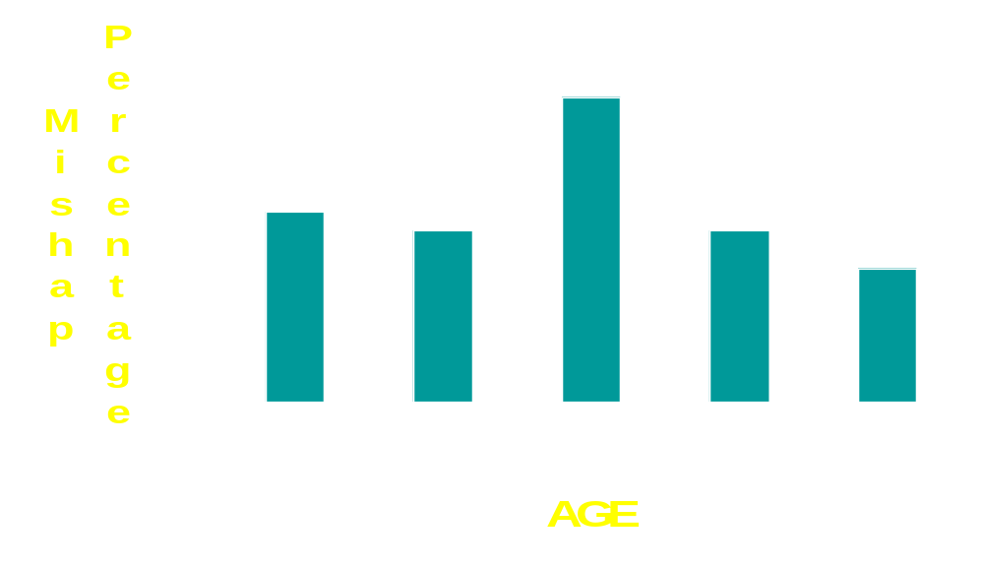
FY 2006 Age vs. Mishap Rate

Slide 6
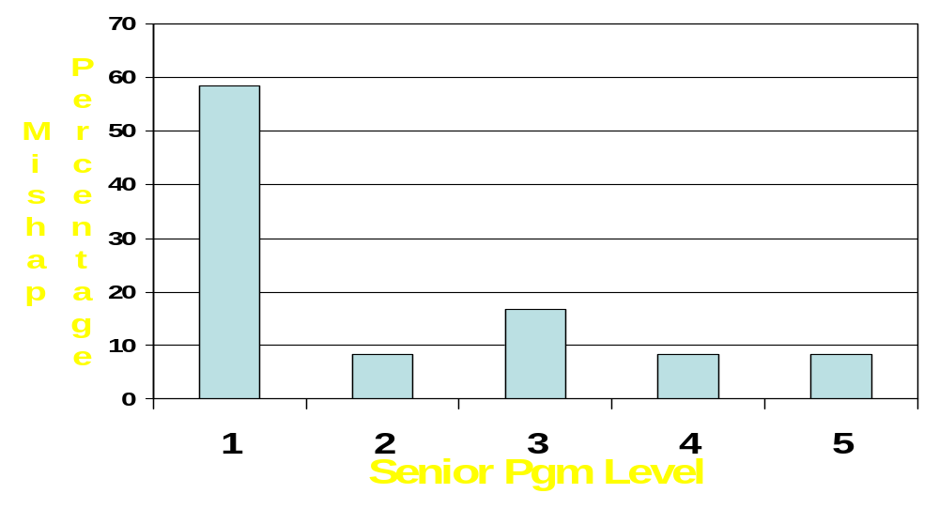
FY 2006 Senior Pgms vs. Mishap Rate

Slide 7
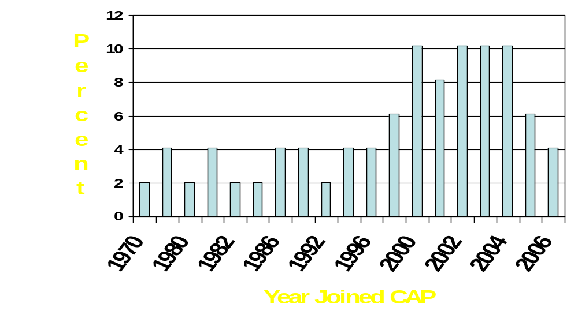
FY 06 LVL 1 Members Having A Mishap

Slide 8
FY 2005 Aircraft Mishap Repair
$293,000

Slide 9
FY 2006 Aircraft Mishap Repair
$214,000

Slide 10
FY 2005 Ground Mishap Repair
$47,162

Slide 11
FY 2006 Ground Mishap Repair
$54,915

Slide 12

Where Have We Been?
(CAP Aircraft Accident Rate 1972 – 2006)

Slide 13
FY 2006 Accident Rate
2.45
The lowest CAP Accident Rate since 2000

Slide 14
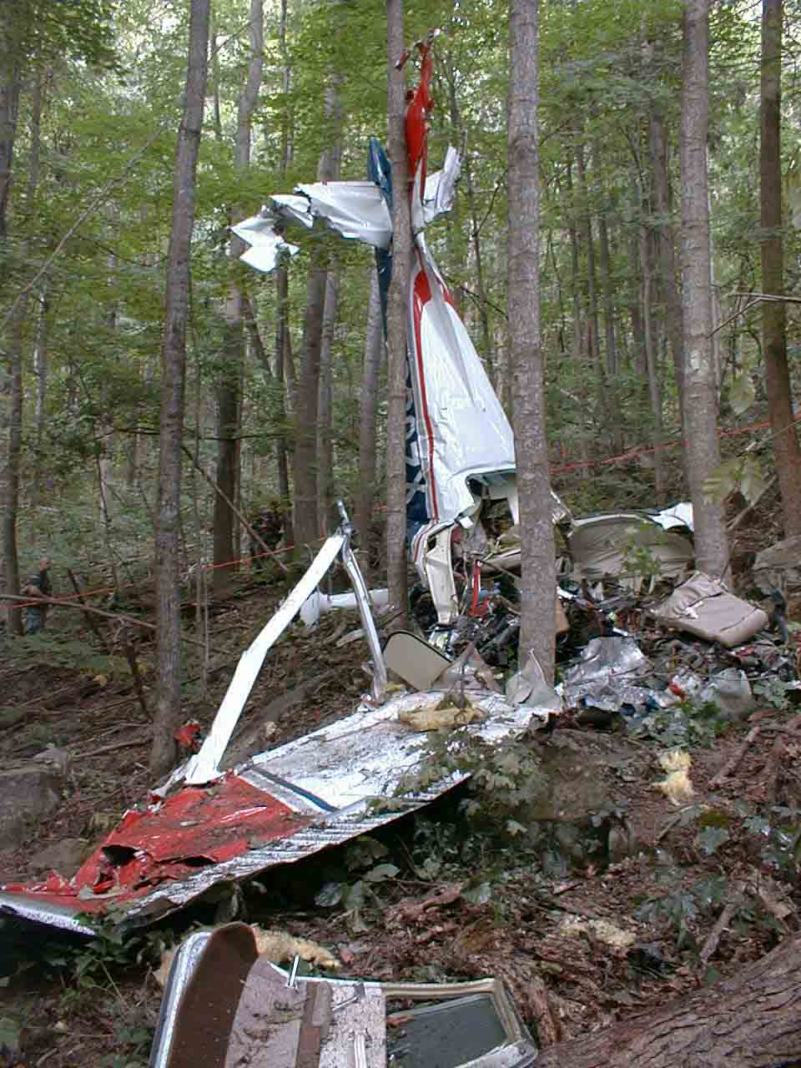
Effective Safety Culture May Have Prevented This Accident
Mountain Flight Clinic
IP was an ATP, CFII. Mission IP & Check Pilot
12,500 hours
2- year history of
undisciplined behavior
Routinely broke rules “meant for less skilled pilots”
Multiple aircraft incidents
Does this sound like a Check Pilot?
Leadership was aware but, failed to intervene
AM Ground School covered safety precautions
IP and 2 students flew into a draw with steep terrain 5 times at tree-top level
During the course reversal, the tail snagged a tree
The crash killed all three
A key position filled by the wrong person
Standards were not enforced

Slide 15
Operation CAPSafe
or
How not to break anything or hurt anybody.

Slide 16
Operation CAPSafe
What is Operation CAPSafe?
  Have every CAP Senior and Cadet member send in one Safety idea a month either for Ground Safety, Air Safety, or both.
  A way to have every Senior and Cadet member think of Safety at least once a month.
  This will hopefully instill a Safety Mindset into every CAP member.

Slide 17
Operation CAPSafe
Where do I send my Operation CAPSafe ideas?
  LLetteer@cap.gov
  or
  Col Lyle Letteer
  P.O. Box 1010
  Locust Grove, GA 30248-1010

Slide 18
Operation CAPSafe
Each month, the best Safety Idea for Air and Ground will receive an Operation CAPSafe travel coffee mug and a keychain Maglite.
Both have Operation CAPSafe engraved on the side.

Slide 19
2006 CAP National Safety Down Day
Preparing For
CAP National Safety Day
Col Lyle Letteer
National Safety Officer
National Chief of Safety

Slide 20
Why a Safety Day?
Pause for introspection
  Look at unit culture – how the unit trains, talks, acts and listens
  Look at your self – your attitude toward risk
Focus on problem areas (trends)
  Both from a National and a local perspective
Learn how to manage risks
  Formally and informally
This is a pre-emptive strike on future mishaps
  To help keep us safe on and off-duty

Slide 21
Getting Organized
CAP Safety Day will be in October
Commanders will choose the day
Recommend selection of a project officer
Involve all sections, seniors and cadets
Be creative and keep people’s interest
Perhaps, have seminars given by subject-matter experts
Keep it fun and informative
Limit topics to maybe 3-aviation, 3-driving and 3-bodily injury
Cover local risks and discuss risk controls

Slide 22
Other Suggested Topics
Aviation
  Taxiing safely
  Winter flying
  Carburetor icing
  Local bird hazards
  Emergency procedures
  Ground handling techniques
  Distractions in the cockpit
  Weight and balance
  Landing characteristics of the C-182, C-206, MT-7-235 or GA-8
  The challenges for aging pilots
  Instrument refresher course
  Crew Resource Management
  Carbon monoxide – insidious killer

Slide 23
Other Suggested Topics Cont.
Driving
  Turning characteristics and roll hazards of 15 passenger vans
  Coping with deer on our highways
  Hazards of winter driving
  Cell phones and driving
  Fatigue
  Highway emergencies
  Defensive driving
  The dangers of driving impaired
  Railroad crossings
  Aggressive driving and road rage
  Tire maintenance
  How aging affects driving safety
  The effectiveness of seatbelts

Slide 24
Other Suggested Topics Cont.
Personal Safety
  Preventing falls
  Knife safety
  Confidence course safety
  Eye protection
  The dangers of mixing cleaning solutions
  Power line safety
  Cadet sports injuries
  Avoiding lightning strikes
  Protecting yourself in a tornado
  Food safety
  Cadet supervision
  Fire extinguisher training
  Lawnmower safety
  Protecting your hearing

Slide 25
Remember
When you look in the
mirror, you see the
person most responsible
for your safety.

