Slide 1
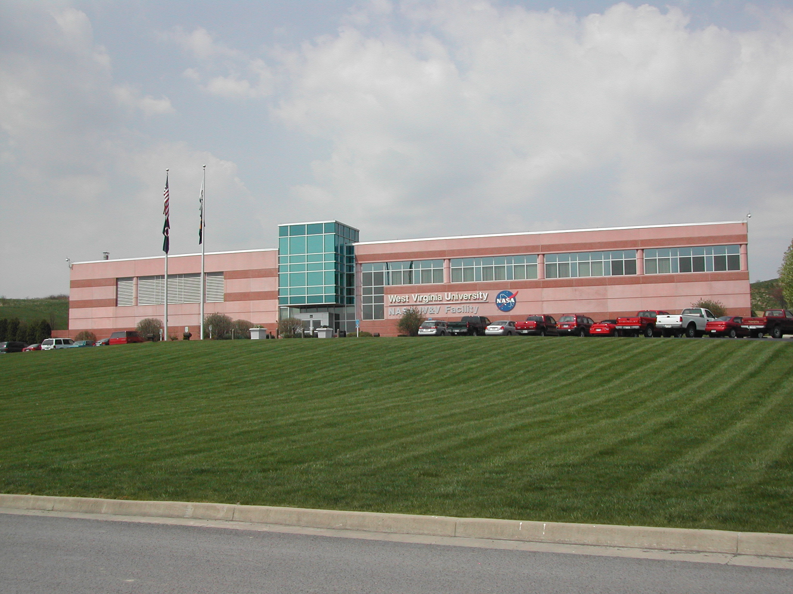
NASA IV&V Facility
New Employee Orientation

Slide 2
Welcome to West Virginia and welcome to the NASA IV&V Facility!
Providing orientation for new employees, to ensure a safe stay while at the Facility is the goal of our Staff.

Slide 3
Vision/ Mission
Vision: The NASA IV&V Program is valued for its superior performance in independent software validation and verification, its ability to provide high-confidence safety and mission assurance of NASA software, its positive impact on the development of high quality software, and its expertise in software engineering.
Mission: The NASA IV&V Program provides assurance to our stakeholders and customers that NASA's mission-critical software will operate dependably and safely.
The NASA IV&V Program performs leading-edge research that improves IV&V and software assurance methods, practices, and tools.
The NASA IV&V Program participates in the vitality of the community, as well as engages the public in the experience and benefits of exploration and discovery.

Slide 4
Facility values
Safety
Being safe and ensuring personal safety for employees and the public; providing security for everyone and protection of our resources and assets; being good stewards.
Integrity
Doing what was said would be done; having trust; being honest, fair, and accountable, both personally and organizationally; having steadfast ethical conduct; living by high standards of individual behavior.
Respect
Noticing individual worth; being open-minded; accepting diversity; seeking first to understand and then to be understood; having credibility; empowering oneself and others; welcoming every idea; listening; being civil.
Teamwork
Working together; supporting each other; collaborating effectively; sharing accomplishments and successes; providing collective wisdom; being responsible; helping others; leveraging synergy; exhibiting open communication.
Balance
Being well rounded with work, family, and self; balancing professional and personal time; giving to the community; practicing wellness of living; having a balanced involvement that enhances all; being there; coaching others.
Innovation
Seeking better ways or new methods to do things; being imaginative to enhance processes; staying on the leading edge; being original, agile, adaptive, and responsive to change.
Excellence
Producing quality goods and services; doing the right thing; performing second to none; practicing continuous improvement; being distinctive, creative, and committed; leading in best practices; being efficient.

Slide 5
In case of Fire
Follow the Emergency evacuation plan located on our Facility Services page @ http://services.ivv.nasa.gov/documentation/Emergency_Evacuation.pdf
All exit signs are clearly marked.
If exiting from the front, stand beyond the flag poles.
If exiting from the back, stand on the second tier parking lot.
Exiting from side doors muster in front or rear
Do not try to extinguish the fire, exit immediately

Slide 6
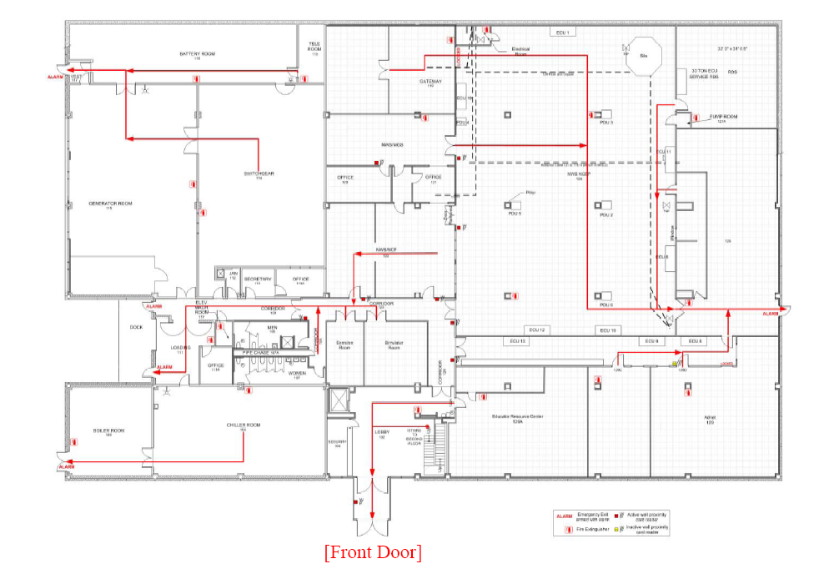
First floor evacuation routes

Slide 7
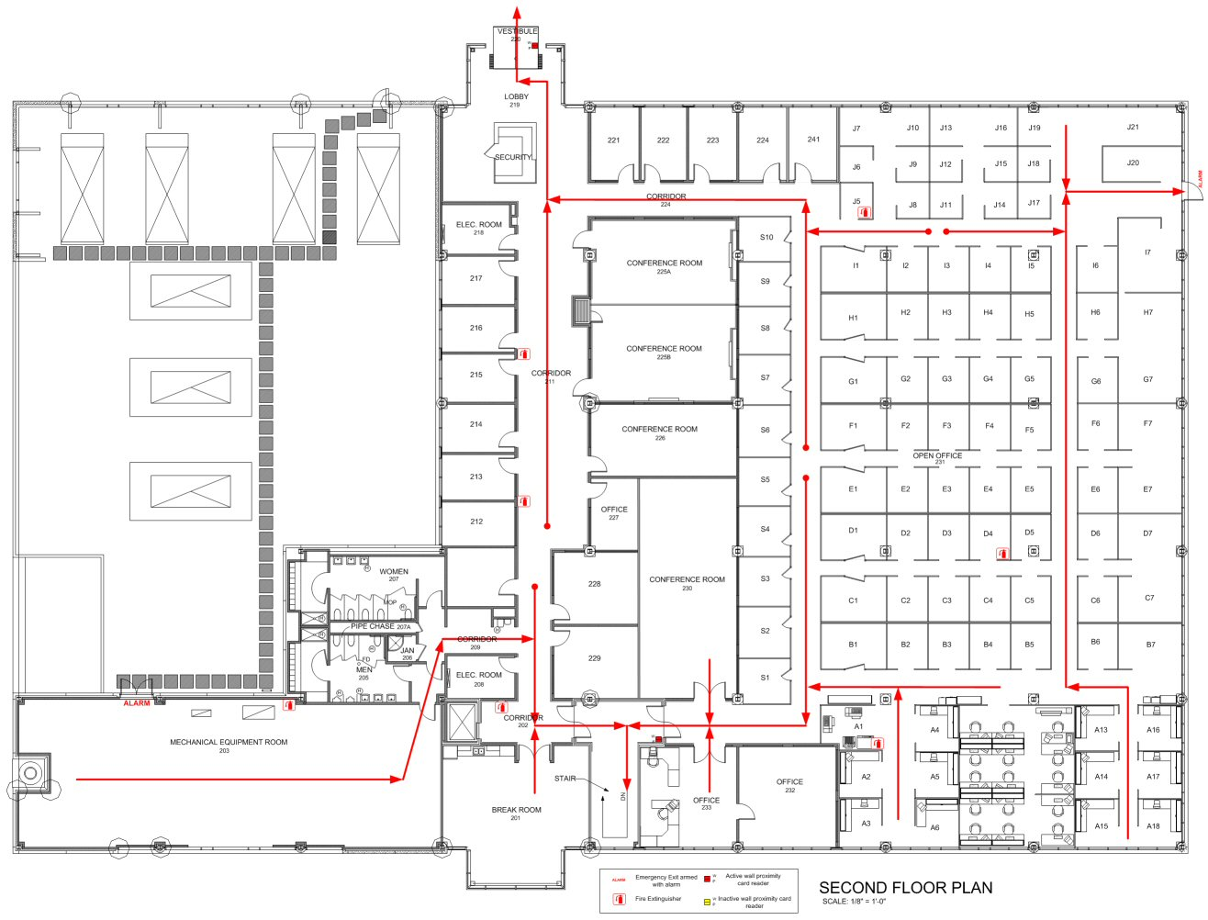
Second floor evacuation routes

Slide 8
In case of medical emergency
Follow the Medical Emergency Procedure located on our Facility Services page @ http://services.ivv.nasa.gov/documentation/Medical_Emergency_Procedure.pdf
Call 8200 or 9-911 direct.
All Security Officers are First aid,CPR & AED trained.

Slide 9
Health & Safety issues
Follow the IV&V Safety reporting located on our Facility Services page procedure @ http://services.ivv.nasa.gov/documentation/Safety_Reporting.pdf
Report all close calls to 8200
Report all accidents to 8200
Report all Health & Safety concerns to 8200

Slide 10
Fairmont Clinic for Civil Servants
All civil servants have the option of using the Fairmont clinic for your annual physicals
Call QTC medical to schedule an appointment @1800.260.1515
Fairmont Clinic 1322 Locust Ave.
Fairmont, WV 26554
Telephone: 304-366-0700

Slide 11
IV&V Emergency Action Plan
Please review the Facility EAP located on the services page.

Slide 12
If you host Visitors & Guests
Stay with your guest as required
Ensure they return their badge upon leaving the Facility
Review Visitors responsibilities located on our Facility Services page @ http://services.ivv.nasa.gov/documentation/Escorting_Visitors.pdf

Slide 13
Employee Safety Committee
We are an OSHA Voluntary protection program work site. The OSHA VPP is designed to promote excellence in safety and health by recognizing facilities with outstanding occupational safety and health management systems. It is based on a cooperative relationship between management and employees to promote employee protection and emphasize the continual identification and elimination of hazards in the workplace.
To participate on the committee please contact your supervisor

Slide 14
Employee Safety Committee Members
Ken Vorndran (NASA) phone# 8247
David Dial (WVU) phone# 8210
Debbie Radabaugh (TITAN) phone# 8257
Ben Kelly (NGIT) phone# 367-2032
Joe Irons (Crothall) phone# 8348
Jeremy Titus (Crothall) phone# 8393
Roger Hoops (Adnet) phone# 8354
Carol Muto (SETA) phone# 8244
Jess White (FSU) phone# 8433
David Sheldon (NASA) phone# 8289
Kurt Kehl (SETA) phone# 8341

Slide 15
Ergonomics program
We take a proactive approach and strive to set up your work station properly from day one.
Ergonomics is the science that characterizes the effects of physical exertion on the human body.
The practical application of ergonomics is the study of how working affects people.
Please work with our IT department to ensure your work station is set up ergonomically.
Review the ergonomics presentation located on the employee orientation page @ http://services.ivv.nasa.gov/orientation.html
If you need assistance and are supported by Adnet please contact the IT HELP DESK @ 8237. TITAN # 367-8265, NGIT # 367-2032

Slide 16
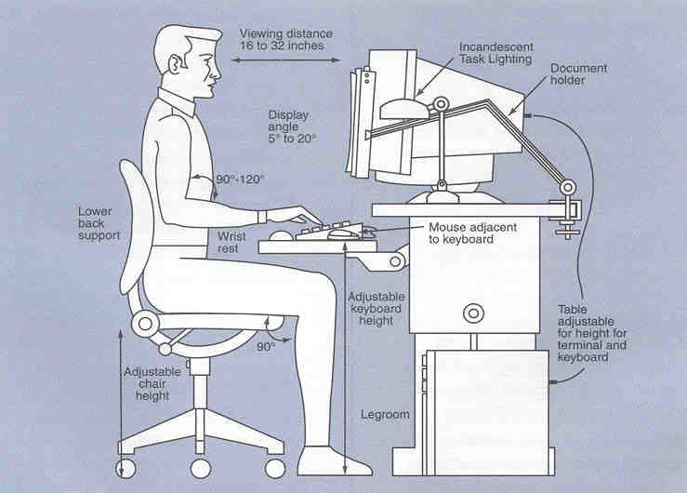
Ergonomics setup

Slide 17
Wellness program
Prior to using the fitness center you must have a Physicians approval
Aerobic exercise equipment is located in room 124B.
One of our Facility values is Balance: Being well rounded with work, family, and self; balancing professional and personal time; giving to the community; practicing wellness of living; having a balanced involvement that enhances all; being there; coaching others.
Please check our the wellness procedure on our Facility services page @http://services.ivv.nasa.gov/documentation/Wellness.pdf

Slide 18
IT Security
As a new employee you must complete the basic IT Security training located on SATERN. Plateau Learning → Login

Slide 19
Contact information
Network Operations IT Help Desk ext. 8237
L3 Systems Help Desk ext. 8265
NGIT Help Desk (304) 367-2032
Security Services ext. 8200
NetOps Help Desk email help@ivv.nasa.gov
Security Services email security@ivv.nasa.gov
Help Desk Web Page http://ithelpdesk.ivv.nasa.gov
Emergencies dial ext 8200 or 9-911
Please pick up a copy of our NASA IV&V Facility guide at the Security desk. http://ithelpdesk.ivv.nasa.gov/documentation/Computing_guide.pdf

Slide 20
NASA IV&V Facility welcomes you
I have read and understood the new Employee Orientation.
________________________________
Print name Signature Date
If you have any questions please contact our service desk @ 8200.
*Please sign & print a copy and return to Security

