Slide 1
Section 8
Instrument Status

Slide 2
Advanced Land Imager (ALI)
. . . Ralph Welsh
ALI Instrument Manager

Slide 3
Instrument Status
The instrument is in excellent condition, has passed all the environmental tests and has been fully calibrated
  A contaminant has appeared at times on the focal plane and was removed by raising the focal plane temperature to 270 K. We are prepared to take similar action in flight, as necessary.
The hardware is in flight configuration
  In the course of T/V testing the launch latch for the aperture cover will be released and it will have to be reset at the completion of the T/V tests
The software is in flight configuration
  Unchanged (except for project mandated RSN upgrades) since the completion of the MIT/LL T/V tests (Dec. 1998)

Slide 4
Changes Since the Last T/V Test
One of the aperture cover HOPA’s (High Output Paraffin Actuators) was found in a partially retracted position and was reset
  It is believed that it was not properly reset the last time that it had been triggered
The RSN software was upgraded to a more recent version
  Part of project-wide action

Slide 5
Remaining Work Prior to T/V
No open Problem Reports
No work on ALI required prior to pump-down
Critical limits in the ASIST data base have been updated
Review of Test Procedures to be completed by 6/8/00

Slide 6
Preparation for T/V Tests
The thermal analysis and design of appropriate heating and/or cooling plates for the T/V tests have been performed by Swales
  MIT/LL provided the thermal model for ALI
Trending parameters to support T/V have been established. No significant change expected from last T/V
Important conditions:
  The solar calibration diffuser launch latch and fail-safe HOPA’s are not to be triggered
  The aperture cover fail-safe HOPA’s are not to be triggered

Slide 7
MIT/LL T/V Test Support Team
Jeff Mendenhall, ALI System Engineer
Don Lencioni, ALI Scientist
Costas Digenis, ALI Program Manager
Dave Hearn, ALI Performance Analyst
Jennifer Evans, ALI Ground Systems

Slide 8
Readiness Statement
The Advanced Land Imager is ready for the second series of EO-1 thermal vacuum tests

Slide 9
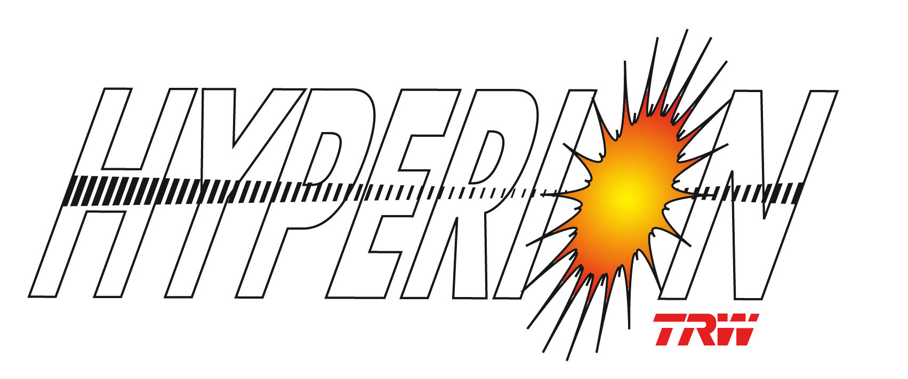
Hyperion Hyperspectral Imager
. . . Bill Browne
Hyperion Instrument Manager

Slide 10
Hyperion Instrument Readiness
Instrument ready for thermal vacuum test
  No open problem reports
Changes since last EO-1 Thermal Vacuum Test
  No changes to flight hardware or software. VNIR ASP temperature set point was increased (by command)
  Hyperion Electronics Assembly (HEA) and Cryocooler Electronics Assembly (CEA) have been twice re-integrated after having been removed to accommodate removal and replacement of the WARP
    Functional tests have verified operation following re-integration
  Test Heaters have been added to the HEA and CEA because of a different chamber arrangement, which does not have a thermal control panel for these boxes
  One test heater on the Hyperion Sensor Assembly (HSA) was replaced because it did not work during the last test (open circuit)

Slide 11
Special T/V Tests Involving Hyperion
Hyperion/Leisa Atmospheric Corrector (AC) Spectral Registration Comparison (SRC)
  An arc lamp outside the chamber will be viewed through a fiber optic cable and associated optics simultaneously by Hyperion and AC to enable comparison of spectral data in the SWIR range
  A dry run in air before chamber pump down will use the VNIR image to verify optical alignment of the fiber
VNIR Analog Signal Processor (ASP) Temperature Test
  Based on data from the first EO-1 T/V tests, the VNIR ASP temperature set point has been increased from -10 C to +32C to avoid increased noise in the image data (see following charts)
  VNIR dark current data will be collected every 2 minutes during the ASP temperature rise to extend the data baseline beyond that available, and confirm the noise is reduced
  The VNIR ASP data will be acquired twice, once at a hot plateau, and once at a cold plateau

Slide 12
VNIR ASP Temperature Versus Noise
The noise increase has been characterized and can be avoided by operating the ASP at temperatures above 32°C
Thermal models predict ASP temperature ranges of 32°C to 41°C when the ASP heater setpoints are 32°C on and 34°C off. This is based on heating which occurs during a standard Data Collection Event. Note that 41°C is acceptably below the upper ASP operating limit of 50°C. Also setpoint can be reset on-orbit through command upload.
The power required for the higher heater setpoints is 2W at the beginning of life. No additional power is required for end of life operations due to gradual increase in solar radiation absorption of the silver Teflon radiator surface.
Resolution: Increase heater setpoint temperatures to 32/34°C

Slide 13
Hyperion Thermal Control
TRW shipped to GSFC the computer-based thermal control system used during instrument-level T/V tests to provide control the array of Hyperion test heaters
  First EO-1 T/V test used manually adjusted controls
  System has been checked out following arrival 6/5 in preparation for EO-1 T/V II
  Experienced TRW technicians will oversee the system during T/V II
Cryocooler operations will be limited to three cycles to minimize the accumulated cycles on the SWIR focal plane
  Each cycle adds to limit of 100 cycles recommended by manufacturer (Boeing-Anaheim)
  Limit is based on bump-bonded focal plane assembly; bonds are life-cycle limited
  Aircraft-based TRWIS has accumulated many more that 100 cycles without any problems
  About 25 (TBR) cycles have been accumulated to date on Hyperion

Slide 14
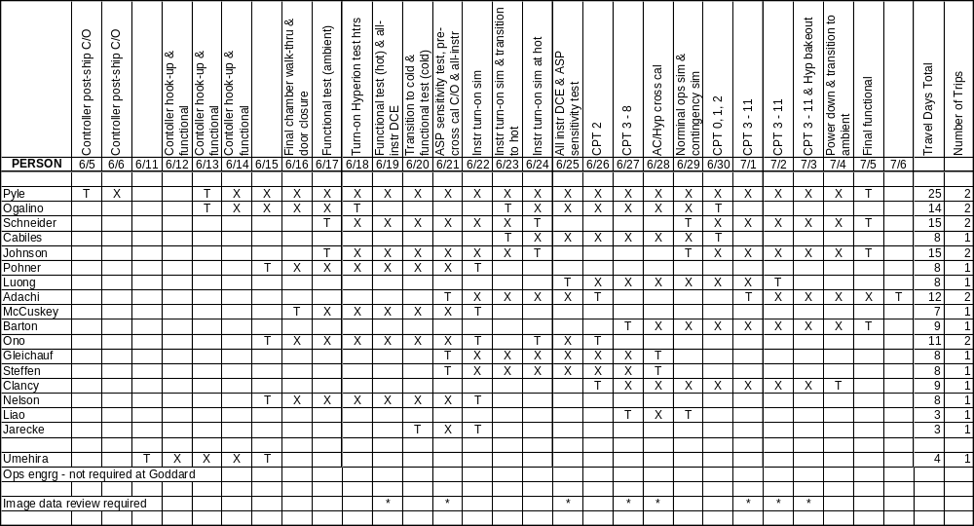
Hyperion Staffing Support to EO-1 T/V II
18 people cover 3 shifts at GSFC plus others provide remote support at TRW

Slide 15
Hyperion Data Processing
Quick look data processing at GSFC
  Some image data can be analyzed at GSFC, using available software tools, when a quick confirmation is needed
    For example, the Pre-launch Aliveness test internal cal image
Level 1 data processing at TRW
  SIMs & CPT Data Collection Events (DCEs) will be processed to level 0 and made available to TRW
    Via FTP or mailed tape
  TRW will process them through the level 1 algorithms and return a tape to GSFC
Instrument performance analysis
  Comprehensive tools used at TRW Hyperion Ops Center to evaluate instrument performance

Slide 16
Atmospheric Corrector (AC)
. . . Dennis Reuter
EO-1 LEISA Atmospheric Corrector

Slide 17
Since Last T/V
Operation Limited to Mount Temperatures < 30°C
  Operational Constraints Added to Flight Software
Unnecessary Function Call to Switch Bytes in TSM 207
  Function Call Removed from TSM 207 in Rev H
Red Limits Reviewed and Modified
Default Focal Plane Temperatures Set to -10°C and 2°C

Slide 18
Status
Instrument in Final Flight Configuration
No Hardware or Software Modifications Required Before T/V (or Flight)
No Open Issues
No Work Required on Instrument Before Pump-down (AC/ Hyperion Spectral Comparison Test Set-up Still in Progress)

Slide 19
Hyperion
(AC Spectral Registration Comparison Test)
. . . Tim Zukowski
Instrument Systems

Slide 20
Test Description (1)
Test presents both Hyperion and LEISA/AC with a light source having spectral features.
Comparison of spectral retrievals will demonstrate instrument spectral calibration accuracies.
Test source consists of an arc lamp with filters: light is delivered to the instruments via silica fibers, with all source elements external to T/V chamber.
Measurements of output from a source “breadboard” setup are basis for predicted SNRs of >200 for both instruments for a single frame - frame averaging will increase this.
Test procedure drafted - consists of a series of short scene collects of unmodified lamp spectrum, then lamp plus long-pass filters at 1.1, 1.2, 1.3, and 1.4 microns.

Slide 21
Test Description (2)
Technical Issues:
Alignment - Test has been designed to rely on mechanical tolerance, but ...
Hyperion requires “collimating”, so test images before chamber roll-in will verify source alignment (VNIR only). This is possible because of contamination control measures already planned.
Implementation - Large core fibers required for adequate light collection have large bend radius requiring special routing. Fibers are custom order with last minute delivery, so source characterization will be post-test.

Slide 22
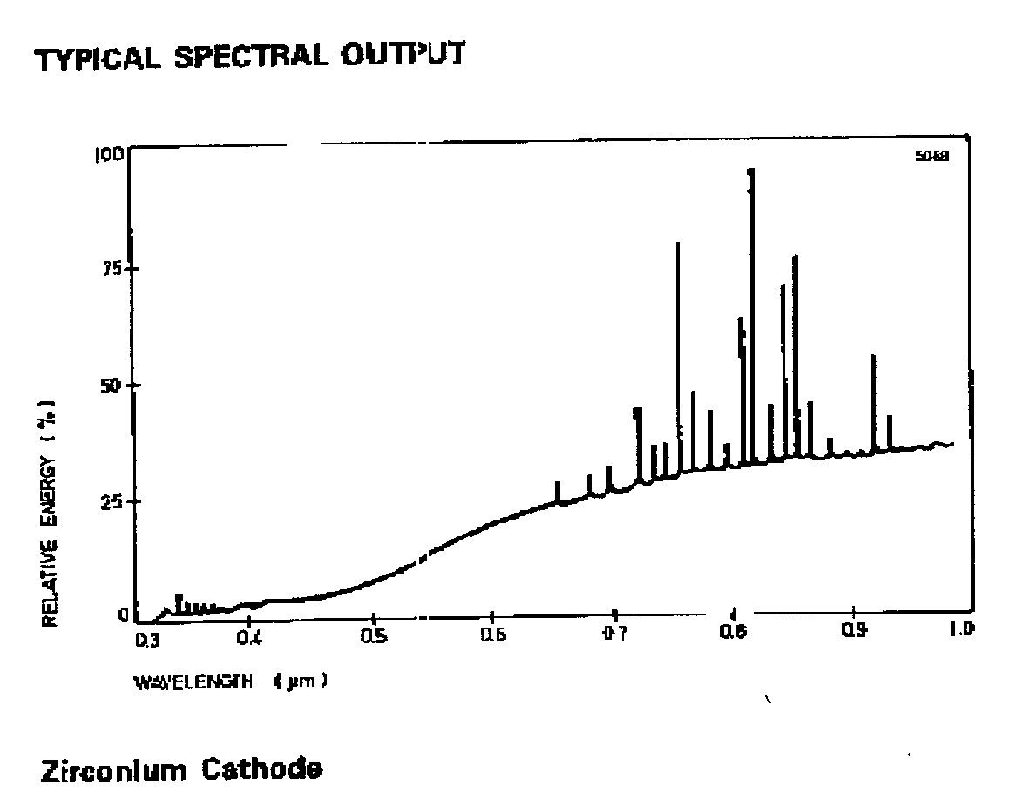
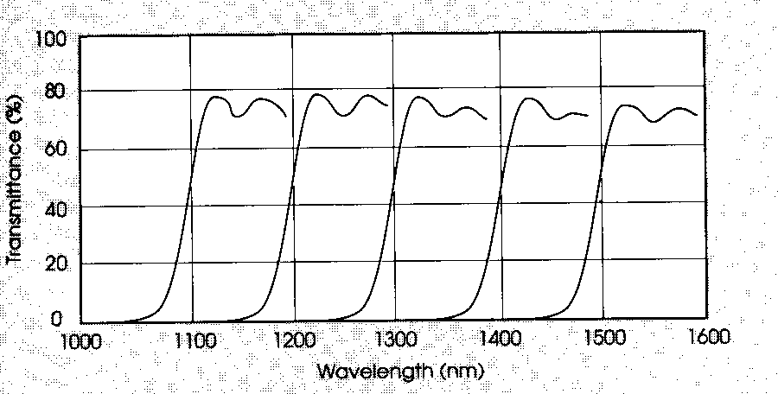
SRC Test GSE
Iris
Filter
Off Axis Parabola (2)
Fiber feedthrough (custom fab and potting)
Beam Splitter
Feedthrough plate
EEV Arc Lamp Source
Fiber input ends on 3-axis translators
Collimating Lens Assembly
SMA connector (typ.)
To Hyperion
To LEISA/AC

