Slide 1

Completion and Disposition of
FAA form 337, & Field Approvals

Slide 2

US. Department of Transportation
Federal Aviation
Administration
Notes:
Opening slide that introduces the fact that the FAA is a branch of the Department of Transportation.
_________________________________________________________________________________________________

Slide 3


Completion and Disposition of
FAA form 337, & Field Approvals
Notes:
Modify this presentation in any way you see fit.
It may be better for your purposes to split it into 2 segments.
You will be hard pressed to pull it off in 2 hours.

Slide 4
Introduction
FAA Form 337`s, & when to complete them
Procedures for completion & disposition
Use of acceptable and/or approved Data
Major Alterations
Applying for a Field Approval- MAJOR ALTERATIONS
Notes:
THE FIRST PART OF THIS PRESENTATION DEALING WITH THE COMPLETION AND DISPOSITION OF A 337, FOLLOWS AC 43.9-1E.
WE WILL NOT COVER FIELD APPROVAL OF MAJOR REPAIRS IN THIS PRESENTATION.
Advisory Circular
Subject: INSTRUCTIONS FOR COMPLETION OF Date: 5/21/87 ACNO: 43.9-lE
FAA FOPM 337 (OMB NO. 2120-0020), Initiated by: AFS-340 Change:
MAJOR REPAIR AND ALTERATION
(AIRFRAME, POWERPLANT, PROPELLER,
OR APPLIANCE)
PURPOSE. This advisory circular (AC) provides instructions for completing Federal Aviation Administration
(FAA) Form 337, Major Repair and Alteration (Airframe, Powerplant, Propeller, or Appliance).
2. CANCELJ-ATION. AC 43.9-lD, Instructions for Completion of FAA Form 337
(OMB 04- or Repair and Alteration (Airframe, Powerplant, Propeller, or Appliance), dated 9/5/79, is canceled.
RELATED FEDERAL AVIATION REGULATIONS (FAR) SECICIONS. FAR Part 43, Sections 43.5, 43.7,
43.9, and Appendix B.
INFORMATION. FAA Form 337 is furnished free of charge and is available at all FAA Air Carrier (ACDO),
General Aviation (GADO), Manufacturing Inspection (MIDD), and Flight Standards (FSDO) district offices,
and at all International Field Offices (IFO). The form serves two main purposes; one is to provide aircraft owners
and operators with a record of major repairs or alterations indicating details and approval, and the other is to
provide the FAA with a copy of the form for inclusion in the aircraft records at the FAA Aircraft Registration
Branch, Oklahoma City, Oklahoma.

Slide 5
REFERENCE MATERIAL
AC 43.9-1E, INSTRUCTIONS FOR COMPLETING FAA FORM 337
FAR PART 43 APPENDIX “A” Par. (a)
FAR PART 43 APPENDIX “B”
FAA ORDER 8300.10, (FIELD APPROVALS)
FSAW 98-03 - FSAW 98-18
LAACO & AWP-200 WORKING AGREEMENT GUIDANCE FOR FIELD APPROVALS
AC 65-19G, INSPECTION AUTHORIZATION KNOWLEDGE TEST GUIDE
Notes:
READ THE SLIDE
DUE TO COST INVOLVED IN OBTAINING AC 65-19, IT WILL NOT BE USED AS A HANDOUT (IT IS listed ONLY A REFERENCE.)

Slide 6
HANDOUT MATERIAL
AC 43.9-1E, INSTRUCTIONS FOR COMPLETING FAA FORM 337
EXCERPT FROM FAA ORDER 8300.10, (FIELD APPROVALS)
FSAW 98-03 & FSAW 98-18
EXAMPLE OF COMPLETED 337
COPY OF THIS PRESENTATION
Notes:
YOU MAY NOT WISH TO INCLUDE ALL HANDOUT MATERIAL AS REFERENCED ON SLIDES. REMEMBER THAT A PICTURE IS WORTH A THOUSAND WORDS.( HANDOUTS ARE GOOD.)
IF THE MECHANICS HAVE THE SAME DATA AVAILABLE TO THEM AS WE USE, IT WILL ONLY MAKE OUR JOB EASIER.

Slide 7

TEST !
THERE WILL BE A SERIES OF VERBAL QUESTIONS
Hopefully at the end of this presentation you will better understand the use and disposition of FAA form 337`s, and when, and how you need to apply for a field approval.
Notes:
Read the slide
Ice Breaker

Slide 8
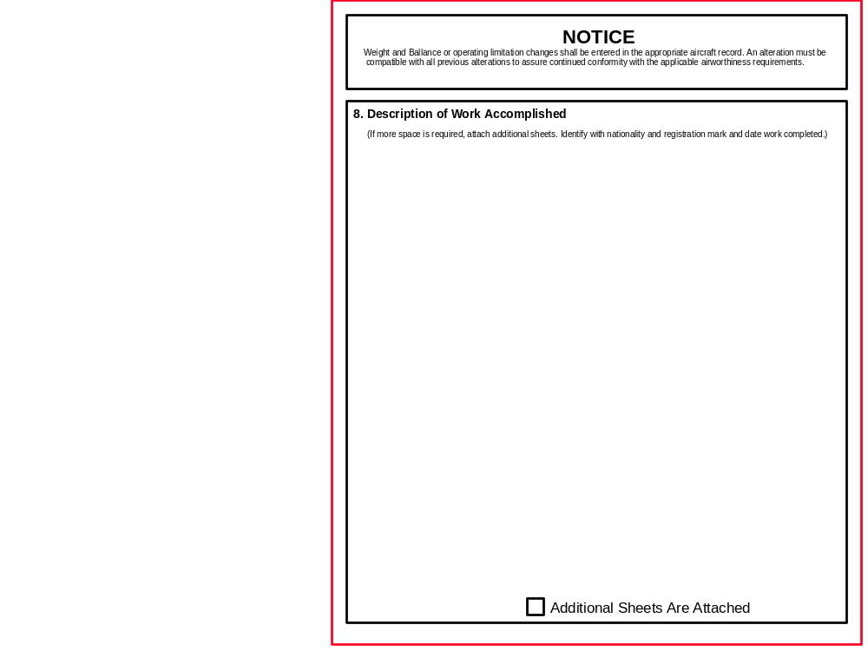


.337.DOC
Block 8
The Back
side
This is the hard
Part, or at
least it seems to be
for SOME mechanics
and repair stations
Notes:
Show and tell

Slide 9
Instructions fo completing “FAA Form 337”
BLOCK 1 & 2
AIRCRAFT and Registered Owner Information
VERIFY INFORMATION IS COMPLETE AND ACCURATE .
The Current AIRCRAFT REGISTRATION WILL PROVIDE THE REQUIRED INFORMATION.
LAST NAME USUALLY APPEARS FIRST FOR PRIVATE OWNERS.
Notes:
Read the slide - self explanatory
The next 2 slides will show a picture
Aircraft Registration Cert., followed on the next slide with form 337

Slide 10
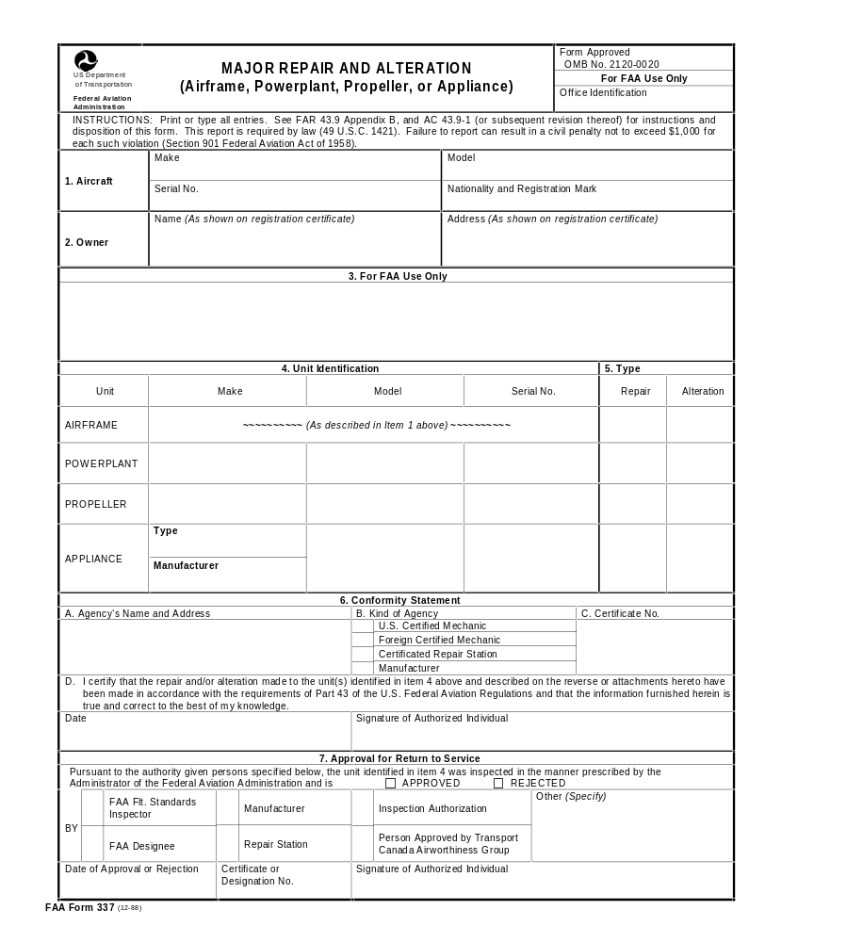

.
Blocks 1 & 2
Aircraft Information
Registered Owner/s
1
CESSNA
170
18454
N4122V
2
597 4th street
Rooster town, CA. 12345
      FARKLE, FRED B.
The Required information will be found On THE CURRENT Aircraft Registration Certificate
Notes:
Read the slide
AC 43.9-1E
Item 1 - Aircraft. Information to complete the "Make," "Model," and "Serial number" blocks will be found
on the aircraft manufacturer's identification plate. The "Nationality and Registration Mark" is the same as
shown on AC Form 8050-3, Certificate of Aircraft Registration.
Item 2 - Owner. Enter the aircraft- owner's complete name and address as shown on AC Form 8050-3

Slide 11



UNITED STATES OF AMERICA
DEPARTMENT OF TRANSPORTATION - FEDERAL AVIATION ADMINISTRATION
CERTIFICATE OF AIRCRAFT REGISTRATION
This Certificate
must be in the air-
craft when operated.
NATIONALITY AND
REGISTRATION MARKS
N
AIRCRAFT
SERIAL NO.
4122V
18454
MANUFACTURER AND MANUFACTURER’S DESIGNATION OF AIRCRAFT
CESSNA 170
This certificate is
issued for registra-
tion purposes only
and is not a cerrtif-
icate of title.
The Federal Avia-
tion Administration
does not determine
rights of ownership
as between private
persons.
I
S
S
U
E
D
T
O
FARKLE, FRED B.
597 4TH STREET
ROOSTER TOWN, CA 12345
INDIVIDUAL
It is certified that the above described aircraft has been entered on the register of the Federal
Aviation Administration, United States of America, in accordance with the convention on
International Civil Aviation dated December 7, 1944, and with the Federal Aviation Act of 1958,
and regulations issued thereunder.
DATE OF ISSUE
Foghorn Leghorn
APRIL 03, 1978
Administrator
AC Form 8050-3 (5-77)
Notes:
Self explanatory,
Some technicians are not aware of the aircraft registration certificate, as evidenced by some of their completed 337’s

Slide 12
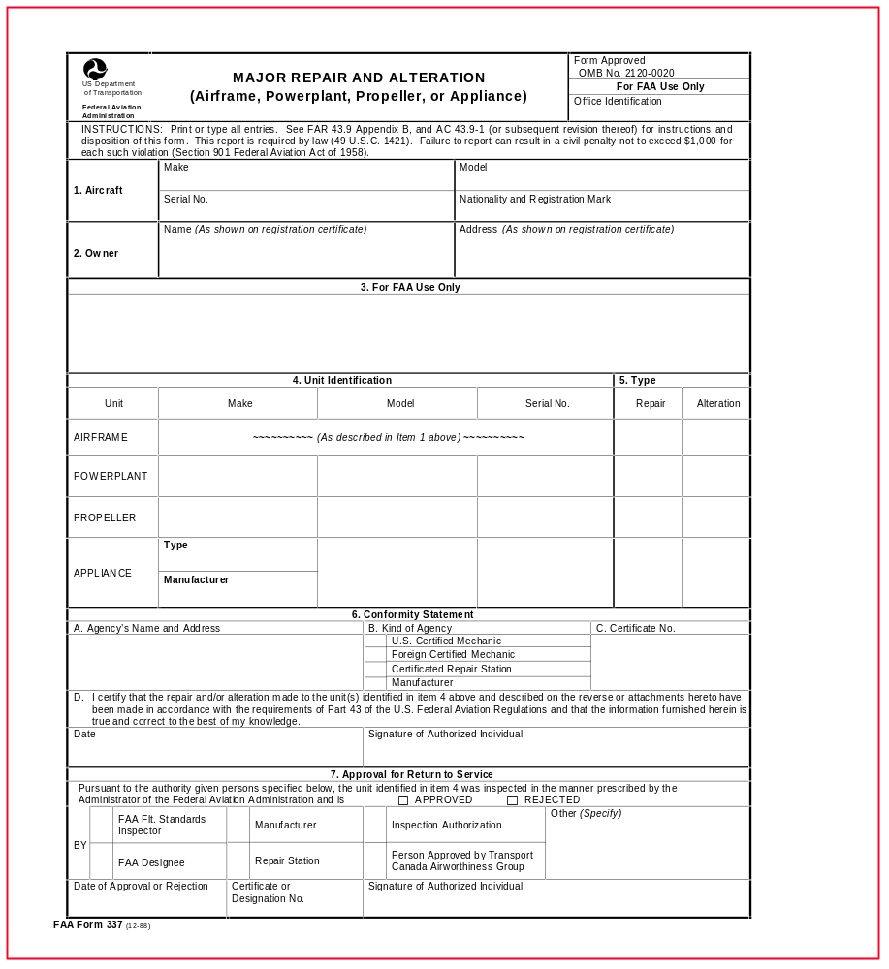

.
BLOCK 3
FAA USE
ONLY
WHEN FIELD APPROVAL IS REQUIRED
3
FAA Stamp Here
Notes:
For Field Approval stamp by FAA Inspector
AC 43.9-1E
c. Item 3 - For FAA Use Only. Approval may be indicated in Item 3 when the FAA determines that data to be used in performing a major alteration or a major repair complies with accepted industry practices and all applicable FAR. Approval is indicated in one of the following methods. (See paragraph 6b for further details.)

Slide 13

QUESTION # 1
How many different types of
Field approvals are there ?
One hundred ?
Two hundred ?
Only Three ?
Forty ?
I don't Know
3
Notes:
The answer is in the crystal ball
It helps to ease the audience. You don’t need to prove how smart you are. Don’t play mind games.

Slide 14
QUESTION # 1
How many different types of
Field approval are there ?
There are 3 Types of field approvals.
Notes:
The next 3 slides will show examples

Slide 15
Approval by Examination of Data Only
- One Aircraft Only:
#1
3. For FAA Use Only
The Data herein complies with applicable
airworthiness requirements and is approved only for the
above described aircraft, subject to conformity inspection
by a person authorized in FAR 43.7
04/22/98 Joe B. Cool
Date Signature SAC-FSDO
of FAA Inspector
Notes:
Self explanatory
(1) Approval by examination of data only - one aircraft only: "The data identified herein complies with the applicable airworthiness requirements and is approved for the above described aircraft, subject to conformity inspection by a person authorized in FAR Part 43, Section 43.7."

Slide 16
Approval by physical Inspection
Demonstration, Testing, etc...,
#2
3. For FAA Use Only
The Alteration (or repair) identified herein complies with applicable airworthiness requirements and is approved only for the above described aircraft, subject to conformity inspection by a person authorized in FAR 43.7
04/22/98 Joe B. Cool
Date Signature SAC-FSDO
of FAA Inspector
of The Data and Aircraft
- One Aircraft Only:
Notes:
DITO
(2) Approval by physical inspection, demonstration, testing, etc., of the data and aircraft - one aircraft only: "The alteration (or repair) identified herein complies with the applicable airworthiness requirements and is approved for the above described aircraft, subject to conformity inspection by a person authorized in FAR Part 43, Section 43.7."

Slide 17
#3
Approval by Examination of Data Only
3. For FAA Use Only
The Alteration identified herein complies with applicable
airworthiness requirements and is approved for duplication on identical aircraft, make, model, and altered configuration by the original modifier.
04/22/98 Joe B. Cool
Date Signature SAC-FSDO
of FAA Inspector
Duplication on Identical Aircraft
Multiple Field Approval
Notes:
Let them know that his is the entry used for multiple Field Approvals.
Commonly misunderstood.
Duplication on Identical Aircraft etc.
(3) Approval by examination of data only - duplication on identical aircraft. "The alteration identified herein complies with the applicable airworthiness requirements and is approved for duplication on identical aircraft make, model, and altered configuration by the original modifier."

Slide 18


Block 4
Unit
Identification
EXAMPLE
Installation of a different model Engine or Prop on an aircraft would be an Airframe Alteration
Reference the block for the unit being repaired or altered
4
Notes:
Should be self explanatory
The next slide will help to clarify with STC numbers.
d. 4 - Unit Identification. The information blocks under item 4 are used to identify the airframe, powerplant, propeller, or appliance repaired or altered. It is only necessary to complete the blocks for the unit repaired or altered.

Slide 19
BLOCK 4
STC NUMBER WILL REFERENCE THE UNIT BEING ALTERED
EXAMPLE
STC. SA1234SW (AIRFRAME STC)
STC. SE1234NM (ENGINE STC)
STC. SP1234AL (PROPELLER STC)
Notes:
You might wish to further explain the suffix of the STC number.
SW = South West region etc.

Slide 20
Question #2
Major Repairs and Alterations are defined in - - -
A. Websters Dictionary
B. The Bible
C. FAR 43 Appendix A
D. FAR 43.13
E. I'm not sure
C
Notes:
Answer is in the crystal ball

Slide 21
Question #2
Major Repairs and Alterations are defined in - - -
C. FAR 43 Appendix A
C
Notes:
Answer is in the crystal ball

Slide 22
MAJOR REPAIRS AND ALTERATIONS ARE DEFINED IN FAR PART 43 APPENDIX A.
PAR (a) MAJOR ALTERATIONS
PAR (b) MAJOR REPAIRS
Notes:
Let the audience know that Preventive Maintenance is also
found in Appendix “A”
Will be covered in more detail later on in presentation.

Slide 23
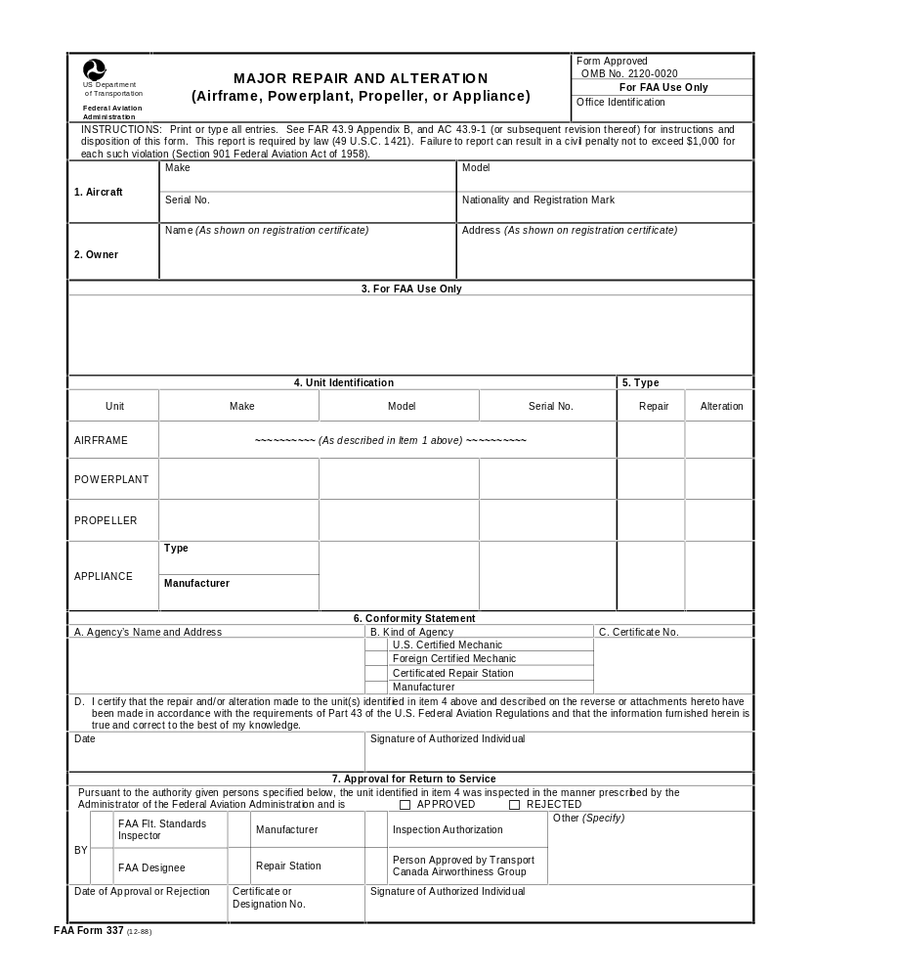
BLOCK 5
USED FOR
MAJOR REPAIR,
ALTERATION
OR
BOTH
5
Repair and Alteration blocks may both be checked if the unit being repaired is also altered at the same time, by STC, or Field Approval
Example
Piper J3 wing was repaired and recovered with Stits Poly Fiber per an STC
Notes:
Self Explanatory
Read the slide
e. Item 5 - Type. Enter a checkmark in the appropriate column to indicate if the unit was repaired or altered.

Slide 24
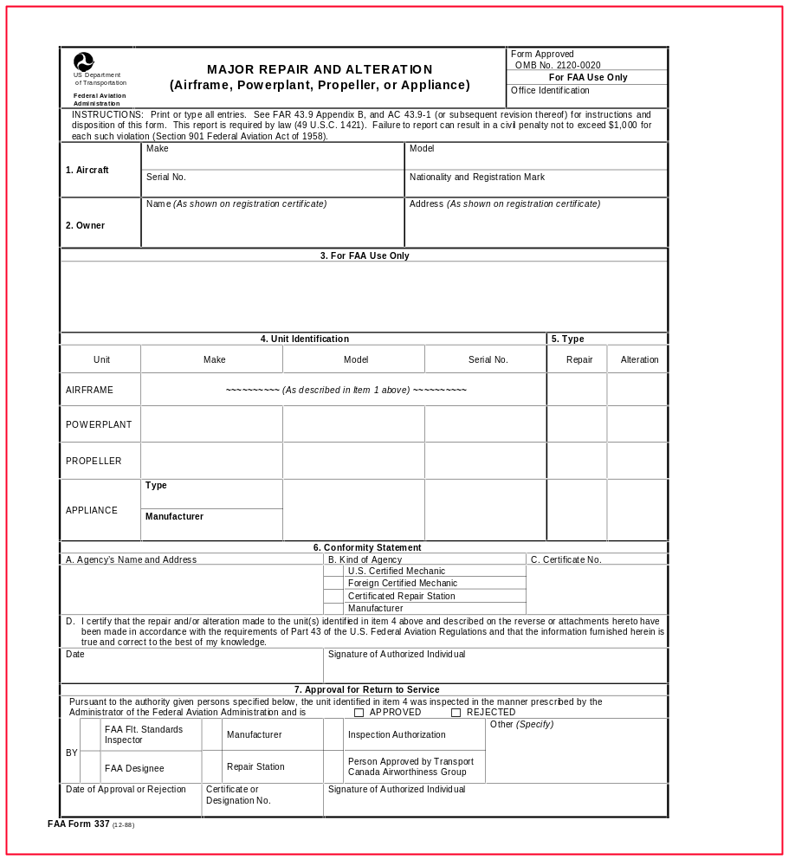


Block 6
Conformity
Statement
A
Agency's Name and address,
Mechanics name and permanent mailing address
MANUFACTURER'S AND REPAIR STATIONS NAME AND ADDRESS UNDER WHICH BUSINESS IS DONE
6
A
  ART FARKLE
  594 SIXTH AVE.
  ANYTOWN, USA 12345
A&P 12345678
MAY 16,1998
  Art Farkle ART FARKLE
Notes:
Self Explanatory
Read the slide
f. Item 6 - Conformity Statement.
(1) "A" - Agency's Name and Address. Enter name of the mechanic, repair station, or manufacturer accomplishing the repair or alteration. Mechanics should enter their name and permanent mailing address. Manufacturers and repair stations should enter the name and address under which they do business.

Slide 25

Block 6
Conformity
Statement
B
B Kind of Agency,
CHECK THE APPROPRIATE BOX TO INDICATE CERTIFICATED MECHANIC OR TYPE ORGANIZATION THAT PERFORMED THE WORK, SUCH AS REPAIR STATION
6
B
Art Farkle
someplace, USA 12345
A&P 123456789
Notes:
Read the slide
(2) "B" - Kind of Agency. Check the appropriate box to indicate the type of person or organization who performed the work.
2 Par 5

Slide 26
Block 6
Conformity
Statement
C
C Certificate Number & ratings held
MECHANICS - CERTIFICATE NUMBER
REPAIR STATION - AIR AGENCY CERTIFICATE NUMBER AND RATING(S)
MANUFACTURERS - TYPE PRODUCTION OR STC NUMBER
MANUFACTURERS OF TSO APPLIANCES SHOULD ENTER TSO NUMBER OF THE APPLIANCE ALTERED
6
C
  Art Farkle
  address
A&P 123456789
Notes:
Read the slide
(3) ”C” - Certificate Number. Mechanics should enter their
mechanic certificate number block, e.g., 1305888. Repair stations
should enter their air agency certificate number and the rating or ratings under which the work was performed, e.g., 1234, Airframe Class 3. Manufacturers should enter their type production or Supplemental Type Certificate (STC) number. Manufacturers of Technical Standard Orders (TSO) appliances altering these appliances should enter the TSO number of the appliance altered.

Slide 27


Block 6
Conformity
Statement
D
D THIS SPACE IS USED TO CERTIFY THAT THE REPAIR OR ALTERATION WAS MADE IN ACCORDANCE WITH THE FARS
CERTIFICATED ENTITY: ENTER DATE WORK COMPLETED AND SIGNATURE & Print Your Name
REPAIR STATIONS : MAY AUTHORIZE PERSONS IN THEIR EMPLOY TO DATE AND SIGN THE CONFORMITY STATEMENT
6
Art Farkle
address
A&P 123456789
D
MAY 16, 1998 Art Farkle Art Farkle
Notes:
Self Explanatory
(4) “D" - Compliance Statement: This space is used to certify that:
the repair r alteration was made in accordance with the FAR. When work was performed or supervised by certificated mechanics not employed by a manufacturer or repair station, they should enter the date the repair or alteration was completed and sign their full name. Repair stations are permitted to authorize persons in their employ to date and sign this conformity statement.

Slide 28
APPROVAL FOR RETURN TO SERVICE
Block 7
REMEMBER THE APPROVED AND REJECTED BOXES.
CHECK APPROVING AUTHORITY
ENTER CERTIFICATE NUMBER AS IT APPEARS ON ENTITIES CERTIFICATE
Notes:
The next slide will show the blocks in question
The first 2 blocks are commonly overlooked

Slide 29
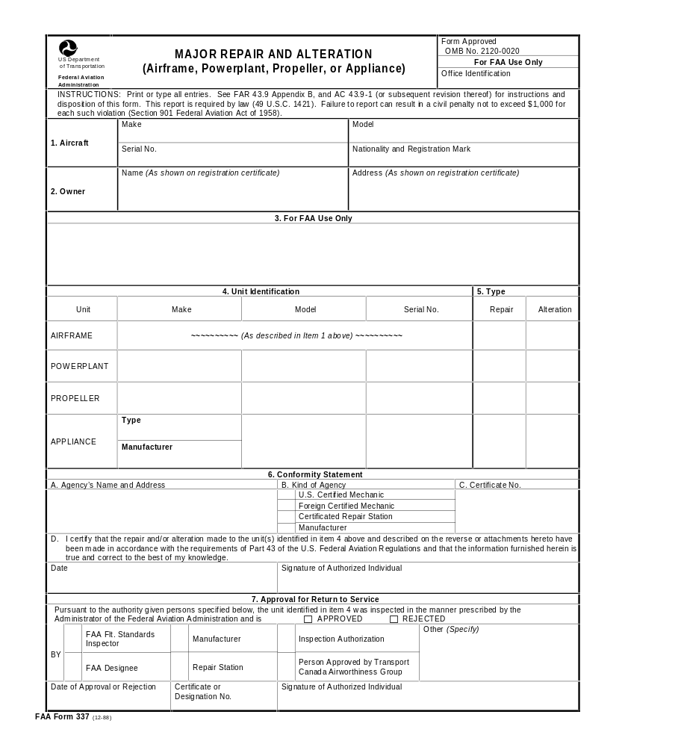



Block 7
Approval for
Return to
Service
APPROVED OR REJECTED
APPROVING
AUTHORITY, IA,
REPAIR STATION,
OR WHATEVER
DATE, CERTIFICATE
NUMBER, AND
SIGNATURE OF
AUTHORIZED
INDIVIDUAL
7
MAY 16,1998
IA 123456789
Foghorn Leghorn Foghorn Leghorn
Notes:
Read the slide
g. Item 7 - Approval for Return to Service. FAR Part 43 establishes
the conditions under which major repairs or alterations to airframes,
powerplants, propellers, and/or appliances may be approved for return to service. This portion of the form is used to indicate approval or rejection of the repair or alteration of the unit involved and to identify the person or agency making the airworthiness inspection. Check the "approved" or "rejected" box to indicate the finding. Additionally, check the appropriate box to indicate who made the finding. Use the box labeled "other" to indicate a finding by a person other than those listed. Enter the date the finding was made. The authorized person who made the finding should sign the form and enter the appropriate certificate or
designation number.
Note - A signature in item 7, "Approval for Return to Service," does not signify FAA approval unless the box to the left of "FAA Flight Standards Inspector" or "FAA Designee" is checked. The other person.-, listed in item 7, are authorized to "approve for return to service" if the repair or alteration is accomplished using FAA-approved data, is performed in accordance with applicable FAR, and found to conform.

Slide 30

.337.DOC
1.
CONCISE, AND LEGIBLE STATEMENT
DESCRIBING THE WORK ACCOMPLISHED.
DESCRIPTION OF THE REPAIR OR
ALTERATION, RELATIVE TO THE
AIRCRAFT OR COMPONENT.
2.
IDENTIFY AND DESCRIBE THE APPROVED
DATA USED AS THE BASIS FOR APPROVING THE MAJOR REPAIR OR ALTERATION
FOR RETURN TO SERVICE.
3.
STC, FIELD APPROVAL,
SERVICE MANUAL,
AC 43.13-1B etc.
ICA?
Notes:
show and tell
This slide more closely resembles the back of a 337.
(2) Data used as a basis for approving major repairs or alterations for return to service must be FAA-approved prior to its use for that purpose and includes: FAR (e.g., airworthiness directives), AC's (e.g., AC 43.13-lA under certain circumstances), TSO's parts manufacturing approval (P.MA), FAA-approved manufacturer's instructions, kits and service handbooks, ty .pe certificate data sheets, and aircraft specifications. Other forms of approved data would be those approved by a designated engineering representative (DER), a manufacturer holding a delegation option authorization (DOA), STC'S, and, with certain limitations, previous FAA field approvals. Supporting data such as stress analyses, test reports, sketches, or photographs should be submitted with the FAA Form 337. These supporting data will be returned to the applicant by the local FAA district office since only FAA Form 337 is retained as a part of the aircraft records at Oklahoma City.
(3) If additional space is needed to describe the repair or alteration, attach sheets bearing the aircraft nationality and registration mark and the date work was completed.
(4) Showing weight and balance computations under this item is not required; however, it may be done. In all cases where weight and balance of the aircraft are affected, the changes should be entered in the aircraft weight and balance records with the date, signature, and reference to the work performed on the FAA Form 337 that required the changes.

Slide 31
AC 43.13-1B
ARE YOU
USING IT?

Slide 32
BLOCK 8 INFORMATION
IF ADDITIONAL SHEETS ARE ATTACHED IDENTIFY THEM WITH;
AIRCRAFT REGISTRATION `N` NUMBER
Date Work Completed
Aircraft Total Time (Recommended)
Notes:
Read slide
State that total time is recommended only, as occasionally maintenance records are lost and there may be no other way to help determine
aircraft time

Slide 33
DIAGRAMS AND DRAWINGS MAY BE INCLUDED IF REQUIRED TO ADEQUATELY EXPLAIN LOCATION AND DETAILS OF THE REPAIR OR ALTERATION
REMEMBER TO CHECK THE BOX on Bottom OF BLOCK 8 IF ADDITIONAL SHEETS ARE ATTACHED
Notes:
Read slide

Slide 34
REMEMBER !!
The description should be in sufficient detail to permit a person unfamiliar with the work to understand what was done, and the methods and procedures used in doing it.
Notes:
Read slide

Slide 35
ENGINES, PROPELLERS,
SPARE PARTS, OR COMPONENTS
DISPOSITION OF 337 AFTER REPAIR OR
ALTERATION OF COMPONENTS
NOT CURRENTLY INSTALLED ON AIRCRAFT
Notes:
The next slide shows a picture of what a 337 looks like.

Slide 36
REPAIR AND
ALTERATION
OF COMPONENTS/
ENGINE, PROPS,
etc..
1
2
COMPLETE APPROVAL PORTION IN DUPLICATE, LEAVING BLOCKS 1 & 2 BLANK --------
ESCORT
X
110
765432A
ATTACH 2 COPIES TO PART OR COMPONENT UNTIL IT IS INSTALLED ON AN AIRCRAFT
NARCO
RADIO FIXERS INC..
ANYTOWN,USA. 12345
RFI321R
RADIO CLASS 1
X
MAY 16,1998
Foghorn Leghorn Foghorn Leghorn
x
x
May 17,1998
RFI123R
Bull Durham Bull Durham
Notes:
Read slide
Should be self explanatory.
AC 43.9-1E 5/21/87
Note: When a major repair or alteration is made to a spare part or appliance, items 1 and 2 will be left blank, and the original and duplicate copy of the form will remain with the part until such time as it is installed on an aircraft. The person installing the part will then enter the required information in blocks 1 and 2, give the original of the form to the aircraft owner/operator, and forward the duplicate copy to the local FAA district office within 48 hours after the work is inspected.

Slide 37
REQUIREMENTS OF INSTALLER
COMPLETE BLOCKS 1 & 2 OF BOTH ORIGINALS. (See Aircraft Registration)
MAKE AN ENTRY IN THE AIRCRAFT RECORDS MAKING REFERENCE TO THE FAA FORM 337
GIVE SIGNED ORIGINAL 337 TO THE OWNER AND FORWARD A COPY TO THE FAA FSDO IN THE AREA WHERE THE INSTALLER IS OPERATING
Notes:
Read slide

Slide 38

REMEMBER TO COMPLETE
LOG BOOK ENTRY and FAA FORM 337
LOG BOOK ENTRY IS REQUIRED WITH 337
337 is to provide aircraft owners and operators with a record of major repairs or alterations indicating details and approval.
To provide permanent record for FAA in Oklahoma City
Copy may be retrieved at a later date for a small fee
Notes:
Many IA’s are not aware that as the person approving block 7 of the
337 for return to service, he/she must also make an entry in the
maintenance record referencing the 337 and work accomplished.
A copy of the aircraf 337,s and Registration may be obtained from
Aircraft Registration Branch in OKC for a few dollars.

Slide 39
DISPOSITION AFTER COMPLETION
1 SIGNED ORIGINAL TO OWNER/OPERATOR
1 COPY TO FAA FSDO WITHIN 48 HOURS
Notes:
read slide
It is the rule
Will be covered in more detail later in this presentation

Slide 40
EXTENDED RANGE FUEL TANKS INSTALLED IN PASSENGER OR BAGGAGE COMPARTMENT
FAA FORM 337 AT LEAST IN TRIPLICATE.
1 SIGNED ORIGINAL TO THE OWNER
1 COPY ABOARD THE AIRCRAFT, (FAR 91.417)
1 COPY TO FAA
Notes:
Read slide
It is the rule
FAR Part 43 Appendix B
(d) For extended-range fuel tanks installed within the passenger compartment or a baggage compartment, the person who performs the work and the person authorized to approve the work by 43.7 of this part shall execute an FAA Form 337 in at least triplicate. One (1) copy of the FAA Form 337 shall be placed on board the aircraft as specified in 91.417 of this chapter. The remaining forms shall be distributed as required by paragraph (a)(2) and (3) or (c)(1) and (2) of this paragraph as appropriate.
(Arndt. 43-10, Eff. 11/29/68); (Arndt. 43-29, Eff. 12/8/87); (Arndt. 43-31, Eff. 8/18/90)

Slide 41
APPROVED DATA

Slide 42
APPROVED DATA
TC DATA SHEETS
AIRCRAFT SPECS
STC’s
AD’s
APPLIANCE MANUFACTURER’S MANUALS
(excluding installation instructions)
MANUFACTURER’S APPROVED DATA (DOA)
DER APPROVAL, FAA FORM 8110-3
DAS APPROVED DATA

Slide 43
AC 65-19G
APPROVED DATA CONTINUED
AC43.13-1B: (Aircraft Inspection and Repair section), may be used directly as approved data without further approval ONLY when there is no manufacturer repair or maintenance instructions that address the repair and the user has determined that it is:….

Slide 44
APPROPRIATE TO THE PRODUCT BEING REPAIRED ; i.e.. (aircraft) Piper J3C-65 etc.
DIRECTLY APPLICABLE TO THE REPAIR BEING MADE
NOT CONTRARY TO MANUFACTURERS DATA
APPROVAL APPLIES ONLY TO REPAIRS,
NOT Alterations
Notes:
Piper J3 is referenced because the AC is approved data for repair of that aircraft.

Slide 45
ACCEPTABLE DATA

Slide 46
ACCEPTABLE DATA
INSTALLATION INSTRUCTIONS
MAINTENANCE MANUALS
ADVISORY CIRCULARS
SERVICE BULLETINS
SERVICE INSTRUCTIONS
SERVICE LETTERS

Slide 47

WHAT IS A MAJOR ALTERATION ?
How and When do I Apply for a Field Approval ?
Notes:
THE FOLLOWING SLIDES WILL COVER MAJOR ALTERATIONS AS EXTRACTED FROM PART 43 APPENDIX “A”
WILL LEAD INTO “HOW TO APPLY FOR A FIELD APPROVAL

Slide 48
FAR Part I, “MAJOR ALTERATION”
(DEFINITION)
“Major Alteration” means an alteration not listed in the aircraft, aircraft engine, or propeller specifications -
Notes:
Read the slide

Slide 49
“Major Alteration” cont.
1. That might appreciably affect weight, balance, structural strength, performance, Powerplant operation, flight characteristics, or other qualities affecting airworthiness; or
Notes:
Read the slide

Slide 50
“Major Alteration” cont.
2. That is not done according to accepted practices or cannot be done by elementary operations.
Notes:
Read the slide

Slide 51
“Major Alteration” cont.
Major alterations are to be recorded on FAA form 337. (FAR 43 Appendix B)
Give the signed original of that form to the aircraft owner.
Forward a copy of that form to the local FSDO within 48 HOURS after the approval for return to service.
Don't forget the Log Book Entry
Notes:
This slide is somewhat repetative, but it helps to drive the point home and to increase awareness of part 43 Appendix “B”
The Rule. FAR Part 43
Appendix B - Recording of Major Repairs and Major Alterations
Except as provided in paragraphs (b), (c), and (d) of this appendix,
each person performing a major repair or major alteration shall-
(1) Execute FAA Form 337 at least in duplicate;
(2) Give a signed copy of that form to the aircraft owner; and
(3) Forward a copy of that form to the local Flight Standards District Office
within 48 hours after the aircraft, airframe, aircraft engine, propeller, or appliance
is approved for return to service.

Slide 52

Field Approval
What is it ?
How do I apply for a Field Approval ?
Notes:
Your time may be running out !
You might have to step up the pace.
Be very familiar with FAAOrder 8300.10 (Field Approvals) prior to administering this segment.

Slide 53
What is a field Approval ?
(7) Field approval: An approval by an authorized Airworthiness Aviation Safety Inspector
(ASI) of a major repair or major alteration that is accomplished by one or more of the following, as appropriate:
* Examination of data only - one aircraft
· Physical inspection, demonstration, testing, etc. - one aircraft
· Examination of data only - duplication on identical aircraft
Notes:
Read slide, it is from 8300.10
Below is beginning excerpt from FAA Order 8300.10
PTRS code data etc have been deleted to save space.
10/30/95 8300.10 CHG 10
CHAPTER 1. PERFORM FIELD APPROVAL OF MAJOR REPAIRS
AND MAJOR ALTERATIONS
SECTION 1. BACKGROUND
3. OBJECTIVE. This chapter provides guidance in determining the category of a repair or alteration and ensuring, that the aircraft can be returned to service in accordance with approved technical data.
5. GENERAL.
A. Definitions:
(]) Aircraft: For purposes of this chapter, means aircraft, aircraft engine, propeller, appliances and any component thereof.
(2) Alter: To change or modify.
(3) Major alteration: An alteration not listed in the aircraft, aircraft engine, or propeller specifications that also fits one or more of the following:
a Might appreciably affect airworthiness by changing weight, balance, structural strength, performance, powerplant operation, or flight characteristics
Is not done according, to accepted practices or cannot be done by elementary operations

Slide 54
What is Needed
FAA Order 8300.10
(8) Data: Information that supports and/or describes the alteration or repair,-including the following:
Drawings, sketches, and/or photographs
Stress analysis
Service Bulletins
Engineering Orders
Operating limitations
Notes:
Excerpt from 8300.10

Slide 55
Approved data: is Data that can be used to substantiate major repairs/major alterations, derived from the following:
Type Certificate Data Sheets
·Supplemental Type Certificate (STC) data, provided that it specifically applies to the item being repaired/altered & Airworthiness Directives (AD)
Airframe, engine, and propeller manufacturer's "FAA-approved" maintenance manuals or instructions
Appliance manufacturer's manuals or instruction, unless specifically not approved by the Administrator or resulting, in an alteration to the airframe, engine, and/or propeller
Notes:
The slide is right out of 8300.10
8300.10
(9) Approved data: Data that can be used to
substantiate major repairs/major alterations, derived from the following:
Type Certificate Data Sheets
· Supplemental Type Certificate (STC) data, provided that it specifically applies to the item being repaired/altered & Airworthiness Directives (AD)
· Airframe, engine, and propeller manufacturer's "FAA-approved" maintenance manuals or instructions·
Appliance manufacturer's manuals or instruction, unless specifically not approved by the Administrator or resulting, in an alteration to the airframe, engine, and/or propeller·
·

Slide 56
Approved data cont.
FAA Form 337, Major Repair or Alteration, when the specified data has been previously approved and will be used as a basis for a field approval
· CAA Form 337, dated prior to 10/l/55
* FAA Form 337, used to approve multiple usage only, by the original modifier
Notes:
FAA Form 337, Major Repair or Alteration, when the specified data has been previously approved and will be used as a basis for a field approval
· CAA Form 337, dated prior to 10/l/55
* FAA Form 337, used to approve multiple usage only, by the original modifier
* Structural Repair Manuals (SRM), only as a source of approved data for a major repair, when it is an FAA-approved document. Data that is contained in an SRM that is not FAA approved, can be used on a case-by-case basis if prior FAA approval is granted for that repair.
* Parts Manufacturer Authorization (PMA), is considered approved data for the part only, an STC may be required for the actual installation
* Technical Standard Order Authorization (TSOA)
* Delegation Option Authorization produced FAA-approved data
* Designated Engineering, Representative (DER) approved data, only within authorized limitations
* Designated Alteration Station (DAS) FAA approved data
* Repair data, under SFAR 36, for the holder's aircraft only
* Foreign bulletins, for use on U.S.-certificated foreign aircraft, when approved by the foreign authority

Slide 57
Apply for Field Approval
FAA ORDER 8300.10 Chapter 1, section 1. Perform Field Approval of Major Repairs and Major Alterations
LAACO & AWP-200 WORKING AGREEMENT
  GUIDANCE FOR FIELD APPROVALS
Notes:
Note - The guidance in FAA Order 8300.10 is mirrored in the
AWP-200 Working Agreement and the Alaska Alteration Handbook.
Some regional procedures have been added.
Data describing an article or appliance used in an alteration which is FAA-approved under a TSO. As such, the conditions and tests required for TSO approval of an article are minimum performance standards. The article may be stalled only if further evaluation by the operator (applicant) documents an acceptable installation which may be approved by the Administrator
Data in the -form of (TCA) Appliance Type Approval issued by the Minister of Transport Canada for those parts or appliances for which there is no current TSO available. The TCA certificate is included within the installation manual provided with the appliance and includes the date of issuance and an environmental qualification statement.
Data describing a part or appliance used in an
alteration which is FAA-approved under a Parts Manufacturer Approval (PMA). (An STC may be required to obtain a PIMA as a means of assessing, airworthiness and/or performance of the part.)

Slide 58
REMEMBER !
FIELD APPROVALS ARE NORMALLY USED FOR MAJOR ALTERATIONS
REQUIRES THE SAME DATA AS AN STC
NOT REQUIRING DETAILED ENGINEERING ANALYSIS
NORMALLY FOR ONE PRODUCT ONLY; BY SERIAL NO….
MAY REQUIRE ENGINEERING APPROVAL or ASSISTANCE
WILL IT REQUIRE A FLIGHT MANUAL SUPPLEMENT ?
WILL AIRCRAFT REQUIRE A FLIGHT TEST ?
Notes:
Read the slide
These are only some of the things the technician needs to know prior to applying for a field approval
You should familiarize yourself with 8300.10 field approval procedures prior to administering this presentation.

Slide 59
YOUR RESPONSIBILITIES
CONTACT FSDO PRIOR TO INCORPORATING A MAJOR CHANGE
COORDINATE WITH AIRCRAFT OWNER AND FAA
DETERMINE IF ALL DATA IS APPROVED
SUBMIT YOUR PROPOSAL AND DATA TO FSDO FOR EVALUATION
WAIT FOR APPROVAL BY ASI BEFORE CONTINUING
YOU MAY NEED TO SUBMIT ADDITIONAL INFORMATION
Notes:
The next slide shows a flow chart, also found in more detail in LAACO/AWP-200 Working agreement
LAACO & AWP-200 Working Agreement
2.1 Applicant
Performs a major repair/alteration to the aircraft and obtains FAA approval.
Determines the interrelationship between the proposed repair/alteration and any other approved modifications so that there is no adverse effect on the aircraft airworthiness.
Submits substantiating data to show compliance with the Federal Aviation Regulations (FARs).

Slide 60
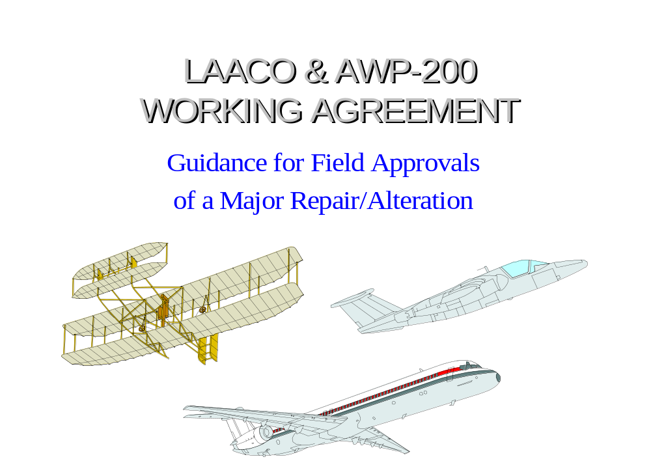
Notes:
This slide only to depict cover of document

Slide 61
3.0 Field Approval Process
3.1
3.2
3.3
Applicant
FSDO
ACO
3.3.1
3.3.2
Focal Point
Project Engineer
A
D
All data
NO
Review
Branch
approved?
Repair/Alteration
Assign Work
L
YES
B
J
Project Engineer
M
Field
E
Assigned
Contact
NO
Approval
Multi
ACO for STC
Appropriate
Engineering
?
Disciplines
Review Data
*
STC
Guideline
N
YES
- Team Members
NO
-DERs
F
I
ACO
YES
Only
Assistance
AFM/RFM
Prepare Findings
O
Req’d
Supplement
- Memo/Fax
?
?
C
NO
YES
Accomplish
G
K
Return Data
Repair/Alt.
Approve
and Findings
P
Complete
Repair/Alt. Data
Approval by
337 Form
Flight Test Branch
NO
All Data
H
YES
Approved?
Q
File
Correspondences
1
Notes:
TYPICAL PROCEDURE FOR FIELD APPROVAL PROCESS.
SHOULD BE VERY LITTLE DIFFERENCE BETWEEN FSDO’S OR REGIONS, IF ANY.
ACO PROCEDURES NOT SHOWN DUE TO COMPLEXITY AND NOT RELEVANT TO THE INTEREST OF MOST MECHANICS.
ONLY THE ASI DEALS WITH THE ACO, NOT THE APPLICANT.
This slide will put them to sleep, don’t dwell on it.
This Slide is only intended to show the audience that procedures have been established

Slide 62
REMEMBER !!
THE ASI MUST FOLLOW GUIDANCE OF FAA ORDER 8300.10
Change 10, Chapter 1
Aviation Safety Inspector guidance to perform Field Approval of Major Repairs and
Major Alterations
Contrary to popular belief,
Inspectors do have limitations
Notes:
Read the slide
Some mechanics think Inspectors have no
Limitations.
FAA Order 8300.10.
ASI Qualifications. The Airworthiness ASI must be authorized, experienced, and/or trained with the methods, techniques, and materials involved in the major repair/major alteration.
C. ASI Responsibilities.
(1) The ASI must be able to determine if, by granting a field approval, the affected product can be expected to result in safe operation and conform to regulatory requirements.
(2) If the ASI is not thoroughly familiar- with all aspects of the alteration or repair, or has any doubt about the expected airworthiness, approval/denial must not be given. Approval/denial can be given once the necessary assistance has been acquired and the ASI has made a determination about the expected airworthiness.
D. Data Requirements and Coordination.
(]) The source of the data used by an operations strictly the operator's responsibility.
ASI's should not obtain nor provide data for the operator's use.
Source, cost, and other matters concerning an operator's acquisition of data, presented as part of an alteration approval action, should not be questioned.

Slide 63
FSAW 98-03
FLIGHT STANDARDS AIRWORTHINESS BULLETIN
To ensure that Instructions for Continued Airworthiness are provided for Major Alterations Approved Under the Field Approval Process
EFFECTIVE DATE: 01-30-98
INSTRUCTIONS MUST BE INCLUDED ON FAA FORM 337
Notes:
Actual Copy of FSAW 98-03
BULLETIN TYPE: Flight Standards Information Bulletin for Airworthiness (FSAW) BULLETIN NUMBER: FSAW 98-03
BULLETIN TITLE: Instructions for Continued Airworthiness for Major Alterations Approved Under the Field Approval Process
EFFECTIVE DATE: 01-30-98
1. PURPOSE. This bulletin establishes a Federal Aviation Administration (FAA) wide policy that will direct FAA aviation safety inspectors (ASI) , who are authorized to approve major alterations under the field approval process, to ensure that Instructions for Continued Airworthiness are provided for major alterations.
2. BACKGROUND. During discussion of Title 14 of the Code of Federal Regulations (14 CFR) part 135, single engine Instrument Flight Rules (IFR) passenger carrying rule, it was found that no policy existed to ensure that major alterations such as a stand-by electrical system or vacuum system, that could be approved under the field approval process, would be maintained to a published acceptable standard. This policy will require field approvals for major alterations to match 14 CFR part 21, section 21.50 for at least one set of complete Instructions for Continued Airworthiness for each supplemental type certificate (STC) that was applied for after January 28, 1981.
3. ACTION. Airworthiness ASI's will ensure that each major alteration approved under the field approval process identified in FAA Order 8300.10, volume 2, chapter 1, will have at least one copy of Instructions for Continued Airworthiness prepared in accordance with 14 CFR parts' 23, 25, 27, 29, 31, 33, or 35; sections 23.1529, 25.1529, 27.1529, 29.1529, 31.82, 33.4, or 35.4, as applicable. The Instructions for Continued Airworthiness will be documented on FAA Form 337, Major Repair and Alteration. The Instructions will become a part of the aircraft's inspection and/or maintenance program for aircraft operated under this chapter. The ASI shall ensure that the entry for the major alteration in the aircraft's maintenance records required by part 43, section 43.9 will also include a reference to the Instructions for Continued Airworthiness and identify FAA Form 337 where the instructions are documented. The form will be kept in the aircraft's permanent records in accordance with part 91, section 91.417(2)(vi).
4. INQUIRIES. This bulletin was developed by Flight Standards, Aircraft Maintenance Division, AFS-300, General Aviation and Commercial Branch, AFS-340. Any questions regarding this bulletin should be directed to AFS-340 at (202) 267-8203.
EXPIRATION. This bulletin will expire on 01-31-99.
/s/
Ava L. Mims, Manager,
Aircraft Maintenance Division

Slide 64
HBAW 98-18
FAA ORDER 8300.10
Flight Standards Handbook Bulletin
For Airworthiness (HBAW)
Checklist for Instructions for Continued
Airworthiness for Major Alterations
Approved Under the Field Approval Process
EFFECTIVE DATE: 10-07-98
DATA IS IN YOUR HANDOUT
Notes:
ORDER: 8300.10
APPENDIX: 4
BULLETIN TYPE: Flight Standards Handbook Bulletin
for Airworthiness (HBAW)
BULLETIN NUMBER: HBAW 98-18
BULLETIN TITLE: Checklist for Instructions for Continued
Airworthiness for Major Alterations
Approved Under the Field Approval Process
EFFECTIVE DATE: 10-07-98-----------------------------------------------------------------
1. PURPOSE. This bulletin is in response to Federal Aviation Administration (FAA) field requests for guidance on what constitutes acceptable Instructions for Continued Airworthiness (ICA) for major alterations accomplished under a Field Approval, as addressed by Flight Standards Information Bulletin for Airworthiness FSAW 98-03. This bulletin includes an ICA checklist which was developed using extensive regional office and field inspector input.
A. The purpose of the ICA is to provide instructions on how to maintain aircraft which are altered and appliances which are installed in accordance with a field approved major alteration. The ICA checklist is a guide for both the applicant who creates the ICA and the FAA Flight Standards inspector who accepts the ICA. The ICA developed in accordance with this guidance constitutes methods, techniques and practices "acceptable" to the Administrator. If the ICA for the submitted field approval major alteration is not acceptable to the FAA inspector, that inspector should not sign Block 3 of the applicant’s FAA Form 337, Major Repair and Major Alteration.
B. The purpose of the ICA being addressed in Block 8 of
Form 337 is to provide the aircraft owner/operator with the following three advantages:
(1) The major alteration and reference to ICA are contained in one document;
(2) The ICA becomes a permanent aircraft record as
required by Title 14 of the Code of Federal Regulations (14 CFR), section 91.417(a)(2)(vi); and
(3) The owner/operator can contact FAA registry for a replacement FAA Form 337 if the ICA is lost or destroyed. The additional reference to the presence of ICA as part of the major alteration in the aircraft’s maintenance entry, will ensure that maintenance personnel appropriately address ICAs during future inspections.

Slide 65
HBAW 98-18
Checklist contains 16 items
Instructions for Continued
Airworthiness for Major Alterations
Approved Under the Field Approval Process
Applicable Procedures must be
attached to - FAA Form 337
Notes:
ORDER: 8300.10
APPENDIX: 4
BULLETIN TYPE: Flight Standards Handbook Bulletin
for Airworthiness (HBAW)
BULLETIN NUMBER: HBAW 98-18
BULLETIN TITLE: Checklist for Instructions for Continued
Airworthiness for Major Alterations
Approved Under the Field Approval Process
EFFECTIVE DATE: 10-07-98-----------------------------------------------------------------
1. PURPOSE. This bulletin is in response to Federal Aviation Administration (FAA) field requests for guidance on what constitutes acceptable Instructions for Continued Airworthiness (ICA) for major alterations accomplished under a Field Approval, as addressed by Flight Standards Information Bulletin for Airworthiness FSAW 98-03. This bulletin includes an ICA checklist which was developed using extensive regional office and field inspector input.
A. The purpose of the ICA is to provide instructions on how to maintain aircraft which are altered and appliances which are installed in accordance with a field approved major alteration. The ICA checklist is a guide for both the applicant who creates the ICA and the FAA Flight Standards inspector who accepts the ICA. The ICA developed in accordance with this guidance constitutes methods, techniques and practices "acceptable" to the Administrator. If the ICA for the submitted field approval major alteration is not acceptable to the FAA inspector, that inspector should not sign Block 3 of the applicant’s FAA Form 337, Major Repair and Major Alteration.
B. The purpose of the ICA being addressed in Block 8 of
Form 337 is to provide the aircraft owner/operator with the following three advantages:
(1) The major alteration and reference to ICA are contained in one document;
(2) The ICA becomes a permanent aircraft record as
required by Title 14 of the Code of Federal Regulations (14 CFR), section 91.417(a)(2)(vi); and
(3) The owner/operator can contact FAA registry for a replacement FAA Form 337 if the ICA is lost or destroyed. The additional reference to the presence of ICA as part of the major alteration in the aircraft’s maintenance entry, will ensure that maintenance personnel appropriately address ICAs during future inspections.

Slide 66
Summary
How to complete FAA form 337
APPROVED and ACCEPTABLE DATA
MAJOR ALTERATIONS
APPLYING FOR A FIELD APPROVAL
YOUR Responsibilities
NEW item… HBAW 98-18 ICA
Notes:
Tell them again what you just told them
We covered all these items

Slide 67
US. Department of Transportation
Federal Aviation
Administration
Notes:
Opening slide that introduces the fact that the FAA is a branch of the Department of Transportation.
_________________________________________________________________________________________________

