Slide 1
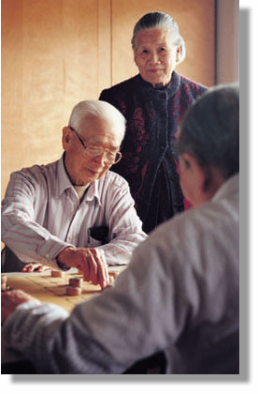




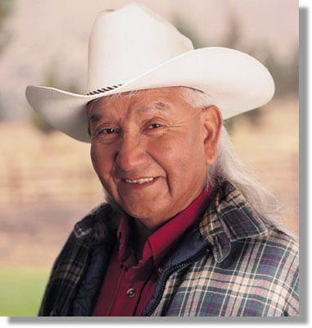

Census 2000:
Census 2000:
Data on:
Race and
Hispanic Origin
Data on:
Race and
Hispanic Origin
Notes:
The purpose of this presentation is to:
Explain how data on race and Hispanic or Latino origin were collected in Census 2000.
• Explain why the Census 2000 data on race are not directly comparable with data from 1990 and previous censuses.
Explain the difference between the concepts of race and Hispanic or Latino origin.
• Illustrate how the race tables are shown in Census 2000 data tabulations.
Racedata3_9_3_27.ppt

Slide 2
Population Growth: 1990’s
U.S. population grew in both size and racial & ethnic diversity.
Census 2000 showed that the U.S. population on April 1, 2000 was 281.4 million.
This is a 13 percent increase over the 248.7 million people counted in the 1990 census.
Notes:
•The population of the U.S. grew not only in size during the 1990s, but also in terms of racial & ethnic diversity.
• Census 2000 showed that the U.S. population on April 1, 2000 was 281.4 million.
• This is a 13 percent increase over the 248.7 million people counted in the 1990 census.
• ? people indicated White Alone. An additional ? People identified as White in Combination with 1 or more race groups
• ?? People indicated Black or African American Alone. An additional ?? People identified as Black or African American in combination with 1 or more race groups.
• ?? People indicated American Indian and Alaska Native alone. An additional ?? Of people identified as American Indian and Alaska Native in combination with 1 or more race groups.
• ?? people indicated Asian alone. An additional ?? People identified as Asian in combination with 1 or more race groups.
• ??? People indicated Native Hawaiian and Other Pacific Islander alone. An additional ??? People identified as Native Hawaiian and Other Pacific Islander in combination with 1 or more race groups

Slide 3
Data Collection:
New Federal Guidelines
1997: Revised standards for collecting data on race and ethnicity
Census 2000: Respondents could report more than one race
Notes:
In 1997, after a lengthy analysis and public comment period, the Federal Office of Management and Budget (OMB) revised the standards for how the Federal government would collect and present data on race and ethnicity. The new guidelines reflect “the increasing diversity of our Nation’s population, stemming from growth in interracial marriages and immigration.”
These new guidelines revised some of the racial categories used in 1990 and preceding censuses and allowed respondents to report as many race categories as were necessary to identify themselves on the Census 2000 questionnaire.
Note: The full report is available at: http://www.whitehouse.gov/omb/inforeg/race.pdf

Slide 4
Federal Guidelines and Census 2000
Major Changes
Hispanic or Latino asked before race
Respondents could select more than one race
American Indian and Alaska Native combined
Asian and Pacific Islander category split
  Asian
  Native Hawaiian or Other Pacific Islander
Notes:
As a result of the new Federal guidelines, there were several changes to the Census 2000 questionnaire.
The question on whether a person is Hispanic or Latino was asked before race. In 1990 it followed the race question. [Speaker Note: Research has shown that Hispanics do not select the "Other" race category as often when this sequencing is used.]
Respondents could choose more than one race to identify themselves.
The American Indian and Alaska Native categories were combined. In 1990 there were separate categories for American Indian, Eskimo and Aleut.
The 1990 Asian or Pacific Islander category was split into Asian and Native Hawaiian and other Pacific Islander

Slide 5
New Federal Guidelines: Implications
More and improved information on racial and ethnic diversity
Census 2000 race data are not directly comparable with data from 1990 and previous censuses
Notes:
What do the new guidelines mean for the Census 2000 data on race and ethnicity?
The changes to the way race and ethnicity are collected make for improved and more accurate information.
And allowing people to report more than one race adds to our knowledge about racial diversity of the United States.
It also means that Census 2000 race data are not directly comparable with data from 1990 and previous censuses.

Slide 6
Why a Question on Race?
Various Federal Programs Require Data on the Racial Make-Up of the Community
  Federal Affirmative Action Plans
  Home Mortgage Disclosure Act Reporting
  Community Reinvestment Act Reporting
  Veterans Benefits
  Public Health Service Act Needs
Notes:
The Census has included a question on race since the first census in 1790.
The data are used to apply for, to report on, or to monitor compliance with a variety of Federal programs, including the ones shown on this slide.

Slide 7
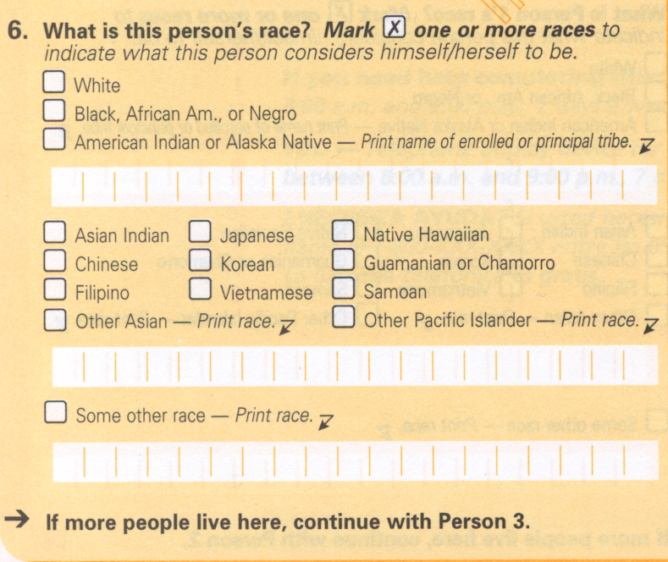
Census 2000 Question on Race
Notes:
The Census 2000 question on race included 15 separate response categories and 3 areas where people could write in a more specific race group.
White
Black, African American or Negro
American Indian or Alaska Native
7 Asian categories
Native Hawaiian and Other Pacific Islander
With the concurrence of the Office of Management and Budget, the Census Bureau added an additional race category: Some Other Race.
American Indians and Alaska Natives could write in their tribe; Other Asian, other Pacific Islander and persons indicating Some other Race could also provide a write-in entry.

Slide 8
Some Other Race
Respondents providing write-in entries, such as, multiracial, mixed, interracial, or a Hispanic or Latino group are included in the “Some Other Race” category
In Census 2000 about 43 percent of Hispanics or Latinos classified themselves as “Some Other Race”
In Census 2000, 97 percent of the people who reported as “Some Other Race” were Hispanic or Latino.
Notes:
Respondents providing write-in entries, such as, multiracial mixed, interracial, or a Hispanic or Latino group are included in the “Some Other Race” category.
About 43 percent of Hispanics or Latinos classified themselves as “Some Other Race” in Census 2000.
In 2000, 97 percent of the people who reported as “Some Other Race” were Hispanic or Latino.
Speakers Note:
- Hispanic or Latino is defined as an ethnic characteristic rather than a race and
- People of Hispanic or Latino origin may be of any race
- Data on Hispanic or Latino population are obtained from a separate question on Hispanic origin

Slide 9
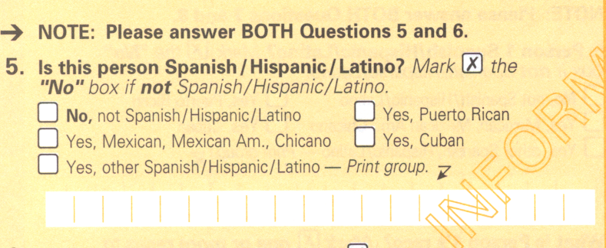
Census 2000: Hispanic or Latino
Notes:
Hispanic or Latino origin was a separate question on the Census 2000 questionnaire. Persons of Hispanic or Latino background may be of any race.
Persons of Hispanic or Latino origin could further define their ethnicity by checking one of four boxes:
□ Puerto Rican
□ Mexican
□ Cuban
□ Other Spanish/Hispanic/Latino,
and could write in the group or country of origin.
Persons NOT of Hispanic or Latino origin could check the No box.

Slide 10
Why a Question on Hispanic or Latino Origin?
Various Federal Programs Require Data on the Ethnic Make-Up of the Community
  Federal Affirmative Action Plans
  Community Reinvestment Act Reporting
  Public Health Service Act Needs
Notes:
The Census has included a question on Hispanic origin since 1970.
The data are used to apply for, to report on, or to monitor compliance with a variety of Federal programs, including the ones shown on this slide.

Slide 11
How will race and ethnicity be shown in Census 2000 data tables?
In some tabulations, race data will be shown for 63 categories
In other tabulations race will be collapsed and shown as
  Race alone categories
  A two or more races category
  Race alone or in combination with one or more races
Data for Hispanic/Latino in many tables
Data for non-Hispanic/Latinos
Counts and characteristics for specific groups in later tabulations
Race choice is by self-identification
Notes:
Depending on the data product and the particular table, you will be able to get data on race and ethnicity tabulated in several different ways.
In some tables, including the first release of census 2000 information, data will be tabulated for 63 possible combinations of race.
Other tables will show data for 7 race categories: the 6 major race- alone categories (White, African-American, American Indian and Alaska Native, Asian, Native Hawaiian and Other Pacific Islander, and some other race) and a two or more races category.
There will be other tabulations where race alone or in combination will be shown.
Hispanic or Latino is shown in many of the tables.
Data for non-Hispanic/Latinos is available.
You will also be able to get counts, that is, totals for the detailed race (that is, Chinese, Japanese, Filipino, etc.) detailed Hispanic origin (Mexican, Puerto Rican, Cuban, etc.) as well as many American Indian and Alaska Native categories in some of the early products.
Characteristics of these groups will be available in later releases of Census 2000 information.
Race choice is by self-identification.

Slide 12
Race Alone Categories
Six mutually exclusive racial categories:
  White alone
  Black or African American alone
  American Indian or Alaska Native alone
  Asian alone
  Native Hawaiian or other Pacific Islander alone
  Some other race alone
Notes:
As part of Federal guidelines on collecting and presenting data on race, the Federal Office of Management and Budget requires agencies to use a minimum of five categories:
White
Black or African American
American Indian or Alaska Native
Asian
Native Hawaiian or Other Pacific Islander
The Census Bureau, with OMB approval, included some other race as a sixth race category on the Census 2000 questionnaire and will tabulate data for the some other race category.
Additionally, in many of the data products, you will also see tabulations of the number of persons who checked two or more races.

Slide 13
Two or More Races
Single category that groups together all multiple -race responses
This category, together with the 6 single race-alone categories will add up to 100% of the population
Notes:
The two or more races category groups together in a single category all of the multiple race responses. This category, together with the six race-along categories (White, Black or African American, American Indian and Alaska Native, Asian, Native Hawaiian and Other Pacific Islander and Some Other Race) will add to 100 percent of the population.

Slide 14
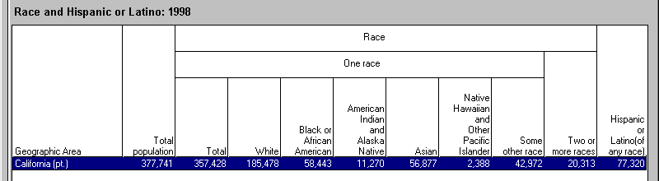
Total Population by Race
The six race alone groups and the two or more races group, when combined, sum to 100 percent of the population
100% population
Notes:
To illustrate, here’s an example of Census 2000 table. You can see from the table that the six “race alone” groups and the “two or more” races group, when combined, sum to 100 percent of the population.
Remember that Hispanic or Latino is not a race group and should not be added to the race categories.

Slide 15
63 Race Categories
  6 Race alone categories
  +15 Categories of 2 races
  +20 Categories of 3 races
  +15 Categories of 4 races
  + 6 Categories of 5 races
  + 1 Category of 6 races
63
Possible combinations
Notes:
In other tables, including the first release of Census 2000 information, multiple race data will be tabulated not as a single category, but for all possible combinations of race. That is, in addition to the 6 race alone categories, you will get the 57 possible combinations of these 6 groups, including:
15 categories of 2 races (e.g., White and African American, White and Asian, etc.)
20 categories of 3 races
15 categories of 4
6 possible categories of 5 races, and
1 category of 6 races.
For 63 possible categories of race.

Slide 16
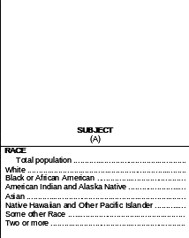
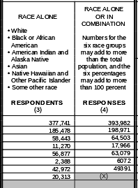
Race: Alone or In Combination
Notes:
In some of the later tabulations you will see race data reported “alone or in combination”
This tabulation includes not only persons who marked only one race (the race alone category) but also those who marked that race and at least one other race.
For example, a person who indicated that she was of Filipino and African American background would be included in the African American alone or in combination count, as well as in the Asian alone or in combination count.
The alone or in combination totals (column (4)) are tallies of responses, rather than respondents. So the sum of the race alone or in combination will add to more than the total population.

Slide 17
Detailed Race, Tribes, and Hispanic or Latino Groups
Includes specific entries and write-in categories
Chinese, Japanese, Filipino, etc.
American Indian and Alaska Native categories
Cuban, Mexican, Puerto Rican, etc.
Notes:
Most of the Census 2000 data tables will be presented for the total population, as well as for the 6 OMB race groups, and often for the two or more races category. In some tabulations however, you will see information for individual groups that make up the 6 categories as well as for some write-in entries.
This additional detail includes information for the various
Asian racial groups--Chinese, Japanese, Indian, Filipino, Korean, etc.,
Native Hawaiian and Other Pacific Islander groups, such as Samoan and Guamanian.
American Indian and Alaska Native tribes and other write-in categories
Hispanic and Latino groups including those on the questionnaire and write-in entries such as Guatemalan, Peruvian, etc.

Slide 18
How Do I Compare 1990 - 2000 Race Data?
With caution
Direct comparisons back to 1990 racial categories cannot be made
Notes:
Given the way race data were collected in Census 2000, you may be wondering, “How can I compare 1990 and 2000 race data?”
Remember that direct comparisons in racial categories from 1990 to 2000 CANNOT be made.
The individual data user must decide whether to use a single race alone figure or the race alone or in combination number.

Slide 19
How Do I Compare 1990 - 2000 Race Data?
Race alone categories: the lower range
Race alone or in combination categories: the upper range
Notes:
Here are some things to consider:
Review the data for your area. If there are few people who indicated a multi-racial background, you may be able to use the race alone tabulations.
However, if there is a significant number of persons who indicated a multi-racial background, your task will be more difficult. And the number you use will depend on your specific application.
The race alone numbers will provide a lower range for calculating a difference between 1990 and 2000.
The race alone or in combination will provide an upper range for doing the calculation.

Slide 20
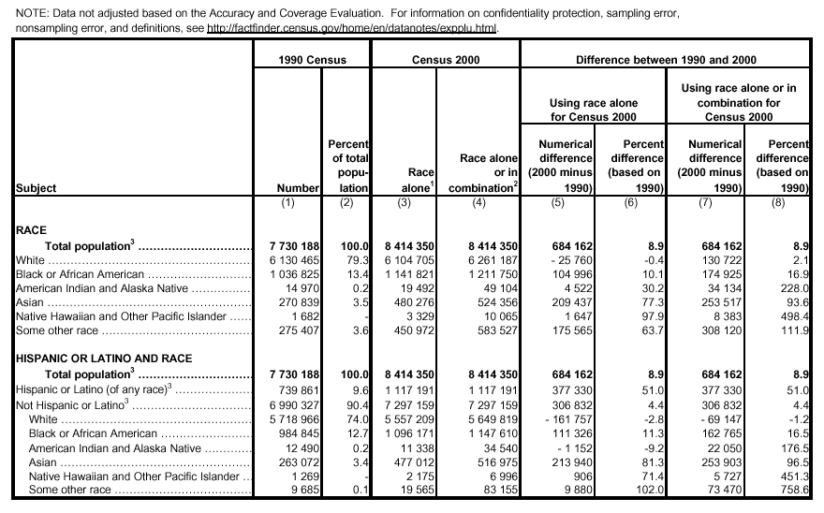
How Do I Compare the Data?
Notes:
Looking at the example on the slide, we can see that the White population decreased by 25,760 persons (using race alone) or increased by 130,722 persons (using the race alone or in combination categories). The difference is somewhere between minus 0.4 and 2.1 percent.
Remember, the numerical difference, when using the race alone or in combination category, will add to more than the total population, since people can be counted in more than one category.

Slide 21
Which Data Should I Use?
Contact the agency or organization that is requesting the information
The Office of Management and Budget suggests specific categories and allocation procedures for Civil Rights Monitoring and Enforcement (OMB Bulletin No. 00-02)
Notes:
If you are unsure which set of numbers to use for a specific application, you should contact the agency or organization that is requesting the information.
The Office of Management and Budget has issued specific guidelines for how to use the multiracial data in civil rights monitoring and enforcement activities. These can be found in OMB Bulletin No. 00-02, which is on the OMB website at http://www.whitehouse.gov/omb/bulletins/b00-02.html
Speakers Notes : From OMB Bulletin No. 00-02:
Responses in the five single race categories are not allocated.
Responses that combine one minority race and white race are allocated to the minority race.
Responses that include two or more minority races are allocated as follows:
If the enforcement is in response to a complaint, allocate to the race that the complaint alleges the discrimination was based on.
If the enforcement action requires assessing disparate impact or discriminatory patterns, analyze the patterns based on alternative allocations to each of the minority groups.

Slide 22
What Data Will Be Available?
Short-Form Information
Redistricting Summary File
Summary File 1
Summary File 2
Long-Form Information
Summary File 3
Summary File 4
Notes:
Census 2000 information will be released on a flow basis starting in early 2001. Information from the short form questions that were asked of every person and household (age, race, gender, Hispanic or Latino, owner/renter status) will be released first.
Information from the long-form (income, education, occupation, housing rent and value) will be tabulated later in the process and will be available starting in Summer of 2002.
Summary File 1 is a series of basic tables of short-form information; Summary File 2 presents some of these same tables for various racial, Hispanic, and American Indian and Alaska Native categories.
Summary File 3 presents sample-data tables; Summary File 4 repeats some of these same tables for the same race, Hispanic, American Indian and Alaska Native categories, as well as for ancestry groups.

Slide 23
Redistricting Summary Data File
Total population by 63 racial categories
Hispanic or Latino population and not-Hispanic-or-Latino population by 63 racial categories
Voting-age population by 63 racial categories
Hispanic or Latino voting-age population and not-Hispanic-or-Latino voting-age population by 63 racial categories
Notes:
The first release of Census 2000 race and ethnic data will be information provided for State redistricting efforts and made available for areas as small as blocks.
This release,called the Redistricting Summary Data File (Public Law 94-171), will be available on the internet, on CD-ROM and on DVD.
It will contain the tabulations you see on this slide.

Slide 24
Hispanic/Latino
Population by Race
You can get the Hispanic population by race through subtraction:
PL 94-171 Redistricting Data:
  Table PL1 gives the total population by race
  Table PL2 gives the Not Hispanic or Latino population by race
By subtracting table PL2 from table PL1, you will get the number of Hispanics who are White, African American, American Indian, Asian, etc.
Notes:
Since Hispanic is an ethnic characteristic and Hispanics can be of any race, how do I know what races were marked by persons of Hispanic origin?
You can get these numbers from the Public Law Redistricting data by subtracting Table 2 from Table 1.

Slide 25
Summary File 1
(100 Percent Data)
Population Totals For
63 Racial categories
28 Hispanic or Latino categories
36 Specific American Indian categories
5 Alaska Native tribes
17 Detailed Asian categories
12 Detailed Native Hawaiian and Pacific Islander categories
Notes:
Summary File 1, available in the summer of 2001, will provide population counts for the various groups shown on the slide as well as characteristics for the major race groups. The information will be available on the Internet, on CD-ROM and on DVD.
SPEAKER’S NOTES (Use only if needed)
36 American Indian categories
Apache Delaware Potawatomi
Blackfeet Houma Pueblo
Cherokee Iroquois Puget Sound Salish
Cheyenne Kiowa Seminole
Chickasaw *Latin Am. Shoshone
Chippewa Lumbee Sioux
Choctaw Menominee Tohomo O’Odham
Colville Navajo Ute
Comanche Osage Yakama
Cree Ottawa Yaqui
Creek Paiute Yuman
Crow Pima All other
*Aztec, Inca, Mayan, etc.
17 Detailed Asian categories:
Asian Indian Laotian
Bangladeshi Malaysian
Cambodian Pakistani
Chinese, except Taiwanese Sri Lankan Filipino Taiwanese
Hmong Thai
Indonesian Vietnamese
Japanese Other Asian
Korean
12 Detailed Native Hawaiian and
Pacific Islander categories:
Polynesian:
Native Hawaiian Melanesian
Samoan Fijian
Tongan Other Melanesian
Other Polynesian Other Pacific Islander
Micronesian:
Guamanian or Chamorro
Other Micronesian
28 Hispanic or Latino categories:
Mexican
Puerto Rican
Cuban
Dominican Republic
Central American:
Costa Rican
Guatemalan
Honduran
Nicaraguan
Panamanian
Salvadoran
Other Central American
5 Alaska Native tribes:
Alaska Athabaskan Eskimo
Aleut Tlingit-Haida
All other tribes
South American:
Argentinean
Bolivian
Chilean
Colombian
Ecuadorian
Paraguayan
Peruvian
Uruguayan
Venezuelan
Other South American
Other Hispanic or Latino:
Spaniard
Spanish
Spanish American
All other Hispanic or Latino

Slide 26
36 American Indian Categories
Apache Delaware Potawatomi
Blackfeet Houma Pueblo
Cherokee Iroquois Puget Sound Salish
Cheyenne Kiowa Seminole
Chickasaw *Latin Am. Shoshone
Chippewa Lumbee Sioux
Choctaw Menominee Tohomo O’Odham
Colville Navajo Ute
Comanche Osage Yakama
Cree Ottawa Yaqui
Creek Paiute Yuman
Crow Pima All other categories
*Aztec, Inca, Mayan, etc.
Notes:
Summary File 1 contains population counts for 36 American Indian categories.
Apache Delaware Potawatomi
Blackfeet Houma Pueblo
Cherokee Iroquois Puget Sound Salish
Cheyenne Kiowa Seminole
Chickasaw *Latin Am. Shoshone
Chippewa Lumbee Sioux
Choctaw Menominee Tohomo O’Odham
Colville Navajo Ute
Comanche Osage Yakama
Cree Ottawa Yaqui
Creek Paiute Yuman
Crow Pima All other categories
*Aztec, Inca, Mayan, etc.

Slide 27
28 Hispanic or Latino Categories
Mexican
Puerto Rican
Cuban
Dominican Republic
Central American:
Costa Rican
Guatemalan
Honduran
Nicaraguan
Panamanian
Salvadoran
Other Central American
South American:
Argentinean
Bolivian
Chilean
Colombian
Ecuadorian
Paraguayan
Peruvian
Uruguayan
Venezuelan
Other South American
Other Hispanic or Latino:
Spaniard
Spanish
Spanish American
All other Hispanic or Latino
Notes:
Summary File 1 contains population counts for 28 Hispanic or Latino categories.
Mexican
Puerto Rican
Cuban
Dominican Republic
Central American:
Costa Rican
Guatemalan
Honduran
Nicaraguan
Panamanian
Salvadoran
Other Central American
South American:
Argentinean
Bolivian
Chilean
Colombian
Ecuadorian
Paraguayan
Peruvian
Uruguayan
Venezuelan
Other South American
Other Hispanic or Latino:
Spaniard
Spanish
Spanish American
All other Hispanic or Latino

Slide 28
5 Alaska Native Categories
Alaska Athabaskan
Aleut
Eskimo
Tlingit-Haida
All other tribes
Notes:
Summary File 1 contains population counts for 5 Alaska Native categories.
Alaska Athabaskan
Aleut
Eskimo
Tlingit-Haida
All other tribes

Slide 29
17 Detailed Asian Categories:
Asian Indian Laotian
Bangladeshi Malaysian
Cambodian Pakistani
Chinese, except Taiwanese Sri Lankan
Filipino Taiwanese
Hmong Thai
Indonesian Vietnamese
Japanese Other Asian
Korean
Notes:
Summary File 1 contains population counts for 17 detailed Asian categories.
Asian Indian Laotian
Bangladeshi Malaysian
Cambodian Pakistani
Chinese, except Taiwanese Sri Lankan
Filipino Taiwanese
Hmong Thai
Indonesian Vietnamese
Japanese Other Asian
Korean

Slide 30
12 Detailed Native Hawaiian and Pacific Islander Categories:
Polynesian:
Native Hawaiian
Samoan
Tongan
Other Polynesian
Micronesian:
Guamanian or Chamorro
Other Micronesian
Melanesian
Fijian
Other Melanesian
Other Pacific Islander
Notes:
Summary File 1 contains population counts for 12 detailed Native Hawaiian and Pacific Islander categories.
Polynesian:
Native Hawaiian Samoan
Tongan
Other Polynesian
Micronesian:
Guamanian or Chamorro
Other Micronesian
Melanesian:
Fijian
Other Melanesian
Other Pacific Islander

Slide 31
Summary File 2
(100 Percent Data)
Totals and Characteristics Available For
249 Iterations of racial and Hispanic or Latino categories, and American Indian and Alaska Native tribes
1 Iteration for the total population
User selects specific iteration
Notes:
Some of the tables from Summary File 1 will be included on Summary File 2. These tables will be repeated or “iterated” for each of 249 specific race and ethnic groups. Information is generally available down to the census tract level. However, there must be 100 persons in the group at that geographic level for information to be shown.
Summary File 2 will become available in the Fall of 2001. On the Internet, you will be able to select the specific group and table you want to see displayed. The information will also be available on CD-ROM and DVD.

Slide 32
Summary File 3
(Sample Data)
Population Totals For
6 Racial categories (alone)
Hispanic or Latino by race
(Same as
Summary File 1)
plus
108 Ancestry groups
Notes:
Summary File 3 will be available in the Summer of 2002 on the Internet and on CD-ROM and DVD. These tables will be for the major race groups and Hispanic or Latino by race. In addition there will be counts for 108 ancestry groups.
Information will be available down to the block-group level.

Slide 33
Summary File 4
(Sample Data)
Totals and Characteristics Available For
249 Iterations (same as Summary File 2)
plus
86 Iterations of ancestry categories
plus
1 Iteration for the total population
336 Iterations
User selects
specific iteration
Notes:
Similar to Summary File 2, Summary File 4 will contain sample tables that repeat for the same race and ethnic groups. In addition these tables, which will show sample characteristics, will be available for ancestry groups as well. And just as in Summary File 2, there will be thresholds, that is, there must a minimum number of persons in the group in the specific geographic area for the characteristics to be shown. [Speaker’s Note: The threshold in SF 4 is 50 responses or about 300 persons.]
On the Internet, you will be able to choose the table and the iteration or group you want.

Slide 34
Summary Files 1-4
SF 1 and 3
  Geographic detail (down to block/block group)
  Source of community profiles
  Will meet data needs of most users
SF 2 and 4
  Subject detail (down to tract level)
  Tables repeated for each race/ethnic group
  Specialized users
Notes:
Here’s a summary of some of the differences between Summary Files 1, 2, 3 and 4.

Slide 35
Summary Population and
Housing Characteristics
Population Totals For
6 Racial categories (alone)
Hispanic or Latino and race
4 Combinations of two races
• White; Black or African American
• White; American Indian and Alaska Native
• White; Asian
• Black or African American; American Indian
and Alaska Native
Notes:
There will also be several printed report series. Generally information will be provided for the groups shown on the slide. The printed reports will provide information for governmental units, but not for smaller areas.

Slide 36
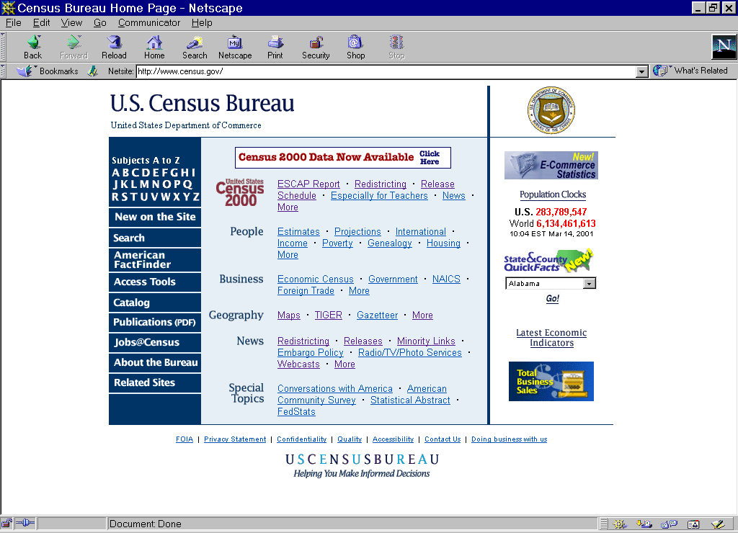
For More Information
Visit the Census Bureau’s website:
http://www.census.gov
Notes:
For more information, visit the Census Bureau’s website at http://www.census.gov

