Slide 1
Pipeline Markers
How Are They Used?
Gas Transmission and Hazardous Liquid Pipeline Marker Workshop
Terry Boss

Slide 2
Present Gas Pipeline Regulations
§ 192.707 Line markers for mains and transmission lines.
  (a) Buried pipelines. Except as provided in paragraph (b) of this section, a line marker must be placed and maintained as close as practical over each buried main and transmission line:
    (1) At each crossing of a public road and railroad; and
    (2) Wherever necessary to identify the location of the transmission line or main to reduce the possibility of damage or interference.
  (b) Exceptions for buried pipelines. Line markers are not required for the following pipelines:
    (1) Mains and transmission lines located offshore, or at crossings of or under waterways and other bodies of water.
    (2) Mains in Class 3 or Class 4 locations where a damage prevention program is in effect under §192.614.
    (3) Transmission lines in Class 3 or 4 locations until March 20, 1996.
    (4) Transmission lines in Class 3 or 4 locations where placement of a line marker is impractical.
  (c) Pipelines aboveground. Line markers must be placed and maintained along each section of a main and transmission line that is located aboveground in an area accessible to the public.
  (d) Marker warning. The following must be written legibly on a background of sharply contrasting color on each line marker:
    (1) The word “Warning,” “Caution,” or “Danger” followed by the words “Gas (or name of gas transported) Pipeline” all of which, except for markers in heavily developed urban areas, must be in letters at least 1 inch (25 millimeters) high with1/4inch (6.4 millimeters) stroke.
    (2) The name of the operator and the telephone number (including area code) where the operator can be reached at all times.
    [Amdt. 192–20, 40 FR 13505, Mar. 27, 1975; Amdt. 192–27, 41 FR 39752, Sept. 16, 1976, as amended by Amdt. 192–20A, 41 FR 56808, Dec. 30, 1976; Amdt. 192–44, 48 FR 25208, June 6, 1983; Amdt. 192–73, 60 FR 14650, Mar. 20, 1995; Amdt. 192–85, 63 FR 37504, July 13, 1998]

Slide 3

Purpose of a Sign

Slide 4
Purpose of a Pipeline Marker
Communicate Information
  Warning or Caution
  Type of Facility
  Owner
  Ability to Obtain Additional Information
    Operator Phone Number
    One Call Number?
  Location

Slide 5
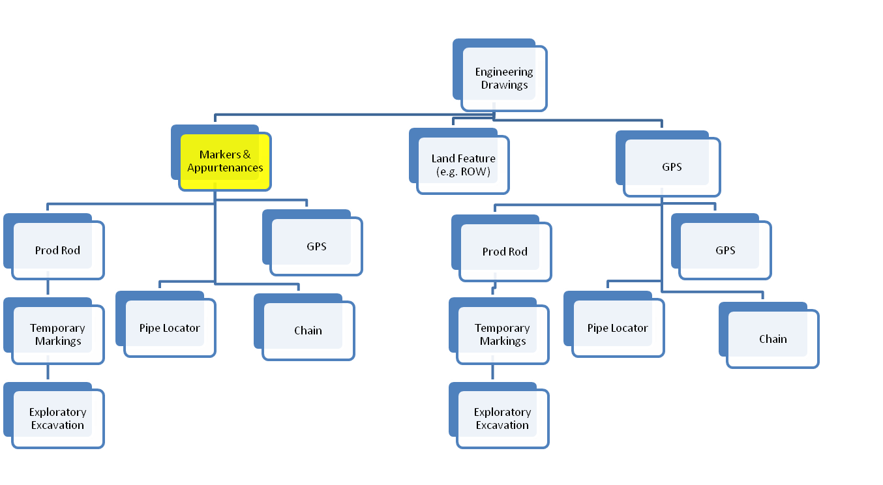
Pipeline Company Operations

Slide 6
What does Pipeline Operations Person want to know
Operator of Pipeline (It’s our pipeline)
Danger (safety moment)
Which Pipeline Is It? (multiple pipeline corridor)
Approximate Location of the Pipeline (starting point for more accurate location)

Slide 7
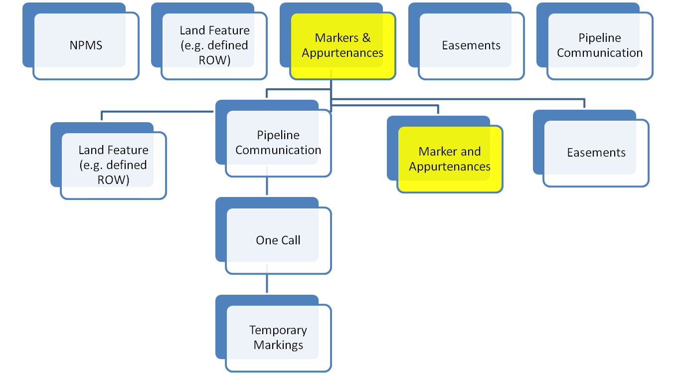
Landowner and Tenant

Slide 8
Landowner and Tenant
Type of Under Ground Facility (There is a gas pipeline)
Danger (Safety Moment)
Operator of Pipeline (website connection?)
Approximate Location of the Pipeline (below grade)
Ability to Obtain Additional Information
    Operator Phone Number
    One Call Phone Number?

Slide 9
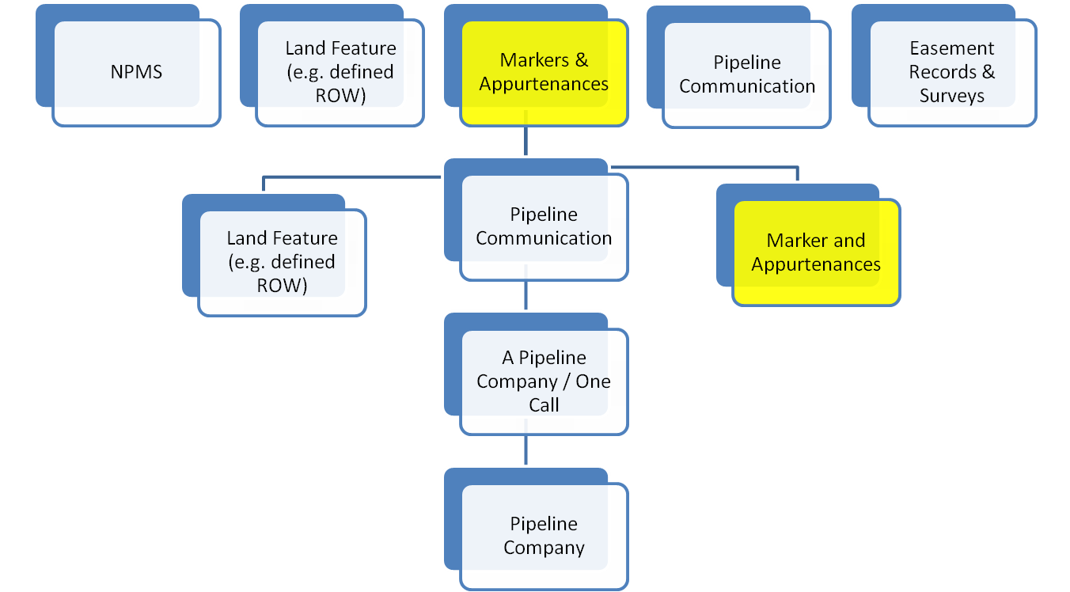
Emergency Responders, and Public

Slide 10
Emergency Responders and Public
Type of Underground Facility (it is a gas pipeline)
Danger (Safety Moment)
Operator of Pipeline (name recognition)
Approximate Location of the Pipeline (below grade)
Ability to Obtain Additional Information
    Operator Phone Number
    One Call Number?

Slide 11
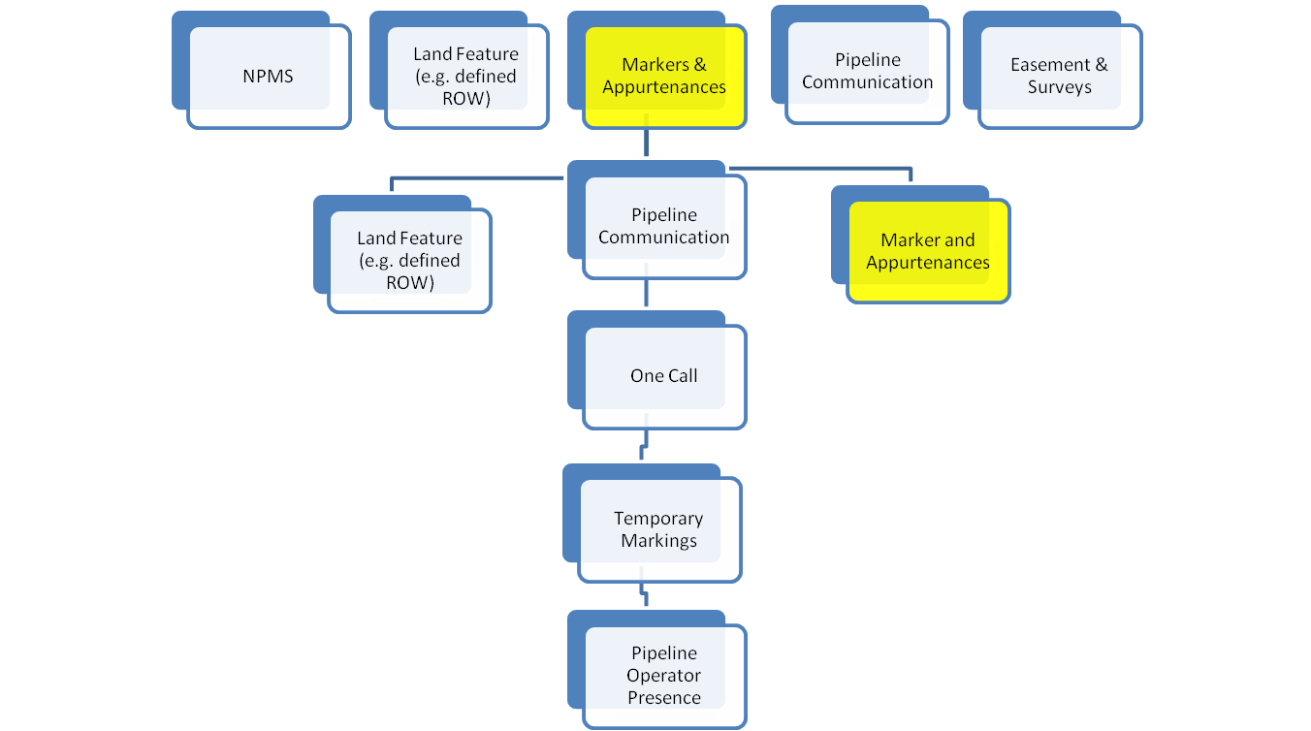
Excavators

Slide 12
Excavators
Type of Underground Facility (gas pipeline)
Danger (Safety Moment)
Operator of Pipeline (name recognition)
Approximate Location of the Pipeline (need more information)
Ability to Obtain Additional Information
    Operator Phone Number (???)
    One Call Number? (Implicit Knowledge)

Slide 13
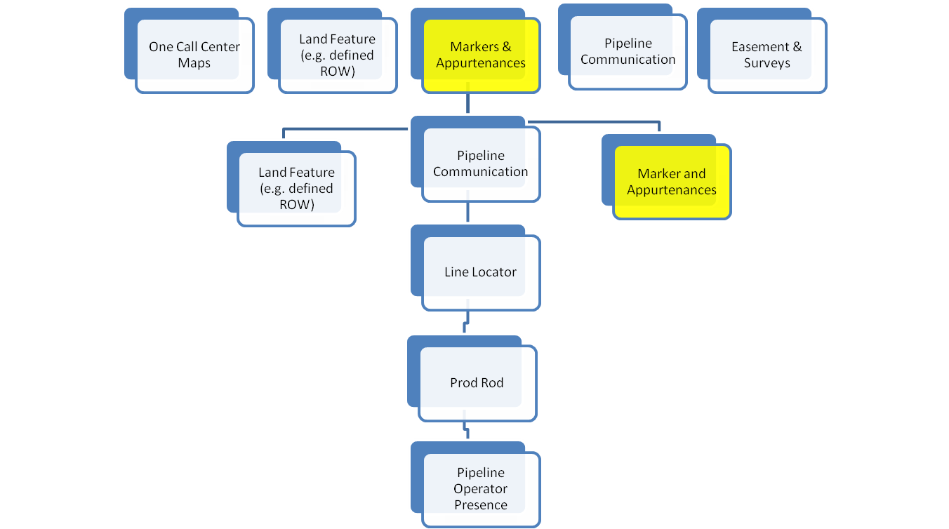
Locators

Slide 14
Locator
Type of Underground Facility (Gas Pipeline)
Danger (Safety Moment)
Operator of Pipeline (Contact Reminder)
Approximate Location of the Pipeline
Ability to Obtain Additional Information
    Operator Phone Number
    One Call Number? (Implicit Knowledge)

Slide 15
Conclusions
Different Groups need Different Information
Pipeline Marker is a Path to Additional Information
Pipeline Marker is a Reminder of Previous Communication
Risk Perception (Danger, Pipeline Name)??
One Call Reminder???
Importance of Emergency Response Number Response
Website=> What does a pipeline marker mean?

