Slide 1
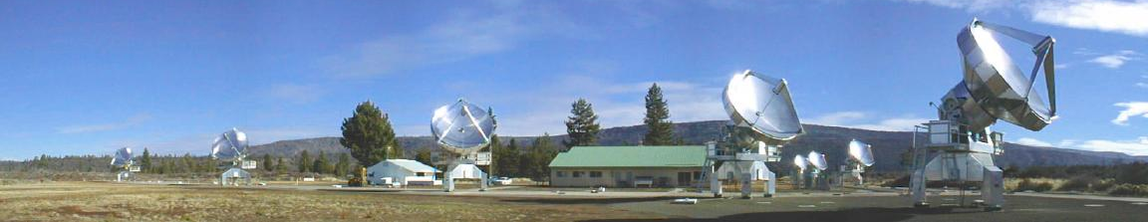



Radio Telescope Data Grids
Ray Plante
Dave Mehringer
Daniel Goscha
Harold Ravlin
NCSA Radio Astronomy Imaging
PDQ Expedition Meeting October 1-2, 2002

Slide 2
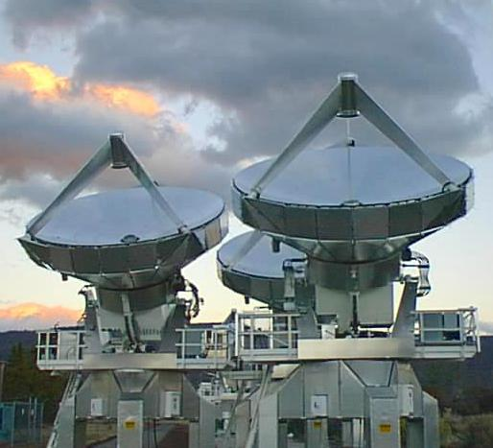
BIMA Image Pipeline
Data is transferred from the telescope to NCSA in real time
Data is ingested into the BIMA Data Archive automatically
Astronomers use Web front-end to search, browse, and retrieve data
Raw data is automatically processed by the pipeline using AIPS++
BIMA
Data Archive
(current size: ~800 GB)
BIMA
Image Pipeline
AIPS++
Web Interface

Slide 3
BIMA Image Pipeline
Data is transferred from the telescope to NCSA in real time
Data is ingested into the BIMA Data Archive automatically
Astronomers use Web front-end to search, browse, and retrieve data
Raw data is automatically processed by the pipeline using AIPS++
Use Grid technologies to distribute the processing
The Grid
BIMA
Data Archive
(current size: ~800 GB)
BIMA
Image Pipeline
AIPS++
Web Interface

Slide 4
BIMA Image Pipeline
Data is transferred from the telescope to NCSA in real time
Data is ingested into the BIMA Data Archive automatically
Astronomers use Web front-end to search, browse, and retrieve data
Raw data is automatically processed by the pipeline using AIPS++
Use Grid technologies to distribute the processing
Expedition Application Driver for PDQ, Portals, & Community Codes
The Grid
BIMA
Data Archive
(current size: ~800 GB)
BIMA
Image Pipeline
AIPS++
Web Interface

Slide 5
Beyond the BIMA Image Pipeline: CARMA
CARMA = Combined Array for Millimeter Astronomy
A combination of the BIMA and CalTech arrays at a 3rd higher-altitude site (2003-2004)
Data rate will increase by at least a factor of 4
    BIMA: Raw data ~ 0.5 GB/day
    Processed data 0.75 – 4 GB/day
    CARMA: Raw data ~ 4 GB/day
    Processed data 1 – 16 GB/day
TeraGrid application: distributing data and processing between CalTech and NCSA.
Partial mirrors at other consortium institutions
  (UC Berkeley & University of MD)
BIMA Image Pipeline system will be used to process the data

Slide 6


Grid Drivers
Radio Astronomy Imaging
Characteristic Features of the BIMA Grid application
Fully-Automated Processing
  There is no user initiating action
  processing in response to new data arriving at the archive
Robust to machine/network outages/bottlenecks
  when services return, system must pick up where it left off without human intervention
Easily monitored
  web-based; connecting to running (or dead) service

Slide 7
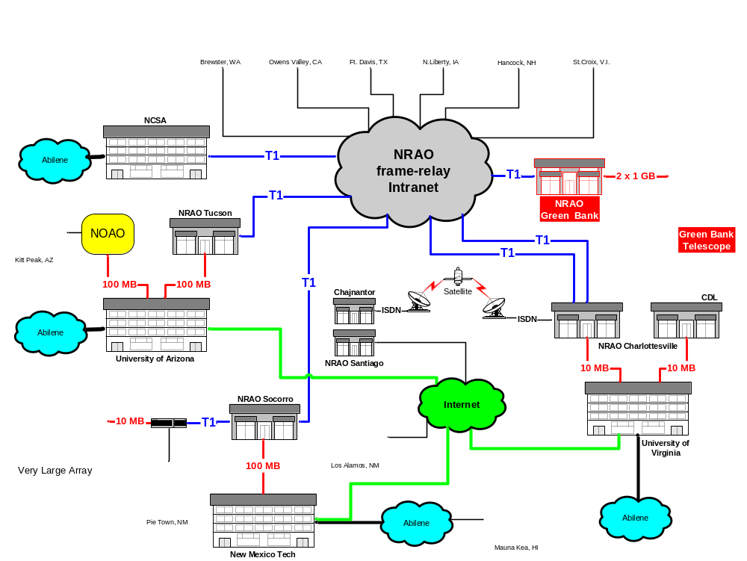
Networking within the National Radio Astronomy Observatory (NRAO)

Slide 8


VLA Archive & Pipeline Mirrors
NRAO End-to-End (e2e) Project: archive & pipeline system for NRAO telescopes
Desire archive mirrors for access by NRAO scientists
Archive mirror at NCSA for outside access & processing on Alliance platforms (using AIPS++)
Plan to establish mirror of the VLA pipeline processing system at NCSA
Very Large
Array (VLA)
Array Operations Center
Socorro, NM
NRAO/UVA
T1
T1
25 TB*
Frame-Relay
Intranet
Very Long
Baseline
Array (VLBA)
13 TB*
T1
Abilene
3 TB*
NCSA
Urbana, IL
Greenbank
100 m
Telescope (GBT)
*by 2005

Slide 9
Expedition Milestones
3.0
6.0
9.0
15.0
24.0
Complete installation of basic Globus servers on pipeline platforms
Complete initial integration of generic grid data management tools into pipeline system. Grid tools should be used to access and move input and output data using GridFTP
Integrate generic procedures for grid job submission and monitoring into Pipeline.
Establish initial mirror of VLA archive using Globus replication management tools
Demonstrate distributed data processing between NCSA and NRAO

Slide 10
BIMA Pipeline Components
Radio Astronomy Imaging
Archive System
Signal the arrival
of new data
Ingest
Engine
Event Server
Script Generator
Determine what
processing can take
place.
Match data to
processing recipes
Queue Manager
Submit and monitor
jobs on multiple
platforms
Data
Manager
Serial
Parallel
SM
Grid
Platform
4-processor
Linux box
NCSA Linux
Clusters
Origin 2000

Slide 11
BIMA Pipeline Components
Radio Astronomy Imaging
Archive System
Signal the arrival
of new data
Ingest
Engine
Event Server
Script Generator
Determine what
processing can take
place.
Match data to
processing recipes
3.0 Milestone:
Complete installation of basic
Globus servers on pipeline
platforms
Queue Manager
Submit and monitor
jobs on multiple
platforms
Data
Manager
Serial
Parallel
SM
Grid
Platform
4-processor
Linux box
NCSA Linux
Clusters
Origin 2000

Slide 12
BIMA Pipeline Components
Radio Astronomy Imaging
Archive System
Signal the arrival
of new data
Ingest
Engine
Event Server
Script Generator
Determine what
processing can take
place.
Match data to
processing recipes
3.0 Milestone:
Complete installation of basic
Globus servers on pipeline
platforms
Queue Manager
Submit and monitor
jobs on multiple
platforms
Data
Manager
Serial
Parallel
SM
Grid
Platform
6.0 Milestone:
Complete initial integration of
generic grid data management
tools into pipeline system.
4-processor
Linux box
NCSA Linux
Clusters
Origin 2000

Slide 13
BIMA Pipeline Components
Radio Astronomy Imaging
Archive System
Signal the arrival
of new data
Ingest
Engine
Event Server
Script Generator
Determine what
processing can take
place.
Match data to
processing recipes
3.0 Milestone:
Complete installation of basic
Globus servers on pipeline
platforms
Queue Manager
Submit and monitor
jobs on multiple
platforms
Data
Manager
9.0 Milestone:
Integrate generic procedures for
grid job submission and monitoring
into Pipeline.
Serial
Parallel
SM
Grid
Platform
6.0 Milestone:
Complete initial integration of
generic grid data management
tools into pipeline system.
4-processor
Linux box
NCSA Linux
Clusters
Origin 2000

Slide 14
Expedition Milestones
3.0
6.0
9.0
15.0
24.0
Complete installation of basic Globus servers on pipeline platforms
  install on archive on archive server & serial processing platform
  need availability on Grid platforms
Complete initial integration of generic grid data management tools into pipeline system. Grid tools should be used to access and move input and output data using GridFTP
  reimplement data manager using GridFTP (C or Java)
Integrate generic procedures for grid job submission and monitoring into Pipeline.
  will use Java COG kit to handle job submission
  in collaboration with Portals expedition
Establish initial mirror of VLA archive using Globus replication management tools transfer to other NRAO sites
Demonstrate distributed data processing between NCSA and NRAO
  in collaboration with Community Codes expedition
  grid job submission tool within AIPS++

Slide 15
Data Stats
BIMA Image Pipeline
  typical per-job data traffic (per day: x3)
    Input: 0.2 – 1 GB Output: 0.3 – 3 GB
  total archive size
    Now: 0.8 TB end of 2003: 1.5 – 2 TB?
VLA mirror
  currently moving tape-based archive to spinning disk
  total archive size
    Now: 0.5 TB end of 2002: 2 TB 2005: 25 TB
  network AOC - NCSA: T1 (frame relay) and Abilene
  distribute processing between AOC & NCSA

Slide 16
Project requirements
Ability to do simple, organized bulk data movement between NCSA storage and computing resources using GridFTP
ability to manage replicated data between NRAO and NCSA storage systems using Globus replication management tools.
Grid job management (submission, monitoring) should be supported by NCSA computing platforms (i.e. Linux clusters).
Web Service-oriented implementations are highly desirable for integration with current BIMA pipeline software and related planned work under the Portal expedition, as are Java interfaces.
C-interfaces are useful as well, particular for support of the VLA pipeline.
    Grid job submission tool within AIPS++ (Community Codes)

