Slide 1
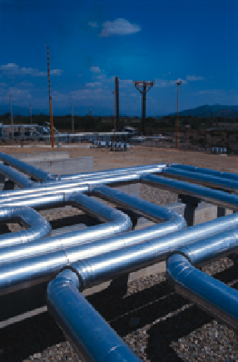
A Regulator’s View of Stress Corrosion Cracking
December 2, 2003
Linda Daugherty
Office of Pipeline Safety

Slide 2
What Is the Regulatory Community Doing About SCC?
What Concerns and Unanswered Questions Are Driving Regulatory Decisions?

Slide 3
Linda Daugherty – Federal Office of Pipeline Safety
Brian Pierzina – Minnesota Office of Pipeline Safety
Josef Jan Kopec – Canada National Energy Board

Slide 4
We have more questions than answers.
An Uninformed (or
Ill-Informed Regulator) is More Likely to Make Incorrect Regulatory Decisions

Slide 5
Federal Office of Pipeline Safety
Research and Development
Public Workshop
  We are working to come up to speed on SCC issues.
  We are promoting information exchange within the pipeline and research communities AND with the regulatory community.

Slide 6
Federal Office of Pipeline Safety
Investigations and Monitoring of SCC Programs
Inspections
  Standard Inspections
    2004 Inspection Emphasis Area
  Integrity Management Audits

Slide 7
Federal Office of Pipeline Safety
October 2003 Advisory Bulletin
  All owners and operators of pipeline systems, whether or not their pipeline systems are subject to the Integrity Management Plan rules, should determine whether their pipeline system is susceptible to SCC and assess the impact of SCC on pipeline integrity.

Slide 8
Federal Office of Pipeline Safety
SCC has not appeared to be a leading cause of pipeline failures over the years.
  Is this a misperception?
  Are the numbers of SCC failures increasing?
  If so, why?

Slide 9
Federal Office of Pipeline Safety
Questions/Concerns
  There is a perception that near neutral SCC is a Canadian problem. It might be more prevalent, but we cannot discount it in the US.
  If coating is a primary issue, why aren’t more pipelines being recoated?
  When is it time to replace problematical pipelines?

Slide 10
Federal Office of Pipeline Safety
Question/Concerns
  DA can identify SCC indications but may not find all of it.
    Not as definitive as hydrostatic testing
    Large role in combination with other testing (hydrostatic and pigging).

Slide 11
Everyone Has a Different Solution
Pigging
versus
Hydrostatic testing
versus
Direct Assessment
versus
???

Slide 12
Federal Office of Pipeline Safety
How does a regulator determine that a company is taking (or has taken) appropriate action?
What to do when a pipeline in a SCC program fails…once, twice?

Slide 13
We still have more questions than answers.
An Uninformed (or
Ill-Informed Regulator) is More Likely to Make Incorrect Regulatory Decisions

Slide 14
Do Your Part…
Share Your Knowledge to Improve Safety

