Slide 1
FINDINGS OF A PREVIOUS INVESTIGATION ON THE FEASIBILITY OF USING ABANDONED PIPELINES IN COASTAL LOUISIANA

Slide 2
ABANDONED PIPELINE FEASIBILITY STUDY
STUDY ORIGINATION
In 1992, Louisiana Senate Resolution No 164 was passed.
Resolution directed the Louisiana Department of Natural Resources to develop and implement a pilot project to determine the feasibility of using abandoned pipelines for sediment diversion in the coastal restoration program.
Resolution stated that many such abandoned pipelines existed.
Resolution stated that pipeline owners were willing to work with the state to allow use of pipelines for sediment diversions.

Slide 3
WHO PERFORMED THE STUDY?
Pyburn & Odom, Inc.
      Provided engineering services for study
      Project Director: Charles H. Coates, P.E.
      Team of 9 engineering, environmental and dredging technical personnel
McGlinchey Stafford Lang
      Provided legal research
      Contact lawyer: Richard Curry

Slide 4
PYBURN & ODOM, Inc: SCOPE OF WORK
Part I: Perform investigation to determine the potential feasibility of using abandoned oil and gas pipelines for sediment diversion to marshes.
Part II: If the Part I investigation is found feasible, prepare a conceptual design and an estimated cost for a pilot project to demonstrate practical feasibility
Note: Canvassing the oil and gas companies for abandoned pipelines was not a task for Pyburn & Odom.

Slide 5
DELIVERABLES
Capacities of abandoned pipelines for various pipeline lengths, diameters, slurry concentrations, slurry compositions, and other variables.
Projected erosion and corrosion rates for pipelines.
Preliminary designs and cost estimates for potential slurry pipeline systems.
Results of feasibility analysis.
5. Preliminary design and cost estimate of a prototype pipeline slurry project.

Slide 6
TASKS
Task 1. Pipeline Capacities. Capacities of pipelines were evaluated as to :
Lengths: Abandoned pipeline lengths of 5, 15 & 30 miles in length were examined.
Diameters: Diameters similar to those in the oil and gas pipeline industry were used: 8, 12, 16, & 24-in diameter pipe.
c. Slurry concentration: Slurry concentrations of 10, 20, 30 and 40 % solids were analyzed. A slurry content of 30% was used for cost estimate.
d. Slurry composition: Typical sediment compositions found on the Lower Mississippi River were used in calculations. Median grain size of 0.182 mm used to prepare cost estimates.

Slide 7
Task 1 - Continued
e. Pumping capacity: Operating velocities were assumed to be at least 10% above the minimum velocity to establish flow with a heterogeneous mixture. Booster pumps placed at about one mile intervals for cost estimates.
f. Allowable pressure: A design operating pressure of 165 psi (310 feet of head) was used for costing.

Slide 8
Task 2. Pipeline Erosion and Corrosion Rates.
Projected erosion rates: Erosion rate is high and will be highest on pipe bottom. Rough estimate of 1/8 inch of wear per 500,000 – 2,000,000 cubic yards of dredged material. Liners?
Projected corrosion rates: Negligible compared to erosion.

Slide 9
Task 3. Potential Slurry Pipeline Systems.
Basic Conceptual Design Components
1. Sediment source.
    - Miss. R. used for cost estimates
    2. Sediment pipelines
    3. Sediment deposition
      - Volumes of deposited sediment are based on 9 feet of height, including compaction, settlement, and sediment loss, in 3 feet of water.

Slide 10
TASK 3 – CONTINUED
Additional Cost Assumptions
1. Residual condition of abandoned pipelines is expected to be good in respect to erosion, corrosion, and presence of contaminants.
2. Type of dredges = cutterhead and hopper.
3. Temporary & distribution pipeline material will consist of HDPE pipe.
4. Temporary pipelines to be two miles in length.
5. Marsh areas are 10, 50, and 100 acres.
6. Pumping time = 18 hours & pumping efficiency = 60%
7. Barge transportation distances will be 50, 100, and 200 miles.

Slide 11
Task 3 –Continued
Pipeline systems to transport sediment. Three scenarios:
1. Direct connection: Pipeline System No. 1A
2. Indirect connection: Pipeline System No. 1B
3. Bank storage and Barge/Truck Transport System 2A

Slide 12
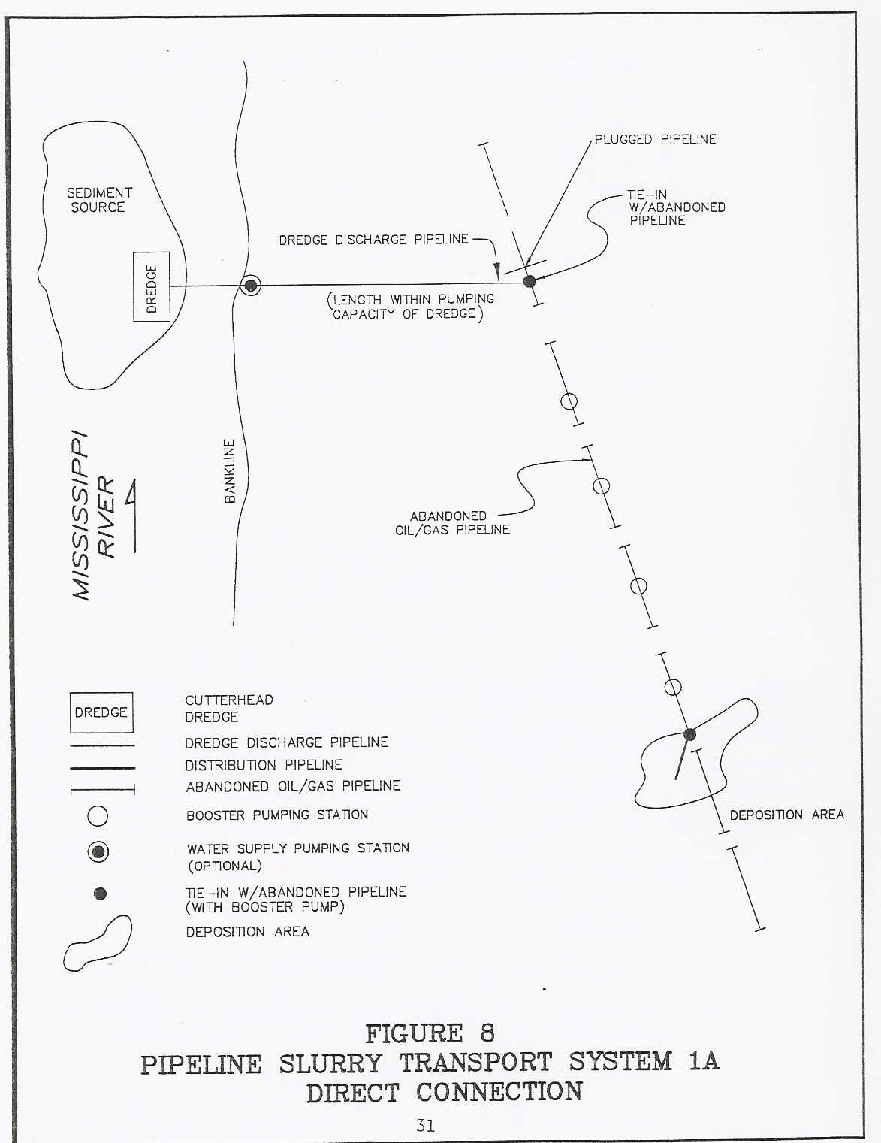

Slide 13
Cost Estimate Summary
Pipeline Slurry Transport System 1A – Direct Connection
Pumping
Marsh Pipe Time Unit Costs
Area Size (Days) Opn. Cost Total Cost $/yd. $/Acre
10 ac. 8- 112.8- $1,815,000- $1,815,000- $12.50- $181,500-
24” 7.2 508,200 508,200 3.50 50,820
50 8- 564.1- 9,075,000- 9,075,000- 12.50- 181,500-
24” 36.0 2,541,000 2,541,000 3.50 50,820
100 8- 1128.2- 18,150,000- 18,150,000- 12.50- 181,500-
24” 71.9 5,082,000 5,082,000 3.50 50,820
Notes: 1. Total abandoned pipeline lengths = 5 miles. No temporary pipeline construction necessary.
2. Costs increase rapidly as pipe diameters decrease.

Slide 14
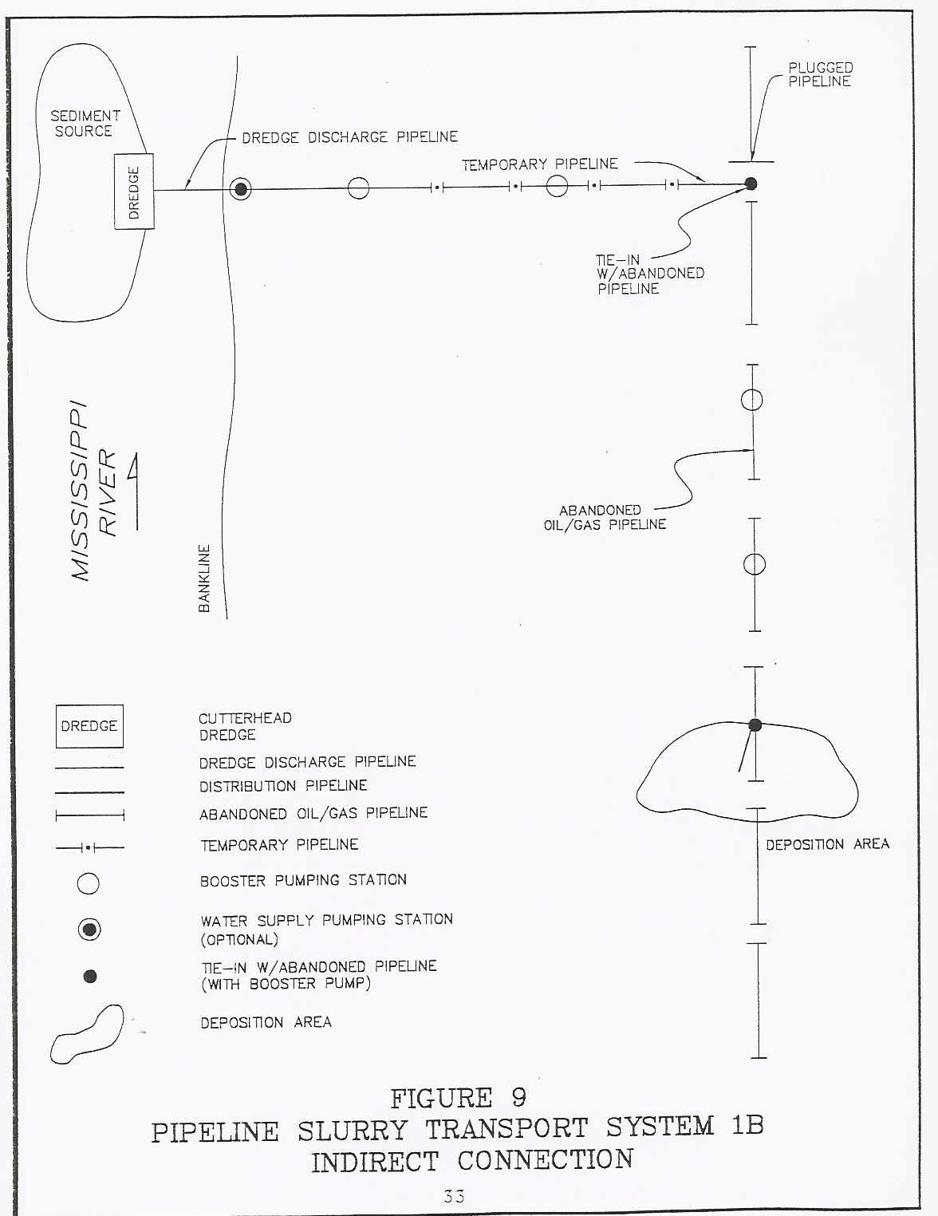

Slide 15
Pipeline Slurry Transport System 1B – Indirect Connection
Cost Estimate Summary
Total Temp. Pumping
Pipeline Pipe Pipeline Time Operating Total Unit Costs
Length Size Const. Cost Days Cost Cost $/Yd $/Acre
7 mi. 8- $242,880- 564.1- $12,705,000- $12,947,880- $17.83- $259,500-
24” 950,400 36.0 3,557,400 4,507,800 6.21 90,150
17 8- 242,880- 564.1- 30,855,000- 31,097,880- 42.83- 621,950-
24” 950,400 36.0 8,639,400 9,589,800 13.21 191,800
32 8- 242,880- 564.1- 58,080,000- 58,322,880- 80.33- 1,166,500-
24” 950,400 36.0 16,262,400 17,212,800 23.71 344,250
Note: 50 Acre Marsh Areas would be created for each example.

Slide 16
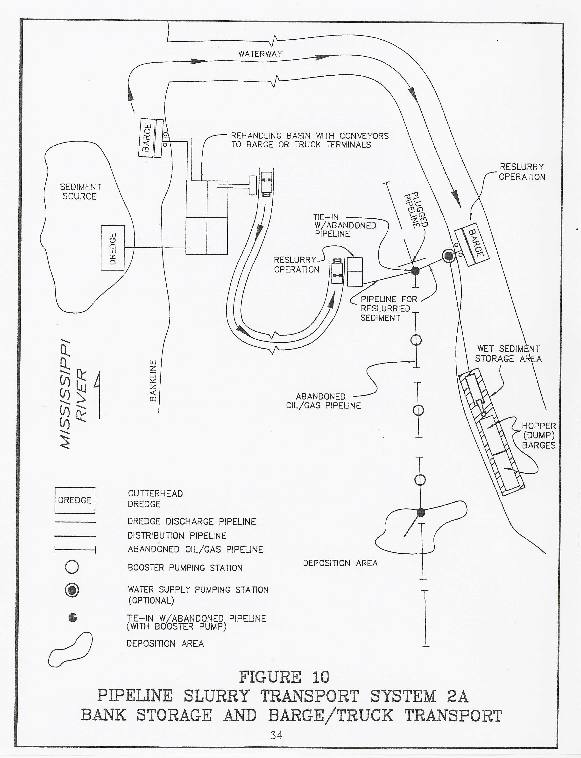

Slide 17
Cost Estimate Summary
Pipeline Slurry Transport System 2A-
Bank Storage and Barge Transport
Barge Bank Barge Trans.
Trans. Pipe Storage Load & To Dep. Total Unit Costs
Dist. Size Cost Trans. Cost Area Cost Cost $/Yd $/Acre
50 mi. 8- $1,452,000- $2,178,000- $9,075,000- $12,705,000- $17.50- $254,100-
24” 435,600 2,541,000 5,154,600 7.10 103,100
100 8- $1,452,000- $3,630,000- 9,075,000- 14,157,000- 19.50- 283,100-
24” 435,600 2,541,000 6,606,600 9.10 132,100
200 8- $1,452,000- 6,534,000- 9,075,000- 17,061,000- 23.50- 341,200-
24” 435,600 2,541,000 9,510,600 13.10 190,200
Note: For each example, marsh areas to be created = 50 acres and pipeline lengths = 5 miles.

Slide 18
Cost Estimate Summary
Range of Estimated Costs
Unit Costs
System Total Cost $/cu yd $/Acre
1A-Direct Connection $18,150,000- $12.50- $181,500-
508,200 3.50 50,180
1B-Indirect Connection 58,322,880- 80.33- 1,166,500-
4,507,800 6.21 90,150
2A-Bank Storage and 17,061,000- 23.50- 341,200-
Barge Transport 5,154,600 7.10 103,100

Slide 19
Legal, Environmental, and Regulatory Factors
1. Legal
- Servitude
- Ownership
- Liability
2. Environmental
- Contaminants
3. Regulatory
- Permits

Slide 20
Task 4. Feasibility Analysis of Using Abandoned Pipelines
a. Technical
b. Legal
c. Cost
d, Environmental
e. Regulatory

Slide 21
Conclusions of Study
1. The use of abandoned pipelines to transport sediment to create or restore marshes in Coastal Louisiana was reported to be potentially feasible.
2. The study recommended that a pilot project be undertaken to demonstrate practical feasibility.

Slide 22
Pilot Project
To demonstrate practical feasibility of using abandoned pipelines
Conceptual design by Pyburn & Odom
  - Tiger Pass near the Tidewater facility
  - Abandoned Exxon 8” diameter pipeline
  - Dewatering and reslurrying of dredged material required
  - Estimated cost = $1,028,000 for 10 acres of restored marsh

Slide 23
ABANDONED PIPELINE AVAILABILITY
• Oil companies canvassed and showed interest
• Abandoned pipelines exist
• No pipelines were found to be unconditionally available
• Pipelines that were conditionally available were of less than optimum size

Slide 24
Summary
Use of abandoned pipelines was found to be feasible on a technical, legal, environmental, and regulatory basis
Practical feasibility was not proven
Cost per acre created was high
• Abandoned pipeline availability was a question

