Slide 1
Natural Gas Infrastructure

Slide 2
T&D Task Group Participants
T&D Task Group: Working Group Team Composition
Task Group
Transmission
Distribution
Storage
Leads
Chair–Kinder Morgan
El Paso
NiSource
Kinder Morgan
Scott Parker
Pat Johnson
Mark Maassel
Ron Brown
EnCana
Rick Daniel
Assist-Kinder Morgan
Byron Wright
Ron Brown
DOE
Mark Maddox
Sara Banaszak
Members
ANR Pipeline
BP Energy
BP N. Am Gas & Power
Burlington Resources
Columbia
ConocoPhillips
Dominion Energy Inc.
Duke Energy
ElPaso Pipeline Group
ExxonMobil
Kinder Morgan Inc.
TransCanada Pipeline
Memphis Light and Gas
NiSource Inc.
Northwest Natural Gas
Peoples Energy
Wisconsin Public Service Corp.
BP Energy
Dominion Energy Inc.
EIA
ElPaso Pipeline Group
EnCana Corp.
Duke Energy
Falcon Gas Storage
FERC
Kinder Morgan
PB Energy Storage Services

Slide 3
Transmission

Slide 4
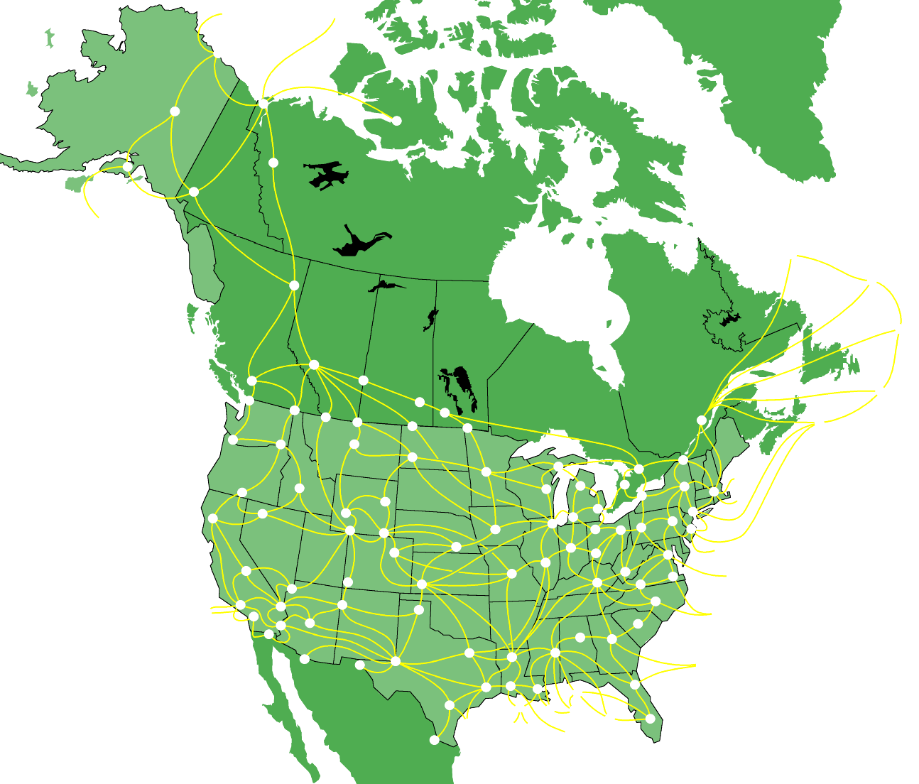
Scope of Work
The modeling system consists of a complex nodal (physical flow) structure
Unit pricing concepts determine gas flow through existing facilities and/or decisions to build pipelines between nodes
The model will always attempt to utilize existing facilities to their maximum

Slide 5
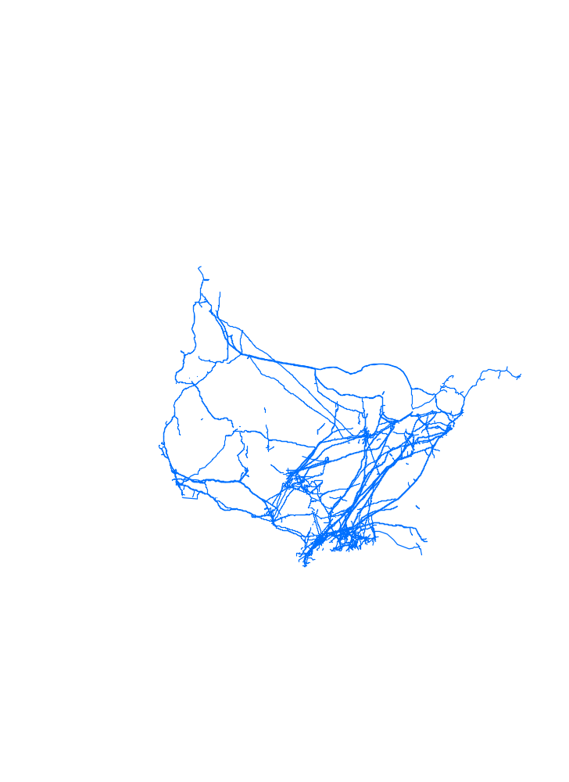
North American Transmission Grid
300,000+ miles of pipeline facilities
  More than 88% installed prior to 1970
19+ million Hp of compression
  More than 52% installed prior to 1970
Notes:
Review of historical pipeline corridors, updating:
Capacity
Max rate
Fuel/Loss
Analysis of announced pipeline projects through 2005 for inclusion in model runs
Review of timing of expansions after 2005
Analysis of costs to maintain existing Transmission infrastructure
Pipeline Safety Improvements Act
Horsepower replacement

Slide 6

Pipeline Market Outlook, 2003 to 2010
Forecast created from integrated corridor analysis model
Changes in supply and demand rebalance flows across entire North American grid
Pipeline capacity is built in response to basis pricing
1070
(460)
(320)
600
(480)
1050
500
770
(350)
1060
(580)
590
900
(400)
760
200
2530
750
Changes in Pipeline Flow (MMCF/D)
Notes:
Pipeline infrastructure is primarily supply drive
Arctic
LNG
Rockies
Offshore Gulf of Mexico
12 month basis signal required
2 ½ years to build pipelines (12 months for Rockies)
Arctic, Eastern Canada and Deep Offshore – Just In Time

Slide 7
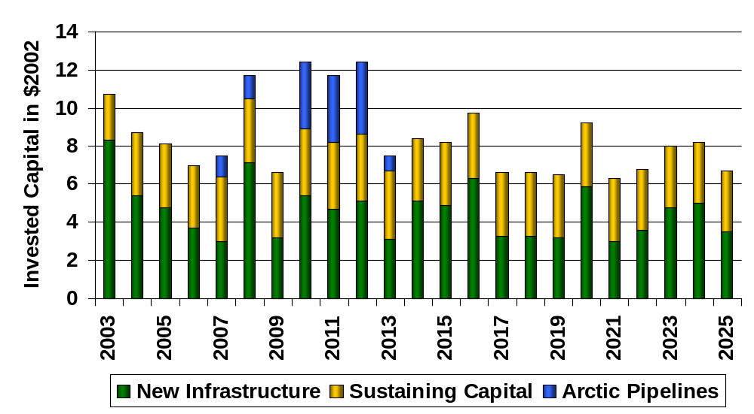
Sustaining Capital is Becoming More Significant
  Lower 48
  $35 Billion - New transportation & storage
  $70 billion - New distribution
  $70 billion – Sustaining capital: all segments
Finding: Pipeline and distribution investments will average $8.0 billion/year, with an increasing share required to sustain the reliability of existing infrastructure.
Recommendation: “Federal and State regulators should provide regulatory certainty by maintaining a consistent cost recovery and contracting environment ”

Slide 8
Changes in Pipeline Contracting Practices
Firm Contract Expirations
Cumulative Expirations
80%
1998 2002
1st Year 15% 22%
2nd Year 27 35
3rd Year 39 48
4th Year 44 55
5th Year 51 64
6th Plus 49 36
60%
40%
Total Expirations of Firm Contracts
20%
0%
Shorter than
Longer than 5
5 Years
Years
Finding: Regulatory barriers to long-term contracts for transportation and storage impair infrastructure investment.
Recommendation: “Regulatory policies should address the barriers to long-term, firm contracts for entities providing service to human needs customers ”

Slide 9
Who Will Be the Future Customers?
LDC Cumulative Expirations
Firm Contract Holders
1998 2002
1st Year 8% 17%
2nd Year 17 37
3rd Year 32 50
4th Year 37 59
5th Year 43 71
6th Plus 57 29
100%
80%
Expirations
Retail unbundling
60%
40%
Expirations
Bankruptcy Credit
20%
0%
1998
2002
Recommendation: “FERC should allow operators to configure transportation and storage infrastructure and related tariff services to meet changing market demand profiles.”
Power
Marketer
Producer
LDC
Industrial
Pipeline
Other

Slide 10
Changes in Pipeline and LNG Capacity, 2003 to 2010
28,900 incremental pipeline miles required by 2010
2.5 million Hp of incremental compression required by 2010
1500
760
600
750
1370
North American pipeline expenditures will average $2.7 billion per year from 2003 to 2025 for a total of $59.4 billion
800
450
470
360
1000
380
2070
1000
750
Incremental Pipeline and LNG Capacity in MMCF/D

Slide 11
Changes in Pipeline and LNG Capacity, 2011 to 2025
57,500 miles of pipeline additions required by 2025
7 million Hp of incremental compression required by 2025
4000
500-2000
700
1600
750
Recommendation: Local, state, and federal permit reviews of major infrastructure projects should occur within a one year period utilizing a “Joint Agency Review Process.”
650
1000
750
750
600
2500
Incremental Pipeline and LNG Capacity in MMCF/D

Slide 12
Sensitivity Analyses
No New East Coast LNG Terminals
Extreme Weather
(hypothetical weather stress cases)
0.5
2.0
Weather induced volatility
1.5
0.4
1.0
0.3
0.5
Average Annual Price Impact, $/MMBtu
Average Annual Henry Hub Price Impact, $/MMBtu
0.2
0.0
-0.5
0.1
30-year average weather
(Balanced Future)
-1.0
0.0
-1.5
2000
2005
2010
2015
2020
2025
Cold Weather
Warm Weather
Hypothetical cases displaying results of coldest and hottest sequences on record

Slide 13
Distribution

Slide 14
Modeling Assumptions
Expansion follows demographic trends
Usage per customer continues to decline
  Conservation
  Energy efficiency
Cost data assembled from all regions
  Reviewed based on industry data
  Reviewed based on benchmarking data
Operations & Maintenance costs based on industry data
  Replacement of some existing facilities
  No replacement of any facility built during the study
Assumed continued enhanced productivity
  Requires development of new technologies

Slide 15
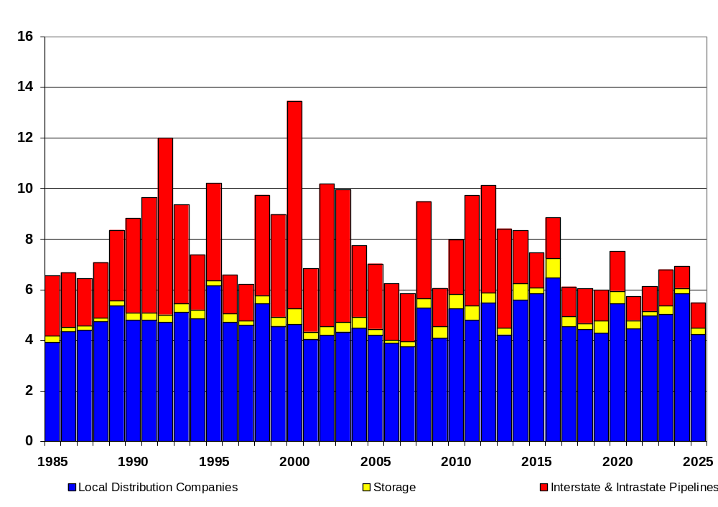
Cost Projections
Total Costs - $135 billion
Slightly less than average annual expenditures in 1990s
Impact of Pipeline Safety Improvement Act
  FERC definition of “distribution” differs from DOT
  22,000 miles impacted
  Costs $2.7 – $4.7 billion

Slide 16
Challenges
Siting and Permitting
  Larger distribution projects may face review by multiple agencies
  States should develop centralized, coordinated siting processes
  One model is the NARUC/IOGCC Pipeline Siting Work Group Report (similar to Joint Agency Review Process)
Access to Capital
  Future expansion will require external funding
  Requires a stable regulatory environment
Reliable Gas Service in a Changing Market
  Changing requirements on pipelines by their customers
  Can impact “traditional” LDC purchases
Possible Tension: LDC Revenues and Capital Requirements
  US needs continued market driven improvements in efficiency
  Rate of customer growth continues upward
  LDCs have historically financed a significant portion of their expansion needs through internal funding mechanisms. Future revenues may not increase at a sufficient rate for sustaining and new capital requirements
  Innovative tariff structures may assist in proper balance

Slide 17
Challenges
Technology Contribution To Distribution Through Research
  Base assumption: 1% per year productivity improvement can be achieved to enhance operations and lower costs
  Research has played a key role; technology advances are required
    Historical funding gone
    Estimated savings $300-$400 million per year
  Safety
  Improved replacement techniques with less disturbance
  Enhanced locational technologies
  Advanced environmental remediation
Recommendation: “Regulators should encourage collaborative research into more efficient and less expensive infrastructure options”

Slide 18
Challenges
Firm Contract Expirations
80%
Contract length appears to be shortening
Customers need service and stability
Long-term contracts must be an option
60%
40%
Total Expirations of Firm Contracts
20%
0%
Shorter than
Longer than 5
5 Years
Years
Recommendation: “Regulatory policies should address the barriers to long-term, firm contracts for entities providing service to human needs customers.”

Slide 19
Storage

Slide 20
Storage Methodology
Forecast aggregate North American demand for seasonal storage
  Assumed monthly gas supply will continue to be relatively flat as supply is stretched to meet demand
  Analyzed detailed monthly, daily demand outlooks developed by Demand Task Group
  Calculated seasonal demand differential (April-Oct versus Nov-March) to estimate seasonal storage requirement
Forecast regional development of new storage capacity
  Estimated regional storage development costs (by type of facility, new projects vs. expansions)
  Model uses regional summer / winter price differentials versus supply costs to determine most likely regions for capacity additions
  Model output may still overestimate market area storage development versus supply area
    geological, other constraints on development

Slide 21
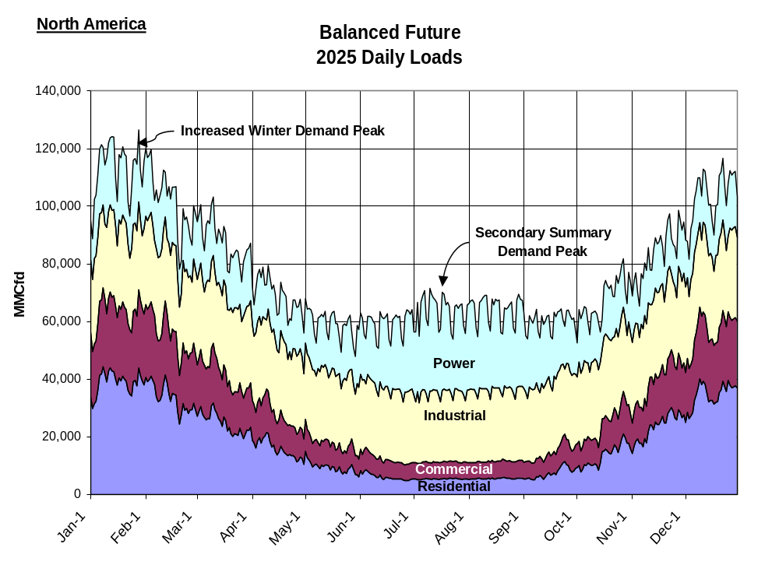
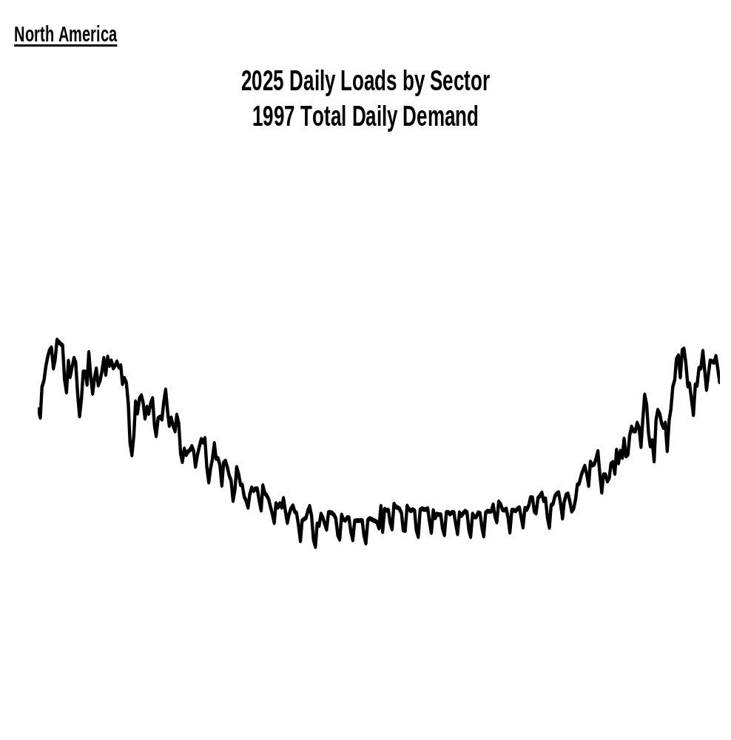
Increasing Peak Demands
Stable Industrial loads are declining
Weather-sensitive residential, commercial, power loads growing
Electric generation is not only amplifying winter peaks ,but is creating a secondary summer peak, competing with storage injections
Storage facilities and services will have to be more flexible in the future
  high shoulder season injections
  higher peak day withdrawals
1997 Total

Slide 22
Recommendation
Recommendation: “FERC Should Allow Operators to Configure Transportation and Storage Infrastructure and Related Tariff Services to Meet Changing Market Demand Profiles.”

Slide 23
Demand for Seasonal Storage
Total North American Demand for Seasonal Storage
'Normal Weather'
3,500
1999-2002 average: 2269
Total demand for seasonal storage grows by 1 Tcf by 2025 (versus ‘99-02 average)
Residential, commercial demand requires most seasonal storage
Power generation sector slightly reduces total seasonal storage demand due to summer peak, but more than offset by strong residential/commercial growth
3,000
2,500
2,000
BCF
1,500
1,000
500
0
(500)
(1,000)
2000/01
2005/06
2010/11
2015/16
2020/21
2025/26
Withdrawal Year
Residential
Commercial
Industrial
Power Generation
Total

Slide 24
Current North American Seasonal Storage Capacity
U.S. Working Gas in Storage vs. Average Wellhead Price
‘Theoretical’ working gas capacity over 4.5 Tcf
Maximum cycled (peak to trough) is approx 2.9 Tcf
  2.5 U.S. (see chart), plus Canada
Cycling 2.9 Tcf pushes limits of injection / withdrawal capability:
  extreme winter prices, demand destruction
  low summer prices, production shut-ins
Current infrastructure appears capable of 2.6 Tcf without extreme prices
(Monthly Jan/94 - Feb/03)
3,500
$8.00
3,000
$7.00
2,500
$6.00
$5.00
BCF
2,000
$/mcf
$4.00
1,500
$3.00
1,000
$2.00
500
$1.00
Jan-94
May-94
Sep-94
Jan-95
May-95
Sep-95
Jan-96
May-96
Sep-96
Jan-97
May-97
Sep-97
Jan-98
May-98
Sep-98
Jan-99
May-99
Sep-99
Jan-00
May-00
Sep-00
Jan-01
May-01
Sep-01
Jan-02
May-02
Sep-02
Jan-03
Source: EIA
Working Gas in Storage (Left Axis)
Average Wellhead Price (Right Axis)

Slide 25
Projected Demand for Seasonal Storage
Total North American Storage Demand - Reactive Path
Normal Weather
Average 2000-2002 seasonal storage demand approx. 2.3 Tcf
5 year average storage fill 2.2 Tcf
Return to ‘normal weather’ requires 2.7 Tcf in near term
Current capacity plus expected expansions of over 100 Bcf by 2005 may be sufficient to meet ‘normal weather’ demand
Additional builds of 600 Bcf required beyond 2005 to meet market growth
3,500
3,300
3,100
2,900
2,700
BCF
2,500
2,300
Average 1999-2002 demand 2269 Bcf
2,100
1,900
1,700
1,500
1999/00
2000/01
2001/02
2002/03
2003/04
2004/05
2005/06
2006/07
2007/08
2008/09
2009/10
2010/11
2011/12
2012/13
2013/14
2014/15
2015/16
2016/17
2017/18
2018/19
2019/20
2020/21
2021/22
2022/23
2023/24
2024/25
Withdrawal Year

Slide 26
Weather Sensitivities
Total North American Storage Demand - Reactive Path
(Normal Weather vs. Historical Weather variability)
Weather sensitivities based on historical pattern of HDDs, CDDs
Very high year-to-year variability in demand for seasonal storage
Cold winters could stretch storage capacity beyond previous limits, even in near term
Price volatility could exceed levels of recent years
4,000
Cold winter storage demand exceeds previous maximum in near term.
3,500
3,000
Bcf
2,500
2,000
1,500
1999/00
2000/01
2001/02
2002/03
2003/04
2004/05
2005/06
2006/07
2007/08
2008/09
2009/10
2010/11
2011/12
2012/13
2013/14
2014/15
2015/16
2016/17
2017/18
2018/19
2019/20
2020/21
2021/22
2022/23
2023/24
2024/25
Withdrawal Year
Normal Weather
Historical Variability

Slide 27
Seasonal Storage Demand:
Reactive Path vs. Balanced Future
Total North American Storage Demand
4,000
(Balanced Future vs. Reactive Path - Variable Weather)
Over time, ‘Balanced Future’ scenario reduces growth rate in demand for seasonal storage
In near term, ‘Cold Winters’ could still stretch storage infrastructure beyond current capabilities
3,500
3,000
BCF
2,500
2,000
1,500
1999/00
2000/01
2001/02
2002/03
2003/04
2004/05
2005/06
2006/07
2007/08
2008/09
2009/10
2010/11
2011/12
2012/13
2013/14
2014/15
2015/16
2016/17
2017/18
2018/19
2019/20
2020/21
2021/22
2022/23
2023/24
2024/25
2025/26
2026/27
2027/28
2028/29
2029/30
Withdrawal Year
Balanced Future
Reactive Path

Slide 28
Gas Storage Infrastructure: Challenges and Opportunities
  Higher peaking capability needed to meet weather sensitive demand growth
  Higher inventory capability needed primarily for colder than average winters
    alternative may be greater price volatility, demand destruction
  High cushion gas costs are constraint on new projects, opportunity for enhancement of some existing projects
    reduce cushion gas with added investment in wells, compression
  Daily volatility of power demand will require more flexible physical capability and more flexible services

Slide 29
Gas Storage Infrastructure: Challenges and Opportunities
  Geological limitations may require additional supply area storage, coupled with pipeline capacity to market
  Despite attractive fundamentals, storage developers face many market uncertainties:
    decline of energy merchants as major storage customers
    lack of long term contracting by LDCs for pipeline, storage capacity
    uncertainties regarding future seasonal price differentials
  Most storage remains highly regulated re: project approval timelines, market rates, service flexibility

Slide 30
Gas Storage - Summary
Demand profiles are changing, requiring greater flexibility in physical capabilities of storage facilities and in the services they provide
Demand for seasonal storage capacity will continue to grow. The greatest risk to the adequacy of the system continues to be cold winter weather
FERC should allow operators to configure transportation and storage infrastructure and related tariff services to meet changing market demand profiles

Slide 31
Conclusion

Slide 32
Findings
“There has been a fundamental shift in the natural gas supply/demand balance that has resulted in higher prices and volatility in recent years. This situation is expected to continue, but can be moderated.”
Demand
Supply
Infrastructure
“Greater energy efficiency and conservation are vital near-term and long-term mechanisms for moderating price levels and reducing volatility.”
“Traditional North American producing areas will provide 75% of long-term U.S. gas needs, but will be unable to meet projected demand.”
“Pipeline and distribution investments will average $8 billion/year, with an increasing share required to sustain the reliability of existing infrastructure.”
“Power generators and industrial consumers are more dependent on gas-fired equipment and less able to respond to higher gas prices by utilizing alternate sources of energy.”
“Increased access to U.S. resources (excluding designated wilderness areas and national parks) could save consumers $300 billion in natural gas costs over the next 20 years.”
“Regulatory barriers to long-term contracts for transportation and storage impair infrastructure investment.”
Markets
“Gas consumption will grow, but such growth will be moderated as the most price-sensitive industries become less competitive, causing some industries and associated jobs to relocate outside North America.”
“New, large-scale resources such as LNG and Arctic gas are available and could meet 20-25% of demand, but are higher-cost, have longer lead times, and face major barriers to development.”
“Price volatility is a fundamental aspect of a free market, reflecting the variable nature of demand and supply; physical and risk management tools allow many market participants to moderate the effects of volatility.”
“A balanced future that includes increased energy efficiency, immediate development of new resources, and flexibility in fuel choice, could save $1 trillion in U.S. natural gas costs over the next 20 years. Public policy must support these objectives.”
Notes:
You have seen the report.
Here are the findings.
We will go into detail on each finding.

Slide 33
Recommendations
A balanced future that includes increased energy efficiency, immediate development of new resources, and flexibility in fuel choice, could save $1 trillion in U.S. natural gas costs over the next 20 years. Public policy must support these objectives.
Demand
Supply
Infrastructure
Markets
Improve demand flexibility and efficiency
Encourage increased efficiency and conservation through market-oriented initiatives and consumer education.
Increase industrial and power generation capability to utilize alternate fuels.
Increase supply diversity
Increase access and reduce permitting impediments to development of Lower-48 natural gas resources.
Enact Enabling Legislation in 2003 for an Alaska gas pipeline.
Process LNG project permit applications within one year.
Sustain and Enhance Infrastructure
Provide regulatory certainty by maintaining a consistent cost-recovery and contracting environment and remove regulatory barriers to long-term capacity contracting and cost recovery of collaborative research.
Permit projects within a one-year period utilizing a “Joint Agency Review Process.”
Promote Efficiency of Markets
Improve transparency of price reporting.
Expand and enhance natural gas market data collection and reporting.

Slide 34
National Petroleum Council
Natural Gas Study
Federal Energy Regulatory Commission
Natural Gas Markets Conference
Balancing Natural Gas Policy:
Fueling the Demands of a Growing Economy
October 14, 2003

