Slide 1
Suzaku processing and archive
Lorella Angelini/HEASARC
Notes:
1

Slide 2
Highlights
Data Processing
  Operations and Data flow
  Pipeline products & versions & current issues
  Upcoming version 2
US Archive collocated with the HEASARC
  Archive operations
  Archive content and version 2
  Public data
Software and calibration distribution
Notes:
2

Slide 3
Basic Operations
At ISAS after an observation is performed :
  Data are packed in Raw Packet telemetry (RPT)
  RPT are transformed in First FITS Files (FFF) via mk1stfits
    These are uncalibrated FITS files
  Orbit, Attitude and time correction (tim) files are generated
  Observation database (ODB metadata) is updated
GSFC implements the processing pipeline & installs it at ISAS
  Two sides are running the same pipeline on all data
RPT, FFF, orbit, attitude, tim files and ODB are transferred to the processing sites and used as input to the pipeline
  Generate calibrated and cleaned event files, and average products
After processing data are transferred to the archive encrypted
  Archives notify the PI that data are ready to be picked-up
Databases are made at GSFC (post processing) & grabbed by ISAS
Notes:
2

Slide 4
Data flow
GSFC processing
SFF + Cleaned
GSFC HEASARC
PI distribution
Archive
ISAS data production
FFT+RPT
Orbit
Attitude
Tim
ODB
Pipeline software
Databases
ISAS processing
SFF + Cleaned
ISAS
PI distribution
Archive
Notes:
2

Slide 5
Transfer rates, size, process time
Problem in determining the attitude solution
Transfer rate to GSFC is 250 kbytes/s
Transfer occurs without hand-shake between sites.
  More robust check soon in place for version 2
Data Size at GSFC :
  Processing : RPT 52 Gb , FFF+Additional files 92 Gb
  Archive : 558 Gb (output from processing)
Typical processing time
  ~ 30 minutes small sequences
  5-7 days large sequences (3 Gb of FFF equivalent to 6.2 Gb after processing)

Slide 6
Pipeline products (1)
Starting from the FFF the pipeline produces
Science & housekeeping : data organized by observation on specific target
=> Level 1 (unfiltered) , 2 (cleaned), 3 (products) for the HXD and XIS ,
their HK, supporting files and log
  HXD :
    Unfiltered events for the WELL, WAM (x RPT) and bursts
    Cleaned event files . WELL RPTs are merged to create GSO and PIN files one for each clock rate.
    Average spectra PIN & GSO; light curves PIN, GSO, WAM & bursts
  For each of the XIS units
    Unfiltered event files x RPT & edit modes. No sub-mode division
    Cleaned event files. All RPTs for specific edit mode are merged and splitted x sub-mode
    Average spectrum & light curve extracted for the XIS configuration with the longer exposure
=> These data are encrypted & distributed to the PI
    TOO & CAL observations are public immediately

Slide 7
Pipeline products (2)
Starting from the FFF the pipeline also produces:
  Trend data
  Data containing specific HK parameters or calibration information extracted from the event data
    These data are organized by instrument and data type
    These data are not encrypted and not distributed to the PI
Starting from the ODB the pipeline produces:
  Database tables ASCII (suzamaster and suzaxislog) updated when a new sequences is processed
    Used to select data via the Web based search facility (BROWSE)
File format:
  Science, HK & calibration data are provided in FITS (OGIP standard)
  Preview of summary products (e.g. GIF)
  HTML used to record processing

Slide 8
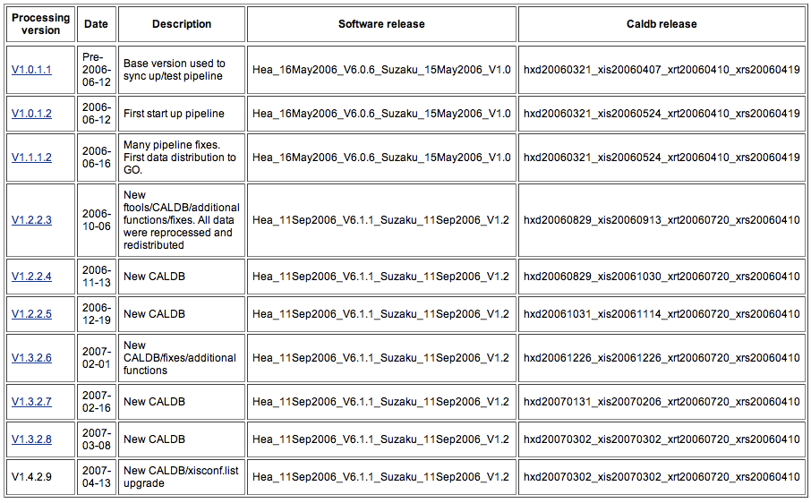
Pipeline versions

Slide 9
Known Pipeline issues
XIS Charge Injection data are not processed with the appropriate calibration data
XIS timing data (psum) are not processed or transferred to the archives
XIS events are not screened for the Cut-off rigidity
XIS extraction regions are always circles not check in place for modes where the circle is outside of the detector window.
XIS minor modes added in the mkf file to allow event minor mode selection
HXD gain is applied using two different methods :
  (1) Gain from CALDB or (2) Gain calculated on the fly
  If (2) users are recommended to reprocess the data soon after the gain CALDB file is available
HXD background is not generated with the pipeline
Not all sequences were processed with the same pipeline at ISAS & GSFC New verification will be in place with version 2 processing.

Slide 10
Version 2 reprocessing
Version 2 processing foreseen to start late June
  All data will be reprocessed (almost 2 years of data)
    Data format will change (mk1stfits)
      All data need to be re-transferred from ISAS to GSFC
    New release of the Suzaku software and calibration data
    New way to calculate the attitude (attitude files longer in time)
    Most of the Known issues will be addressed
      but for the HXD background and the HXD gain
    HXD new products: pseudo event files and a burst ID file
Not a good estimate to how long will take to reprocess all data
  Mainly driven by the rate on how quickly ISAS can prepare the data
  New data will have high priority
    Previous reprocessing uses 5 months to process 1.3 year

Slide 11
GSFC: Archive operations
In US the Suzaku archive is collocate at the HEASARC
The GSFC processing site transfer data to the HEASARC
  All data (US & Japan) populate the archive
  For US PI and Co-PI :
    HEASARC notifies the PI via E-mail when data are in the archive
    Same email is ‘bcc’ to ISAS.
    PI are also notified if data are reprocessed within their propriety period with a new pipeline version.
  The transfers and the archive population are automatized
    Cron job running hourly retrieve data from the processing site via DTS (data transfer system)
    Science & trend data are archived via DAS (data archive system)
      Science data are kept encrypted in the archive
    Databases are ingested in the W3Browse
      Copies made available in the FTP area

Slide 12
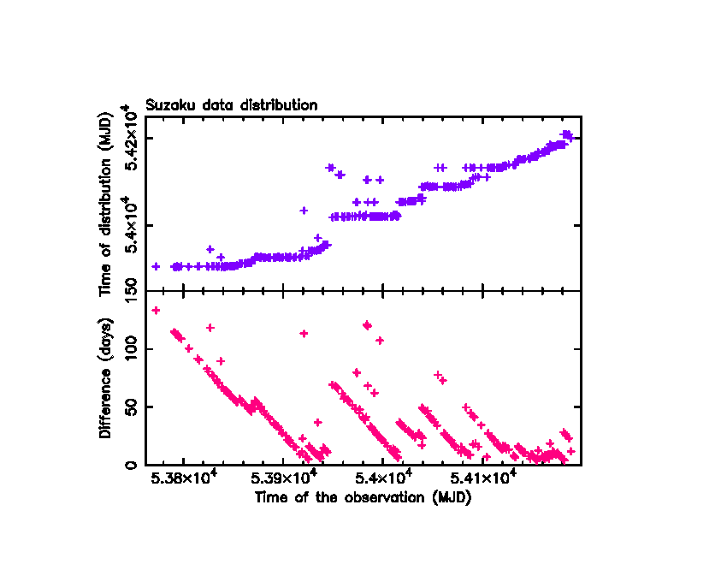
Data delay before distribution

Slide 13
Archive content (1)
There are 566 observations at the HEASARC
  216 are SWG
  317 are AO1 & 15 A02
  5 real TOO (public immediately)
  9 are SWG-TOO, 3 AO1-TOO, 1 AO2-TOO
There are 127 US observations (PI 112 & 15 Co-PI)
  AO1 and AO2
What is missing :
  8 observations not in the archive compared with the timeline
    5 problems in processing (none are PI data), 3 not yet here
  100 steps pointing (short observations)
  Slew data
  Background HXD

Slide 14
Archive content (2)
Daily retrieval of the Suzaku timeline
  Place on line in the HEASARC timeline Tools
GSO and PIN background
  Retrieved at HEASARC every month but currently not on-line
    Difficult to keep-up with changes that occur at ISAS
    There is a noticeable time delay between the data distribution and HXD background availability
Version 2 processing will not produced the background
  HXD team will still produce the background
  A copy will be given to the archives
  However timescale or the transfer mechanism are not clear

Slide 15
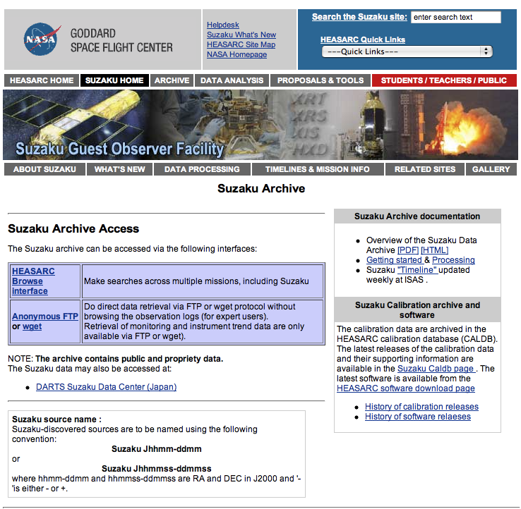
Archive access

Slide 16
Archive: Version 2 processing
HEASARC data management for version 2 processing:
  The results of the version 2 processing will populate new disks
  The content of the current disks (processing version 1.X.X.X) will be backup into final archive tapes
  New disks will be populated at first with links to the 1.X.X.X data
    The link is substituted with the version 2 soon as ready
  Users will always see the latest version
  Version 1.X.X.X of observations that have already the version 2 available is kept on disk but not visible from the users
  When all data are reprocessed, the 1.X.X.X version will be moved out from disks

Slide 17
Archive and Public data
Currently the archives includes 56 public sequences data
  5 are TOO , 10 are from SWG time, remaining are calibration observations
May 27 the propriety period for all the SWG data ends
  All SWG data will be decrypted, checked for data corruption & put on-line
  Estimate time to conclude operation ~10 days (or earlier)
AO data. The propriety period is one year. The clock starts after calibration is made available (CI and Timing) . Public date set at ISAS
Operationally : ISAS sends to GSFC the list with the observations that become public 15 days ahead their public date.
  GSFC notify US PI & Co-PI within 10d , before data are decrypted
  At the end of the propriety period both archive sides decrypt the observation. It is expected up to 2 days difference .

Slide 18
Software and CALDB
Calibration data distributed via the HEASARC CALDB
  Deliveries from Japan arrive to the GOF
  GOF checks the agreed file standards and requires CALDB keywords
  GOF deliveries the file to the HEASARC for ingest into CALDB and distribution
  CALDB updates one a month (end of the month, if any)
Software distributed in the HEAsoft package
  Suzaku tools are developed in Japan & delivered to the HEASARC by the Software Team via CVS
  General support software is provided by the HEASARC
  GSFC performed the software testing before distribution :
    Individual tool with test bed provided from Japan
    Within the pipeline with test bed generated at GSFC
  Software updated on 3 months timescale (if needed)
  Software allows to reprocess the data (all the steps in the pipeline are reproducible)
  Software available from the HEASARC software distribution page

Slide 19
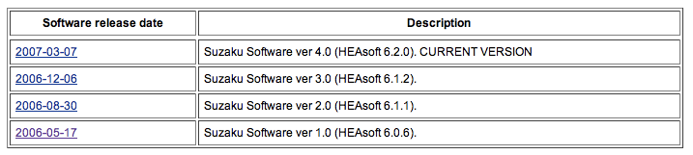
Software distribution
Four Software releases. First public software release May 2006
Most of the software is used within the pipeline
  Pipeline is running version 2 of the software
  Version 3: tools updates not relevant to the pipeline processing
  Version 4 : tools updates mostly in parameter file adjustment and CALDB query
Next software freeze May 7. Expected release in early June
  New tools and updates, support for CI . Attitude library update new rigidity file
  Updates of the help files
  Support for new/old version of the science FITS files
  Support for new/old version of the CALDB files
This new version will be used in the version 2 of the pipeline

Slide 20
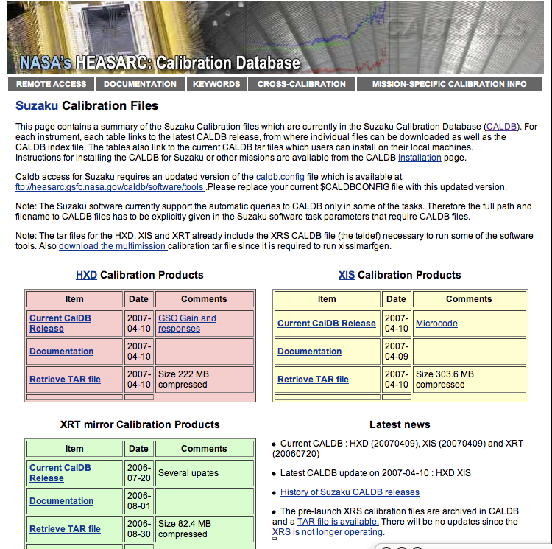
CALDB distribution
Twelve CALDB releases
  First release April 2006
Include all files necessary for the processing or for the spectral analysis
CALDB updated in the pipeline if new files are relevant to the processing
Next delivery is May 7 . Includes :.
  Files necessary for the CI data
  New gain format for the GSO
Still under discussion the creation of a XIS background data

Slide 21
Conclusions
NEXT two months :
Processing version 2 is coming :
  All data will be reprocessed
New software and Calibration soon to be released
Several Suzaku data will be made public

Slide 22
Software test procedure (??)
Next release foreseen
  Software changes
  Data file changes
  Calibration changes
Next software release has to be tested against:
  Two different data formats ,
    since for a while 2 processing version will be availalble
  New calibration formats , need to work on old and new data format

