Slide 1
MARATHON ASHLAND PIPE LINE
ULSD TESTING
  Wesley Neff
  November 20, 2002
Notes:
EPA ULSD WORKSHOP – 11/20/02
I plan to briefly describe the results of the ULSD testing performed by Marathon Ashland Pipe Line last year.

Slide 2
Distribution Concerns
The distribution system has no experience in handling ultra low specification product in a batched system
  Off-highway /heating oil <5000 ppm
  Jet Fuel <3000 ppm
  Low sulfur diesel <500 ppm
  Kerosene <2000 ppm
  Ultra low sulfur diesel ,15 ppm
Notes:
The distribution system has no experience in handling an ultra low specification product in a batched system. At 15 ppm sulfur, ULSD will be the lowest sulfur product in the distribution system.
Listed are Marathon Ashland’s distillate sulfur specifications. Assuming that the sulfur specification of ULSD in pipelines will need to be about 10 ppm, and comparing that with heating oil at 5000 ppm, results in a product specification ratio of 500:1. The system has only dealt with sulfur specification ratios in the 10:1 range. As an example a 0.10% contamination (10 bbls in 10,000 bbls) of 5000 ppm sulfur heating oil in ULSD will raise the sulfur content level by 5 ppm.

Slide 3
Goals for MAPL
ULSD Testing
Determine whether sulfur from other refined products will “trail-back” in the pipeline
Determine what batch sequences will work and the amount of interface generated
Notes:
Our refineries in Robinson, IL and Garyville, LA planned some test runs of ULSD in the summer and fall of 2001. We decided to take advantage of this production of ULSD and perform some pipeline tests.
The next two slides list the goals for MAPL’s ULSD Testing
1) Determine whether sulfur from other refined products will “trail-back” in the pipeline
2) Determine what batch sequences will work and the amount of interface generated

Slide 4
Goals for MAPL ULSD Testing (Con’t)
Determine sulfur degradation due to:
  The originating tank and receipt manifold piping
  The pipeline and its associated appurtenances
  The delivery manifold, tank piping and transport loading equipment
Determine an appropriate field test for sulfur
Notes:
3) Determine sulfur degradation due to:
The originating tank and receipt manifold piping
The pipeline and its associated appurtenances
The delivery manifold, tank piping and transport loading equipment
4) Determine an appropriate field test for sulfur

Slide 5
ULSD Testing
Initial tests conducted with Premium Gasoline on 4 pipeline systems
  Many lessons about contamination learned
Precautions taken with ULSD tests
  Automatic sumps were locked out
  Booster pump units along the pipeline were not started
  Simple tank to tank movements
  Pipeline shutdowns minimized
  Tank lines and tanks emptied prior to ULSD
  Special sampling procedures implemented
Notes:
Since ULSD is not readily available, we did our first series of tests with premium gasoline. The premium gasoline had sulfur of 15 – 20 ppm.
We conducted gasoline tests on 4 pipeline systems. Some useful data was developed from the gasoline tests, but the best benefit were the lessons learned that were incorporated into the ULSD testing protocol.
Precautions taken with ULSD tests
Automatic sumps were locked out. We had one gasoline test spoiled because of a sump injection of high sulfur material into the test batch.
Booster pump units along the pipeline were not started unless they had been purged with ULSD
Our tests were conducted with simple refinery tank to terminal tank movements – no stops along the way
Pipeline shutdowns minimized – we scheduled our tests so that no pipeline shutdowns would occur while ULSD was in the system. Also, the lines used for the tests have minor elevation change
Tank lines and tanks emptied prior to ULSD
Special sampling procedures were implemented, making sure all sample lines were thoroughly flushed, samples taken with precise timing, and with detailed labeling

Slide 6
ULSD Testing
ULSD tests were conducted on 4 pipeline systems
  10”, 12”, 16” and 20” diameter - 70 to 250 miles long
Garyville to Zachary test was the most recent
  Test is representative of all tests
  Test covered movement from Garyville refinery tankage to MAP’s tankage at Zachary, La
    70 miles of 20” pipeline
  Second test on this system in April, 2002
Notes:
ULSD tests were then performed on the same 4 pipeline systems, ranging in size from 10” diameter to 20”, 70 miles to 250 miles in length.
The tests on our Garyville to Zachary System were the most recent ( September, 2001). I will briefly describe the results of the testing on this system This test is representative of all the tests we performed. The ULSD batch tested was moved from MAP’s Garyville, LA refinery to MAP’s tankage in Zachary , LA (about 70 miles of 20” pipeline)
We ran a second test on this system in April, 2002

Slide 7
ULSD Testing – Garyville to Zachary
Garyville made 90,000 bbls of ULSD in mid-September, 2001
  ULSD in tank had 10 ppm sulfur and API gravity of 38.7 degrees
  ULSD from unit had 7 ppm sulfur
76,500 bbls lifted to Zachary
  LSD at head end
  Regular gasoline at tail end
Notes:
MAP’s Garyville Refinery made 90,000 bbls of ULSD in September, 2001.
The ULSD in the refinery tank had 10 ppm sulfur and an API gravity of 38.7 degrees
The ULSD at the refinery unit had 7 ppm sulfur.
The sulfur change between the unit rundown and the refinery tank is an indication of how easily ULSD can be contaminated.
76,500 bbls was lifted into the Garyville to Zachary 20” Pipeline with LSD (~400 ppm sulfur) at the head end and regular gasoline (~180 ppm sulfur) at the tail end

Slide 8
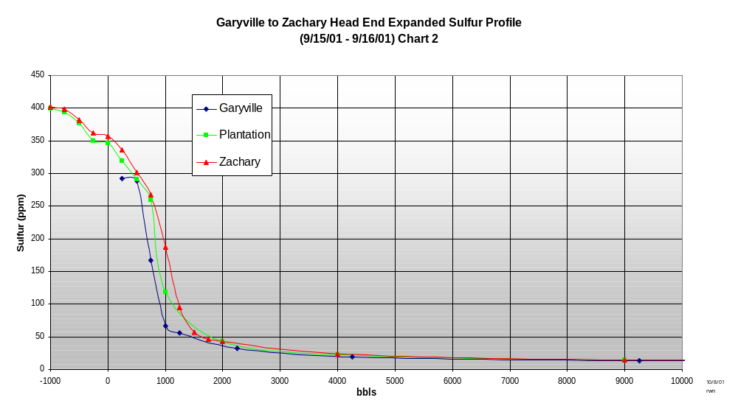
ULSD Testing – Garyville to Zachary Results (Con’t)
Notes:
We experienced some sulfur contamination at the head end of the ULSD at Garyville.
This is an expanded plot of sulfur(y-axis) vs. bbls (x-axis) at the head end of the batch. Samples were taken at each end of the pipeline, and at Plantation Jct which is at the ¾ point on the pipeline. Note that the sulfur content is elevated for over 4000 bbls. Also note that the sulfur profiles are essentially the same at Garyville, Plantation Jct and Zachary. Once the contamination occurred, it did not “trail back” into the batch. The contamination occurred in the refinery tank line from the refinery tank to the pipeline manifold. The tank is at the end of a long tank line which passes by several other tank connections (or dead leg piping ) before reaching the pipeline manifold. These connections apparently had higher sulfur/lower gravity distillate in them that contaminated the ULSD batch as it passed.
As I mentioned earlier, we did a second test at the head end of an ULSD batch from Garyville in April. The refinery attempted to flush the tank line prior to lifting the ULSD batch into the pipeline. The results were disappointing – and nearly identical to the prior test.

Slide 9
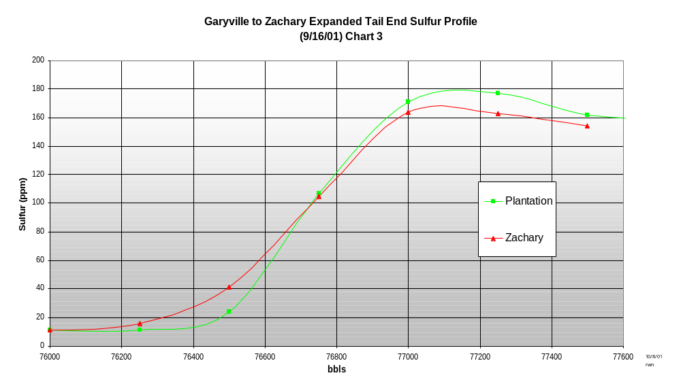
ULSD Testing – Garyville to Zachary Results (Con’t)
Notes:
This is the tail end sulfur profile of the batch at Plantation Jct and Zachary - 1000 bbls long, and more typical of what current critical interfaces (ie gasoline/distillate) are on the system.

Slide 10
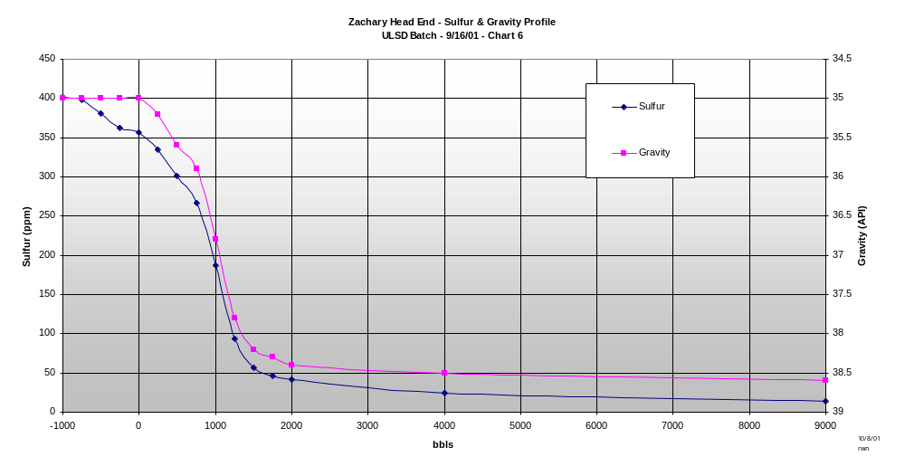
ULSD Testing – Garyville to Zachary Results (Con’t)
Notes:
This is the head end interface sulfur and gravity profile as it arrived at Zachary. Note that the sulfur and gravity profiles are nearly identical. Since there was no way to determine the sulfur content of the products, we made our switches from adjacent product to ULSD based upon the gravity of the products. As you will see on the next slide, this provided the ULSD batch reasonable protection from contamination

Slide 11
ULSD Testing – Garyville to Zachary Results (Con’t)
Zachary via 20” system wrapped with LSD and gasoline
  73,034 bbls out of 76,588 bbls delivered to a clean tank at Zachary
  1-2 ppm sulfur degradation tank to tank
  4.6% loss to interface
  Refinery tank line at Garyville contaminated head end 4000 bbls
  No migration of sulfur at head end or tail end beyond the normal gravity interface zone
  No degradation due to the pipeline and associated appurtenances
  No sulfur degradation from delivery piping
Notes:
Results:
73,034 bbls of ULSD out of 76,588 bbls lifted were delivered to a clean/empty tank at Zachary
There was 1-2 ppm sulfur degradation between the tank at Garyville and the tank at Zachary. The sulfur level at Zachary was 11-12 ppm.
4.6% was lost to interface
The refinery tank line at Garyville contaminated 4000 bbls at the head end of the batch
The rest of the results are the same as we saw on our tests in 3 other systems,IE:
There was no migration of sulfur at the head end or tail end interfaces beyond the normal gravity interface zone
There was no sulfur degradation due to the pipeline and its associated appurtenances
And there was no sulfur degradation from the delivery piping at Zachary.
This batch was then moved through the Colonial Pipeline System, and Buster will describe their test results in a few minutes.

Slide 12
Testing Summary
MAPL results indicate:
  Pipelines can transport ULSD and maintain the sulfur specification
  Gravity changes correspond closely to sulfur changes; protective gravity cuts may be acceptable
  The loss to interface should be the same as with current critical cuts
Notes:
To summarize the results of our ULSD tests:
Pipelines can transport ULSD and maintain the sulfur specification
Gravity changes correspond to sulfur changes; protective gravity cuts may be acceptable (I will talk about this more when I discuss in-line testing)
The loss to interface should be the same as with current critical cuts

Slide 13
Testing Summary (Con’t)
MAPL results indicate:
  Contamination occurs from front end systems such as refinery piping and origin station piping
  Little sulfur contamination occurs in the pipeline
  Tankage and delivery system piping does not add significant sulfur contamination
Notes:
Contamination (in our tests) occurred in front end systems such as refinery piping and origin station piping
Little sulfur contamination occurs in the pipeline
Tankage and delivery system piping does not add significant sulfur contamination
Keep in mind that all of our testing was done from refinery tank to terminal tank, with no stops in between. As compared to some systems, our lines are relatively short and small diameter. We did the tests under ideal conditions.

Slide 14
Testing Conclusions
Must have in-line testing equipment
  Control contamination that happens during transit
  Define cut points
  Suitable test equipment is not available
Test equipment must be robust
May need an indirect method for interface detection
Notes:
Pipeline operators need in-line sulfur testing equipment that can operate remotely and quickly. Monitoring the sulfur content of product in a flowing line has never been necessary, and fast acting field equipment is not available.
The industry needs something that will find contamination that may have happened to the ULSD batch while in transit and allow the operator to take action before off-specification material enters terminal tanks.
The same in-line equipment is needed to help define cut points. Since sulfur content in an interface changes more rapidly than gravity. it would be desirable to be able to see sulfur as well as gravity during an ULSD cut. Also, there may not be an adequate gravity difference between the ULSD and wrap material to facilitate a cut. Without in-line equipment, protective cuts will be necessary increasing the amounts of interface created.
The test equipment needs to be robust and able to operate at a remote location with only periodic attention. Needs to be able to handle dirty product, water, etc.
If in-line equipment is not developed, we may need to use a surrogate property to identify change such as a dye or some other type of marker.

Slide 15
Testing Conclusions (Con’t)
Each pipeline system will have its own “personality”
  Anything which creates a product quality problem today will be exacerbated when handling ULSD
    Slow actuating valves – leaking valves
    Non-dedicated tank lines
    Long dead-legs in stations – long suction/discharge piping at pump stations
    Sumps that inject automatically – prover loops that are not flushed
    Systems with frequent shutdowns or large elevation differences
  May need to redesign facilities to minimize contaminaiton
Notes:
Each pipeline system will have its own “personality”, and batch sulfur specifications will need to be adjusted accordingly. Anything which creates a product quality issue problem today will be exacerbated when handling ULSD. Concerns include:
Non-dedicated tank lines
Non-dedicated suction/delivery headers
Long dead legs in stations
Leaking valves
Long suction/discharge piping at pump stations
Sumps that inject automatically
Prover loops that are not continuously flushed
System shutdowns and systems with large elevation changes
Some facilities may need to be redesigned to minimize contamination.

Slide 16
Testing Conclusions (Con’t)
  Pipeline ULSD sulfur specifications could vary by system or routing
    Simple tank to tank movements could add only 1 ppm sulfur with a moderate interface loss
    More complex network routings could add several ppm sulfur and have a large loss to interface
Notes:
The pipeline ULSD sulfur specification might need to vary batch to batch depending on the origin and destination. For example, sulfur degradation for a simple tank to tank movement from a refinery to a terminal should be about 1 ppm. More complex pipeline network movements that involve passing through breakout tanks and multiple pipeline segments could result in a several ppm sulfur degradation. These will need to have lower sulfur at the origin.

Slide 17
DISCUSSION

