Slide 1


The Evolution of Gas Markets in the United States
Barbara Mariner-Volpe
May 2000
Bangladesh Ministry of Energy and Mineral Resources
Barbara.Marinervolpe@eia.doe.gov

Slide 2
Scope of this Presentation
Market and Regulatory Development
Regulatory Reform and Industry Restructuring
Market Trends
Current Issues
Outlook

Slide 3
The U. S. Natural Gas Industry At A Glance
Participants
Miles of Pipe
Regulatory Regime in 2000
Producers
8,000 Independents
0
Phased price deregulation
24 Majors
Begun in 1979, completed in 1989
Pipelines
160
285,000
Federal Energy Regulatory
Commission (FERC)
Natural Gas Marketers
260
0
Unregulated
Local Gas Utilities
1500
833,000
State Utility Commissions
End Users
Residential 53 million
0
Unregulated
Commercial 4.5 million
Industrial 40 thousand
Electric Utilities 500
0
Interstate - FERC
Intrastate - State Commissions

Slide 4
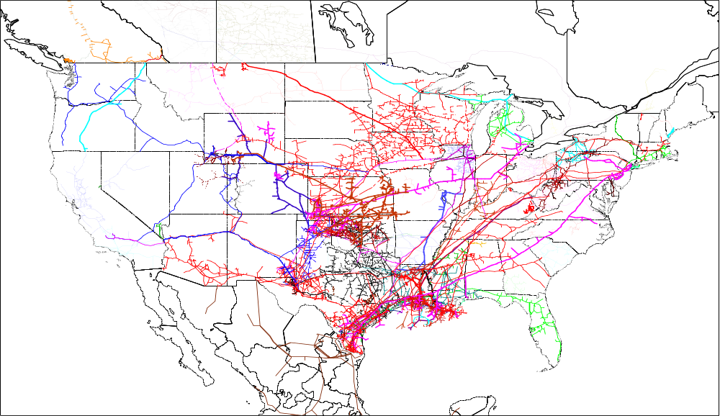
A Vast Network of Pipelines Provides Interstate Transportation

Slide 5
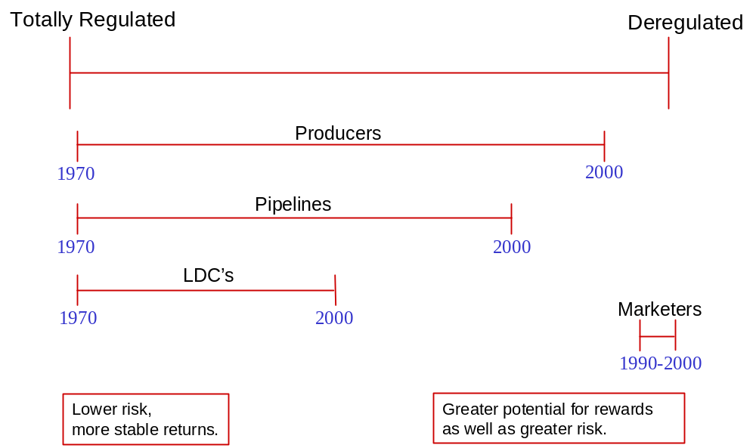
Regulatory - Market Continuum Within the Natural Gas Industry

Slide 6
Evolution of the Natural Gas Industry
Era of Development: 1910 - 1950
Era of Regulation: 1950 - 1970’s
Era of Market Inefficiency: late 1970’s - mid 1980’s
Era of Adjustment/Restructuring/Deregulation:
late 1980’s - 2000

Slide 7
Era of Development: 1910 - 1950
Supply sources
Transportation technology/Infrastructure
Demand

Slide 8
Era of Regulation: 1950 - 1970’s
Concern about monopoly power
Federal, state and local regulations
Significant market growth
Gas still considered an oil by-product

Slide 9
Era of Market Inefficiency: late 1970’s - mid 1980’s
Market signals not transmitted - prices not market driven
Curtailments, followed by market restrictions
Growing perception of supply scarcity, then supply “bubble”
Disincentives to efficiency improvements

Slide 10
Era of Adjustment/Restructuring/Deregulation: late 1980’s - 2000
Period of transition - policy and market changes
Wellhead prices deregulated - spot, futures markets develop
Restructured transmission industry - emergence of marketers
Market centers, hubs, storage expand
Retail Market regulatory changes

Slide 11
Key Federal Decisions/Regulation of the Gas Industry
Natural Gas Act of 1938: regulation of interstate pipelines
Supreme Court Decisions (Phillips, 1954): Interstate Gas
Natural Gas Policy Act of 1978: Response to curtailments in mid 1970’s
  Led to market dislocations, gas “bubble”
Orders 436, 500, 636 (1985 - 1993)
  restructured interstate market
Natural Gas Decontrol Act
  decontrol of wellhead prices
Others: PUHCA repeal, Energy Policy Act

Slide 12


Changes over the Last Few Years:
Physical Changes:
  significant increase in pipeline capacity
  development of high-deliverability storage
  new pipeline routes, more interconnections
  technology advances
Structural Changes:
  regulations -- encourage competition, protect environment
  role of pipelines -- transporters only
  open access to suppliers -- development of new supplies
  deregulation of wellhead prices
  emergence of a secondary market for trading pipeline capacity

Slide 13
Effects of Physical and Structural Changes: Pipeline Companies
Shifting risk/cost
Increased competition
Customer oriented
New business strategies:
consolidate
“spin-off”
diversify
enter unregulated business areas

Slide 14
Effects of Physical and Structural Changes: Shippers
New responsibilities and risks
More Choices - for services and providers
More transparent price information
Changes to delivery system utilization
strategic use of storage
more inventory management
shedding unused capacity
Financial instruments (e.g. future market)

Slide 15
Effects of Physical and Structural Changes: Industry
New industry players: Marketers
Increased competition
Development of hubs and market centers
Efficiency Gains: Increased throughput, decreased unit costs
Technology advances
Market signals communicated
Corporate combinations & convergence
Spot Market Development
More opportunities and risks (volatility)

Slide 16

The Paradigm for the Gas Market Has Changed
Pre Restructuring Paradigm:
  heavy regulation
  efficiency not rewarded
Post Restructuring Paradigm:
  principles of competition and choice, while recognizing a continuing, although greatly reduced role for regulation

Slide 17
Financial transactions are no longer closely tied to the flow of the commodity
Physical Flow of Natural Gas Remain Much the Same
Physical Flow of Natural Gas Remain Much the Same
Producers
Pipelines
LDC’s
End Users
More Market Participants Involved in Financial Transactions
More Market Participants Involved in Financial Transactions
On-System
Producers
LDC’s
End Users
(Wellhead
Pipelines
Prices)
Off-System
Marketers
End Users
Transportation
Commodity
Bundled
= Transactions captured by current data collectors.
= Transactions not captured by current data collectors.

Slide 18
Current Market Developments

Slide 19
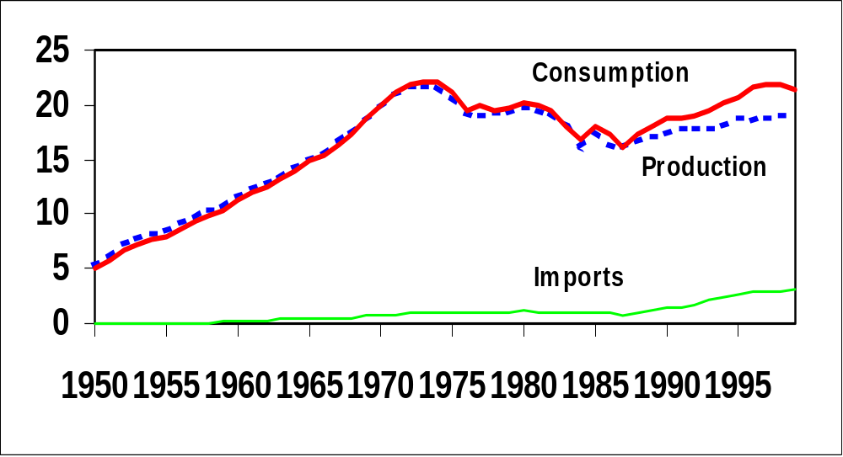
Trends in Natural Gas Consumption and Supply

Slide 20
Consumer Prices Declined Substantially From 1980’s Peak Prices
$10.00
$9.00
$8.00
$7.00
Residential
Commercial
$6.00
$5.00
1999 Dollars per
Thousand Cubic Feet
Industrial
$4.00
Electric Utilities
$3.00
$2.00
Wellhead
$1.00
$0.00
1973
1975
1977
1979
1981
1983
1985
1987
1989
1991
1993
1995
1997
1999

Slide 21
Supply Reliability
Ownership of assets equated to control of supply
Market system relies on diversification and flexibility
  alternate transportation routes
  transportation and storage are both substitute and complementary services
  commercial arrangements
Supplier performance / Supplier of last resort

Slide 22
The Restructured Interstate Pipeline
Market

Slide 23
Interstate Transportation Market in 2000
Pipelines -- Transporters, Not Merchants
More Choices for Shippers
Improved Pricing Information
Increased Competition
New Services
New Challenges

Slide 24
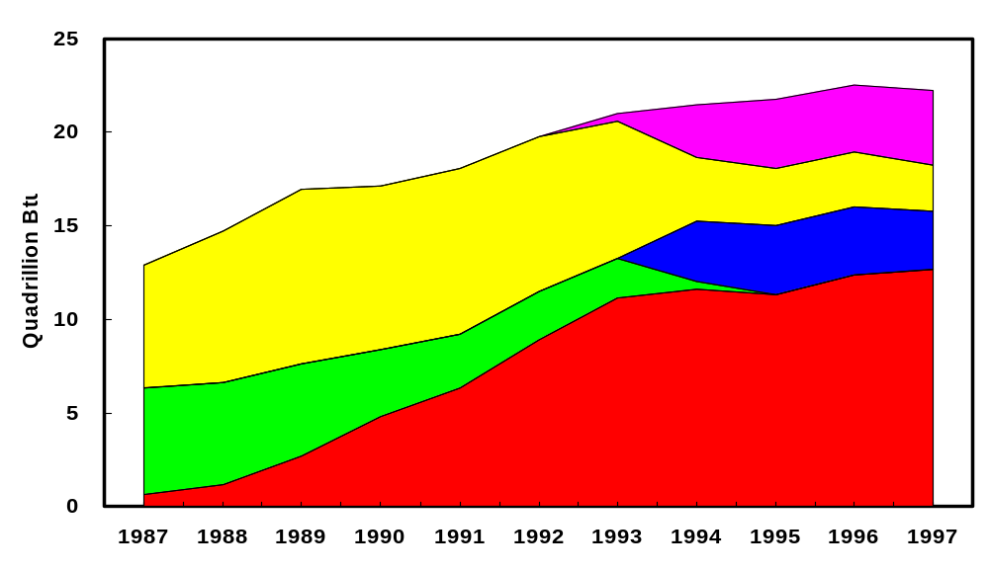
Choices of Pipeline Services Have Changed in the 1990’s
Released Capacity
Interruptible Transportation
No-Notice Service
Sales
Firm Transportation

Slide 25
Capacity Release
Order 636 ordered pipelines to establish release programs (EBBs).
Shippers are now able to “release” or resell their firm capacity rights.
Referred to as the “secondary market” in pipeline capacity.
Holders of firm capacity initiate the release and specify terms.
Competes with interruptible transportation service offered by the pipeline.
The rate structure in Order 636 increased the cost of reserving capacity.

Slide 26
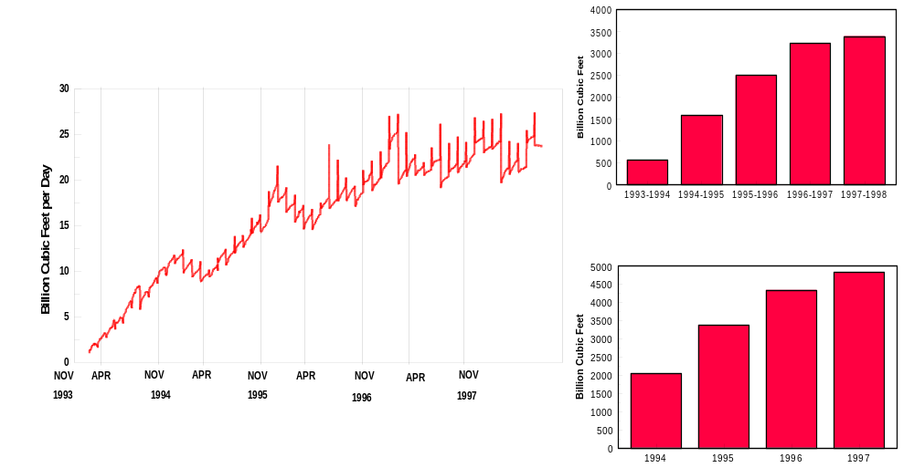
Released Capacity Has Increased
Heating Season Totals
Capacity Held by Replacement Shippers
Non-Heating Season Totals
Nov Apr Nov Apr Nov Apr Nov Apr Nov
1993 1994 1995 1996 1997

Slide 27
Natural Gas Transmission Markups have Declined as Deliveries Increased
130
120
Deliveries to End Users
110
100
Index 1985=100
90
80
70
Unit Transmission Markup
60
0
1985
1986
1987
1988
1989
1990
1991
1992
1993
1994

Slide 28
Trends in Transportation Contracts
LDCs hold the bulk of contracted capacity.
Contract expirations are significant
Shippers want flexibility and reliability
In the aggregate total commitments have increased slightly.
The length and size of long-term contracts have decreased.
Market concentration varies by region

Slide 29
Marketers Have Increased Their Share of the Transportation Market
July 1, 1997
July 1, 1999
Electric Utilities
Electric Utilities
4%
4%
Marketers
22%
Marketers
27%
LDCs
Pipeline
52%
Companies
LDCs
7%
59%
Pipeline
Others
Companies
3%
7%
Industrials
Others
5%
5%
Industrials
5%
Total Firm Capacity is 93 trillion Btu per day.
Total Firm Capacity is 97 trillion Btu per day.
Notes:
Observations: the non-heating season was chosen due to the fact that there is less of a chance for weather variation to impact the data.
Over the two years the percent of total for LDCs decreased from 59% to 52%. The Marketers increased from 22% to 27%, and other increased from 3% to 5%. The total capacity also increased from 92.7 to 96.7 TBtu/d.
This is most likely due to the fact that Marketers are taking over natural gas contracts due to retail unbundling. This is most likely happening with the “Others” category too.

Slide 30

Emerging Issues for Interstate Transportation Market
Does the current formula for computing regulated rates send the ‘right’ market signals?
How, when or will the pricing structure change from cost of service rates to market based rates?
Shifting risk - How will the industry deal with capacity that shippers don’t want on a long-term basis (capacity turnback, decontracting)?
Regulation v. Competition -- What’s the right balance?

Slide 31
Total Firm Capacity Under Contract Has Generally Increased Each Quarter
1996
1997
1998
1999
120
Long-Term
Short-term
120
100
102
104
105
80
100
96
95
97
96
96
97
99
60
90
95
95
93
93
40
20
80
0
Jul-
Jan-
Jul-
Jan-
Jul-
Jan-
Jul-
Capacity (TBtu/d)
96
97
97
98
98
99
99
60
40
20
0
Note: Data are for 60 interstate pipeline companies.
Apr
Jul
Oct
Jan
Notes:
Observations: generally capacity is increasing. Except for in april when it has a huge spike in 1997 and then settles down in 1998. This is most likely linked to the fact that in 1997 there was a huge spike in new contracts, (seen in previous slide), the new contracts came about in April.

Slide 32
Firm Transportation Capacity by Year for Contract Expiration, 1999 - 2025,
as of July 1, 1999
Trillion Btu per Day
16
14
Short term
12
Long term
10
8
6
4
2
0
1999
2001
2003
2005
2007
2009
2011
2013
2015
2017
2019
2021
2023
2025+
Note: Data are for 60 interstate pipeline companies. Data for 1999 are for the last 6 months.
Notes:
Observations: There is a decreasing trend over the years. This could mean that there are not that many extremely long-term contracts.
There is a huge peak in 2023. There was the large about of contracts that were started in April of 1997, and there were many of them that had the 2023 expiration date.

Slide 33
Volatility of Natural Gas Prices has Increased
Over the Last Several years

Slide 34
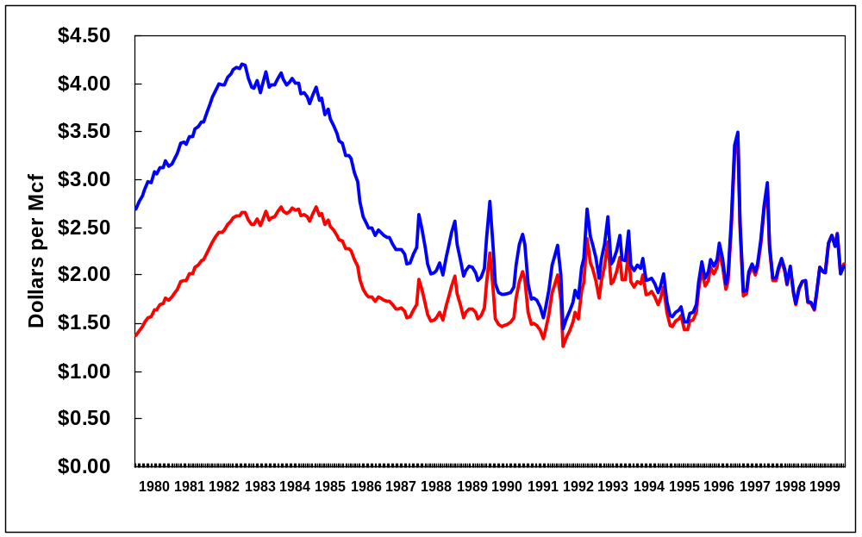
In Recent Years Natural Gas Prices Show
Greater Volatility
1999 Dollars
January 1980 - January 2000
Nominal Dollars

Slide 35
What Are The Main Drivers Of Short-term Price Volatility?
Affects Supply Affects Demand
Weather
Economic/business conditions
Stock levels
Pipeline capacity
Operational difficulties
Lack of timely,
reliable information

Slide 36
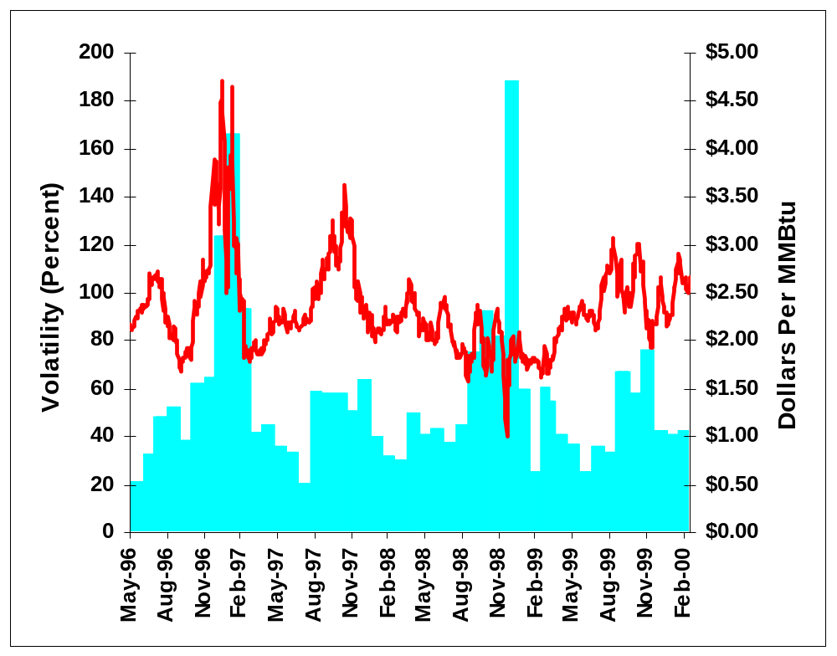
High Prices Do Not Always Coincide With High Volatility
Wholesale gas price in Henry, LA
Monthly Variations
in Daily Prices
(Volatility Index)

Slide 37
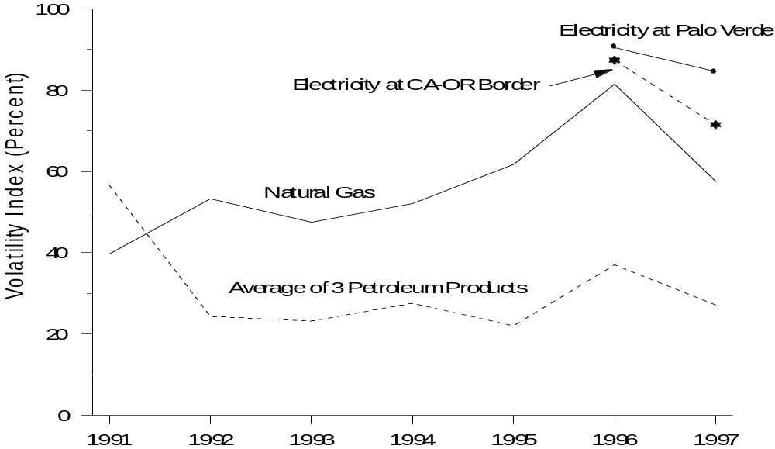
Natural gas is second only to electricity in energy futures price volatility

Slide 38
Spot Distillate & Crude Oil Prices
(Prices through March 3, 2000)
180
Peak $1.77
160
140
West Texas Intermediate (WTI)
120
Gulf Coast (GC) No. 2
100
New York Harbor (NYH) No. 2
Cents Per Gallon
80
60
40
20
0
Jan-
Apr-
Jul-
Oct-
Jan-
Apr-
Jul-
Oct-
Jan-
98
98
98
98
99
99
99
99
00
Notes:
Retail distillate prices follow the spot distillate markets, and crude oil prices have been the main driver behind distillate spot price increases until recently. Crude oil rose about $17 per barrel or 40 cents per gallon from the beginning of the latest “up cycle” in mid February 1999 to mid-January, 2000.
Over this same time period, New York Harbor spot heating oil rose about 42 cents per gallon, reflecting both the crude price rise and the beginning of a return to a more usual seasonal spread over the price of crude oil.
The week ending January 21, distillate spot prices in the Northeast spiked dramatically to record levels, closing on Friday at $1.26 per gallon -- up 50 cents from the prior week. Gulf Coast prices were not spiking, but were probably pulled slightly higher as the New York Harbor market began to draw on product from other areas. The Gulf Coast heating oil spot price closed at 83 cents per gallon, an increase of 11 cents from the prior Friday. Crude oil rose about 4 cents from the prior week.
Since then, New York Harbor spot distillate prices have been volatile. Prices initially peaked on Tuesday, January 25 at almost $1.36 per gallon before a brief weather respite and signs of cargoes coming to the East Coast encouraged buyers to begin to relax. By January 31, they fell to 82 cents, only to rebound again as cold weather and supply delays continued, peaking February 4 at $1.77 as weather continued to hinder re-supply. By Friday, February 11, prices had fallen below 80 cents per gallon, and remained below that level ever until February 25, when rising crude oil prices began to pull them upward again.
What happened the week ending January 21 to set off this price spike?

Slide 39
Retail Unbundling

Slide 40

Developments in Retail Markets
Many states are promoting consumer choice
More than half of the states have choice programs
States are taking different approaches

Slide 41
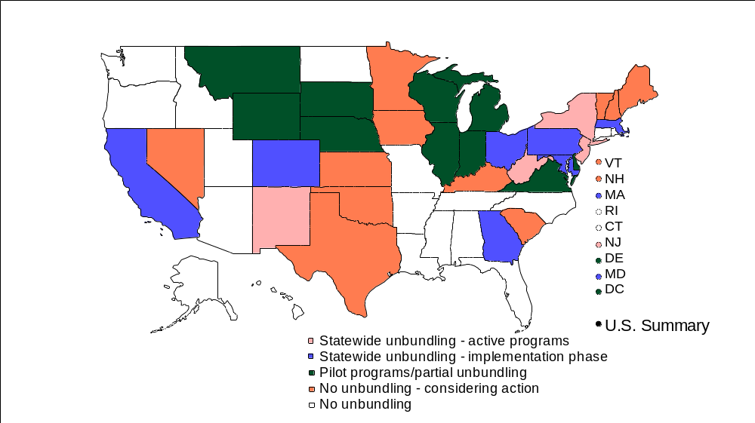

Status of Retail Unbundling in the US as of February 2000

Slide 42
Issues in Retail Unbundling:
Do the benefits of choice outweigh the cost?
Should all services be offered competitively? How should services be priced?
“Obligation to serve.”
Who should pay for the transition?
Marketers and local distributors -- a level playing field?
Reliability
Business Standards

Slide 43
Infrastructure Development

Slide 44
Demand Growth Has Led to Expanded Pipeline Capacity
Options:
- New pipelines
- Additional compression
- Looping
- A combination of each

Slide 45
Between 1990 & 1998, 18 new natural gas pipeline systems were built in the U.S.
Bluewater Pipeline 1995
Empire Pipeline 1994
(250 MMcf/d Bi-directional)
(500 MMcf/d)
PNGTS/Maritime 1998
(632 Mmcf/d)
Tuscarora Pipeline 1995
Iroquois Pipeline 1991
(110 MMcf/d)
(850 MMcf/d)
Northern Border Extn 1998
(650 Mmcf/d)
Kern River Pipeline 1992
(750 MMcf/d)
Crossroads Pipeline 1995
(250 MMcf/d)
Pony Express Pipeline 1997
(255 MMcf/d)
Mojave Pipeline 1992
(450 MMcf/d)
Mobile Bay Pipeline 1993
(600 MMcf/d)
TransColorado Pipeline 1996
Nautilus Pipeline 1997
(Southern Leg)
(600 MMcf/d)
Destin Pipeline 1998
(1,000 Mmcf/d)
(120 MMcf/d)
Garden Banks Offshore System 1997
DIGS Main Pass Gathering System 1997
(600 MMcf/d)
(200 MMcf/d)
Manta Ray Gathering System 1997
Discovery Pipeline 1997
(300 MMcf/d)
(600 MMcf/d)

Slide 46
Pipeline Expansion Projects Reflect:
The expanding development of deep-water production in the Gulf of Mexico.
The growing production capacity in western and offshore eastern Canada.
Shippers seeking greater access to alternate sources of supply.
Capacity constrained production seeking greater access to Non-traditional markets.

Slide 47
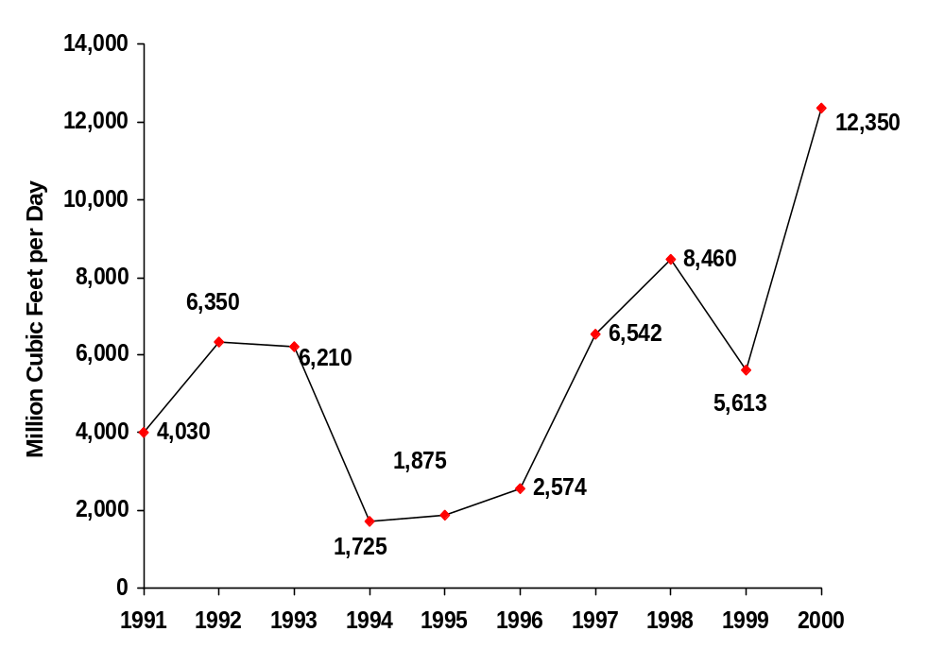
Except for 1994-96, the amount of added capacity each year has been above 4 Bcf/d
Additions to Capacity
(Announced
and/or
Approved
Projects)
Notes:
Highlights:
During the past decade, except for 1994-96, the amount of added capacity each year has been above 4 Bcf/d. In the early years, new pipeline system, such as the Kern River Transmission, Mohave pipeline and Iroquois Pipeline systems were installed, the former two to feed the expanding California market and the latter the first time substantial volumes of natural gas were imported into the Northeast from Canada.
The large growth in new capacity between 1997 and 1999 reflects the substantial development of new capacity supporting the expansion of deep-water production in the Gulf of Mexico (e.g. the Natutilis and Discovery pipelines). In addition, growth in Canadian import capacity (the expansion of the Northern Border and Great Lakes Transmission systems to name but two) continued unabated.

Slide 48
The Outlook for Natural Gas

Slide 49
What is the Big Picture for the Natural Gas Industry?
Answer: Many Opportunities for Growth.
Natural gas is a clean burning fuel.
Natural gas is an abundant source of energy.
The existing pipeline network could support market growth.
Capital investments continue to be made.

Slide 50
Natural Gas Market Outlook: Through 2020
  Continued optimism about market growth (32 Tcf in 2020)
  Increasing wellhead prices to $2.81 Mcf ($98) in 2020
  Declining margins/prices to small customers
  Imports increase to 5.1 Tcf in 2020
  Rising prices and lower drilling costs increase reserve additions and production
  Centralized technology improvements limit cost increases

Slide 51
U.S. Natural Gas Production, Consumption, and Imports,
1970 - 2020 (trillion cubic feet)
35
Consumption
}
30
Net Imports
Production
25
20
15
10
5
History
Projections
0
1970
1975
1980
1985
1990
1995
2000
2005
2010
2015
2020

Slide 52
U.S. Natural Gas Production by Source, 1970-2020
(trillion cubic feet)
15
History
Projections
Lower 48 NA
conventional
10
Lower 48 offshore
5
Lower 48 NA
unconventional
Lower 48 AD
Alaska
0
1970
1980
1990
2000
2010
2020

Slide 53
Natural Gas Consumption is Expected to Increase for Each Consumer Group
10
History
Projections
Industrial
8
Electric
Generator
6
Residential
Trillion Cubic Feet
4
Commercial
2
0
1990
1995
2000
2005
2010

Slide 54
Electricity Generation by Fuel
1990-2020 (billion kilowatthours)
Reference Case
Renewable
Hydropower
Nuclear
Petroleum
Natural Gas
Coal
1990
1995
2000
2005
2010
2015
2020

Slide 55
Projections for Wellhead Prices are Influenced by Technology Assumptions
5
History
Projections
4
Slow
technology
3
1996 Dollars Per Thousand Cubic Feet
Reference
2
Rapid
technology
1
0
1970
1980
1990
2000
2010
2020

Slide 56
New Technologies and Initiatives Could Improve the Environment
Government/industry partnership: best practices
Gas-to-Liquids technology
Developments in fuel cell technology

Slide 57
SUPPLY MAY BE AFFECTED BY NUMEROUS ASPECTS OF THE PROJECTION
Demand growth, both absolute levels and the expected rate of change
Conditions in competing fuel markets, such as world oil prices
Projected foreign trade volumes: both imports and exports
Resource assumptions: both the geology base and the costs of discovery and recovery
Technology--impacts demand and supply side conditions

Slide 58
Technically Recoverable U.S. Natural Gas Resources
as of January 1, 1998 (trillion cubic feet)
Undiscovered nonassociated
Offshore
Inferred nonassociated
Onshore
Offshore
Unconventional
Onshore
Coalbed methane
Other unproved
Shale gas
Tight gas
Alaska
Proved
Lower 48 associated-dissolved
0
100
200
300
400

Slide 59
Natural Gas Will Hold a Larger
Share of the Energy Market in 2020
Total Energy Consumption
Total Energy Consumption
Natural Gas Consumption
Natural Gas Consumption
94.7 Q
94.7 Q
22.5 Q
(Quadrillion Btu)
22.5 Q
(Quadrillion Btu)
21.0
3.3
5.1
1997
1997
36.9
22.5
9.1
2.1
14.3
2.9
118.6 Q
118.6 Q
33.0 Q
33.0 Q
25.6
3.8
10.0
6.0
2020
2020
47.6
33. 1
3.2
10.1
12.3
Natural Gas
Petroleum Products
Industrial
Residential
Coal
Other
Electric Utility
Commercial
Other

Slide 60
A Competitive Market…...
Allows consumers and service providers to make individual decisions about managing and allocating risks and associated costs.
Can benefit informed customers who may choose the terms and prices that best meet their needs.

Slide 61
The Information Revolution...
How far we’ve come
Information that was not available prior
to the industry restructuring
Transparent wholesale natural gas prices
Weekly storage ‘estimates’
Futures market information
Electronic access to capacity information
Electronic gas trading systems

Slide 62
In the Future
Information Needs May Include
Transparent retail natural gas and electricity prices
Wide dissemination of daily price and quantity information on exchanges of gas
(Maybe even daily storage estimates)
Gas/electric convergence (and developing Btu markets) may lead to additional information needs

Slide 63
To allow competitive markets to develop and function effectively, actions may be needed that:
Foster choices that serve the public interest
promote system efficiencies
reduce regulatory uncertainty
support development and commercialization of technologies that reduce costs and increase choices available to consumers

Slide 64
In Summary: The Gas Industry is Dynamic
and Faces Opportunities and Challenges...
Continued volatility of prices
Significant market growth (to 32 Tcf by 2020)
Domestic production and imports will increase significantly in the future
Natural gas is an abundant resource
Continuing surplus of U.S. productive capacity in the short term
Increased competition in retail markets

