Slide 1

Efficient Pigging of Gathering Lines
Lessons Learned from Natural Gas STAR
Processors Technology Transfer Workshop
Gas Processors Association,
Devon Energy, Enogex
Dynegy Midstream Services, and
EPA’s Natural Gas STAR Program
April 22, 2005

Slide 2
Agenda
Methane Losses from Pipeline Pigging
Methane Recovery
Industry Experience
Is Recovery Profitable?
Discussion Questions

Slide 3
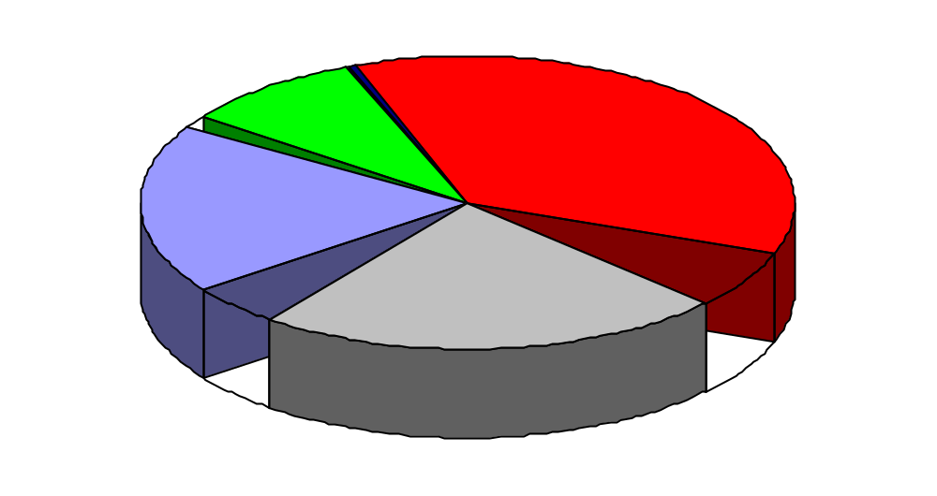
Natural Gas and Petroleum Industry Emissions
Processing plants responsible for 36 Bcf of methane emissions annually, and gathering/ booster stations contribute >22 Bcf
Oil Downstream
2 Bcf
Emissions
Processing
36 Bcf
1 Bcf
Reductions
10 Bcf
Production/ Gathering/ Booster
150 Bcf
Distribution 73 Bcf
25 Bcf
Inventory of U.S. Greenhouse Gas Emissions and Sinks 1990 - 2002
18 Bcf
Transmission & Storage
98 Bcf
Notes:
To arrive at Gathering/Booster emissions, went into the 2002 inventory and identified gathering sources within the production sector. This was 22.2Bcf
FYI: The DI&M Lessons Learned says Processing plants AND Booster stations emit a total of 36 Bcf…this is out dated.

Slide 4
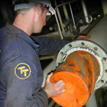
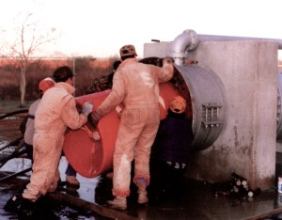
Pigging Gathering Lines
Hydrocarbons and water condense inside wet gas gathering lines, causing pressure drop and reducing gas flow
Periodic line pigging removes liquids and debris to improve gas flow
Efficient pigging:
  Keeps pipeline running continuously
  Keeps pipeline near maximum throughput by removing debris
  Minimizes product losses during launch/capture
http://www.girardind.com/

Slide 5
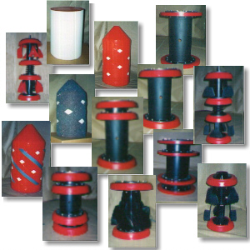
Pigging Applications
Pipeline pigs come in a variety of shapes and sizes for different applications
  Cleaning pigs
    Have brushes or blades to help remove debris
  Sealing pigs
    Make tight seal for removing
    liquids from the pipe
  Inspection pigs
    Specialized pigs outfitted with
    instruments to monitor the
    pipeline integrity
www.westernfilterco.com

Slide 6
Pigging and Methane Losses
Gas lost when launching and receiving a pig
Fugitive emissions from pig launcher/receiver valves
Gas lost from storage tanks receiving condensate removed by pigging
Gas vented from pipeline blowdowns

Slide 7
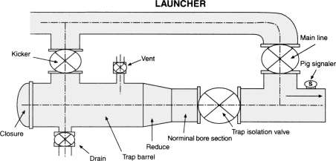
How Does Pigging Vent Methane?
Gathering lines have built-in pig launchers
Pig launchers have isolation valves for loading pigs, pressurizing pigs, and launching pigs with gas bypassed from the pipeline
Launcher pressuring/depressuring loses methane out the vent valve
Gas Flow
Vent Valve
Pig Launcher
Gas Flow
http://www.girardind.com/

Slide 8
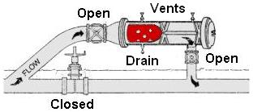
Pigging Vents Methane Twice!
Methane lost through vent valve on the launcher and again through vent valve on the receiver
  Once receiver is isolated from the line, it must be depressured to remove the pig
  Liquids ahead of the pig drain to a vessel or tank
Isolation valve leaks cause excessive venting to depressure
http://www.girardind.com/
Notes:
Depending on the company practices, a launcher will remain pressurized or they will depressurize it. Fugitives should be a lot less in the latter case.

Slide 9
Estimating Pigging Vents
E = P * V / 14.7 * n * f
where:
E = methane emissions (cubic feet)
P = Gathering line pressure (psia)
V = Launcher and receiver volume (cubic feet)
n = % methane
f = number of piggings
Pig trap isolation valve leakage increases this minimum amount of gas venting
Notes:
P is more of a factor than T, so omitted T as a variable as to simplify for the audience

Slide 10
Estimating Emissions from Pigging
Estimating V
Estimating P
  Default: 315 psia
Estimating n
  Default: 78.8
Line Diameter (inches) | V (cf)
6 | 0.9
12 | 4.6
18 | 11.5
26 | 27.7
34 | 65.2
48 | 170.7
Adapted from http://www.pigsunlimited.com

Slide 11
Gas Recovery from Pipeline Condensate Storage Tanks
Pressurized condensate collected from pigging is sometimes stored in atmospheric tanks
Gas released during atmospheric flashing can be recovered using a vapor recovery unit (VRU) rather than venting the gas
Facilities with existing pigging and liquid storage capabilities can install an electric or gas powered VRU compressor to recover flashed gasses

Slide 12
Industry Experience
One partner pigged gathering lines 30 to 40 times per year, collecting several thousand barrels of condensate per application
Partner reported saving 21,400 Mcf/yr from recovering flash gases
Dedicated VRU was installed with an electric compressor

Slide 13
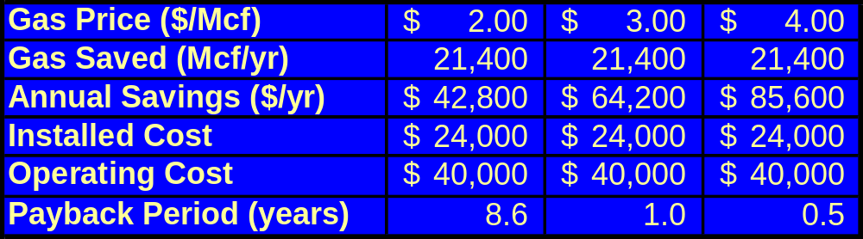
Is Recovery Profitable?
Partner reported installation cost of $24,000 for electric VRU compressor
Annual operating cost of $40,000 mostly electricity
Large gas savings and increasing gas prices will offset costs

Slide 14
Use Inert Gases and Pigs to Perform Pipeline Purges
Pipeline maintenance requires pipe section blowdown before work can begin
Gas in pipeline is usually vented to the atmosphere
Inert gas can be used to drive a pig down the section of pipe to be serviced, displacing the natural gas to a product line rather than venting
Inert gas is then blown down to the atmosphere, avoiding methane loss

Slide 15
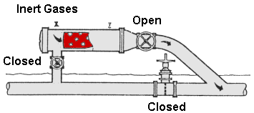
Inert Gas Setup
Existing pig launcher can be used, set up to work with inert gases
Portable nitrogen supply connected to the pig launcher vent
Close valve on the main pipeline, pressurize launcher with inert gas, open launcher to
main pipeline
Supply nitrogen until pig reaches receiver
http://www.girardind.com/

Slide 16
Industry Experience
One partner reported using inert gas to purge six pipelines for maintenance
Gas savings from these applications was 538 Mcf
These savings correspond to a typical application of:
  2 miles of 10” diameter pipeline
  Nitrogen at 280 psi

Slide 17
Is Recovery Profitable?
No capital costs with existing pigging facilities
Labor costs are estimated at eight hours for two operators
Nitrogen costs are roughly $8/Mcf
Increased safety is the primary benefit of this opportunity
Gas savings are a secondary benefit, as the labor and nitrogen costs outweigh the gas value

Slide 18
Discussion Questions
What opportunities do you have to reduce methane emissions from your pigging operations?
How can this presentation be made more useful to help you identify and evaluate opportunities?
What are the barriers to your implementing the technologies and practices in this presentation?

