Slide 1
U.S. Natural Gas Markets
Dr. Mark Rodekohr
Presented to the Philippines Department of Energy
February 2001

Slide 2
Organization
Infrastructure
Regulatory Structure
Trends and Projections
Regulatory Status
Other

Slide 3
Overview of U.S. Natural
Gas Pipeline Network
  There are more than 160 large natural gas pipeline systems in the U.S.
    These systems represent over 200,000 miles of transmission lines and over 100 trillion cubic feet per day of transport capacity.
  There are more than 1,500 local distribution companies in the U.S. that deliver gas directly to the consumer
  There are over 3,000 natural gas producers, 500 of which account for 90 percent of natural gas reserves in the U.S.
  There are over 1,500 compressor stations on the network
  and 600+ Natural Gas Processing Plants
  and 410 Underground Storage Facilities
  and 100 Liquefied Natural Gas Storage (LNG) facilities.

Slide 4


Evolution of the U.S.
Natural Gas Industry
Era of Development: 1910 - 1950
Era of Regulation: 1950 - 1970’s
Era of Market Inefficiency: late 1970’s - mid 1980’s
Era of Adjustment/Restructuring/Deregulation:
late 1980’s - 2000

Slide 5
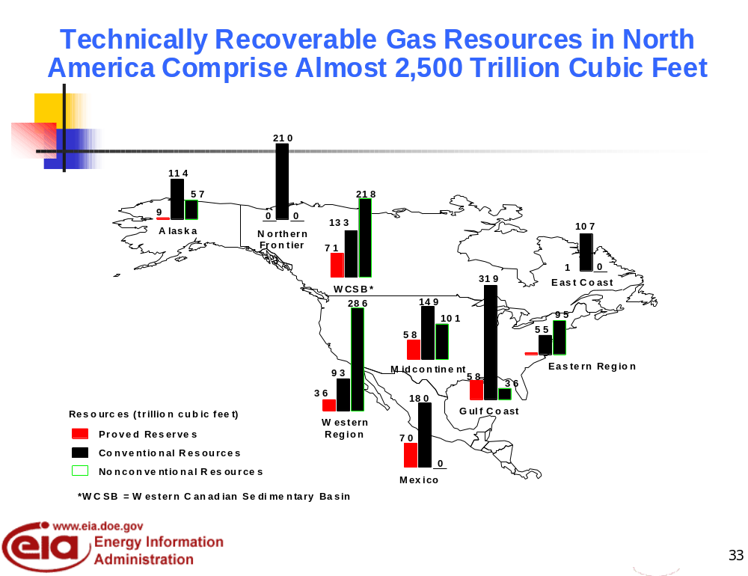

Slide 6
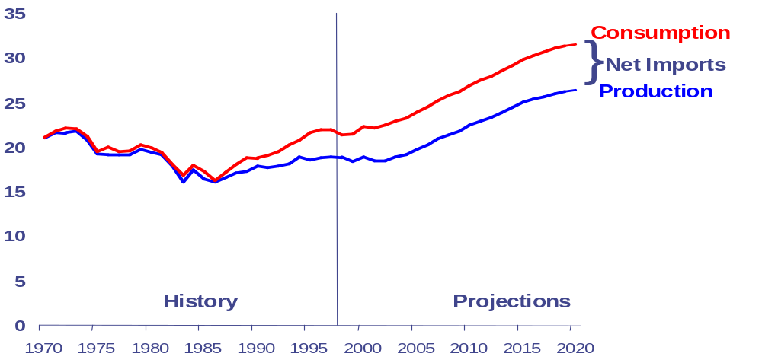
U.S. Natural Gas Consumption
Tcf

Slide 7
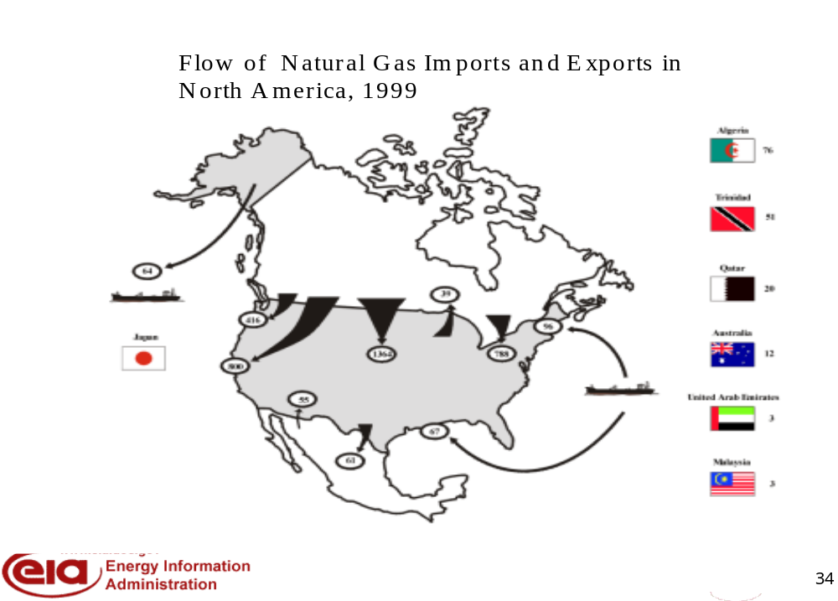

Slide 8
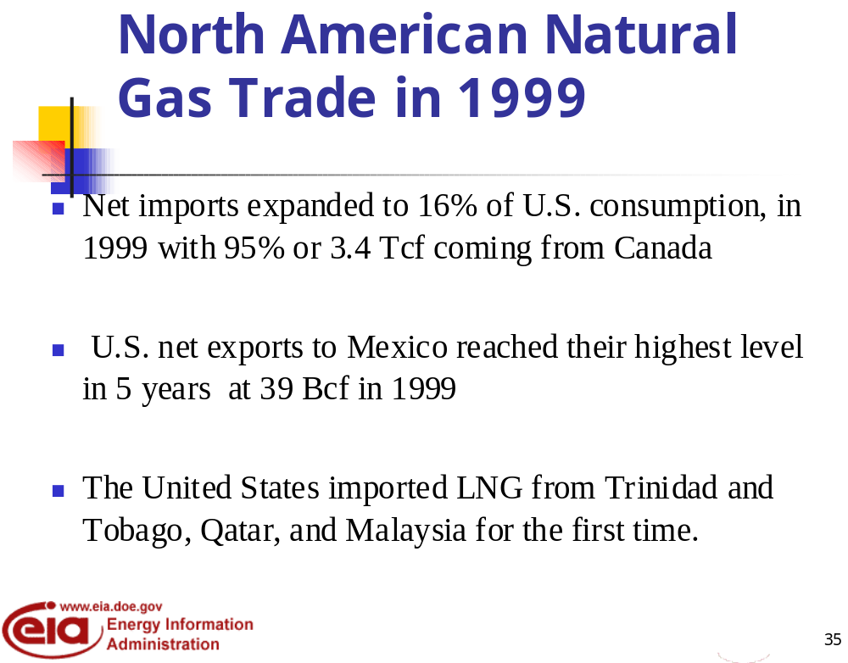

Slide 9
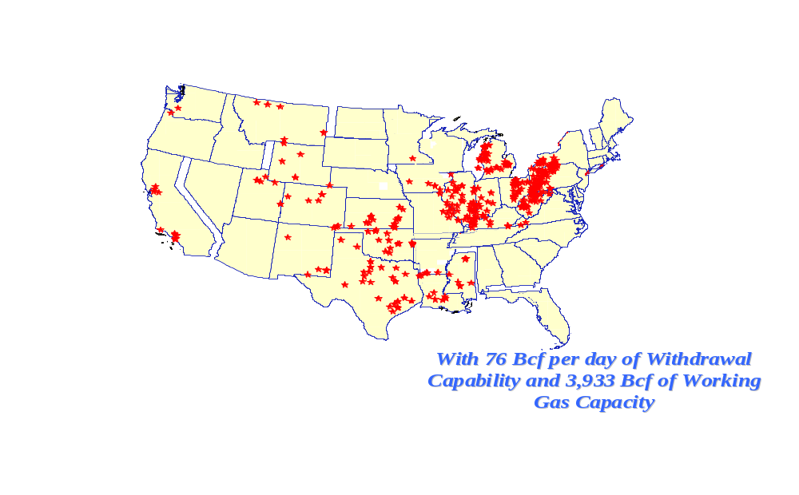
Storage Services Can Play a Critical Role Spot Market

Slide 10
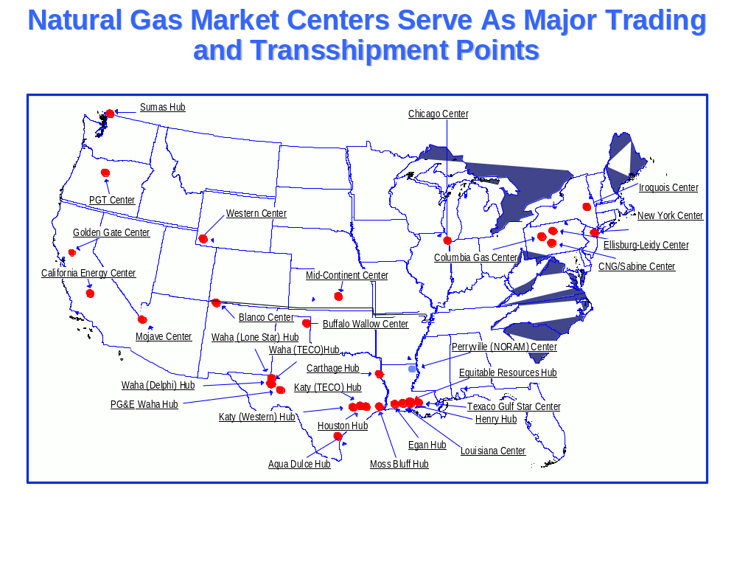

Slide 11
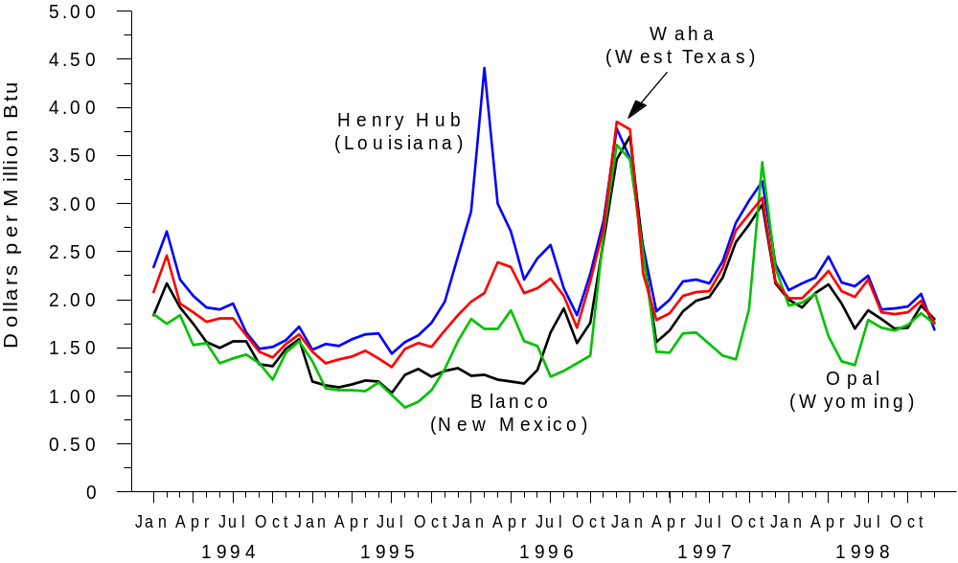
Natural Gas Prices Can Vary Between Hubs

Slide 12
Regulations/Laws Affect Natural Gas Pipeline Companies
State
  Regulate intrastate pipeline companies
Federal
  Federal Energy Regulatory Commission (FERC) regulates interstate pipeline rates, construction and certain operations
  U.S. Department of Transportation - pipeline safety, inspections
  EPA - emissions
  Treasury Department

Slide 13
Regulations/Laws Affect Local Distribution Companies
State
  Regulate local utility rates, certain operations, siting, construction, emissions
Federal
  Environmental regulations - emissions, ground water impact
Local Jurisdictions
  Regulate municipal utilities rates and operations

Slide 14
Federal Energy Regulatory Commission
Independent regulatory agency that regulates aspects of the electric, natural gas and oil pipeline and nonfederal hydropower industries.
Ensures that rates, terms and conditions of service are just and reasonable
Authorizes construction of natural gas pipeline facilities
Ensures hydropower licensing, admin. and safety actions are consistent with the public interest.

Slide 15
Regulations/Laws Affect the Production/Supply Segment of the Gas Industry
State
  Conservation Laws - well spacing, mineral rights, environmental impact, production rates, draining
Federal
  Environmental Protection Agency (EPA) - emissions
  U.S. Department of Energy - authorizes import/exports, Strategic Petroleum Reserve
  Bureau of Land Management, Minerals Management Service - leasing
Other
  U.S. Coast Guard, U.S Dept. of Transportation, Natural Gas Act, Energy Policy Act, Laws affecting access to wilderness areas and offshore

Slide 16
Countries are Establishing Independent Regulatory Bodies as Part of Restructuring
Australia
Finland
Italy
Norway
Netherlands
Spain
Sweden
U.K
U.S.
Germany
New Zealand

Slide 17
Features of Independent Regulatory Bodies
Independence from regulated companies
Legal mandate separating regulators and regulatory body from political control
Organizational autonomy
Obligations for transparency and accountability

Slide 18
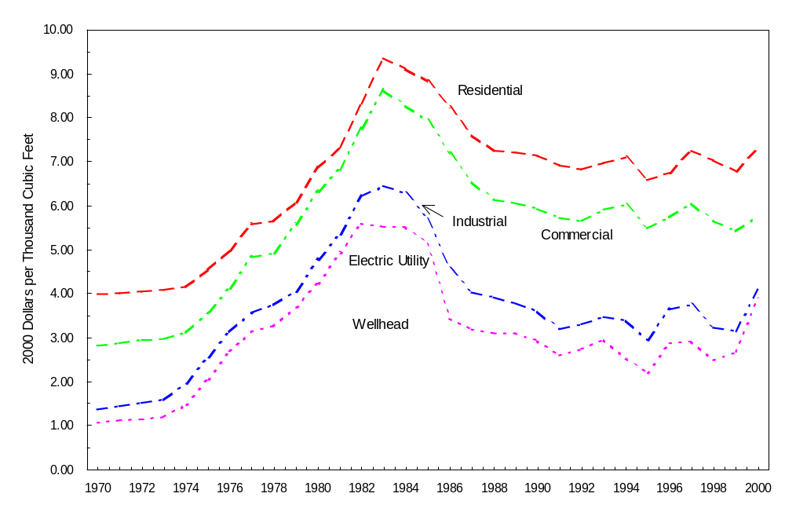
Average Transmission and Distribution Costs Have Declined for Most End-Use Sectors

Slide 19
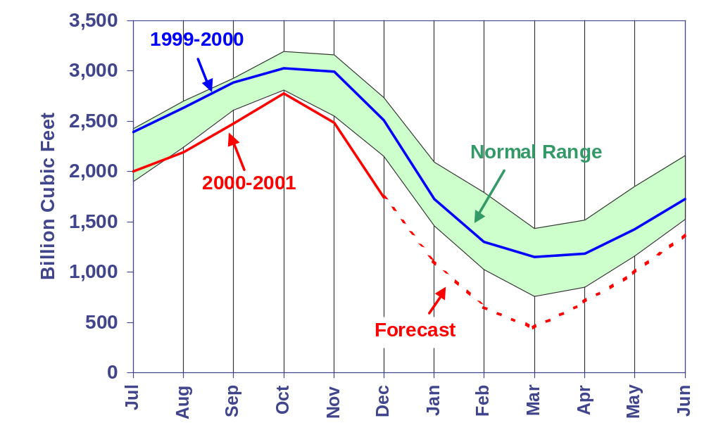
U.S. Natural Gas -
Working Gas in Underground Storage
Sources: History: EIA; Projections: Short-Term Energy Outlook, January 2001.
Notes:
Working gas in storage is estimated to have been about 2,425 billion cubic feet at the end of November, 14% below the previous 5-year average. The current outlook for winter demand and supply suggests that storage is headed for record lows this winter if weather is normal or colder than normal. In the base case, we project that gas storage will fall to about 640 billion cubic feet at the end of the heating season (March 31, 2001). The previous record low was 758 billion cubic feet at the end of the winter of 1995-1996. If summer gas demand next year is as strong as we currently expect it to be, the low end-winter storage levels will present a strong challenge to the North American gas supply system to maintain flexibility and provide additional gas in preparation for the subsequent winter season.
Based on the latest data relating to planned additions to U.S. electric generating capability over the next year (additions which will primarily consist of gas-fired units), we have increased our expected level of gas demand by the electric power sector from previous outlooks to 6.65 trillion cubic feet in 2001. That level is 3.4 % above the estimated level of 6.43 trillion cubic feet in 2000. The higher gas demand for power generation presumes a limited incremental propensity for switching to other fuels, including coal and oil, mainly due to environmental concerns. At the same time, we expect gas production in the United States to increase to 19.46 trillion cubic feet, about 3.6% above 2000 levels.

Slide 20
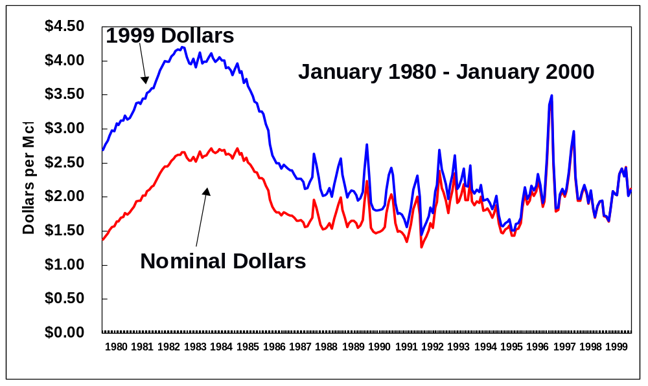
Recent Years Have Seen More Price Volatility

Slide 21
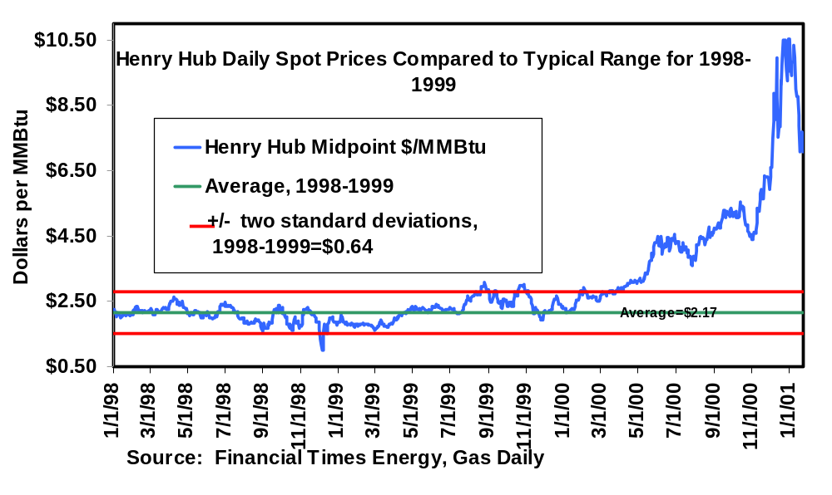
Current Natural Gas Spot Prices:
Notes:
The surge in spot prices at the Henry Hub since April has taken prices well above a typical range for 1998-1999 (in this context, defined as the average, +/- 2 standard deviations)
The upper bound on the typical range for 1998-99 is less than one-third of recent spot prices.
The Henry Hub spot price spiked at $10.53 per MMBtu on December 29.
Reasons for the price run-up include:
relatively flat natural gas production for several years
increased demand for natural gas as the economy has grown, especially from the electricity generating sector
expectations for a colder winter than experienced in the last few years (generally borne out so far this heating season)
low levels of natural gas in storage
high prices for oil limiting the economic incentive to switch to petroleum-based fuels
Natural gas spot prices have dropped in the past few weeks, with Henry Hub falling under $7 per MMBtu on January 24.

Slide 22
Why Have Natural Gas Prices
Surged in 2000?
Supply Tightness
Storage Stocks - lower than average
Consumption increases
Oil Price Increases
Market Perceptions

Slide 23
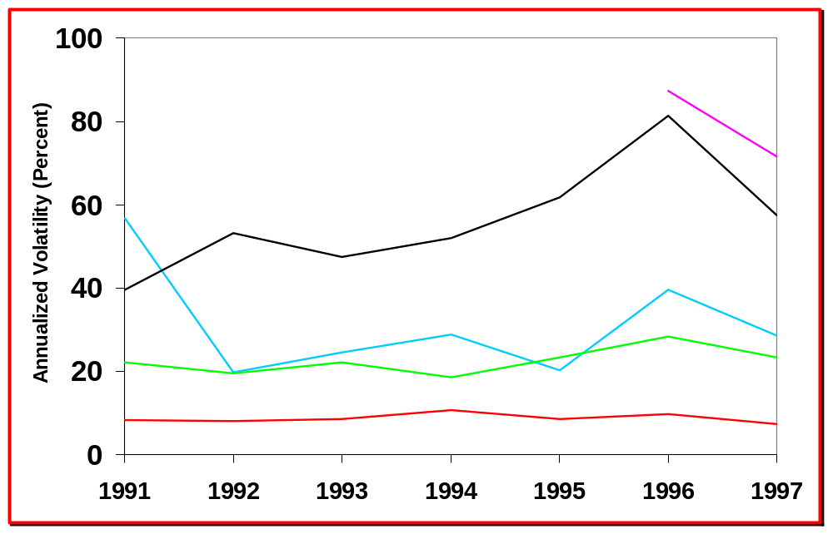
Energy Prices Are More Volatile Than Other Commodities
COB Electricity
Natural Gas
Crude Oil
Wheat
T Bonds

Slide 24
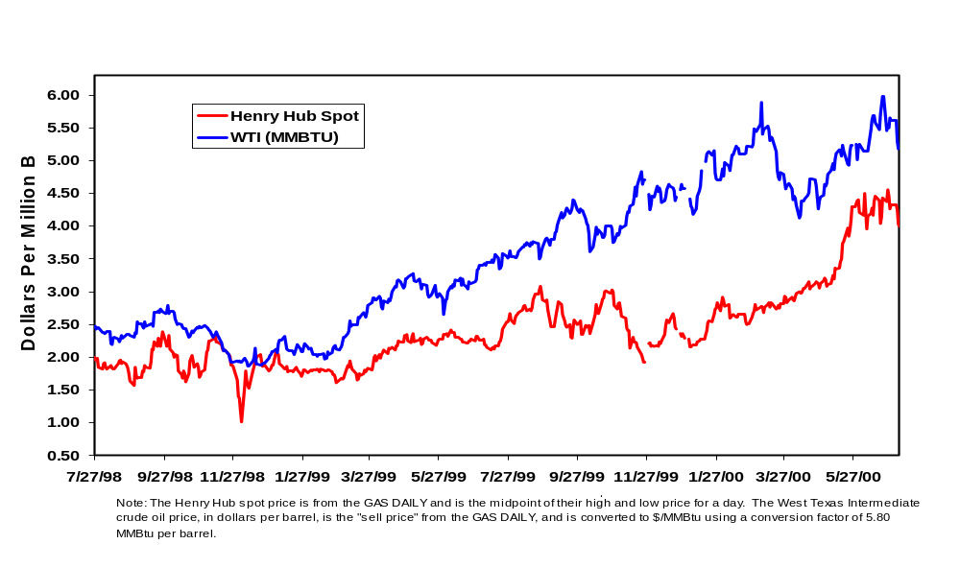
The Gap Between Crude Prices and
Gas Prices Widened in Early 2000
and Has Narrowed Since Spring 2000

Slide 25
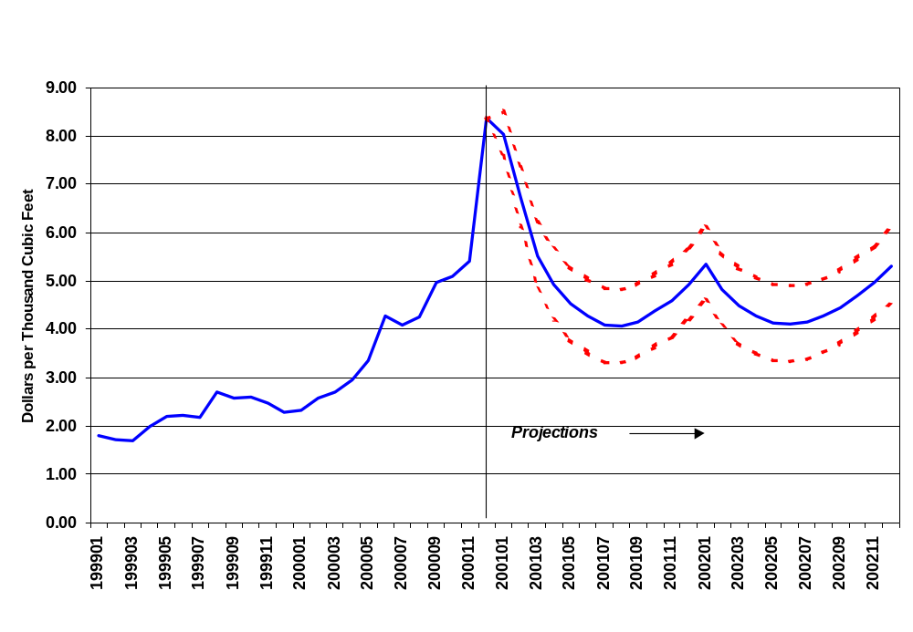
Natural Gas Spot Prices:
Base Case and 95% Confidence Interval
Sources: History: Natural Gas Week; Projections: Short-Term Energy Outlook, January 2001.
Notes:
We expect to see peak monthly spot wellhead prices this winter of over $8.40, the monthly average reported for December 2000. Recently, concern about cold weather and low stocks pushed daily spot gas prices over $10.50 per mcf. However, in early January of this year, forecasts of warm weather pushed the price down by more $1.00 per mcf in one day, indicating the extraordinary volatility in the current U.S. market.
The gas storage situation in the United States has not improved over the last few months, a sign that demand remains strong. We believe that the 30-year records for (seasonally adjusted) storage lows may be challenged throughout the heating season.

Slide 26
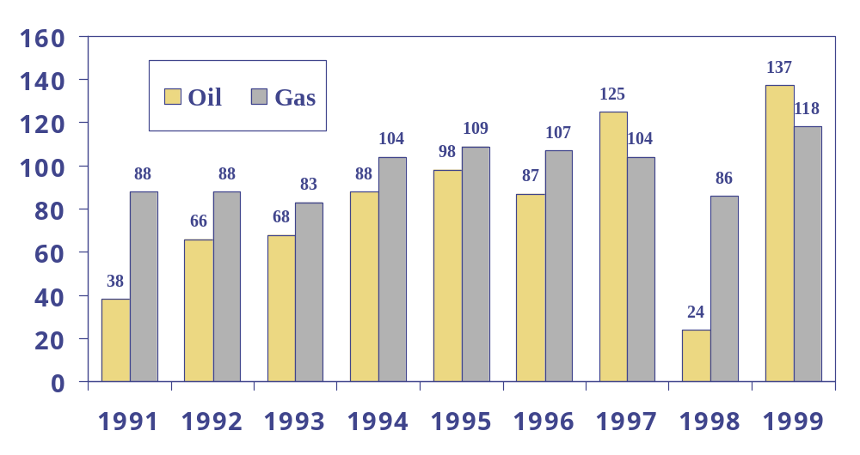
1998 Gas Reserve Additions Did Not Replace Production For The
First Time in 5 Years

Slide 27
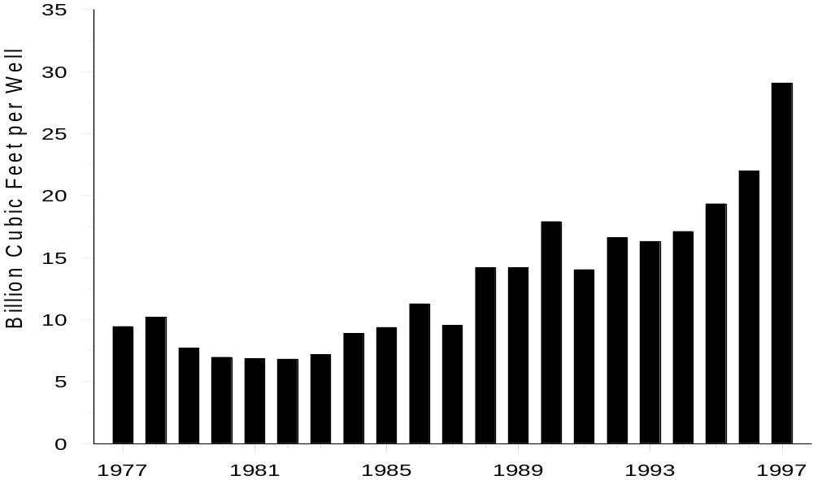
Gas Discoveries Per Exploratory Gas Well Have Been Trending Up Since The Mid-1980’s

Slide 28
Era of Market Inefficiency: late 1970’s - mid 1980’s
Market signals not transmitted - prices not market driven
Curtailments, followed by market restrictions
Growing perception of supply scarcity, then supply “bubble”
Disincentives to efficiency improvements

Slide 29
Over Half of the States Have
Residential Retail Restructuring Programs
VT
NH
MA
RI
CT
NJ
DE
MD
DC
Statewide unbundling - active programs
Statewide unbundling - implementation phase
Pilot programs/partial unbundling
No unbundling - considering action
No unbundling
About 22 Percent of Eligible Customers are Participating

Slide 30
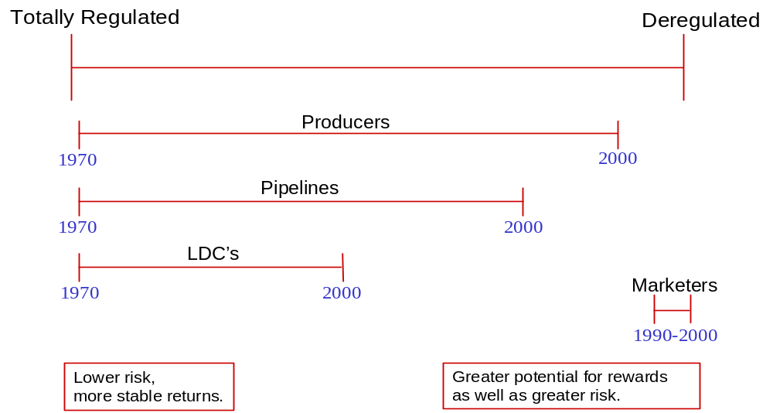
Natural Gas Market Development

Slide 31
EIA Natural Gas Geographic Information System
  EIAGIS-NG - geographic information system (GIS) centered on the natural gas industry.
  EIAGIS-NG - being developed by DOE/EIA as an analytical and tracking tool to expand our capabilities to study an industry undergoing rapid and significant changes.

Slide 32
EIAGIS
Includes Maps For:
  53 Interstate Pipeline Systems
  45 Intrastate Pipelines and Local Distribution Companies
Includes Point Locations for:
  More than 1100 Compressor Stations
  Over 7500 Delivery Points
  Over 800 Receipt Points
  Over 1000 Interstate Interconnections
  77 Proposed Storage Projects
  390 Existing Underground Storage Sites
  360 State Border Crossings
  as well as for Electric Power Plants, Cogeneration Facilities
  and other energy facilities.

