Slide 1

The Impact of Pipeline Drugs on Pharmaceutical Spending
C. Daniel Mullins, Ph.D.
Francis Palumbo, Ph.D., J.D.
Bruce Stuart, Ph.D.
University of Maryland School of Pharmacy

Slide 2
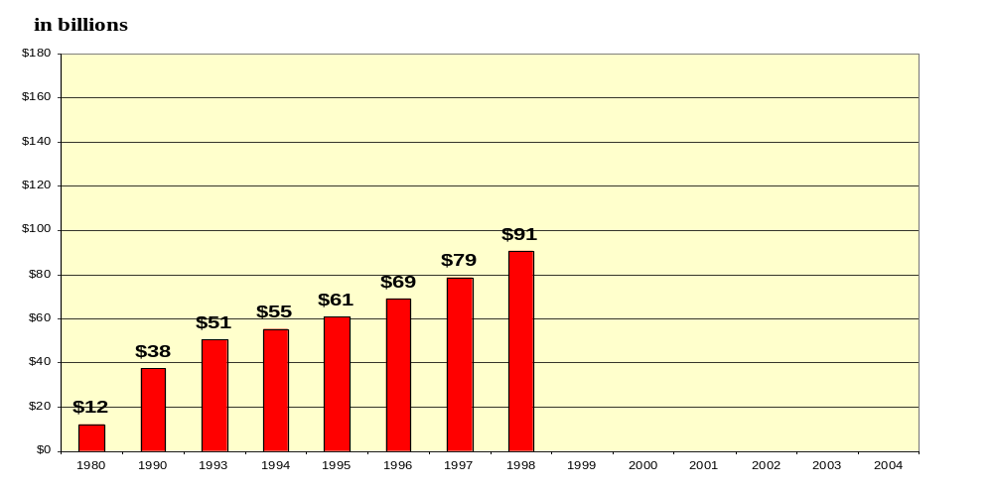
Pharmaceutical expenditures have risen significantly in recent years
Source: Levit K et. al. “Health Spending In 1998: Signals of Change”
Jan/Feb 2000, Health Affairs: 19(1)124-132.

Slide 3
University of Maryland Study
Purpose: project future drug spending
  Methods:
    straight line actuarial projections
    focus on major drugs/drug classes
  Sources:
    Expenditure data (1989-1998):
      top 100 drugs (proxy for existing)
      newly marketed drugs (proxy for pipeline)
    Price data: Average Wholesale Price (AWP)
    Utilization data: number of prescriptions
        (published in American Druggist)

Slide 4
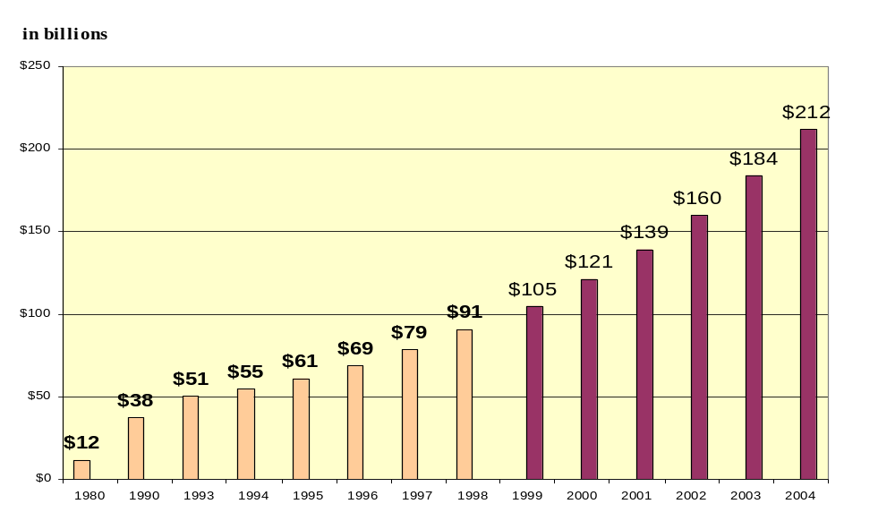
Overall, Rx expenditures will increase 15-18% annually from 1999-2004

Slide 5
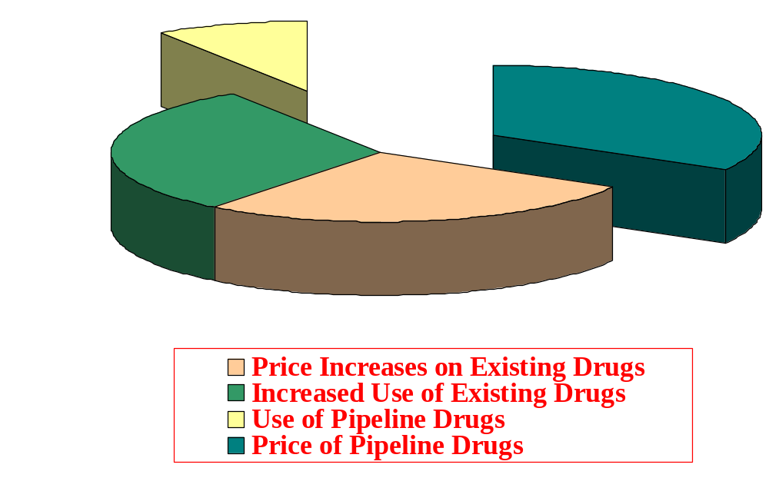
Increased price and use of existing drugs account for 60 percent of future spending increases
1-2%
5-6%
4-5%
4-5%
Pipeline drugs include replacement therapies and new therapies for which no equivalent currently exists.

Slide 6
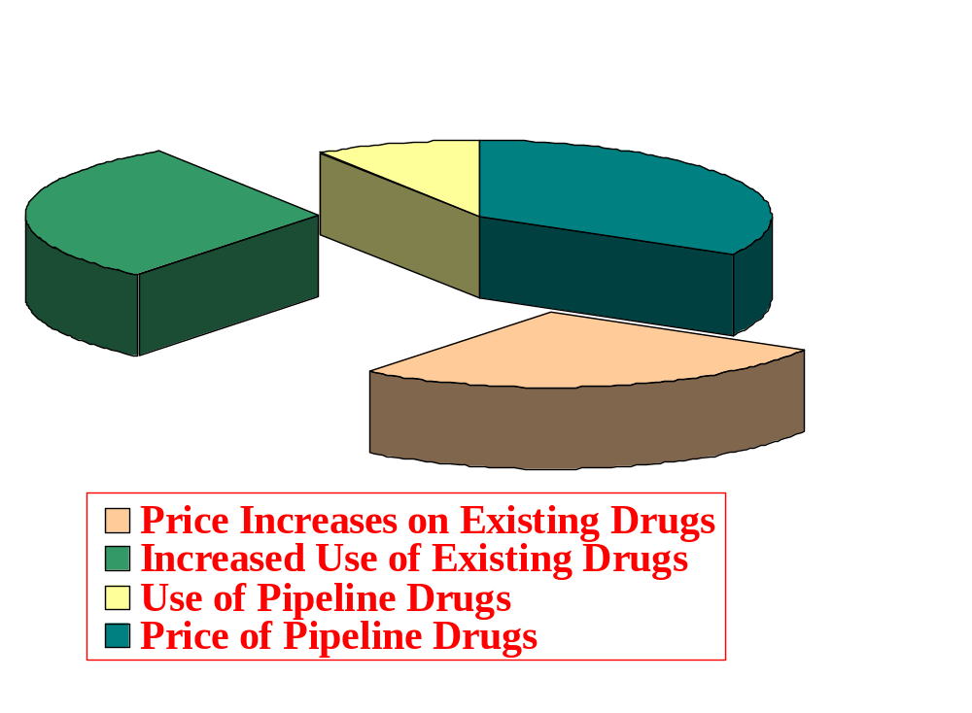
Expenditures on pipeline drugs account for 40 percent of future spending increases
1-2%
5-6%
Pipeline drugs include replacement therapies and new therapies for which no equivalent currently exists.

Slide 7
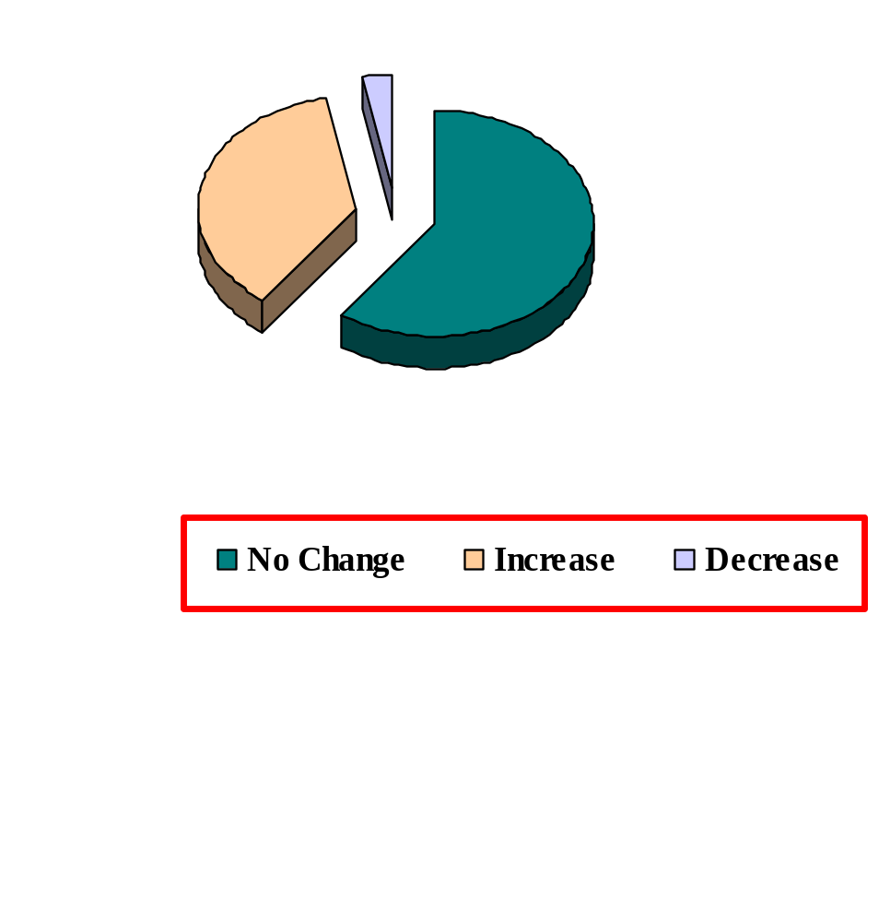
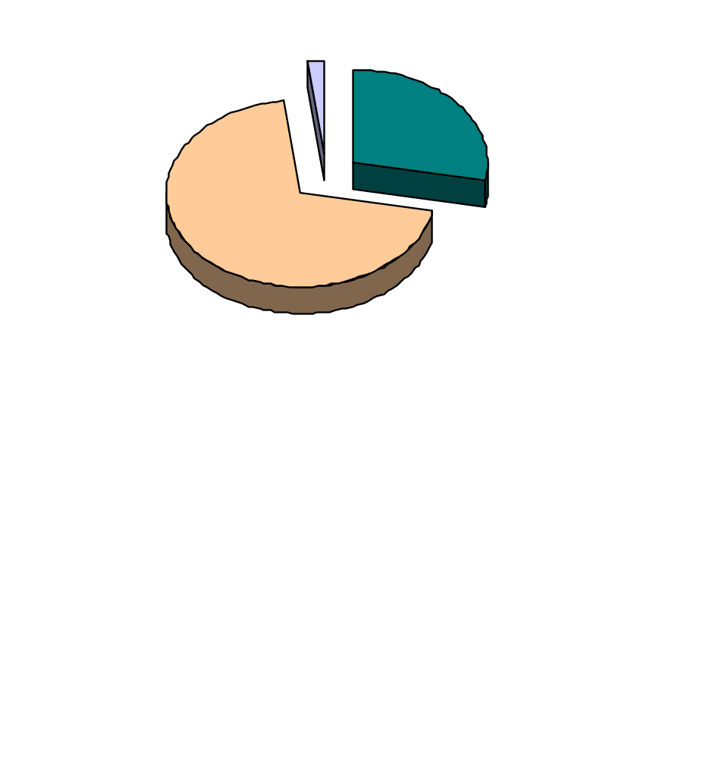
New drugs are most likely to exhibit price increases
*Top 100 Drugs
**Recently Marketed Drugs
3%
2%
28%
37%
60%
70%
* All dosages
* *Most frequently prescribed dosages

Slide 8
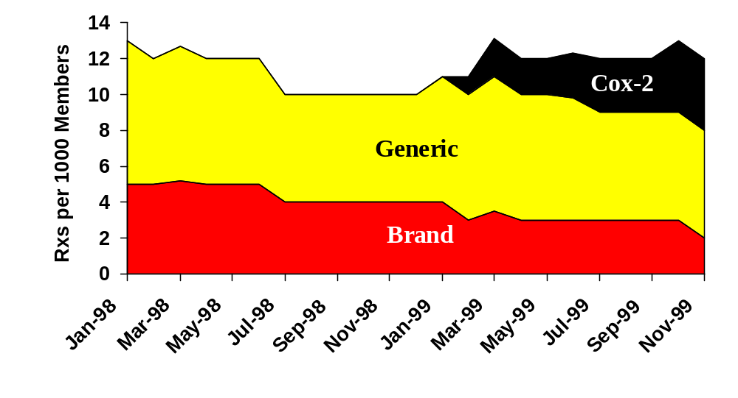
CASE STUDY:
While use of pain relievers is fairly constant...
NSAID Volume
Source: PCS Health Systems, Data Warehouse; Eligibility File

Slide 9
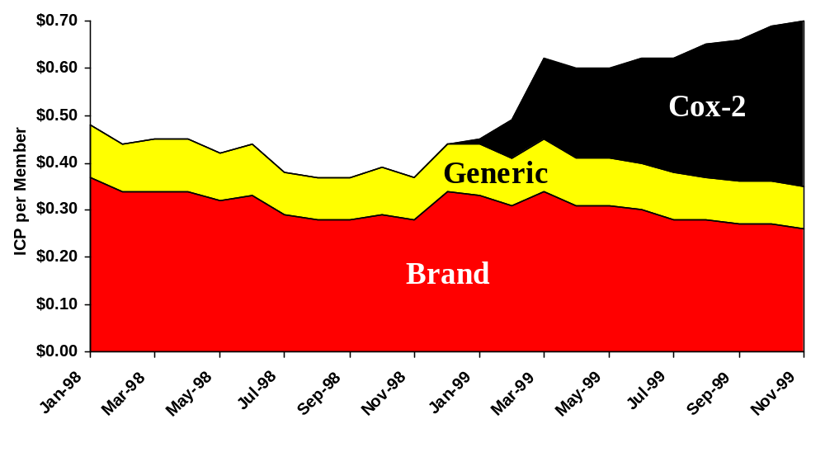
NSAID Costs
. . . per capita spending has increased by 46%
Source: PCS Health Systems, Data Warehouse; Eligibility File

Slide 10
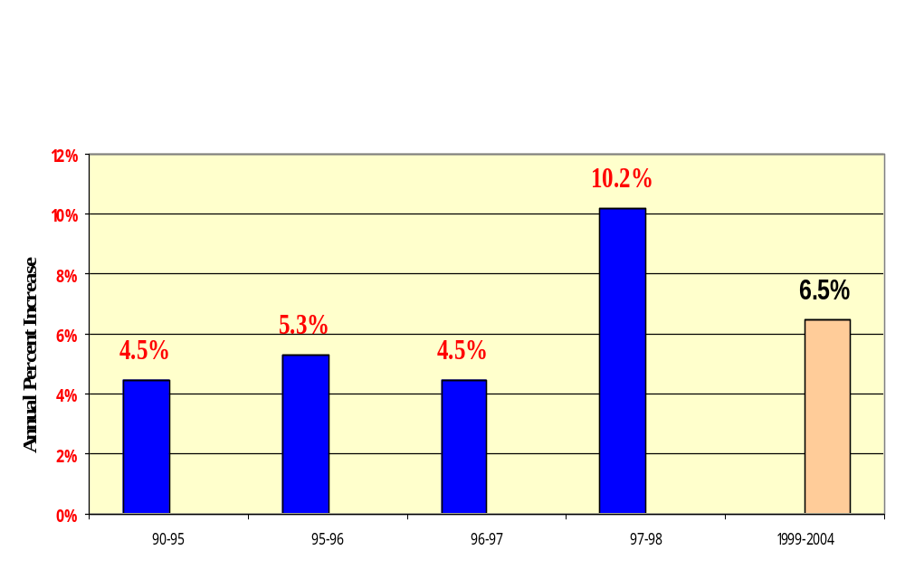
The number of prescriptions will continue to rise

Slide 11
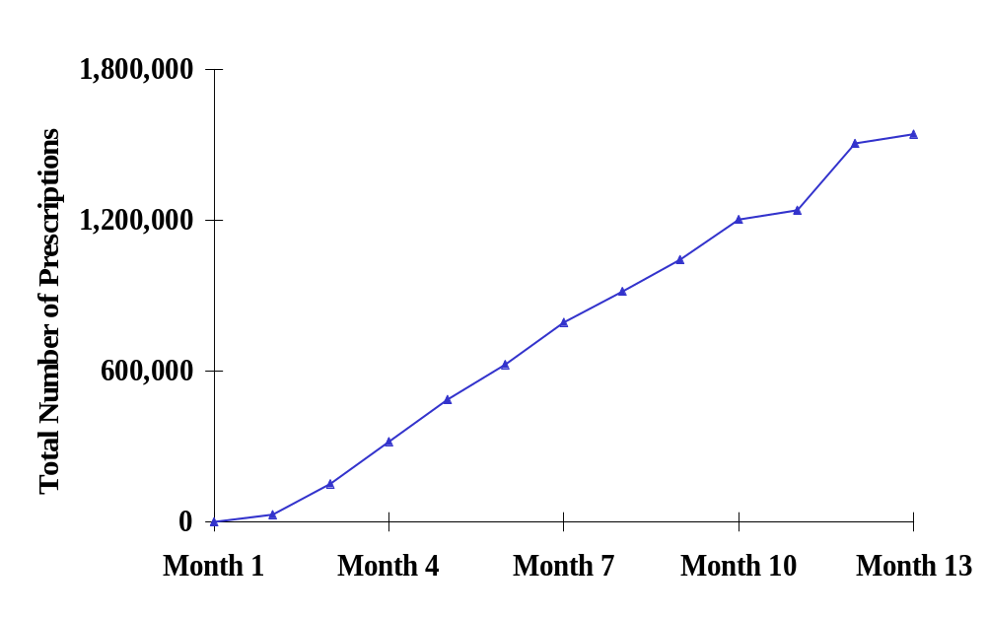
CASE STUDY:
New drugs are adopted rapidly and bring in new patients
Lipitor
1,540,000
730,000
Source: IMS America; June 1998, November 1998

Slide 12

What’s in the Pipeline?
Blockbuster drugs
“Me too” drugs
Lifestyle drugs
Top classes of pipeline drugs
  Biotechnology drugs
  Cardiovascular drugs
  Antidepressants
  Anti-cancer
  Erectile dysfunction

Slide 13
What other factors could influence future spending?
Increase
Decrease
Aging population
DTC advertising
Lifestyle drugs
New technology
Generic drugs
Pharmacy cost management
Reductions in other spending?

Slide 14
Factors with uncertain impact
Legislative and regulatory issues
Other demographic changes
Internet
Mergers and changes in drug distribution

Slide 15
Conclusions
Expenditures will continue to rise at a double digit rate
Pipeline drugs account for 40 percent of projected expenditure increases
Existing drugs account for the remaining 60 percent of projected expenditure increases
Price continues to be an important factor

