Slide 1
Studies of Pedestal Spliting
Andrei/Daekwang/Kazu
8 modules on the support structure
Read out only 1 and 2 in this study
  We know cal_sr in 2 has contribution to 1
  Try to see the effect of clock
HV = 50 V
BW = 4 with 132 ns integration time
4 3 2 1
8 7 6 5
z = 0

Slide 2
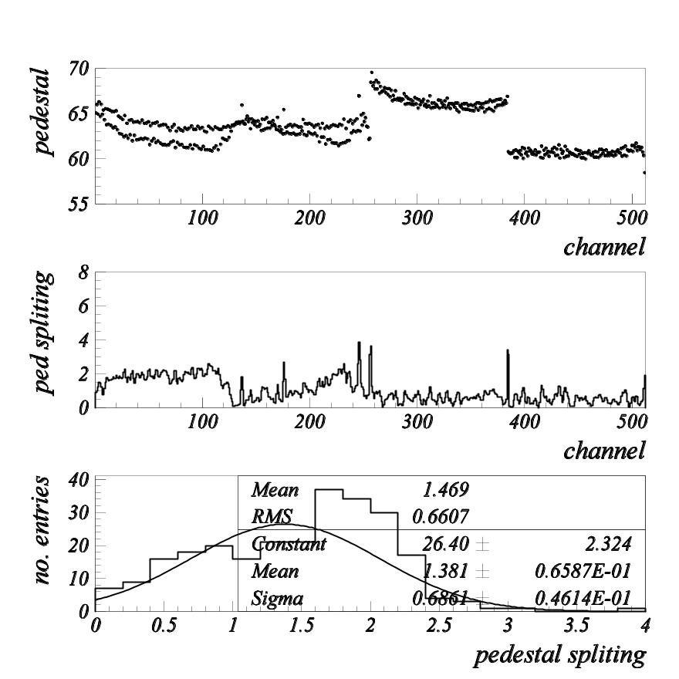
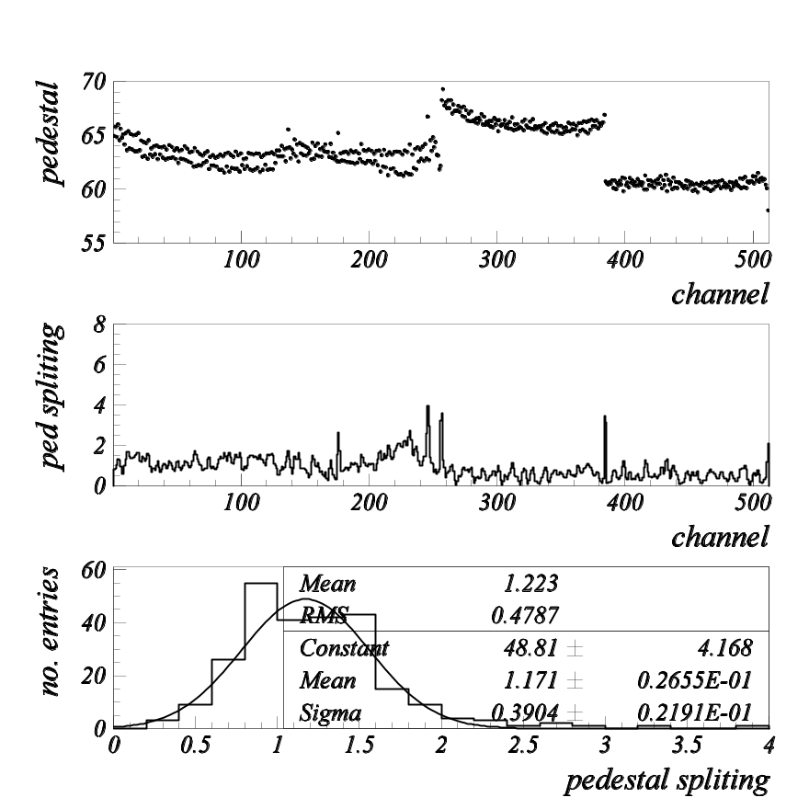
Starting point
pipeline depth same timing with cal_sr
cal_sr away from sampling pipeline
Size of pedestal splitting is ~1.2 after eliminating cal_sr contribution (0.8-0.9 in single module)

Slide 3
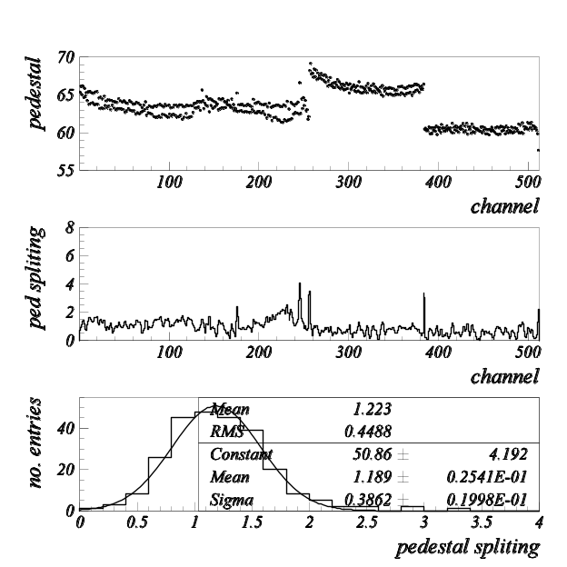
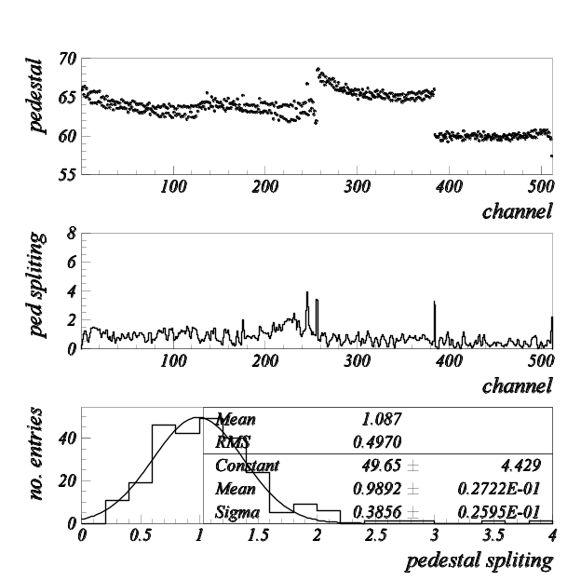
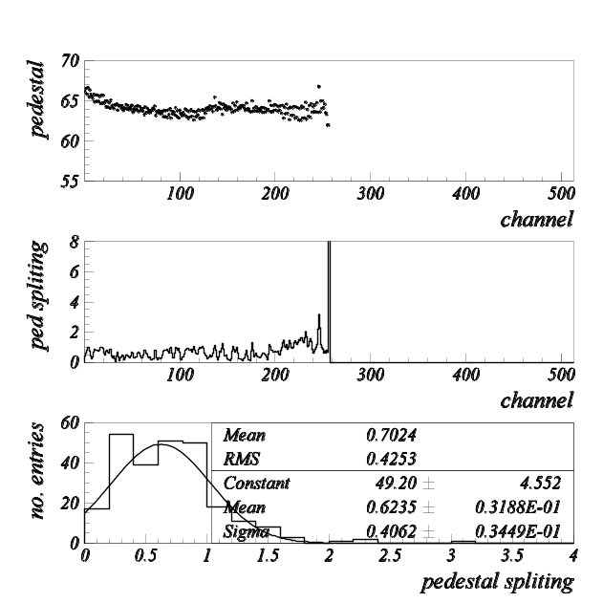
Putting capacitor in parallel
Failed to see the effect in the last report, but there was some mistake → repeated measurement
capacitor is added on module 2
sampling pipeline away from cal_sr
some effect seen
20pF
ADC=0
56pF
100pF

Slide 4
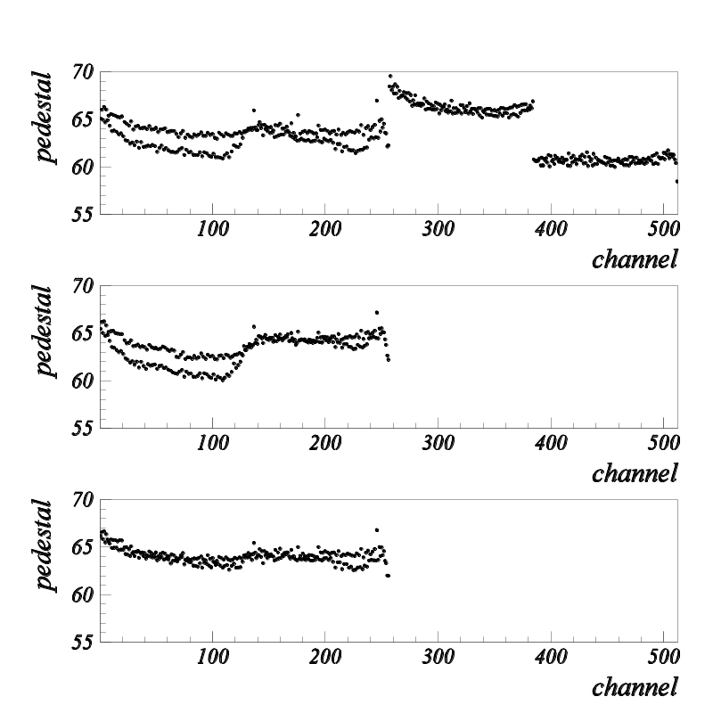
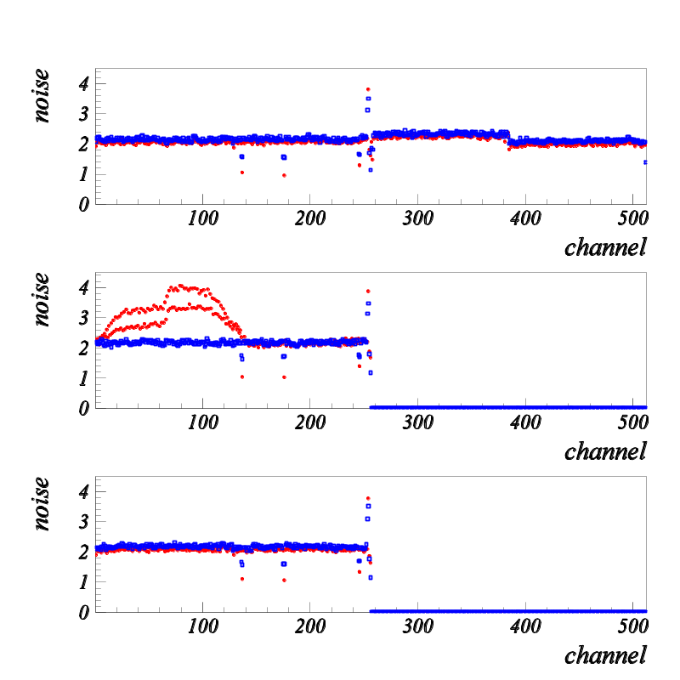
Noise level
default (no cap. pipeline=cal_sr)
100pF pipeline=cal_sr
100pF pipeline away from cal_sr
We finally see not only the pedestal splitting but also pick-up noise, but why with this configuration?

Slide 5
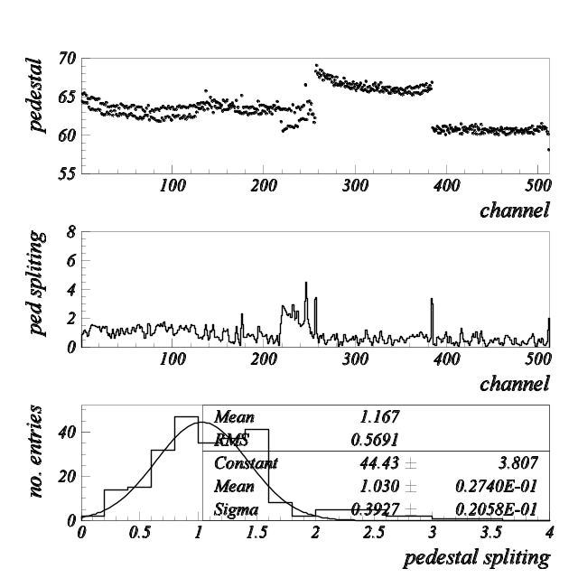
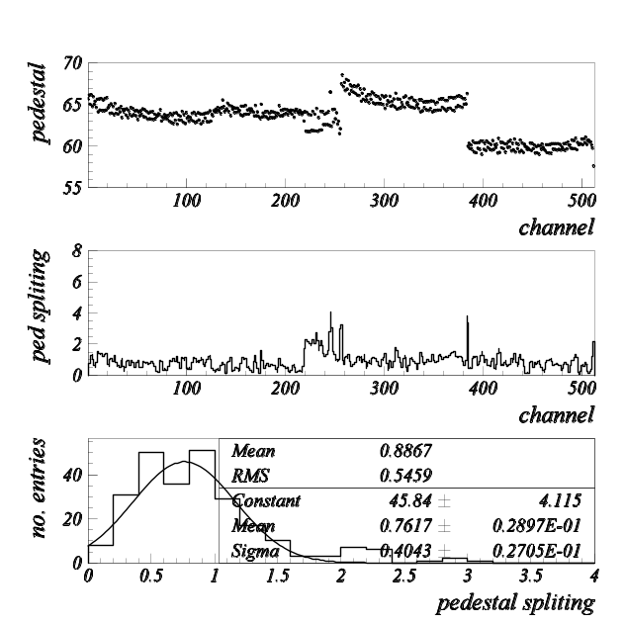
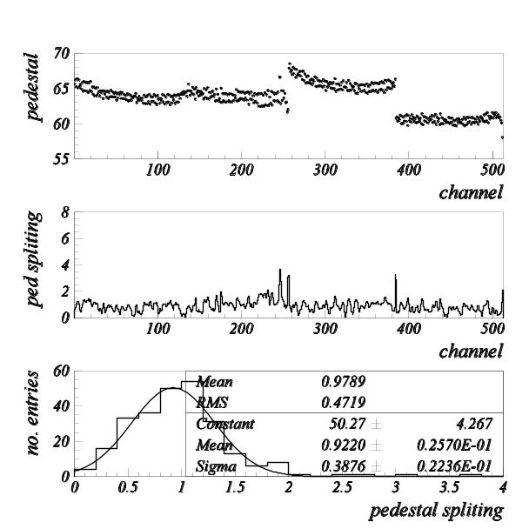
Reduced clock amplitude
Again sampling pipeline away from cal_sr
Pedestal splitting becomes smaller in module 1, but larger in 2 (?)
longer cable
320 mV swing
100 mV swing

Slide 6
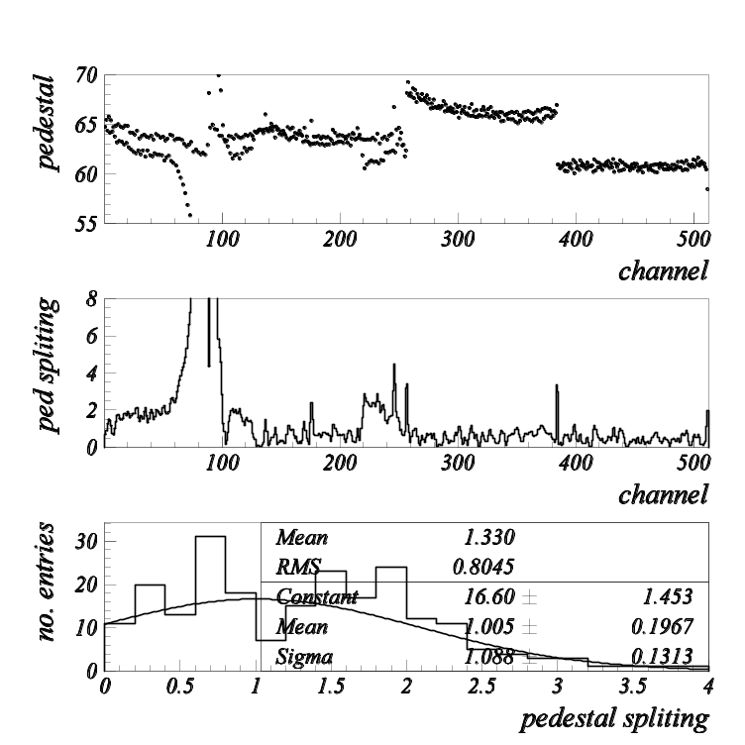
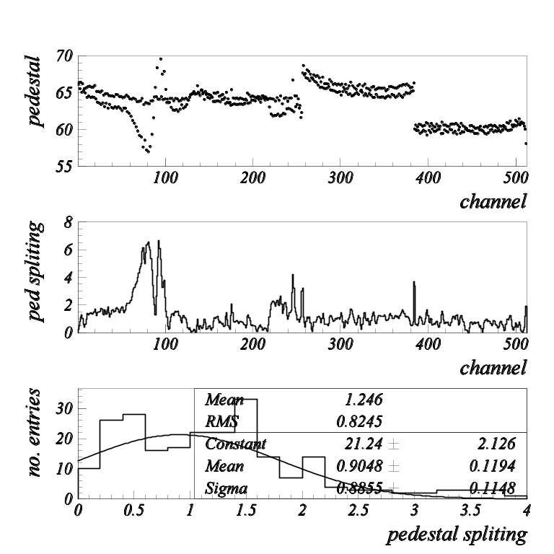
Other observation
Local effect by cal_sr is enhanced after replacing the digital cable ⬅ distance between digital cable to chip changed ???
normal clock
clock-clockbar 320mV

Slide 7
Summary
We confirmed clock actually affects the size of pedestal splitting, on top of cal_sr
Detailed mechanism is not clear
  Reduced clock in module 2 helps to improve module 1, but makes module 2 worse
  cal_sr effect is local or only for chip below the cal_sr trace, however, clock gives contribution to whole module

