Slide 1

Inslee
I s s u e
F o r u m
On
Pipeline Safety

Slide 2

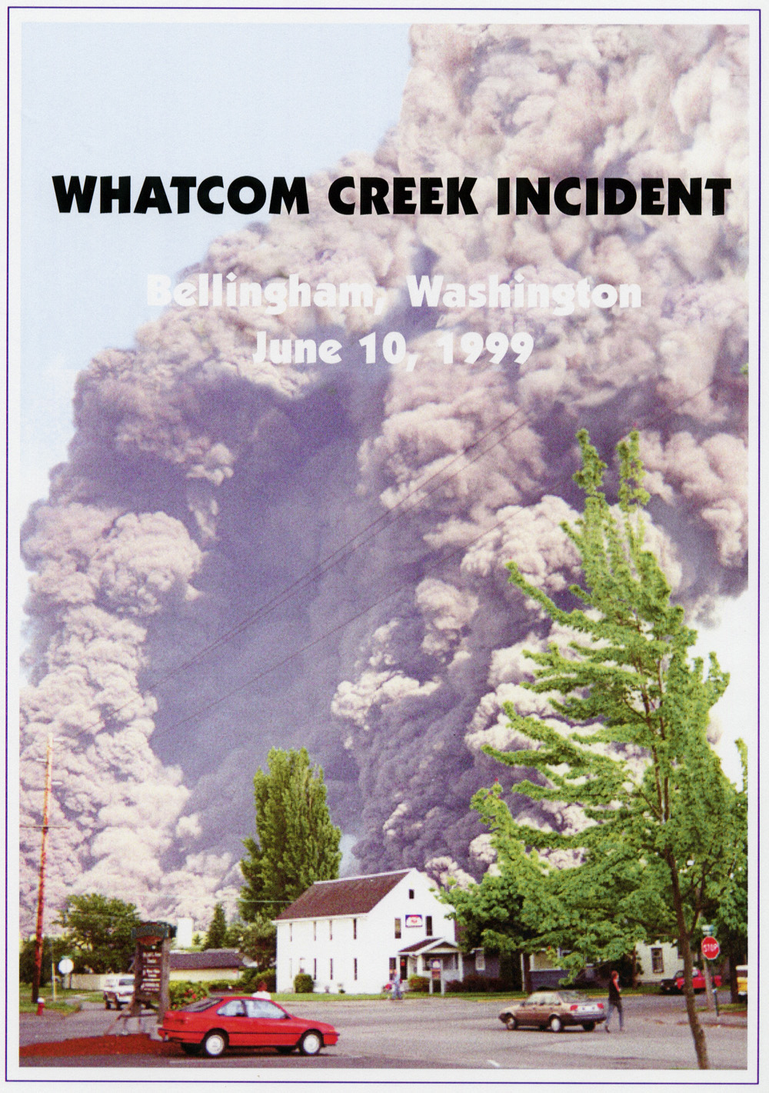
Never Again
Olympic Pipeline Explosion June 10, 1999

Slide 3
Pipeline Transportation of Fuel Can Be The Safest Option
Without the pipeline to carry fuel to customers in Seattle and Portland, transporting it would require the equivalent of 1,800 tanker trucks a day on Interstate 5. That’s approximately one truck every minute.

Slide 4
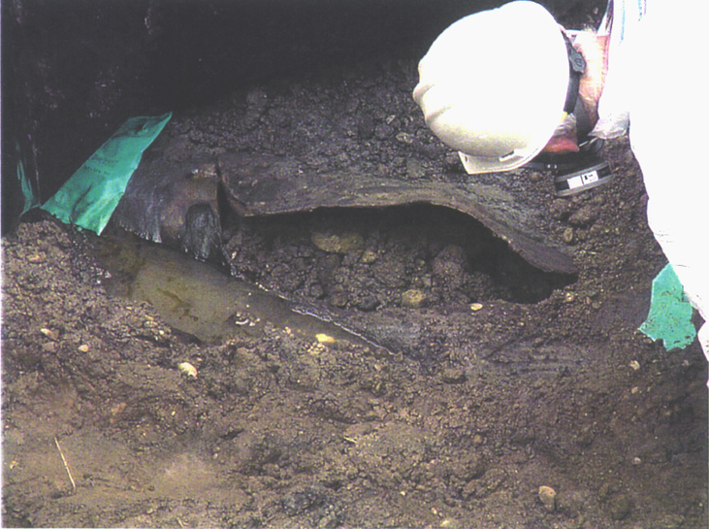
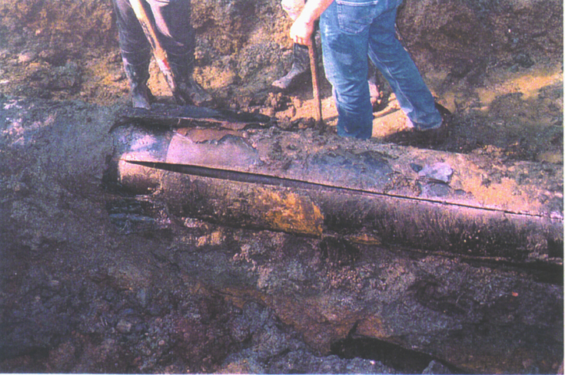
Yet, Failures Do Occur
Types of Failures
Bellingham Explosion, June 1999
Seam Failure During Hydrostatic Test, September 1999
Notes:
In the past 15 years, there have been over 6,000 accidents in liquid and gas pipelines across the county, resulting in over 400 fatalities.

Slide 5
Rupture Along Pipe Body
Bellingham, June 1999
Potential Causes
Corrosion
Third party damage
Methods to Detect Problems
Magnetic Flux Smart Pig
Deformation (Caliper) Smart Pig
Ultrasonic Smart Pig
Hydrostatic Test
Notes:
There are different types of pipe failures.
This picture of the explosion in Bellingham shows a rupture along the body of the pipe.

Slide 6
Longitudinal Seam Failure
Hydrostatic Test, September, 1999
Potential Causes
Manufacturing defects (hook cracks)
Methods to Detect Problems
Hydrostatic Test
New Generation of Smart Pigs
Notes:
On ERW pipe:
Low-frequency ERW pipe mostly found in pre-1970 pipe.
US Steel pipe in King County is high-frequency ERW.
No more than 5% of Olympic pipeline is low-frequency ERW pipe
According to OPS’ own regulation (CRF 195.303(d)), “All pre-1970 ERW pipe and lapwelded pipe is deemed susceptible to longitudinal seam failures...”

Slide 7
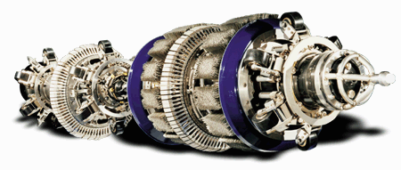
Current Generation of Smart Pig Devices
Effective in Identifying
Metal Loss (Magnetic Flux Tool)
Roundness of Pipe (Deformation Tool)
Not Effective in Identifying
Longitudinal Seam Problems
Some Third Party Damage
Some Stress Cracks
Notes:
Mention that these pigs run inside the pipe, when product is running at 2-5 MPH.

Slide 8
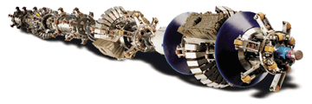
New Generation of Smart Pig Devices
Transverse Field Inspection Tools
TFI Tools Designed to Identify Longitudinal Seam Failures
Emerging Technology
Used once under OPS review
Lack of track record in analyzing data
Notes:
Used in the Marathon Platt pipeline in Wyoming, a low-frequency ERW pipe from the 1950s.
It has not been used on high-frequency ERW pipe.

Slide 9
Why Not Hydro Test?
Issue
Hydrostatic Tests are Destructive
  Last year in California, 89% of all intrastate pipeline tests were hydrostatic tests, according to the California State Fire Marshall.
Issue
High-Frequency ERW Pipe Does Not Have a History of Seam Failure
  Data indicates otherwise.
Notes:
Note that the information from California was confirmed yesterday. 132 lines were hydrostatically tested.
According to Equilon in 1999
“Hydrostatic proof testing is a widely used and accepted method to determine the structural integrity of pipelines…the [test] reveals any harmful manufacturing, fabrication or time dependent defects that could cause service failures”
According to GAO in 1993
“Therefore neither technique [pigs or hydrotesting] can be substituted for the other because each produces information unique within its own scope.”

Slide 10
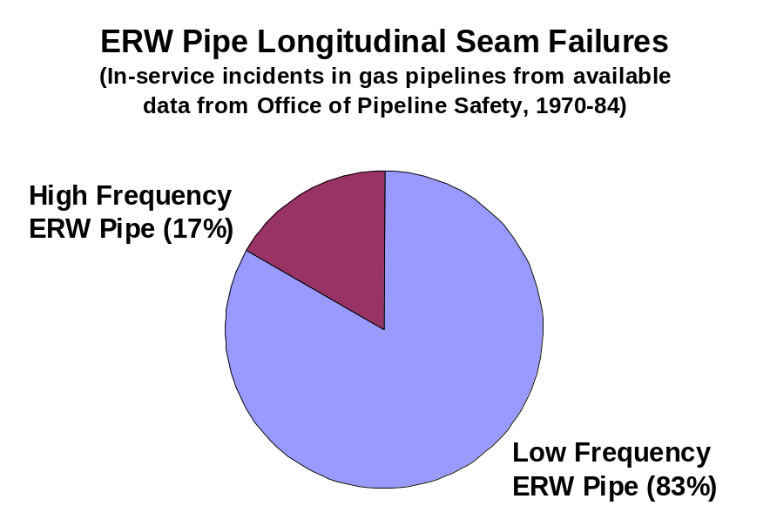
ERW Seam
Failure Incidents
Most incidents occur in low-frequency ERW pipe.
My research shows, however, that from the available OPS data, 17% of seam failure incidents occurred in high-frequency ERW pipe from 1970-1984.
Notes:
1970-1984 OPS data on gas pipeline incidents.
Of the 37 in-service leaks, 25 were from pipelines manufactured through the Electrical-Resistance Weld (ERW) method. Of these 25 leaks:
15 or 60% were from pipelines manufactured before 1960, and therefore must be low-frequency ERW pipe.
7 or 28% did not provide enough information for analysis.
3 or 12% were from pipelines manufactured with high-frequency ERW pipe. Two of the three of these leaks were from U.S. Steel manufactured, high-frequency ERW pipe.
Therefore 3 of 18 leakes (17%) were from High-Frequency ERW Pipe

Slide 11
Community Deserves a High Level of Confidence
The Same Level as Whatcom County
Test
  Use smart pigs to identify most corrosion and dents
  Use the emerging technology of smart pigs (TFI) to hopefully identify longitudinal seam failures
But Verify
  Use Hydrostatic tests to validate the data from the TFI
  Well known, well used, well understood technology
  Find other damage

Slide 12
Inslee
I s s u e
F o r u m
On
Pipeline Safety

