Slide 1
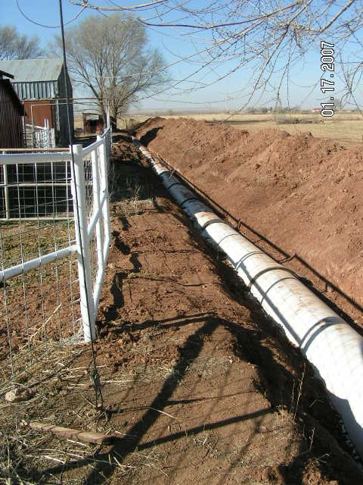
(IS-6) Achieving Irrigation Water Management (IWM) With
Irrigation Water Conveyance – Pipeline
Basic requirements: Benefits:
Irrigation pipelines come in a variety of diameters (4” to Increases efficiency of water delivery from well
24” are the most common) and a variety of materials to point of irrigation.
(Poly Vinyl Chloride, Steel, Non-reinforced concrete, and Maintenance is minimal compared to an earthen
Aluminum). ditch or concrete lined ditch.
Irrigation pipelines are used with sprinklers, drip systems, Will work on any field, regardless of shape.
and flood applications on a variety of crops.
Photo From Ft. Sumner FO
24” PVC Pipe

Slide 2
Page 2 Table Of Contents
Page # | Title | Purpose
1 | Achieving Irrigation Water Management (IWM) with Irrigation Pipelines | To describe the basic requirements and benefits obtained with irrigation pipelines
2 | Table of Contents | Table of Contents
3 | Friction Loss Table | Example of friction loss table to assist in sizing irrigation pipeline
4 | Pump Discharge Assembly | To show valves on a typical pump discharge assembly
5 | Typical Pump Discharge Assembly | To show typical set up of valves for a pressurized irrigation pipeline at the well assembly
6 | Pump Dogleg Assembly | To show typical pump dogleg assembly
7 | Typical Gravity Discharge Assembly | To show typical gravity discharge assembly
8 | Pipe Markings | To provide explanation of typical pipe markings
9 | Tee & Elbows | To show tees and elbows in an irrigation pipeline system
10 | Thrust Blocks | To show typical types of thrust blocks
11 | Minimum Depth of Cover | To show minimum depth of cover for different sizes
12 | Documentation of Depth of Cover | Photo verification of depth

Slide 3
Page 3 Friction Loss In Plastic Pipe (Ft / 100 Ft)
(example)
Diameter In Inches
 |  | 8 | 8 | 10 | 10 | 12 | 12 | 15 | 15 | 18 | 18
Flow GPM | Flow CFS | Vel Ft/sec | Hf | Vel Ft/sec | Hf | Vel Ft/sec | Hf | Vel Ft/sec | Hf | Vel Ft/sec | Hf
450 | 1.00 | 2.865 | 0.330 | 1.833 | 0.101 | 1.273 | 0.038
600 | 1.33 | 3.820 | 0.588 | 2.445 | 0.179 | 1.698 | 0.068
900 | 2.00 | 5.730 | 1.322 | 3.667 | 0.402 | 2.546 | 0.152
1500 | 3.33 | 9.549 | 3.672 | 6.112 | 1.118 | 4.244 | 0.423 | 2.716 | 0.129 | 1.886 | 0.049
2000 | 4.44 |  |  | 8.149 | 1.987 | 5.659 | 0.752 | 3.622 | 0.229 | 2.515 | 0.087
2500 | 5.56 |  |  |  |  | 7.074 | 1.175 | 4.527 | 0.358 | 3.144 | 0.135
3000 | 6.76 |  |  |  |  |  |  | 5.432 | 0.515 | 3.773 | 0.195
4000 | 8.89 |  |  |  |  |  |  | 7.243 | 0.916 | 5.030 | 0.346
To properly size the pipeline diameter, choose a velocity less than 5.0 Ft/sec and a friction loss (Hf) equal to,
or less than, 1.0 Ft/100 Ft. Friction loss will vary based on pipe material, pipe diameter, change in elevation,
and flow rate.
Note: Cubic Feet Per Second (CFS) x 450 = Gallons Per Minute (GPM)

Slide 4
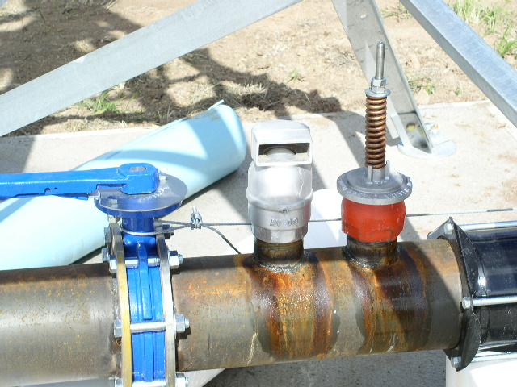
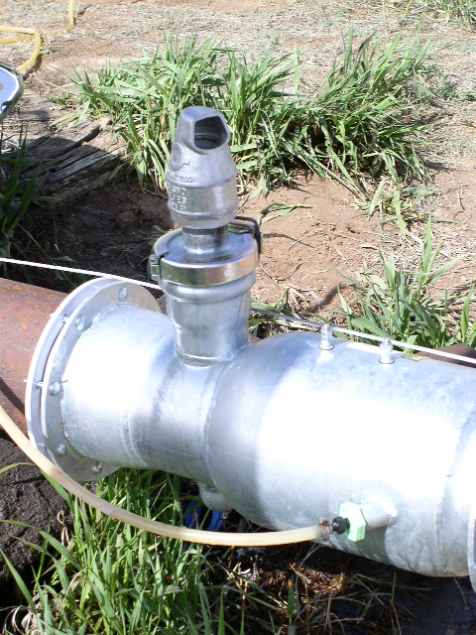
Page 4
Pump Discharge Assembly
Pressure Relief Valve
Air Vent & Vacuum
Relief Valve
Chemigation Valve
Injection Hose
Photos From Alamogordo FO

Slide 5
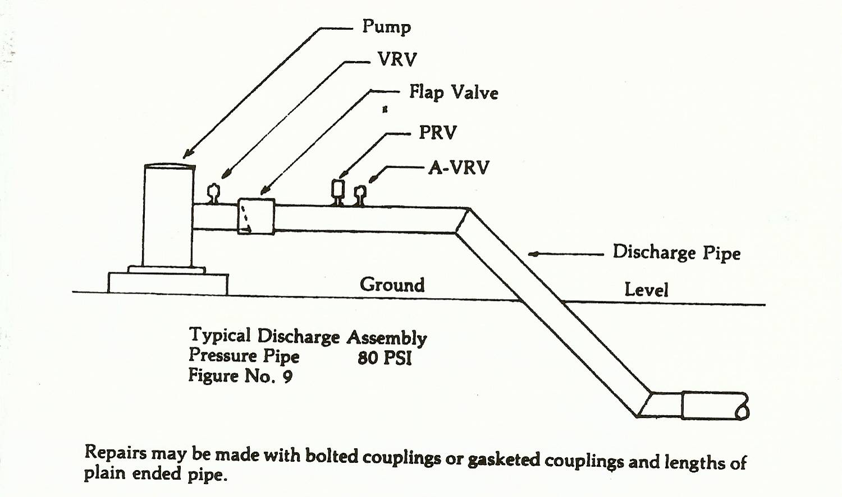
Page 5 Typical Pump Discharge Assembly
VRV = Vacuum Relief Valve
PRV = Pressure Relief Valve
A-VRV = Air and Vacuum Relief
Valve

Slide 6
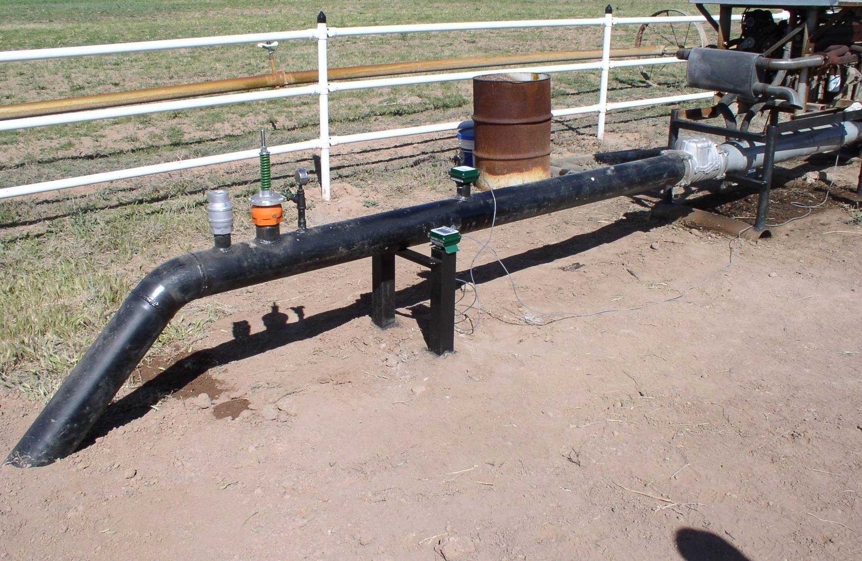
Typical Pump Dogleg Assembly
Page 6
Pressure
Gauge
Chemigation
Valve
Flow Meter
Pressure Relief
Valve
Air Vent & Vacuum
Relief Valve
Photo From Alamogordo FO

Slide 7
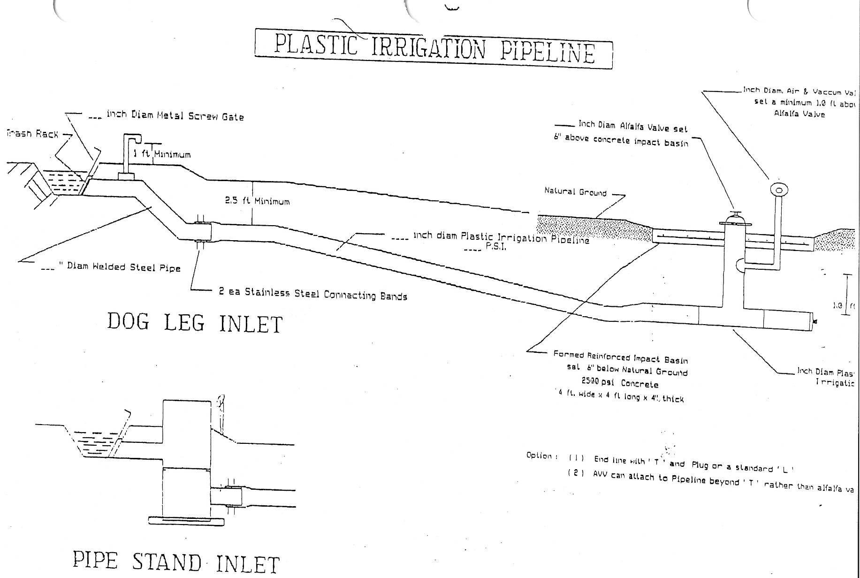
Page 7 Typical Gravity Discharge Assembly

Slide 8
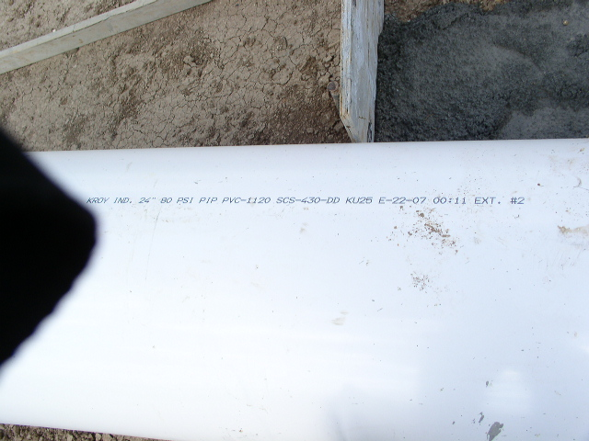
Plastic Irrigation Pipe Markings
Example
Page 8
Manufacturer’s
Name
Material
Designation
Pressure
Rating
NRCS Practice
Description
Pipe Diameter
Pipe Description -
i.e. Plastic Irrigation
Pipe (PIP)
Photo From Clayton FO

Slide 9
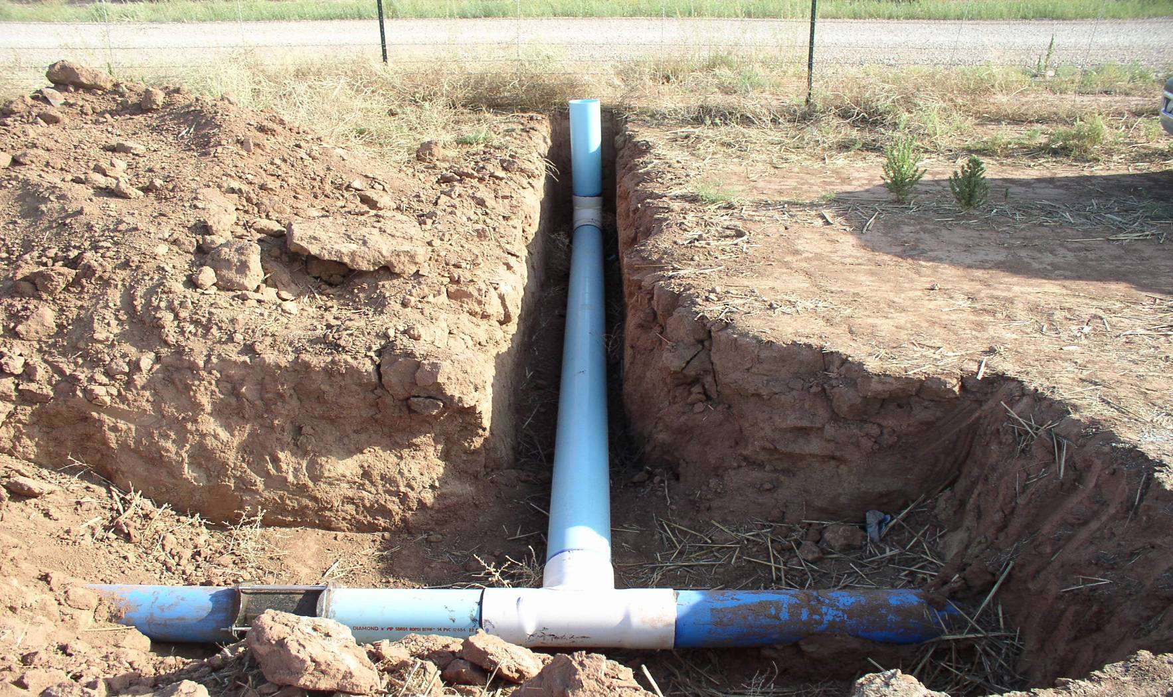
Irrigation Pipeline
Tee and Elbow
Page 9
Photo From Alamogordo FO
Elbow
Tee
Coupler

Slide 10
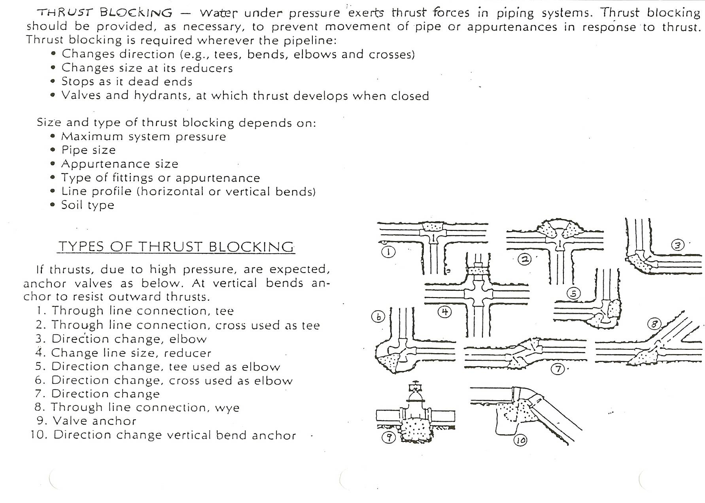
Page 10 Typical Types Of Thrust Blocks

Slide 11
MINIMUM DEPTH OF COVER
Page 11
Pipe shall be installed at sufficient depth below the ground surface to provide protection from hazards imposed by traffic crossings, farming operations, freezing temperatures, or soil cracking. The minimum depth of cover for pipe susceptible to any of these hazards shall be:
Pipe Diameter (in.) | Depth of Cover (in.)
½ through 2 ½ | 18
3 through 5 | 24
6 or more | 30
In areas where the pipe will not be susceptible to freezing and vehicular or cultivation hazards, and the soils do not crack appreciably when dry, the minimum depth of cover may be reduced to:
Pipe Diameter (in.) | Depth of Cover (in.)
½ through 1 ½ | 6
2 through 3 | 12
4 through 6 | 18
6 or more | 24

Slide 12
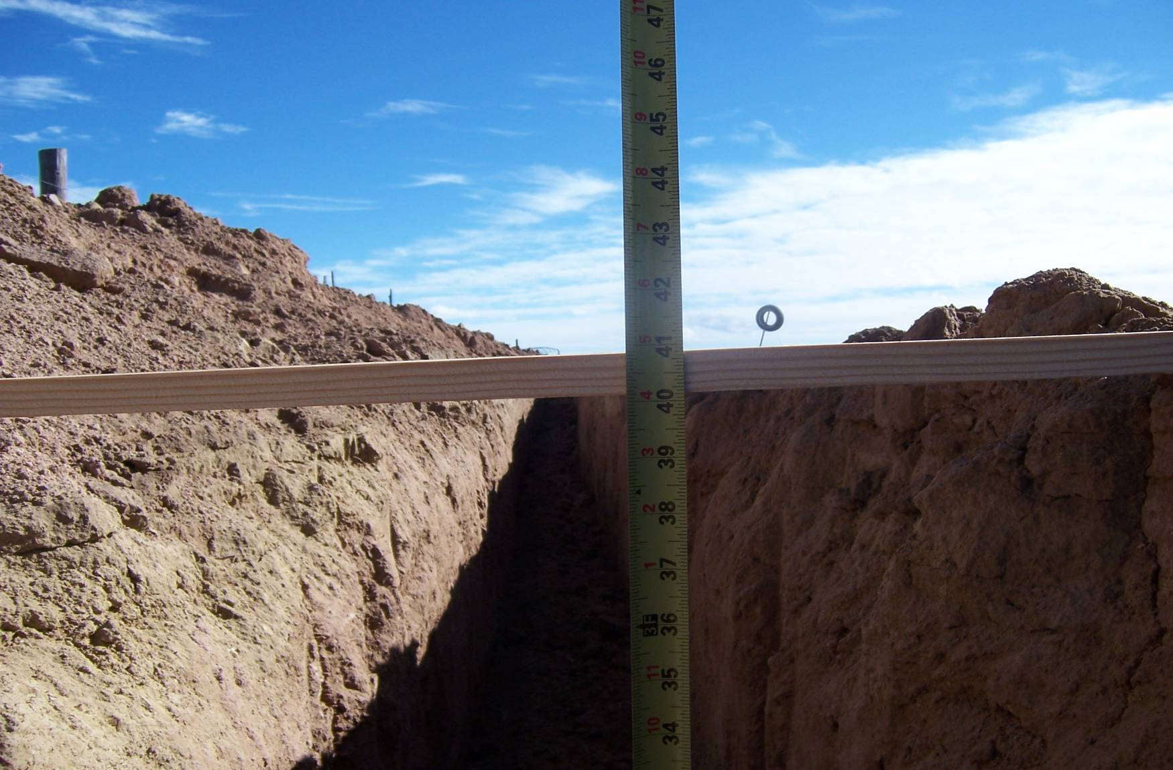
Documentation of Depth of Cover
Page 12
Photo from Estancia FO

