Slide 1
L0 prototype modules
L0#3 --- both sensor and cable are bonded. AVDD and DVDD tied together.
L0#4 --- only cable is bonded.
L0#5 --- ch1-64: only cable bonded. ch65-128 both sensor and cable bonded. Kapton backing for grounding is done.
Firmware ready for testing (thanks to Mike).
bug fix for the preamp reset.
capability to choose one pipeline cell (cal_sr in init).
ensure all pipeline cell reset by extra 46 clocks.

Slide 2
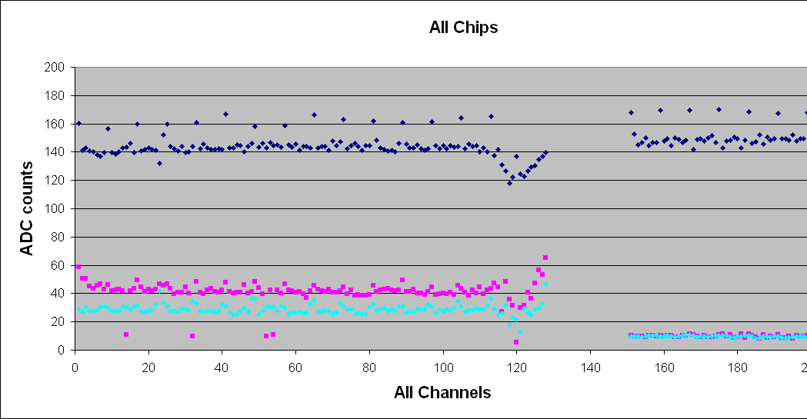
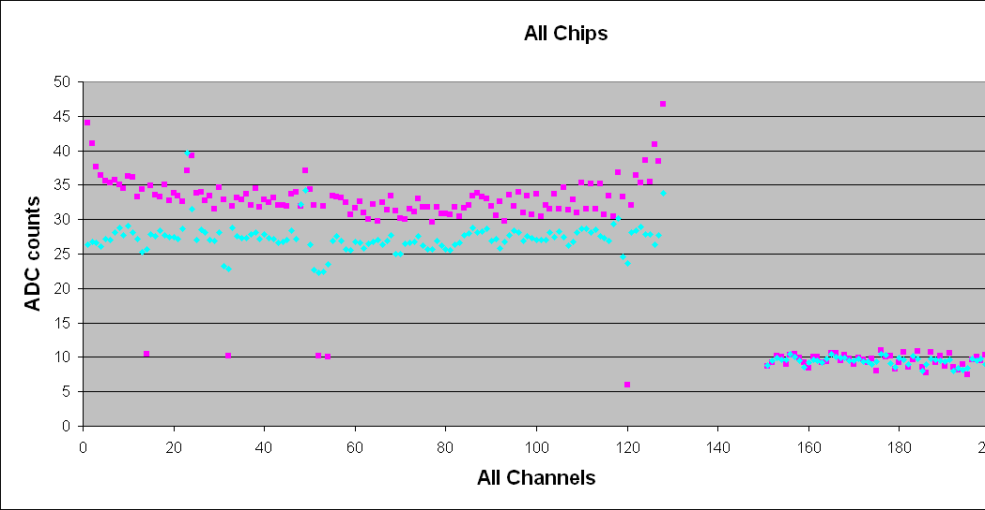
L0#3 (cable and sensor)
Disabling this channel

Slide 3
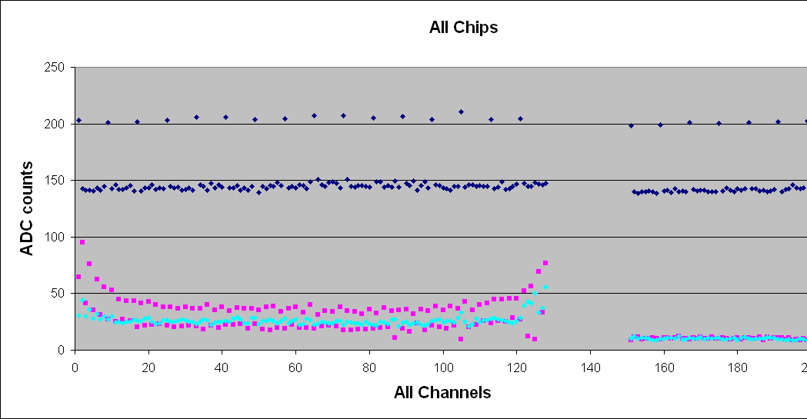
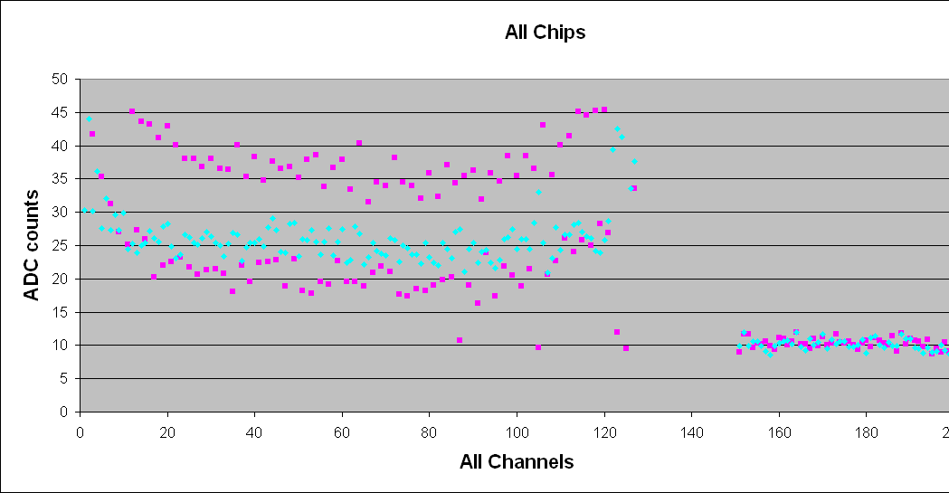
L0#4 (only cable)
bottom cable
top cable

Slide 4
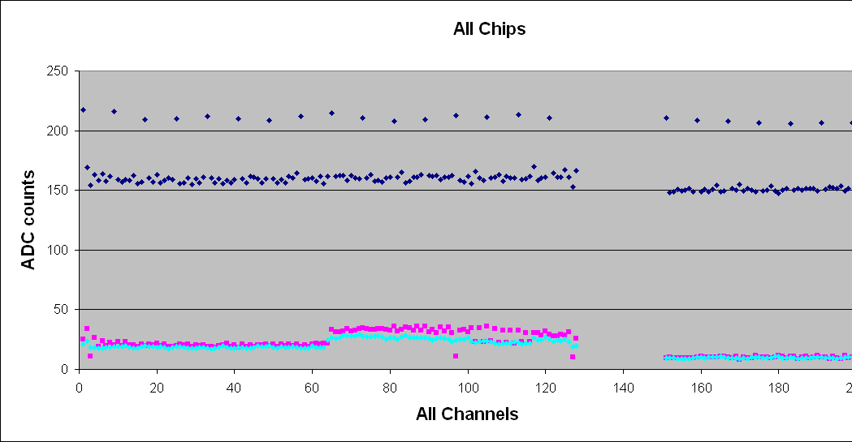
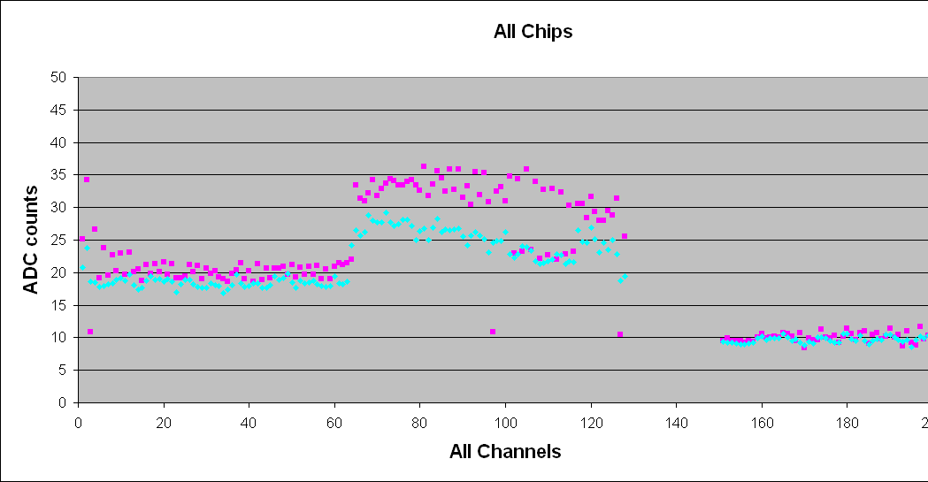
L0#5 (cable and/or sensor)
cable only
cable + sensor

Slide 5
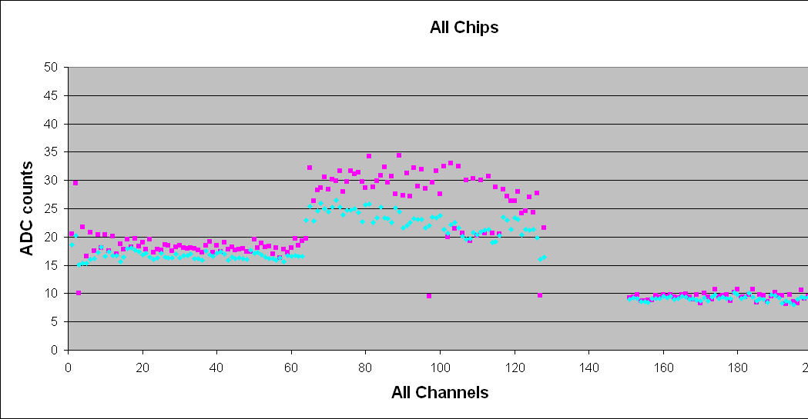
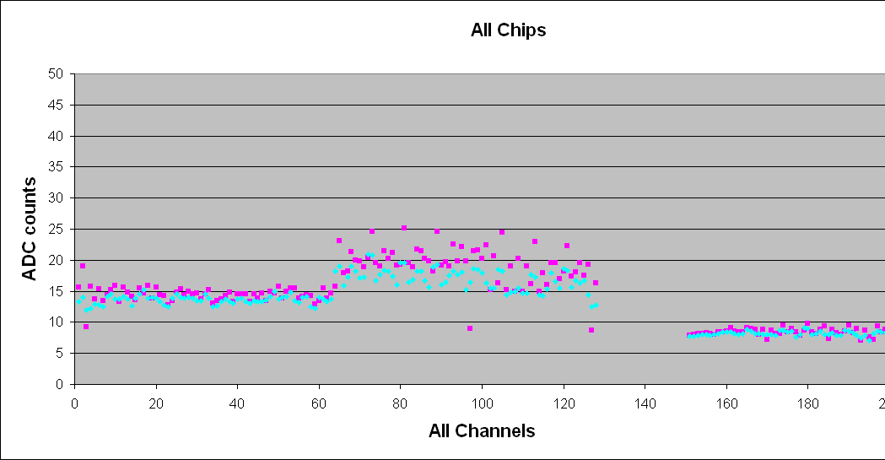
Band Width dependence
BW=8
BW=15
All three modules reasonable response!

Slide 6
Status Summary
BW=4, ramp slope=1 for this summary.
L0#3 and L0#5(sensor part) have similar noise level. ~2.2 ADC counts (1500e) of noise increase relative to the bare chip. Random noise by ~1.6 ADC (1100e).
L0#5 (only cable part): ~1.0 ADC counts (700e) of noise increase relative to the bare chip. Random noise by ~0.9 ADC (600e).
L0#4 has higher noise for the bottom cable.
All has reasonable bandwidth dependence.
Common mode noise when sensor bonded (?).
cf. ENC = 300 + 41C @40pF 1100e → 27pF(cable+sensor), 600e → 15pF(cable)

Slide 7
Plan
L0#5 put on the L0 structure.
Test and compare the result with the current status.
Kapton (grounding mesh) backing for L0#3.
Test before putting it onto the L0 structure.
L0#3 put on the L0 structure.
Simultaneous read out of L0#5 and L0#3 on the structure.

Slide 8
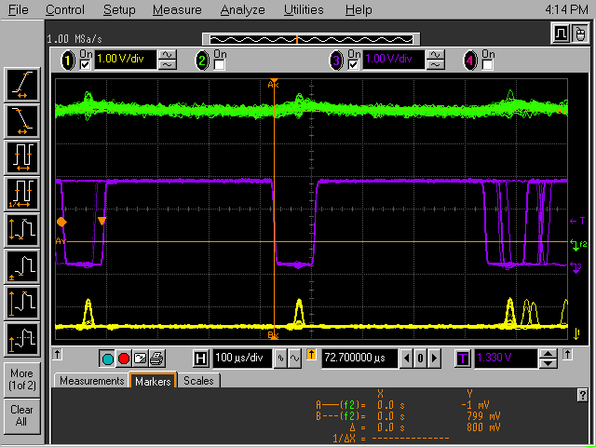
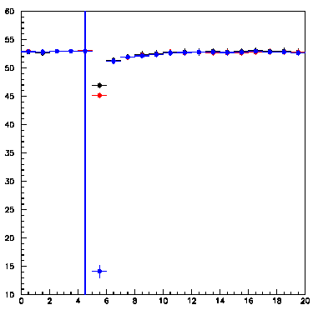
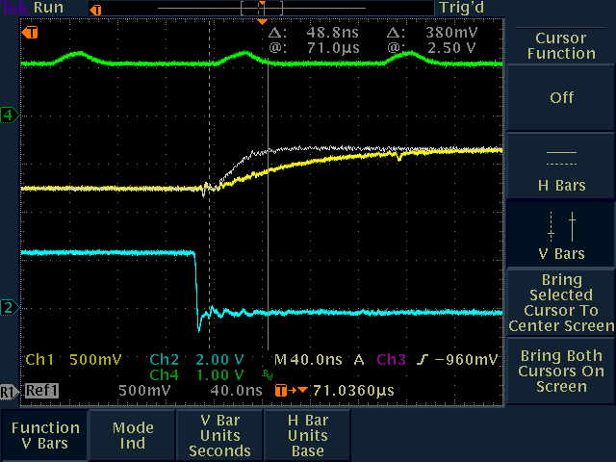
SVX4 preamp reset issue
350ns
pipeline cell
release preamp reset
This is quite small effect at the front end. ← acceptable. cf. 4.4mV/fC at preamp, voltage gain of 3.4 at pipeline.
Should gone by the real time pedestal subtraction.

Slide 9
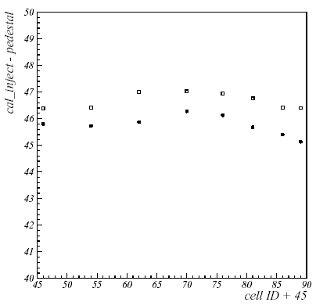
Pipeline cell dependence of gain
Sara sees pipeline cell dependence of gain (2 or 3%) in her hybrid/module testing.
The same effect has been observed in single chip (1 or 2% variation).
Wafer dependence???
Different symbols denote different channel.

