Slide 1

Pipeline pharmacogenetics: efficacy and safety applications
Allen D. Roses, MD, FRCP [Hon]
GSK Genetics Research
FDA Hepatotoxicity, 28 January 2005

Slide 2
Asset Risk Management during Development
The earlier an AE can be recognized during development, the earlier that risk can be effectively managed
Observations during clinical trials mimics practice in that patients present sequentially
This presentation will cover:
  The differences between efficacy PGx and safety Pgx
  Examples of AEs recognized and characterized during development
  A taxonomic strategy for risk management using Genetics

Slide 3
Prospective efficacy pharmacogenetics
Prospective efficacy
Identifying
non-responders and
hyper-responders
Risk Management
Post Marketing
Surveillance
Target selection
Pathway analysis
Target
Lead
POC
Phase 2
Launch
Candidate
FTIH
Phase 3
Reg^{n}
Identifying AEs during full development
Predictive
Toxicology

Slide 4
All published Efficacy Pharmacogenetics is Retrospective
ADME PGx literature relating to drug metabolism - dosage
Corticotropin-releasing hormone receptor (CRHR1) sequence variants and improved lung function with inhaled steroids in asthmatics [HumMolGen 2004]
Insulin receptor substrate-1 associated with increased risk of sulfonylurea treatment in Type 2 Diabetes [DiabetesCare, 2004]
Growth hormone receptor polymorphism associated with increased responsiveness [Nat Gen 2004]
Activating mutations of Epidermal Growth Factor Receptor underlying responsiveness of non-small cell lung cancer to Gefitinib [NEJM 2004, Science 2004]
Herceptin for breast cancer
Polymorphism CYP3AP1*1 linked to time to achieve Tacrolimus concentrations after kidney transplantation [AmJTransplant 2004]

Slide 5
Prospective efficacy and safety pharmacogenetics
The earlier PGx hypotheses can be tested - the highest value to the pipeline
  A chemical asset that fails after Phase III is very expensive and any PGX salvage post-hoc hypotheses must be tested in new expensive trials
  Years are lost and more expenses added
The value comes from proving prospective efficacy PGx hypotheses early – or by killing the asset early

Slide 6
Prospective efficacy pharmacogenetics
There are only three outcomes from Phase IIA proof of concepts studies
  1- There is no clinical efficacy – kill the compound
  2- There is obvious clinical efficacy – progress the compound to Phase IIB
  3- There are ambiguous results with some patients, but confidence in going forward for expensive trials is weak – apply efficacy PGx to define non- responders and responders

Slide 7
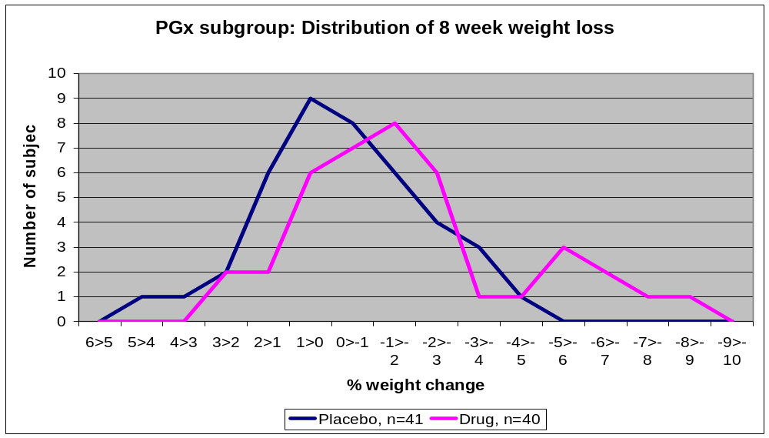

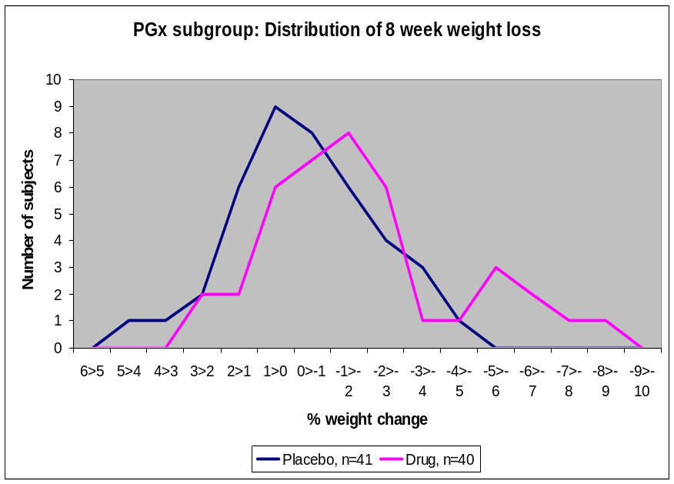
1,1 1,2 2,2

Slide 8
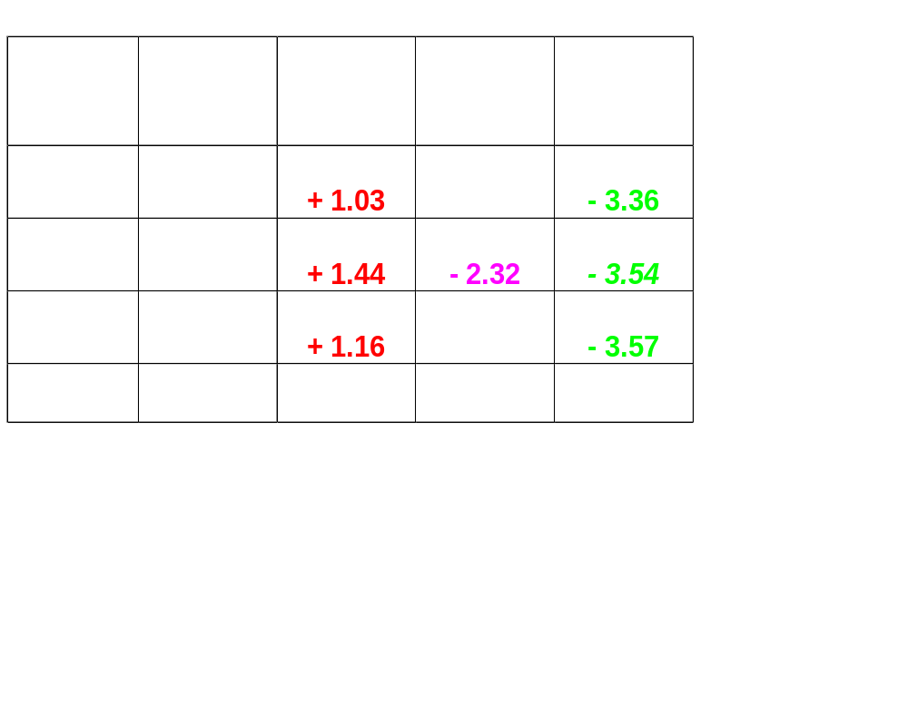
Effect of genotype on absolute mean weight loss (Kg) for combined (capsule and tablet) high dose groups

Slide 9
Mechanics of prospective efficacy and AE pharmacogenetics in the pipeline
All patients in clinical trials can provide DNA sample following specific informed consent, including commercial uses.
All samples maintain the usual GLP train of custody, although investigative [hypothesis generating] PGx is not performed under GLP conditions.
PGx analyses are available to assist development decisions and regulatory consultation
The same DNA samples are available to study AEs

Slide 10
Prospective Safety Pharmacogenetics
Prospective efficacy
Identifying
non-responders and
hyper-responders
Risk Management
Post Marketing
Surveillance
Target selection
Pathway analysis
Target
Lead
POC
Phase 2
Launch
Candidate
FTIH
Phase 3
Reg^{n}
Predictive
Toxicology
Identifying AEs throughout development

Slide 11
Adverse event profiles are personalized
AE - the classic example of environmental interaction with an individual’s genetic make-up
To experience an AE, a patient must receive the drug and develop a defined phenotype within a recognized time period.
PERSONALIZED: “Will I get an adverse event?”

Slide 12
Retrospective Safety PGx: avoiding SAEs
Ziagen (abacavir) is a highly-effective treatment for HIV/AIDS ... but 4-5% of patients have hypersensitivity reactions (HSR)
Exploratory study of 114 genetic markers in 85 abacavir-treated patients who developed HSR vs. 115 patients without such responses
HSR cases Controls
HLA-B57 46% 4%
TNFαG(-238)A 43% 7%
HLA association independently confirmed - Mallal et al, Lancet 359: 727 (2002)
There are large ethnic differences

Slide 13
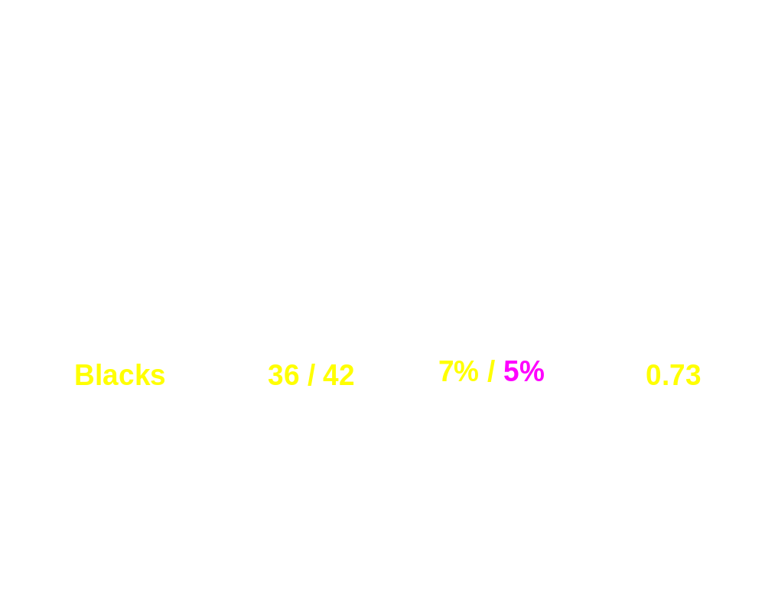
Is the association of HLA B-57 found in minority samples?
(CNA30032 Subjects: Summary of Allelic Test Results)

Slide 14
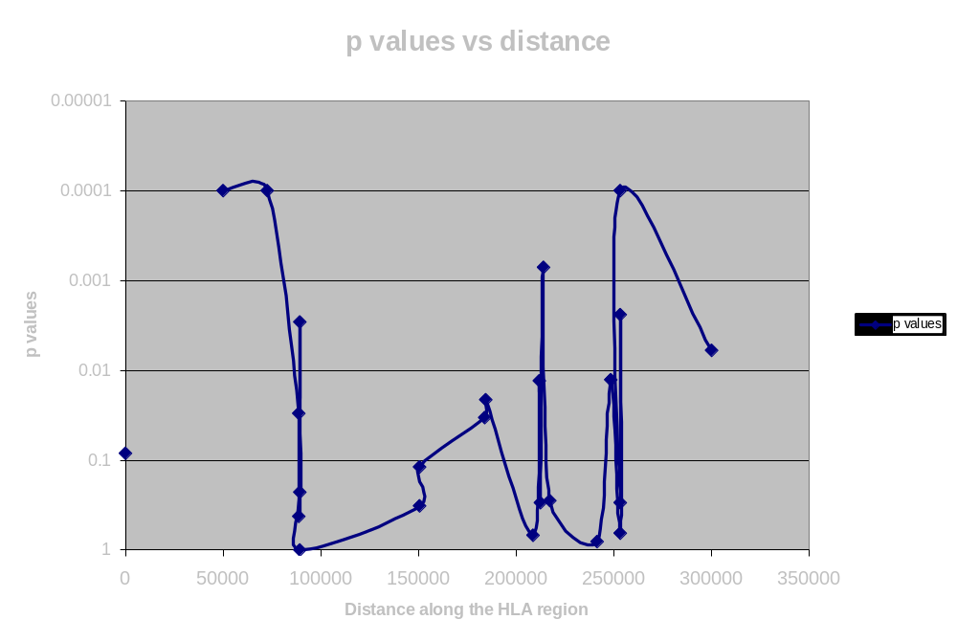
Two genes detected in initial candidate screen
~ 150 Kb apart over >3 LD blocks
EXTENDED LINKAGE DISEQUILIBRIUM
HLA-B
MICA
TNFa-238

Slide 15

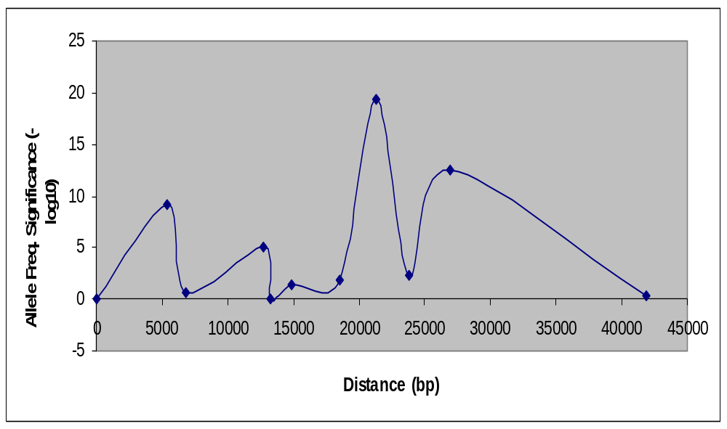
AD vs Controls: A high density SNP map around APOE Lai et al, 1998
22 kb
APOE4
APOC1
PEREC1-X2
PEREC1-Int5
PEREC1-X5
intron
intron
PEREC1-X6
APOE-X1
Low allele freq (2-3%)
Notes:
A fine map and case-control analysis of the 40 kb APOE region. The region of high significance (p< E-10) span over 20 kb.

Slide 16
Is the locus B57? or another locus due to ethnic-specific recombination in the B57-TNFα --> extended LD region?
HLA-B57
TNFa-G308A
Caucasians
Blacks
X
X

Slide 17
PRESTO Trial - Example of prospective
AE PGx during Phase III
Use of Tranilast to treat re-stenosis after percutaneous transluminal coronary revascularisation
Double-blind placebo trial of 11,500 patients
4% of patients in the trial developed hyperbilirubinemia
Why was this not observed in Phase II studies?

Slide 18
Hyperbilirubinemia with Tranilast – candidate gene panel tested during Phase III
The 7- repeat polymorphism in the TATAA box of UGT1A1 (UDP-glucuronosyltransferase 1) - a form of Gilbert’s syndrome – highly associated with hyperbilirubinemia in trial subjects
Double blind control trial – after the trial completed- 96% of the hyperbilirubinemia patients were 7/7 homozygous [4%, 6/7]
None of the 7-7 patients receiving placebo developed hyperbilirubinemia

Slide 19
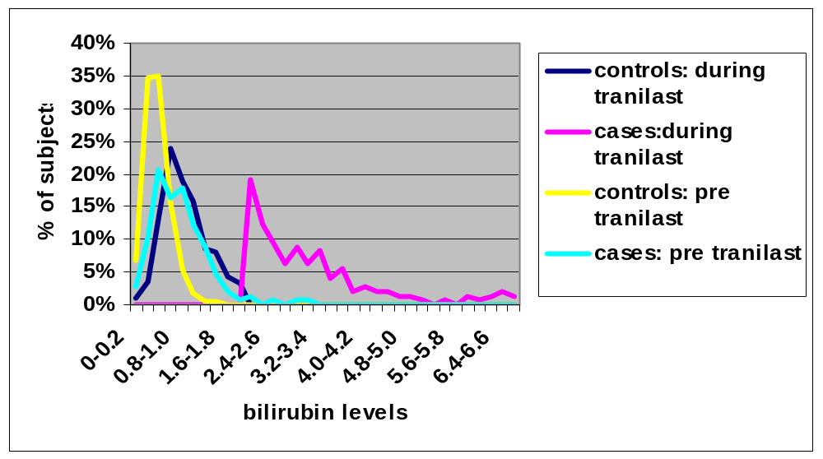
Tranilast AE Pharmacogenetics
Distribution of Bilirubin Levels in Hyperbilirubinemia Cases (>2mg/dl, n=146) and Controls (n=1085)

Slide 20
How few patients does it take to recognize a SNP profile related to an AE during a drug trial?
Mathematical analysis reflects taxonomy principles
Also highly dependent on the number and the ethnicity of “controls”
Theoretical projections are that differences in SNP LD patterns can be recognized prospectively as statistically significant with as few as 10-20 patients
Experimental support for these data exists

Slide 21
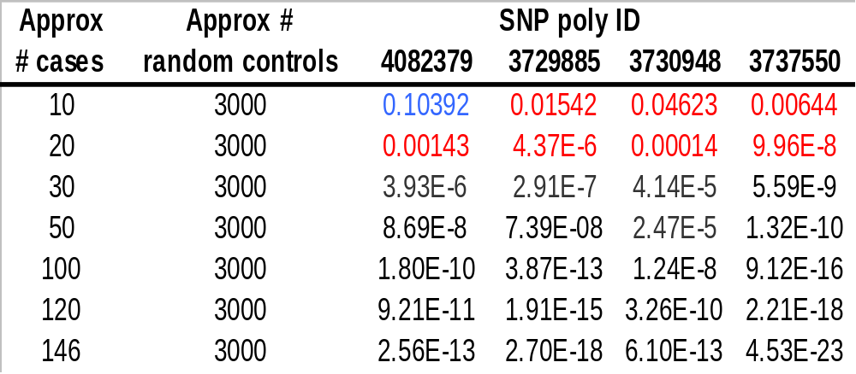
Can Safety SNP profiles be identified during trials using as few as 10-20 AE patients? Yes
4 SNPs flanking UTP1A1 locus of tranilast hyperbilirubinemia
Cases from tranilast clinical trial (US Caucasian)
3,000 White controls from Aberdeen UK (Caucasian)
Fisher’s exact test

Slide 22

Why do PGx AE surveillance and how to do it?
Why
  Rare adverse events = slow accumulation of cases
  Pressure on GSK to make interim decisions long before traditional significance/power achieved
    Genetics may give clues to rapidly explore
    ‘One at a time’ thinking is the tactic of ‘Focus on this patient’
    Let’s make decisions as ‘evidence based’ as possible
    Need to be sample sparing (prudent insurance for the future)
How
  Assesses how likely each case is to be classified as genetically distinct from the controls
    Requires large no. of well characterised controls
    Cases must come from the same population as controls
    Method ‘steps along the genome’ using the presence/absence data of all the single nucleotide (SNP) markers available at that time to form an ‘extreme’ hypothesis
  Offers a ‘traffic light’ alarm to signal possible genetic correlate to follow-up at earliest juncture

Slide 23
Imagine a large control population
With invariably brown skin & brown eyes
Cases arrive - when do you think there is a skin & eye correlate of AE?
Skin/eye ‘profile’ appears different =>
Possible genetic correlate with adverse event - invariably pale eyes & pale skin

Slide 24
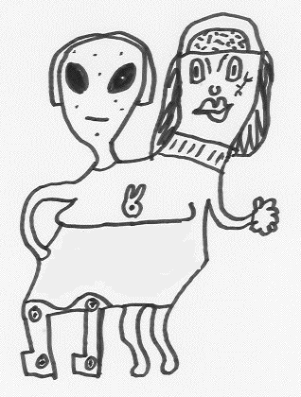
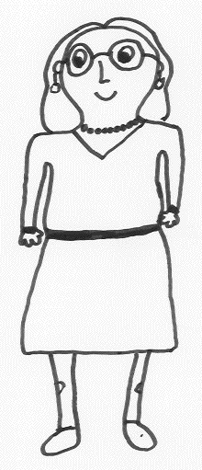
An analogy for why the PGx method works => classify to nearest centre of gravity, stop when enough information has accumulated
Four
Legs
One
SNP based genotype or Character 2
<= Case
STOP !
<= Control
Two
One
Two
None
Heads
SNP based genotype or Character 1
Notes:
Nearest (updated centre of gravity) to classify case,
but note
strength of prediction is Manhattan distance to red star - distance to blue star
and only keep if positive.. Closest in difference in log allele frequencies
conditional on allele in that case

Slide 25
Pharmacogenetics: correcting misperceptions
PGx will not increase costs of drug development – but will provide new safe and effective drugs for more people
PGx will provide the opportunity to find effective drugs for definable [and perhaps overlapping] segments of the patient population
PGx will reduce attrition in the late pipeline, significantly translating to more safe and effective therapies
PGx diagnostics will be standardised and less expensive than the one-off diagnostic models currently being imagined and debated
PGx is applicable to patient populations in developing countries, decreasing the potential for disparity of differentiated medicines
There are ethical challenges that can be evaluated, based on other secure data management systems
Differentiation of medicines makes risk/benefit sense and is cost/effective

Slide 26
Acknowledgements
GSK R&D Executive
Genetics Research Team
Medical Genetics
UK and US Discovery Genetics
Bioinformatics
Applied Pharmacogenetics
Genomics & Proteomic Sciences
All the Drug Discovery and Clinical Development (especially WW Regulatory) Teams
Notes:
Specifically, Linda, David B., David Y., Maha and Mike Moore for providing data.

Slide 27
GSK Human Genetics Resource
DNA [and other human samples] collected from families and sporadic cases of major human diseases
>80,000 subjects recruited (DNA, full prospective clinical data, informed consent for commercial purposes)
>18 disease collections initiated since 1997 and continue in 2004
Association studies usually use ~500 affected patients and ~500 controls, confirmed by a second 500p/500c (each larger than most published disease association studies)
Clinically assessed by > 190 academic clinical investigators in 18 disease-focused world-wide networks collected over six+ year period

