Slide 1

Life Science Education and Employment: Minorities in the Pipeline
Nirmala Kannankutty
National Science Foundation
Division of Science Resources Studies
Workshop on Recruitment and
Retention of Minorities
Bethesda, MD
May 24, 2001

Slide 2
Goals
Show some characteristics of the education and employment pipeline for individuals educated in the life sciences
Show some comparisons between underrepresented minorities and the majority population
Learn about access to data that may help to inform policy and program decisions

Slide 3
Data on Minorities
Current categories: late 1970s / early 1980s
Categories of interest:
  African-American
  Hispanic
  American Indian/Alaskan Native
New categories in 2003
  Black/African-American
  Hispanic
  American Indian/Alaska Native
  Native Hawaiian/Pacific Islander
  Multiple choices

Slide 4
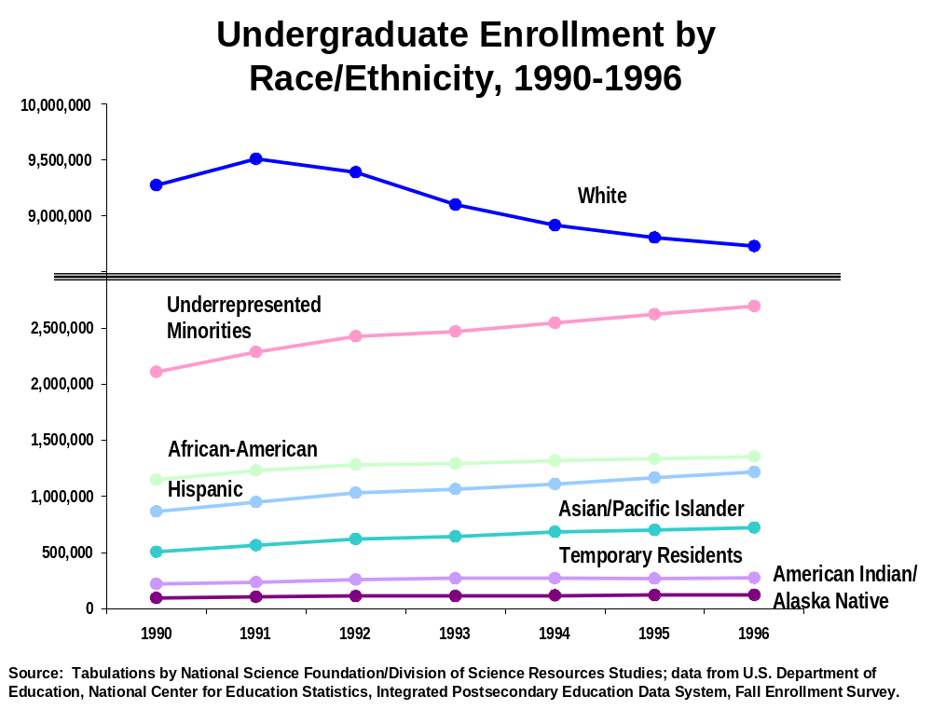

Slide 5
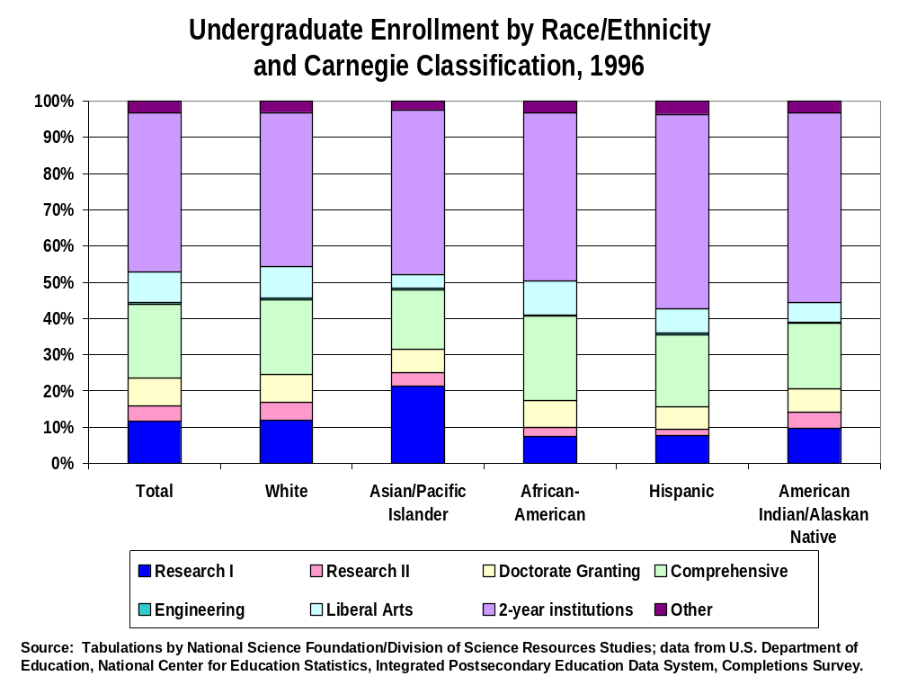

Slide 6
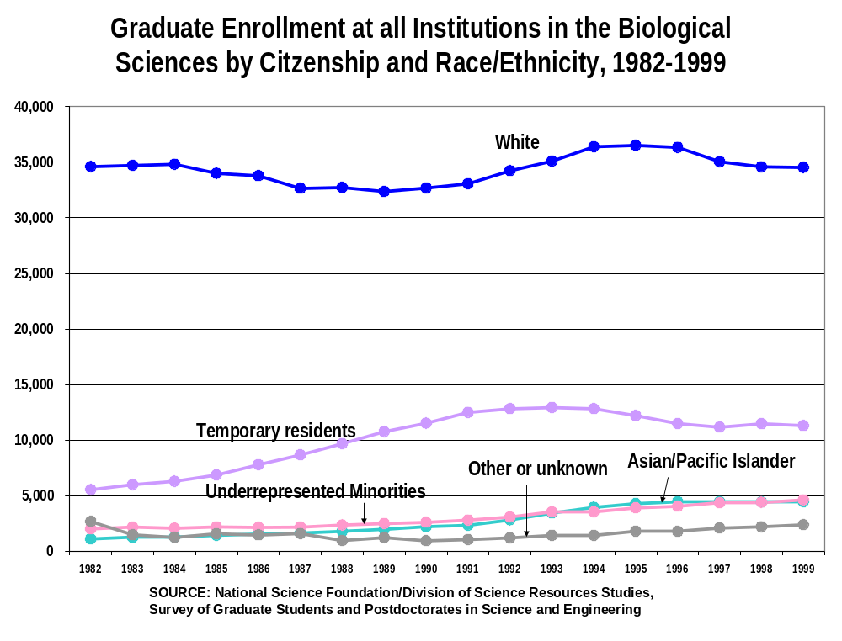

Slide 7
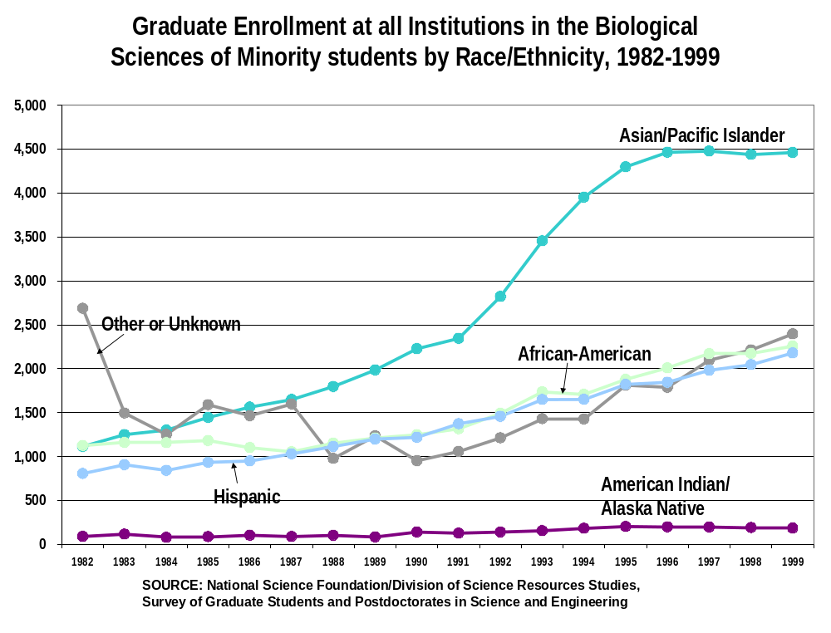

Slide 8
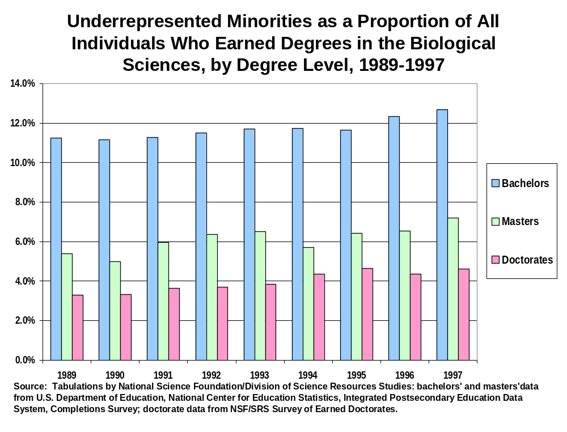

Slide 9
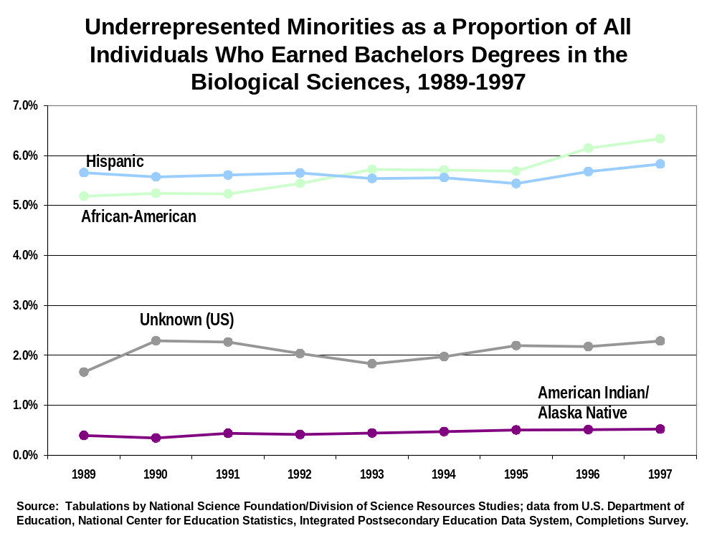

Slide 10
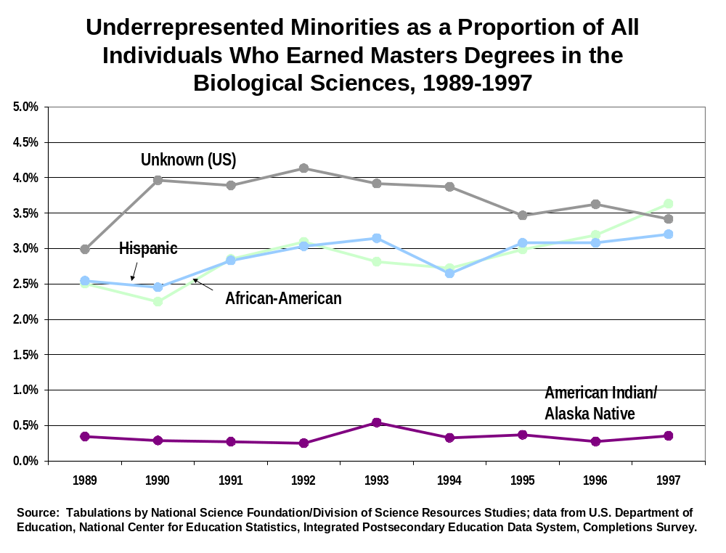

Slide 11
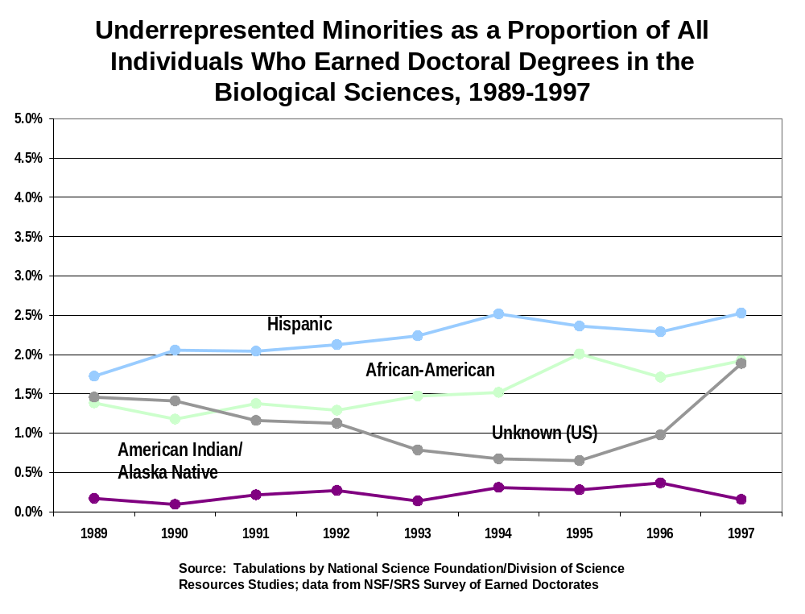

Slide 12
Top Fields for Underrepresented Minority Doctorate Earners in the Biological Sciences (1999)
Total Underrepresented
Minorities
All Biological Science Fields 5,600 300
Molecular Biology 719 39
Neuroscience 437 31
Biochemistry 763 27
Microbiology 382 20
Pharmacology (human & animal) 254 18
Physiology (human & animal) 243 15
Cell Biology 285 14
Source: NSF/SRS, Survey of Earned Doctorates, 1999

Slide 13
Life Science Degree Holders in the Labor Force (1997)
10.6M employed scientists and engineers
  959,000 (9.1%) are underrepresented minorities
1.78M employed scientists and engineers hold at least one degree in the life sciences
  142,000 (14.9%) are
  underrepresented minorities
Source: NSF/SRS, Scientists and Engineers Statistical Data System (SESTAT), 1997

Slide 14
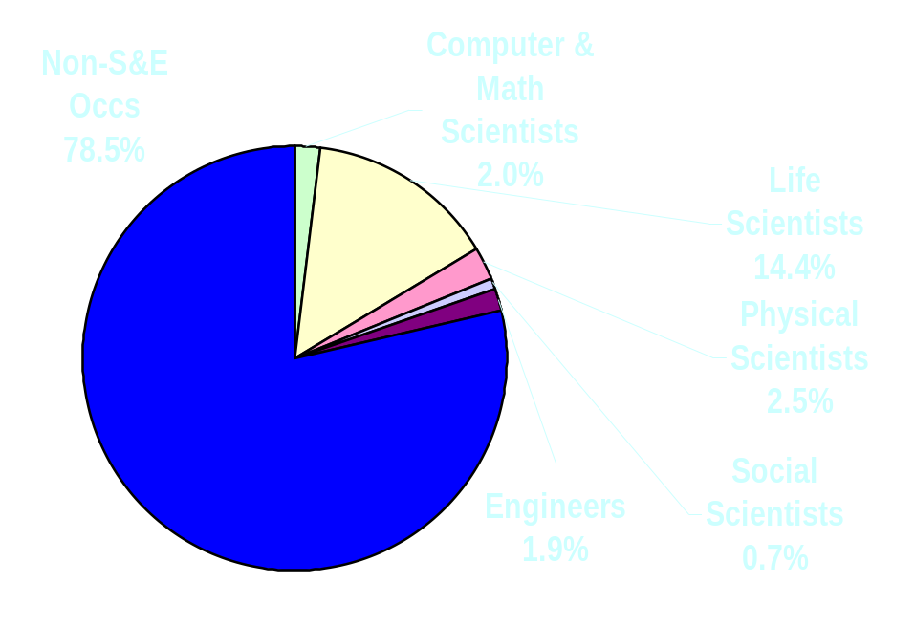
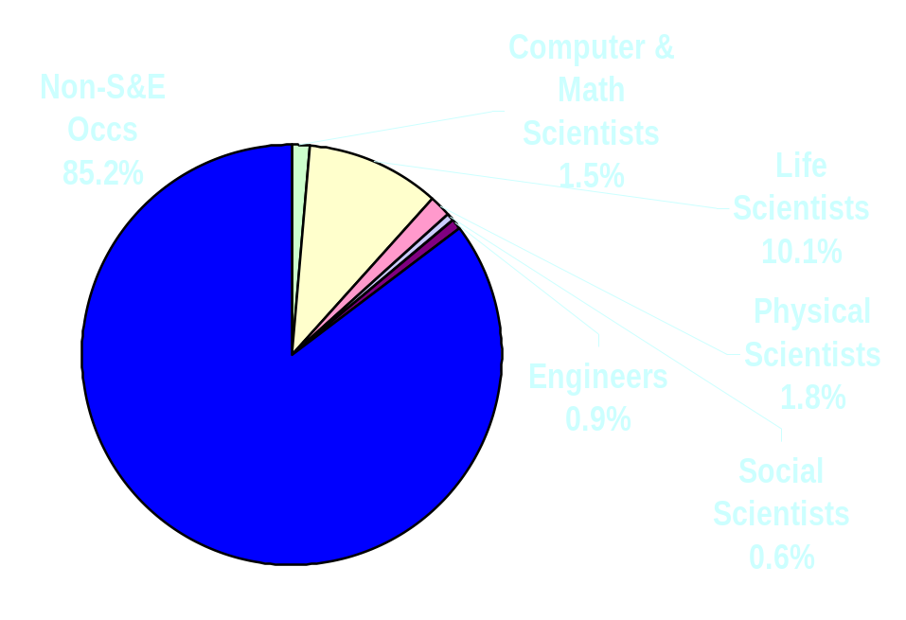
Occupational Profile of Life Science Degree Holders (1997)
Underrepresented Minorities
Total
Source: NSF/SRS, Scientists and Engineers Statistical Data System (SESTAT), 1997

Slide 15
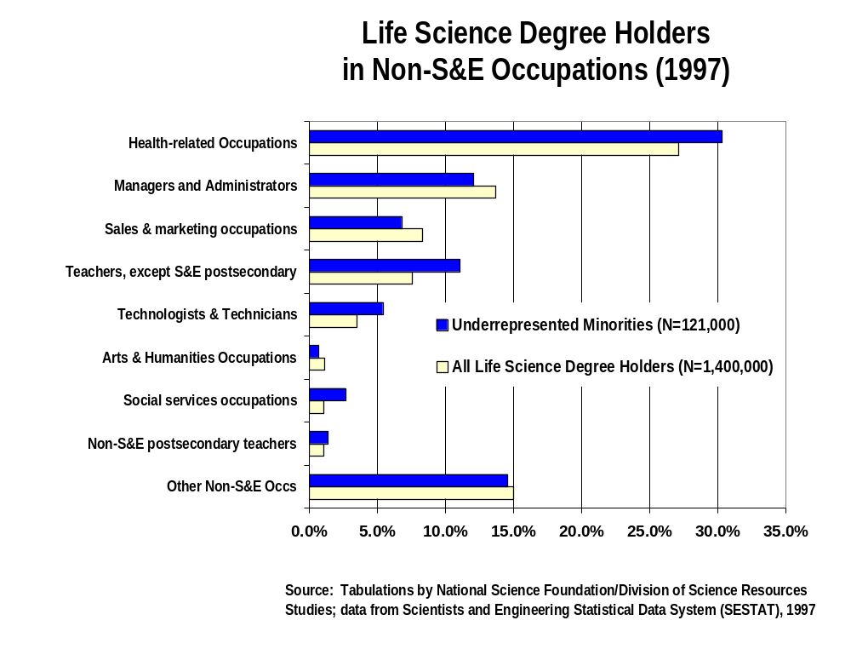

Slide 16
The Pipeline Picture - Education
Trends
Higher Undergraduate URM Enrollments
Some Growth in Graduate URM Enrollments
Stable Proportion of Biological Science Degrees Awarded to
URM Students in the 1990s
Possible Implications
Potential for Growth in Graduate Enrollments of URM Students
More Diversity in
the Educational Pipeline
Potential for Growth in Programs to Attract Minority Students

Slide 17
The Pipeline Picture - Workforce
Trends
Higher proportion
of employed life
science degree
holders are from URM groups than all S&Es
Employed life science degree holders who
are from URM
groups are more
likely to be in
Non-S&E Occs
Possible Implications
Bio degree programs may be attracting URM students with more success than some other types of S&E degree programs
Potential to attract URM individuals educated in the life sciences to Life Science Occupations

Slide 18
Data Resources
Science Resources Studies Website
www.nsf.gov/sbe/srs/stats.htm
Electronic Publications
www.nsf.gov/sbe/srs/pubdata.htm
PUBLIC ACCESS TO ALL THE DATA
sestat.nsf.gov
caspar.nsf.gov

