Slide 1



Lost in Transition?
Policies and Programs Making Real Connections Between High School and Postsecondary Education
Preparing America’s Future Regional High School Summit
May 14-15, 2004
Archived Information

Slide 2
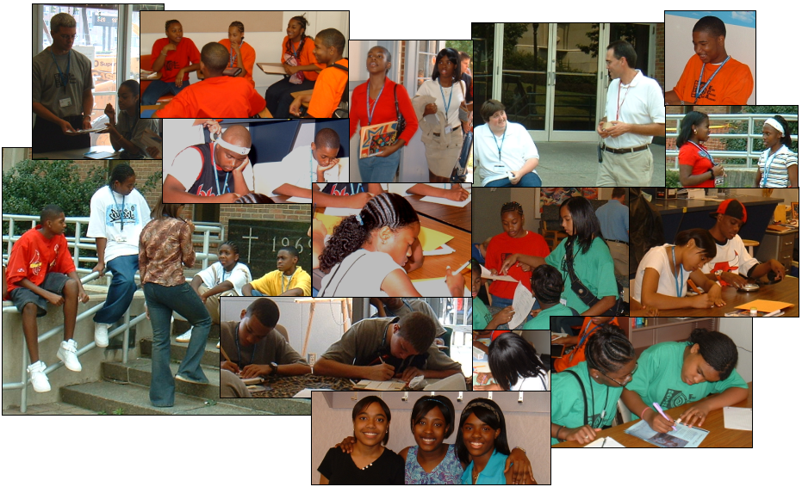
Opening Day at
Dayton Early College Academy
August 25, 2003

Slide 3
Agenda
What is the problem in the educational pipeline?
What’s new, what’s different: college level work in high school.
Policy and finance Issues

Slide 4
What is the Problem?
Gaps in Attainment Are Caused by Failures at Critical Points Along the Higher Education Pipeline
GED: 11%
Coordination required across secondary and postsecondary to produce better outcomes
Note: Data represents survey responses in 2000 from the cohort of 1988 8th graders; high school completion rates exclude GED recipients; college enrollment and completion percentages are as a percent of all 8th graders
*Manhattan Institute estimates even lower high school graduation rates, and postsecondary education opportunity research shows lower rates for on-time college enrollment and attainment
Source: NCES National Education Longitudinal Study, 1988/2000; Parthenon analysis

Slide 5
Problems Are Worse for Those with Low Incomes…
Percent of Total 8th Graders
Note: Data represents survey responses in 2000 from the cohort of 1988 8th graders
* Manhattan Institute estimates even lower high school graduation rates, and postsecondary education opportunity research shows lower rates for on-time college enrollment and attainment
Source: NCES National Education Longitudinal Study, 1988/2000; Parthenon analysis

Slide 6
Breaks in the Pipeline:
All States Have Room for Improvement
Percent Lost at Each Stage of Transition
9th to 12th Grade
HS Graduate to College
College Entrance to Graduation
College Graduates
Source: National Center for Higher Education Management Systems

Slide 7
Agenda
What is the problem in the educational pipeline?
What’s new, what’s different: college- level work in high school.
Policy and finance Issues

Slide 8
CONTEXT:
College-Level Work in High School
Hypothesis/Theory of Change
Challenge not remediation serves to motivate underprepared students to accelerate in high school.
Strategies:
  Provide opportunities and supports for students to take college courses in high school based on performance
  Remove financial and “red tape” barriers to participation
  Get students onto college campuses for academic work as early as 9th grade

Slide 9
College-Level Work in High School: What’s Already in Place
Advanced Placement/
International Baccalaureate
Dual and concurrent enrollment (college in the high school/ college courses on campus)
Tech Prep
Middle Colleges
Early College High Schools
Postsecondary Incentive Programs

Slide 10
Evidence About College-Level Work in High School
AP
Number of AP tests taken doubled in one year when offered to all students in Fairfax County, VA, at school’s expense. After initial drop in 75% pass rate, rate stabilized at 65%, close to national rate of 63%.
Dual Enrollment
13,400 NYC high school students received a C grade or better in credit-bearing CUNY courses through College Now in 2001-02.
Middle College
41% of 4,500 students enrolled in middle colleges in 1999-2000 took college classes. 97% passed.
Tech Prep
Tech Prep students had higher 11th and 12th grade GPAs, better attendance, and higher Regents Math II scores than comparison students (NYDOE study, 1999).

Slide 11
States With Policies for College-Level Credit in High School
New Jersey
12th Grade Option Pilot Program in May 2003
High school seniors who have completed all graduation requirements and passed the high school proficiency test can enroll in college-credit courses while still in high school.
Virginia
Governor Mark Warner launched Senior Year Plus in 2003.
College-bound seniors and seniors who want to immediately enter the workforce can earn up to 15 college credits leading to industry certification or the AA, paid for by the state.
Senior Year Plus will go statewide in 2005-2006.

Slide 12
Not the Same:
Plans Eliminating 12th Grade
Florida
In June 2003, Florida passed legislation permitting students to graduate high school with 18 credits instead of 24, allowing graduation after the junior year.

Slide 13
Blended Institutions:
Pushing the Idea Further
Why “blended” institutions as a strategy to move at risk students into and through a postsecondary credential?
Remove physical transition to college;
Create an integrated, “real” 9-14 school;
Provide guidance, support, and coaching from adults through the first two years of college;
Offer two years of college credit for free;
Assume everyone in the school goes to college.

Slide 14
What Is Early College High School?
Students start some college work based on performance, usually in the 10th or 11th grade.
The eventual completion of a baccalaureate is assumed for students.
Early college high schools reach out to seventh graders with preparatory programs that make it possible for students to catch up on skills and be ready for college-level courses in high school.

Slide 15
The Initiative:
Scale and Scope
10 organizations are establishing 150 early college high schools over the next five to seven years:
Antioch University/Seattle (8)
Foundation for California Community Colleges (15)
KnowledgeWorks Foundation Ohio (8)
Middle College National Consortium (20)
National Council of La Raza (12)
City University of New York, Office of Academic Affairs (10)
Portland Community College (11)
SECME, Inc. (8)
Utah Partnership for Education (6)
Woodrow Wilson National Fellowship Foundation (14)
In addition to these partners, high school/early college reform efforts in North Carolina and Texas are affiliated with the initiative and receive funding from the Bill & Melinda Gates Foundation.

Slide 16
Example of Early College Designs
Middle College National Consortium
New York, Connecticut, California
Grades 9-14
Final year is a full community college curriculum
On community college campus—“power of site”
Student cohorts move from high school classes, to mixed high school/college classes, to college-only classes.
Students receive extensive support from teachers and coaches/advisors.
Students receive a high school diploma and an Associate’s degree simultaneously.

Slide 17
Example of Early College Designs
Portland Community College’s Gateway to College
Portland, Oregon
The program contracts with school districts to recover out-of-school youth, age 16-20.
Outreach and recruitment includes referrals from area high schools, social service agencies, youth centers, and community-based organizations.
Cohorts of 20 students enter intensive, pre-college, skill-building and customized study skills programs.
Students attend college courses aligned with career pathways leading to a high school diploma, plus a certificate, degree, or minimum of 60 college credits.

Slide 18
Examples of Early Colleges
California Academy for Liberal Studies Early College High School: Pasadena Community College
Tulalip Heritage High School:Everett Community College and Northwest Indian College, WA
University of Dayton Early College High Academy,OH
University of Hartford/Hartford Public Schools, CT
Academy for Math, Engineering and Science: University of Utah
Accelerated Charter High School:California State Los Angeles
International High School @ LaGuardia Community College, New York, NY

Slide 19
Agenda
What is the problem in the educational pipeline?
What’s new, what’s different in approaches to the problem?
Policy and Finance Issues

Slide 20
Requirements of Early College High Schools…
Ability to combine funding streams [ADA], [FTE], and incentive dollars
Flexible eligibility requirements for college courses
College courses that can supplant high school courses to meet high school requirements
Postsecondary credit hours that can be used to fulfill state requirement for days and minutes in secondary school

Slide 21
Requirements of Early College High Schools…
Transferability of EHCS-generated college course credits to meet AA and BA degree requirements
High school teachers qualified and permitted to teach college-level, credit-bearing courses, and
College professors qualified and permitted to teach high school students

Slide 22
The Big Questions: Equity and Cost-Effectiveness
Should/must all young people be entitled to education through grade 14?
If our goals are greater equity of outcomes in postsecondary and cost-effectiveness, how do we calculate the "return on investment" for dual/concurrent enrollment, early colleges and other blended and accelerated school designs?

Slide 23
Implications for High School Reform
Form partnerships with neighboring postsecondary institutions
Accustom students to college environment and culture
Align courses and exit assessments with college placement requirements
Supplant high school courses with duplicate or more challenging college-level courses
Provide supports for students in college courses
Reward performance with college scholarships

