Slide 1
Industry Pipeline:
Smoking Cessation Products
SRNT
New Orleans
February 19, 2003
Charles Grudzinskas, PhD
Drug Development Consultant
Annapolis

Slide 2
With the help of…
Steve Arneric
  Pharmacia
Doug Cary
  Cary Pharmaceuticals
Will Dere
  Lilly
Mark Epping-Jordan
  Addex
Barbara Fox
  Recovery Pharmaceuticals
Jed Rose
  Duke University
Ed Sellers
  Nicogen
Joel Sutton
  GSK
Fred Walker
  Pfizer

Slide 3
Charles Grudzinskas
Conflict of Interest Statement
SAB ADDEX
SAB Cary Pharmaceutical
SAB Recovery (ATI)
NIDA Workshops & IRGs
NIAAA Workshops

Slide 4
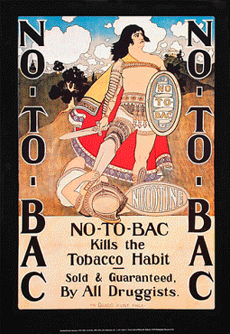
1
1
8
9
6

Slide 5

1
1
9
9
6

Slide 6
Pharmacological Agents for Smoking Cessation
NIDA-NCI-NIAAA Transitional Working Group
October 9-10, 2002
Indications
  Acute withdrawal
    1-More days
  Initiate abstinence
    7 to 14-Days
  Maintain abstinence
    ??-Weeks
  Sustained reduction in use/risk
    Metric for clinical outcome/benefit

Slide 7
Pharmacological Agents for Smoking Cessation
Discovery
Development
  Phase 0—Pre FIH
  Phase 1—Safety & POM
  Phase 2—Safety, activity & POC
  Phase 3—Evidence of safety & effectiveness
Delivery

Slide 8

From PhRMA Website
GW468818
  GSK
TD nicotine & mecamylamine
  Elan
SR141716
  Sanofi-Synthelabo

Slide 9
The Pipeline
Nicotine reduced cigarette
NRT
Vaccines
Nicotine partial agonists
Combinations
  Bupropion-mecamylamine oral
  Nicotine-mecamylamine TD
MAO Inhibitors
Canabinoid antagonist
Gylcine receptor antagonist
mGluR2 agonist
CYP-2A6 inhibitors

Slide 10
Nicotine-Reduced Cigarette

Slide 11
Nicotine-Reduced Cigarette
Vector tobacco—”Quest”
Not marketed as a smoking cessation product
Designed to allow smokers to cut back on nicotine (to become nicotine free)
Quest 1: 17% less nicotine
Quest 2: 58% less nicotine
Quest 3: virtually nicotine free
www.vectortobacco.com

Slide 12
Nicotine
Replacement Therapy (NRT)

Slide 13
Nicotine Replacement
Marketed
  Gum (2 & 4 mg)
  Patch (7, 14, 21 & 42 mg)
  Nasal (0.5mg/nostril)
    8-40 doses/day
  Inhaler (4mg; 2mg absorbed)
    6-16 doses/day
  Lozenge (2 & 4 mg)

Slide 14
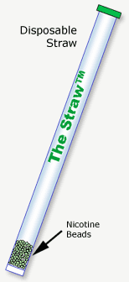
Oral Nicotine Replacement
The Straw™
  8 mg
Recovery Pharmaceuticals
Phase 3
www.recoverypharma.com

Slide 15
The Straw™ Targets
Oral delivery
  An individual sips any beverage through The Straw™ and swallows the nicotine beads
  The entire dose of nicotine is delivered in the first sip
Manual stimuli
Increased compliance
Behavioral component

Slide 16
The Straw™ Status
Phase 1 & 2 completed (1/02)
  “The trial established that The Straw™ generated plasma levels of nicotine comparable to or higher than those seen with marketed nicotine replacement therapy products”
Preparing for a pivotal Phase 3 trial

Slide 17
Nicotine Vaccines

Slide 18
Nicotine Vaccines
Xenova
  TA-NIC
  Cantab (ImmunoLogic)
  Phase 1
NicVax
  Nabi Biopharmaceuticals
  Phase 3

Slide 19
TA-NIC Vaccine
Xenova
Phase 1
The active ingredient of the TA-NIC vaccine is a protein conjugate
Nicotine derivative coupled to recombinant cholera toxin B (rCTB)
http://www.xenova.co.uk/dc_ta_nic.html

Slide 20
TA-NIC Vaccine
Phase 1 clinical testing of TA-NIC began in 9/01 and the results of these trials were announced in 6/02
Well-tolerated both systemically and locally
Shown to generate a specific anti-nicotine response

Slide 21
TA-NIC Vaccine
The double-blind, randomized, placebo-controlled study
  Safety, tolerability and immunogenicity of TA-NIC
  Both smokers and non-smokers
Intra-muscular injection
Two different dose levels
Variety of dosing regimens

Slide 22
NicVax Vaccine
Nabi Biopharmaceuticals
Phase I safety trial reported 10/02
  Demonstrated that a single injection of NicVAX™ resulted in a rapid immune response
  Generated substantial amounts of nicotine specific antibodies
  Associated with only mild to moderate local reactions

Slide 23
NicVax Vaccine
Reduced nicotine levels in the brain by up to 64%
Prevented nicotine-induced blood pressure increases
Attenuated hyperactivity induced by nicotine injections
Blocked the effects of nicotine in nicotine-addicted animals
Reduced the incidence of seizures caused by high doses of nicotine

Slide 24
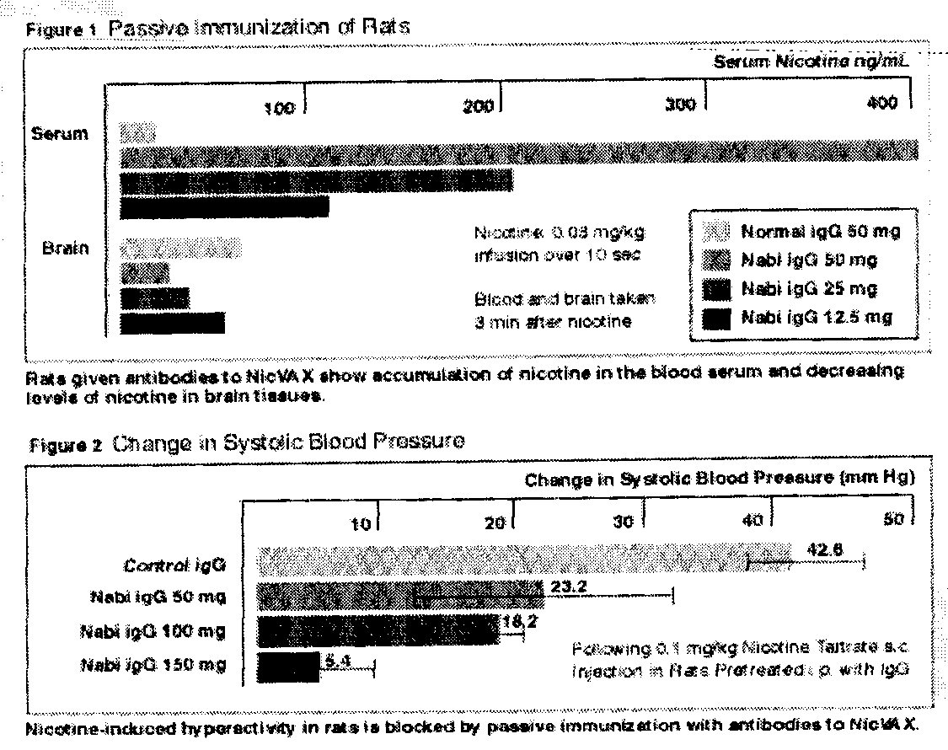

Slide 25
NicVax Vaccine
The company plans to initiate additional clinical trials of NicVAX™ in smokers and ex-smokers in 2002 and 2003

Slide 26
Nicotine Partial Agonists

Slide 27
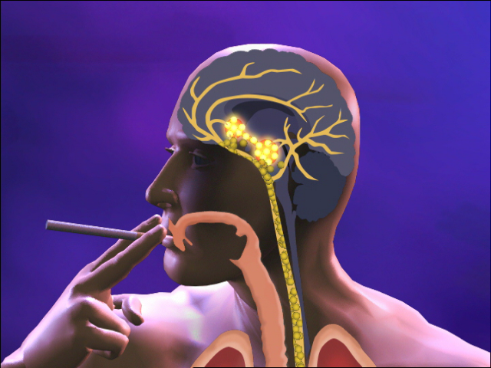
CP-526,555
Smoking Cessation
An Orally Effective Nicotinic Partial Agonist for Smoking Cessation

Slide 28
CP-526,555
Orally-active drug
Nicotinic receptor partial agonist
First non-nicotine therapy in development specifically designed for smoking cessation
As a partial agonist it reduces the severity of nicotine withdrawal symptoms & nicotine craving experienced upon cessation of smoking

Slide 29
CP-526,555
By binding to the nicotine receptors, this compound reduces the satisfaction associated with smoking thereby decreasing the likelihood of relapse
www.rotman.utoronto.ca/~norli/tch/mgt431-2002/
Announcement_Pfizer_SVP.doc

Slide 30
CP-526,555
“Excellent efficacy for CP-526,555 for smoking cessation has been demonstrated in a Phase II double-blind parallel study which compared three different doses of this compound with an active control, Zyban®, and placebo.”

Slide 31
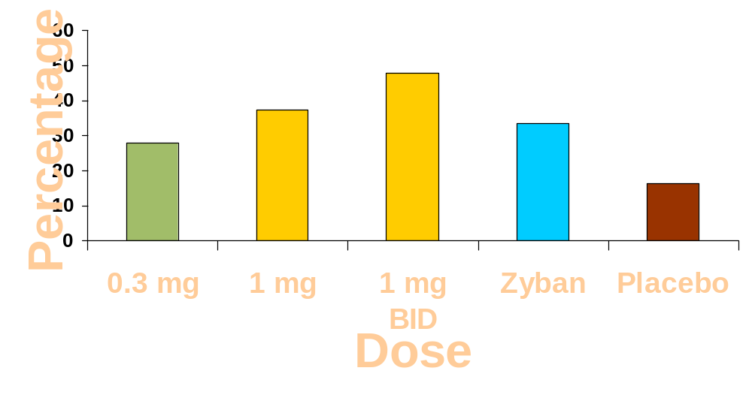
CP-526,555
Continuous Quit Rate
60/125 (48%)
47/126 (37%)
42/126 (33%)
35/126 (28%)
20/123 (16%)
®

Slide 32
CP-526,555
The primary endpoint was a 4-week continuous quit rate observed during treatment
A dose dependent increase in continuous quit rate was seen as one goes from 0.3 mg once-a-day, to 1 mg once-a-day to 1 mg given twice daily with almost half of the smokers quitting at the high dose

Slide 33
CP-526,555
“Zyban® at 150 mg given BID, afforded a continuous 4-week quit rate of 33%
At one year with short term dosing the CP-526,555 quit rate is 17%
CP-526,555 has proven to be well tolerated

Slide 34
CP-526,555
“Also seeing a significant reduction in nicotine craving”
“…exciting results have propelled this agent into a full development program.”
“…includes longer dosing intervals as well as PRN dosing after the treatment interval to prevent relapse.”
“…also performing clinical studies using dose titration.”

Slide 35
Combination Products
Nicotine
Nicotine-Mecamylamine-TD

Slide 36
Mecamylamine/Nicotine TD
In 1996, Sano completed a 260-patient Phase II study with its combination nicotine-mecamylamine patch which identified the therapeutic dose range
Elan Corp.
Still in Phase 3

Slide 37
Mecamylamine/Nicotine TD
48 Volunteers
Combination of mecamylamine plus nicotine patch was more effective than nicotine patch alone
  Abstinence rate at one year 37.5% vs 4.2%
www.update-software.com/abstracts/ab001009.htm

Slide 38
Mecamylamine/Nicotine TD
Second study
80 Volunteers
Treated for four weeks prior to cessation with one of four treatments:
  1. Nicotine patch plus mecamylamine capsules
  2. Nicotine alone
  3. Mecamylamine alone
  4. No active drug

Slide 39
Mecamylamine/Nicotine TD
In the doses used, mecamylamine was well tolerated, although up to 40% of subjects required reductions in dose, usually because of constipation.

Slide 40
Combination Products
Non-Nicotine
Oral Bupropion/Mecamylamine

Slide 41
Oral Bupropion/Mecamylamine
Cary Pharmaceuticals
Daily doses expected to be less than either single product
Completed Phase 1 open-label study testing the following combination of
  Bupropion 150 mg b.i.d.
  Mecamylamine 2.5 mg b.i.d
  Nicotine patch 14 mg/24 hr

Slide 42
Oral Bupropion/Mecamylamine
Subjects (n = 28)
  3-Weeks of meds
  High desire to quit (>74/100 scale)
  Low desire to quit (<26/100 scale)
In general, the combination was well tolerated and there were significant changes in smoking-related measures for both groups

Slide 43
MAO-A Inhibitors
MOA-B Inhibitors

Slide 44
MAO-A Inhibitors
Befloxatone
Sanofi-Synthelabo
Phase 3
Befloxatone was dropped from development for depression and moved into Phase 3 trials for smoking cessation

Slide 45
Befloxatone (1999)
Comparison of the Efficacy & Safety of 3 Oral Doses of Befloxatone
  2.5 mg/day, 5 mg/day & 10 mg/day vs. Placebo
  Aid to Smoking Cessation in Smokers
  A Randomized, Double-Blind, 6-Month Multi-Center Phase II Trial 10-Week Active Treatment
  3.5-Month Follow-Up
www.hsc.wvu.edu/som/bmed/apmr/1996

Slide 46
MAO-B Inhibitors
SL 251188
Sanofi-Synthelabo
Phase 1

Slide 47
Canabinoid Antagonist

Slide 48
Canabinoid Antagonist
SR 141716
Sanofi-Synthelabo
Phase 2

Slide 49
Gylcine Receptor Antagonist

Slide 50
Gylcine Receptor Antagonists
GW468816
GSK
Phase 1?
Launch 2006?

Slide 51
mGluR2 Agonist

Slide 52
mGluR2 agonists
Lilly
Tested in nicotine withdrawal in animals
  Attenuation of nicotine withdrawal
  Potentiation of acoustic startle in rats

Slide 53
Inhibition of Normal Metabolism of Nicotine
CYP-2A6 Inhibitors

Slide 54
CYP-2A6 Inhibitor
Nicogen, Inc.
Nicotine is metabolized by CYP2A6
Variations in CYP2A6 activity account for variations in need for and pattern of nicotine intake

Slide 55
CYP-2A6 inhibitor
CYP2A6 is genetically variable
Hypothesis:
  Decreases in activity result in decreased likelihood of being a smoker
  Decreased smoking intensity
  Decreased risk of lung cancer
  Decreased likelihood of having Ras oncogene mutations
  Increased likelihood of being able to stop smoking

Slide 56
CYP-2A6 inhibitor
Mimic these genetic defects to achieve cessation or exposure reduction
Decrease enzyme activity
  Chemical inhibition
  Decrease expression
  Decrease translation
Enhance bioavailability of NRT
  Oral/patch or other NRT nicotine
  Increase efficacy of existing NRT products

Slide 57
CYP-2A6 inhibitor
Use drugs that:
  Act only in the liver or
  Ones that have CNS activities and both inhibit CYP2A6 and affect smoking in other ways

Slide 58
CYP-2A6 inhibitor
Methoxsalen (a prototypic CYP2A6 inhibitor) in combination with NRT
  AUC nicotine (gum) increase 50% compared to placebo
  AUC nicotine (patch) increase 25% compared to placebo
  Additional studies have been done with tranylcypromine and show similar results

Slide 59
CYP-2A6 inhibitor
Smokers given methoxsalen showed a significant increase in shunting of NNK to NNAL (NNK is activated by CYP2A6) indicating a decrease in body burden of activated NNK carcinogens

Slide 60
CYP-2A6 inhibitor
Two studies of methoxsalen's effect on nicotine.
Study 1:
  17 Regular smokers with normal CYP2A6 metabolism received methoxsalen (3.5, 10, or 30 mg tablets) or placebo in combination with oral nicotine replacement (4 mg capsules)

Slide 61
CYP-2A6 inhibitor
Study 1:
  Blood levels of nicotine at 30-minute intervals for three hours
  10 mg or 30 mg doses of methoxsalen = 2X nicotine levels vs. placebo or 3.5 mg methoxsalen
  Higher methoxsalen dose subjects reported far less desire to smoke

Slide 62
CYP-2A6 inhibitor
Study 2:
  Methoxsalen (30 mg) or placebo in combination with nicotine or placebo
  After 60-minute abstinence were allowed to smoke at will for 90 minutes
  Smokers who received methoxsalen plus nicotine
    Fewer cigarettes
    Longer intervals between cigarettes
    Fewer puffs on each cigarette

Slide 63
1
2
0
0
3

Slide 64
Phase 1
Phase 2
Phase 3
Marketed
CP-526,555
Befloxatone
Nic-Mec TD

Slide 65
Phase 1
Phase 2
Phase 3
Marketed
CP-526,555
Befloxatone
Nic-Mec TD
SR 141716
The Straw™
NicVAC
CYP450-2A6

Slide 66
Phase 1
Phase 2
Phase 3
Marketed
CP-526,555
Befloxatone
Nic-Mec TD
SR 141716
The Straw™
NicVAC
CYP450-2A6
TA-NIC
Bup-Mec
SL 25,1188
GW468816

Slide 67
1
2
0
0
3

Slide 69
GW 320659 (1555U88)
Mixed noradrenergic and dopaminergic uptake inhibitor

Slide 70
GW 320659 (1555U88)
1998 - Glaxo Wellcome, "A Multi-Center, Double-Blind, Double-Dummy, Placebo-Controlled, Randomized, Parallel Group, Dose Response Evaluation of 1555U88 (2.5mg/day, 5mg/day, 10mg/day, 15mg/day) and Zyban™ (bupropion hydrochloride) Sustained Release (300mg/day) versus Placebo As Aids to Smoking Cessation."
www.hsc.wvu.edu/som/bmed/apmr/1996

