Slide 1

Structured Decision Processes
Suzette Kimball
USGS Eastern Regional Director
Department of the Interior
April 24, 2007
Notes:
Ione: Could combine this with next slide giving outline
Multiple methods/models exist for Informed Decision Making
Today present two examples, one from science perspective and another from management perspective
(But 1 of our themes will be that these perspectives should merge, or at least become much more similar, in the conduct of Informed Decision Processes.)
Our distinguished panel members from MMS, BLM, FWS will discuss current bureau applications of informed decision processes

Slide 2
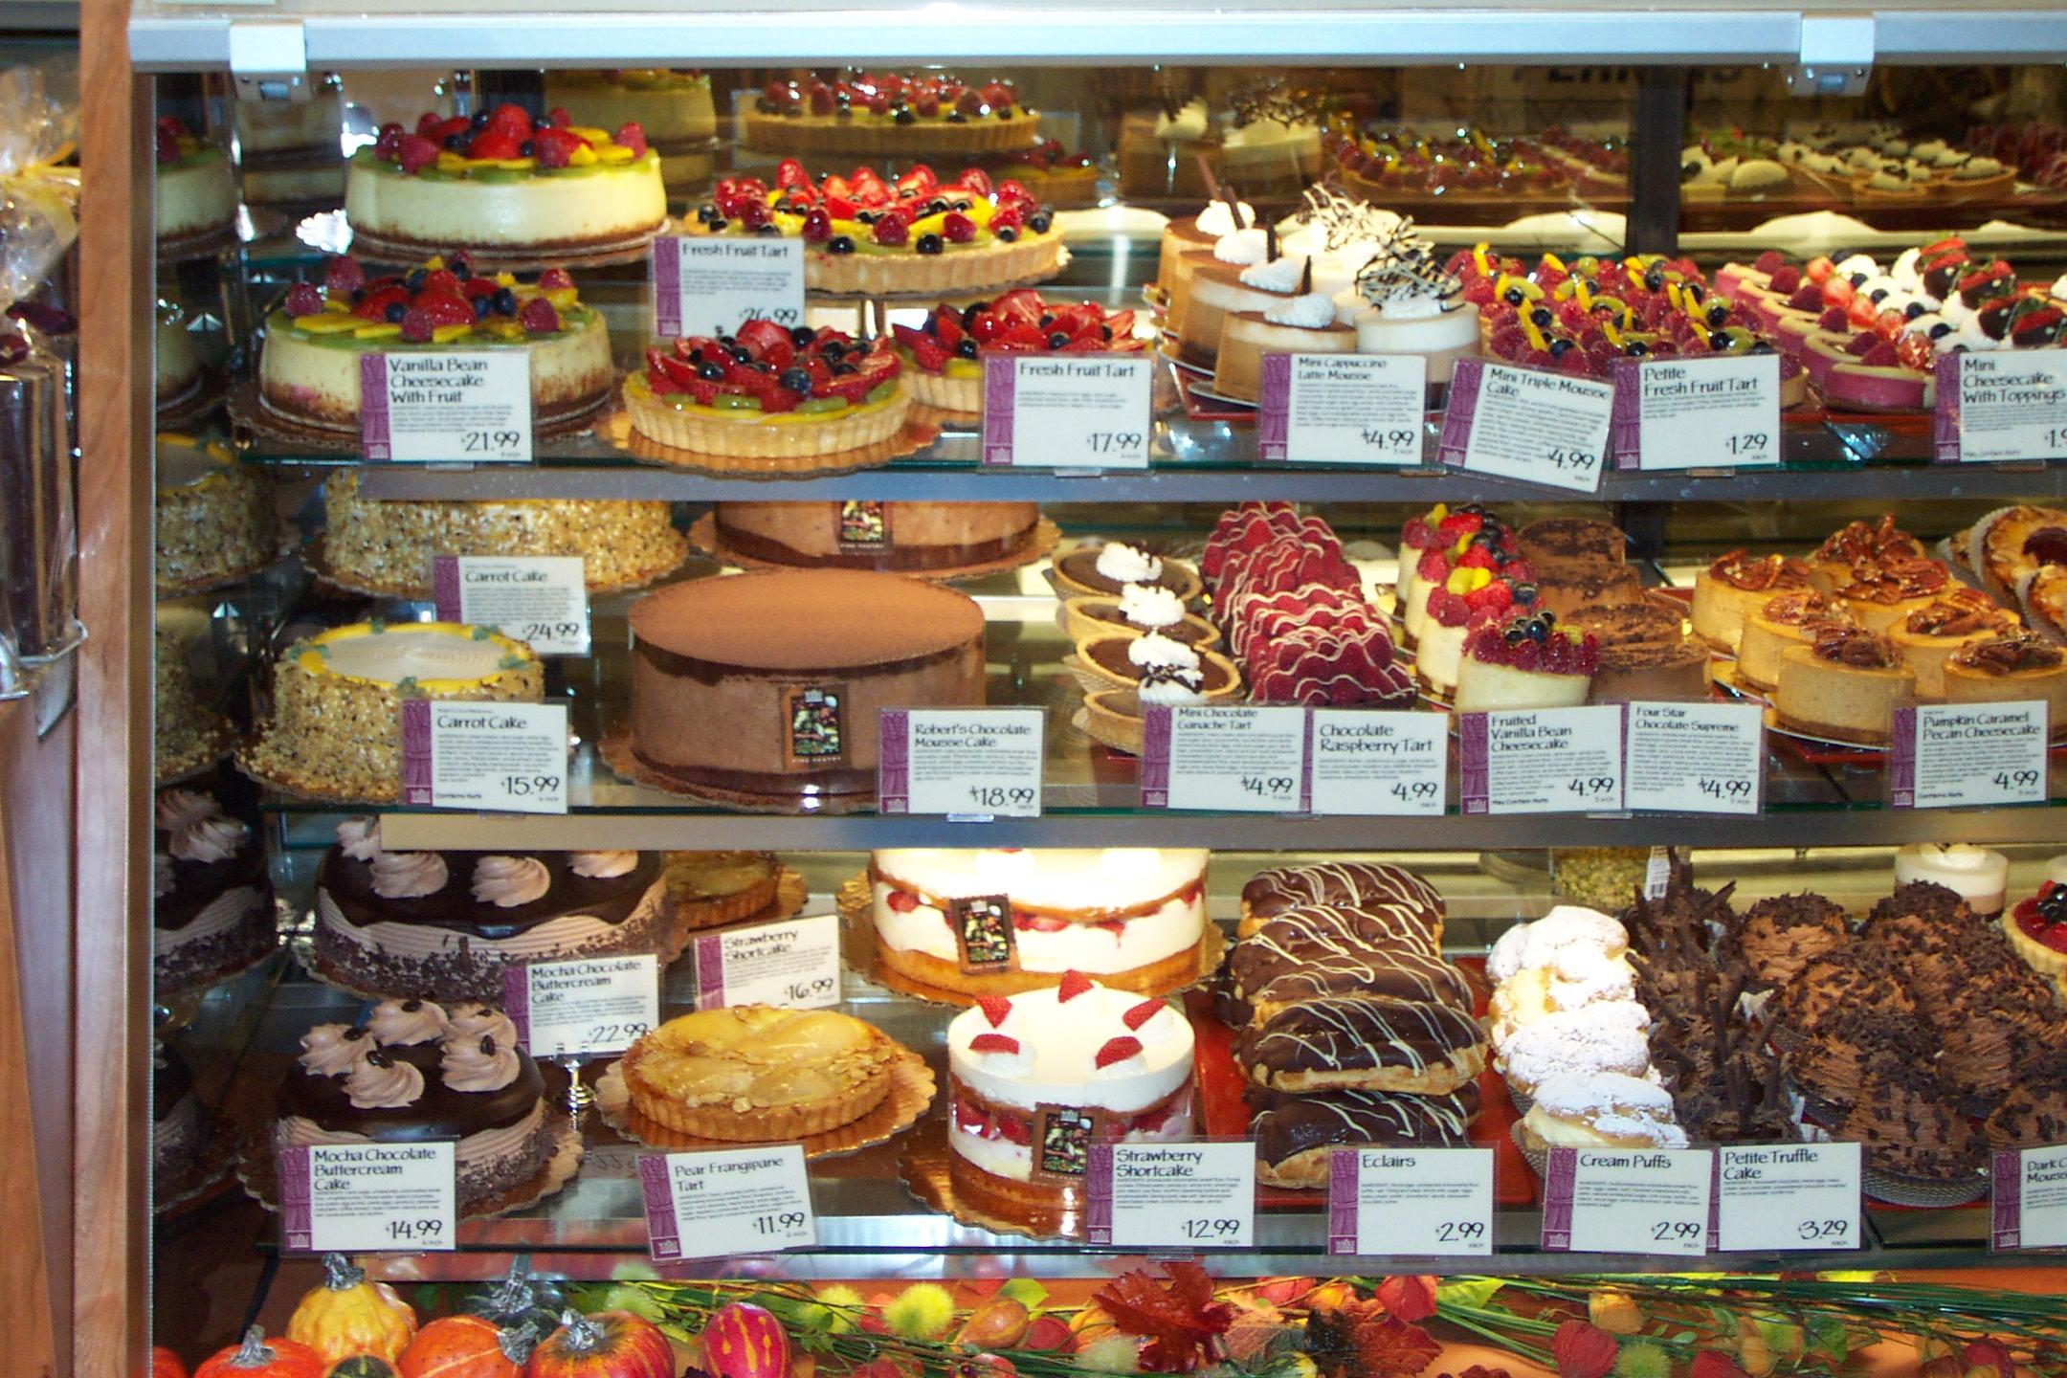
Decisions, Decisions…
Making Choices
Notes:
Ione: Decisions are often no longer between good and bad but are becoming increasingly complex choices between better and best – if you can figure out which is which

Slide 3
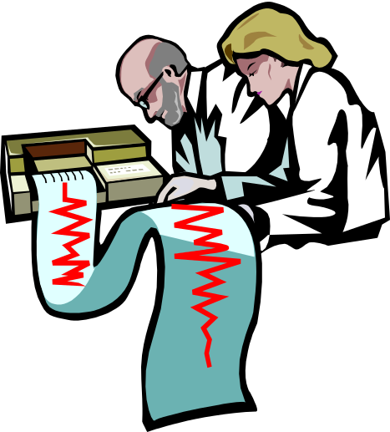
The Evolving Nature of Decision-making
Interface of information providers and decision-makers
Broader applications
More collaborative
Increasing coordination to leverage capabilities
???
Notes:
Ione: Suzette’s key points
Also alerts audience as to expectations for them for this session

Slide 4
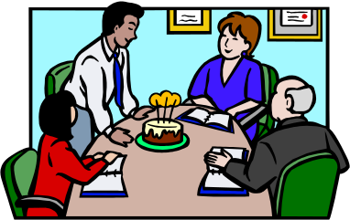
Current Efforts Use Different Language
Community-based Collaboration
Stakeholder Analysis
Others??
Structured Decision- making
Decision Science
Decision Support Systems
Decision Analysis
Joint Fact-finding
Adaptive Management
Notes:
Ione: What other terms to add so everyone feels included?

Slide 5
Elements of a Structured Decision
Identify management objectives
Develop management alternatives
Create models of potential outcomes
Populate models with appropriate
scientific data and information
Test model credibility
Monitor program to assess
effectiveness
Notes:
Ione: added the populate models with data bullet
5 basic elements of informed decision making
First 2: based on societal values, law, politics, stakeholders
Last 3: fall under purview of science
JDN – OK, but these are stated more as steps to take (they begin with verbs) rather than as elements that you must have before embarking on SDP. I would list similarly as: management objectives, management alternatives, models predicting potential outcomes, measures of model credibility (if more than 1 model), and monitoring program
What do you want to accomplish?
What can actually be done?
Develop scenarios based on potential courses of action
JDN- The models provide means of predicting the outcomes of the potential courses of action. This is slightly different from modeling the outcomes, perhaps?
4. Does this do what we need it to do?
JDN- The testing is part of the process itself. If there are multiple models, then we must have measures of model credibility. In the usual listing of elements, the testing itself is not listed. However, the testing does provide the basis for the measures of credibility.
5. Ongoing learning and reintegration of knowledge
JDN- Statement above is probably fine as a summary. We monitor because knowledge of system state is needed for the next decision, and because comparison of what really happened with our model-based predictions leads to changes in our measures of credibility.

Slide 6
Why Structured Decision Making?
Complex decisions
Framework to integrate
Use of scientific data
Policy-relevant
Increased involvement
Requires transparency
Addresses uncertainty
Improves planning and utilization of limited resources: Time, Money, People
Notes:
Ione: Critical to note the data integration and calibration of scale role that structured decision-making brings, added bullet to address Jim’s point about science- management interface
JDN- OK, but it also integrates science into management, because as you learn from current management actions and their outcomes, you are better able to make smart decisions in the future. This insures that the science is maximally useful to managers.
JDN- It is also easily defended (might be an important point to folks who deal with legal issues). You can demonstrate that, conditional on your objectives , available acitons, and state of knowledge, you are taking the smartest decision.

Slide 7
The Future:
How can we develop DOI Capacity?
For use as standard operating procedure
To facilitate interactions between information providers and decision-makers
In training and developing our people in the pertinent competencies
Other ideas?
Notes:
Ione: Might want to get thoughts from audience at end of talk
JDN- might consider switching this slide and next one.
JDN- OK, but we may want to emphasize that very few scientists and managers are trained in this stuff, so capacity building will present a real challenge)
JDN- The final tidal wave was intended to reflect our perception of a substantial increase in the need for expertise in application of SDP, and our current relative lack of trained folks to carry out these processes.
Structured decision making is currently being used throughout DOI by- FWS, USGS, MMS, BLM, XXX, XYZ,
Centers of excellence: build on core groups for natural resources, leasing, litigation, and appeals, OTHER EXAMPLES to create centers of excellence
Build via investment in postdoctoral investigators attached to these groups
Share knowledge and experiences

Slide 8
Panelists
Suzette Kimball, USGS - Moderator
Jim Nichols, USGS
Teresa Woods, FWS
Robyn Thorson, FWS
John Goll, MMS
Henri Bisson, BLM
Plenary Discussion
Notes:
Ione: Gets everyone introduced up front to minimize shuffling and lets audience know they will have a chance to participate

Slide 9
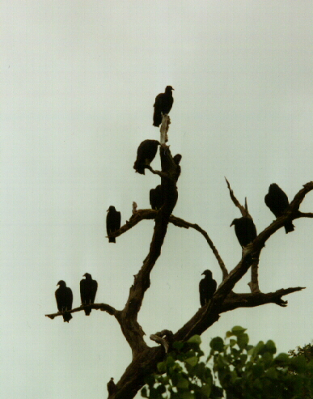
Structured Decisions: An Approach to a Nuisance
James D. Nichols
USGS Patuxent Wildlife Research Center
Department of the Interior
April 24, 2007
Notes:
State of Virginia, FWS, USGS, OTHER STAKEHOLDERS?
JDN- My preference is not to view adaptive management as including scientific and (perhaps by implication) nonscientific examples. I might have used: “Adaptive Management: Integrating Science and Management”.

Slide 10
Conservation/Management:
A Common Approach
Information is collected and provided to managers
Managers make decisions based on information
Notes:
Normally would have done this
Problems with this approach:
Primarily a transfer of data, limited interaction
Can be inefficient
Focus on getting more information rather than the information needed to address the issue/solve problem

Slide 11
Conservation/Management:
A Structured Decision Approach
Collaborative
Focused on objectives
Science based predictions
Transparent
Deals with uncertainty
Broad base of support
Notes:
Information gatherer--scientist, financial analyst, lawyer or other professional works with manager
Information collected is specific to the management decision
Proposed options are based on how the system may respond to management actions
Involves the stakeholders—may be municipal, state, federal, tribal, NGO, interest groups

Slide 12
Sources of Uncertainty
Management
  Predictive uncertainty
  Environmental (weather)
  Indirect actions
  Observation uncertainty
Policy
  Financial constraints and unknowns
  Shifting societal preferences and opinions
  Linguistic imprecision
Notes:
Every DOI bureau deals with uncertainty in various forms
Uncertainty then has to be part of the equation in identifying management decisions
JDN- I would probably recommend redoing slide to capture 2 flavors of uncertainty: scientific and policy. I usually list a few other scientific courses. The policy sources can be dealt with via so-called double-loop learning, and I can emphasize this here and later in the slide dealing with the ARM process.

Slide 13
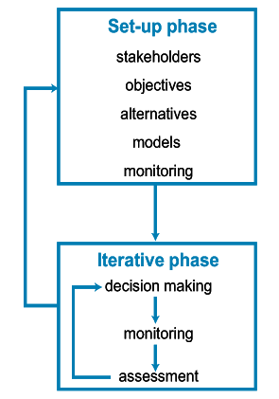
Structured Decision Making: Iterative Process
Notes:
JDN- I think that we tentatively agreed to knock out this slide, but the rationale seemed to concern a desire to not emphasize “adaptive management”. However, our original title (I recommended change above to try to deal with this concern) for this entire part of presentation and another slide or so later on include the terms “adaptive management”. Adaptive management is actually a form of SDM that can be used when decisions are iterated across time or space. Anyway, I thought about this, and I concluded that if it were up to me, I would like to describe the process in general before launching into example. So my vote would be to retain the diagram on p.38 here. Note that I have given it a different name in effort to emphasize that it is simply 1 flavor of the broader SDM. One point to note; this diagram emphasizes the role of policy folks, etc., an emphasis that may appeal to audience?

Slide 14
Black Vulture Nuisance Control
Damage
- Roosting colonies: damage to property
- Individual birds: predation of livestock, pets
Control
- Range of methods, including lethal take
Relevant laws
- Migratory Bird Treaty Act (“take” permits required) - Enabling legislation for USDA
- NEPA (EA or EIS related to ‘take”)
Notes:
Where: State of Virginia
When:
Why: Issues of property damage, management methods and legal framework

Slide 15
DOI in the Decision Structure
USDA & USFWS issue:
  Focus on population estimate to determine vulture “take” permits
USGS proposal:
  -a strategy for setting “take” based on management objectives
  - iterated nature of action leads to reduction in uncertainty
Notes:
Roles of DOI bureaus in the process

Slide 16
Management Objective
Scientific Model
Equilibrium
Legal constraints:
MBTA requires only that take be sustainable
“Significant effect” under NEPA
Sustainable Annual Harvest
Annual take
0
0
K
Population Size (N)
Notes:
Determine population size parameters that remains in the bounds of MBTA- Migratory Bird Treaty Act requires population sustainability . . ..
And National Environmental Policy Act.

Slide 17
Managing Risk
Uncertainty in the example decision of annual black vulture take
  - Population size
  - Population demographics
  - Actual take
Risk management
  - Flexibility of the decision-maker
  - Resiliency in the population
Notes:
In this example population size and projected growth- but also pertains to oil, coal, trees, financial resources

Slide 18
Adaptive Management
Iterated decision process
  Annual monitoring of population size
  Annual lethal take permit
Learning (reducing uncertainty)
  Compare observed/predicted population size following each action
  Better estimates –
    Population size
    Sustainable harvest
Notes:
Learning
Monitor population size
Conduct auxiliary studies to refine the estimate of the population size.
Use demographic studies to refine estimate of sustainable annual harvest.
Compare observed and predicted population size to verify whether the framework is working.

Slide 19
Black Vulture Nuisance Control: Decision Process Benefits
Focused decision-maker efforts on objectives
Focused scientific efforts on needed models and estimates
Products:
  Defensible decisions
  Optimal use of scientist and manager efforts

Slide 20
Structured Decision Making:
An Emerging Practice
Teresa Woods
USFWS Midwest Region
Department of the Interior
April 24, 2007

Slide 21
Agenda
Further develop concepts
Example: Cerulean Warbler conservation
Building capacity for this emerging practice

Slide 22
Structured Decision Processes
Features
  Diagnose problem
  Transparency
  Boundaries
  Address uncertainty
  Break down problems

Slide 23
Cerulean Warbler
Neotropical migratory bird
  Breeds in North America
  Winters in South America
  Trans-Gulf migrant
Declining at 2% - 4% annually
~500,000 individuals
Habitat loss and degradation

Slide 24

Management Questions
How do we conserve this species?
  What are desired population goals?
  What are limiting factors?
  How do we control what is limiting?
Should the species be listed under the Endangered Species Act?

Slide 25
ESA
Extinction risk
  Population size and trend
Expert Workshop
  North and South America
  USGS, FWS, FS, academia, industry, NGO
Explore uncertainty
Make projections

Slide 26
Workshop
Conclusions
Conclusions
  ~500,000, more likely underestimated
  Decline likely to continue at historical rate
  Little risk of extinction for foreseeable future
FWS decided:
  ESA listing not warranted at this time
  Keep going with structured decision making!

Slide 27
Original Issues
Need to know
  Desired population goals
  Limiting factors
  Conservation recommendations
Workshop participants
  6 nations
  Industry & conservation groups
  Government scientists & managers
Conclusions
  Information gaps
  Habitat loss and degradation

Slide 28
Habitat Conservation
Making conservation recommendations for winter habitat
Question: How can we conserve shade-grown coffee plantations in South America when our responsibility is limited to the birds?

Slide 29
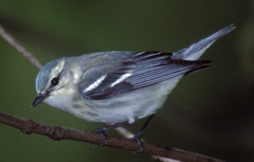
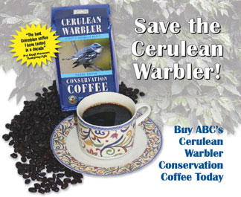
Winter Habitat
Non-traditional partners
  Technical group & el Grupo Ceruleo
Cerulean Warbler habitat preserve in Colombia
Cerulean Warbler coffee
Stay tuned for other creative solutions

Slide 30
Capacity: Skills
Subject matter experts
Modeling & other quantitative analyses
Risk assessment
Risk attitudes
Decision making under uncertainty
Creation of forums
Communication

Slide 31
Capacity Building
Interaction with academic institutions
Sharing expertise
Training, education, learning
Cross-discipline interaction
Willingness to learn by doing

Slide 32
Conclusion
Increased communication
Many benefits
Leadership

Slide 33
Thank you!

